Slide 1







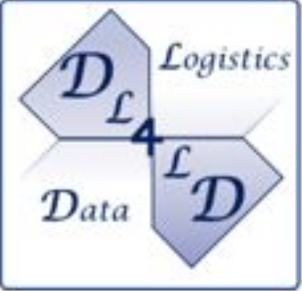

Create dynamic data exchange scenarios
Using a set of core data exchange microservices
In a distributed data marketplace
Compose different service patterns per request
Dynamically adapt data-exchange patterns
Checked against legal policy

Slide 2

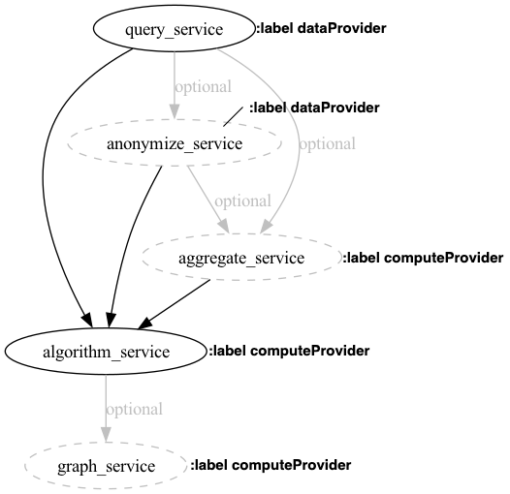
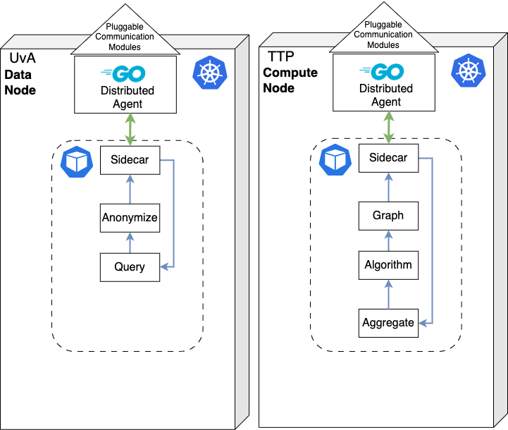
How it works
1.
Check policy and additional requirements
2. Generate microservice chain
3.
Create ephemeral data-exchange job(s)

Slide 3
Next steps
Experiment with different data exchange archetypes
Testing Optimization and Self-Adaptive Algorithms
Experiment with security and networking components
Link Fabric into DYNAMOS
Full distributed scenarios
Sharing large dataset

