Slide 1
ICT.Open demo
Re-composing microservices

Slide 2
Basic scenario
A user requests a set of services to be run (image next slide)
It will query a database with two tables in two organizations
It will anonymise a column of data
Transform the data into Grafana readable format
Return the results
‘ Amdex’ infrastructure manager checks required contracts with an ‘oracle’
‘ Amdex’ infrastructure manager spins up required services and returns results

Slide 3
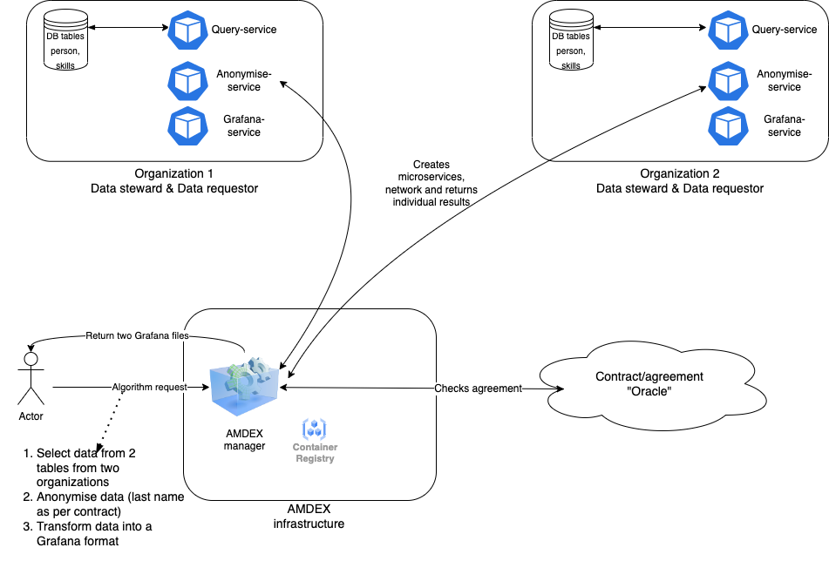
Basic scenario

Slide 4
Scenario 2
A change in the agreement is made
The ‘oracle’ sends a message that the anonymisation service needs to do more
‘ Amdex’ infrastructure manager seamlessly replaces anonymisation service

Slide 5
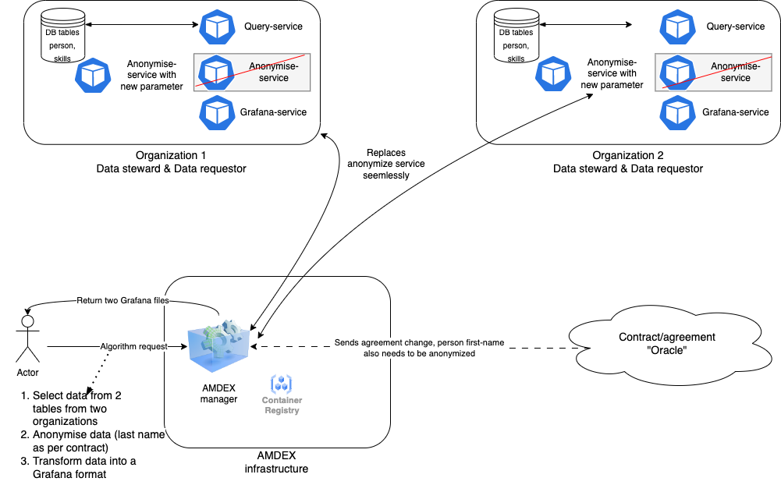
Scenario 2

Slide 6
Scenario 3
The user realize the data of the two organizations is not joined and sends a new microservices architecture
‘ Amdex’ infrastructure manager:
Adds an ‘aggregate’ service on its own infrastructure
Moves the Grafana service from the organizations to its own infrastructure

Slide 7
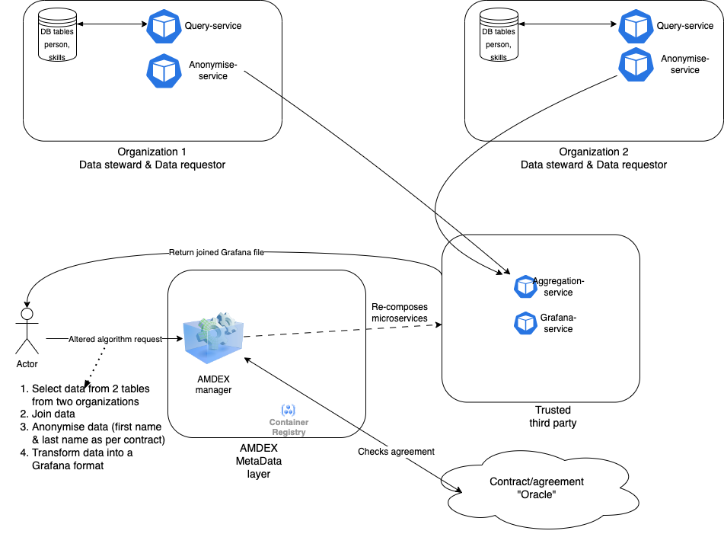
Scenario 3
Notes:
UCI? Repository data sets

