Slide 1
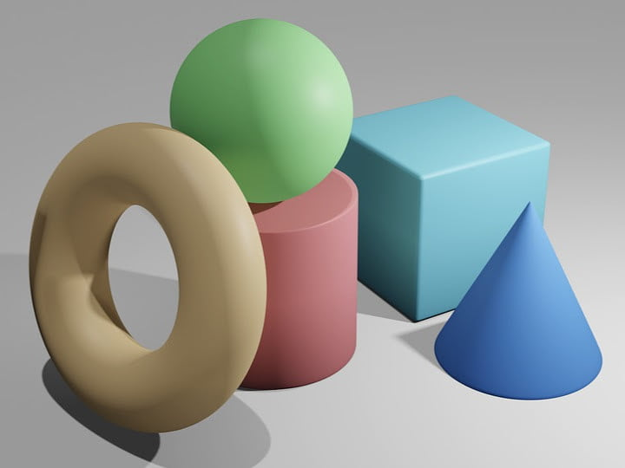
Topic 3: Application Study
Visual Question Answering
Neuro Symbolic AI
Jorrit Willaert

Slide 2
Overview
Introduction
Implementation details
Experiments
Conclusion

Slide 3
Overview
Introduction
Implementation details
Experiments
Conclusion

Slide 4
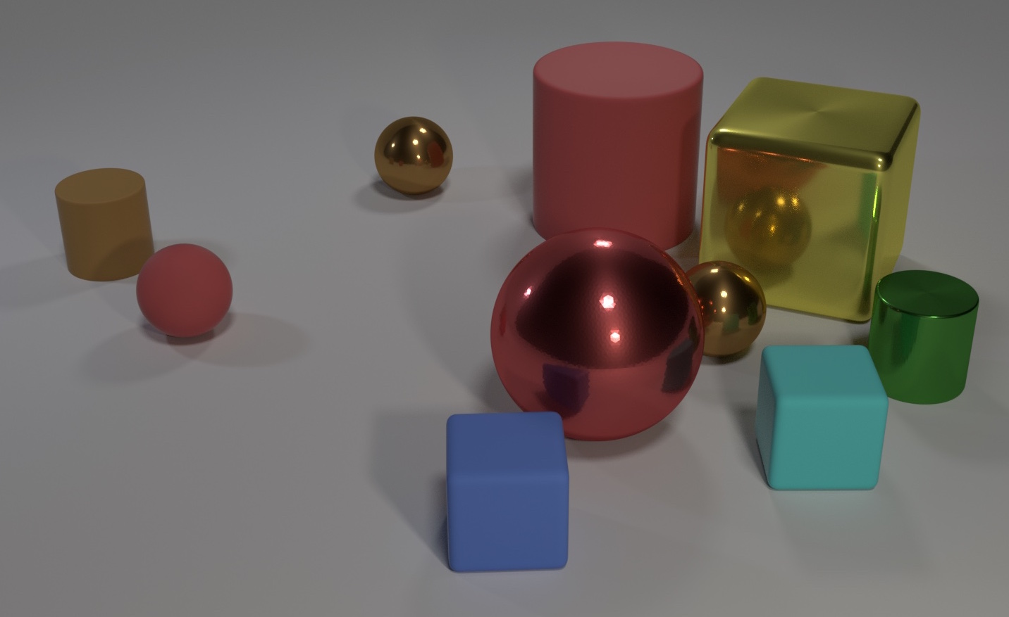
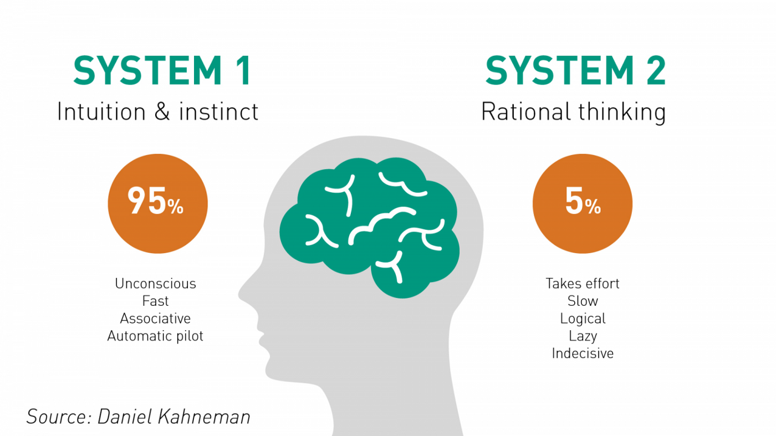
Neuro Symbolic AI – VQA
Q: What size is the cylinder that is left of the brown metal thing that is left of the big sphere?
  System 1: Visual system, processing of languages, …
  System 2: Slow, sequential thinking
J. Johnson, L. Fei-Fei, B. Hariharan, C. L. Zitnick, Van Der Maaten, R. Girshick, “CLEVR: A diagnostic dataset for compositional language and elementary visual reasoning”, Proceedings - 30th IEEE Conference on Computer Vision and Pattern Recognition, CVPR, 2017, vol. 2017-Janua, pp. 1988–1997, 2017, doi: 10.1109/CVPR.2017.215, 1612.06890
D. Kahneman, Thinking, fast and slow, Penguin Books, London, 2012.

Slide 5

DeepProbLog
Combine system 1 & 2
  Prolog: Knowledge base
  ProbLog: Integrate probabilistic facts
  DeepProbLog: Integrate neural predicates
Target optimization process

Slide 6
Overview
Introduction
Implementation details
Experiments
Conclusion

Slide 7

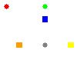
Dataset
Grid: 2x2 & 6x6
Non-relational questions:
  Shape
  Position
    Horizontal
    Vertical
Relational questions:
  Number of objects with the same shape

Slide 8
Training process
Each color has an associated CNN
CNN
  Grid 2x2: output layers = 8
    Width = 2
    Height = 2
    Possible shapes = 2
  Grid 6x6: output layers = 72
    Width = 6
    Height = 6
    Possible shapes = 2

Slide 9
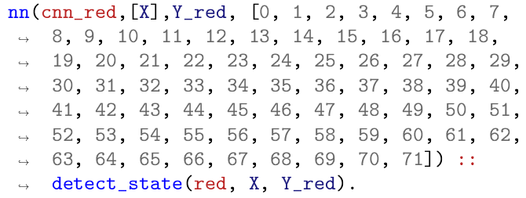
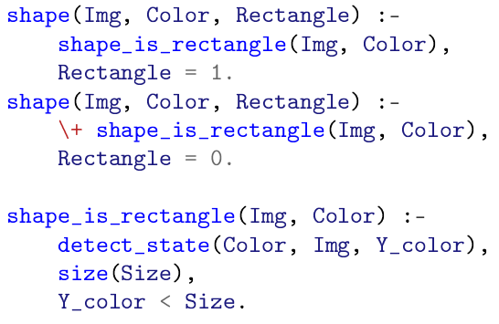
Logical rule encodings
Neural predicate for each color
Predicates for questions

Slide 10
Overview
Introduction
Implementation details
Experiments
Conclusion

Slide 11
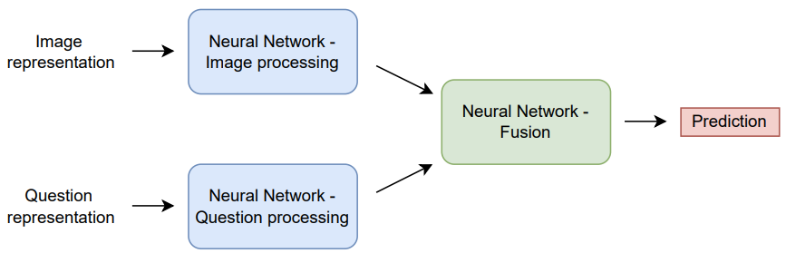
Pure Neural Network baseline
C. Theodoropoulos, “Information Retrieval and Search Engines [ H02C8b ] - Project Visual Question Answering”, Toledo, pp. 1–5, 2022.

Slide 12
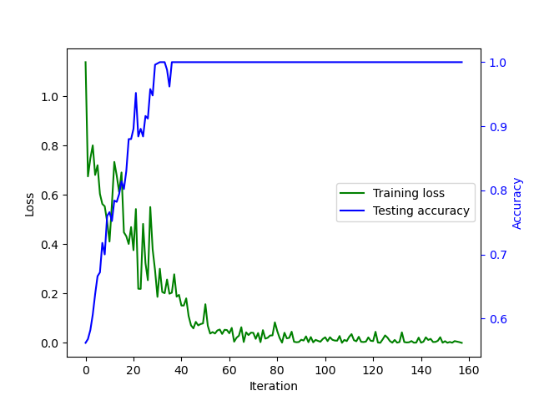
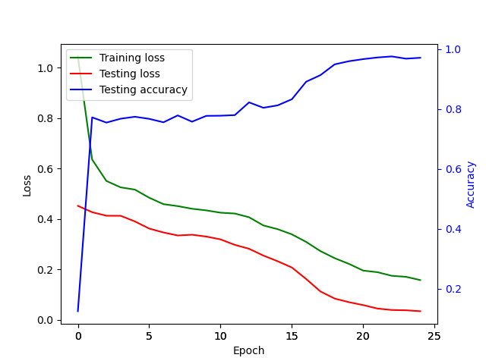
Experiment: 2x2
DeepProbLog
Pure NN based approach
Iterations vs epochs
  DeepProbLog: 40 iterations
  Pure NN based approach: > 7800 iterations
Training time
  DeepProbLog: 10 minutes
  Pure NN based approach: 5 minutes

Slide 13
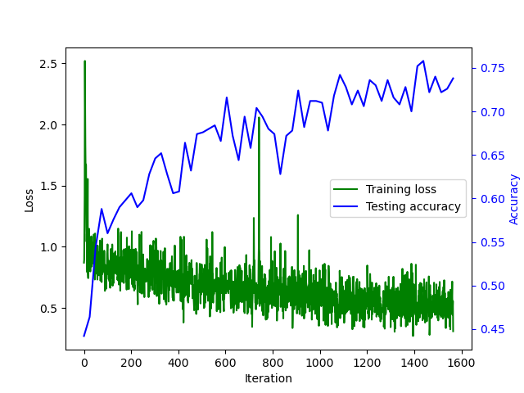
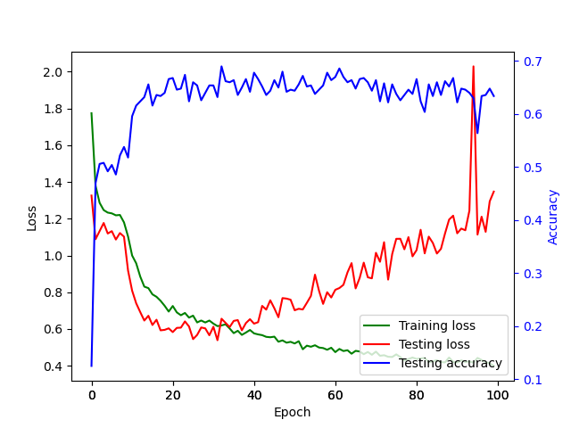
Experiment: 6x6
DeepProbLog
Pure NN based approach
Accuracy
GPU acceleration
Training time
  DeepProbLog: 8 hours
  Pure NN based approach: 20 minutes

Slide 14
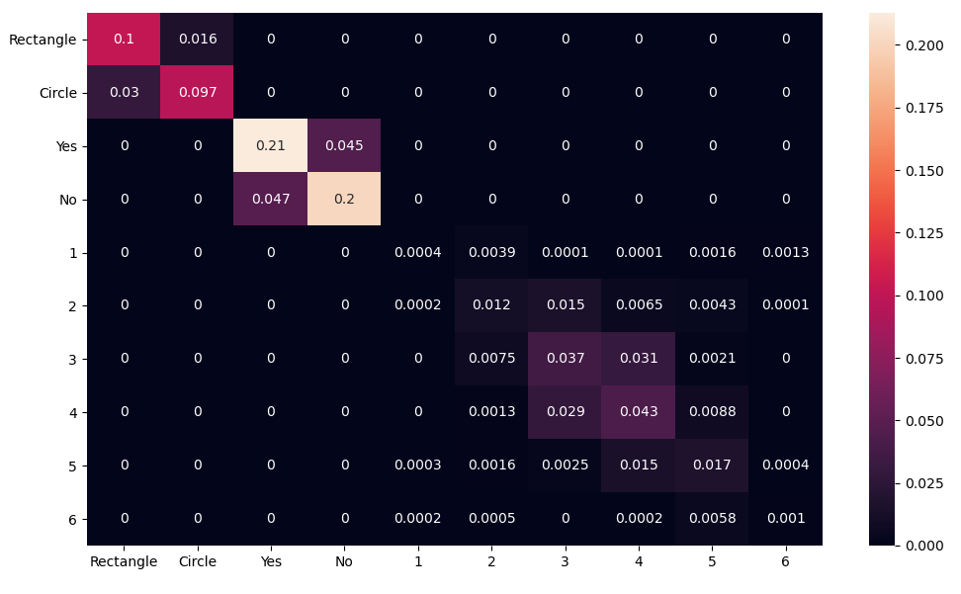
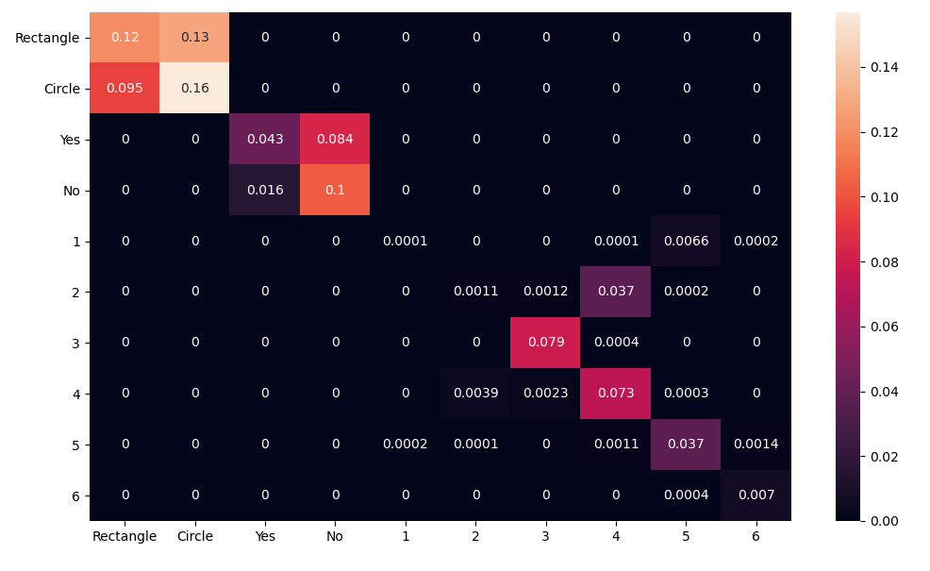
Confusion matrix
DeepProbLog
Pure NN based approach
Perfect question distinction
Accuracy: non-relational vs relational
  Off-by-one
  Probabilistic reasons
A. Santoro et al.
  63% accuracy on relational questions with only CNN’s
  94% accuracy on all questions by adding RN
K. Heecheol, “kimhc6028/relational-networks: Pytorch implementation of "A simple neural network module for relational reasoning" (Relational Networks)”, URL: https://github.com/kimhc6028/relational-networks

Slide 15
Overview
Introduction
Implementation details
Experiments
Conclusion

Slide 16
Conclusion
DeepProbLog
  200 times less iterations
  Much slower due to algebraic operators
  Higher accuracy
Valuable field
  Speedups on algebraic operators

Slide 17
Topic 3: Application Study
Visual Question Answering
Neuro Symbolic AI
Jorrit Willaert

