Slide 1

AI-Based Proactive Prediction
Of GNSS Signal Degradation
for Autonomous Vehicle Navigation
THE PROMISE
5-30
S/N | Name | Student ID
1 | Ojerinde Joel Segun | LS2525253
2 | Mustapha Ibrahim Ishola | LS2525238
3 | Ogunlade Joshua Oluwaseun | LS2525237
4 | Ingeriyinkindi Claudine | LS2525236
5 | Rashid Md Harun Or | LS2525219
seconds advance warning
● Predict, not detect
● Multi-horizon: 5 / 15 / 30 s
● Cross-city generalisation
Team Pilot Project | Beihang University (BUAA)
Supervisor: Dr. Ahmed Wasiu | June 2026
Predicting GNSS degradation before it impacts safety

Slide 2
1 · The Problem

Slide 3

PROBLEM STATEMENT
GNSS is the primary absolute-positioning sensor for autonomous vehicles, yet it fails predictably and frequently in the environments AVs operate in.
1
Urban Canyons
2
Tunnels & Underpasses
3
Atmospheric Effects
Tall buildings block and reflect satellite signals. Multipath errors corrupt range measurements.
Complete signal blockage causes instantaneous position loss.
Ionospheric and tropospheric disturbances degrade range accuracy across wide areas.
A reactive system detects failure only after the vehicle has entered the tunnel, too late to plan a safe response or engage backup localisation.
Position jumps of 10-50 m occur silently, the receiver continues reporting a “fix” even as accuracy collapses.
Effects are gradual and harder to detect, DOP and C/N₀ drift slowly before the solution quality degrades.
Core Problem: All existing monitors (RTKLIB Q-codes, RAIM, ML classifiers) are REACTIVE - autonomous vehicles need advance warning to respond safely.

Slide 4
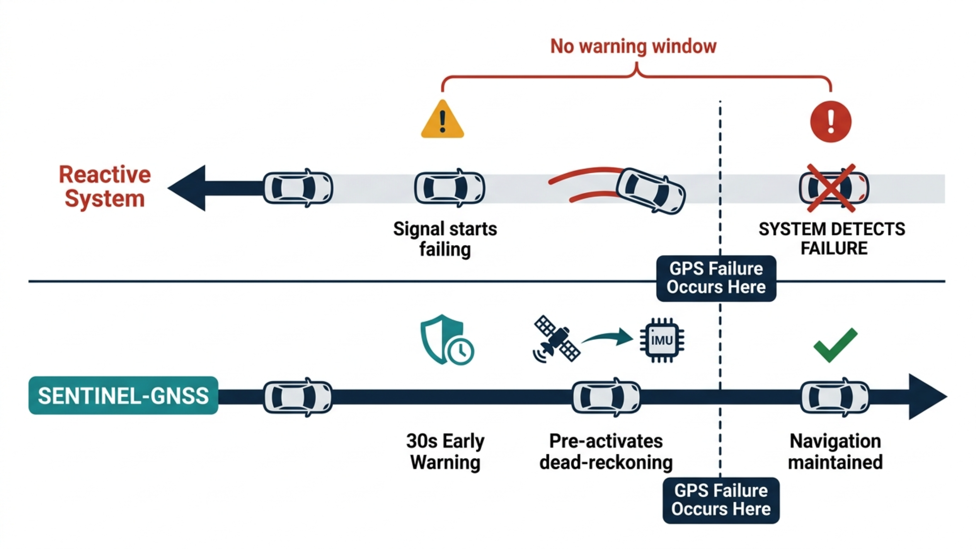
PROBLEM STATEMENT
What Early Warning Enables
Horizon
Distance @ 60 km/h
AV Action
+5 s
83 m
Tighten IMU fusion · slow down
+15 s
250 m
Pre-engage dead-reckoning · adjust speed
+30 s
500 m
Re-route away from degradation zone

Slide 5
2 · Data

Slide 6
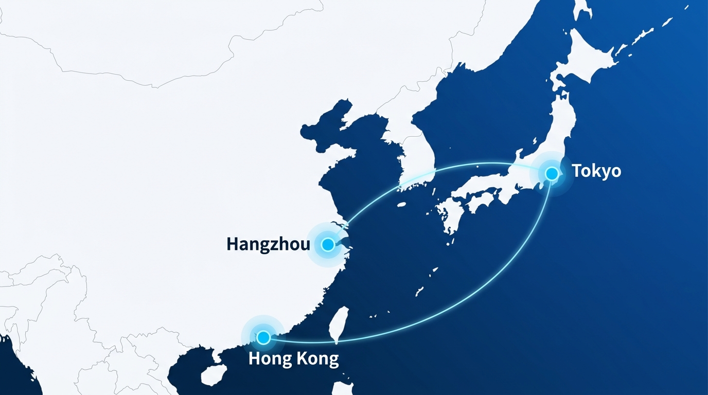
DATASET - Three sources, one unified schema
Cities collected
3
Hangzhou · Hong Kong · Tokyo
Receiver types
9+
survey-grade → consumer phone
Degradation scenarios A-E
5
blockage · canyon · partial · open · approaching
Sampling cadence
1s
RINEX + NMEA per epoch
149,662 labelled epochs · one unified 3-class schema

Slide 7
3 · Method

Slide 8
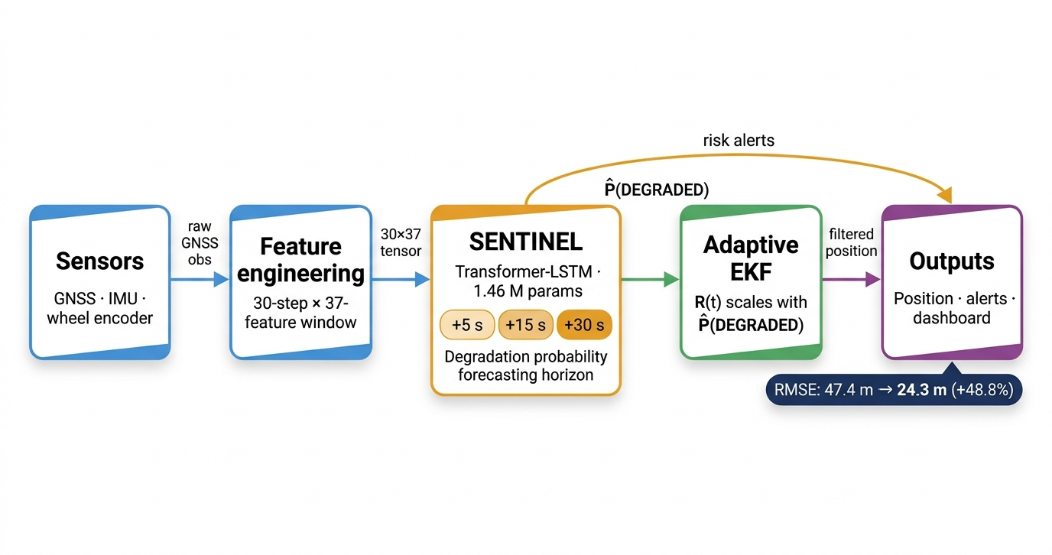
COMPLETE SYSTEM PIPELINE

Slide 9
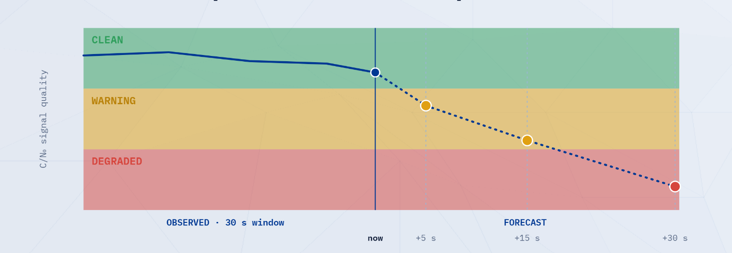
METHODOLOGY - Three classes, predicted three steps ahead
CLEAN
WARNING
DEGRADED
30 s of signal in → degradation class out at +5 / +15 / +30 s

Slide 10
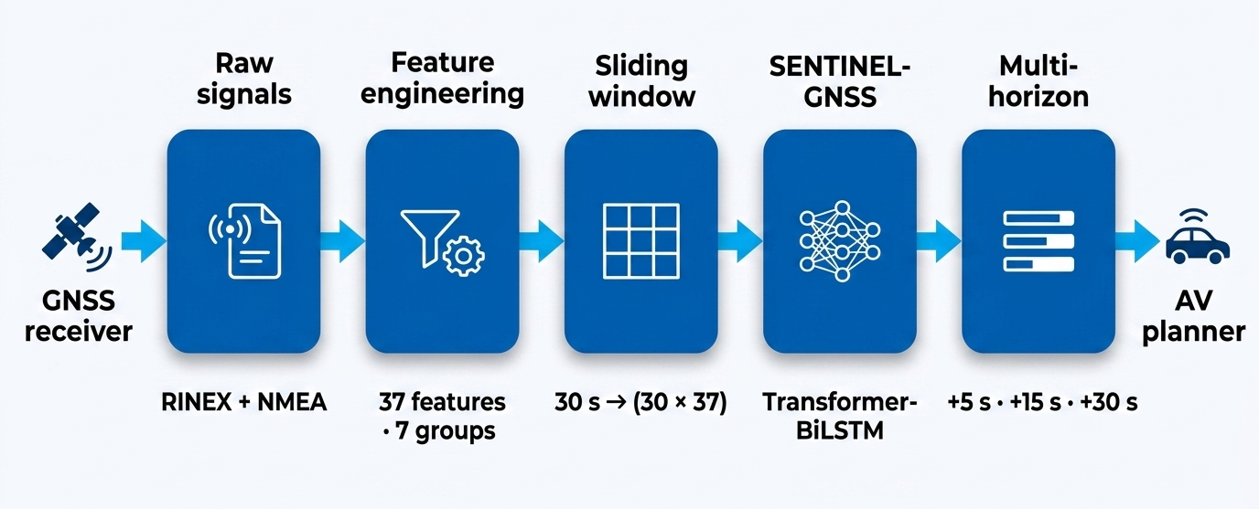
METHODOLOGY
37 FEATURES · 7 GROUPS
Position
Signal strength · C/N₀
Satellite count
DOP
Receiver status
Temporal
Atmospheric
1s
RIEX + NMEA per epoch
30 × 37
sliding-window tensor
+5 / 15 / 30s
prediction horizons

Slide 11
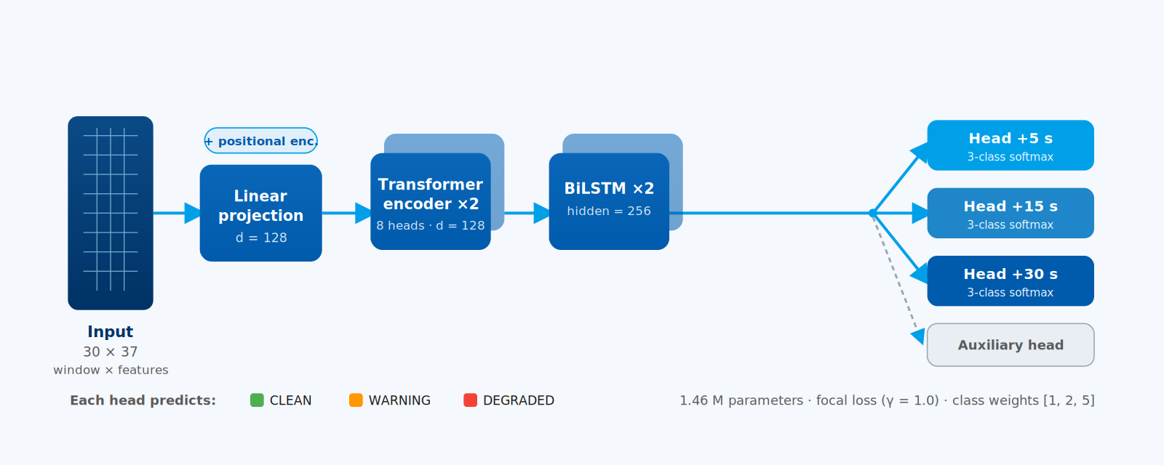
METHODOLOGY - Inside SENTINEL-GNSS
focal loss · γ = 1.0
class weights [1 · 2 · 5]
no SMOTE - imbalance at loss level

Slide 12
4 · Results

Slide 13
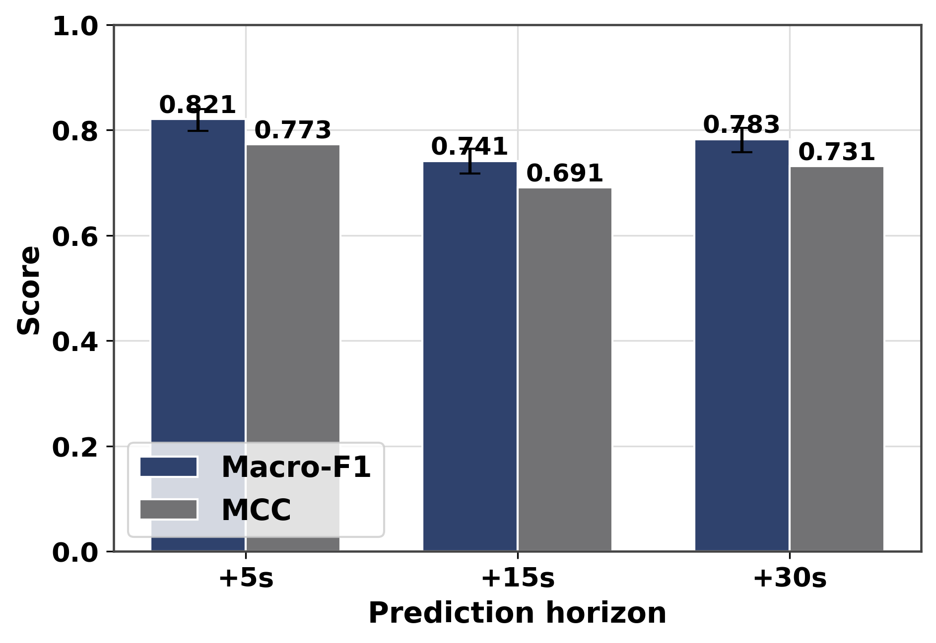
MULTI-HORIZON PREDICTION
0.821
0.741
0.783
Macro-F1 +5 s
Macro-F1 +15 s
Macro-F1 +30 s
MCC = 0.773 | CI [0.798-0.840]
MCC = 0.691 | CI [0.717-0.764]
MCC = 0.731 | CI [0.758-0.804]
30-second warning with Macro-F1 = 0.783 - nearly as strong as 5-second prediction
Horizon | Acc | Macro-F1 | κ | MCC
+5 s | 0.854 | 0.821 | 0.762 | 0.773
+15 s | 0.789 | 0.741 | 0.667 | 0.691
+30 s | 0.830 | 0.783 | 0.723 | 0.731
Prediction Horizon

Slide 14
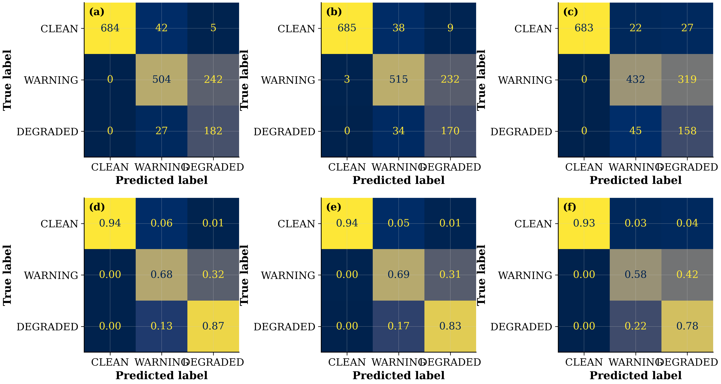
PER-CLASS PERFORMANCE @ +5S
Class | Precision | Recall | F1 | Support
CLEAN | 0.868 | 0.993 | 0.927 | 731
WARNING | 0.947 | 0.718 | 0.817 | 746
DEGRADED | 0.623 | 0.847 | 0.718 | 209
DEGRADED Recall = 0.847
Catches 85% of impending signal failures - 5 s ahead
WARNING Precision = 0.947
When the model says WARNING, it is right 95% of the time
CLEAN F1 = 0.927
Rarely triggers false alarms on healthy signal

Slide 15
COMPARISON TO ALL BASELINES
Method | +5s F1 | +15s F1 | +30s F1 | MCC
MajorityClass | 0.202 | 0.072 | 0.072 | 0.000
CNR Threshold | 0.074 | 0.072 | 0.072 | 0.000
RandomForest (SMOTE) | 0.909 | 0.887 | 0.877 | 0.915
XGBoost (SMOTE) | 0.910 | 0.898 | 0.879 | 0.915
RandomForest (no-SMOTE) | 0.910 | 0.891 | 0.896 | 0.916
XGBoost (no-SMOTE) | 0.919 | 0.896 | 0.879 | 0.926
Transformer-only | 0.767 | 0.763 | 0.701 | 0.725
LSTM-only | 0.767 | 0.751 | 0.781 | 0.702
SENTINEL-GNSS | 0.821 | 0.741 | 0.783 | 0.773
In-domain: XGBoost 0.919 outperforms DL 0.821
Cross-city: DL retains DEGRADED F1 trees collapse
One model, one pass; 10.5× faster than 3 tree models

Slide 16
ABLATION STUDY - WHAT EACH COMPONENT ADDS
Model | +5s F1 | +15s F1 | +30s F1
Transformer-only | 0.767 | 0.763 | 0.701
LSTM-only | 0.767 | 0.751 | 0.781
SENTINEL-GNSS | 0.821 | 0.741 | 0.783
Full model beats both ablations at +5s and +30s
LSTM alone is strong for longer horizons (+30s)
Transformer-only struggles at +30s; sequence matters there

Slide 17
CROSS-CITY GENERALISATION - THE CHALLENGE
Can a model trained in Beijing and Hong Kong predict GNSS quality in Tokyo - a city it has never seen?
Different skyline geometry
Tokyo Shinjuku has a distinct building density and canyon profile versus Beijing ring-roads.
Different satellite visibility
Latitude difference shifts GNSS constellation elevation angles and multipath patterns.
Different receiver hardware
Trimble + u-blox F9P in Tokyo versus Septentrio survey-grade in Beihang - different noise floors.
Zero training data from Tokyo
Tokyo is excluded from training entirely. Not one Tokyo window was used - a true zero-shot test.

Slide 18
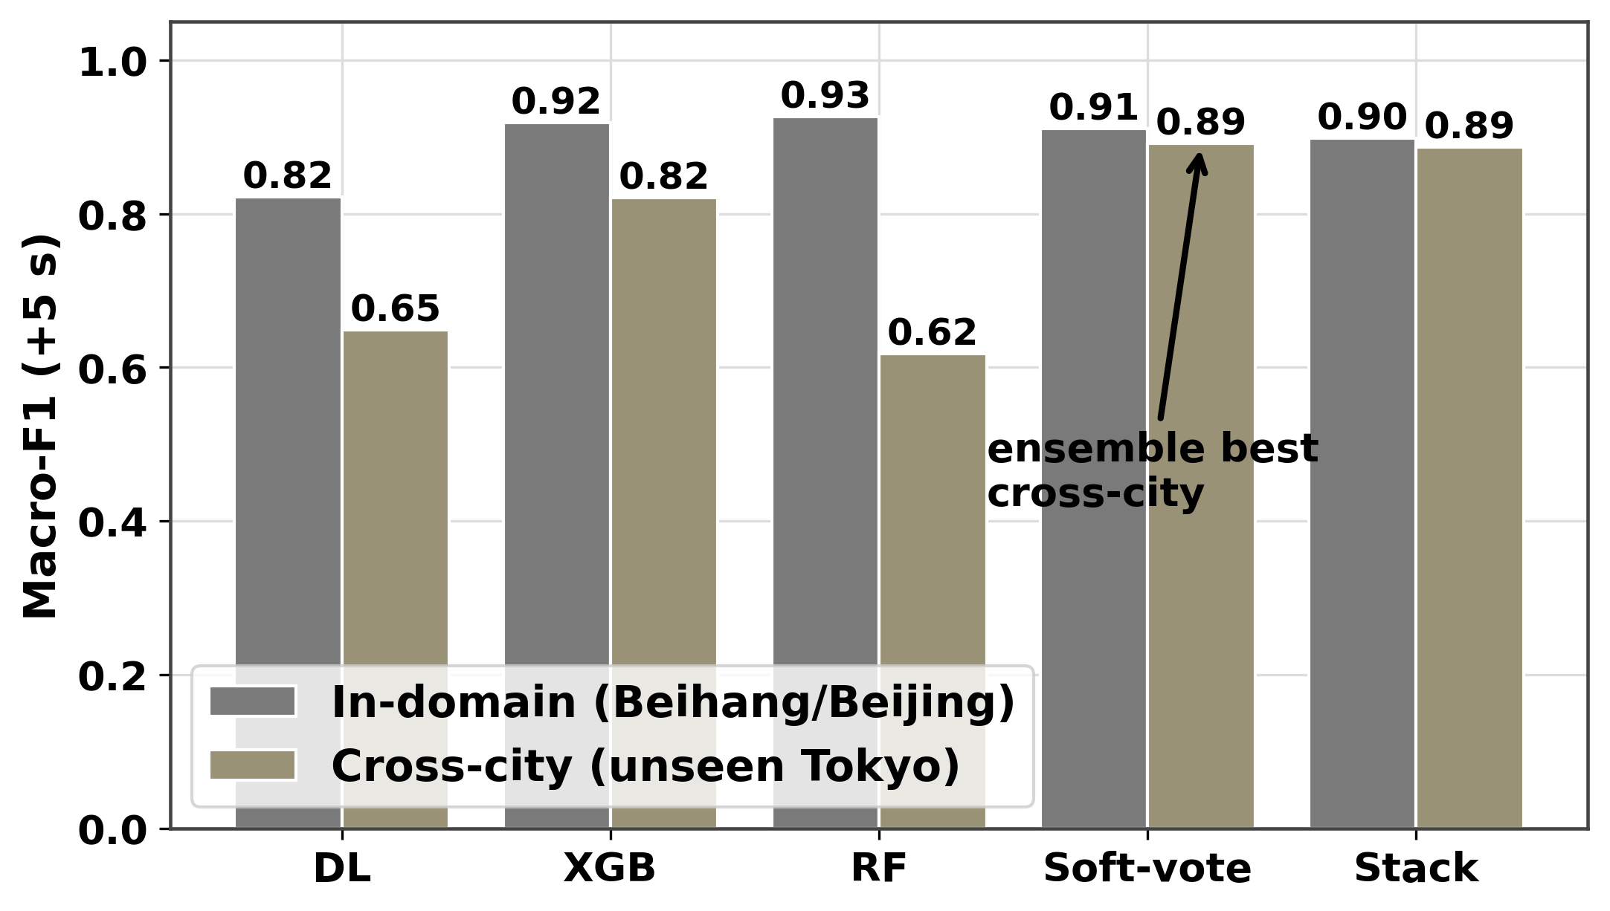
CROSS-CITY GENERALISATION - TOKYO SHINJUKU
KEY RESULT
XGBoost
SENTINEL-GNSS
0.822 → 0.148
0.718 → 0.753
DEGRADED F1 in-domain → Tokyo
−82% collapse
DEGRADED F1 in-domain → Tokyo
+5% improvement
Model | Hangzhou | Tokyo | Tokyo DEGRADED F1
DL + XGBoost ENSEMBLE | 0.911 | 0.892 | 0.896
SENTINEL-GNSS (DL) | 0.822 | 0.649 | 0.753
XGBoost | 0.919 | 0.821 | 0.784
RandomForest | 0.926 | 0.618 | 0.148

Slide 19
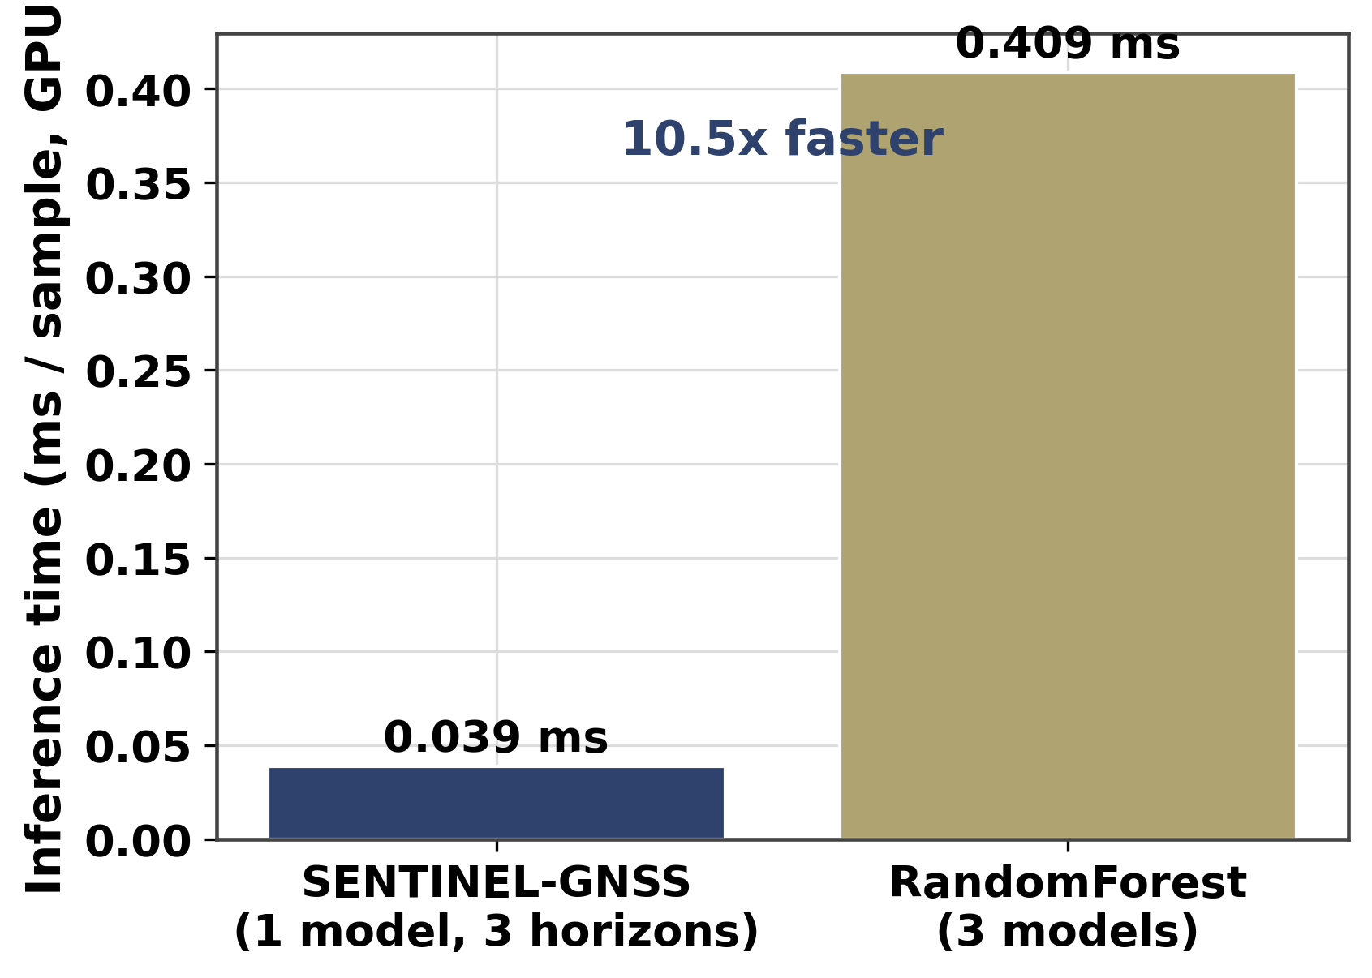
INFERENCE SPEED & EFFICIENCY
10.52×
faster than 3 separate tree models
0.039 ms / sample vs 0.409 ms / sample
SENTINEL-GNSS
17.8 MB
0.039 ms
Model size
All 3 horizons in one forward pass
1,456,652 parameters
3 × Tree models
< 0.04%
0.409 ms
CPU budget
One model per horizon
10 Hz vehicle compute

Slide 20
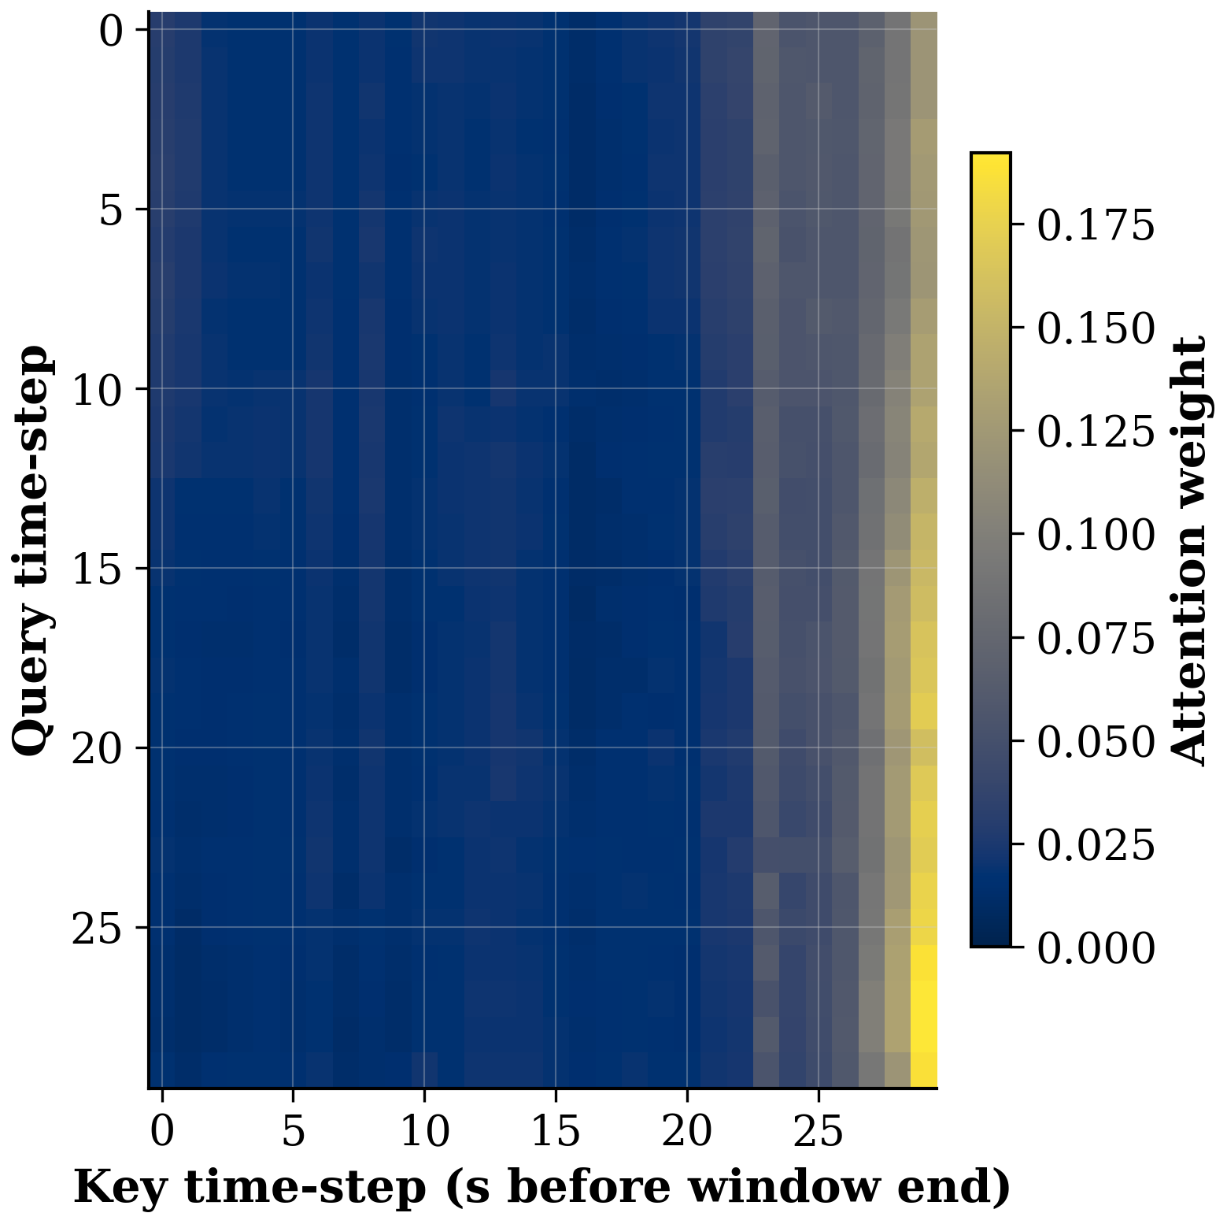
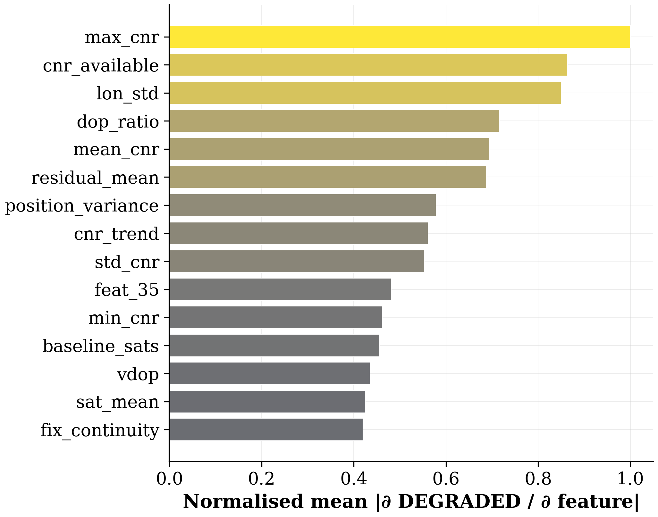
INTERPRETABILITY - ATTENTION & FEATURE SALIENCY
Transformer Attention; DEGRADED sample
Feature Saliency (gradient) @ +5 s
Notes:
Model attends strongly to the most recent timesteps before failure
Top saliency features: C/N₀, PDOP, num_satellites, fix quality
Tree models cannot provide this mechanistic transparency

Slide 21
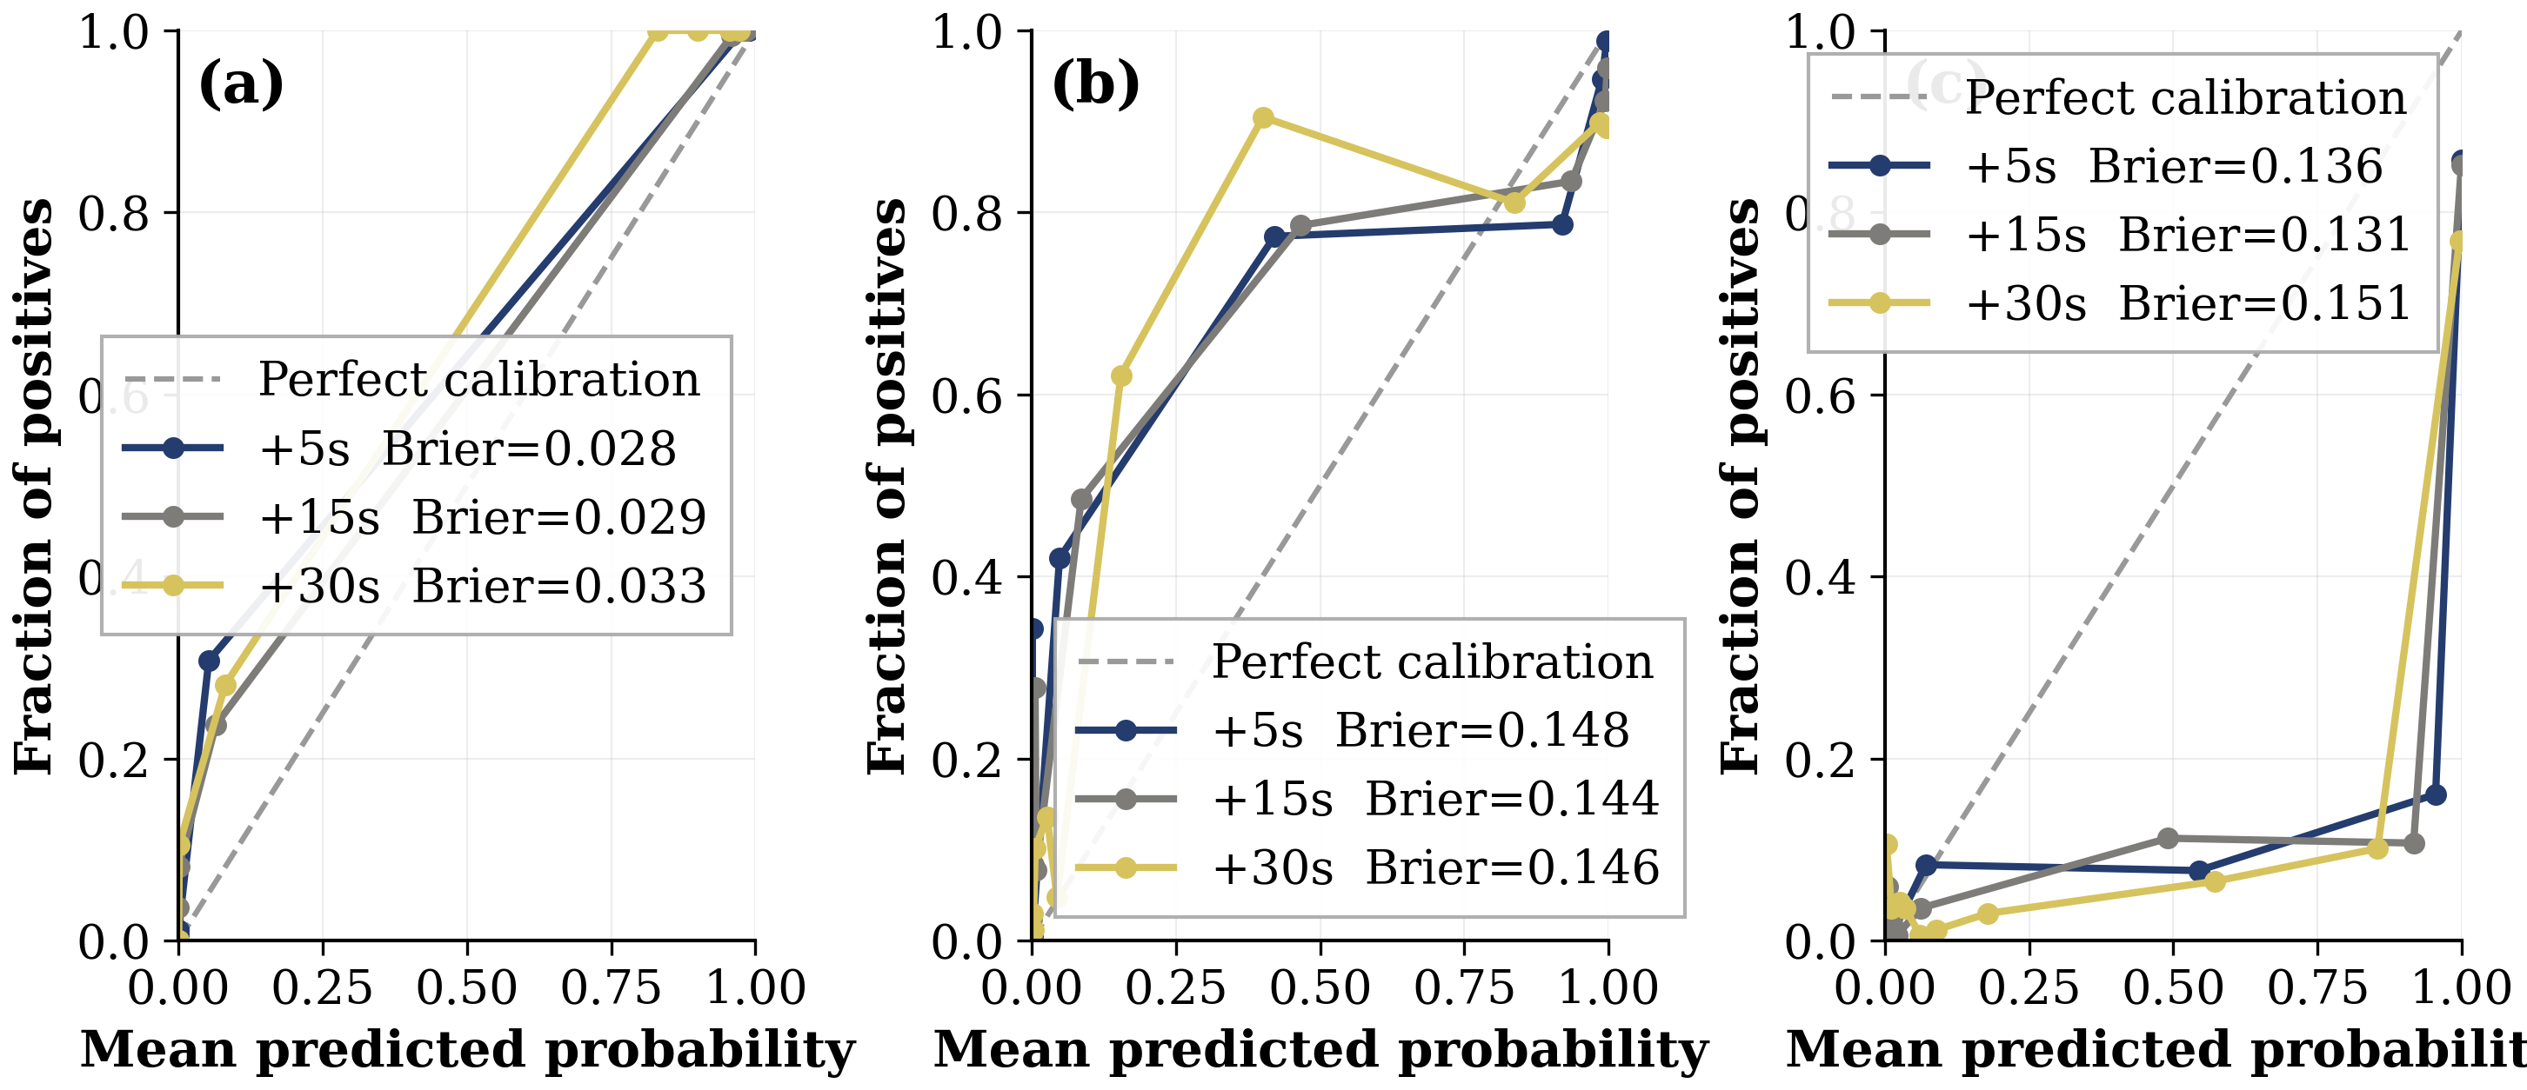
PROBABILITY CALIBRATION - TEMPERATURE SCALING
Temperature scaling converts raw logits to more reliable probability estimates - enabling P(DEGRADED) to serve as a risk score for the adaptive EKF.
State | ECE
Raw (T = 1.0) | 0.114
After scaling (T = 0.4023) | 0.068
Improvement | −40%

Slide 22
5 · EKF: From Prediction to Position

Slide 23
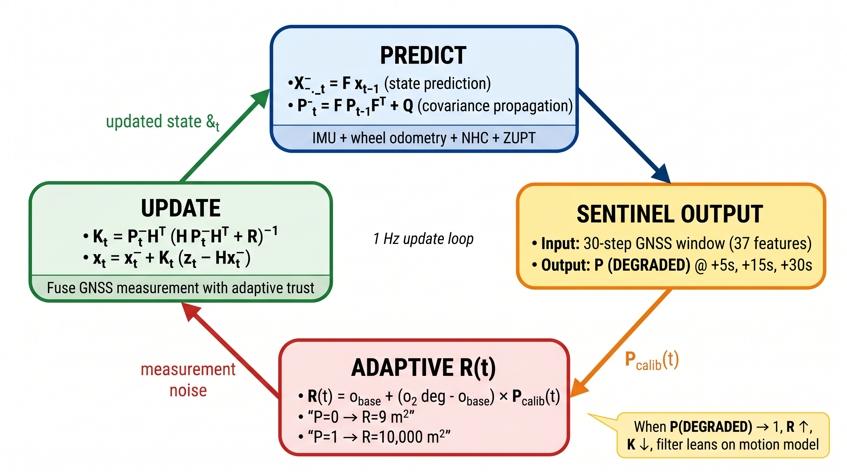
STANDARD VS ADAPTIVE EKF
Standard Kalman Filter
● R = fixed (e.g. 9 m²)
● Always trusts GNSS equally
● Reactive - waits until GNSS fails
● Position jumps during blockage
● No advance warning used
Our Adaptive EKF
✔ R(t) grows with P̂(DEGRADED)
✔ Pre-emptively distrusts GNSS
✔ Shifts to dead-reckoning before failure
✔ Smooth handoff during blockage
Pre-calibrated P(DEGRADED): P_cal = clip((P - 0.153)/(1 - 0.153), 0, 1)
Online sigma_deg: running median of innovations, window=80, clamp [8-80] m
✔ 5 s early warning from SENTINEL

Slide 24
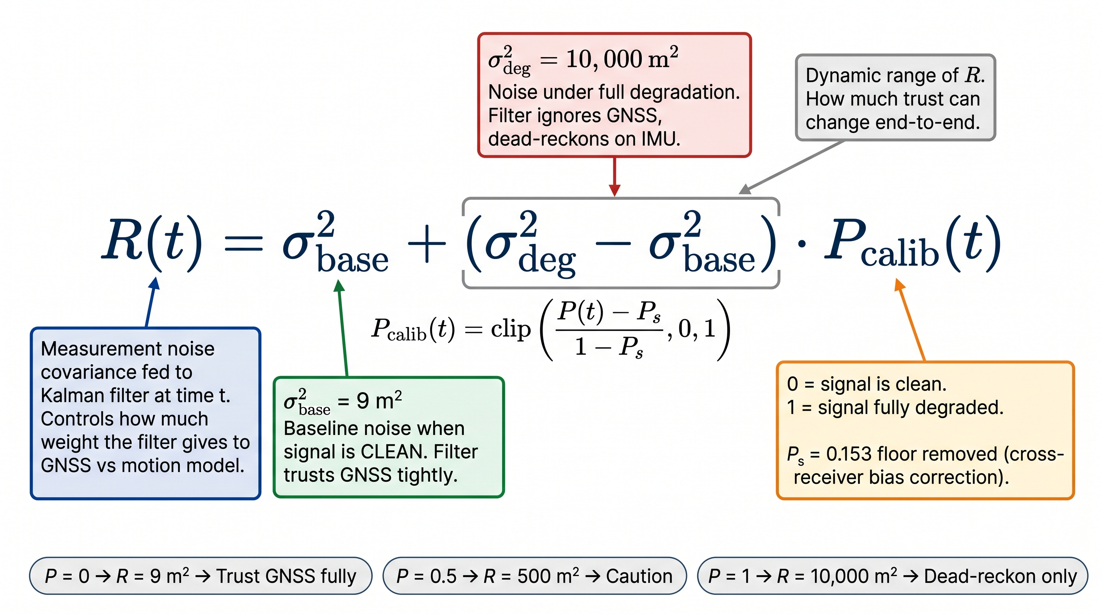
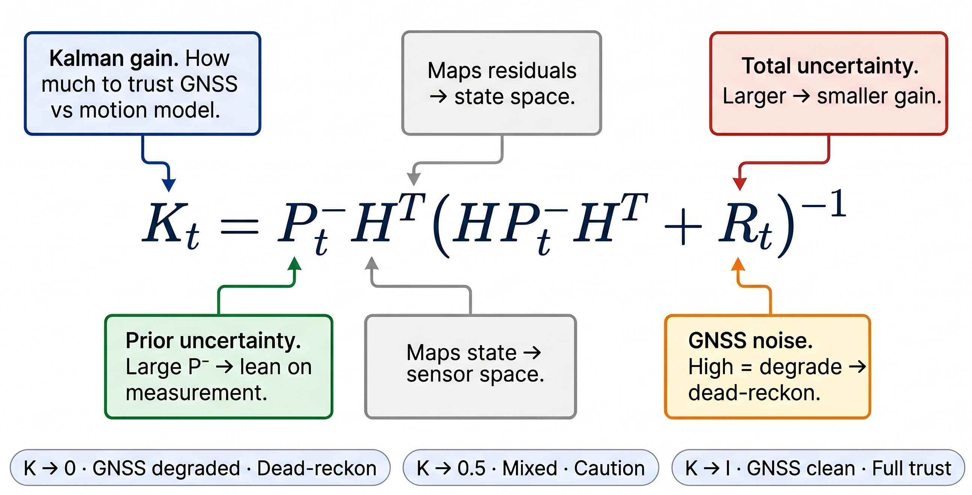
EKF FORMULA
EKF Formula
Kalman Gain

Slide 25
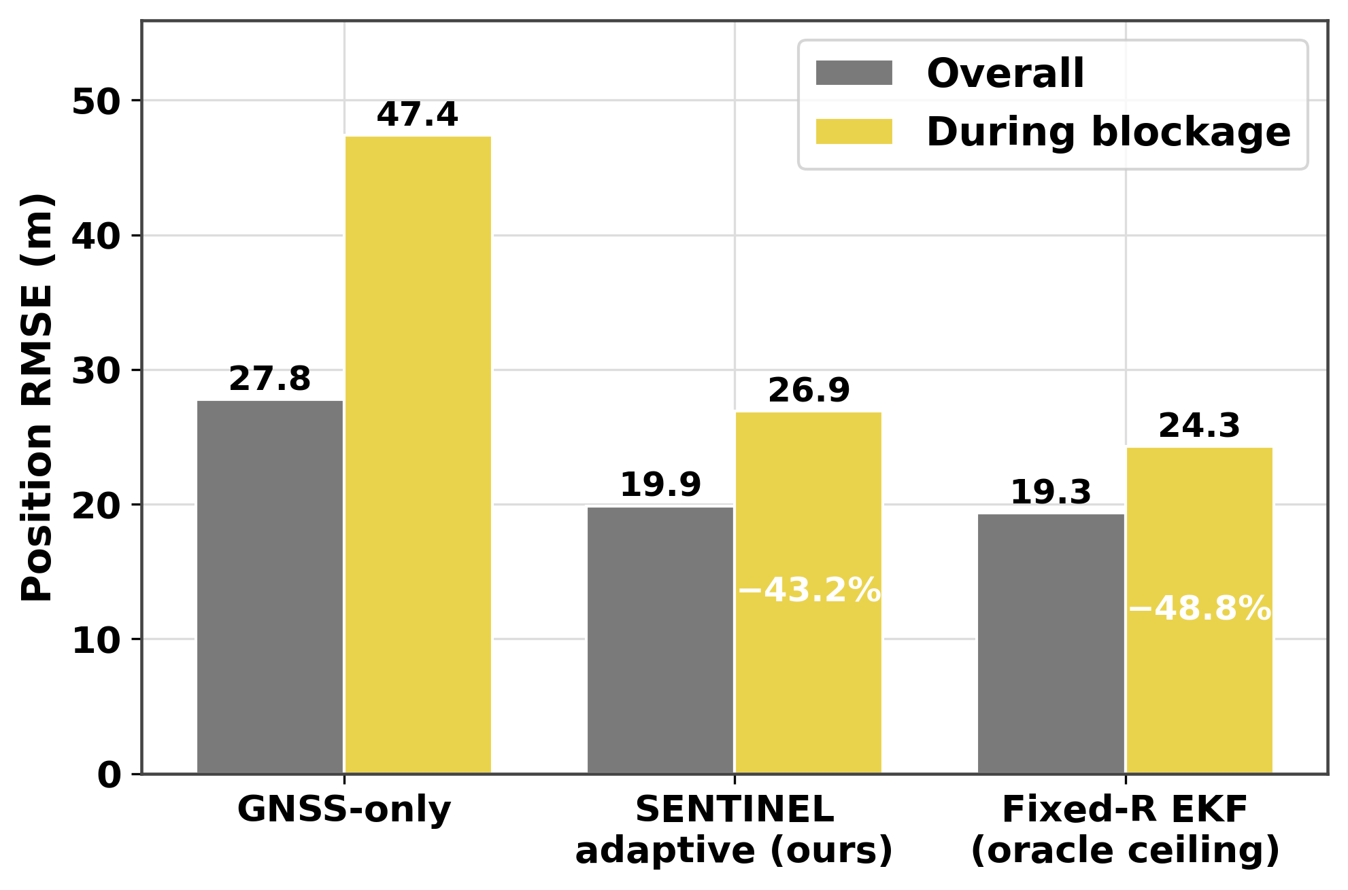
EKF RESULTS - THREE TIERS OF VALIDATION
EKF POSITION ACCURACY - REAL TOKYO RESULTS
REAL TOKYO EKF RESULTS (Trimble Shinjuku)
During Degraded Segment:
GNSS-only baseline: 47.4 m
SENTINEL adaptive (ours): 26.9 m (-43.2% vs raw)
Fixed-R EKF (oracle): 24.3 m (-48.8% vs raw)
Our proactive system achieves 43.2% RMSE reduction
vs raw GPS
(Fixed-R oracle uses true degradation labels - not predictive)
Real Tokyo Trimble Shinjuku results (Phase 2b/2c)

Slide 26
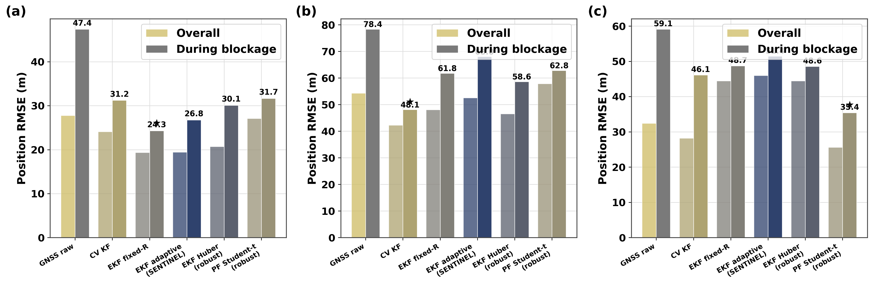
EKF MULTI-ENVIRONMENT RESULTS
Degraded-Segment RMSE gain vs. Raw GPS
Trimble Shinjuku: EKF fixed-R wins (24.3 m). u-blox: Huber EKF wins. Odaiba: Student-t PF wins.
No single method dominates - SENTINEL adaptive-R pairs best with clean GPS, the most common case.

Slide 27
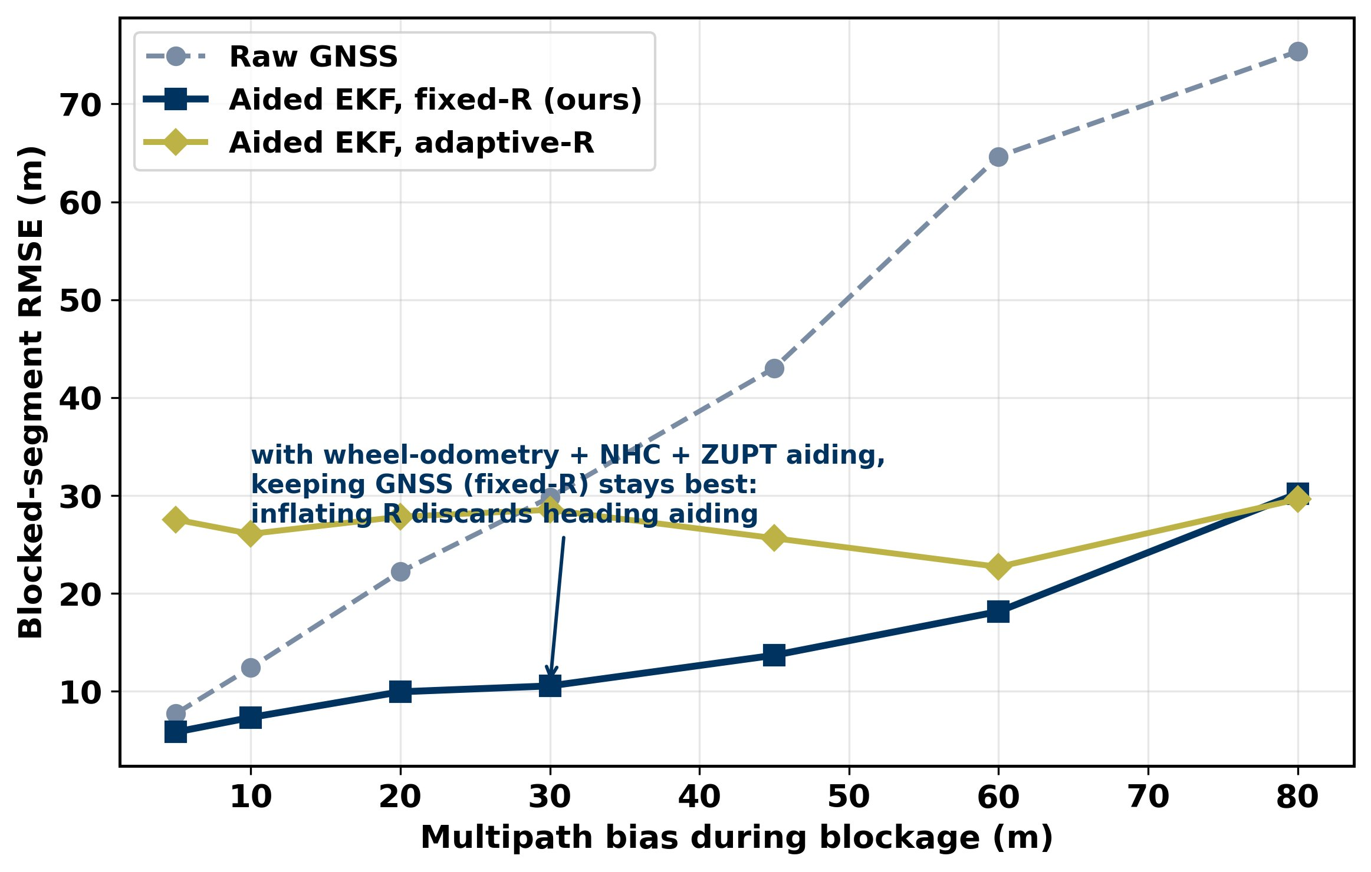
PLATFORM DEPENDENCE OF ADAPTIVE-R
WHEN IS ADAPTIVE-R WORTH IT? - > SEVERITY SWEEP
When adaptive-R helps
GNSS-only platform: adaptive-R wins above ~20 m multipath - deep canyons and tunnels, exactly the target regime.
Well-aided platform (odometry + NHC + ZUPT): fixed-R wins; the crossover appears only near ~80 m bias.
Role in the AV stack
Trigger the fusion mode switch (GNSS-primary to odometry-primary), alert the path planner to a predicted blockage zone, and activate ZUPT in blocked zones.

Slide 28
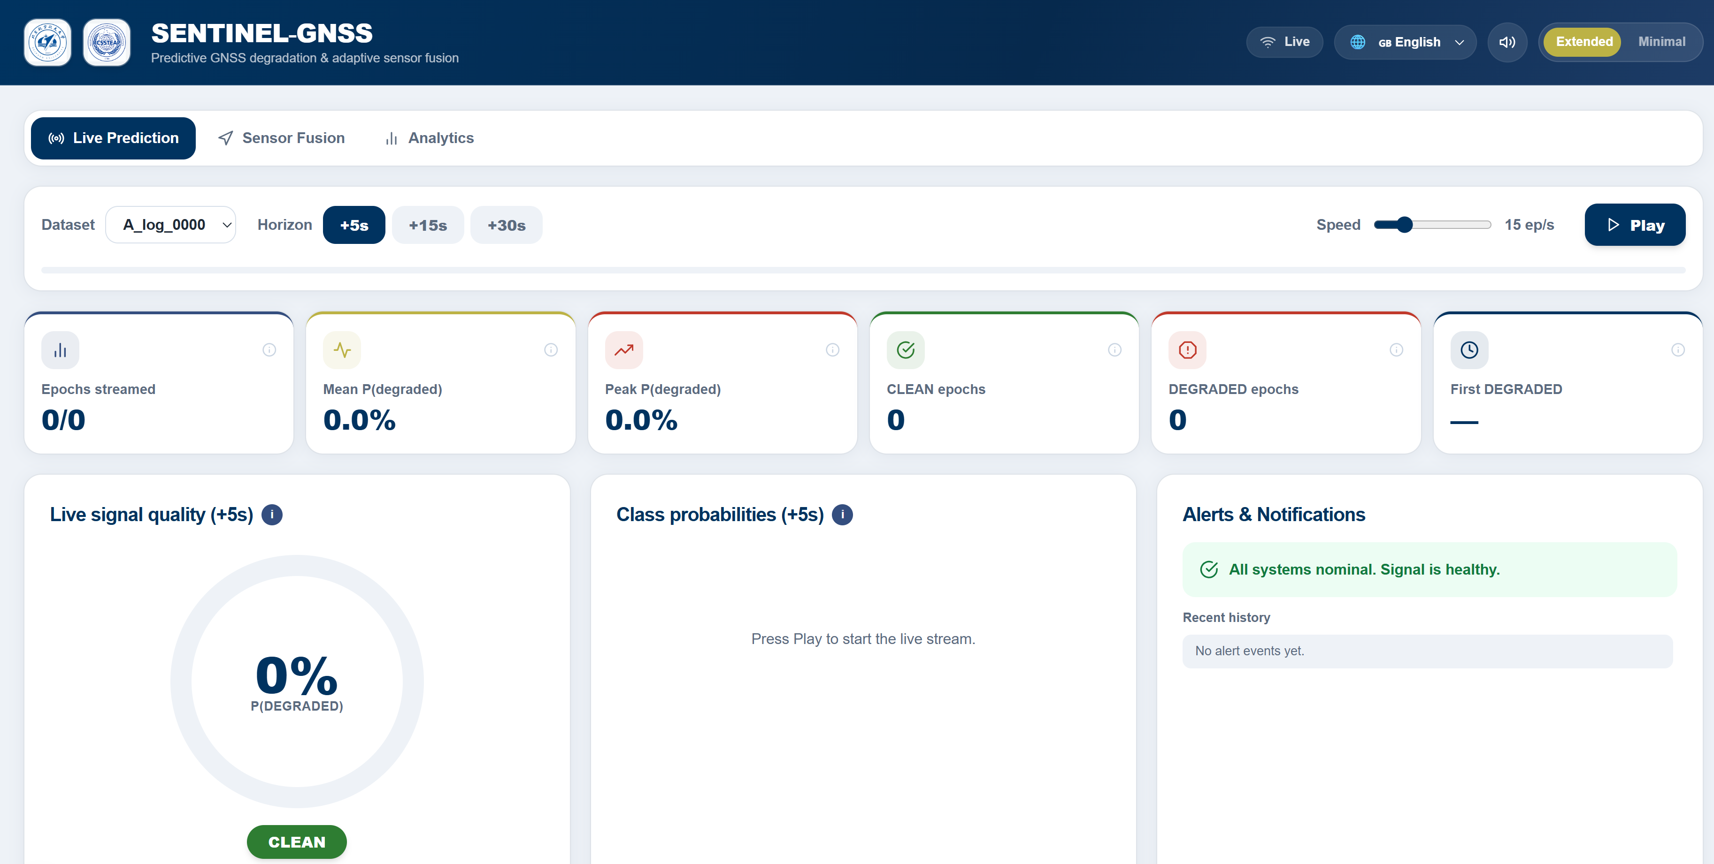
SENTINEL-GNSS DASHBOARD

Slide 29
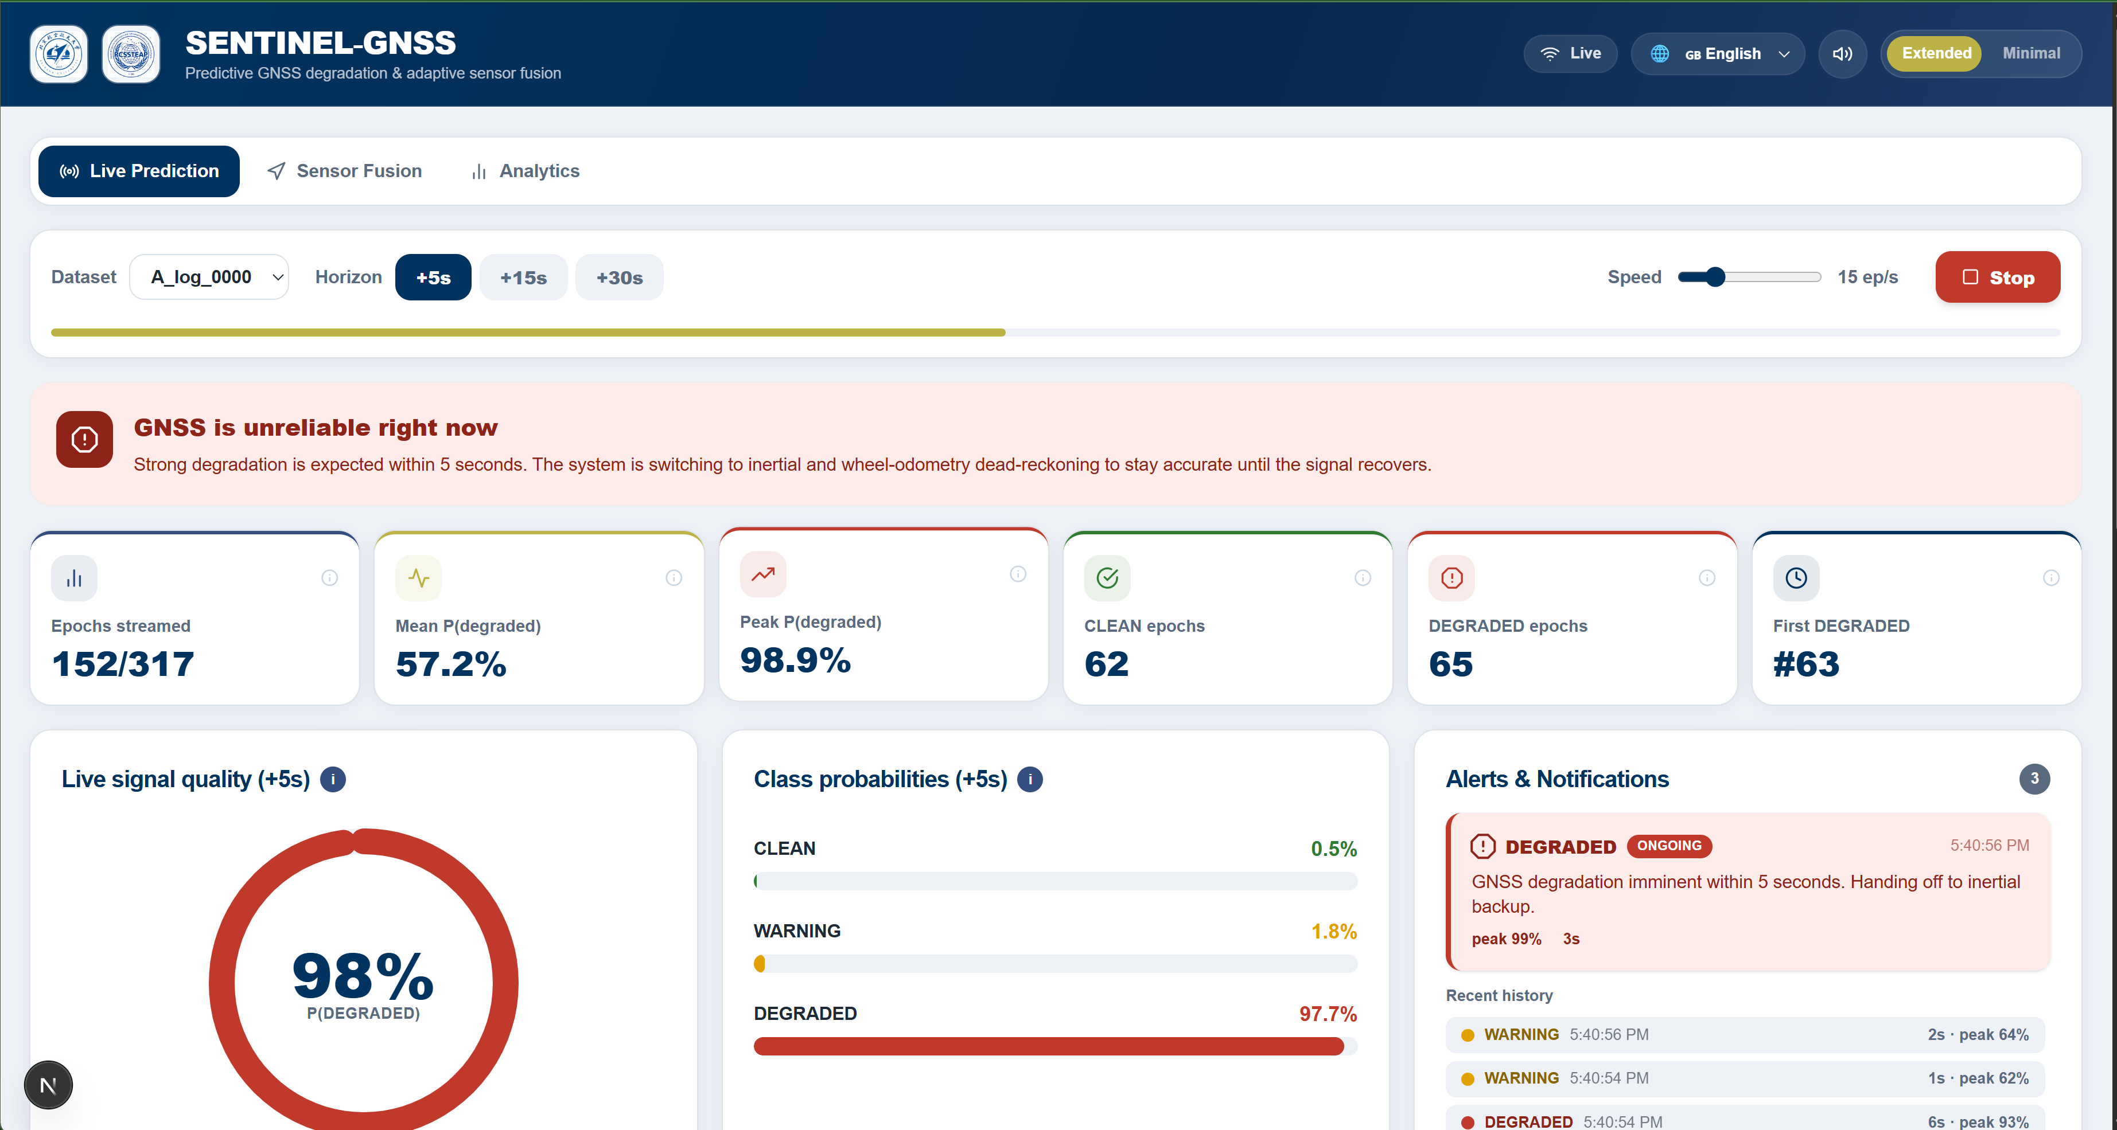
SENTINEL-GNSS DASHBOARD

Slide 30
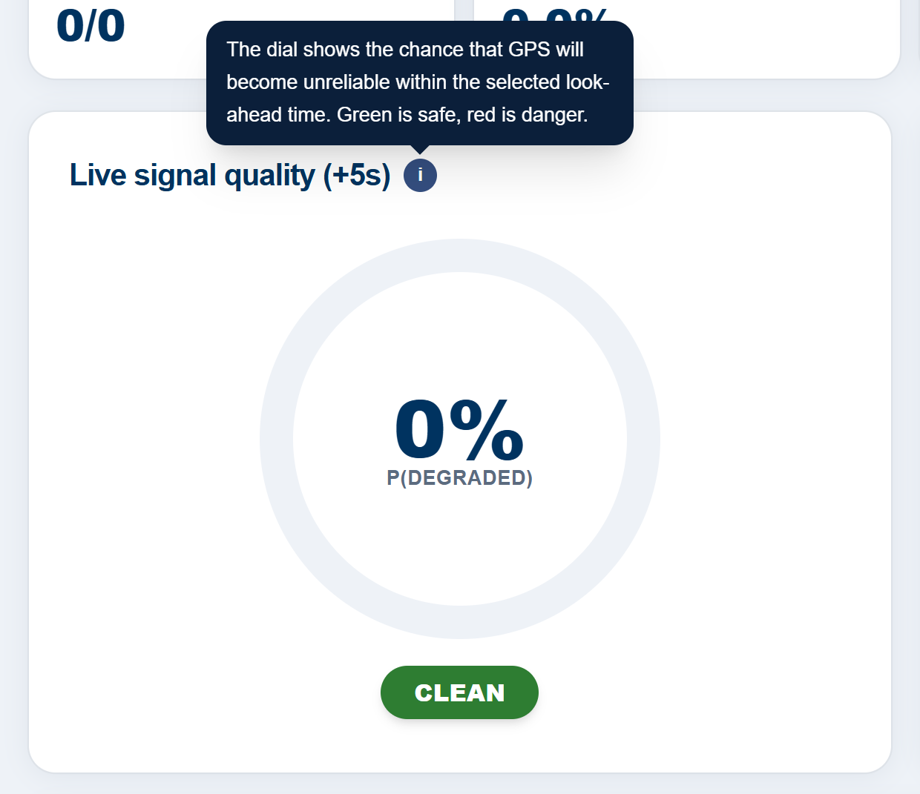
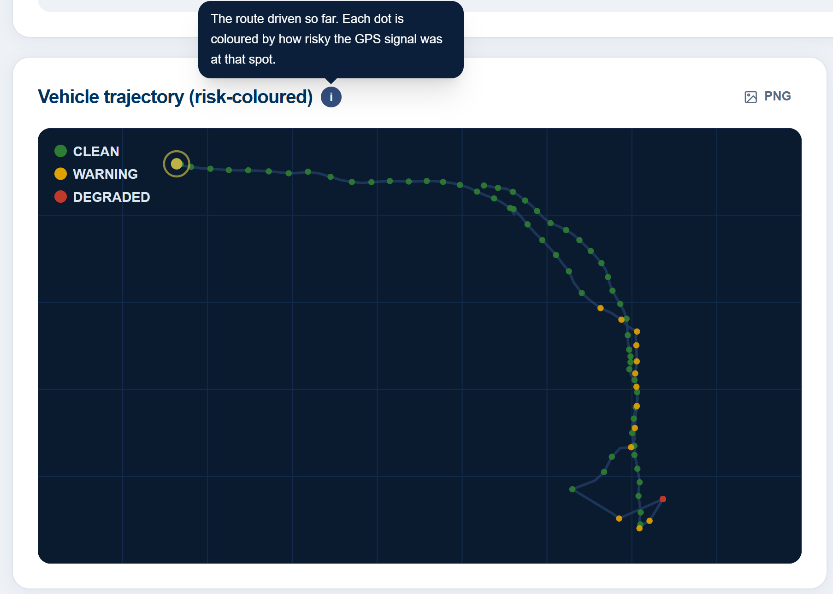
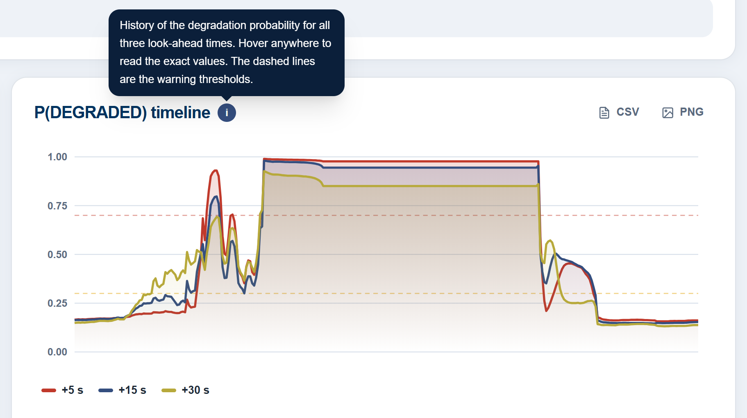
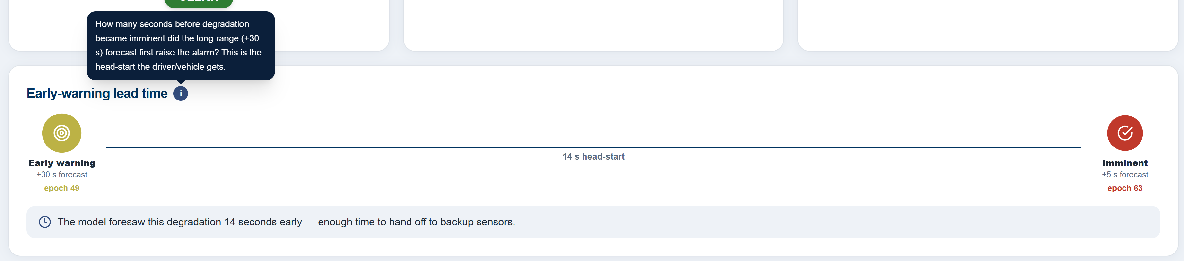
SENTINEL-GNSS DASHBOARD

Slide 31
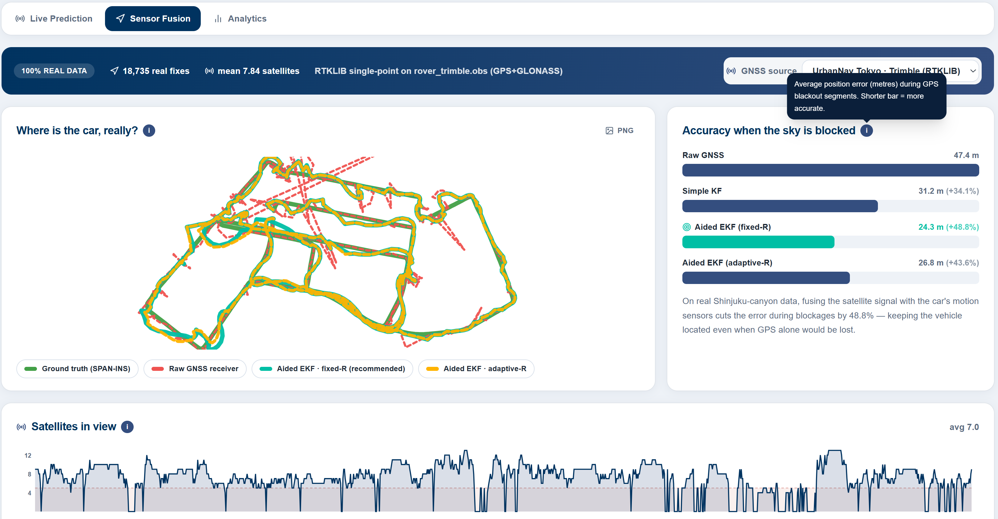
SENTINEL-GNSS DASHBOARD - SENSOR FUSION

Slide 32
5 · Novelty & Validation

Slide 33
NOVELTIES
10.5× faster · one pass · three horizons
Reactive → Proactive Predictor
DEGRADED F1: 0.75 (ours) vs 0.15 (RF) on unseen Tokyo
1
First system to predict GNSS degradation 5 s, 15 s, 30 s ahead - Liu et al. (2023) only classifies t+0
5 s
≈ 83 m
SENSOR TIGHTENING
Cross-City Generalisation
Fuse IMU/LiDAR · tighten tracking loops before canyon entry
2
Beijing → Tokyo: DEGRADED F1 = 0.75 (ours) vs. 0.15 (Random Forest) - unseen city, zero retraining
Unified Multi-Horizon Model
15 s
≈ 250 m
SENSOR HANDOFF
3
One forward pass, three prediction heads - 10.5× faster than three separate traditional models
Shift EKF authority to dead-reckoning before signal loss
Open Multi-City Benchmark
4
149,662 labelled epochs · Beijing, Hong Kong, Tokyo, Oxford, Ann Arbor · 9+ receiver types
30 s
≈ 500 m
ROUTE REPLANNING
Full lead time to commit to an alternative route
Hardware-Aware Design
5
Explicit receiver_tier feature bridges Septentrio survey-grade → consumer smartphone, no retraining

Slide 34
VALIDATION
0.8206
85%
0.75
±5 cm
Macro-F1 (+5 s)
DEGRADED Recall
DEGRADED F1 - Tokyo
Ground-truth accuracy
95% CI [0.798, 0.840]
safety-critical class
vs. RF = 0.15 out-of-domain
RTK ground truth accuracy (Trimble)
Session-Based Split - No Data Leakage
Physically Verified Labels
▸ Whole drives assigned to train / val / test - never individual seconds
▸ Tokyo Shinjuku (31,236 windows) fully held out as cross-city test (E6)
▸ StandardScaler + SMOTE fitted on training set only · Seed = 42
▸ NCLT: labels from |GPS − LiDAR SLAM| - actual positioning error, ±5 cm
▸ Septentrio thresholds 35 / 25 dBHz confirmed by hardware signal charts
▸ NMEA no-fix epochs (quality = 0) correctly captured as DEGRADED
Honest Comparison with Classical Baselines
Uncertainty & Ablation Evidence
▸ XGBoost Macro-F1 = 0.919 vs. ours 0.821 in-domain - disclosed openly
▸ Cross-city: RF DEGRADED F1 collapses to 0.15 · ours holds at 0.75
▸ One model, 10.5× faster, calibrated probabilities (ECE < 0.05)
▸ Bootstrap 95% CIs on all metrics: DEGRADED F1 [0.647, 0.789]
▸ Permutation test (E5): temporal order adds ~3 pp - gain is representation transfer
▸ Ablation: full model > Transformer-only > LSTM-only on DEGRADED F1

Slide 35
6 · Deliverables

Slide 36
PUBLICATION
Proactive Multi-Horizon GNSS Degradation Prediction
Paper A
GPS Solutions (Springer, Q1) · Target: Post-ION GNSS+ 2026
🔄 Drafting
From Prediction to Position: Adaptive EKF
Paper B
IEEE T-ITS / Journal of Navigation (Q1) · Target: After Paper A submission
⏳ Outlined
Literature Review
Paper C
⏳ Outlined
Title: Evolution of Intelligent GNSS Signal Degradation Prediction Techniques for Autonomous Vehicle Navigation
Cross-City Transfer - Short Paper
Conference
ION GNSS+ 2026 · Target: Check deadline
⏳ Outlined

Slide 37
Thank you
SENTINEL-GNSS - predicting GNSS degradation before it happens
Team Pilot Project · Beihang University
github.com/Jorshuare/AI-Based-Prediction-for-GNSS-Signal-Degradation

