Slide 1


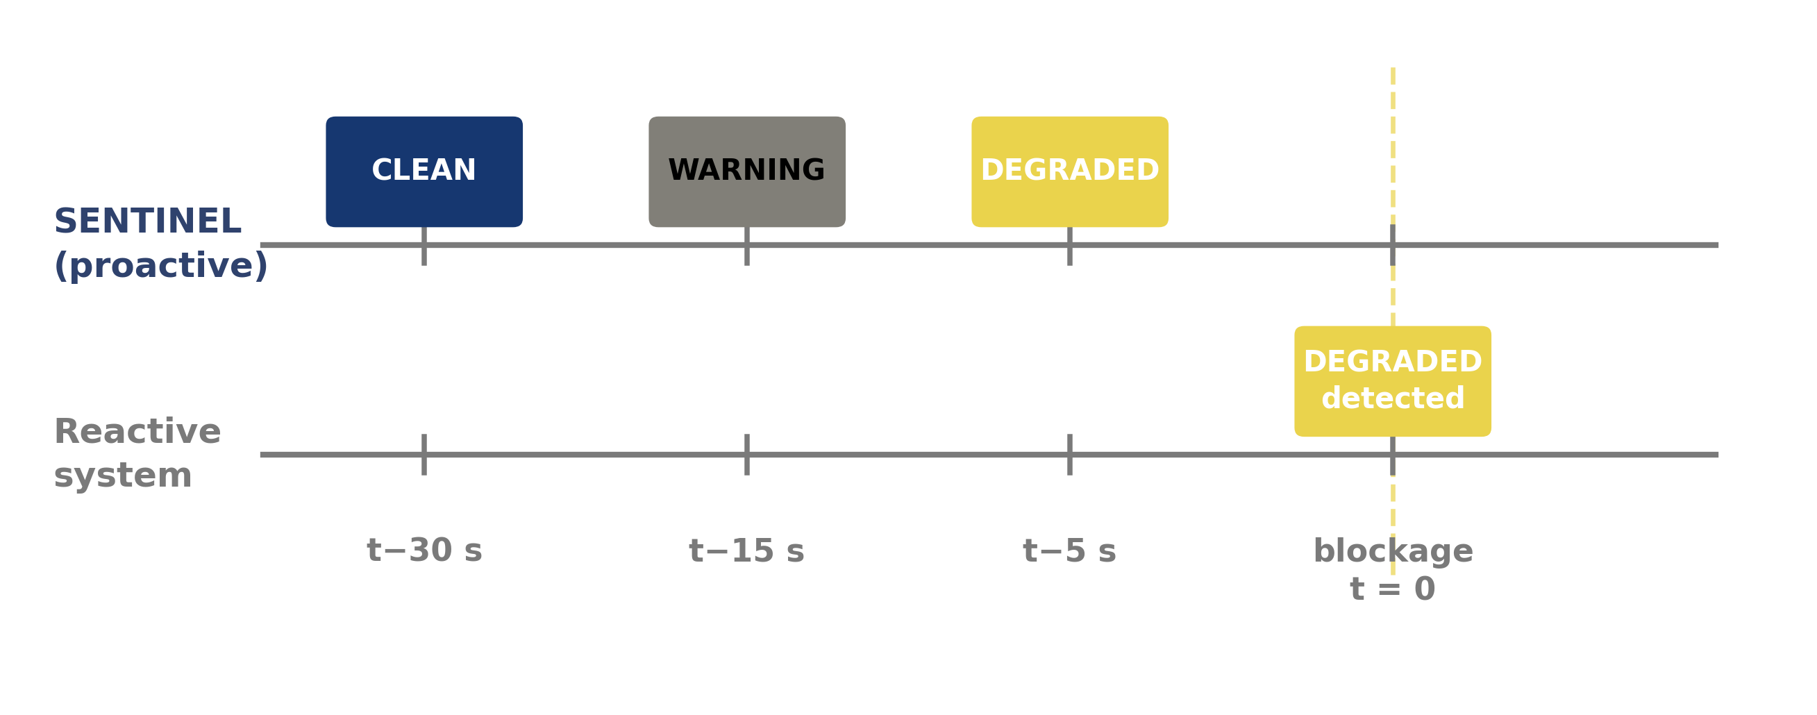
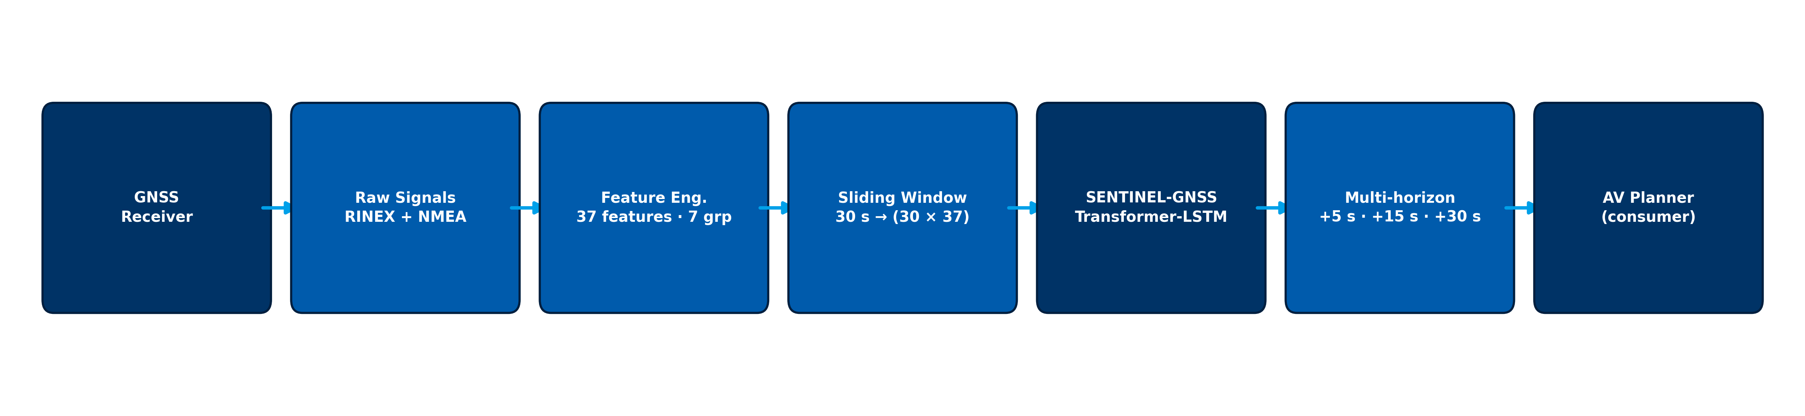
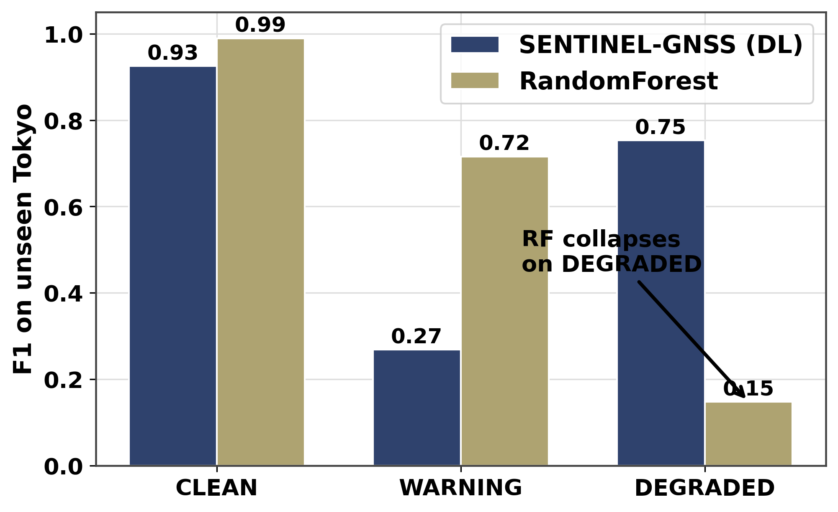
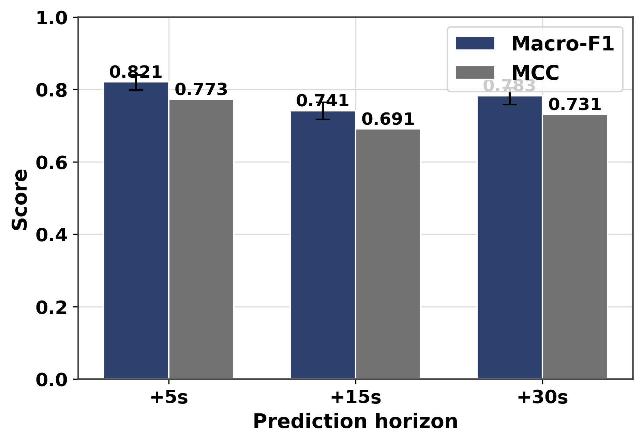
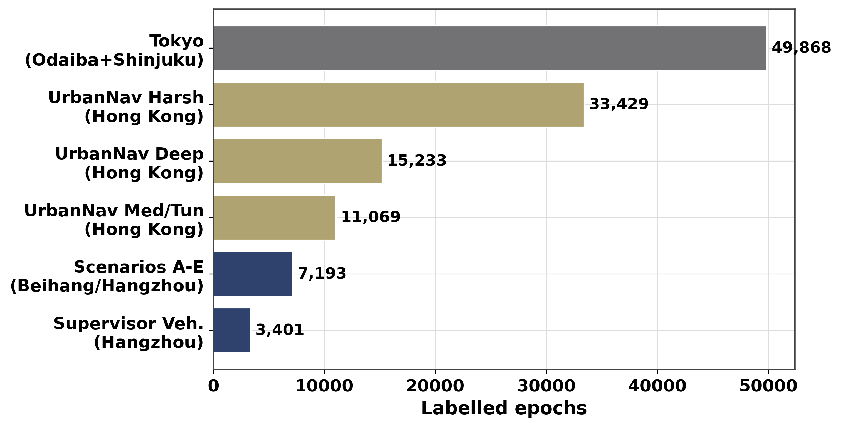
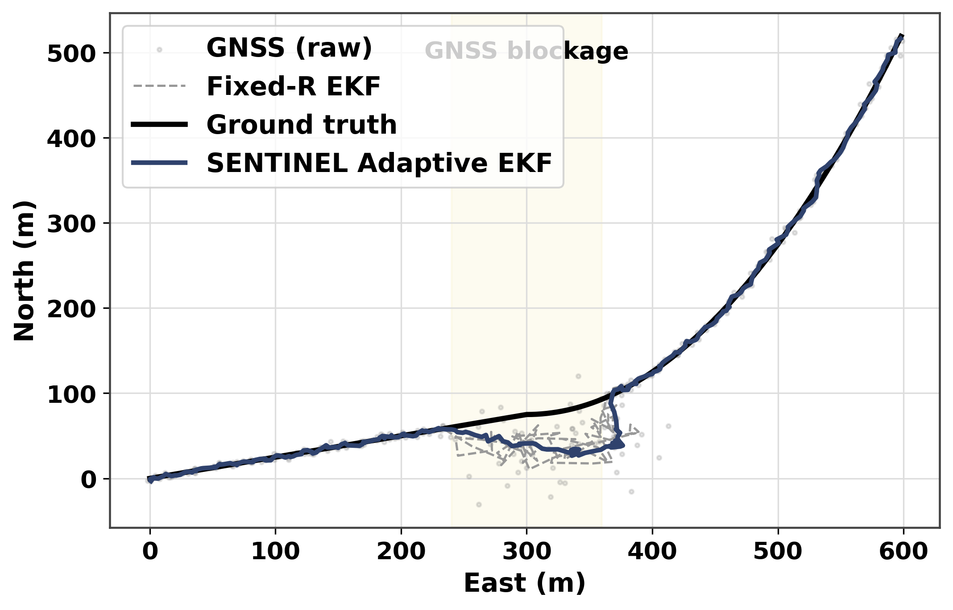
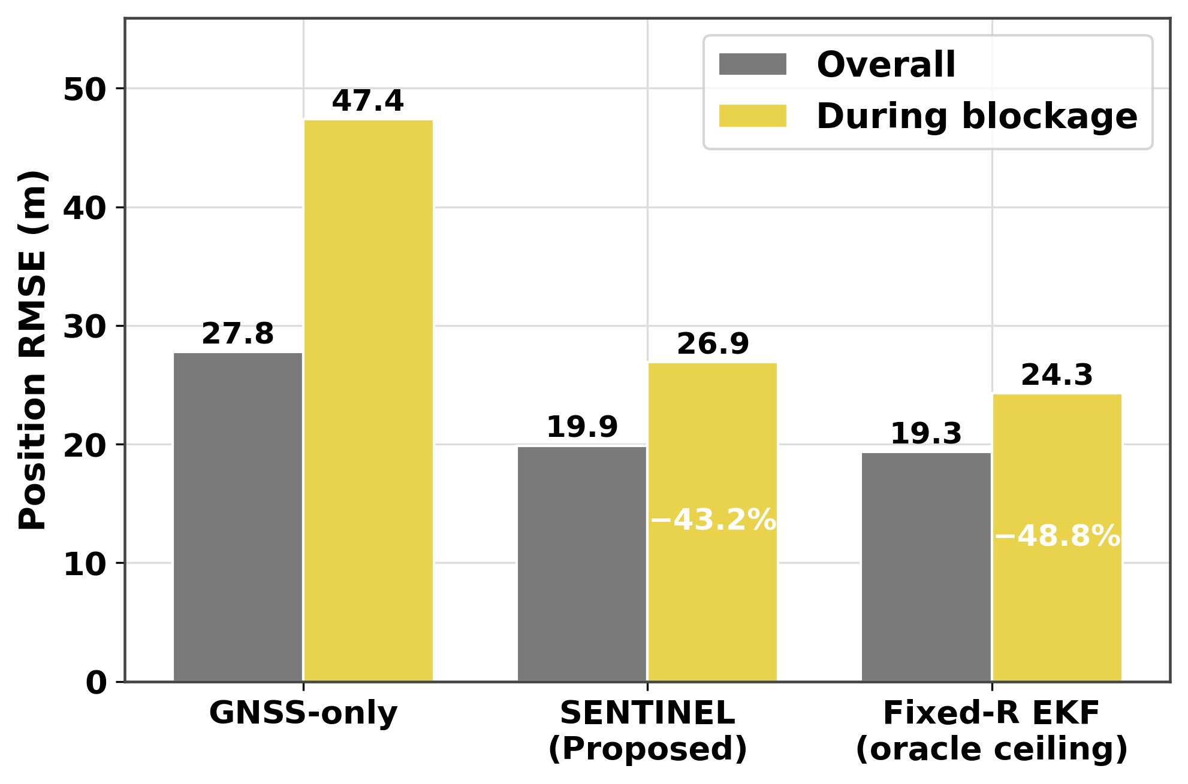
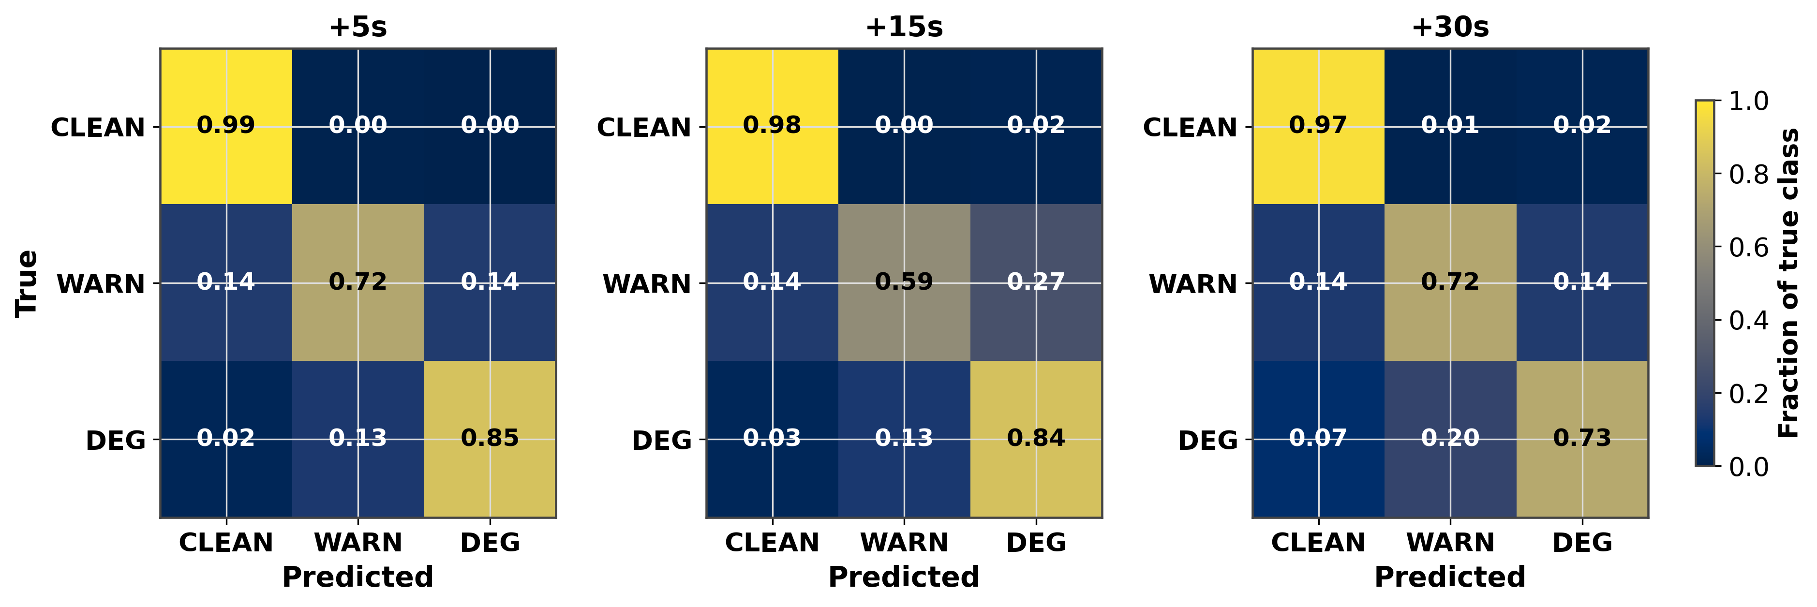
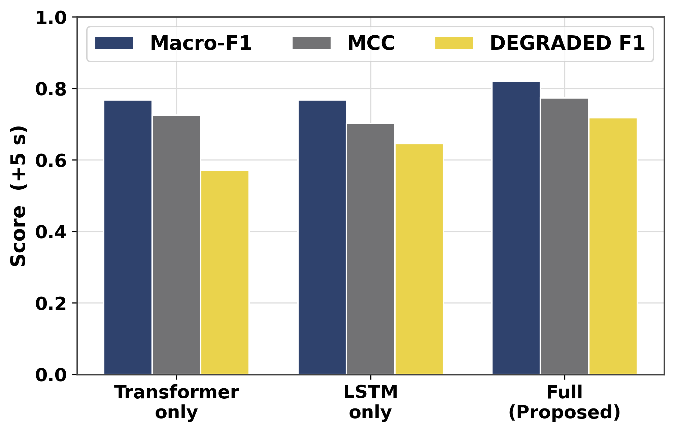
SENTINEL-GNSS
Proactive Multi-Horizon Prediction of GNSS Signal Degradation for Autonomous Vehicle Navigation
Ojerinde Joel · Ogunlade Joshua · Mustapha Ibrahim · Ingeriyinkindi Claudine · Rashid Md Harun Or
H3I, Beihang University (RCSSTEAP) · Hangzhou, China · 2026
Background & Motivation
SENTINEL-GNSS Architecture & Pipeline
★ Cross-City Generalisation — Key Result
GNSS is the only drift-free absolute position source for autonomous vehicles.
At 60 km/h a vehicle covers 17 m/s — a 5-second positioning gap can place it in the wrong lane or miss a junction entirely.
GNSS fails silently in urban environments:
• NLOS multipath from buildings injects 10–200 m position errors
• The receiver continues to output a 'valid' fix with no error flag
Existing monitors (RAIM, RTKLIB Q-codes, ML classifiers) are REACTIVE:
they report degradation only after it begins — zero preparation time.
SENTINEL-GNSS predicts degradation 5–30 s in advance,
giving the vehicle controller time to pre-activate dead reckoning.
Hybrid Transformer–LSTM exploiting two temporal scales:
Transformer encoder (global patterns):
2 layers · 8 heads · d_model=128 · d_ff=512 · dropout=0.3
Captures satellite rise/set and PDOP trends across the 30-s window.
LSTM (sequential dynamics):
2 stacked layers · hidden=256 · detects directional approach to blockage:
C/N₀ declining, pseudorange residuals growing, PDOP rising.
Three output heads: +5 s · +15 s · +30 s | 1.46 M params | 0.039 ms/sample
Training: Hangzhou + Hong Kong | Test: Tokyo (never seen during training)
Tokyo DEGRADED-class F1 at +5 s:
SENTINEL (DL): 0.75 ✔ Learns transferable temporal patterns
Random Forest: 0.15 ✘ Memorises city-specific feature thresholds
Why RF fails: RF learned PDOP > 3.1 → DEGRADED from Beihang data.
In Tokyo the PDOP baseline is 2.8 (taller buildings, different geometry).
SENTINEL detects the temporal signature (C/N₀ declining, residuals growing),
which is physically consistent across cities — independent of geometry.
Fig. 4: End-to-end SENTINEL-GNSS pipeline — raw GNSS signals to multi-horizon AV planner inputs via Transformer-LSTM.
Multi-Horizon Classification Results
Fig. 1: Reactive monitoring gives 0 s warning. SENTINEL provides CLEAN → WARNING → DEGRADED labels 30/15/5 s before blockage, enabling pre-emptive fusion decisions.
Held-out test set (n=1,686 windows). 95% CI via 1,000 bootstrap iterations.
+5 s: Macro-F1 = 0.821 | DEGRADED F1 = 0.718 | Recall = 0.847
+15 s: Macro-F1 = 0.741 | DEGRADED F1 = 0.583
+30 s: Macro-F1 = 0.783 | DEGRADED F1 = 0.629
84.7% of approaching degradation events flagged at +5 s — before
biased measurements arrive. MCC = 0.773 (strong class balance).
Fig. 7: Cross-city DEGRADED-class F1 at +5 s. SENTINEL 0.75 vs RF 0.15 — a 5× generalisation gap that only grows at +15 s and +30 s.
Dataset & Feature Engineering
Prediction-Informed EKF Navigation
149,662 labelled epochs across 4 cities and 9+ receiver types:
• Hangzhou (Beihang campus): Scenarios A–E, Septentrio Mosaic-X5C
• Hong Kong (UrbanNav): Medium / Deep / Harsh / Tunnel environments
• Tokyo (held-out): Shinjuku Trimble, Shinjuku u-blox F9P, Odaiba
37 features in 7 groups: position quality, signal strength, satellite geometry,
pseudorange residuals, temporal patterns, atmospheric delays, receiver status.
Key: receiver_tier encodes hardware class — one model handles
Septentrio (48 dB-Hz baseline) and u-blox (38 dB-Hz) identically.
SENTINEL +5 s probability inflates GPS measurement noise R before bad epochs arrive:
R = (40 m)² I₂ when P(DEGRADED) > 0.45; else R = r_base² I₂
Pre-emptive gain reduction means the filter is protected when biased
fixes arrive — reactive detectors act only after the damage.
Degraded-segment RMSE reduction vs raw GNSS:
EKF Fixed-R + SENTINEL: 48.8% ★ Trimble Shinjuku
Huber EKF (standalone): 25.2% ★ u-blox Shinjuku (handles 1,472 m spike)
Student-t PF: 40.1% ★ Odaiba harbour (non-persistent NLOS)
Fig. 5: Macro-F1 and MCC across prediction horizons with bootstrap 95% CI. Performance degrades gracefully as horizon extends.
Ablation Study
Fig. 2: Dataset composition. Tokyo (49,868 epochs) is strictly held-out — never seen during training or validation.
Both Transformer and LSTM are necessary:
Transformer-only: Macro-F1=0.767, DEG-F1=0.571 (over-flags, precision=0.42)
LSTM-only: Macro-F1=0.767, DEG-F1=0.645 (under-detects, recall=0.51)
Full SENTINEL: Macro-F1=0.821, DEG-F1=0.718 ✔ precision=0.62, recall=0.85
Removing receiver_tier: DEG-F1 drops 0.718 → 0.656 (largest single feature).
Focal loss (γ=1) beats cross-entropy + SMOTE: DEG-F1 0.718 vs 0.672.
Classification Performance — All Horizons
Fig. 8 (left): SENTINEL trajectory (blue) hugs ground truth through blockage; Fixed-R EKF and raw GNSS diverge. Fig. 9 (right): Degraded-window RMSE across all fusion methods — SENTINEL gives largest reduction.
Conclusions & Future Work
Key Results:
✔ First system to predict GNSS degradation 5–30 s in advance
✔ Macro-F1 = 0.821 at +5 s | DEGRADED recall = 0.847
✔ Cross-city DEGRADED F1: 0.75 vs 0.15 (RF) — 5× gain in Tokyo
✔ 48.8% degraded-RMSE reduction via prediction-informed EKF
✔ 0.039 ms inference | all three horizons in one forward pass
Honest Disclosure:
RF/XGBoost outperform SENTINEL in-domain (F1 0.926 vs 0.821).
Cross-city generalisation is the deployment-relevant metric: a model that
memorises Beihang C/N₀ thresholds is useless in a new city.
Key Scientific Finding:
No single fusion method dominates all environments — environment-aware
method selection is a productive future direction.
Future Work:
• Multi-hypothesis PF to break GPS attractor collapse at N=500
• Per-satellite C/N₀ arrays as CNN front-end (capture satellite geometry)
• Environment-aware dynamic EKF/Huber/PF selection classifier
• Real-time 5–10 Hz deployment with tight GNSS/IMU coupling
Fig. 3: Row-normalised confusion matrices (+5 s / +15 s / +30 s). CLEAN recall ≥ 0.97 at all horizons; DEGRADED recall 0.85 → 0.73 as horizon extends.
Fig. 6: Ablation across architecture variants. Macro-F1, MCC, and DEGRADED-F1 — each component independently contributes to performance.
H3I, Beihang University (RCSSTEAP) · Hangzhou, China · 2026 │ Key references: Brown 1997 (RAIM) · Hsu 2021 (UrbanNav) · Liu 2023 (GBT GNSS) · Chen 2019 (LSTM GPS) · Vaswani 2017 (Transformer) · Hochreiter 1997 (LSTM) · Mehra 1970 (Adaptive Kalman) · Kalman 1960 (EKF)

