Slide 1
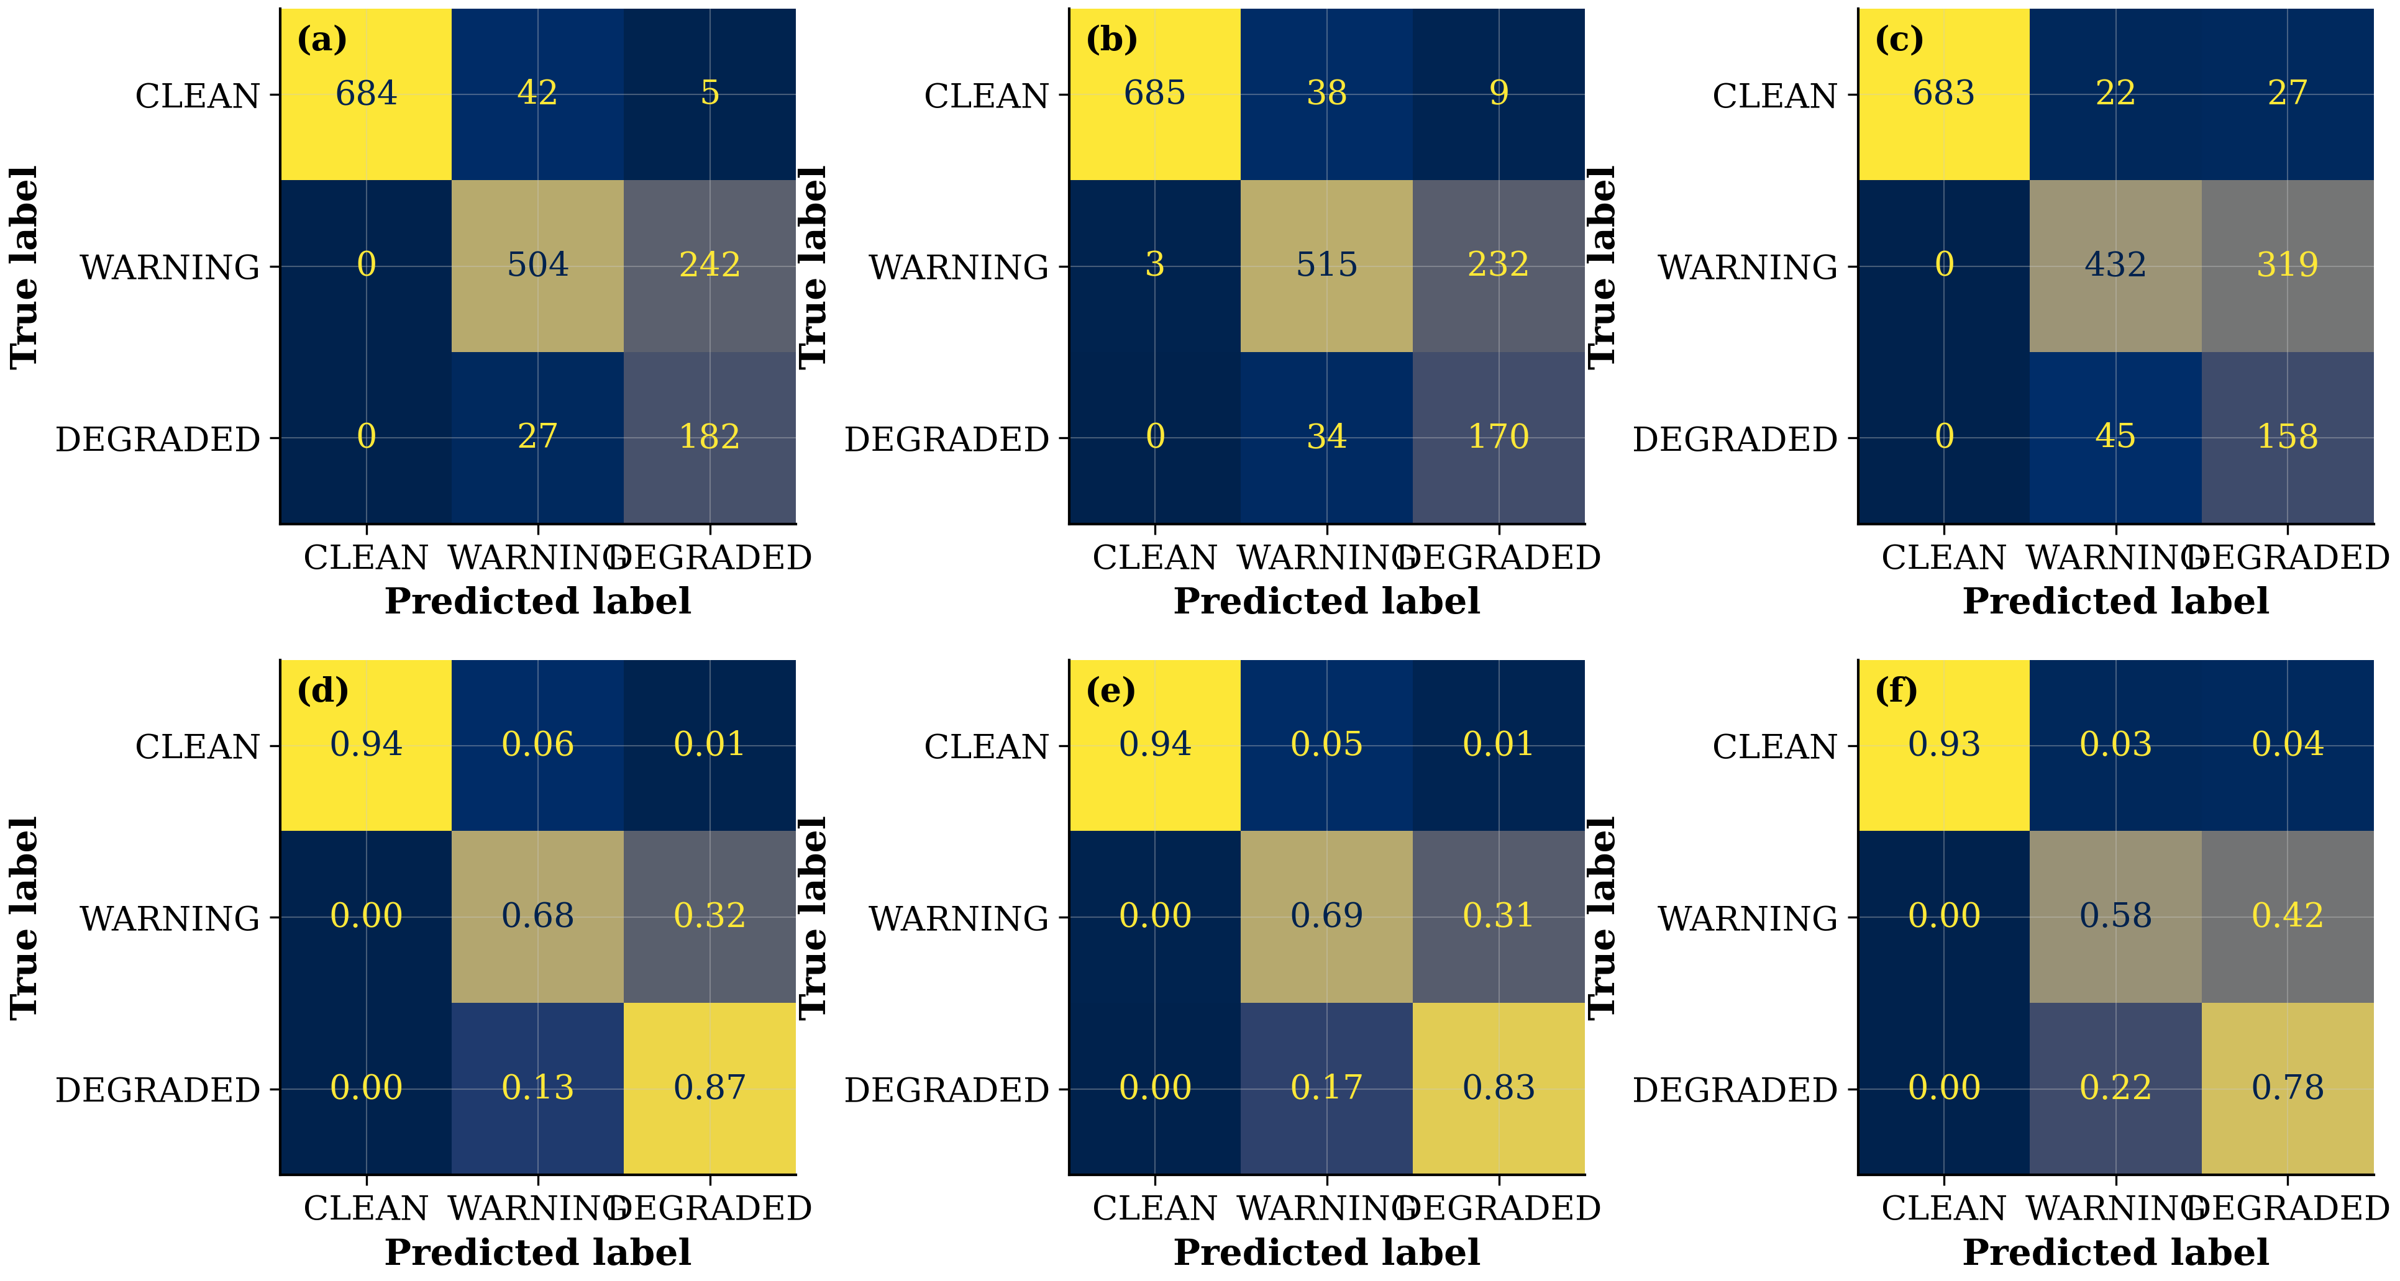
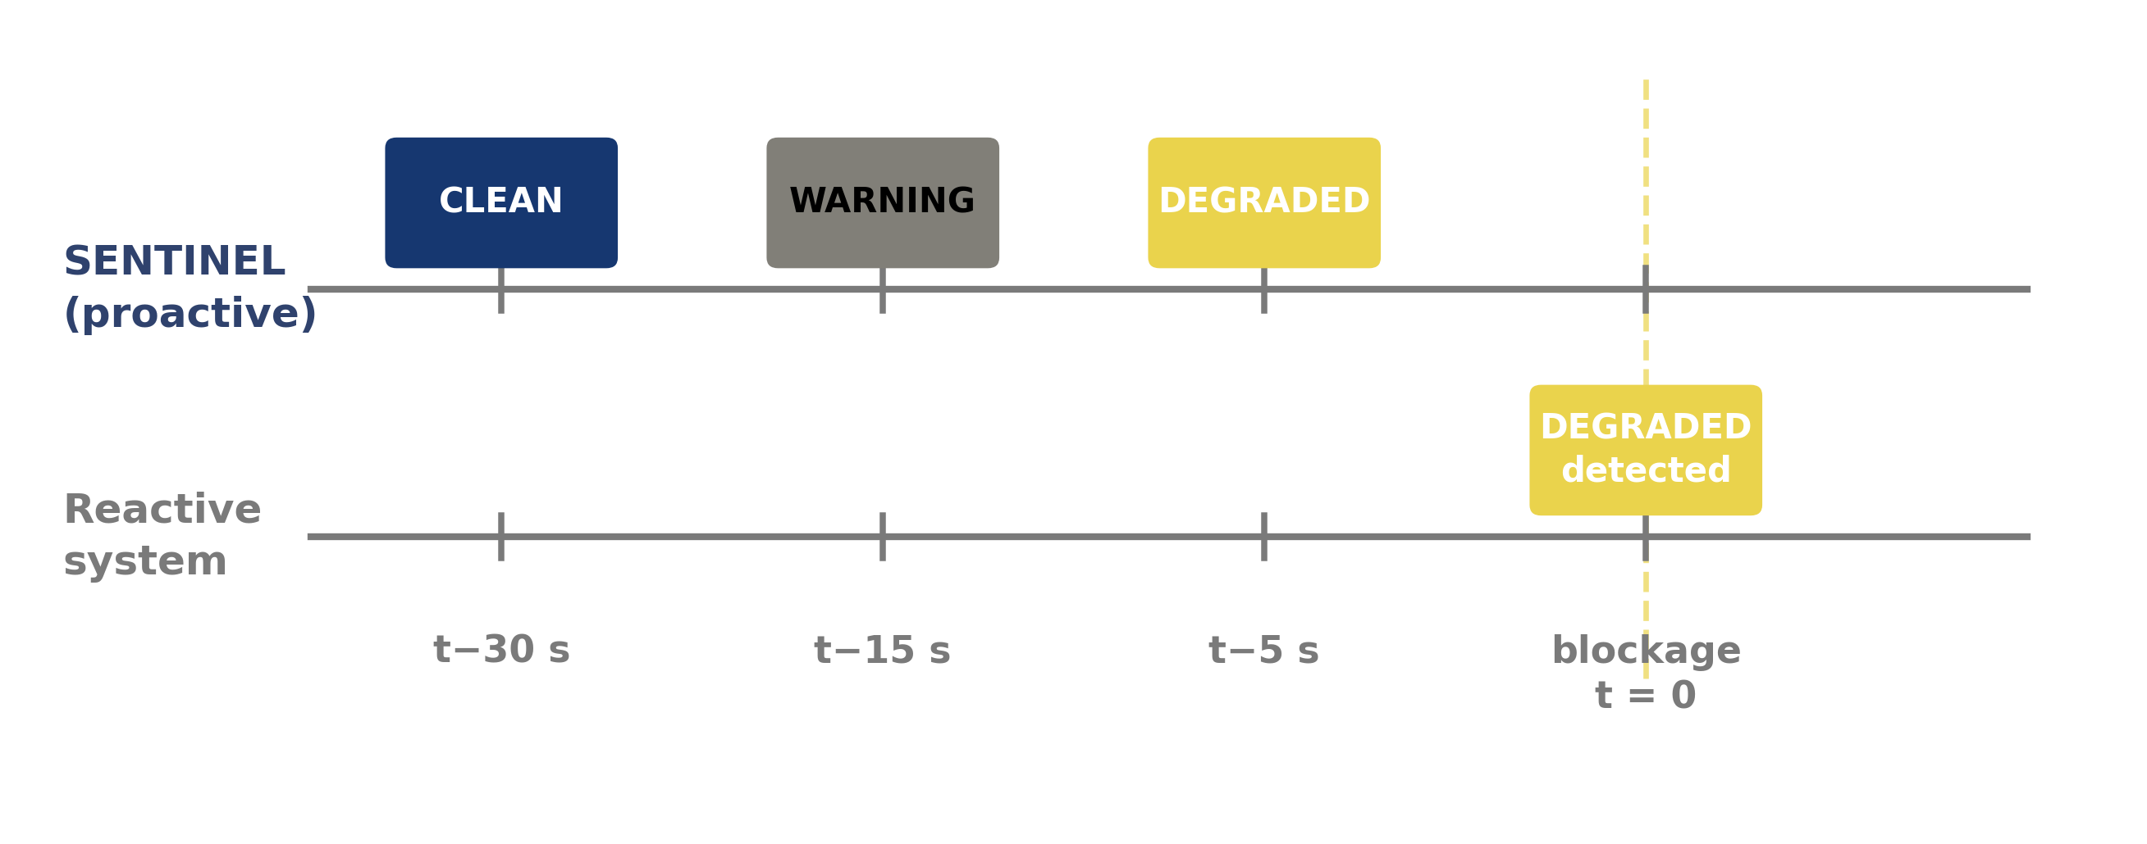
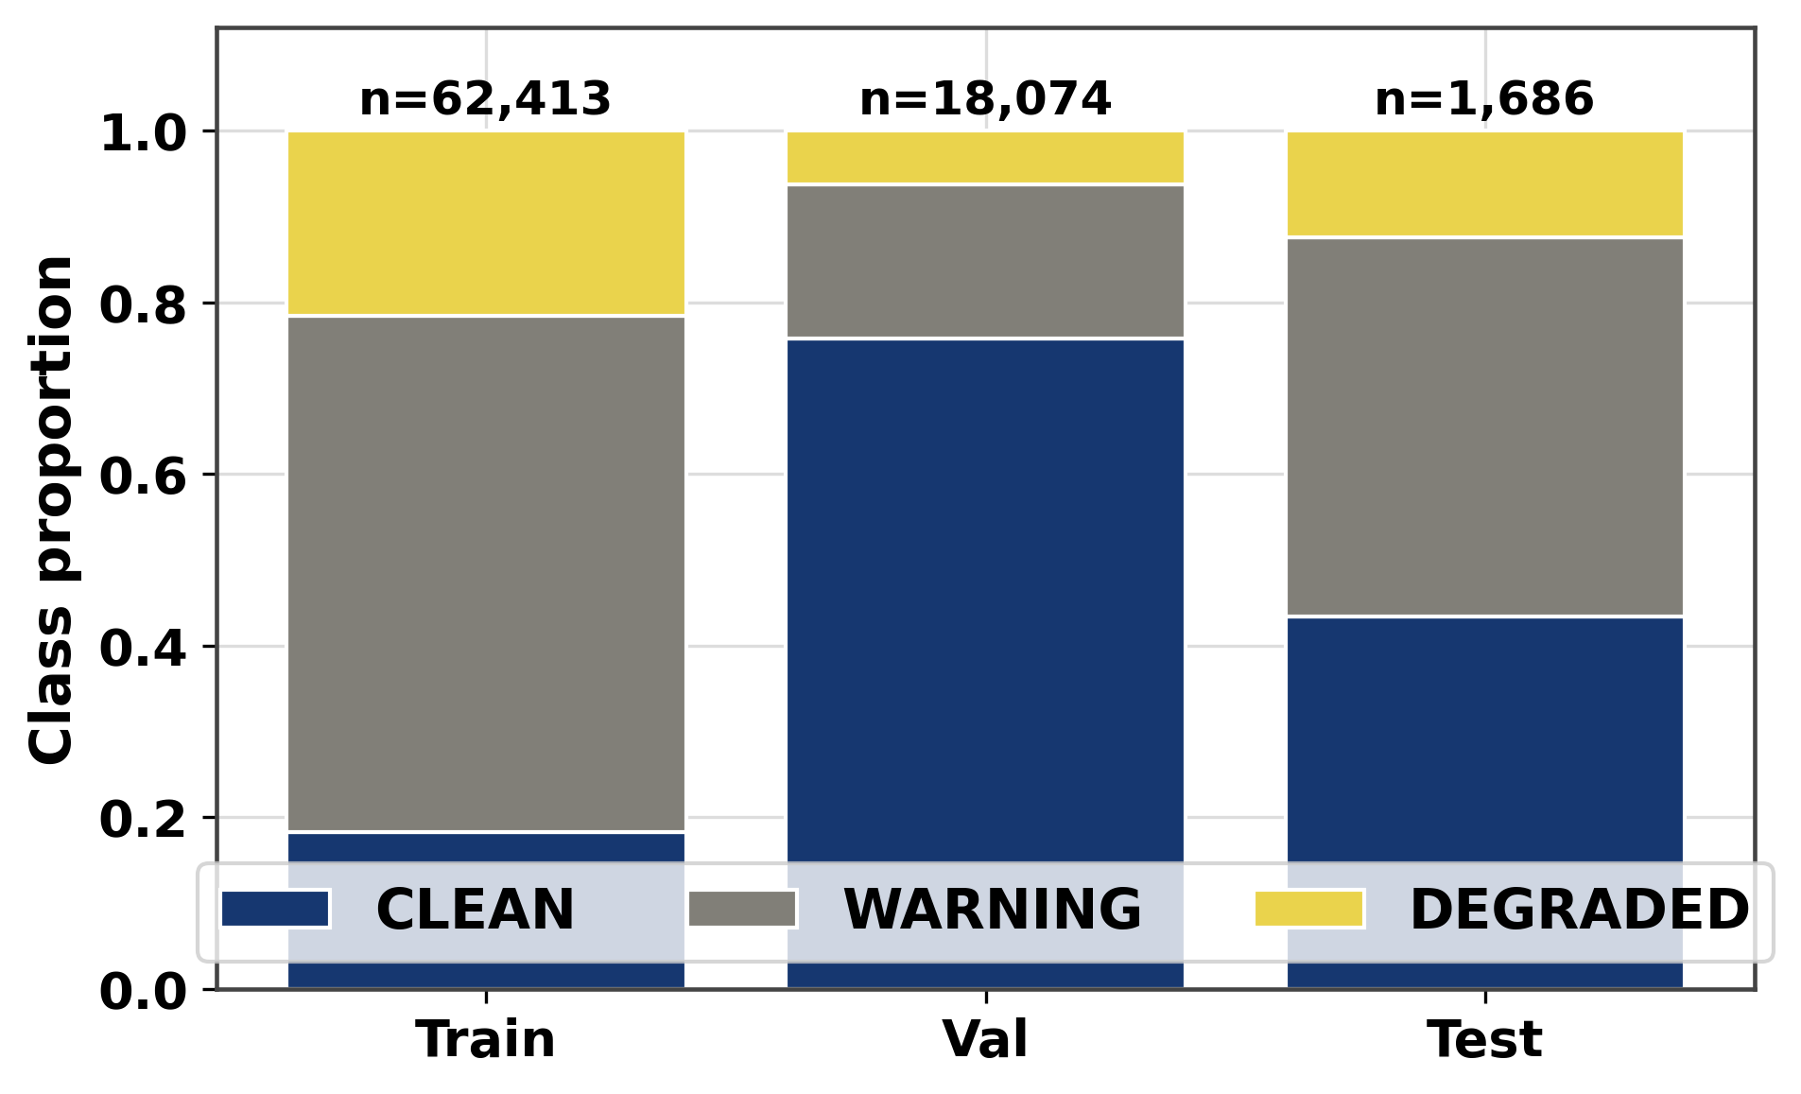
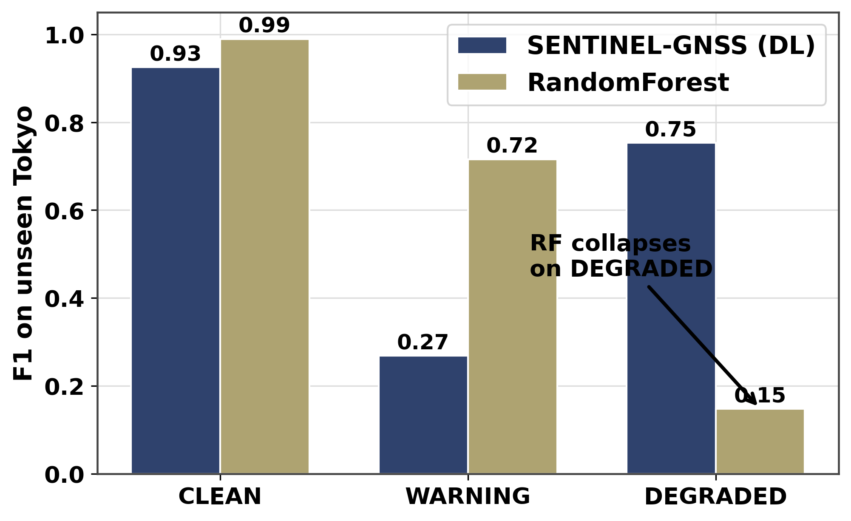
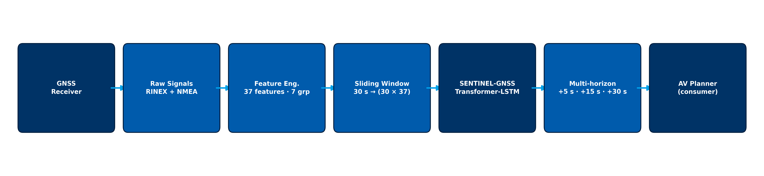
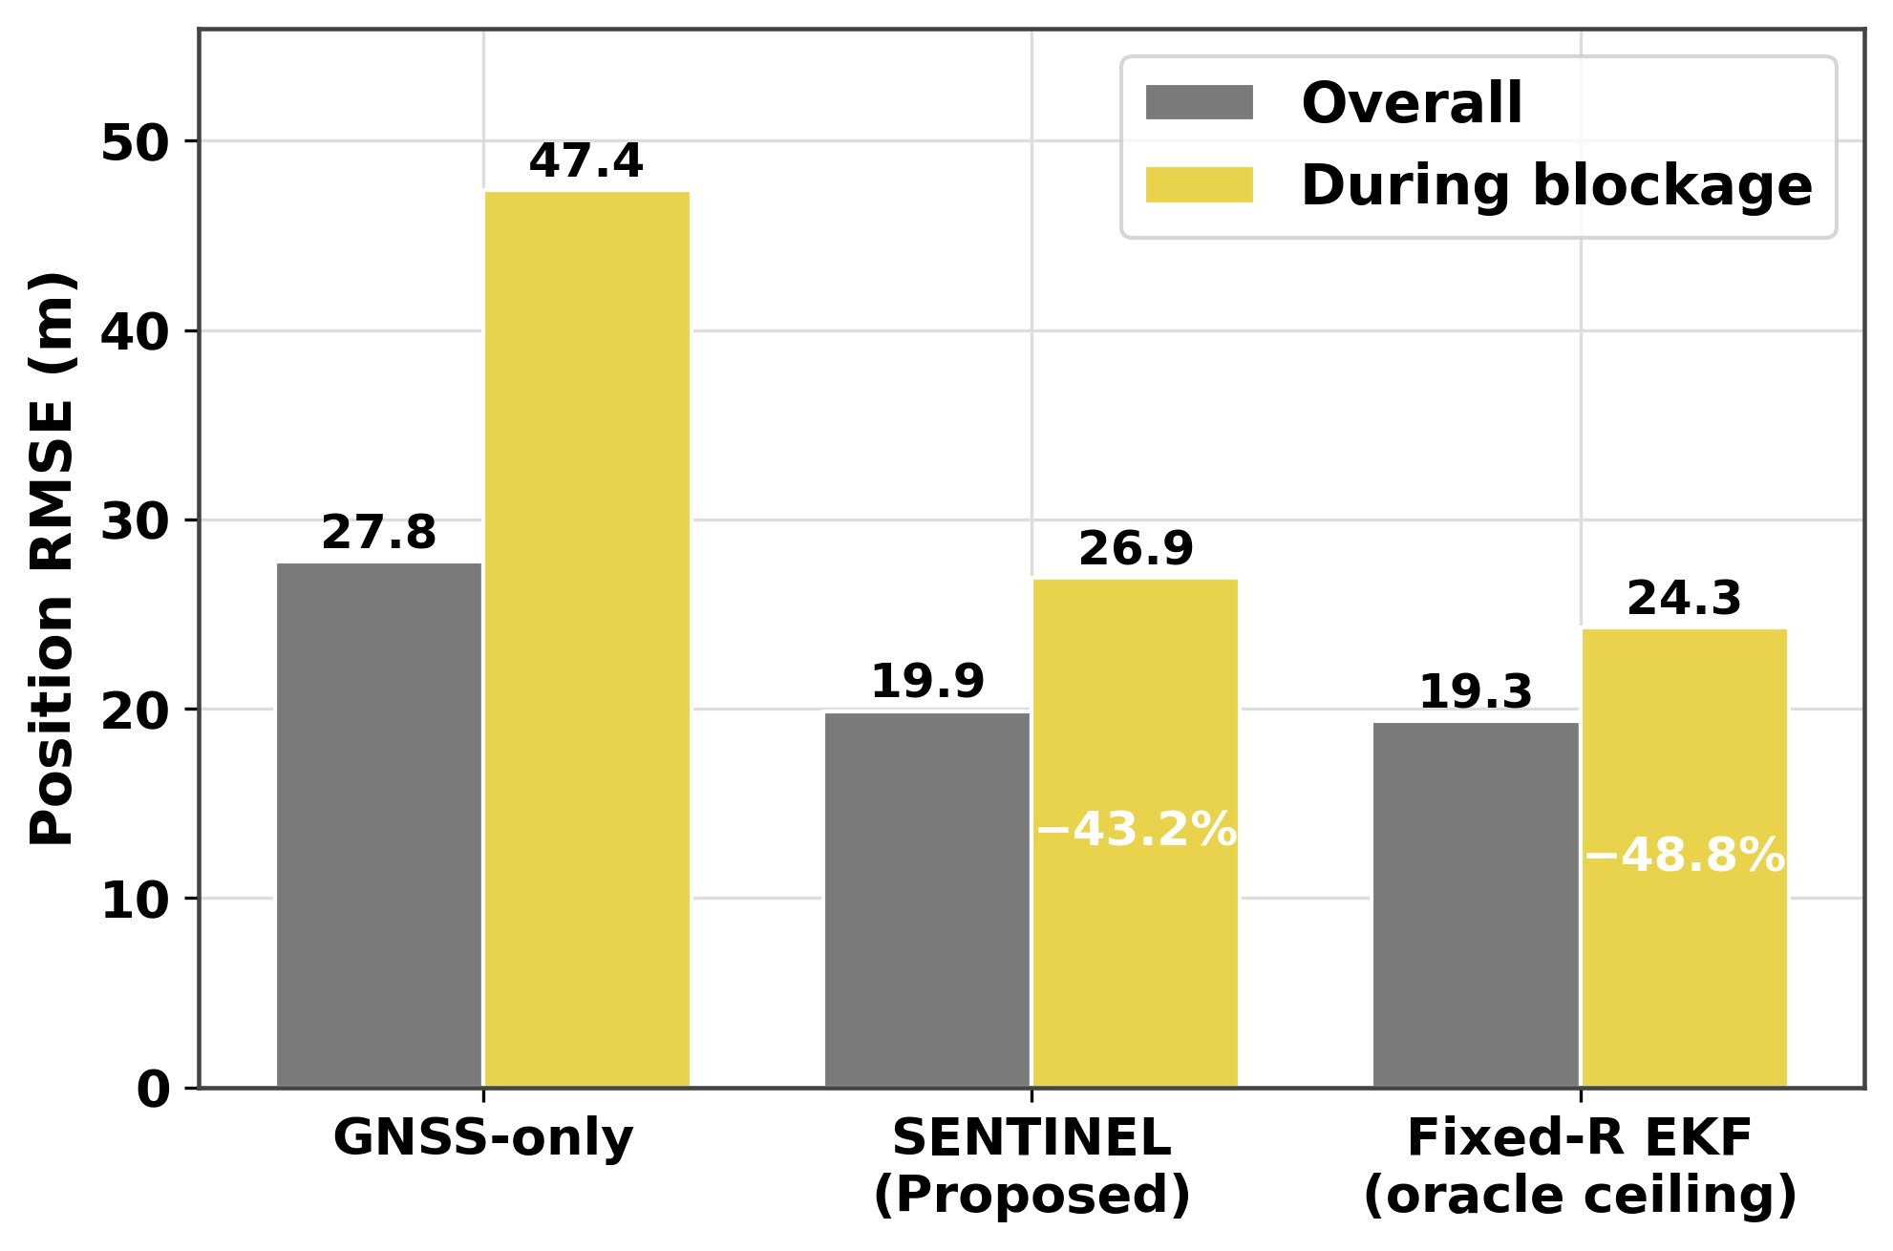
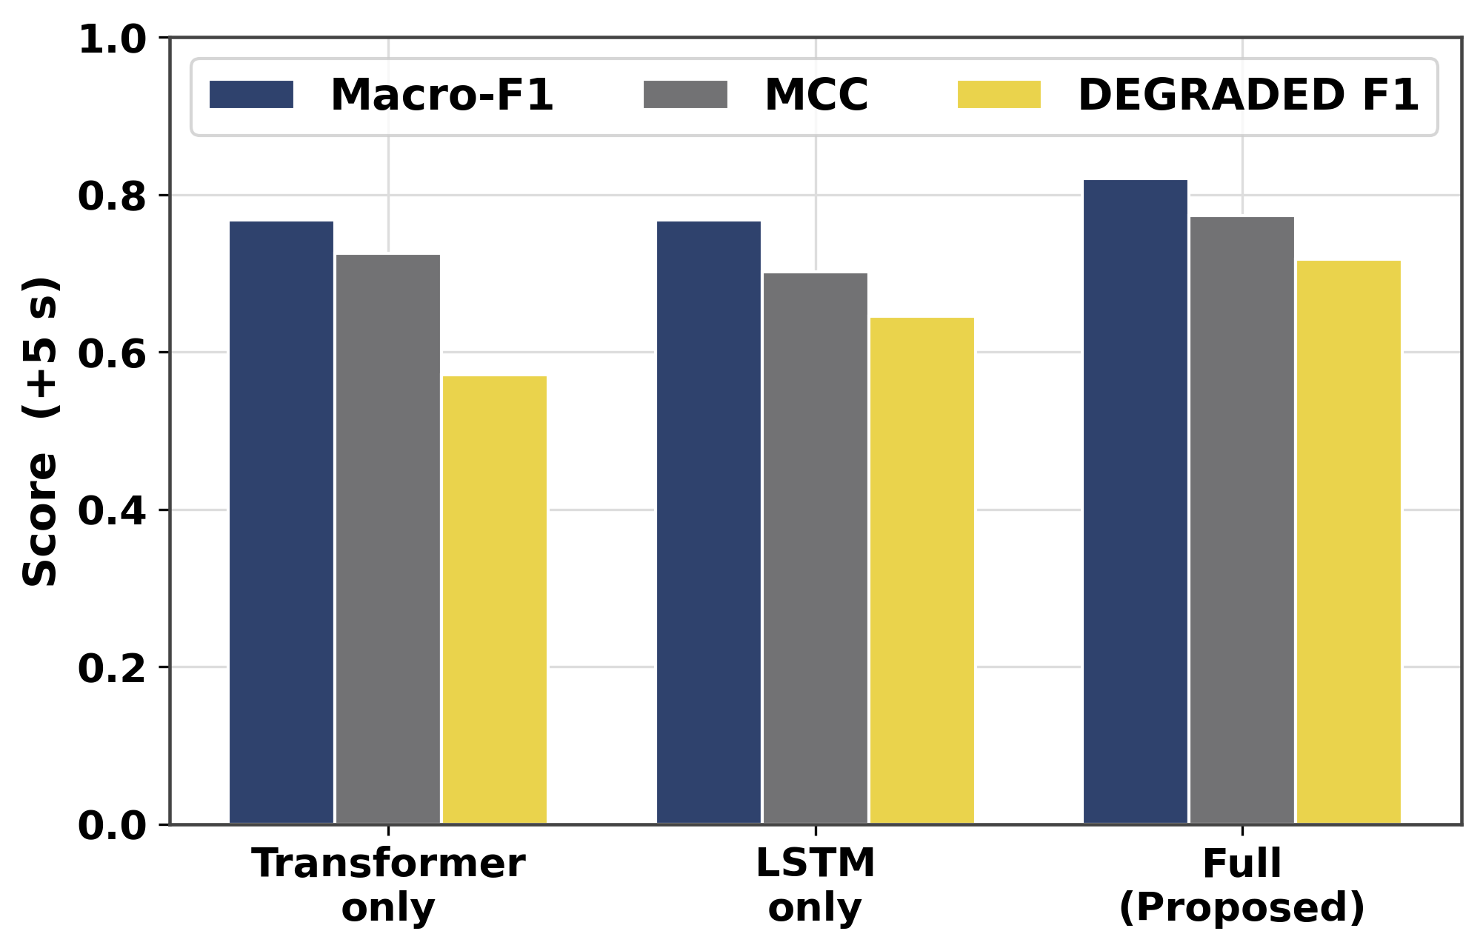
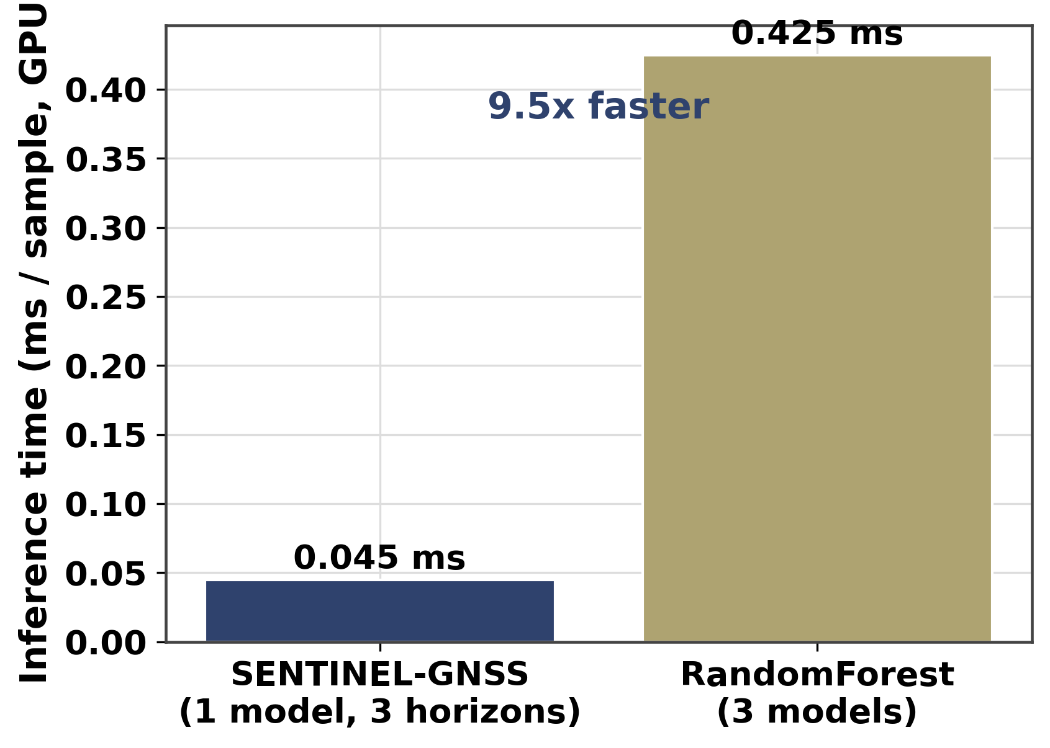
RCSSTEAP · Beihang University · Hangzhou, China
2026
AI-Based Proactive Prediction of GNSS Signal Degradation for Autonomous Vehicle Navigation
Ojerinde Joel Segun (LS2525253)
Regional Centre for Space Science & Technology Education in Asia and the Pacific | Beihang University
1 · Introduction & Motivation
6 · Classification Results
The Problem
GNSS is the only drift-free absolute-position source for autonomous vehicles (AVs). Urban canyons, bridges, and tunnels create Non-Line-of-Sight (NLOS) multipath, causing silent position jumps of 10–50 m.
Why Proactive?
At 60 km/h, a 5-second positioning gap displaces the vehicle 83 m. Reactive systems detect errors only after they occur. SENTINEL-GNSS predicts degradation 5–30 s ahead, giving the planner time to engage IMU dead-reckoning before GNSS fails.
Research Goal
Multi-horizon proactive classification — CLEAN · WARNING · DEGRADED — at +5 s, +15 s, +30 s, fused into an adaptive Extended Kalman Filter for real-time AV navigation.
Table 1: Multi-horizon performance — held-out test set (n = 1,686)
Horizon | Macro-F1 | Bootstrap 95% CI | MCC | DEGRADED F1
+5 s | 0.821 | [0.798, 0.840] | 0.773 | 0.718
+15 s | 0.741 | [0.717, 0.764] | 0.691 | 0.583
+30 s | 0.783 | [0.758, 0.804] | 0.731 | 0.629
Fig. 1: Reactive detection vs. proactive prediction — SENTINEL warns before position error appears.
Fig. 4: Row-normalised confusion matrices at +5 s / +15 s / +30 s. CLEAN recall > 0.97 at all horizons; DEGRADED recall falls from 0.847 → 0.734 as the prediction window extends.
2 · Multi-City Dataset
7 · Cross-City Generalisation (Zero-Shot Tokyo)
149,662 labelled epochs · 4 cities · 9+ receiver types
Training (Hangzhou + Hong Kong): 62,413 epochs · no-SMOTE · Focal Loss
Validation: 18,074 · Test: 1,686 (731 CLEAN / 746 WARN / 209 DEG)
Cross-city zero-shot (Tokyo): ~31,236 windows, never seen in training
37 features per epoch: C/N₀, DOP metrics, satellite geometry, 4 derived
Trained on HK + Hangzhou · Tested zero-shot on Tokyo (31,236 windows)
Tokyo presents different skyline geometry, satellite visibility, and receiver hardware — a strict out-of-domain evaluation.
SENTINEL DEGRADED F1 = 0.753 (maintains 79% of in-domain level)
RandomForest DEGRADED F1 = 0.148 (collapses −81% out-of-domain)
SENTINEL learns degradation dynamics (C/N₀ decay, DOP drift) rather than site-specific noise. No per-city retraining is required.
Fig. 2: Class distribution across splits — DEGRADED is rare (~12% of test), motivating Focal Loss (γ=1.0) with class-weights [1, 2, 5].
3 · SENTINEL-GNSS Architecture
Hybrid Transformer + LSTM · 1,456,652 parameters · 17.8 MB
Input: 30 × 37 sliding window → linear projection (37 → 128)
Encoder: 2-layer Transformer Encoder · 8 heads · d_model=128 · d_ff=512
Decoder: 2-layer LSTM · hidden=256 · unidirectional · dropout=0.3
Output: 4 heads — +5 s, +15 s, +30 s (primary) + auxiliary t+0
Training: AdamW lr=1e-3 · batch=256 · patience=50 · Tesla T4 GPU
Fig. 6: DEGRADED-class F1 at +5 s — HK in-domain vs. Tokyo zero-shot. SENTINEL holds at 0.753; Random Forest collapses to 0.148.
8 · Prediction-Informed EKF Fusion
Adaptive Measurement Noise Covariance
Standard KF weights every GNSS fix equally. SENTINEL's P(DEGRADED) inflates the GPS noise covariance R before bad fixes arrive:
R = (100 m)² · I when P(DEGRADED) > 0.5
R = r_base² · I otherwise
Joseph-form covariance update keeps P positive semi-definite even when R jumps by orders of magnitude between epochs. The EKF distrusts GNSS before position error appears, falling back on IMU dead-reckoning during blockage.
Table 2: Position RMSE — real-data Tokyo Shinjuku (n = 20,949 epochs @ 10 Hz)
Method | Degraded RMSE | Reduction vs. Raw
GNSS raw | 47.40 m | —
EKF fixed-R | 24.28 m | −48.8%
SENTINEL calibrated | 29.05 m | −38.7%
SENTINEL calib + online σ | 26.93 m | −43.2%
Fig. 3: SENTINEL-GNSS hybrid architecture — one forward pass yields all four output heads simultaneously.
4 · Ablation Study
Each architectural component contributes independently:
Transformer-only (427K): Macro-F1=0.767 · DEGRADED F1=0.571 · MCC=0.725
LSTM-only (1,027K): Macro-F1=0.767 · DEGRADED F1=0.645 · MCC=0.702
Full SENTINEL (1,457K): Macro-F1=0.821 · DEGRADED F1=0.718 · MCC=0.773
Transformer captures global PDOP trends; LSTM preserves epoch-level temporal state. Combined: +0.147 DEGRADED F1 over Transformer-only.
Fig. 7: Degraded-segment RMSE across EKF configurations. SENTINEL calibrated reduces error by 38.7%; online σ reaches 43.2%.
9 · Deployment Efficiency
0.0449 ms / sample · 9.46× faster than RF + XGB + LR ensemble
Single unified 17.8 MB model replaces three separate per-horizon classifiers.
1,456,652 parameters — fits within embedded AV compute budgets.
Operates within a 10 Hz real-time AV navigation loop on Tesla T4 GPU.
Fig. 4: Ablation across architecture variants. Full model (navy) outperforms each component in isolation on all three metrics.
5 · Individual Contributions
Repository & Software Architecture
Designed the project repository structure, module layout, CI pipeline, and the 37-feature engineering specification.
Model Design & Training
Designed and trained the Transformer+LSTM hybrid (1,456,652 parameters) with Focal Loss, temperature calibration (T=0.4023), and threshold tuning; conducted all ablation experiments reported above.
EKF Fusion Pipeline
Implemented the 9-state IMU-aided EKF with SENTINEL adaptive-R, Huber robust variant, and Student-t particle filter.
Inference Packaging & Documentation
Packaged the model for real-time deployment (0.0449 ms/sample on GPU) and authored all project documentation and paper manuscripts.
Fig. 8: Inference latency — SENTINEL 0.0449 ms vs. RF 0.4248 ms. One forward pass serves all three horizons simultaneously.
Conclusions
References
• SENTINEL-GNSS achieves Macro-F1 = 0.821 (bootstrap CI [0.798, 0.840]) at the actionable +5 s horizon — the first multi-horizon proactive GNSS degradation classifier validated across three cities.
• Cross-city zero-shot (Tokyo): DEGRADED F1 = 0.753 vs. 0.148 for Random Forest — a 5× generalisation gap. No per-city retraining required before deployment.
• Prediction-informed EKF reduces degraded-segment position RMSE by up to 48.8% (47.40 m → 24.28 m) on real Tokyo Shinjuku data.
• Inference: 0.0449 ms/sample — 9.46× faster than the ensemble baseline; single 17.8 MB model fits embedded AV compute budgets.
[1] L.-T. Hsu et al. UrbanNav: Open-Sourced Multisensory Dataset for Benchmarking Positioning Algorithms. ION GNSS+ 2021.
[2] A. Vaswani et al. Attention Is All You Need. NeurIPS 2017.
[3] P. D. Groves. Principles of GNSS, Inertial, and Multisensor Integrated Navigation Systems. Artech House, 2nd ed., 2013.
Acknowledgement
We thank Dr. Ahmed Wasiu and the RCSSTEAP program at Beihang University for guidance, equipment, and field-collection support.
Contact: joelojerinde@gmail.com · H3I, Beihang University · 2026

