Slide 1



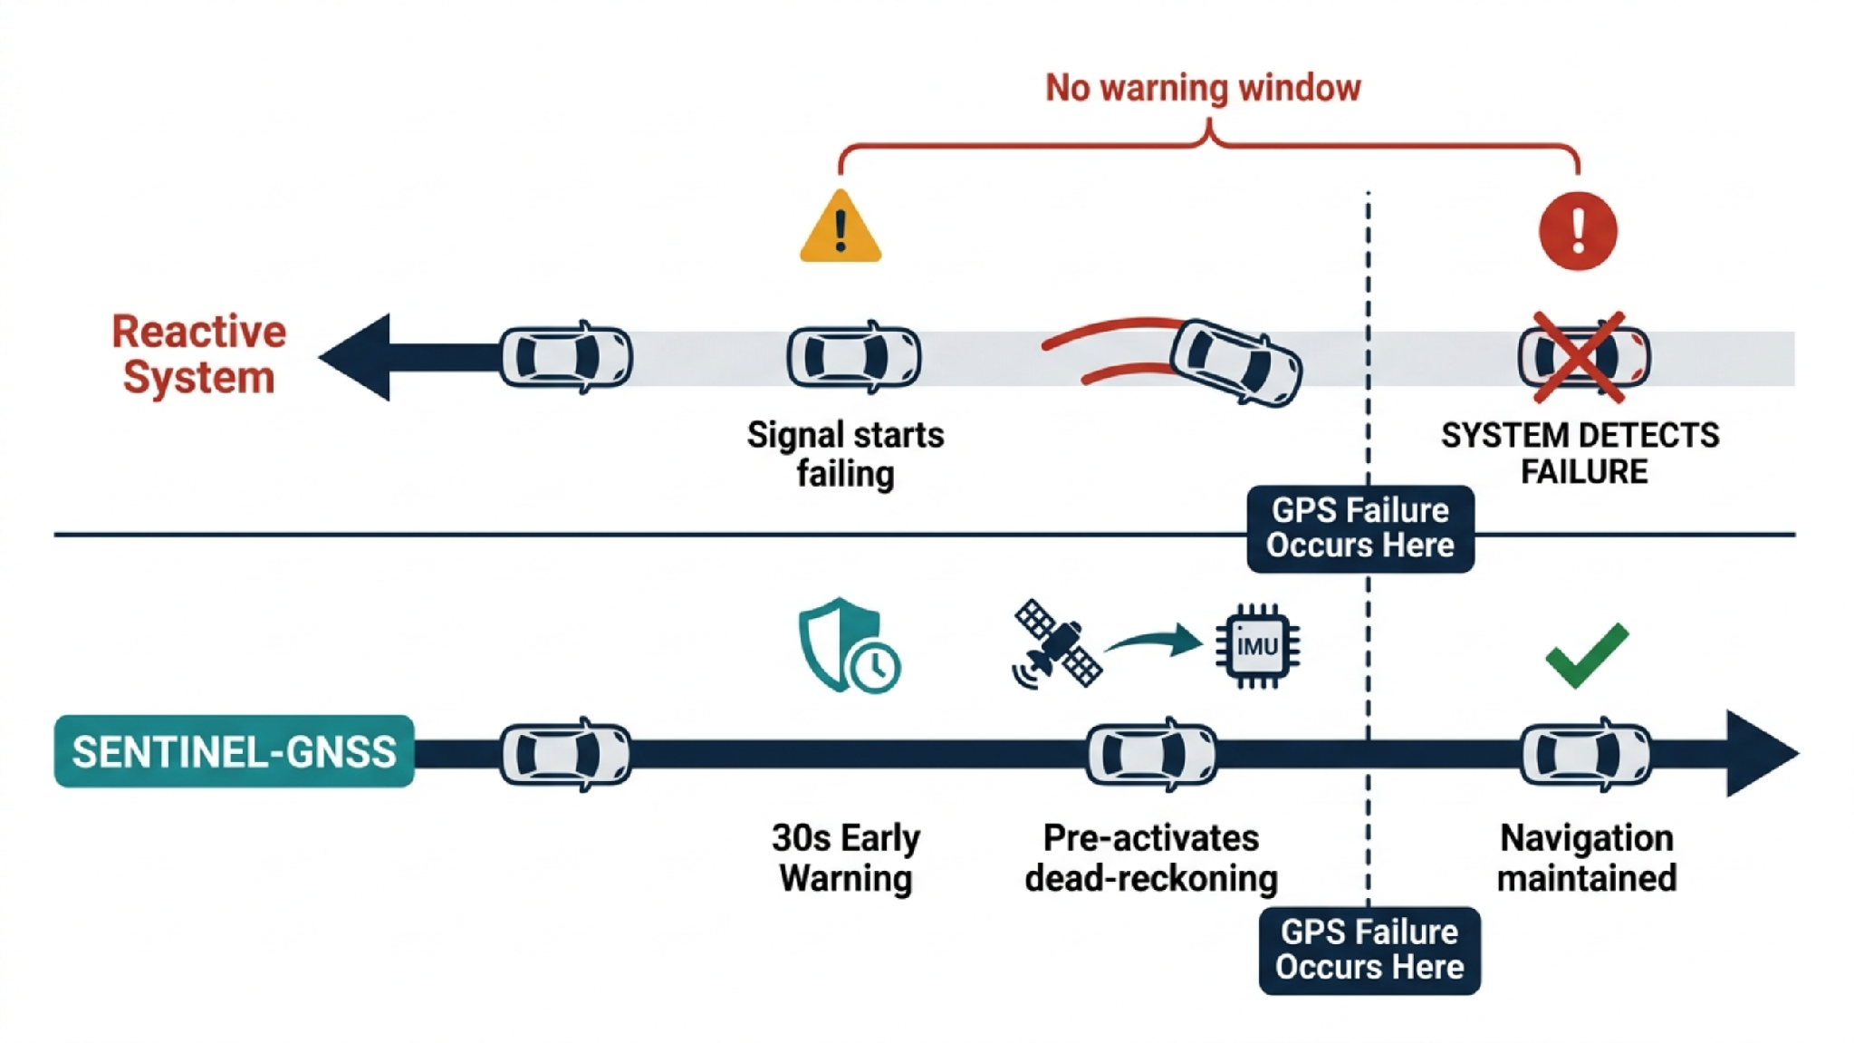
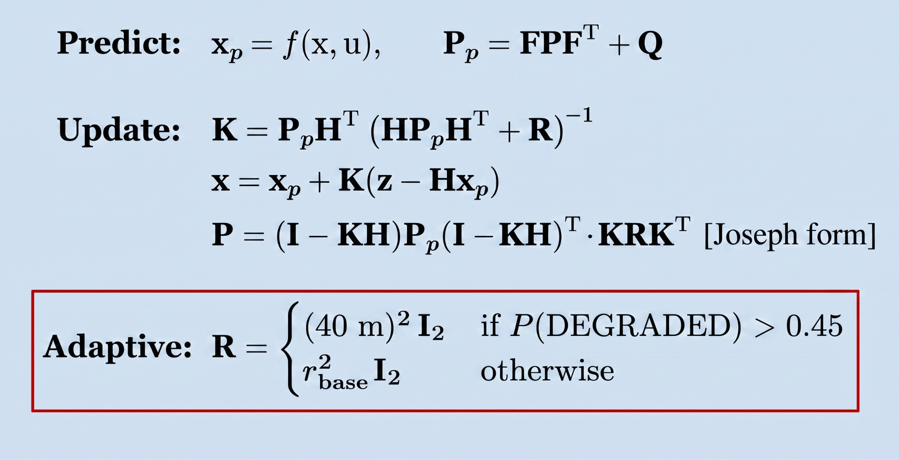
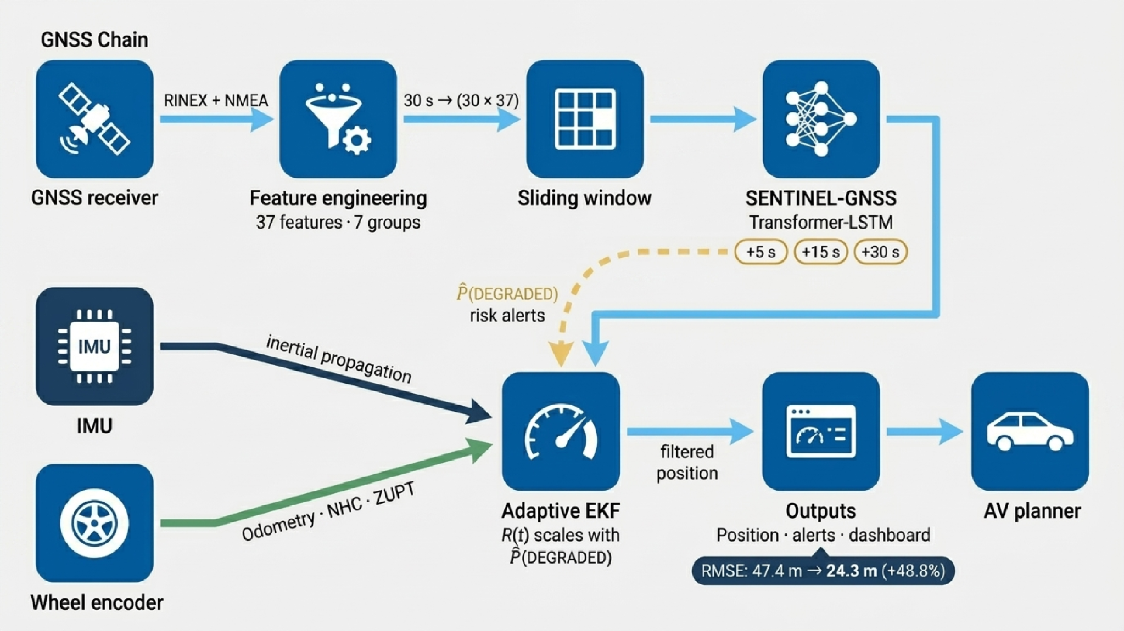
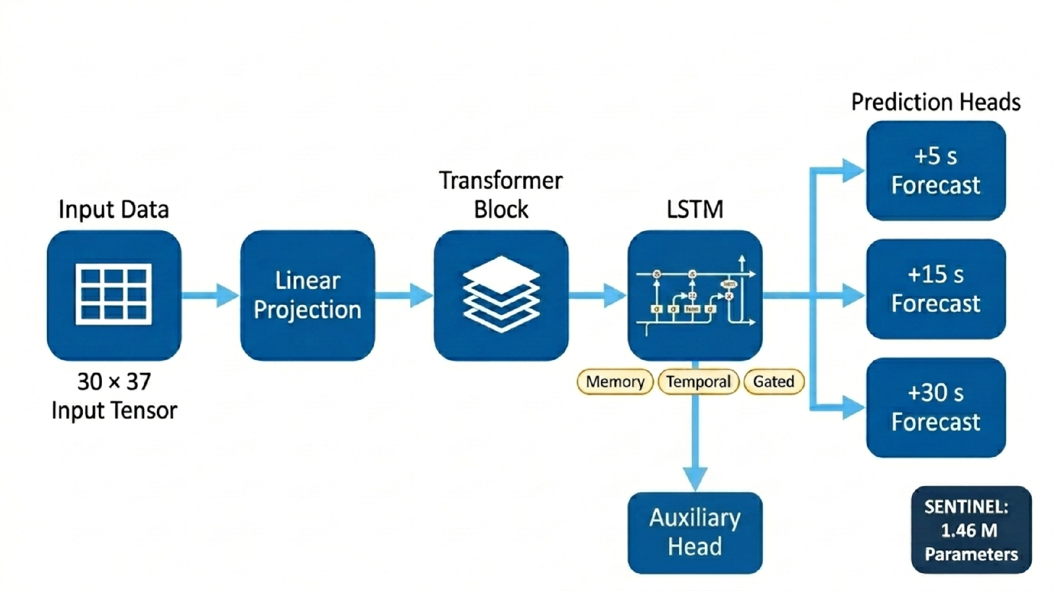
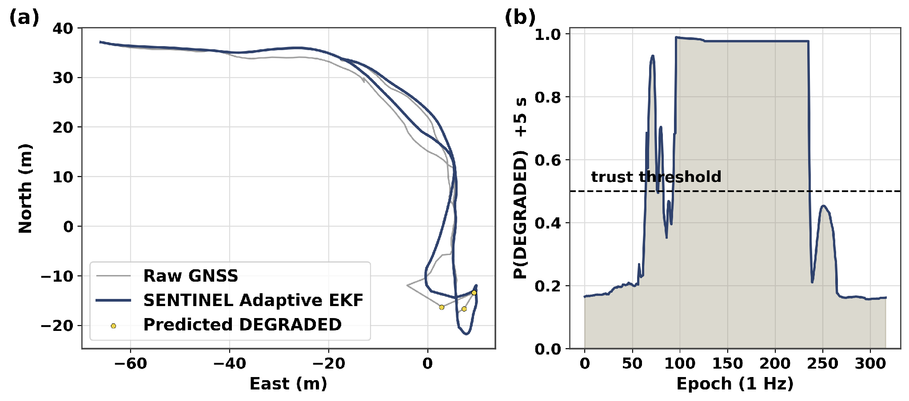
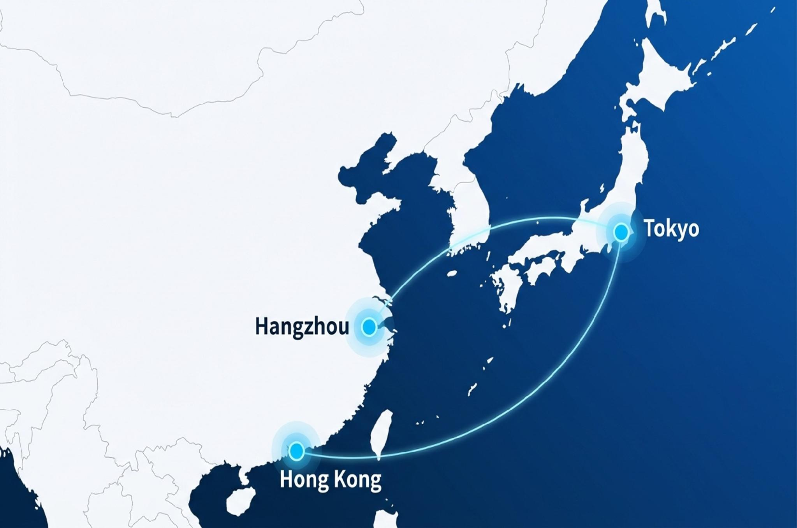
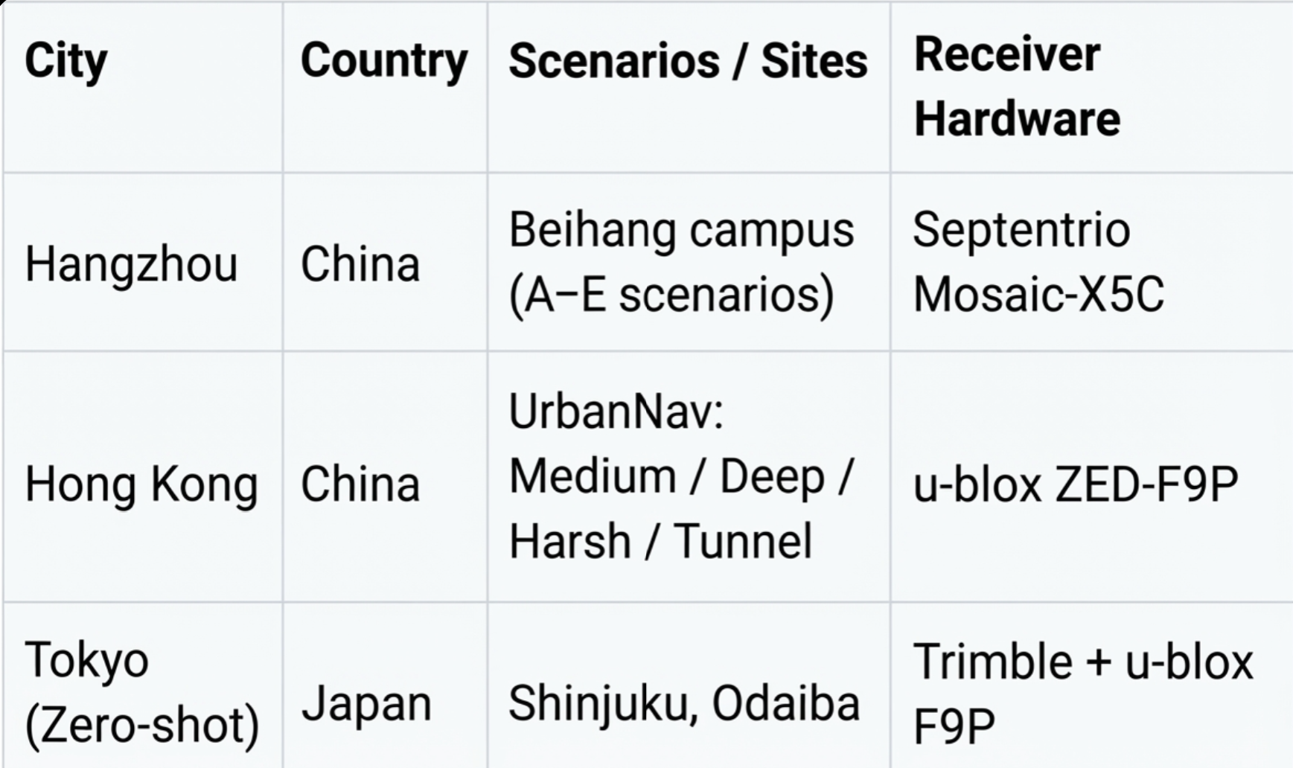
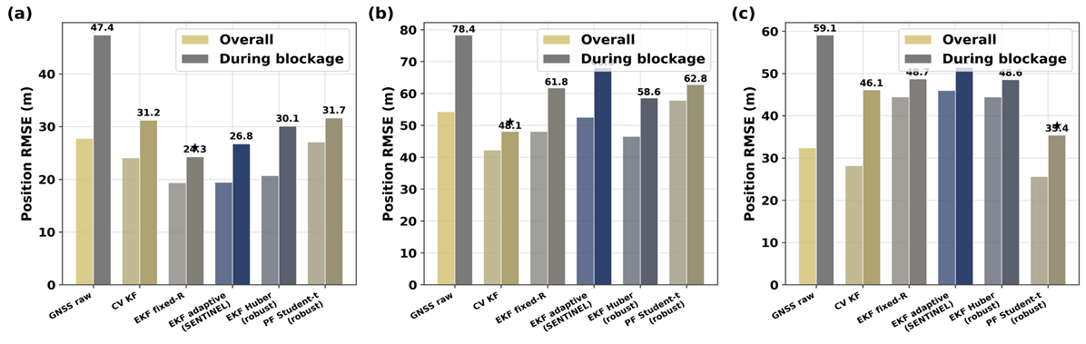
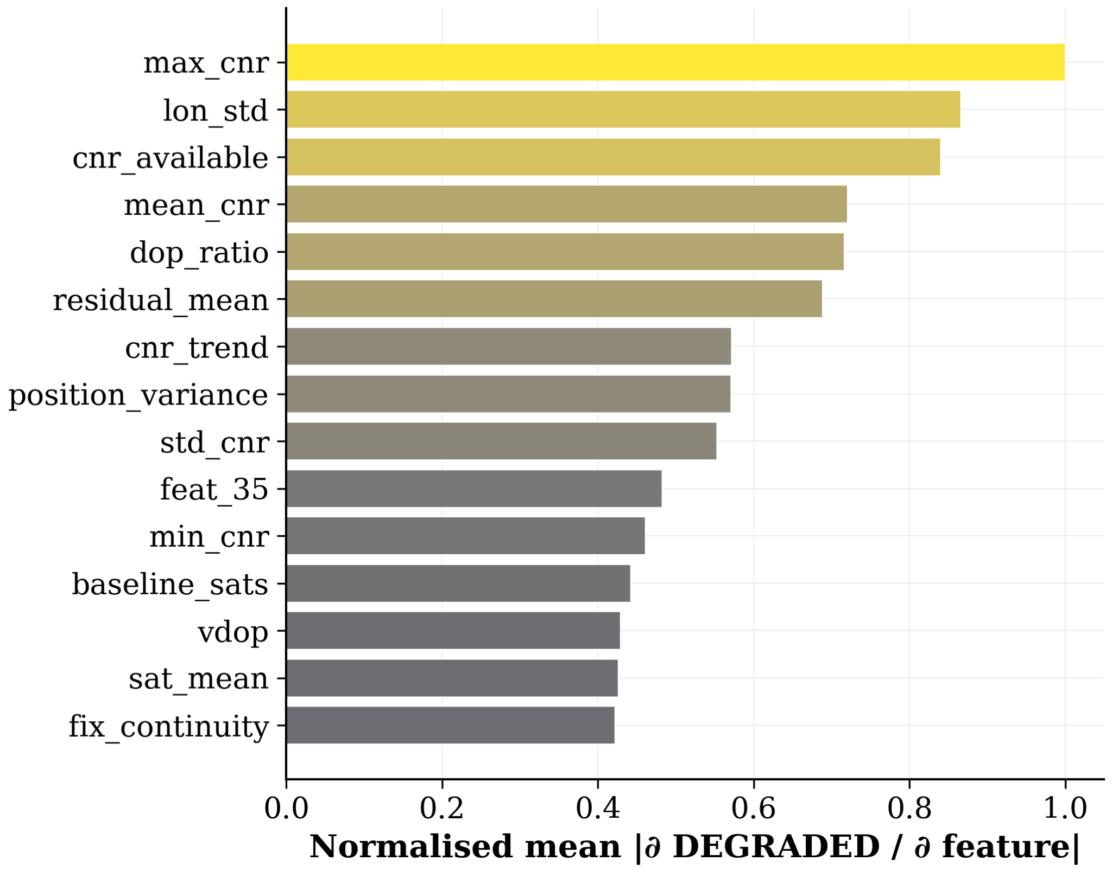
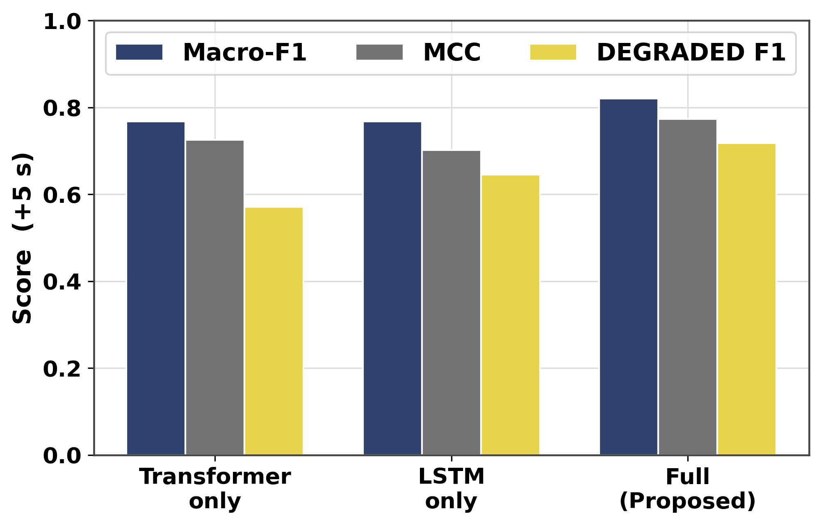
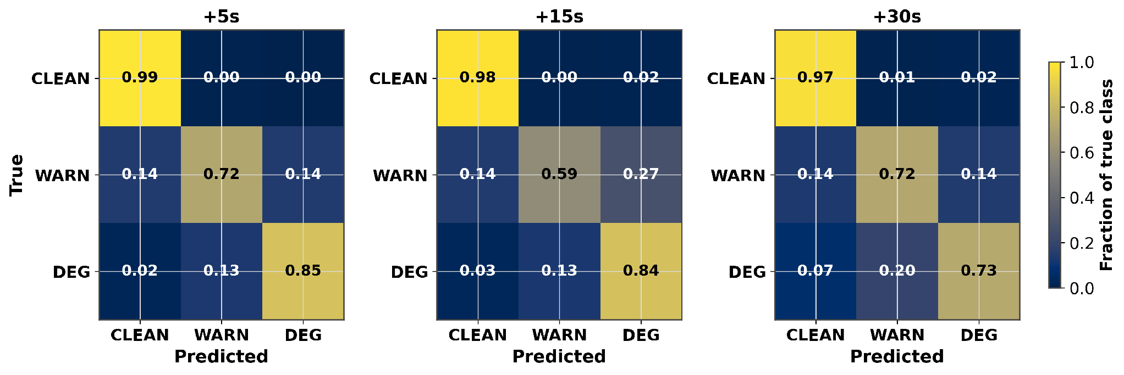
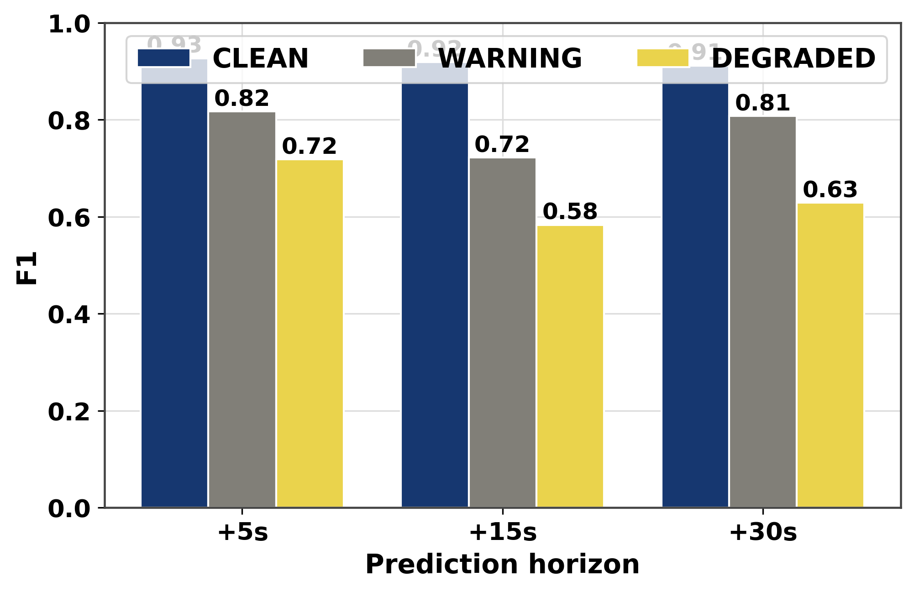
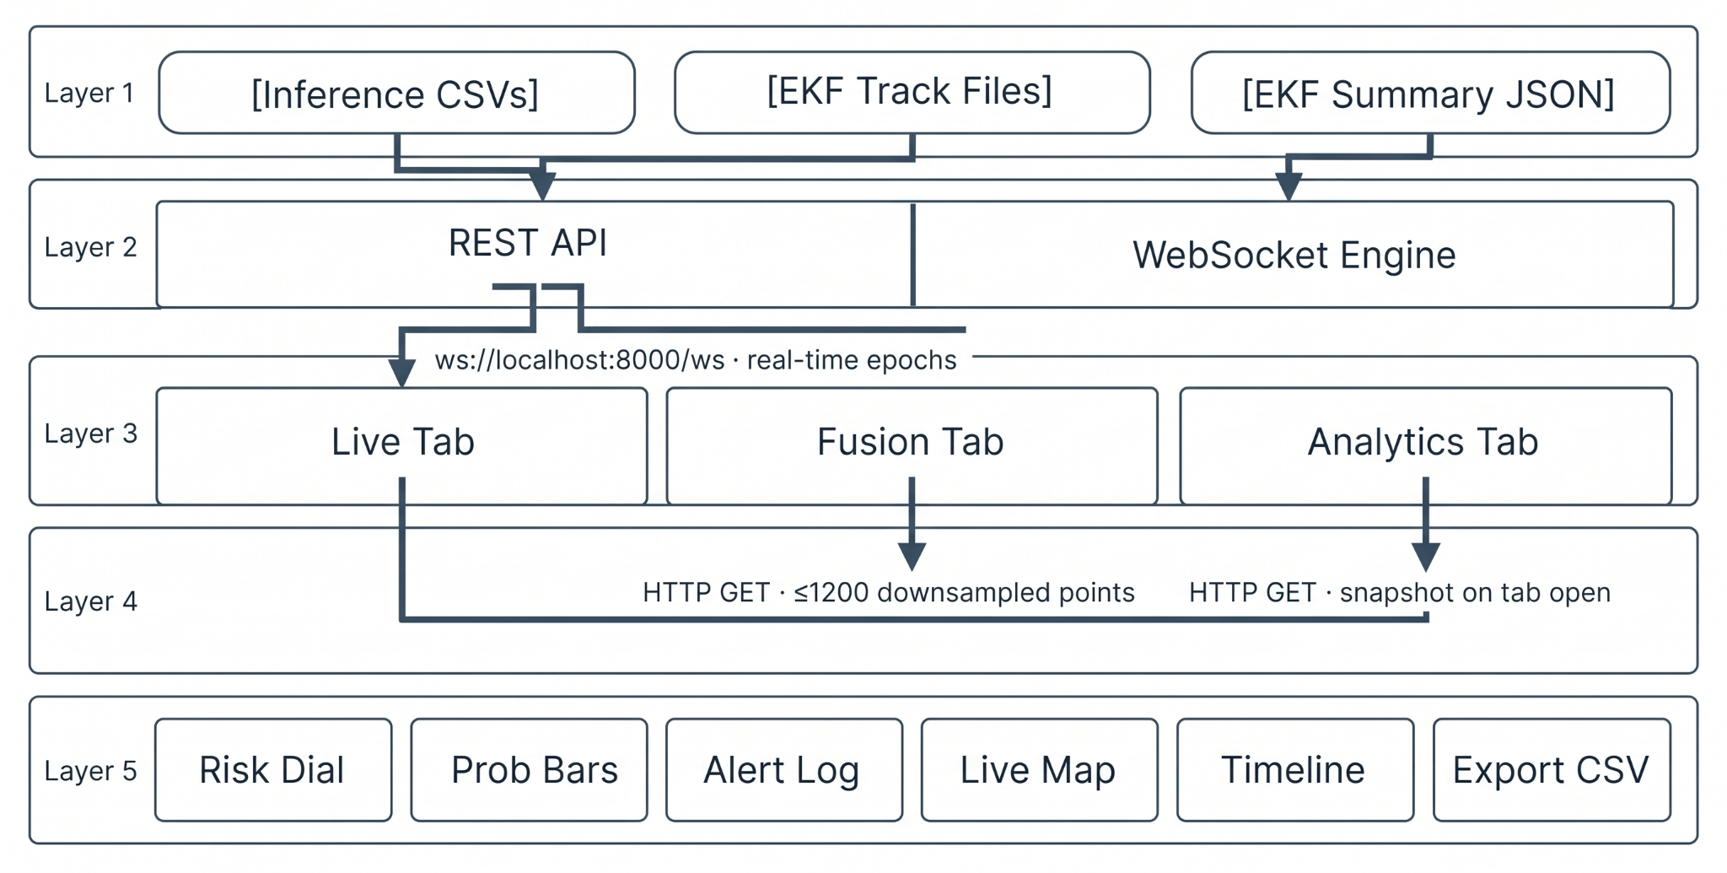
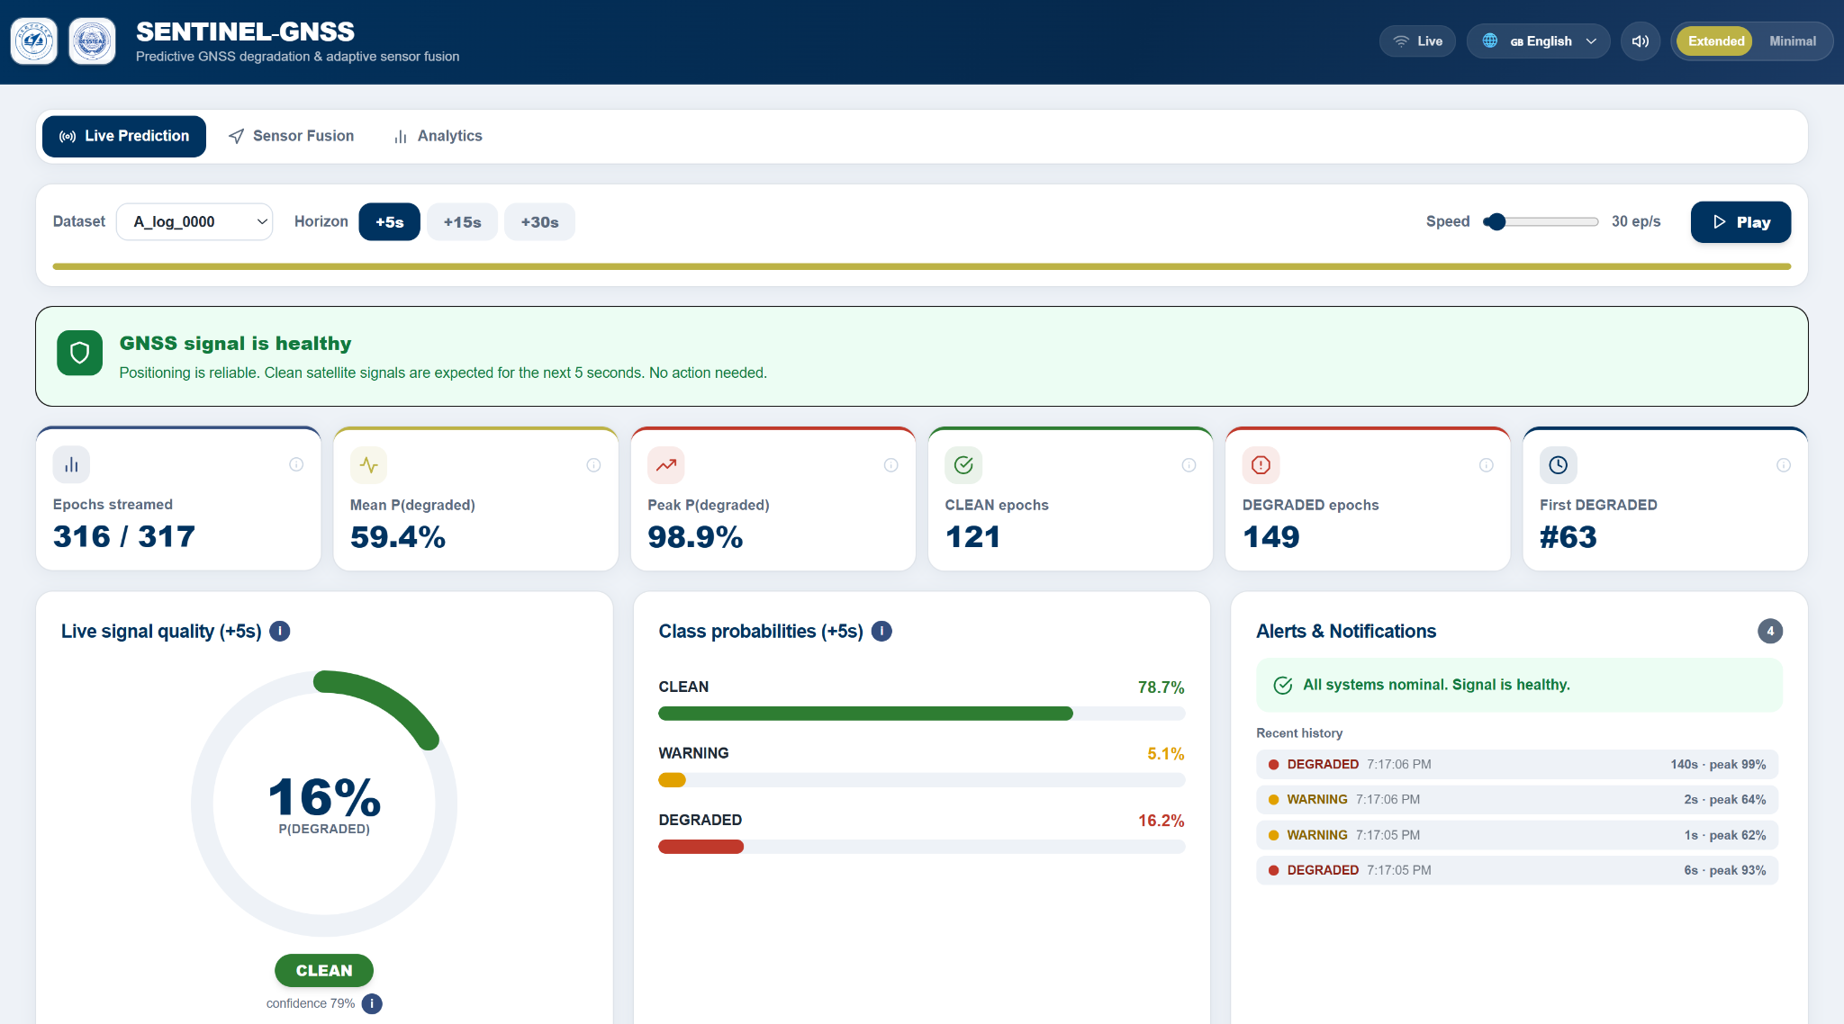
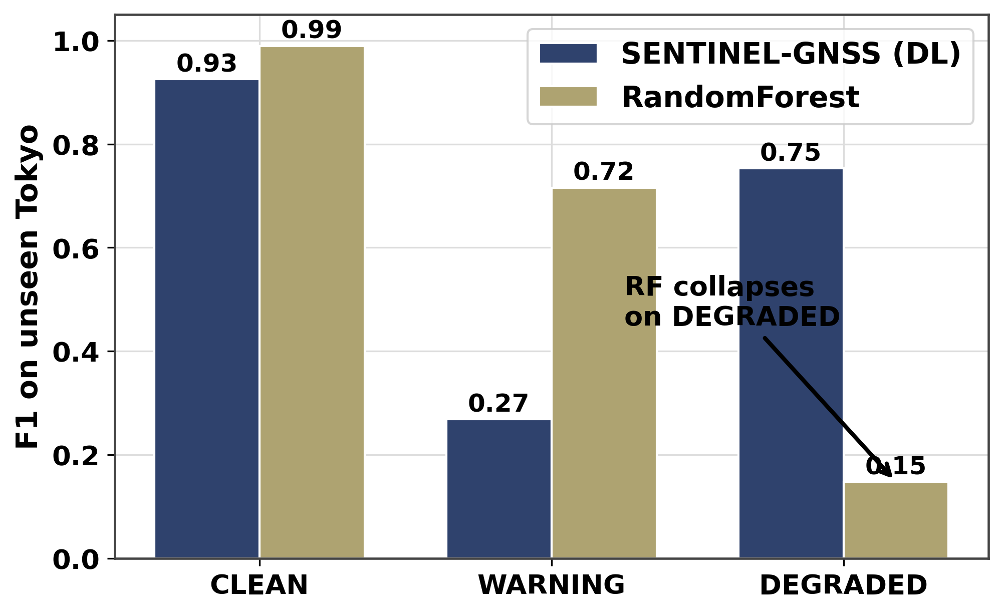
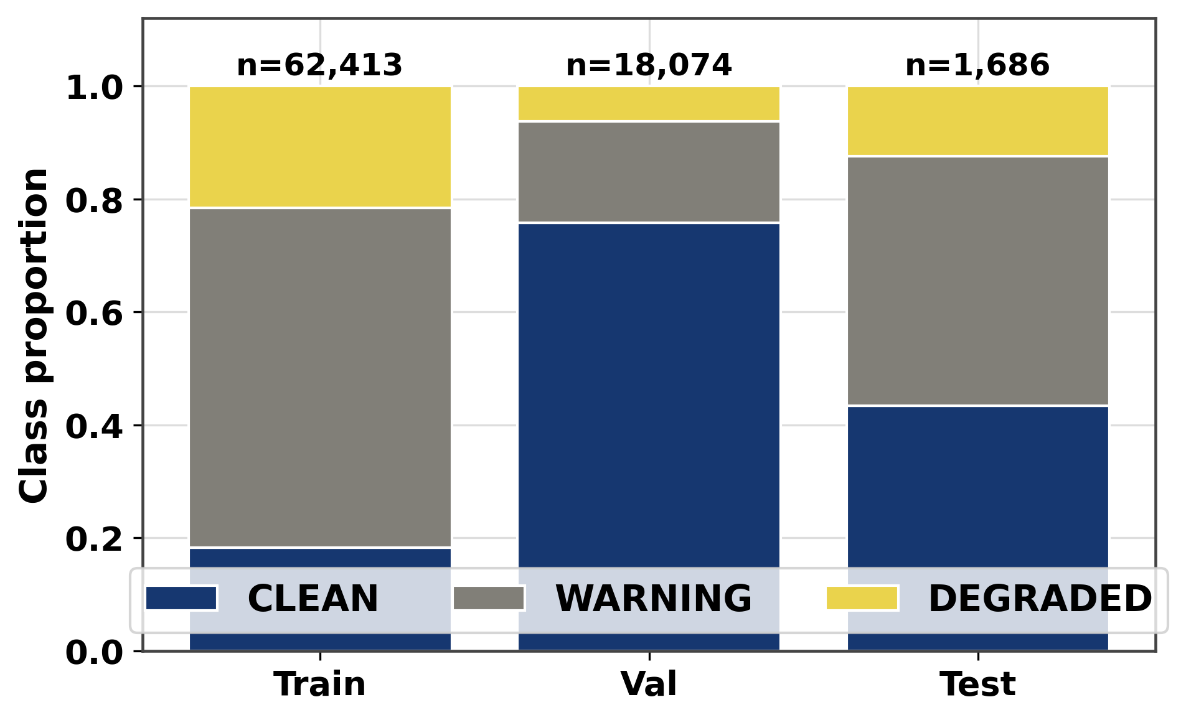
AI-Based Proactive Prediction Of GNSS Signal Degradation For Autonomous Vehicle Navigation
AI-Based Proactive Prediction Of GNSS Signal Degradation for Autonomous Vehicle Navigation
Ojerinde Joel Segun, Mustapha Ibrahim Ishola, Ogunlade Joshua Oluwaseun, Ingeriyinkindi Claudine, Rashid Md Harun Or
Regional Centre for Space Science and Technology Education in Asia and the Pacific | Beihang University
Introduction
System Architecture
Prediction-Informed EKF
GNSS is the only drift-free absolute position source for autonomous vehicles. At 60 km/h, a 5-second positioning gap can place the vehicle in the wrong` lane or miss a junction. In urban areas GNSS fails silently: NLOS multipath injects 10 to 200 m errors while the receiver still reports a 'valid' fix. Existing monitors (RAIM, Q-codes, and ML classifiers) are reactive, acting only after degradation begins. SENTINEL-GNSS instead predicts degradation 5 to 30 s in advance, giving the controller time to pre-activate dead reckoning.
Model Architecture: Transformer Encoder (2 layers, 8 heads, d = 128) + 2-layer LSTM (hidden = 256), operating on a 30 × 37 feature window (37 engineered GNSS features). Multi-horizon forecasting for +5 s, +15 s, and +30 s is performed in a single forward pass.
Model Size & Performance: 1.46M parameters · 0.0449 ms per sample inference latency · unified multi-horizon output (no per-horizon re-inference).
Deployment Efficiency: Achieves 9.46× faster inference than equivalent ensemble tree-based baselines while remaining within a 10 Hz real-time vehicle compute budget.
Standard KF trusts every GNSS fix equally, even during blockage.
Adaptive EKF conditions R on SENTINEL's forecast: when P(DEGRADED) > 0.5, measurement noise inflates to (100 m)², letting the filter fall back on the motion model instead of a corrupted fix.
Joseph form keeps P provably positive semi-definite even under large, fast R changes. This is critical when R jumps by orders of magnitude between epochs.
Net effect: the EKF starts distrusting GNSS before position error appears, not after.
Method | Environment | RMSE red.
EKF Fixed-R + SENTINEL | Trimble Shinjuku | 48.8%
Huber EKF | u-blox Shinjuku | 25.2%
Student-t PF | Odaiba harbour | 40.1%
Multi-City Dataset
149,662 labelled epochs · Training: Hangzhou & Hong Kong · Zero-shot test: Tokyo · 9+ receiver types
Fig. 8: (a) Estimated trajectory (SENTINEL Adaptive EKF, navy) vs. raw GNSS (grey), with epochs. (b) Classifier output P(DEGRADED) over time
Fig. 4: SENTINEL-GNSS end-to-end pipeline—GNSS features + IMU + wheel encoder, fused through the Adaptive EKF to deliver position, alerts, and AV-planner inputs.
Fig. 5: SENTINEL-GNSS Model architecture
Model Analysis
Classification performance across all horizons on the held-out test set.
Fig 9: (a) Trimble — Shinjuku, (b) u-blox — Shinjuku, (c) Odaiba Harbour. Bars compare overall vs. during-blockage RMSE for GNSS raw, CV KF, EKF fixed-R, EKF adaptive (SENTINEL), EKF Huber (robust), and PF Student-t (robust); starred bars indicate the best-performing method per site during blockage.
Dashboard
Fig. 6: Top-15 feature saliency at +5 s. C/N₀ strength and position uncertainty dominate; the model relies on physically meaningful GNSS indicators.
Fig. 7: Ablation across architecture variants (Macro-F1, MCC, DEGRADED-F1). Each component contributes independently to performance.
FIg 1: Row-normalized confusion matrices (+5 s, +15 s, +30 s). CLEAN recall stays above 0.97 at all horizons; DEGRADED recall falls from 0.85 to 0.73 as the horizon extends.
Fig 2: Per-class F1 at +5 s / +15 s / +30 s horizons. CLEAN stays above 0.97; DEGRADED recall falls from 0.85 to 0.73 as horizon extends.
Zero-shot Tokyo: SENTINEL (F1 0.75) vs Random Forest (F1 0.148)
Fig.10: Dashboard system architecture and data flow
Fig. 11: Dashboard showing real-time GNSS degradation prediction
Multi-horizon classification (held-out test, n=1,686): strong +5 s performance that degrades gracefully with horizon.
Trained only on Hangzhou + Hong Kong, tested zero-shot on Tokyo which is a city with different skyline geometry, satellite visibility, and receiver hardware.
Random Forest memorizes site-specific noise patterns and collapses (Macro-F1 0.926 in-domain → DEGRADED F1 0.148 cross-city) the moment DEGRADED signal appears in an unseen city.
SENTINEL-GNSS holds (DEGRADED F1 0.75 cross-city), because it learns degradation dynamics—signal trend, DOP drift, C/N₀ decay — rather than site-specific thresholds.
Deployment implication: no per-city retraining needed before rollout.
Conclusions
Table 1: Macro-F1 and MCC across prediction horizons with bootstrap 95% CI. Performance degrades as the horizon extends.
At the time of this project, SENTINEL-GNSS is the first to predict GNSS degradation multi-horizon (5–30 s), achieving Macro-F1 = 0.821, cross-city DEGRADED F1 of 0.75 vs 0.148 for RF, and 48.8% RMSE reduction at 0.0449 ms inference. While RF outperforms SENTINEL in-domain (F1 0.926 vs 0.821), cross-city generalisation is the deployment-relevant metric where deep learning holds a decisive advantage.
Horizon | Macro-F1 | DEGRADED-F1 | MCC
+5 s | 0.821 | 0.718 | 0.773
+15 s | 0.741 | 0.583 | 0.691
+30 s | 0.783 | 0.629 | 0.731
References
[1] L.-T. Hsu et al. "UrbanNav: An Open-Sourced Multisensory Dataset for Benchmarking Positioning Algorithms Designed for Urban Areas." ION GNSS+ 2021.
[2] A. Vaswani et al. "Attention Is All You Need." Advances in Neural Information Processing Systems (NeurIPS) 2017.
[3] P.D. Groves. Principles of GNSS, Inertial, and Multisensor Integrated Navigation Systems. Artech House, 2nd ed., 2013.
Fig. 8: Cross-city DEGRADED-class F1 at +5 s. SENTINEL 0.75 versus RF 0.148, a 5x generalization gap that widens further at +15 s and +30 s.
Acknowledgement
Fig 3: Class label distribution across the full dataset. DEGRADED epochs are rare, motivating Focal Loss and class-weighted training.
We thank our supervisor Dr. Ahmed Wasiu, and the RCSSTEAP program at Beihang University for guidance, equipment, and field-collection support throughout the SENTINEL-GNSS pilot project.

