Slide 1


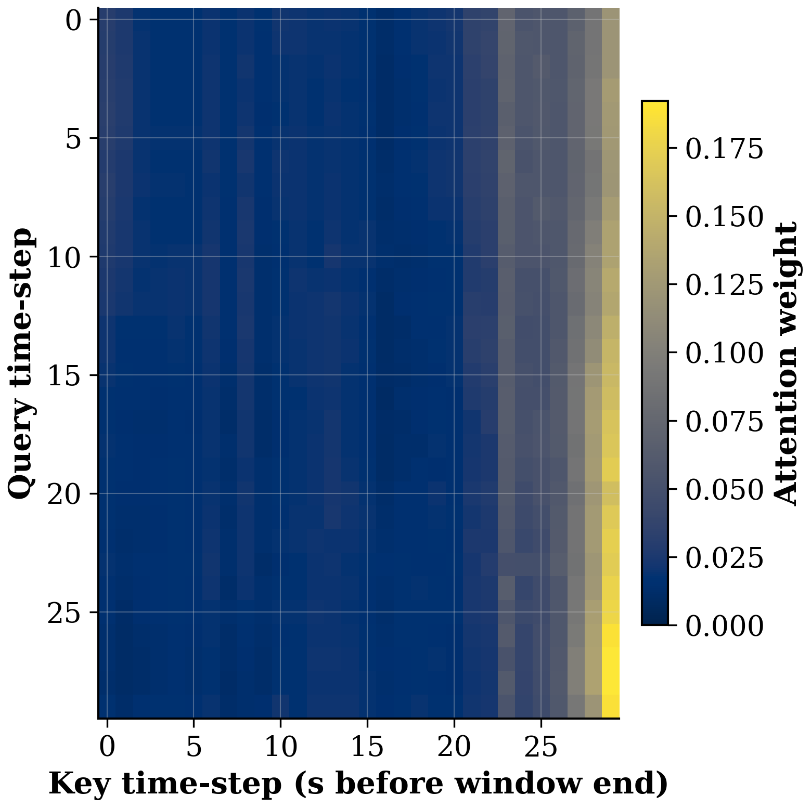
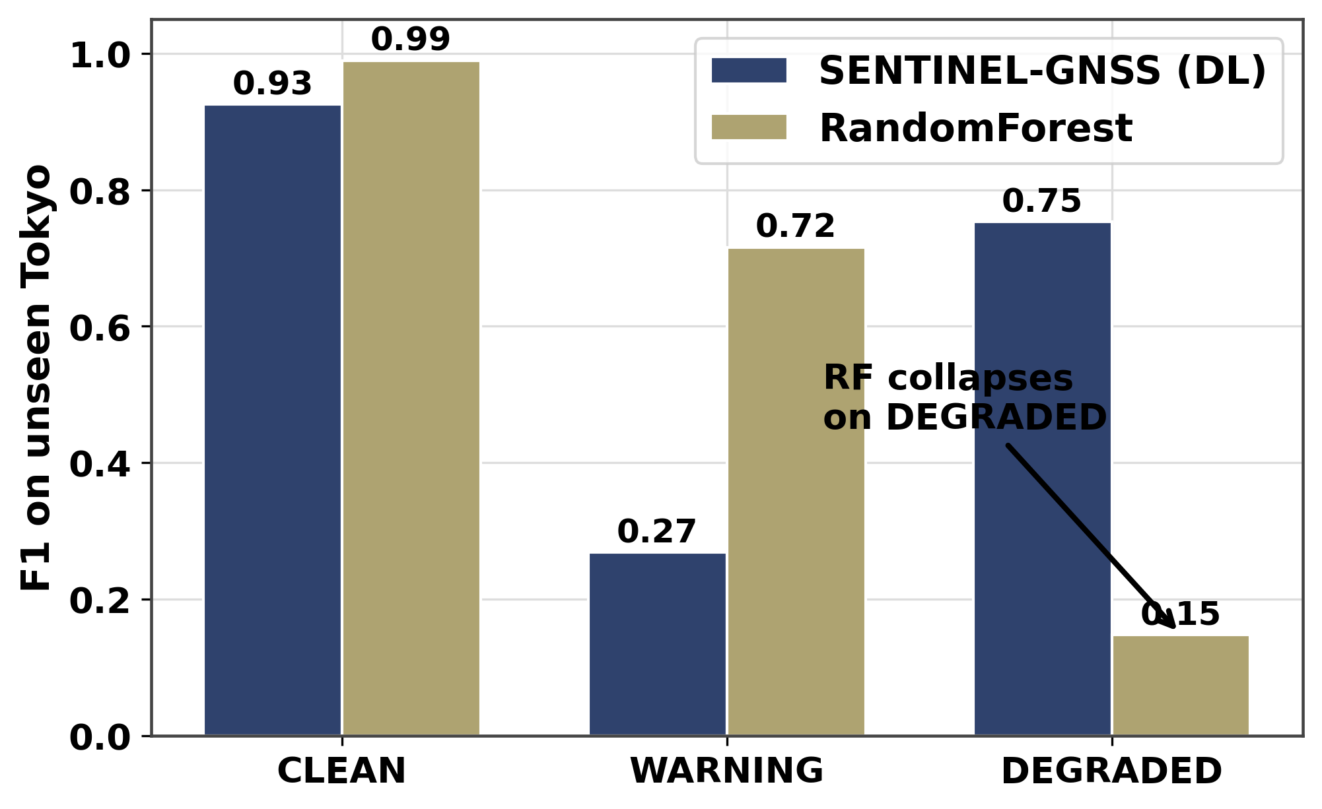
AI-Based Proactive Prediction of GNSS Signal Degradation for Autonomous Vehicle Navigation
Ingeriyinkindi Claudine
Data Collection · Cross-City Generalisation · Results Figures | RCSSTEAP / Beihang University · 2026
My Contributions
Transformer Attention — DEGRADED Example
• Campus site reconnaissance: designed 5 collection scenarios covering
instantaneous blockage (A), urban canyon (B), tree canopy (C),
open-sky baseline (D), and gradual building approach (E).
• Collected all Beihang campus GNSS data; managed equipment checklist,
receiver setup (Septentrio, u-blox), and RTKLIB labelling calibration.
• Ran cross-geography generalisation testing: UrbanNav Hong Kong,
UrbanNav Tokyo (zero-shot), and Oxford RobotCar datasets.
• Produced all 13 publication-quality figures for the team paper
(consistent palette, minimum 11pt font, 300 DPI PNG + PDF).
• Wrote the cross-city generalisation analysis and interpretation
(paper Section 5.5).
Cross-City DEGRADED-Class F1
Fig: Self-attention weights for a correctly-predicted DEGRADED epoch. Attention concentrates on the 5–10 epochs just before blockage onset, confirming the model learns the temporal lead-up signature.
Cross-City Generalisation Findings
• Tokyo NLOS geometry differs from Hangzhou/HK: irregular canyon angles
create structured blockage patterns rather than random dropout.
• RF memorises city-specific C/N₀ thresholds; SENTINEL learns degradation
dynamics (DOP drift, signal trend) that transfer across skyline geometries.
• WARNING class drops cross-city for DL (0.268 vs RF 0.716) — a known
limitation; the DL+XGBoost ensemble recovers to 0.892 overall.
Fig: SENTINEL-GNSS (0.75) vs RandomForest (0.148) on unseen Tokyo. RF collapses on DEGRADED; SENTINEL retains cross-city robustness.
Cross-city DEGRADED F1: SENTINEL 0.75 vs RandomForest 0.148
In-domain RF Macro-F1 = 0.926 → cross-city Macro-F1 = 0.618 (−33%)
No per-city retraining needed — SENTINEL generalises zero-shot.

