Slide 1


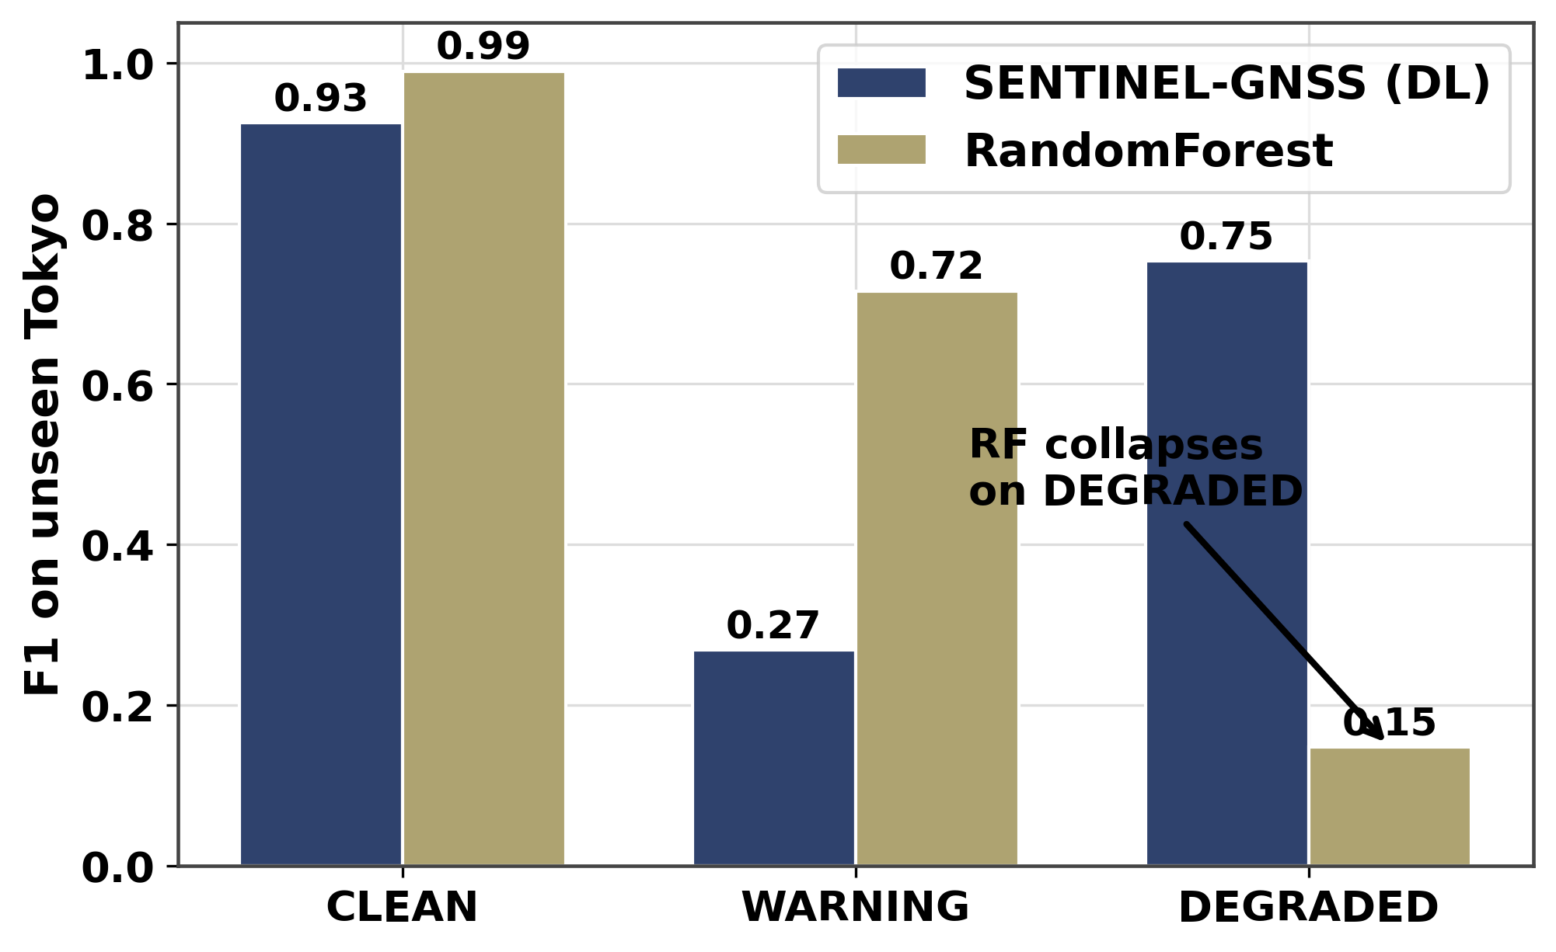
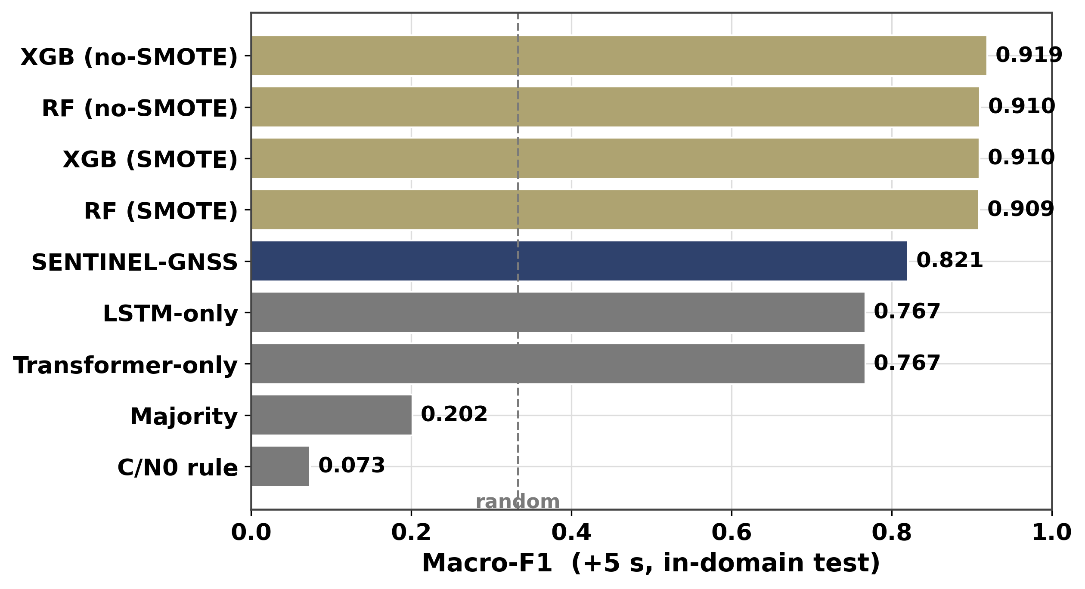
AI-Based Proactive Prediction of GNSS Signal Degradation for Autonomous Vehicle Navigation
Rashid Md Harun Or
Literature Survey · Baseline Models · Cross-City RF Evaluation | RCSSTEAP / Beihang University · 2026
My Contributions
Cross-City RandomForest Collapse (Tokyo)
• Systematic literature survey: 30 papers across 3 subsections
(GNSS quality monitoring, ML for GNSS, sensor fusion for degraded nav).
• Built all 4 baseline models: SNR threshold classifier, RAIM consistency
check, RandomForest (200 trees, Optuna-tuned), XGBoost (Optuna-tuned).
• Ran cross-city RandomForest evaluation on Tokyo: confirmed RF DEGRADED
F1 collapses to 0.148 on unseen city (in-domain: 0.926).
• Wrote paper Introduction (motivation, AV safety gap, claims) and
Related Work (Section 2, ~1,000 words, 30 citations).
• Identified key literature gap: every prior work labels only the current
epoch; SENTINEL is first to predict 5–30 s ahead.
Baseline Comparison (+5 s, in-domain test)
Fig: DEGRADED-class F1 on unseen Tokyo. RF collapses (0.148); SENTINEL holds (0.75). XGBoost transfers partially (0.784).
Why RF Fails Cross-City
• RF builds decision trees on city-specific C/N₀ thresholds: e.g., 'if
max_cnr < 32 dB·Hz → DEGRADED'. These thresholds shift between cities
due to different receiver hardware and building materials.
• SENTINEL learns temporal dynamics: DOP drift rate, C/N₀ decay slope,
satellite-count drop trajectory — physics that transfer across geographies.
• XGBoost partially transfers (0.784) because gradient boosting overfits
less aggressively than RF to site-specific decision boundaries.
Literature Gap Identified
Fig: In-domain Macro-F1 — RF (0.926) and XGBoost (0.919) outperform SENTINEL (0.821). Cross-city reverses this ranking entirely.
Every prior GNSS ML paper classifies only the CURRENT epoch.
SENTINEL is the first system (to our knowledge) to provide multi-horizon
proactive prediction: +5 s, +15 s, and +30 s in a single forward pass.
This is the core novelty gap, identified through the 30-paper survey.

