Slide 1


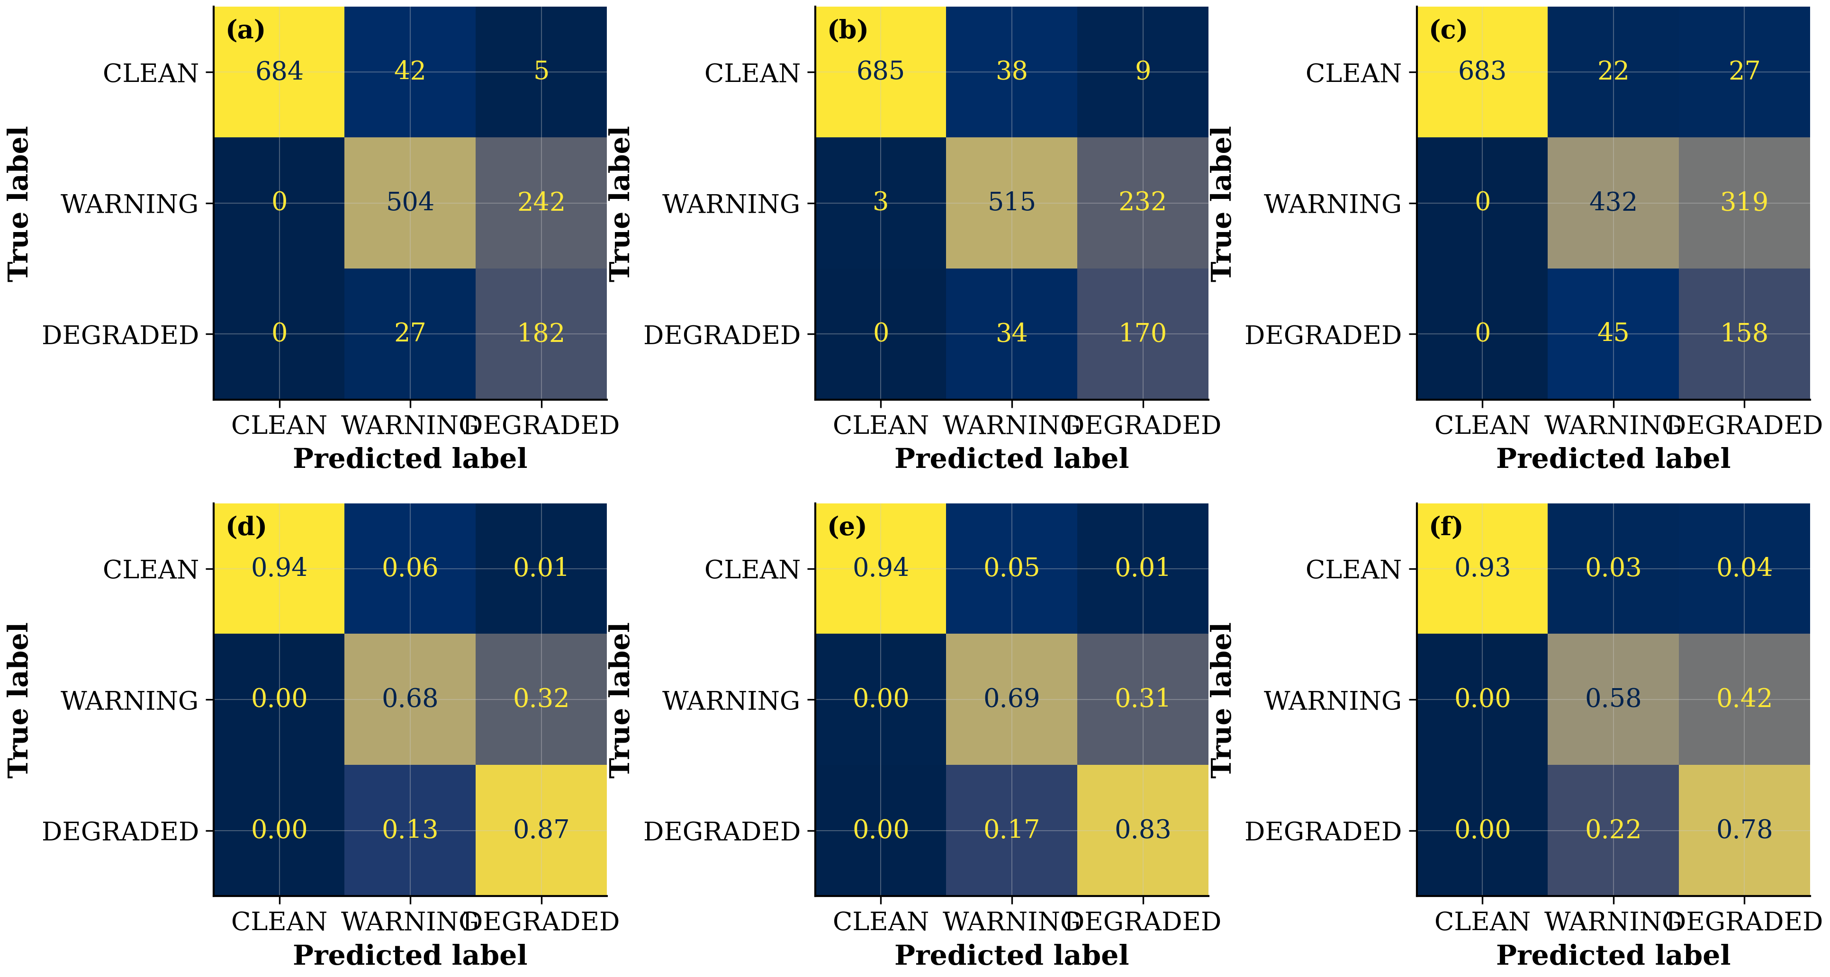
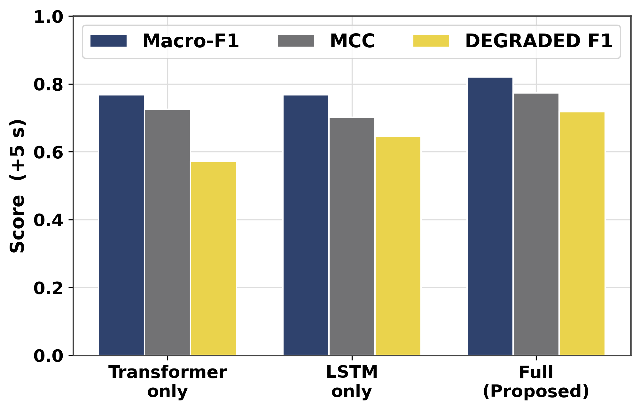
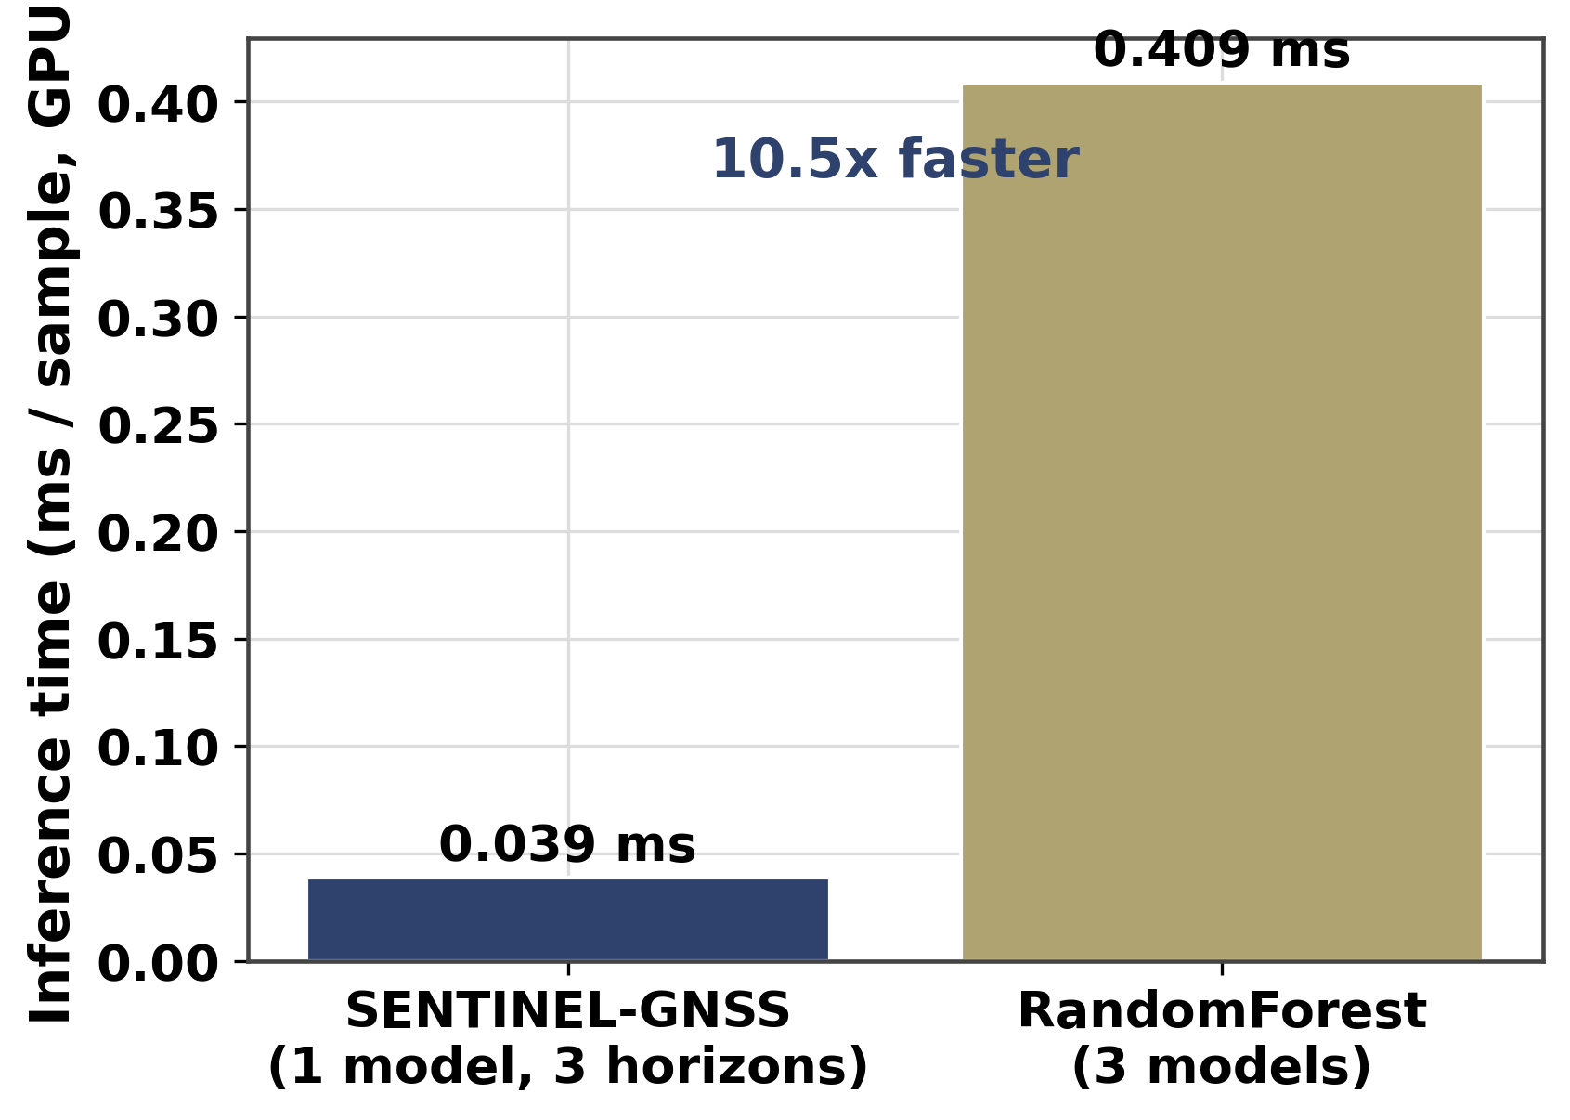
AI-Based Proactive Prediction of GNSS Signal Degradation for Autonomous Vehicle Navigation
Ojerinde Joel Segun
ML Architecture · EKF Integration · Inference Pipeline | RCSSTEAP / Beihang University · 2026
My Contributions
Classification Results (held-out test set)
• Designed the Transformer-LSTM hybrid: 2-layer Transformer (8 heads, d=128)
+ 2-layer LSTM (hidden=256) for causal trend modelling.
• Implemented training pipeline, Focal Loss, class weighting, temperature
scaling (T=0.4023) reducing ECE from 0.114 → 0.068.
• Ran ablation experiments confirming each component's independent contribution.
• Built 9-state Adaptive EKF: prediction-driven R(t), Joseph form, Huber
robust variant, and Bootstrap Particle Filter.
• Inference pipeline: 0.0449 ms/sample (all 3 horizons in one forward pass).
Ablation Study (+5 s horizon)
Fig: Row-normalised confusion matrices at +5 s / +15 s / +30 s. CLEAN recall >0.97; DEGRADED recall 0.85 → 0.73 as horizon extends.
Inference Performance
0.0449 ms / sample — all three horizons in one forward pass
9.46× faster than three separate RandomForest models (RF = 0.4248 ms × 3)
Model: 17.81 MB · 1,456,652 parameters · within 10 Hz AV-compute budget
Fig: Ablation — each component contributes independently to Macro-F1, MCC, and DEGRADED-F1.
Fig: Inference latency comparison — SENTINEL (0.0449 ms) vs RF (0.4248 ms×3) vs XGBoost.

