Slide 1


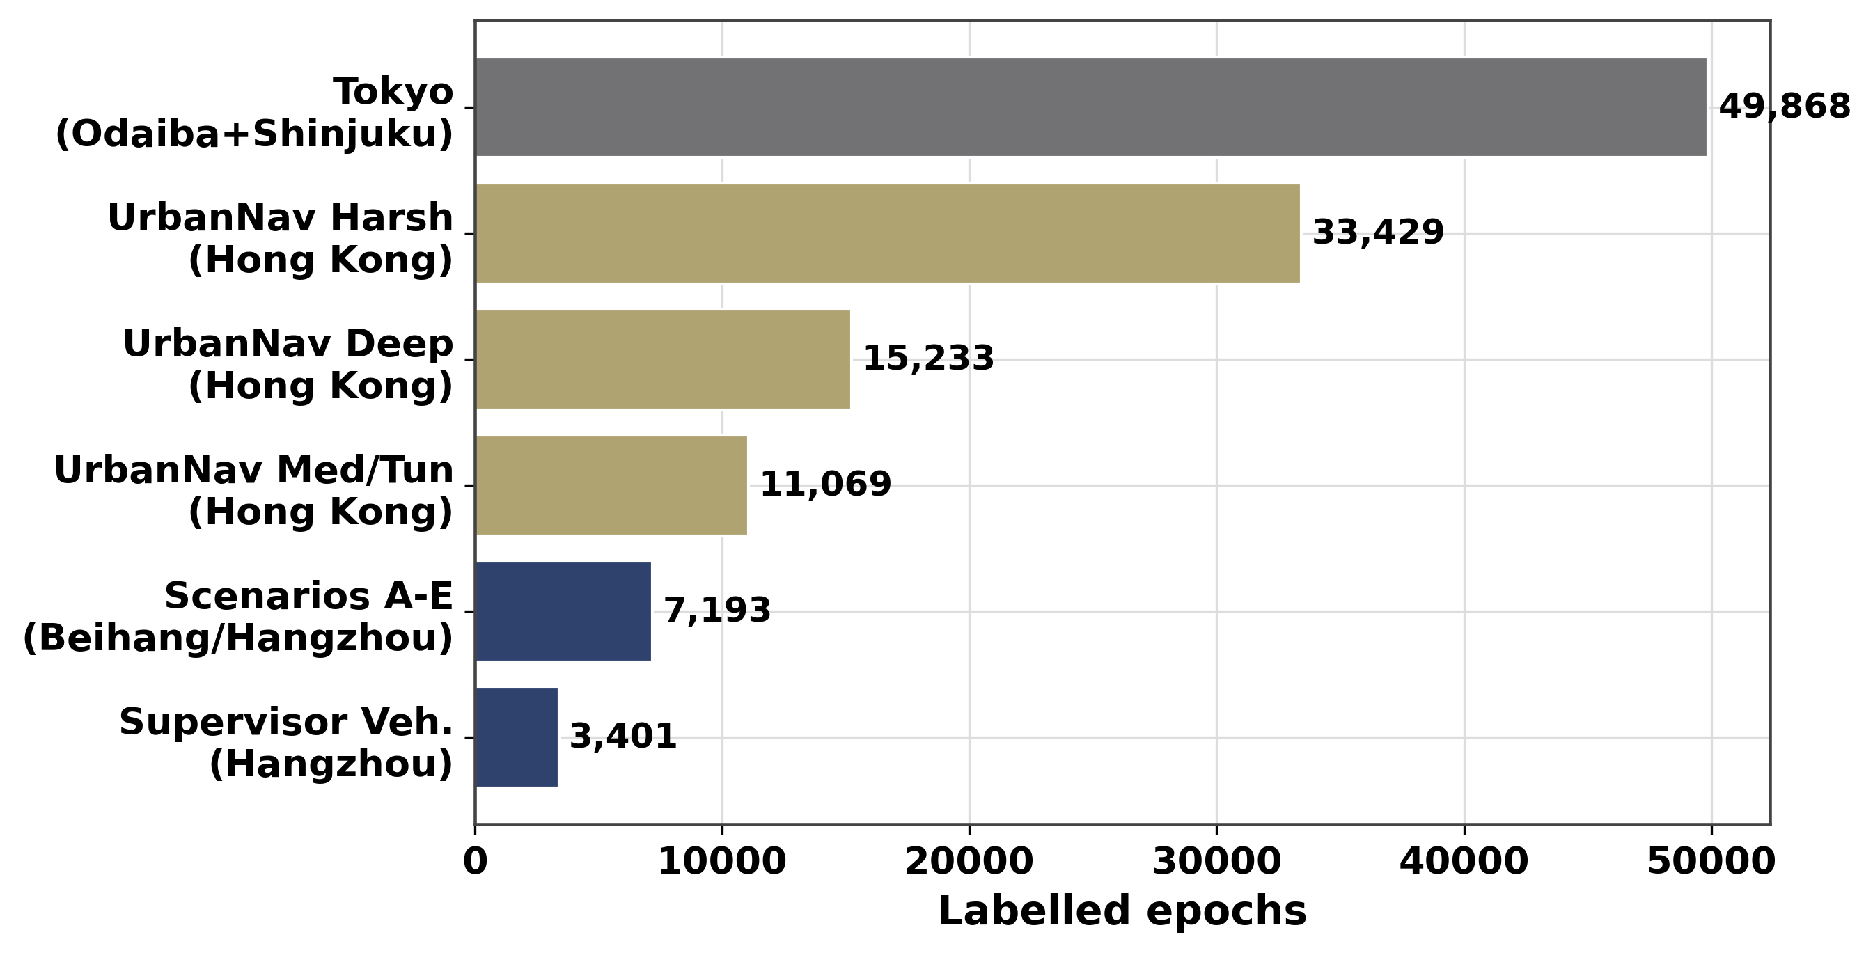
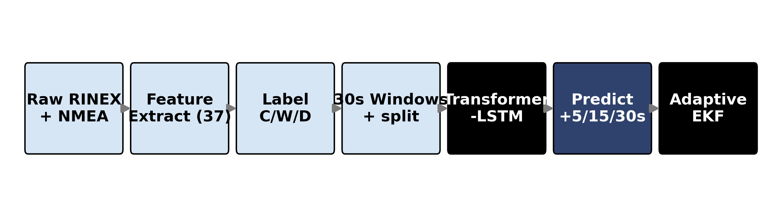
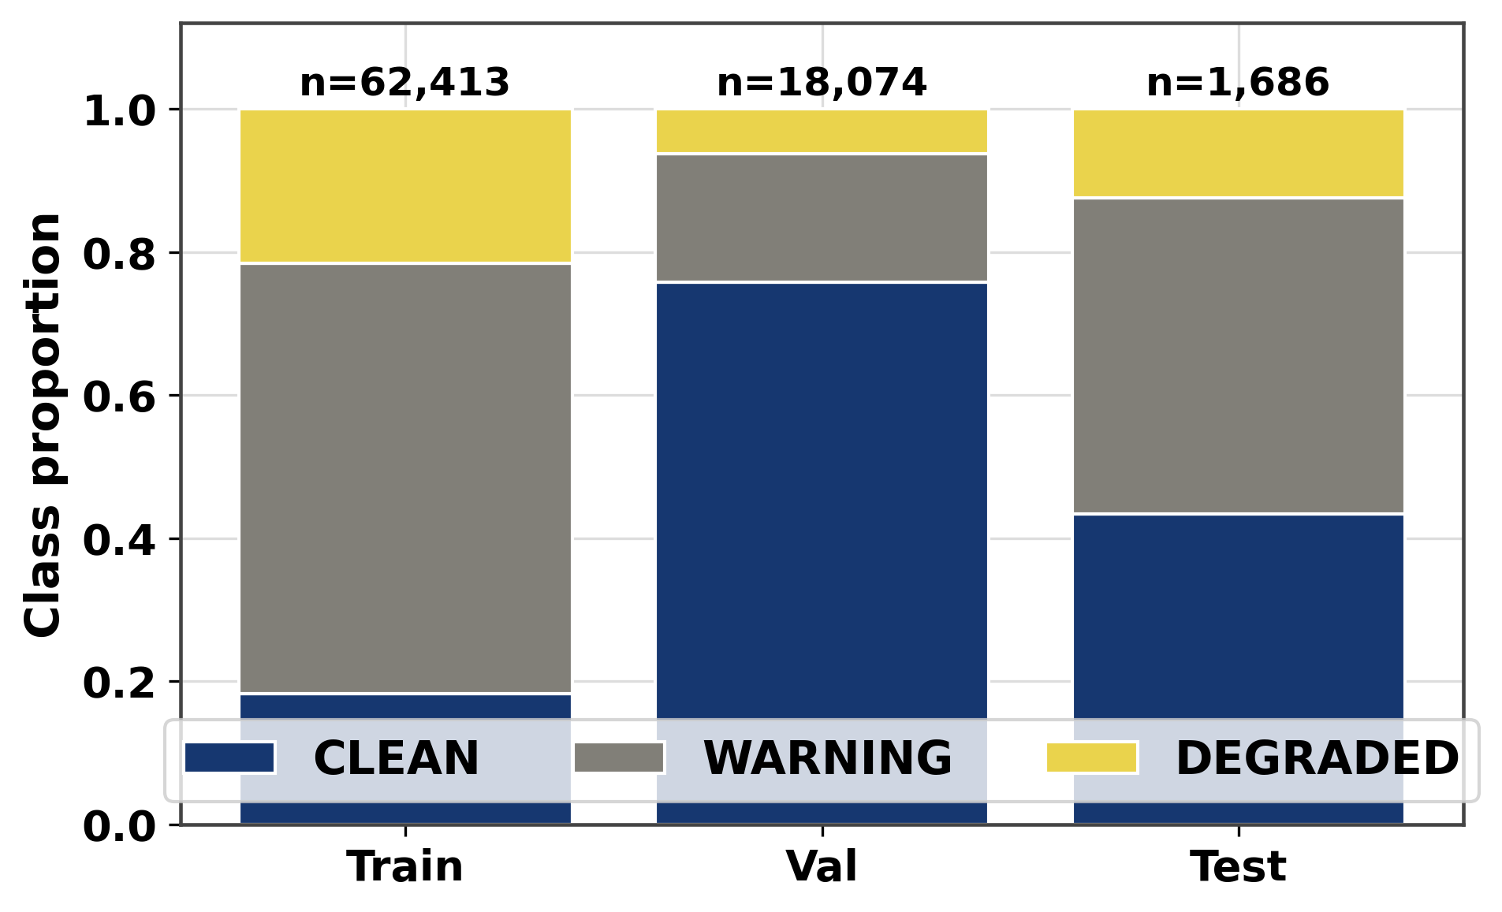
AI-Based Proactive Prediction of GNSS Signal Degradation for Autonomous Vehicle Navigation
Ogunlade Joshua Oluwaseun
Data Engineering · Feature Extraction · Dataset Assembly | RCSSTEAP / Beihang University · 2026
My Contributions
Multi-City Dataset Composition
• Built GNSS extraction pipeline (extract_gnss.py) from ROSBAG files,
RTKLIB automated processing (run_rtklib.py) — 4 stages: format
conversion, precise orbit download, SPP computation, output parsing.
• Engineered all 37 GNSS features across 7 groups: position quality,
signal strength, satellite geometry, residuals, temporal, atmospheric,
and receiver type — used as the model input tensor.
• Assembled the final 149,662-epoch dataset (assemble_dataset.py):
3-class labelling, causal sliding window, session-level split.
• Ran multi-pass QA: histogram inspection, leakage audit, field re-collection
of 5 bad runs totalling ~480 mislabelled epochs.
Data Engineering Pipeline
Fig: Dataset composition by city, environment, and receiver class. Training: Hangzhou + Hong Kong · Zero-shot test: Tokyo.
Class Distribution
Fig: End-to-end data pipeline: raw RINEX/NMEA → RTKLIB SPP → feature extraction → 3-class labelling → causal sliding window → session-level train/val/test split.
37 Feature Groups
Group 1 Position Quality (4): hdop, pdop, gdop, vdop
Group 2 Signal Strength (8): max/mean/std/min C/N₀, available sats, cnr_trend
Group 3 Satellite Geometry (6): baseline sats, sat_mean, dop_ratio, fix_continuity …
Groups 4–7 Residuals, Temporal Δ, Atmospheric, Receiver type (19 features)
Excluded: lat/lon — geographic overfitting guard.
Fig: Class label distribution across splits. DEGRADED is rare (class imbalance → Focal Loss + class weights).
149,662 labelled epochs · 4 cities · 9+ receiver types · 12 source groups
Training: Hangzhou (Beihang) + Hong Kong · Zero-shot: Tokyo · Excluded: Michigan, Oxford

