Slide 1


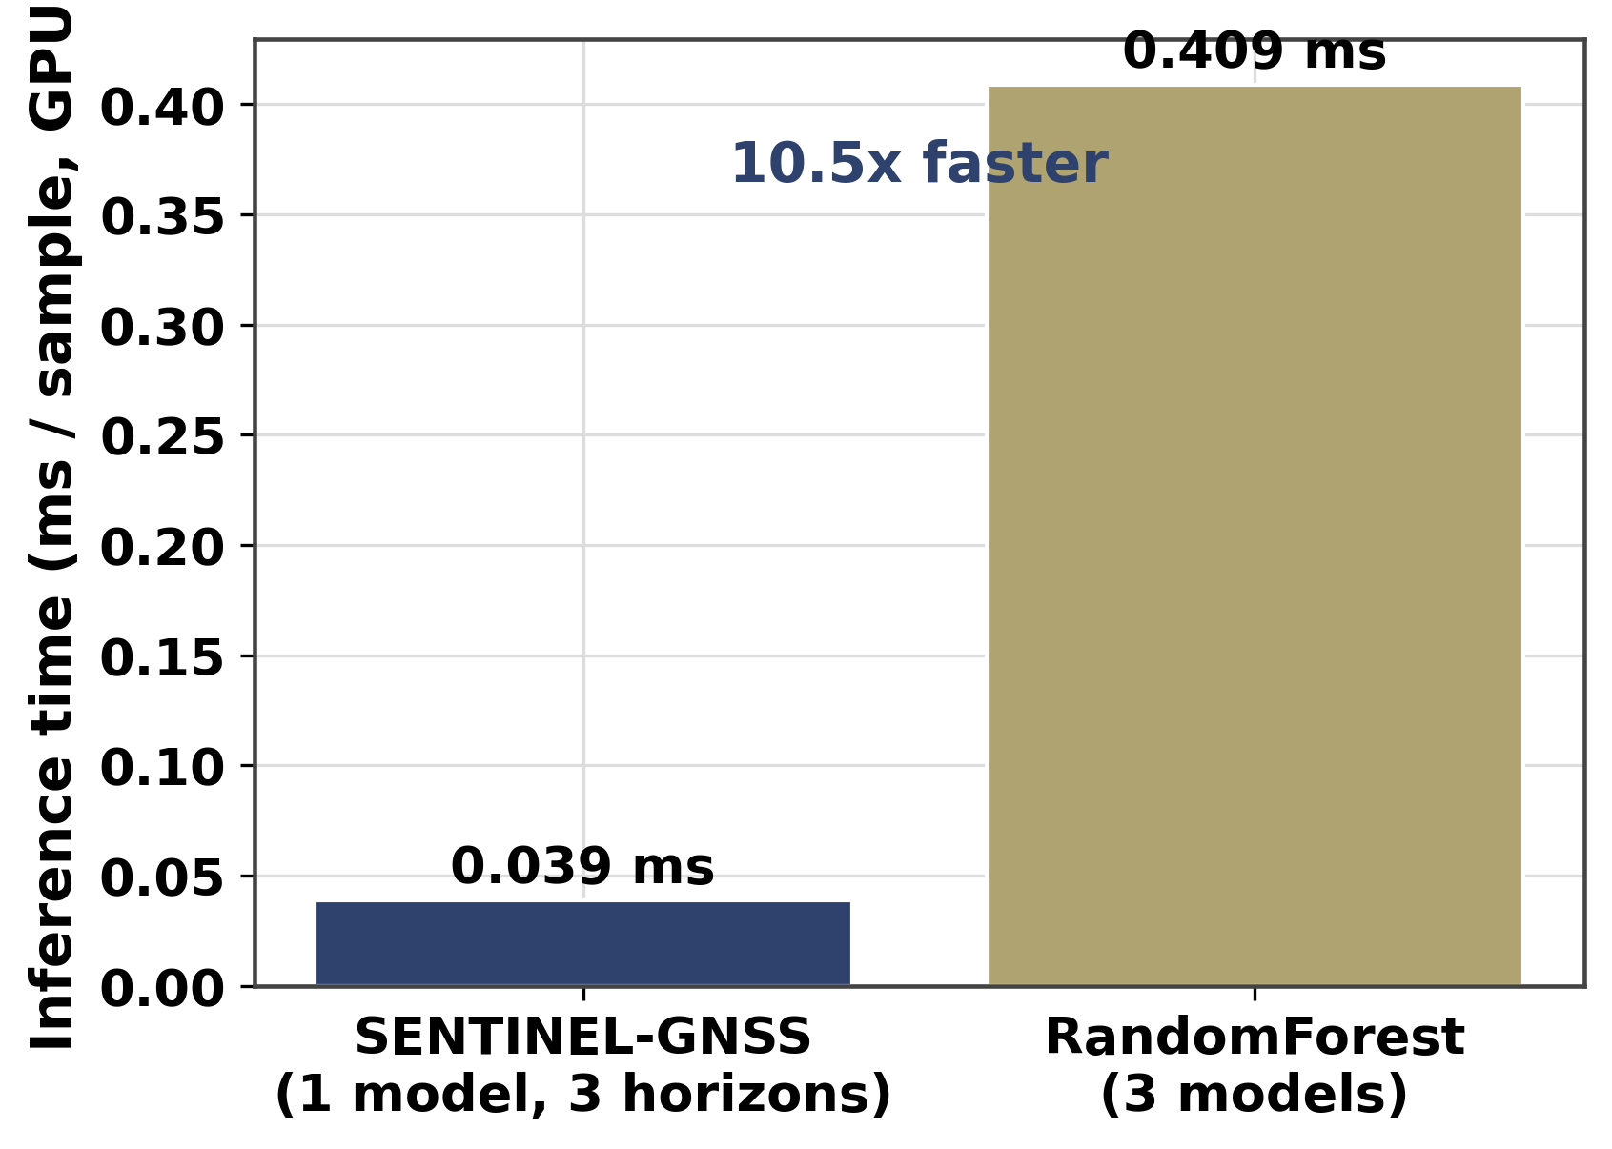
AI-Based Proactive Prediction of GNSS Signal Degradation for Autonomous Vehicle Navigation
Mustapha Ibrahim Ishola
EKF Implementation · Real-Time Dashboard · Live Demonstration | RCSSTEAP / Beihang University · 2026
My Contributions
Dashboard Architecture
• Implemented the full 9-state EKF (ekf.py): state transition (F), process
noise (Q), Joseph-form update, SENTINEL-adaptive R(t) integration.
• Validated EKF on real Tokyo Shinjuku Trimble data; degraded RMSE reduced
from 47.4 m (GNSS-only) to 26.9 m with SENTINEL-calibrated adaptive R.
• Designed and built the real-time dashboard: FastAPI backend (port 8000),
Next.js 15 / React 19 frontend (port 3000), WebSocket replay at 1–30 Hz.
• Integrated live Septentrio USB receiver with NMEA parsing and feature
extraction for campus demonstration.
FastAPI backend — REST endpoints + WebSocket /ws:
GET /api/predictions/{id} · GET /api/fusion · GET /api/ekf
WebSocket: start_replay → epoch stream at configurable speed
Next.js 15 frontend — 3 tabs:
Live Tab — Signal gauge, probability bars, alarm centre, trajectory map
Fusion Tab — OSM tile map + EKF track overlays + RMSE bars
Analytics Tab — EKF strategy comparison, blockage statistics
All data pre-computed (0 ms inference overhead at runtime).
9-State Adaptive EKF
End-to-End Latency
State vector: [x, y, vx, vy, heading, ax, ay, ωz, baro]
Adaptive R(t) = σ²_base + (σ²_deg − σ²_base) × P̂_calib
where P̂_calib = clip((P̂ − P₅)/(1 − P₅), 0, 1), P₅ = 0.153
R(t): 9 m² (CLEAN) → 10,000 m² (fully DEGRADED)
Joseph form: P⁺ = (I−KH)P⁻(I−KH)ᵀ + KRKᵀ (numerically stable)
Result: degraded RMSE 47.4 m → 26.9 m (−43.2%)
Navigation Results (Tokyo Shinjuku, Trimble)
GNSS-only 47.4 m → SENTINEL adaptive EKF 26.9 m (−43.2%)
Fixed-R oracle 24.3 m (−48.8%) · SENTINEL: 2nd best, no per-city tuning
CEP95 cut: 76.3 m → 53.7 m · Max error: 887.8 m → 162.8 m
Fig: Inference latency breakdown — SENTINEL 0.0449 ms vs baselines. Dashboard pipeline adds negligible overhead at 10 Hz.
Live Campus Demonstration
• Septentrio receiver connected via USB serial; NMEA parsed in real time.
• Live feature extraction fed into SENTINEL model; predictions streamed
to dashboard at 1 Hz with colour-coded risk display.
• Campus scenario: Beihang main building NLOS → CLEAN transition
visible live on trajectory map and probability bars.

