Slide 1
AI-Based Prediction of GNSS Signal
Degradation for Autonomous Driving
A Pilot Study
S/N | Name | Student ID
1 | Ojerinde Joel Segun | LS2525253
2 | Mustapha Ibrahim Ishola | LS2525238
3 | Ogunlade Joshua Oluwaseun | LS2525237
4 | Ingeriyinkindi Claudine | LS2525236
5 | Rashid Md Harun Or | LS2525219
Supervisor: Dr. Ahmed Wasiu

Slide 2


01
RECAP
2

Slide 3
Presentation Outline
1 | Problem Statement & Motivation
2 | Why Prediction, Not Detection?
3 | Our Contributions
4 | Data Sources & Collection Strategy
5 | Data Processing Pipeline
6 | Feature Engineering
7 | System Architecture
8 | AI Model Design — Transformer-LSTM
9 | Training Protocol & Class Imbalance Handling
10 | Evaluation Strategy & Datasets
11 | Results Overview
12 | Real-Time Monitoring Interface
13 | Sensor Fusion Adaptation (Dynamic EKF)
14 | Novelty Claims
15 | Team Responsibilities
16 | Project Timeline (Milestones)
17 | Anticipated Challenges & Mitigations
18 | Real-World Impact
19 | Conclusion & Future Work
20 | Q&A
3

Slide 4
Problem Statement
GNSS is the primary positioning source for autonomous vehicles. Yet it fails—predictably and frequently.
Urban Canyons
Tunnels & Underpasses
Atmospheric Effects
Tall buildings block or reflect satellite signals, causing multipath errors and signal loss in densely built environments.
Complete signal blockage causes instantaneous position loss. Reactive systems detect failure too late to plan a safe response.
Ionospheric and tropospheric disturbances degrade range accuracy across wide areas, particularly during daytime and equatorial conditions.
Current systems detect degradation after it occurs — autonomous vehicles need advance warning to respond safely.
4

Slide 5
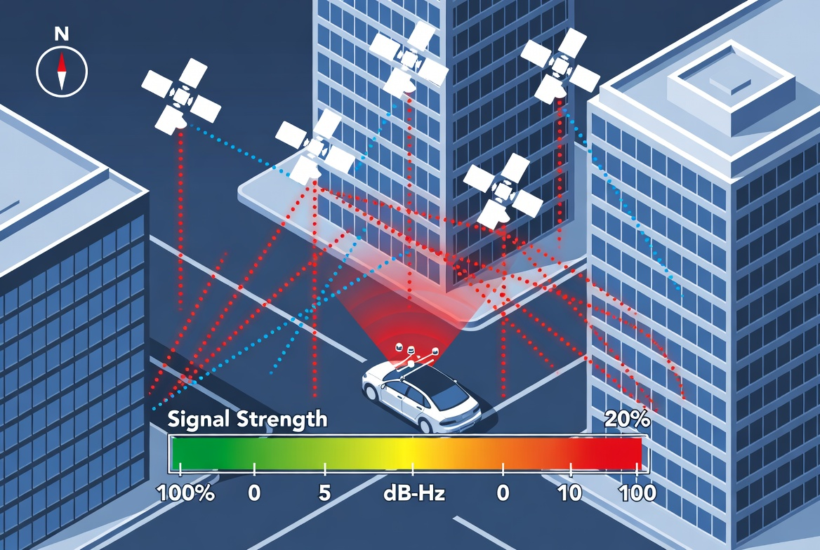
Problem Statement
5

Slide 6
Why Prediction, Not Detection?
Reactive vs. Proactive Navigation Response
REACTIVE SYSTEM (Current State of Practice)
Signal OK
Degradation
Occurs
System
Detects
Response
(Too Late)
PROPOSED SYSTEM (Proactive — This Work)
Signal OK
Model Predicts
30s Ahead
Sensor Weights
Adjusted
Smooth
Navigation
At 60 km/h, a 30-second prediction window provides 500 metres of advance notice — enough for safe, graduated navigation adjustment.
6

Slide 7
PROJECT PROGRESS
02
7

Slide 8
PROJECT PROGRESS
✔ Field data collected — all 5 scenarios, Septentrio MOSAIC-X5C receiver
✔ Public datasets downloaded — NCLT (2 dates), Oxford (4 traversals), UrbanNav HK and Tokyo
✔ Full processing pipeline implemented and validated
✔ Signal quality analysis charts generated for every run
8

Slide 9
Data Sources
Three complementary data platforms — supervisor-provided and self-collected
Ground Vehicle
Drone / UAV
Septentrio MOSAIC-X5C
Urban / Suburban · 0–80 km/h
Aerial · 0–20 m/s
Pedestrian · Campus routes
ROSBAG format
Multipath from buildings
Tunnel & underpass blockage
Primary AV context
ROSBAG / RINEX
Open-sky clean baseline
Healthy signal reference
Processed via RTKLIB
All 5 scenarios collected
Controlled degradation events
Fully repeatable routes
RINEX output
✔ Data acquired
✔ Data acquired
✔ Collected (May 2026)
Public Validation Datasets: UrbanNav (Hong Kong) ✔ · KAIST Urban (Korea) — awaiting delivery · Oxford RobotCar ✔ · NCLT Michigan ✔
10

Slide 10
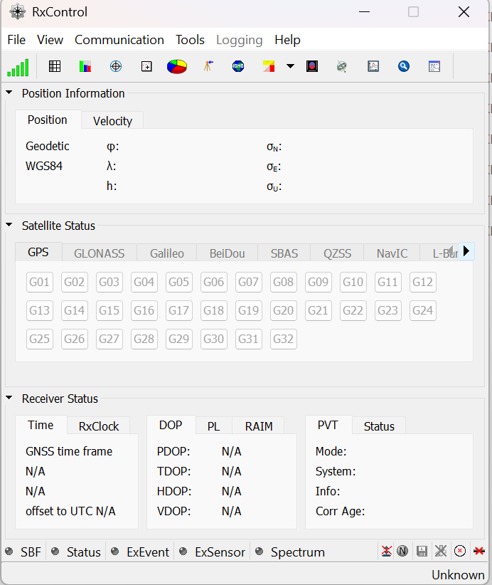
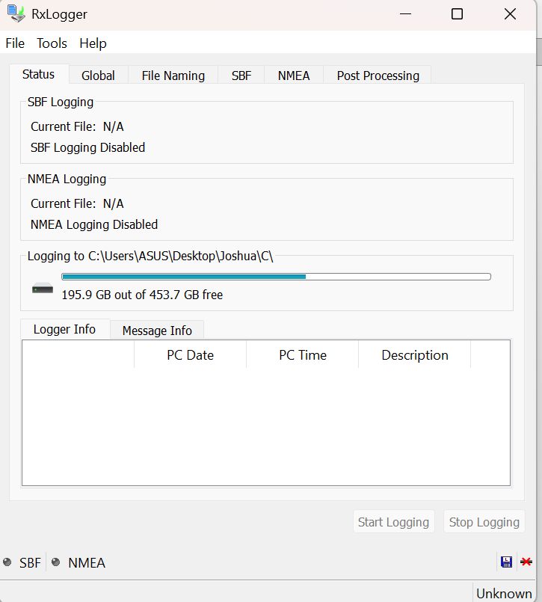
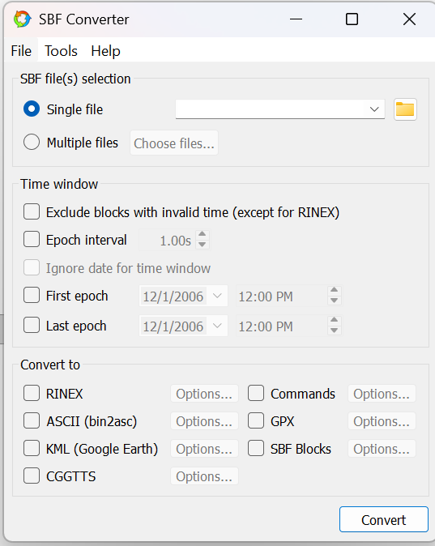
Data Collection Process (Software)
RxControl
RXLogger
SBF Converter
11

Slide 11
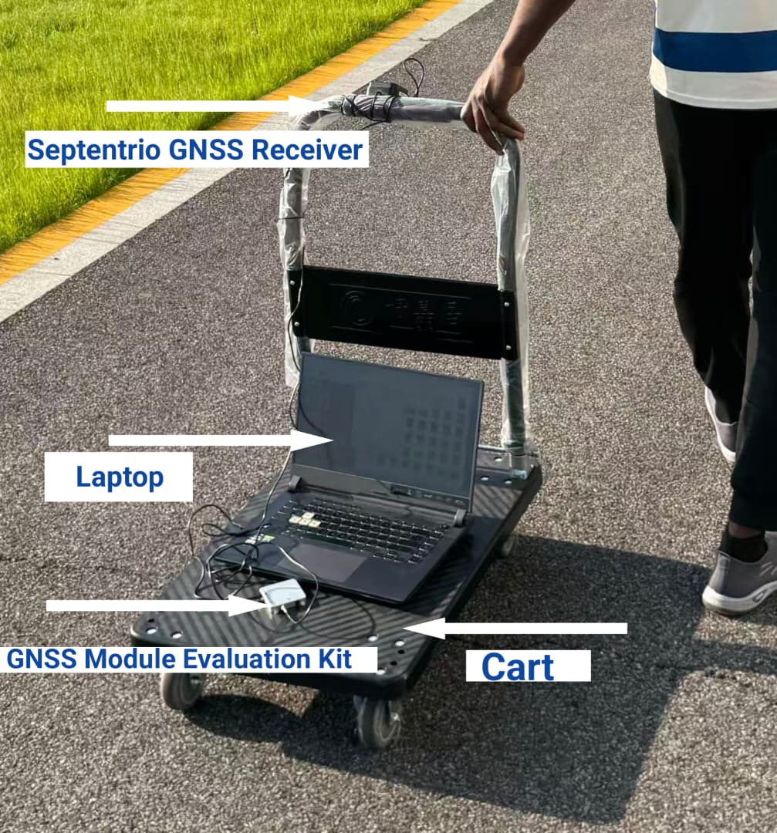
Data Collection Process (Hardware)
Septentrio GNSS Receiver.
Receives and processes satellite signals from GNSS constellations.
2. GNSS Module Evaluation Kit.
Serves as the interface between the GNSS hardware and the laptop. .
3. Laptop.
Used to configure the receiver,
monitor data collection, record GNSS observations, and store the collected data for later processing and analysis.
4. Cart.
Provides a mobile platform for carrying the GNSS equipment during field data collection.
5.USB 3.0 Cord.
Provides connection between the evaluation kit and laptop for data transfer.
12

Slide 12
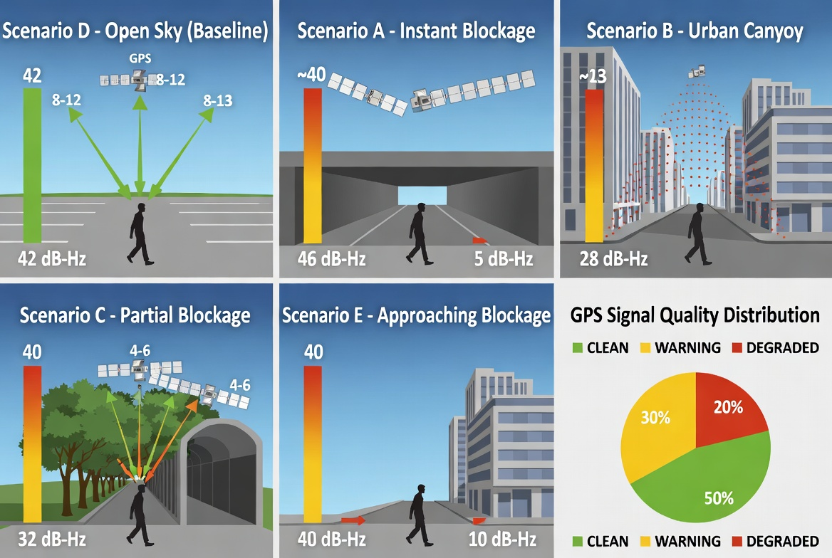
Data Collection — 5 Controlled Scenarios
9

Slide 13
Signal Quality Analysis — Key Findings
Derived from RINEX 3 SNR indicators · all 4 constellations · 1 Hz · Septentrio MOSAIC-X5C
D — Open Sky
41.2 dB-Hz mean · 0.5% epochs below 25 dB-Hz · ~39 obs/epoch (most satellites of any scenario)
C — Partial Blockage (Trees)
38.6 dB-Hz mean · 0.6% epochs degraded · Gradual C/N₀ fluctuations consistent with foliage attenuation
B — Urban Canyon
37.2 dB-Hz mean · 3.0% epochs below threshold · Periodic sharp dips from building reflections visible
E — Approaching Blockage
38.6 dB-Hz mean · 5.9% degraded · Gradual deterioration pattern clearly identifiable for prediction
A — Instant Blockage
Sharp satellite dropout in first 15 s · Count collapses 24 → 0–2 sats · C/N₀ falls below 25 dB-Hz immediately
Key insight: Scenario A shows clear distinct signature; D and A are near-perfectly separable. B/C/E have partial overlaps — exactly the challenge the Transformer-LSTM must solve.
13

Slide 14
VERSION 3
AI Model Development Update
May 2026 · From data collection to trained model
✔ 97,393 labelled epochs — 10 sources, 3 cities (Beijing · Hong Kong · Tokyo)
✔ SENTINEL-GNSS Transformer-LSTM architecture finalised — 359 K parameters
✔ Full pipeline: feature_prep → SMOTE → sliding windows → train → evaluate
✔ Smoke test passed — val macro-F1 = 0.9375 at epoch 3 (5-epoch debug run)
⬡ Full 150-epoch training on Colab T4 GPU — in progress

Slide 15
SENTINEL-GNSS — Transformer-LSTM Architecture
Hybrid model: spatial attention (Transformer) + temporal memory (LSTM) → 3 prediction horizons
Input Window
Model Summary
(B, T=30, F=34) 30 time-steps × 34 features
Parameters:
~359,241 (all trainable)
Input shape:
(B, 30, 34) — 30×1 Hz windows, 34 features
Loss function:
Focal Loss γ=2.0 | class weights [1, 3, 5]
Linear Projection
Optimiser:
AdamW lr=1e-3 | weight_decay=1e-4
LR schedule:
5-epoch linear warmup + cosine decay
34 → d_model = 64 + Positional Encoding
Mixed precision:
AMP enabled (GPU) | batch_size=256 on T4
Training Configuration
Transformer Encoder (×2 layers)
Max epochs:
150 (early stop patience = 20)
• 4 attention heads
Train/Val/Test:
Session-based split 70 / 15 / 15 %
• d_ff = 256 | GELU
Class imbalance:
SMOTE oversampling on training windows
• Pre-LN | dropout 0.1
Checkpointing:
Save every 10 epochs + best val macro-F1
Target metric:
Macro-F1 (equal weight across 3 classes)
LSTM (×2 layers)
hidden = 128 | dropout 0.1
Head: 5 s ahead
Head: 15 s ahead
Head: 30 s ahead
128→64→3 (CLEAN/WARN/DEGR)
128→64→3 (CLEAN/WARN/DEGR)
128→64→3 (CLEAN/WARN/DEGR)

Slide 16
Dataset Expansion — 97,393 Labelled Epochs
3 quality classes: CLEAN / WARNING / DEGRADED · 10 sources · 3 cities · 4 GNSS constellations
Label Distribution
CLEAN 66.8%
WARNING 20.3%
DEGRADED 12.9%
Source
City / Region
Receiver
Rows
Scenarios
Scenarios A-E
Beijing, China
Septentrio
3,586
A B C D E
Supervisor Vehicle
Beijing, China
Septentrio
3,401
B C D E
Supervisor Vehicle (ref)
Beijing, China
Septentrio
3,739
D
Supervisor Drone
Beijing, China
Unicore UB4B0
11,123
D
UrbanNav HK Medium
Hong Kong, China
10 receivers
7,608
B C
UrbanNav HK Tunnel
Hong Kong, China
10 receivers
3,461
A E
UrbanNav Tokyo Odaiba
Tokyo, Japan
Trimble/u-blox
18,603
C D
UrbanNav Tokyo Shinjuku
Tokyo, Japan
Trimble/u-blox
31,265
B C
NCLT (2 sessions)
Ann Arbor, USA
GPS + LiDAR GT
7,493
B D
Total: 97,393 rows · 41 features · Labelled CSV tracked in GitHub
Oxford RobotCar (2 sessions)
Oxford, UK
NovAtel OEM6
7,114
B C D

Slide 17
SENTINEL-GNSS — Full Training Pipeline
3-command workflow: feature_prep → train → evaluate · resumable, reproducible, debug-mode available
feature_prep
train
evaluate
1
2
3
python -m src.models.feature_prep
python -m src.models.train
python -m src.models.evaluate
• Loads labelled CSV (97 k rows)
• Builds SentinelGNSS model
• Loads best checkpoint
• Imputes & scales 34 features
• AdamW + cosine LR schedule
• 14 analysis figures
▶
▶
• Sliding windows T=30 @ 1 Hz
• Focal Loss (γ=2, cls wts)
• Confusion matrix × 3 horizons
• SMOTE on training split
• Saves checkpoint every 10 ep
• Precision-recall & ROC
• Saves train/val/test .npz
• --resume from last checkpoint
• Per-source performance
Debug mode:
python -m src.models.feature_prep --debug python -m src.models.train --debug python -m src.models.evaluate --debug
500 rows/source · 5 epochs · separate debug windows & checkpoints · never overwrites real data

Slide 18
Preliminary Results & Colab Training Setup
Smoke test (5 epochs, debug dataset) · Full 150-epoch run on Colab T4 — in progress
Smoke Test Results (debug mode)
Google Colab Training (Full Run)
5 epochs · 500 rows/source · CPU (Quadro M1200)
GPU:
Tesla T4 — 15.6 GB VRAM
Best val macro-F1
0.9375
at epoch 3 (early stop patience = 20)
Batch size:
256 (vs 64 on local CPU)
Speed:
~20× faster than local
Training time (5 ep)
~45 s on CPU
Epochs:
150 (early stop at plateau)
Checkpoints saved
epoch_3.pt + best.pt
Data:
CSV cloned from GitHub — no Drive
Figures generated
14 evaluation charts
Checkpoints:
→ Google Drive (survives disconnect)
Classes resolved
CLEAN · WARNING · DEGRADED
Figures:
→ Google Drive (14 PDF + PNG)
Pipeline status
All 3 commands passed ✔
Resume:
--resume flag for auto-recovery
!python -m src.models.train --resume --batch_size 256
Full results (confusion matrices, per-source breakdown, 14 figures) available after Colab run completes.

Slide 19
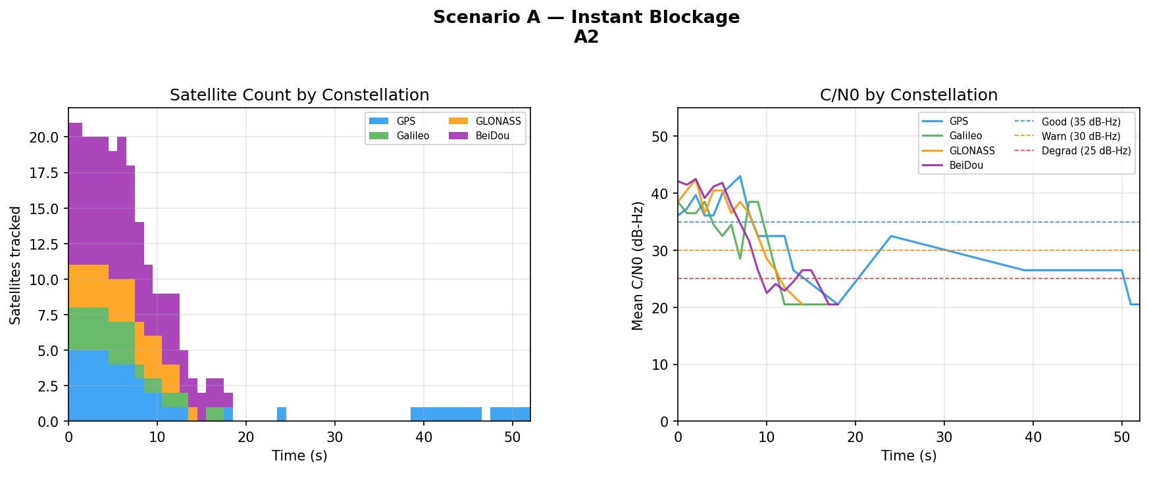
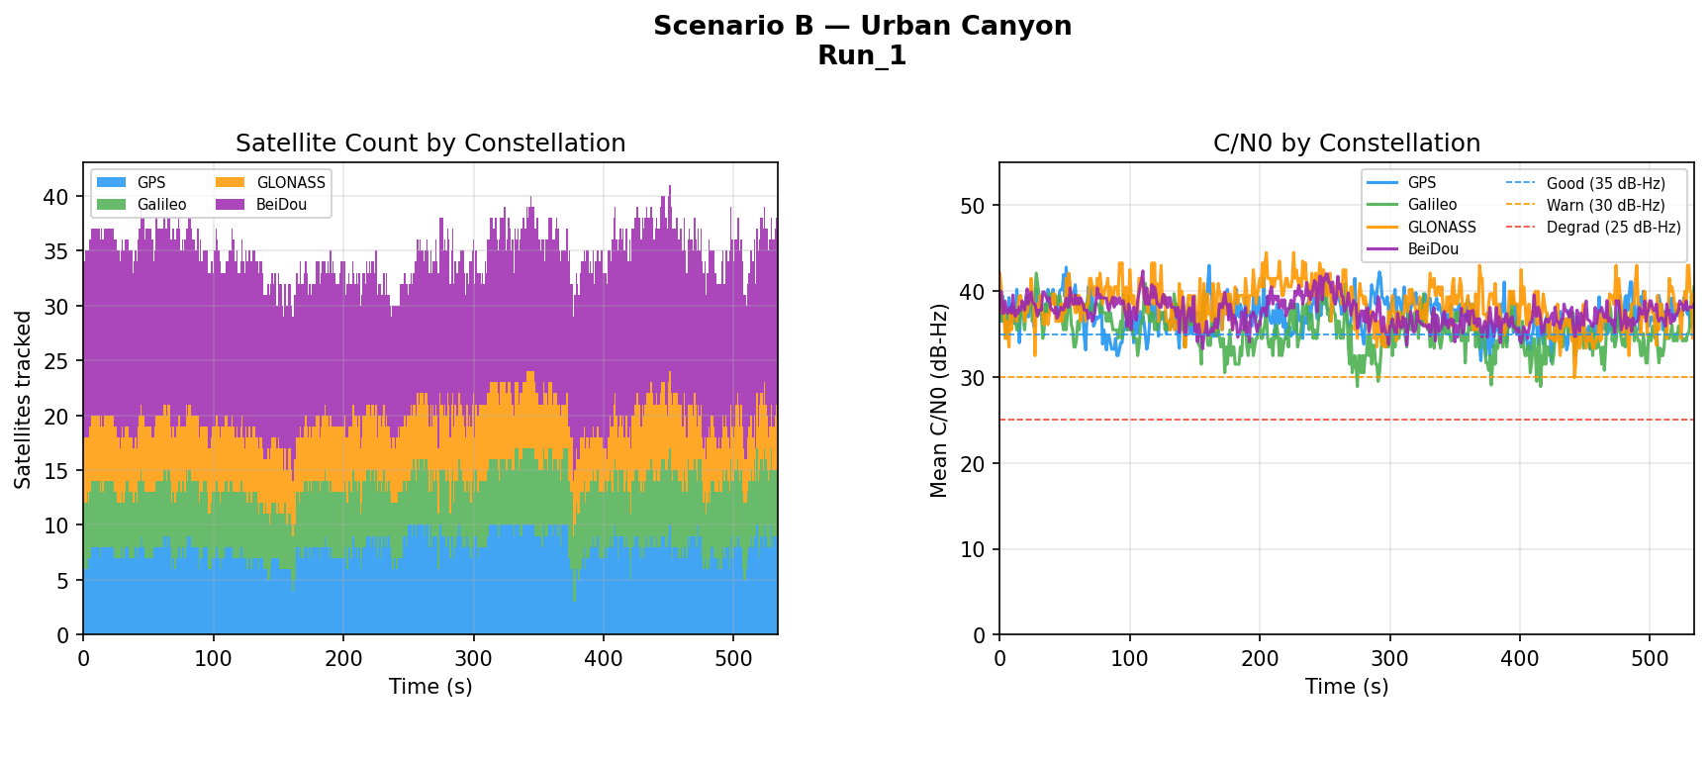
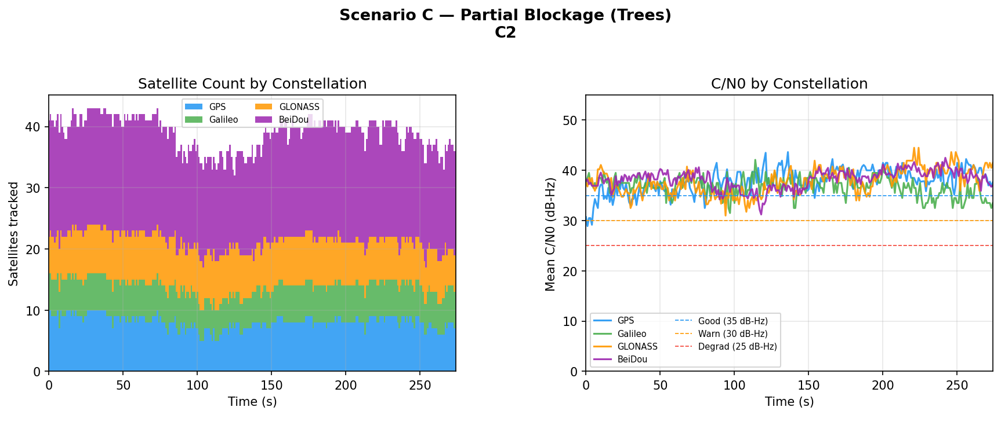
Signal Quality Analysis — Key Findings
Scenario A – Instant Blockage
Scenario B – Urban Canyon
Scenario C – Partial Blockage (Tree)
14

Slide 20
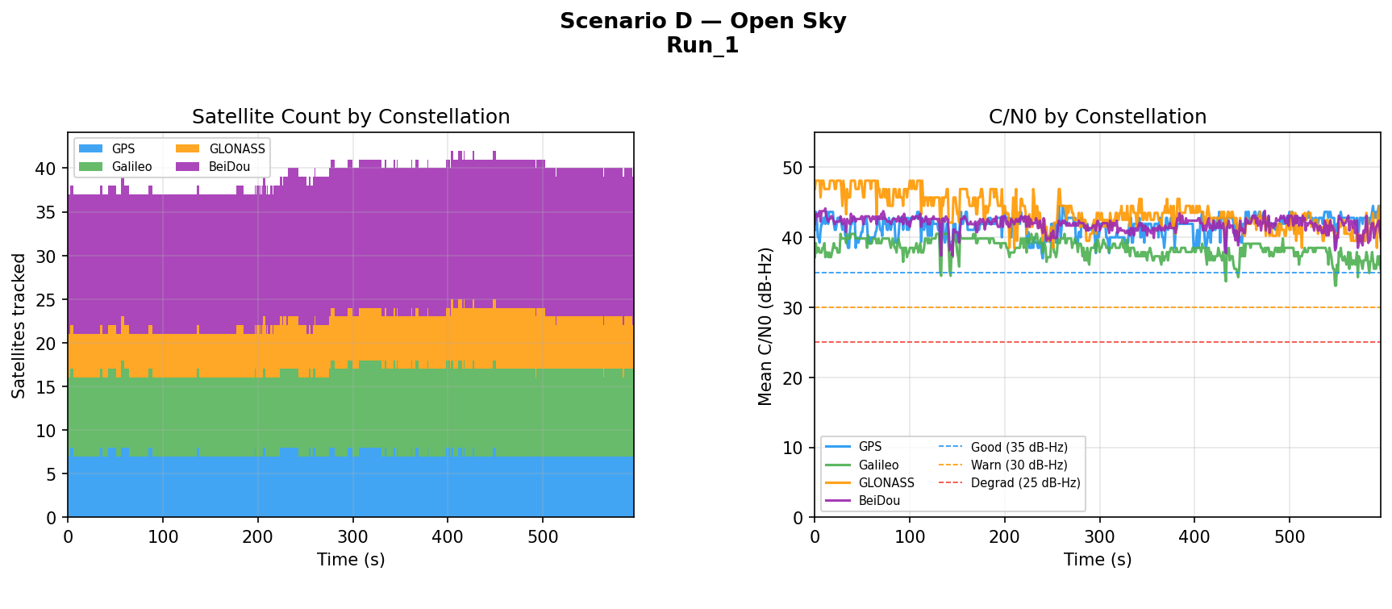
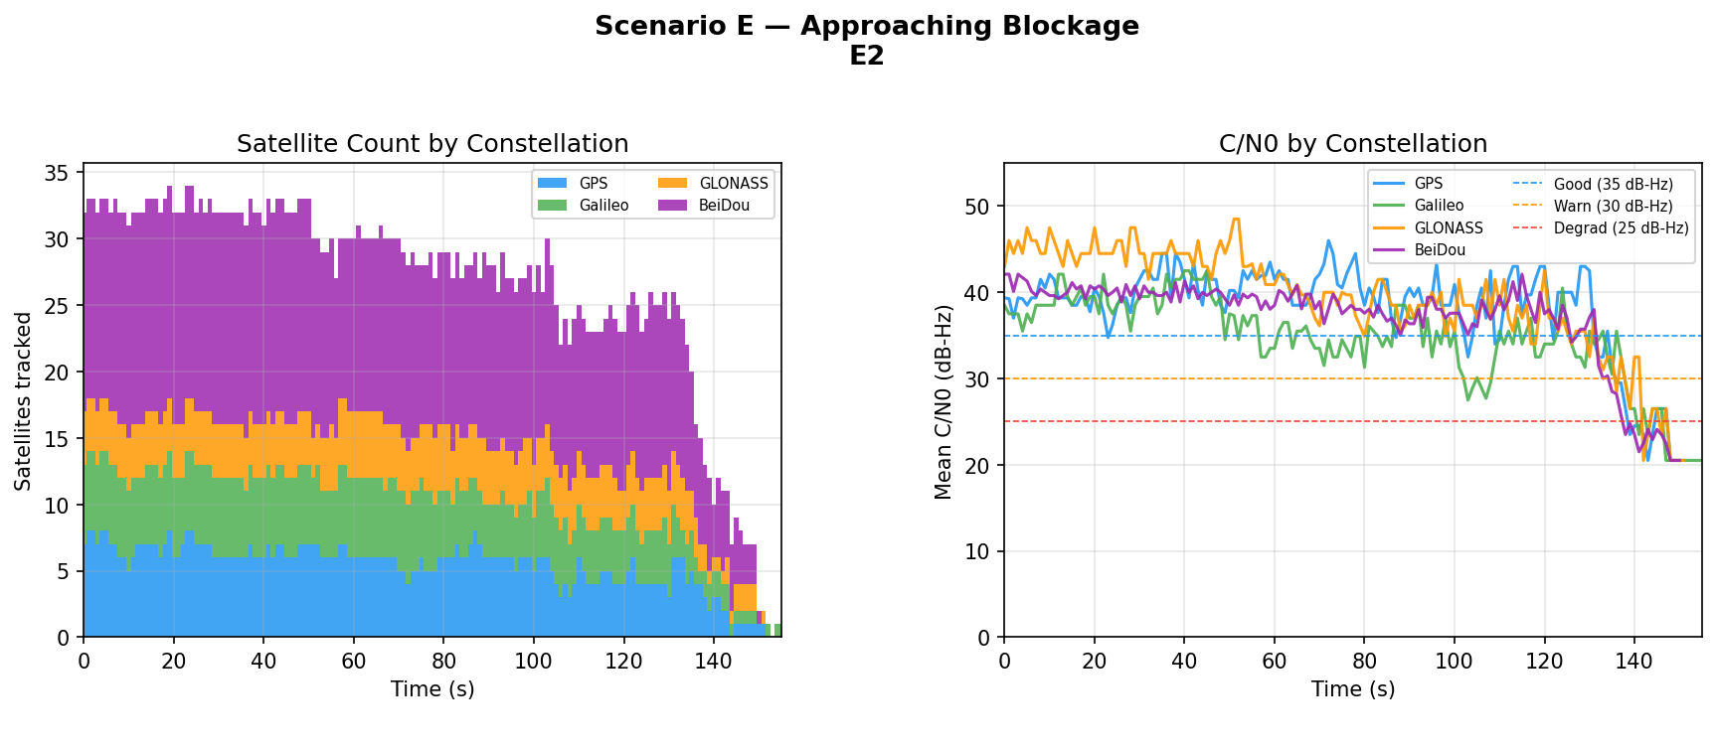
Signal Quality Analysis — Key Findings
Signal Quality Analysis — Key Findings (Contd)
Scenario D – Open Sky
Scenario E – Approaching Blockage
15

Slide 21
03
NEXT STAGE
16

Slide 22
Project Timeline — 4-Week Compressed Plan(Week 1 Goals Achieved)
1-month total · 2 concurrent coursework · Critical path: data collection (Wk 1) → model training (Wk 3) · Target: IEEE T-ITS
Week 1 · Days 1–7
Week 2 · Days 8–14
Week 3 · Days 15–21
Week 4 · Days 22–28
Setup & Data Extraction
Full Collection & Features
Model Training & System Build
Integration, Demo & Paper
✅ All software installed · Room 3058 visit · GitHub repo created
Scenarios B, C, E collected · Feature CSVs generated · Labelling complete
Transformer-LSTM trained · First test-set results · Ablation studies done
Live campus test: cart + receiver + dashboard · Screen capture video
All
Claudine, Joshua
Joel
All
✅ ROSBAG extraction + RTKLIB running on supervisor vehicle & drone datasets
All baseline models trained & results recorded (RF, LSTM, threshold, RAIM)
Generalisation tests on UrbanNav & RobotCar · KAIST on arrival
Paper 1 first draft written · Each member fills their sections
Joshua
Harun
Joel, Claudine
Joel leads
✅ ✅ ALL scenarios A–E collected (May 5, 2026) · RTKLIB processed
Literature review drafted (30 papers) · UrbanNav & RobotCar processed
Dynamic EKF in simulation · Dashboard all 5 panels with data playback
Full team review · Presentation rehearsed · Submission-ready draft
Claudine, Joshua
Harun, Claudine
Mustapha
All
⚠ Risk: Scenarios A & D (Day 5–7) are the critical path — all model work depends on them. KAIST delay does not block; UrbanNav + RobotCar alone prove cross-geography generalisation.
17

Slide 23
Team Responsibilities & Presentation Division
Each member owns specific components and is fully accountable for their delivery.
Member | Role | Owns / Delivers
Rashid Md Harun Or (LS2525219) | Literature & Baseline Lead | Literature review, baseline models (threshold, RF, LSTM, RAIM), related work analysis
Ingeriyinkindi Claudine (LS2525236) | Data Collection & Evaluation Lead | Cart GNSS collection (Scenarios A–E), evaluation metrics, results tables, public dataset processing
Ogunlade Joshua (LS2525237) | Data & Processing Lead | ROSBAG extraction, RTKLIB pipeline, feature extraction code, dataset labelling & QC
Mustapha Ibrahim (LS2525238) | System & EKF Lead | Real-time dashboard (all 5 panels), dynamic EKF implementation, live system testing & video
Ojerinde Joel Segun (LS2525253) | AI & Integration Lead (Lead Author) | Transformer-LSTM architecture, training pipeline, ablation studies, generalization testing, integration
18

Slide 24
Conclusion & Future Work
What We Are Building
Target Results
Future Work
Transformer-LSTM hybrid for multi-horizon GNSS degradation prediction
35-feature engineering pipeline from RTKLIB observables
Dynamic EKF that adapts sensor fusion before degradation hits
Real-time 5-panel monitoring dashboard at <100 ms latency
Macro F1 > 0.85 on in-distribution test set
Cross-geography F1 within 10% of in-distribution performance
Prediction lead time of 15–30 s ahead of positioning failure
Navigation RMSE reduction vs. GNSS-only baseline
Camera-based environmental context as additional feature group
BeiDou-specific constellation analysis for Chinese urban environments
Larger-scale multi-city urban study for broader generalisation
Paper 2: full real-time system integration and field demonstration
Thank you

