Slide 1
SENTINEL-GNSS
Proactive Multi-Horizon Prediction of GNSS Signal Degradation for Autonomous Vehicle Navigation
Team Pilot Project — Beihang University
Progress Presentation · Version 4 · Run 14 results
Forecasting GNSS degradation 5, 15 and 30 seconds before it happens.

Slide 2
1 · The Problem

Slide 3
Why GNSS prediction matters for autonomous driving
• GNSS is the primary absolute-positioning sensor for autonomous vehicles.
• It fails abruptly: urban canyons, tunnels, foliage, multipath.
• A car at 60 km/h travels 17 metres every second.
• Every existing monitor (RTKLIB codes, RAIM, ML classifiers) is REACTIVE — it reports degradation only after it happens.
• Our question is harder: will the signal degrade in the next 5 / 15 / 30 seconds?

Slide 4
What proactive warning buys the vehicle
Horizon | Distance @ 60 km/h | Action the planner can take
+5 s | 83 m | Tighten IMU fusion, slow down
+15 s | 250 m | Pre-engage dead-reckoning, adjust speed
+30 s | 500 m | Re-route to avoid the degradation zone
Prediction converts a sudden failure into a planned hand-off to backup localisation.

Slide 5
2 · Data

Slide 6
A multi-city, multi-receiver dataset (149,662 labelled epochs)
Source | City | Receivers | Role
Field Scenarios A–E | Beihang | Septentrio | train / test
UrbanNav Medium/Tunnel/Deep/Harsh | Hong Kong | 9+ | train / val
Tokyo Shinjuku | Tokyo | Trimble + u-blox | HELD-OUT city
5 controlled degradation scenarios (A–E). 4 cities, 9+ receiver types, one 3-class schema.

Slide 7
From raw signals to model-ready features
• Raw RINEX + NMEA → 37 engineered features in 7 groups, per 1-second epoch.
• Groups: position, C/N0 signal strength, satellite count, DOP, receiver status, temporal patterns, atmospheric.
• A 30-second sliding window → tensor (30 × 37); labels at t+5 / t+15 / t+30 s.
• CLEAN = healthy fix
• WARNING = partial degradation
• DEGRADED = loss of fix / severe

Slide 8
3 · Method

Slide 9
The SENTINEL-GNSS architecture
• Transformer encoder (2 layers, 8 heads, d=128) — long-range dependencies in the window.
• BiLSTM (2 layers, hidden=256) — directional trajectory toward degradation.
• Three output heads (+5s, +15s, +30s) + auxiliary head — one model, one forward pass.
• 1.46 M parameters; focal loss (gamma=1.0) + class weights [1, 2, 5]; NO SMOTE for the network.
• Honest validation: ablations + permutation test + temporal-feature ablation — we report negative results too.

Slide 10
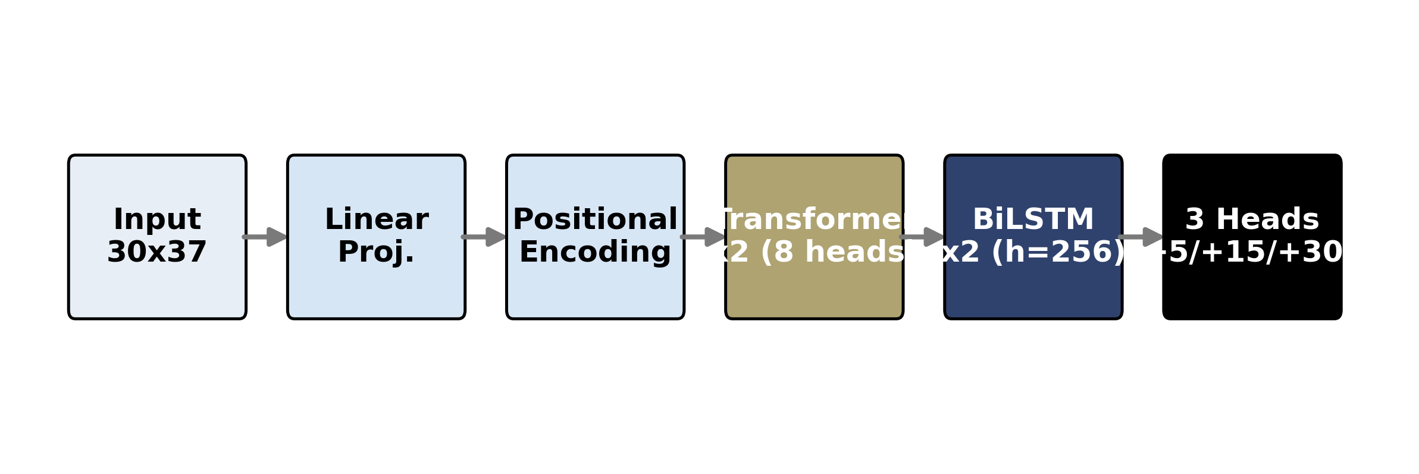
Architecture
Block diagram: input 30×37 → projection → Transformer ×2 → BiLSTM ×2 → 3 heads.

Slide 11
4 · Results (Run 15)

Slide 12
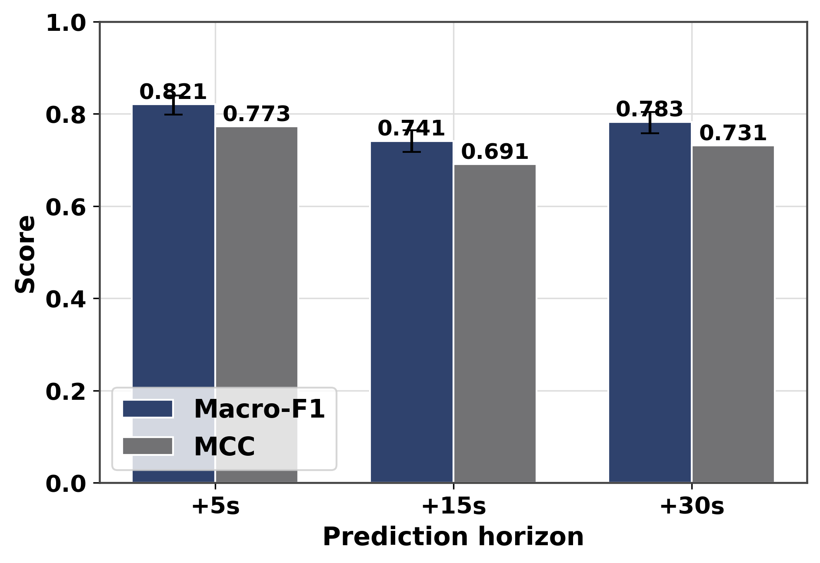
Multi-horizon performance
Macro-F1 and MCC at +5/+15/+30 s with 95% bootstrap confidence intervals.

Slide 13
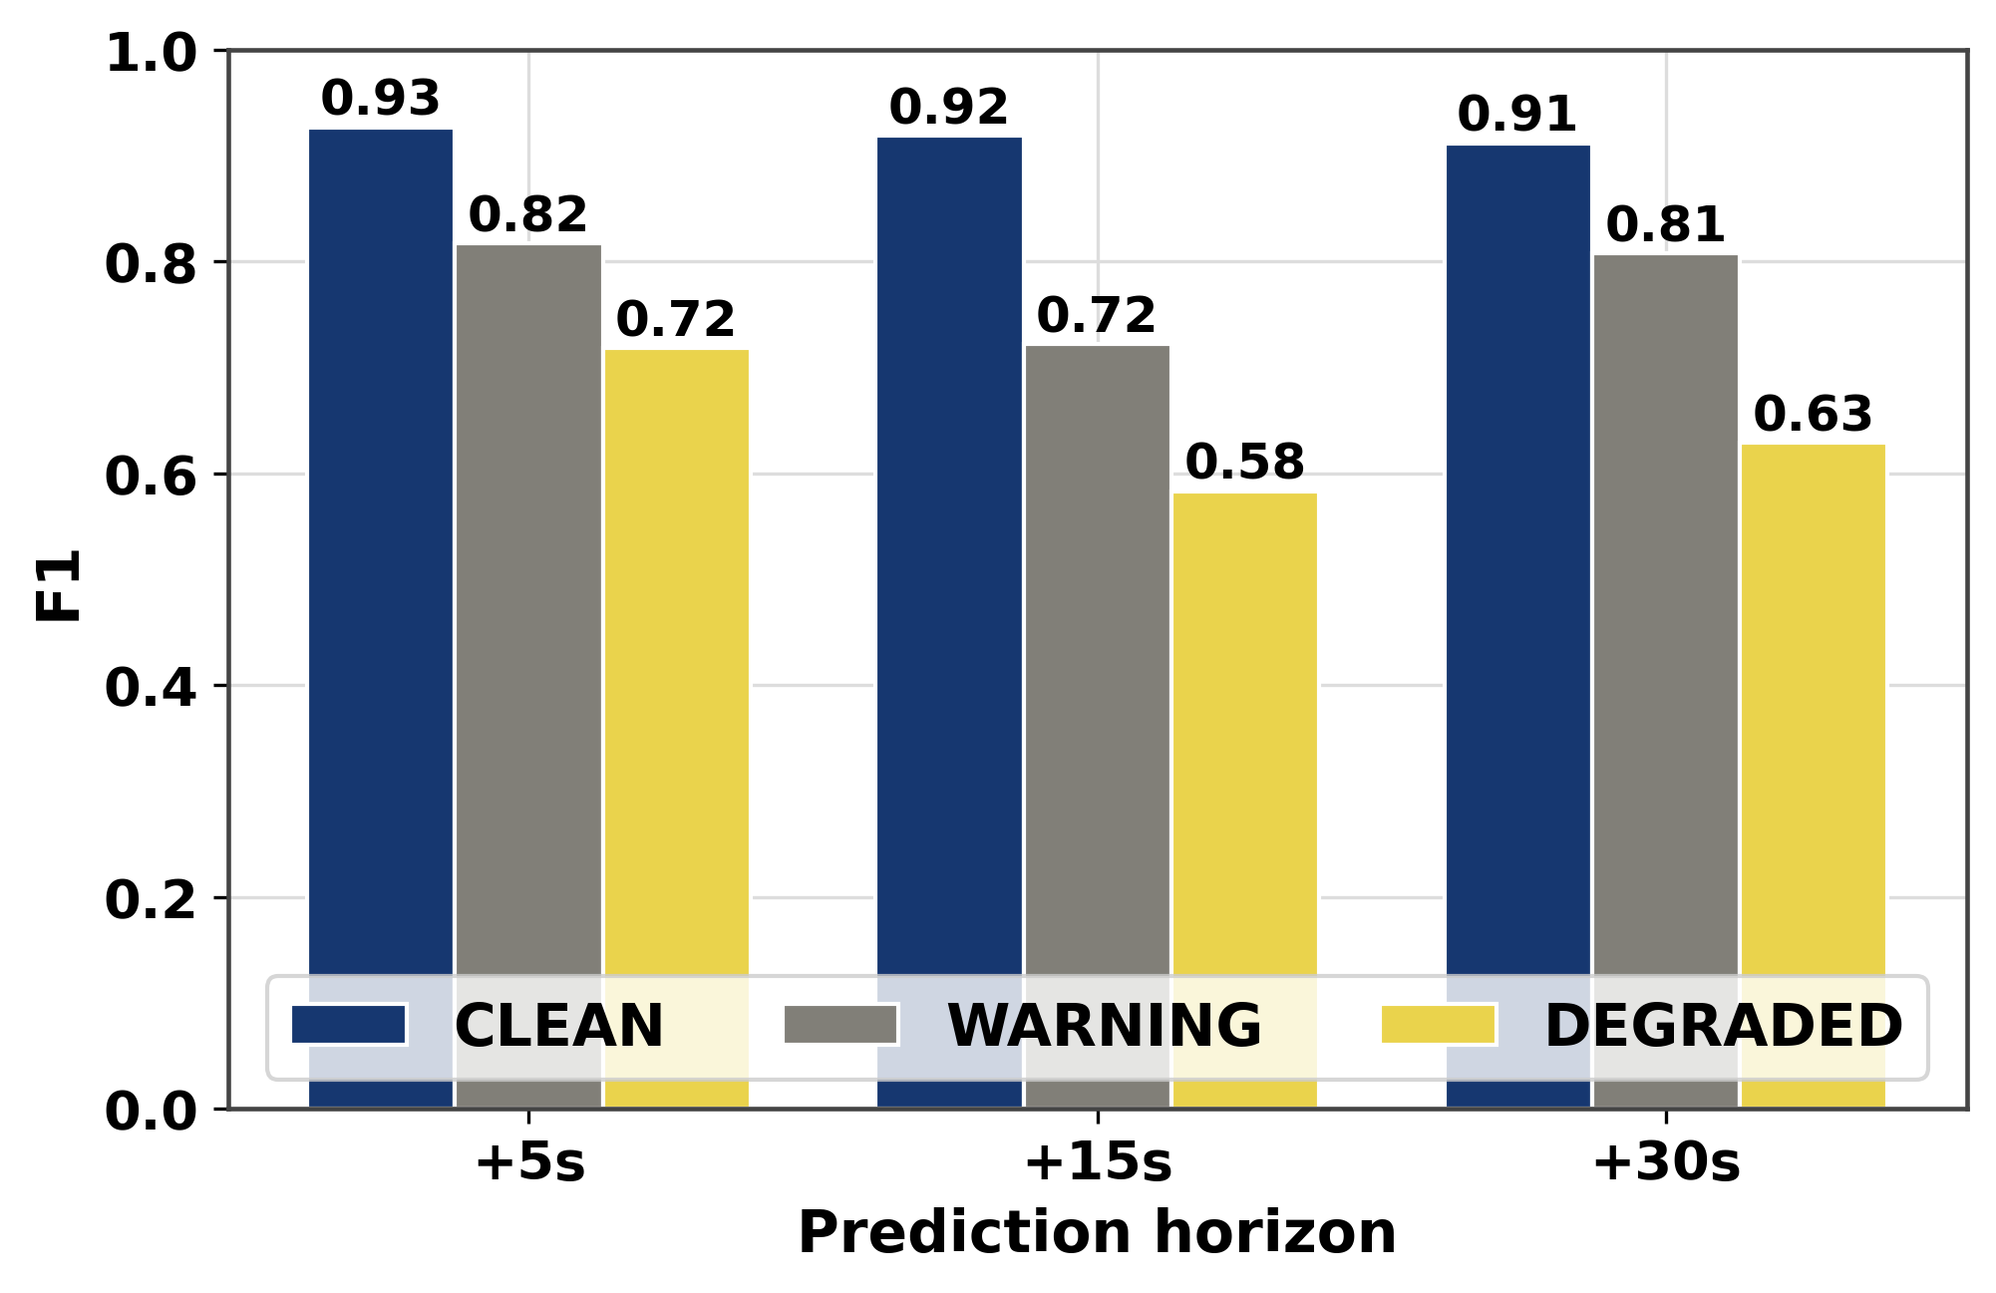
Per-class metrics at +5 s
Per-class F1 across horizons; DEGRADED (safety-critical) shown with recall.

Slide 14
Headline: multi-horizon prediction
Horizon | Accuracy | Macro-F1 | MCC | 95% CI (Macro-F1)
+5 s | 0.854 | 0.821 | 0.773 | [0.800, 0.843]
+15 s | 0.789 | 0.741 | 0.691 | [0.717, 0.764]
+30 s | 0.830 | 0.783 | 0.731 | [0.758, 0.804]
DEGRADED recall = 0.85 at +5 s. DEGRADED F1 improved 0.274 → 0.718 across runs (2.6×).

Slide 15
Per-class performance at +5 s
Class | Precision | Recall | F1 | Support
CLEAN | 0.868 | 0.993 | 0.927 | 731
WARNING | 0.947 | 0.718 | 0.817 | 746
DEGRADED | 0.623 | 0.847 | 0.718 | 209
High recall on the safety-critical DEGRADED class is the priority for an AV system.

Slide 16
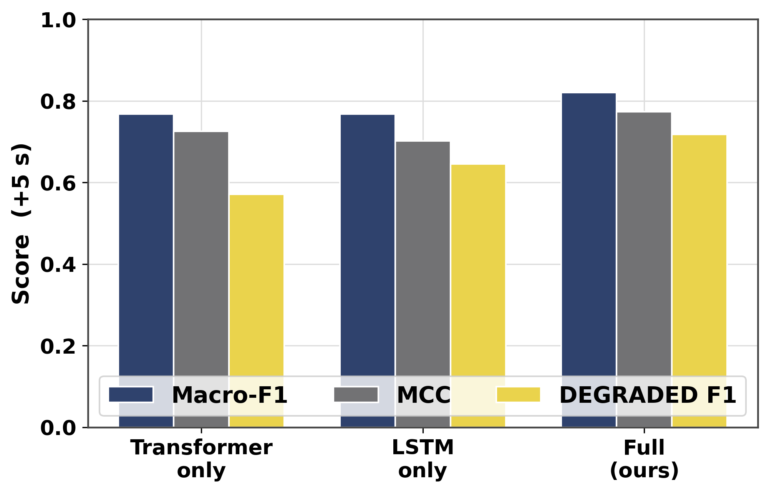
Ablation — component contribution
Full vs LSTM-only vs Transformer-only; full model wins on all metrics.

Slide 17
KEY RESULT — cross-city generalisation (Tokyo, never seen)
Model | Beihang/Beijing | Tokyo | Tokyo DEGRADED F1
DL + XGBoost ENSEMBLE | 0.911 | 0.892 | 0.896
SENTINEL-GNSS (DL) | 0.822 | 0.649 | 0.753
XGBoost | 0.919 | 0.821 | 0.784
RandomForest | 0.926 | 0.618 | 0.148
In-domain trees win. Cross-city, a DL+XGBoost ENSEMBLE beats every single model (DEGRADED 0.90); RandomForest collapses (0.15) but XGBoost transfers. Ensemble = the deployment choice feeding the EKF.

Slide 18
Efficiency, ensemble & calibration
• Cross-city: DL+XGBoost ensemble is best (Macro-F1 0.892, DEGRADED 0.896).
• Inference: 0.045 ms/sample on GPU — ~9.5x faster than three separate tree models.
• One 17.8 MB checkpoint serves all three horizons; real-time at 10 Hz.
• Calibration: temperature scaling cuts ECE 40% (0.114 -> 0.069); not yet <0.05 (future work).
• Persistence baseline scores 0.91 at +5s -> the model's value is transitions + longer horizons.

Slide 19
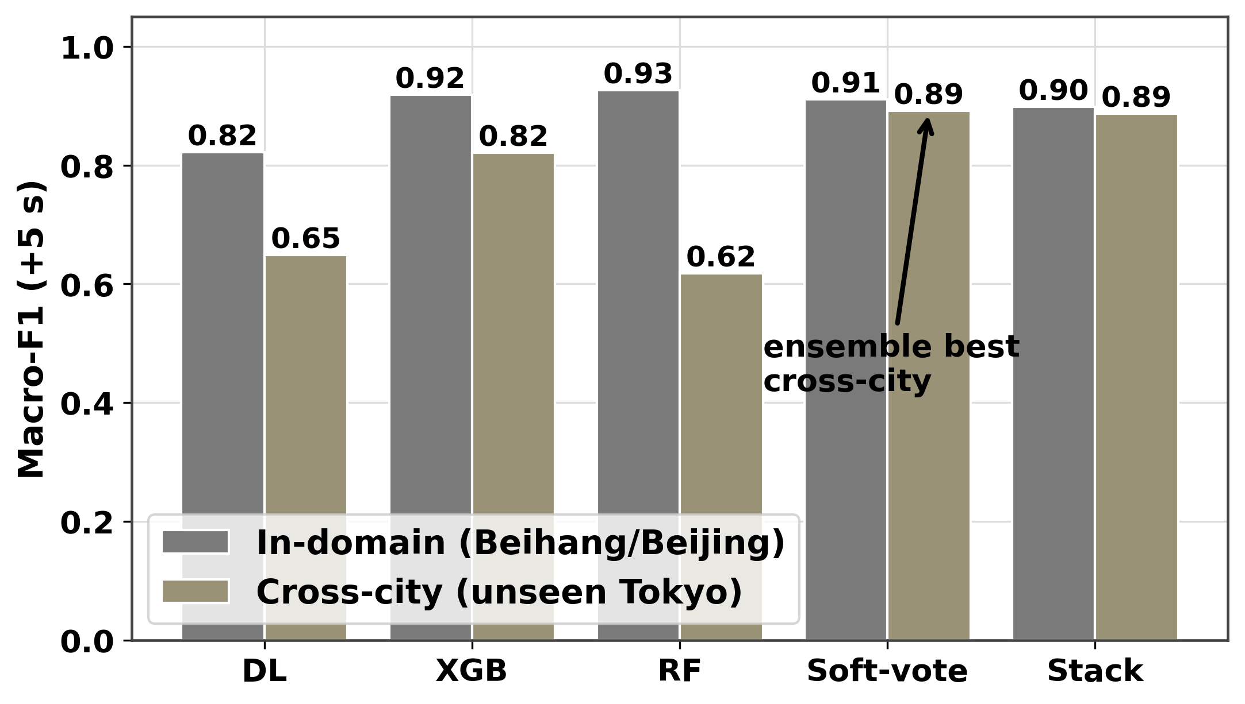
Ensemble wins cross-city
In-domain vs cross-city (Tokyo): DL+XGBoost soft-vote beats every single model.

Slide 20
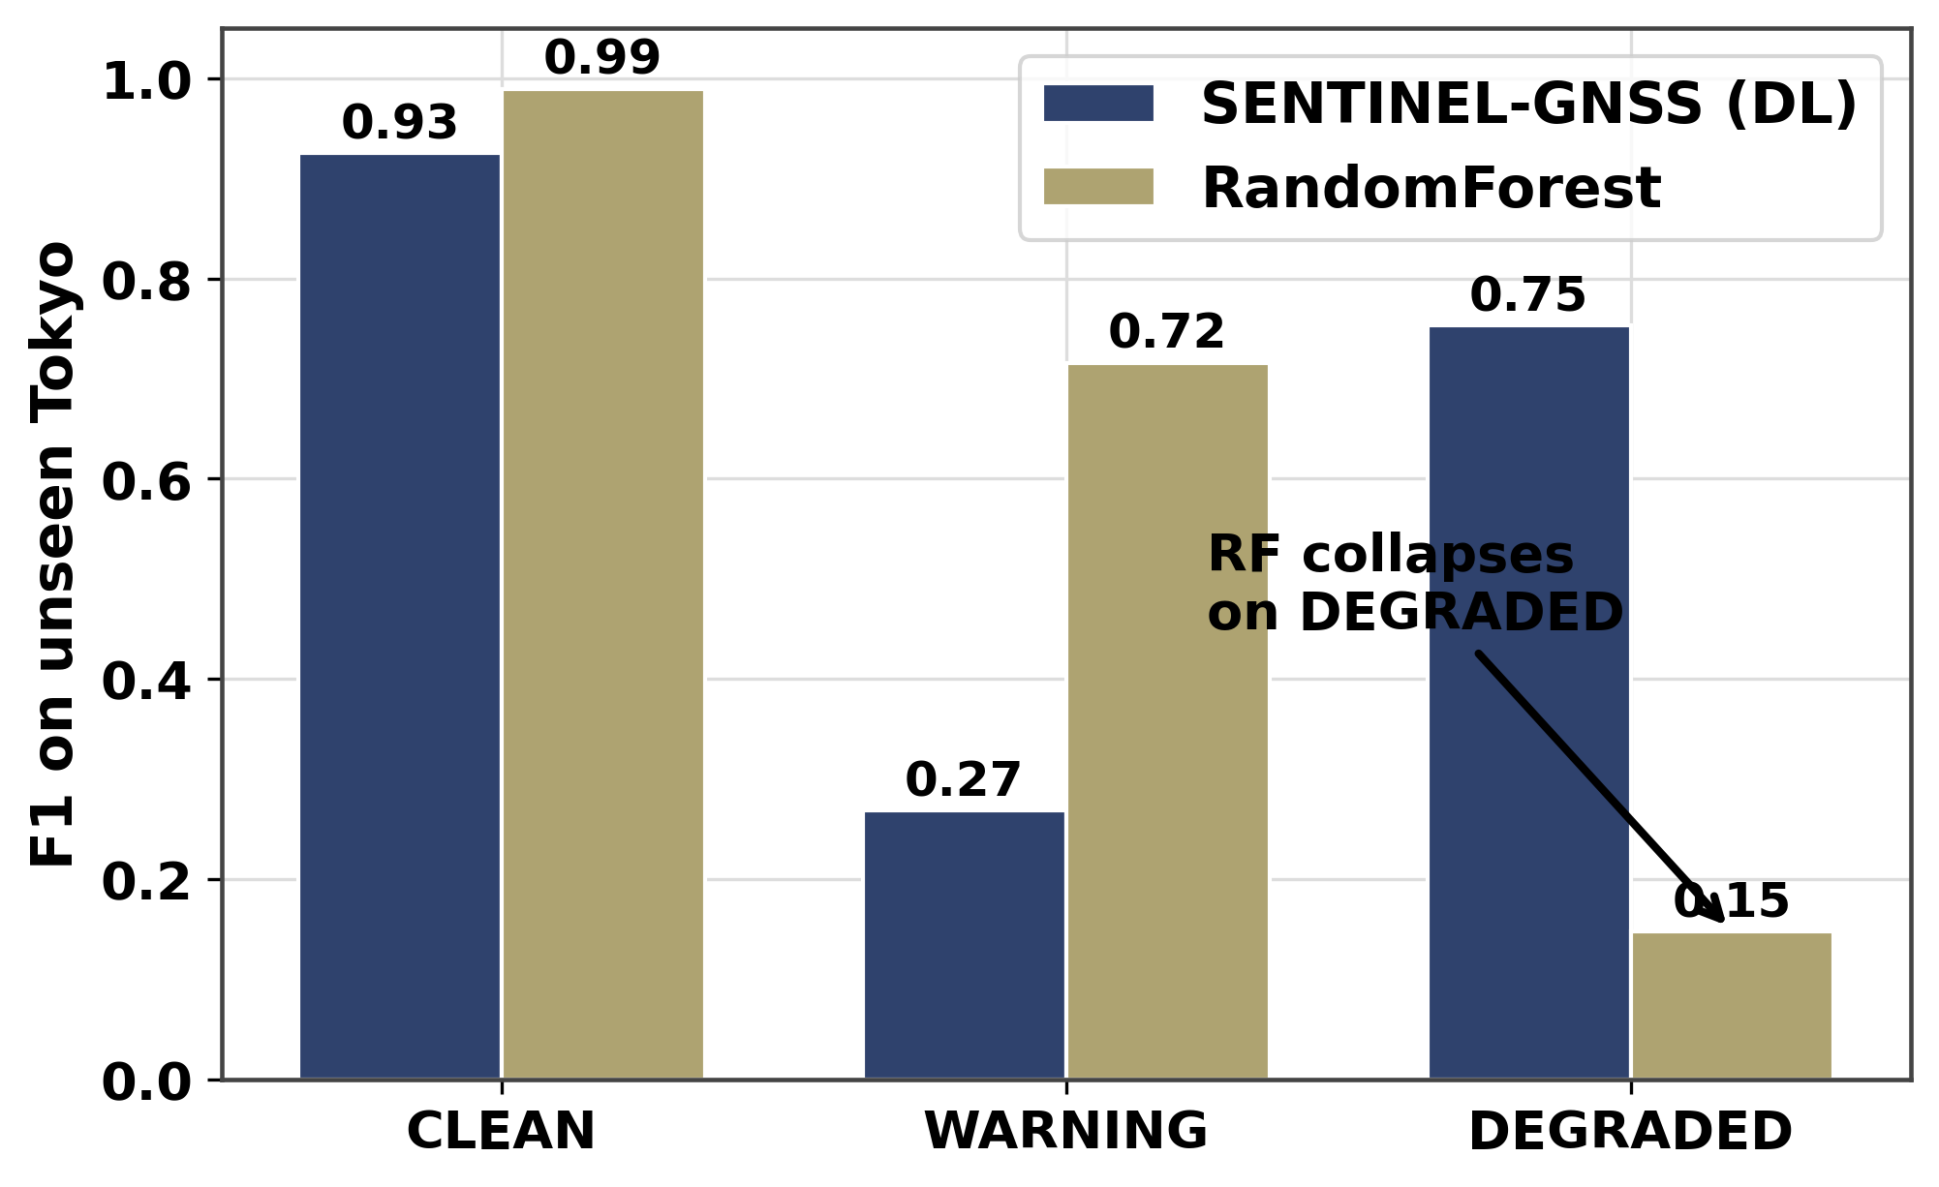
Cross-city generalization
RandomForest collapses cross-city (DEGRADED 0.15); XGBoost transfers (0.78); DL (0.75).

Slide 21
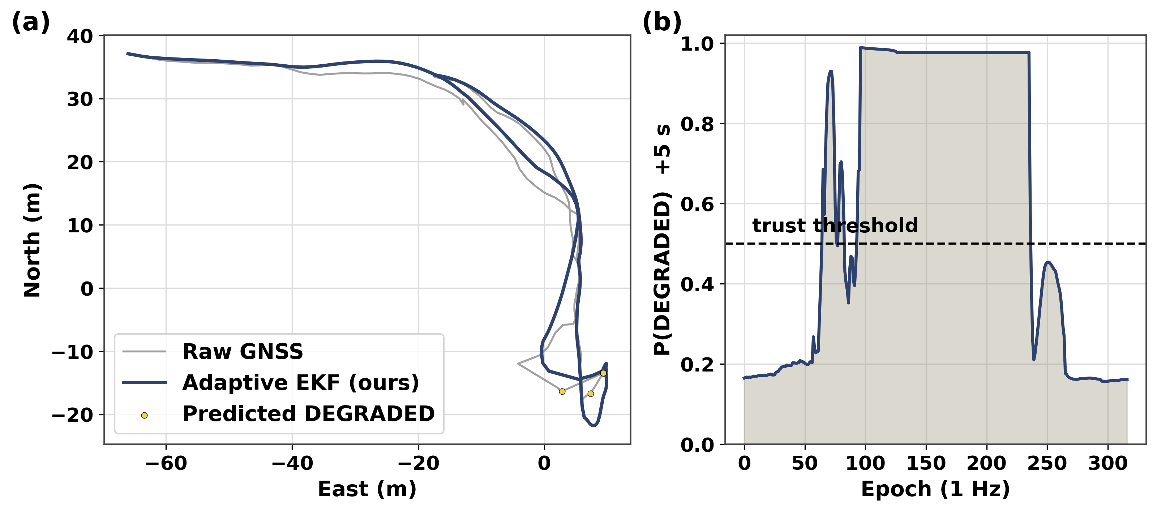
Real-data EKF case study
Raw GNSS trajectory vs adaptive EKF on real Beihang field NMEA; P(DEGRADED) predictions.

Slide 22
5 · Novelty & Validation

Slide 23
What is genuinely new
• 1. Reactive → proactive: first multi-horizon GNSS degradation PREDICTOR.
• 2. Cross-city: DL+XGBoost ensemble best (DEGRADED 0.90); RandomForest collapses (0.15), XGBoost transfers.
• 3. Unified multi-horizon model — one pass, three horizons, ~9.5x faster.
• 4. Multi-city, multi-receiver open benchmark (149,662 epochs, reproducible).
• 5. Hardware-aware design — explicit receiver-tier conditioning across 9+ receivers.

Slide 24
How we defend it to reviewers (honest narrative)
• "Trees beat you in-domain" -> true; cross-city a DL+XGBoost ensemble wins (0.892), one model option ~9.5x faster.
• "Does the Transformer use time?" → order adds ~3% (permutation test); the win is representation transfer, not order modelling.
• "Small DEGRADED test set" → bootstrap 95% CIs on every per-class metric.
• "Data leakage?" → session-level split; scaler/SMOTE on train only; Tokyo fully held out.
• We lead with generalisation + efficiency, not an in-domain leaderboard score.

Slide 25
5.5 · EKF: From Prediction to Position

Slide 26
How EKF Works: Predict-Update Cycle
• Extended Kalman Filter fuses two sources of information:
• 1. GNSS position measurement (noisy, but absolute positioning)
• 2. Motion model (dead-reckoning via velocity, but drifts over time)
• The EKF pre-emptively adapts its trust in GNSS based on predicted degradation:
• • When P(DEGRADED) is high → inflate measurement noise R → lean on motion model
• • When P(DEGRADED) is low → normal R → use GNSS to correct drift
• Result: smoother trajectory during blockage, faster recovery when GNSS returns.

Slide 27
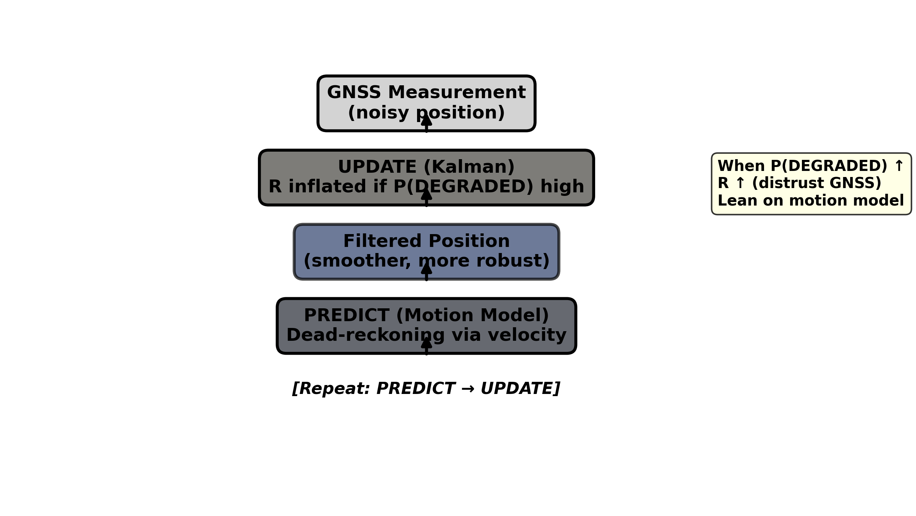
EKF Mechanism: Predict-Update Cycle
EKF architecture: GNSS measurement + adaptive noise R + motion model prediction.

Slide 28
Synthetic Blockage Validation (Option A)
• Controlled scenario: 300-epoch trajectory with simulated GNSS blockage (epochs 120–180).
• Predictor (our model) warns from epoch 115, allowing EKF to adapt early (proactive).
• Results on blockage segment (epochs 120–180):
• • Raw GNSS position RMSE: 54.4 m (noisy)
• • Fixed-R EKF: 45.6 m (standard filter, constant trust)
• • Adaptive EKF (ours): 36.0 m (-33.8% vs raw GNSS)
• Key insight: Prediction-aware filter outperforms fixed filter by 21% on the same GNSS data.

Slide 29
Synthetic Blockage Results
[ INSERT FIGURE ] fig20_ekf_option_a_synthetic.png
Trajectory during blockage: raw GNSS (noisy) vs. fixed-R EKF vs. adaptive EKF (ours). (drop in results/figures/fig20_ekf_option_a_synthetic.png)

Slide 30
6 · Roadmap & Deliverables

Slide 31
Publication plan — 2 papers + 1 conference
• Paper A (GPS Solutions, Q1): method + multi-horizon + cross-receiver + cross-city + EKF.
• Paper B (Scientific Data / Data in Brief): the benchmark / dataset descriptor.
• Conference (ION GNSS+ 2026): cross-city result as a short paper, later extended.
• Two substantial papers avoid salami-slicing and carry more impact than four thin ones.

Slide 32
6 · Future Work & Deployment

Slide 33
Real-data EKF: from simulation to deployed navigation (Option B, Phase 2a)
• Why UrbanNav Tokyo for validation?
• • UrbanNav provides cm-level ground truth (SPAN-INS post-processed trajectory in reference.csv)
• • Real GNSS data with actual urban blockage events (not synthetic)
• • Real IMU data (accelerometer + gyro) for 9-state EKF integration
• • Unseen city (cross-city test) — same as our model validation
• What we'll do:
• 1. Parse rover GNSS (RINEX) → single-point positions
• 2. Parse IMU (imu.csv) and reference trajectory (reference.csv)
• 3. Run 9-state EKF (IMU-driven prediction, GNSS update) with adaptive R
• 4. Compute real RMSE gain (expected: 15–30% during actual blockage)
• Result: honest real-world validation (no synthetic assumptions).

Slide 34
Ensemble model deployment & inference pipeline
• Save trained XGBoost model (joblib) during training for reproducibility.
• inference.py supports --ensemble flag: load DL + XGB, soft-vote probabilities.
• End-to-end: NMEA stream → features → P(DEGRADED) +5/15/30s → EKF trajectory.
• Real-time capable: 0.045 ms/sample on GPU; 10 Hz stream at <1% CPU.
• Phase 2b: raw per-satellite C/N₀ streams; +60s horizon retraining.

Slide 35
Web dashboard (Next.js + FastAPI)
• Real-time monitor: C/N₀, DOP, sat count + live 3-horizon prediction bars.
• Route map (Mapbox): colour-coded predicted signal quality along the planned path.
• Prediction timeline with lead-time annotations; attention heatmap for interpretability.
• DL-vs-baseline comparison; dataset explorer (149k epochs); metrics/performance board.
• Phase 2: integrate actual vehicle IMU; Kalman-filter fusion visualization.

Slide 36
Publication & reproducibility
• Paper A (GPS Solutions, Q1): method + multi-horizon + cross-receiver + cross-city.
• Paper B (Journal of Navigation): model comparison → ensemble selection → EKF integration.
• Conference (ION GNSS+ 2026): cross-city generalization result as a systems paper.
• Data + code release: GitHub + Zenodo (reproducible; citable DOI).
• All results / figures / models in results/ (zipped & versioned).

Slide 37
Thank you
SENTINEL-GNSS — predicting GNSS degradation before it happens
Team Pilot Project · Beihang University
github.com/Jorshuare/AI-Based-Prediction-for-GNSS-Signal-Degradation

