Slide 1
AI-Based Prediction of GNSS Signal
Degradation for Autonomous Driving
A Pilot Study
S/N | Name | Student ID
1 | Ojerinde Joel Segun | LS2525253
2 | Mustapha Ibrahim Ishola | LS2525238
3 | Ogunlade Joshua Oluwaseun | LS2525237
4 | Ingeriyinkindi Claudine | LS2525236
5 | Rashid Md Harun Or | LS2525219
Supervisor: Dr. Ahmed Wasiu

Slide 2
Presentation Outline
1 | Problem Statement & Motivation
2 | Why Prediction, Not Detection?
3 | Our Contributions
4 | Data Sources & Collection Strategy
5 | Data Processing Pipeline
6 | Feature Engineering
7 | System Architecture
8 | AI Model Design — Transformer-LSTM
9 | Training Protocol & Class Imbalance Handling
10 | Evaluation Strategy & Datasets
11 | Results Overview
12 | Real-Time Monitoring Interface
13 | Sensor Fusion Adaptation (Dynamic EKF)
14 | Novelty Claims
15 | Team Responsibilities
16 | Project Timeline (Milestones)
17 | Anticipated Challenges & Mitigations
18 | Real-World Impact
19 | Conclusion & Future Work
20 | Q&A

Slide 3
Problem Statement
GNSS is the primary positioning source for autonomous vehicles. Yet it fails—predictably and frequently.
Urban Canyons
Tunnels & Underpasses
Atmospheric Effects
Tall buildings block or reflect satellite signals, causing multipath errors and signal loss in densely built environments.
Complete signal blockage causes instantaneous position loss. Reactive systems detect failure too late to plan a safe response.
Ionospheric and tropospheric disturbances degrade range accuracy across wide areas, particularly during daytime and equatorial conditions.
Current systems detect degradation after it occurs — autonomous vehicles need advance warning to respond safely.

Slide 4
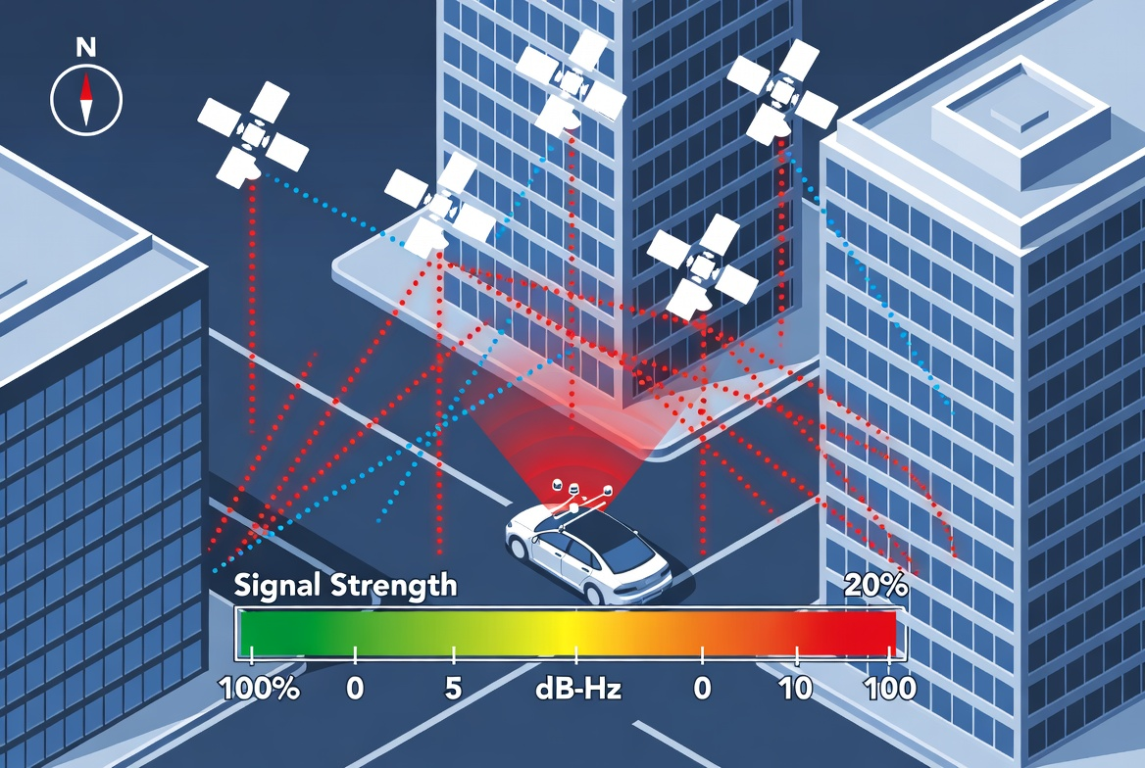
Problem Statement

Slide 5
Why Prediction, Not Detection?
Reactive vs. Proactive Navigation Response
REACTIVE SYSTEM (Current State of Practice)
Signal OK
Degradation
Occurs
System
Detects
Response
(Too Late)
PROPOSED SYSTEM (Proactive — This Work)
Signal OK
Model Predicts
30s Ahead
Sensor Weights
Adjusted
Smooth
Navigation
At 60 km/h, a 30-second prediction window provides 500 metres of advance notice — enough for safe, graduated navigation adjustment.

Slide 6
Our Contributions
1
Multi-Horizon Simultaneous Prediction
Predict GNSS degradation at 5 s, 15 s, and 30 s simultaneously from a single forward pass — enabling graduated autonomous vehicle response.
2
Cross-Satellite Attention Mechanism
A Transformer encoder learns relationships between satellites in real time — the first application of cross-satellite attention to GNSS quality prediction.
3
Multi-Platform, Cross-Geography Generalisation
Trained on vehicle, drone, and cart data; tested without retraining on public datasets from Hong Kong (UrbanNav) and Korea (KAIST).
4
Proactive Sensor Fusion Adaptation
A dynamic EKF adjusts GNSS observation noise covariance before degradation arrives, based on the model's prediction output.

Slide 7
Data Sources
Three complementary data platforms — supervisor-provided and self-collected
Ground Vehicle
Drone / UAV
Survey Cart
Urban / Suburban · 0–80 km/h
Aerial · 0–20 m/s
Pedestrian · Campus routes
ROSBAG format
Multipath from buildings
Tunnel & underpass blockage
Primary AV context
ROSBAG / RINEX
Open-sky clean baseline
Healthy signal reference
Processed via RTKLIB
Self-collected (5 scenarios)
Controlled degradation events
Fully repeatable routes
RINEX output
✔ Data acquired
✔ Data acquired
Data to be acquired
Public Validation Datasets: UrbanNav (Hong Kong) ✔ · KAIST Urban (Korea) — awaiting delivery · Oxford RobotCar ✔ · NCLT Michigan ✔

Slide 8
Data Collection — 5 Controlled Scenarios
Each scenario isolates one degradation type, producing a scientifically labelled dataset.
A
Open Sky → Complete Blockage
Carpark → underground entrance. Captures rapid satellite count drop from 10+ to 0–4.
B
Urban Canyon Multipath
Narrow corridor between buildings. Captures carrier phase noise on low-elevation satellites without full signal loss.
C
Partial Obstruction (Foliage)
Tree canopy / covered walkway. Captures intermittent, stochastic signal degradation.
D
Open Sky Baseline
Open field with unobstructed 360° sky view. Provides the CLEAN class reference for the classifier.
E
Gradual Degradation Transition
Walk toward building face; captures satellite count dropping one at a time — directly trains the pre-degradation ramp-up period.

Slide 9
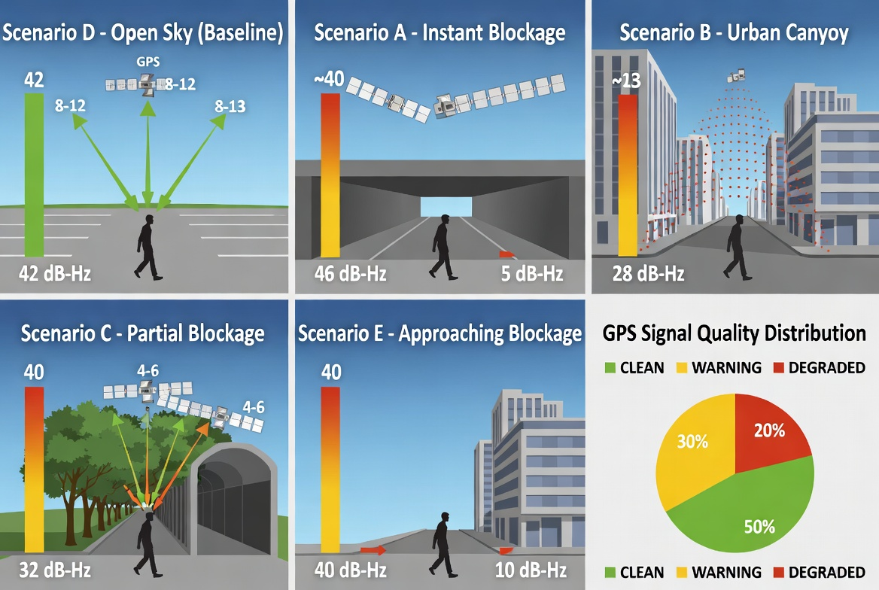
Data Collection — 5 Controlled Scenarios

Slide 10
Data Processing Pipeline
All platforms pass through the same six-step pipeline — ensuring model learns signal physics, not processing artefacts.
1
ROSBAG Extraction
Python script extracts GNSS topics (/fix, /gnss) from .bag files → CSV with timestamps, position, SNR per satellite.
2
RINEX Conversion
RTKCONV converts all sources to RINEX 3.x observation format — the universal standard.
3
RTKLIB Post-Processing
RTKPOST applies IGS precise orbits, Saastamoinen troposphere, Klobuchar ionosphere models → high-accuracy reference positions.
4
Ground-Truth Labelling
Three classes per epoch — CLEAN (error <2m, C/N0 >35 dB-Hz), WARNING, DEGRADED (error >5m or C/N0 <30 dB-Hz or SV count <4).
5
Feature Extraction
35 features per epoch. Z-score normalised on training data only. Sliding 30-second window → predict at 5s, 15s, 30s ahead.
6
Dataset Assembly
Temporal train/val/test split (70/15/15). Public datasets reserved for cross-geography evaluation only.

Slide 11
Feature Engineering — 35 Input Variables
All features computed per epoch (1 Hz) from RTKLIB output — no additional hardware required.
Signal Quality (8 features)
Mean & minimum C/N0 across satellites · Std deviation & rate of change of C/N0 · Mean carrier-phase lock time · Cycle slip event count per epoch
Satellite Geometry (8 features)
Visible satellite count, GDOP, PDOP, HDOP, VDOP · Elevation angles (lowest & mean) · Sky coverage ratio across 8 azimuth sectors
Pseudorange & Carrier Phase (6 features)
Pseudorange residual mean & std deviation · Multipath indicator (code-carrier divergence) · Cycle slip count, carrier phase residual RMS
Positioning Solution (4 features)
Horizontal & vertical positioning error · Solution type (no-fix / single / float / fixed) · Epochs since last fixed RTK solution
Environmental & Platform Context (9 features)
Platform speed (Doppler), heading (degrees) · Time of day, day of year (ionosphere proxies) · Estimated sky obstruction index from 3D map

Slide 12
System Architecture — Five-Layer Pipeline
Raw GNSS signals enter at Layer 1 — reliable autonomous navigation decisions emerge at Layer 5.
L1
Multi-Platform Data Acquisition
Vehicle (ROSBAG) · Drone (ROSBAG/RINEX) · Cart (RINEX)
L2
Raw Data Processing Pipeline
ROSBAG extract → RINEX → RTKLIB post-processing → Feature CSV → Labelled windows
L3
AI Prediction Engine
Transformer-LSTM: 30 s input window → 5 s / 15 s / 30 s degradation probability output
L4
Sensor Fusion Adaptation
Dynamic EKF: GNSS noise covariance R scaled by model's 5 s degradation probability P_deg
L5
Real-Time Monitoring Interface
Python Dash / React · 5 panels · 1 Hz update · < 100 ms end-to-end latency

Slide 13
AI Model — Transformer-LSTM Hybrid
Input shape: (batch, 30 timesteps, 35 features) → Three simultaneous output heads
Input
(30 × 35)
Transformer
Encoder
4 heads · d=64
2 layers
LSTM
Decoder
2 layers
hidden=128
Output Heads
5s · 15s · 30s
3-class softmax
Key Architectural Choices
Why Transformer?
Multi-head attention learns cross-satellite relationships: blockage degrades satellites in a spatial sector simultaneously, distinguishable from single-satellite multipath.
Why LSTM Decoder?
Sequential context capture; translates Transformer output into per-horizon degradation probability vectors efficiently.
Why 3 Horizons?
30 s → sensor weight adjustment | 15 s → route planning update | 5 s → emergency navigation response. All from a single forward pass.

Slide 14
Training Protocol & Class Imbalance Handling
Critical design decisions that prevent naive high accuracy while achieving meaningful degradation detection.
Temporal Data Splits (never random shuffle — adjacent epochs are correlated)
Split | Proportion | Purpose
Training | 70% | Earliest data — all platforms, all scenarios
Validation | 15% | Middle time period — hyperparameter tuning & early stopping
Test | 15% | Most recent data — untouched until final evaluation
Cross-geo | 100% UrbanNav + KAIST | Never used in training — proves geographic generalisation
Class Imbalance Handling (~80% CLEAN / 15% WARNING / 5% DEGRADED)
1
Focal Loss
Mathematically down-weights easy (clean) examples and focuses training gradient on hard (degraded) examples.
2
SMOTE
Generates synthetic degraded epochs by interpolating between existing degraded examples — applied to training set only.
3
Class-Weighted Loss
Multiplies loss for degraded class by a weight inversely proportional to its frequency (×20 if 5% of data).

Slide 15
Evaluation Strategy & Metrics
Four generalisation test types — in-distribution, cross-platform, cross-environment, cross-geography.
Metric | Why It Matters
Macro F1-Score | Balanced measure — prevents gaming by focussing only on majority class
Precision (per class) | Cost of false alarms — alerting system when signal is actually fine
Recall (per class) | Cost of missing a degradation event — safety-critical, must be high
AUC-ROC | Threshold-independent — shows full range of operating points
Prediction Lead Time (seconds) | Primary real-world value metric — more lead time = safer response
Navigation RMSE reduction (%) | Proves system improves actual navigation, not just classification accuracy
Baseline Models for Comparison
Threshold-based SNR alarm (simplest possible baseline — no temporal modelling)
Random Forest on hand-crafted features (classic ML, no temporal modelling)
Single LSTM without attention (removes the Transformer; shows attention adds value)
GNSS RAIM (industry standard for detecting existing signal faults; beating its lead time is a key result)

Slide 16
Ablation Studies — Every Component Earns Its Place
Reviewers specifically look for ablations as evidence of rigorous scientific methodology.
Ablation | What Is Removed | What It Proves
No attention (LSTM only) | Transformer encoder → simple LSTM | Cross-satellite attention adds predictive value
Single-horizon (5 s only) | 15 s and 30 s output heads | Multi-horizon output improves overall performance
Geometry features only | All signal quality features (C/N0, SNR) | Raw signal measurements are necessary, not just geometry
Vehicle data only | Drone and cart data excluded from training | Multi-platform training improves generalisation
No SMOTE / focal loss | Standard cross-entropy, no oversampling | Class imbalance handling is essential
All ablations evaluated on the held-out test set. Results reported with 95% confidence intervals from 5-fold cross-validation.
Generalisation Test Protocol
Train on vehicle + drone → Test on cart | Train on urban data → Test on suburban | Test on UrbanNav (HK) + KAIST (KR) without retraining | Train on Month 1 → Test on Month 2

Slide 17
Real-Time Monitoring Interface
Five display panels · Python Dash / React · 1 Hz update · < 100 ms end-to-end latency
P1
Live Navigation Map
Scrolling map centred on current position. GPS track colour-coded: green (clean), amber (warning), red (degraded). Position marker pulses on alert.
P2
Signal Quality Monitor
Scrolling time series of mean C/N0 (threshold 30 dB-Hz), satellite count (min 4), PDOP (max 6). Individual satellite C/N0 shown as background traces.
P3
AI Prediction Display
Three semicircular gauges (5 s, 15 s, 30 s) showing degradation probability 0–100%. Status banner: NOMINAL / CAUTION / ALERT.
P4
Satellite Sky Plot
Azimuth/elevation plot. Satellite points colour-coded by C/N0 (green >40 dB-Hz, amber 30–40, red <30). Blockage visually obvious as satellites disappear from azimuth sectors.
P5
Sensor Fusion Status
Horizontal stacked bar: GNSS % | IMU %. GNSS bar shrinks in real time as degradation probability rises. Shows the system is acting on its prediction.

Slide 18
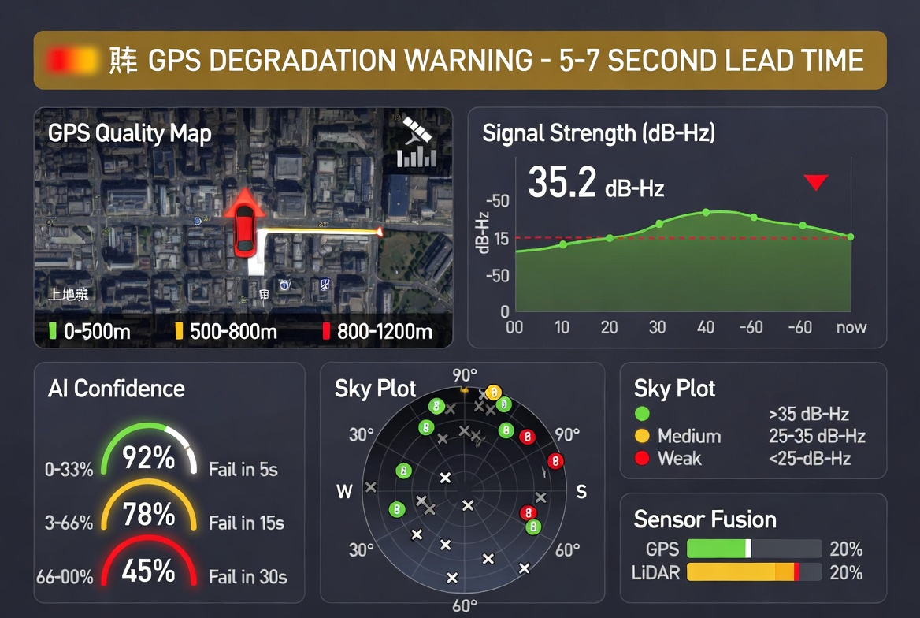
Real-Time Monitoring Interface

Slide 19
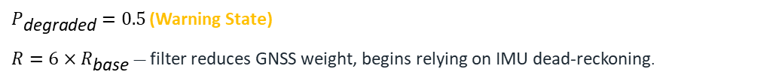
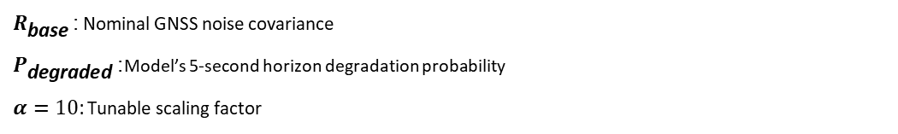
Sensor Fusion Adaptation — Dynamic EKF
Standard EKF uses fixed GNSS noise covariance. Our system adapts it proactively using the model's prediction output.
$$R=R_{\text{base}}×\left(1+α⋅P_{\text{degraded}}\right)$$
$R_{\text{base}}$: Nominal GNSS noise covariance
$P_{\text{degraded}}$: Model’s 5-second horizon degradation probability
$α=10$: Tunable scaling factor
$P_{\text{degraded}}=0.0$(clean signal)
$R=R_{\text{base}}$ — filter behaves normally. GNSS fully trusted.
$P_{\text{degraded}}=0.5$ (Warning State)
$R=6×R_{\text{base}}$ — filter reduces GNSS weight, begins relying on IMU dead-reckoning.
$P_{\text{degraded}}=0.9$ (near-certain degradation)
$R=10×R_{\text{base}}$ — filter relies almost entirely on IMU. Transition completed before degradation reaches positioning.
This is what makes the system complete: the AI prediction directly closes the loop into the navigation stack.

Slide 20
Novelty Claims
N1
Multi-Horizon Simultaneous Prediction
Existing work predicts single-step ahead (typically 1 second). We simultaneously predict at 5 s, 15 s, and 30 s from a single forward pass — enabling graduated autonomous response.
N2
Cross-Satellite Attention Mechanism
No published GNSS degradation prediction paper explicitly models relationships between satellites simultaneously. Our Transformer attention weights are interpretable evidence of model decisions.
N3
Multi-Platform Training for Generalisation
All published papers train and test on a single platform type. We train across three platforms and demonstrate cross-platform and cross-geography generalisation on public datasets.
N4
Proactive Sensor Fusion Adaptation
Existing sensor fusion detects GNSS degradation after it occurs, then reacts. Our EKF increases GNSS noise covariance before degradation affects positioning — the first demonstrated proactive adaptation.

Slide 21
Team Responsibilities & Presentation Division
Each member owns specific components and is fully accountable for their delivery.
Member | Role | Owns / Delivers
Rashid Md Harun Or (LS2525219) | Literature & Baseline Lead | Literature review, baseline models (threshold, RF, LSTM, RAIM), related work analysis
Ingeriyinkindi Claudine (LS2525236) | Data Collection & Evaluation Lead | Cart GNSS collection (Scenarios A–E), evaluation metrics, results tables, public dataset processing
Ogunlade Joshua (LS2525237) | Data & Processing Lead | ROSBAG extraction, RTKLIB pipeline, feature extraction code, dataset labelling & QC
Mustapha Ibrahim (LS2525238) | System & EKF Lead | Real-time dashboard (all 5 panels), dynamic EKF implementation, live system testing & video
Ojerinde Joel Segun (LS2525253) | AI & Integration Lead (Lead Author) | Transformer-LSTM architecture, training pipeline, ablation studies, generalization testing, integration

Slide 22
Project Timeline — 4-Week Compressed Plan
1-month total · 2 concurrent coursework · Critical path: data collection (Wk 1) → model training (Wk 3) · Target: IEEE T-ITS
Week 1 · Days 1–7
Week 2 · Days 8–14
Week 3 · Days 15–21
Week 4 · Days 22–28
Setup & Data Extraction
Full Collection & Features
Model Training & System Build
Integration, Demo & Paper
All software installed · Room 3058 visit · GitHub repo created
Scenarios B, C, E collected · Feature CSVs generated · Labelling complete
Transformer-LSTM trained · First test-set results · Ablation studies done
Live campus test: cart + receiver + dashboard · Screen capture video
All
Claudine, Joshua
Joel
All
ROSBAG extraction + RTKLIB running on supervisor vehicle & drone datasets
All baseline models trained & results recorded (RF, LSTM, threshold, RAIM)
Generalisation tests on UrbanNav & RobotCar · KAIST on arrival
Paper 1 first draft written · Each member fills their sections
Joshua
Harun
Joel, Claudine
Joel leads
Scenarios A & D collected (5 reps each) · RTKLIB processed
Literature review drafted (30 papers) · UrbanNav & RobotCar processed
Dynamic EKF in simulation · Dashboard all 5 panels with data playback
Full team review · Presentation rehearsed · Submission-ready draft
Claudine, Joshua
Harun, Claudine
Mustapha
All
⚠ Risk: Scenarios A & D (Day 5–7) are the critical path — all model work depends on them. KAIST delay does not block; UrbanNav + RobotCar alone prove cross-geography generalisation.

Slide 23
Conclusion & Future Work
What We Are Building
Target Results
Future Work
Transformer-LSTM hybrid for multi-horizon GNSS degradation prediction
35-feature engineering pipeline from RTKLIB observables
Dynamic EKF that adapts sensor fusion before degradation hits
Real-time 5-panel monitoring dashboard at <100 ms latency
Macro F1 > 0.85 on in-distribution test set
Cross-geography F1 within 10% of in-distribution performance
Prediction lead time of 15–30 s ahead of positioning failure
Navigation RMSE reduction vs. GNSS-only baseline
Camera-based environmental context as additional feature group
BeiDou-specific constellation analysis for Chinese urban environments
Larger-scale multi-city urban study for broader generalisation
Paper 2: full real-time system integration and field demonstration
Thank you · Questions?

