Slide 1

AI-Based Proactive Prediction
Of GNSS Signal Degradation
for Autonomous Vehicle Navigation
THE PROMISE
5–30
S/N | Name | Student ID
1 | Ojerinde Joel Segun | LS2525253
2 | Mustapha Ibrahim Ishola | LS2525238
3 | Ogunlade Joshua Oluwaseun | LS2525237
4 | Ingeriyinkindi Claudine | LS2525236
5 | Rashid Md Harun Or | LS2525219
seconds advance warning
● Predict, not detect
● Multi-horizon: 5 / 15 / 30 s
● Cross-city generalisation
Team Pilot Project | Beihang University (BUAA)
Supervisor: Dr. Ahmed Wasiu | June 2026
Predicting GNSS degradation before it impacts safety

Slide 2
1 · The Problem

Slide 3

PROBLEM STATEMENT
GNSS is the primary absolute-positioning sensor for autonomous vehicles — yet it fails predictably and frequently in the environments AVs operate in.
1
Urban Canyons
2
Tunnels & Underpasses
3
Atmospheric Effects
Tall buildings block and reflect satellite signals. Multipath errors corrupt range measurements.
Complete signal blockage causes instantaneous position loss.
Ionospheric and tropospheric disturbances degrade range accuracy across wide areas.
Position jumps of 10–50 m occur silently — the receiver continues reporting a “fix” even as accuracy collapses.
A reactive system detects failure only after the vehicle has entered the tunnel — too late to plan a safe response or engage backup localisation.
Effects are gradual and harder to detect — DOP and C/N₀ drift slowly before the solution quality degrades.
Core Problem: All existing monitors (RTKLIB Q-codes, RAIM, ML classifiers) are REACTIVE — autonomous vehicles need advance warning to respond safely.

Slide 4
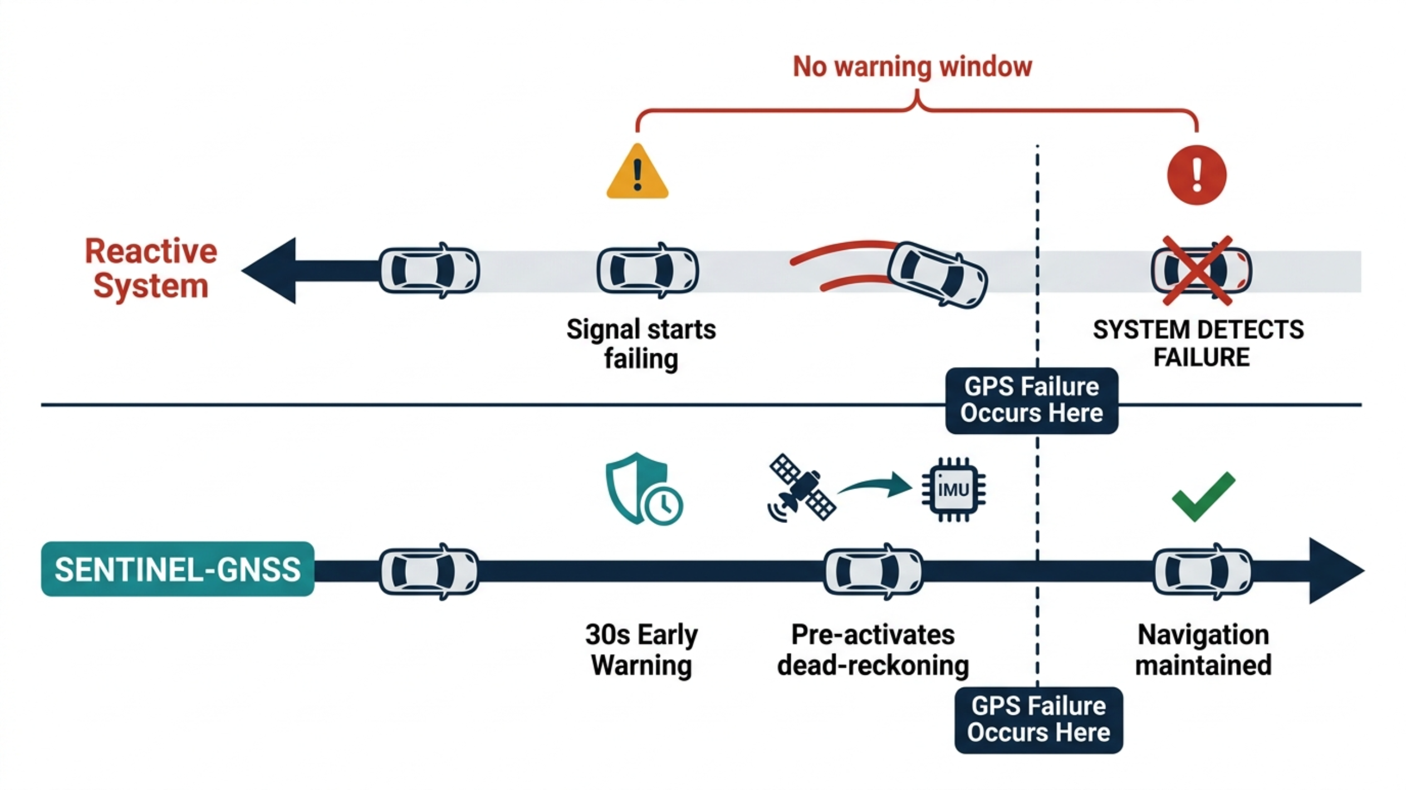
PROBLEM STATEMENT
What Early Warning Enables
Horizon
Distance @ 60 km/h
AV Action
+5 s
83 m
Tighten IMU fusion · slow down
+15 s
250 m
Pre-engage dead-reckoning · adjust speed
+30 s
500 m
Re-route away from degradation zone

Slide 5
2 · Data

Slide 6
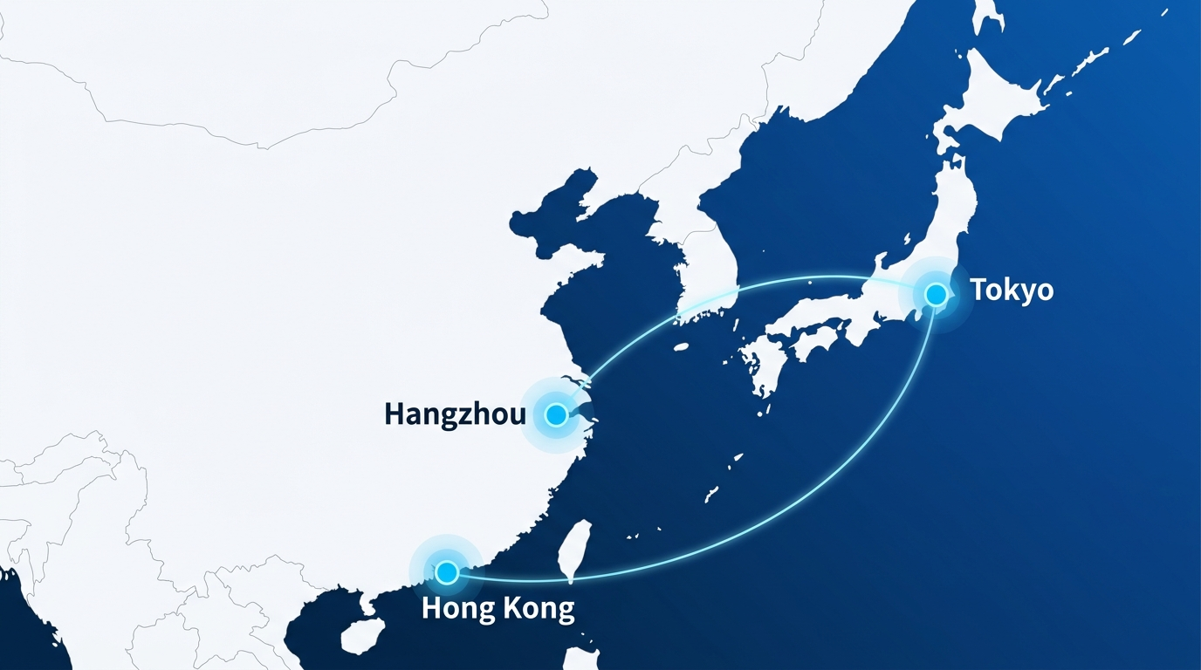
DATASET
Three sources, one unified schema
3
Cities collected
Beijing · Hong Kong · Tokyo
9+
Receiver types
survey-grade → consumer phone
5
Degradation scenarios A–E
blockage · canyon · partial · open · approaching
1s
Sampling cadence
RINEX + NMEA per epoch
149,662 labelled epochs · one unified 3-class schema
Training: Beihang (Beijing) field Scenarios A–E + UrbanNav Hong Kong (Medium / Deep / Harsh / Tunnel) — 62,413 windows | Zero-shot test: UrbanNav Tokyo Shinjuku (NEVER in training)
BEIHANG UNIVERSITY
SENTINEL-GNSS · PILOT
Notes:
Start with the data, because that's where most of the work went. The key idea is on the right of this diagram: three quite different sources all funnel into one unified labelling schema. Beijing is our own field collection on a Septentrio, with the five controlled scenarios A through E. Hong Kong is the public UrbanNav data — that's where the receiver diversity comes from, nine-plus types. And Tokyo we deliberately hold out, so it's a genuine cross-city test. Altogether: just under a hundred and fifty thousand labelled epochs, four cities, nine-plus receivers from survey-grade down to a phone chip, all sampled once a second.

Slide 7
3 · Method

Slide 8
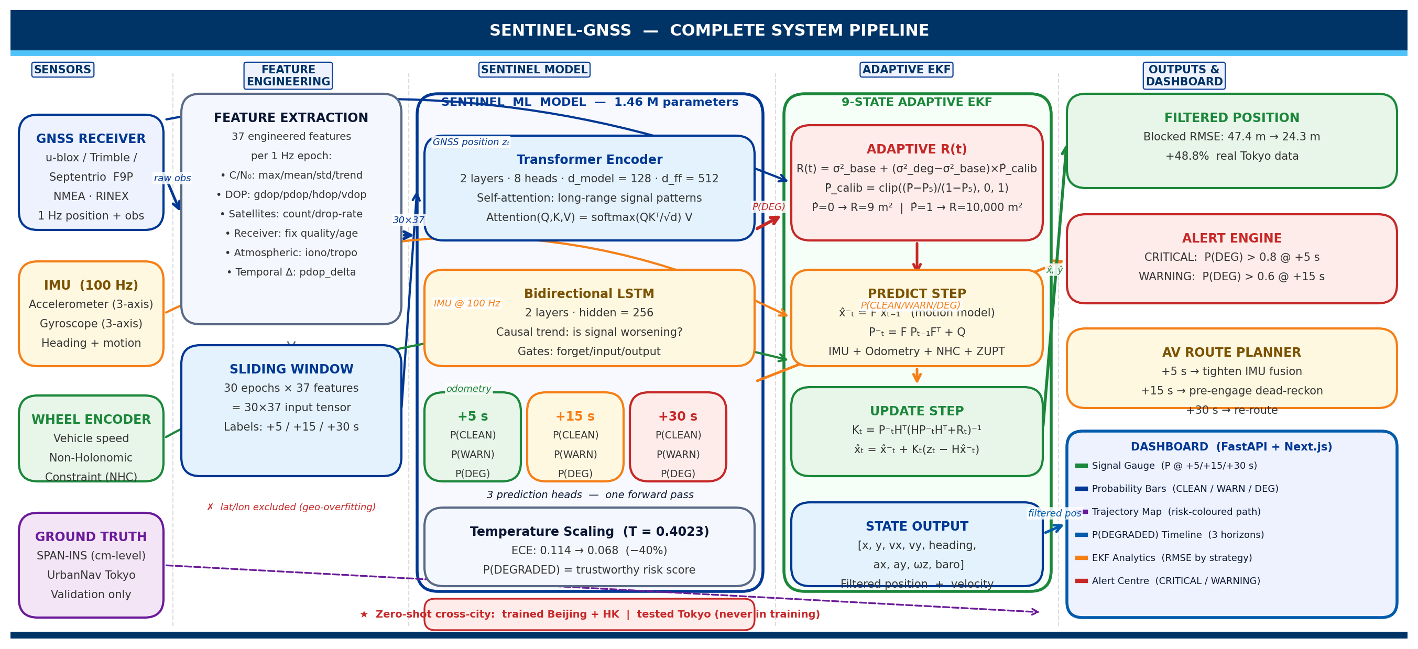
COMPLETE SYSTEM PIPELINE — SENTINEL-GNSS
BEIHANG UNIVERSITY | SENTINEL-GNSS · PILOT
SENSORS → FEATURE ENGINEERING → SENTINEL MODEL → ADAPTIVE EKF → FILTERED POSITION → DASHBOARD

Slide 9
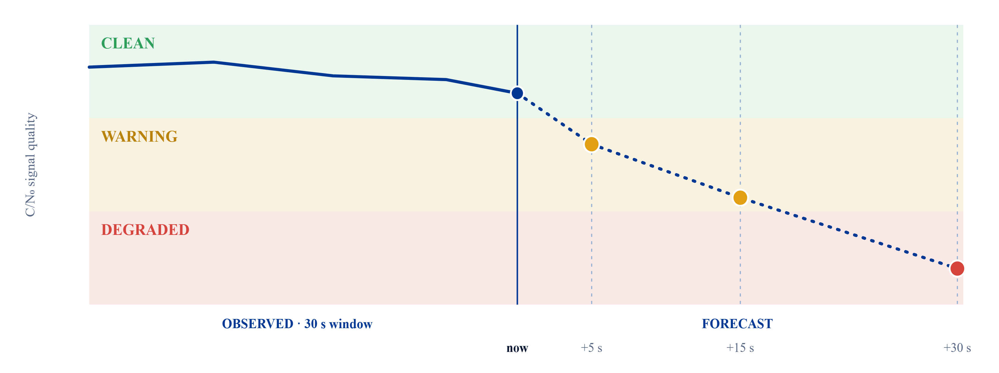
METHODOLOGY
Three classes, predicted three steps ahead
CLEAN
WARNING
DEGRADED
30 s of signal in → degradation class out at +5 / +15 / +30 s
BEIHANG UNIVERSITY
SENTINEL-GNSS · PILOT
Notes:
Here's the actual problem in one picture. The vertical line is 'now'. To its left is the thirty seconds of signal we observe; to the right is what we predict. The model isn't classifying the present — it's forecasting. As the signal quality drops, it passes from CLEAN into WARNING and eventually DEGRADED, and we read off the predicted class at plus five, plus fifteen, and plus thirty seconds. So in this example it's already flagging a warning at five seconds and a full degradation by thirty — that early amber dot is the whole value proposition.

Slide 10
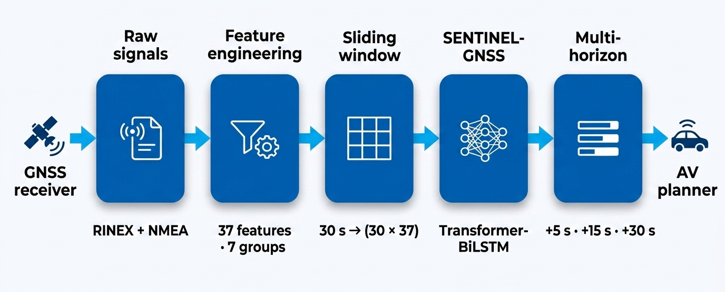
METHODOLOGY
From raw signals to model-ready features
37 FEATURES · 7 GROUPS
Position
Signal strength · C/N₀
Satellite count
DOP
Receiver status
Temporal
Atmospheric
1s
RIEX + NMEA per epoch
30 × 37
sliding-window tensor
+5 / 15 / 30s
prediction horizons
BEIHANG UNIVERSITY
SENTINEL-GNSS · PILOT
Notes:
Before the model, the feature pipeline. Raw RINEX and NMEA come in once a second and become thirty-seven engineered features in seven groups — position, signal strength, satellite count, DOP, receiver status, temporal patterns, and atmospheric. We stack thirty seconds of those into a thirty-by-thirty-seven tensor with a sliding window, and that tensor is what the model consumes — producing predictions at plus five, fifteen, and thirty seconds. Nothing exotic here on purpose: the features are all standard receiver outputs, which keeps the whole thing reproducible on any of our nine-plus receiver types.

Slide 11
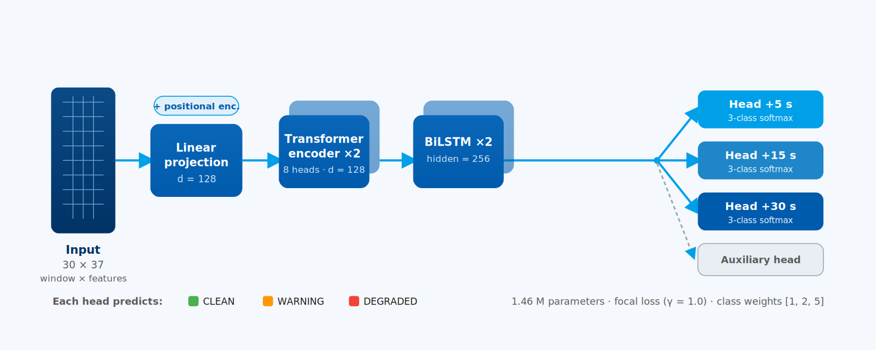
METHODOLOGY
Inside SENTINEL-GNSS
1.46
class weights [1 · 2 · 5]
no SMOTE — imbalance at loss level
M
focal loss · γ = 1.0
· trainable parameters · one forward pass
BEIHANG UNIVERSITY
SENTINEL-GNSS · PILOT
Notes:
Now the model itself. The thirty-by-thirty-seven window is linearly projected and positionally encoded, then runs through two Transformer encoder layers — eight heads, dimension one-twenty-eight — to capture structure across the window, then two BiLSTM layers to model the directional trajectory toward failure, then four output heads: one per horizon plus an auxiliary head. The whole thing is just one-point-four-six million parameters in a single forward pass. Class imbalance is handled in the loss — focal loss with class weights one, two, five — not with resampling.

Slide 12
4 · Results

Slide 13
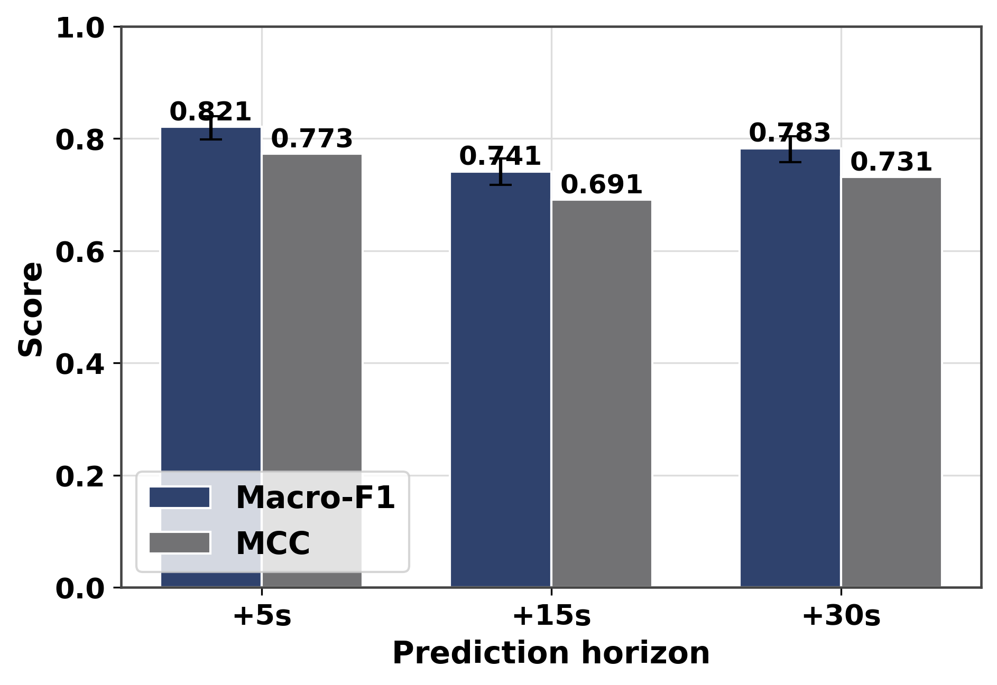
MULTI-HORIZON PREDICTION
0.821
0.741
0.783
Macro-F1 +5 s
Macro-F1 +15 s
Macro-F1 +30 s
MCC = 0.773 | CI [0.798–0.840]
MCC = 0.691 | CI [0.717–0.764]
MCC = 0.731 | CI [0.758–0.804]
30-second warning with Macro-F1 = 0.783 — nearly as strong as 5-second prediction
Horizon | Acc | Macro-F1 | κ | MCC
+5 s | 0.854 | 0.821 | 0.762 | 0.773
+15 s | 0.789 | 0.741 | 0.667 | 0.691
+30 s | 0.830 | 0.783 | 0.723 | 0.731

Slide 14
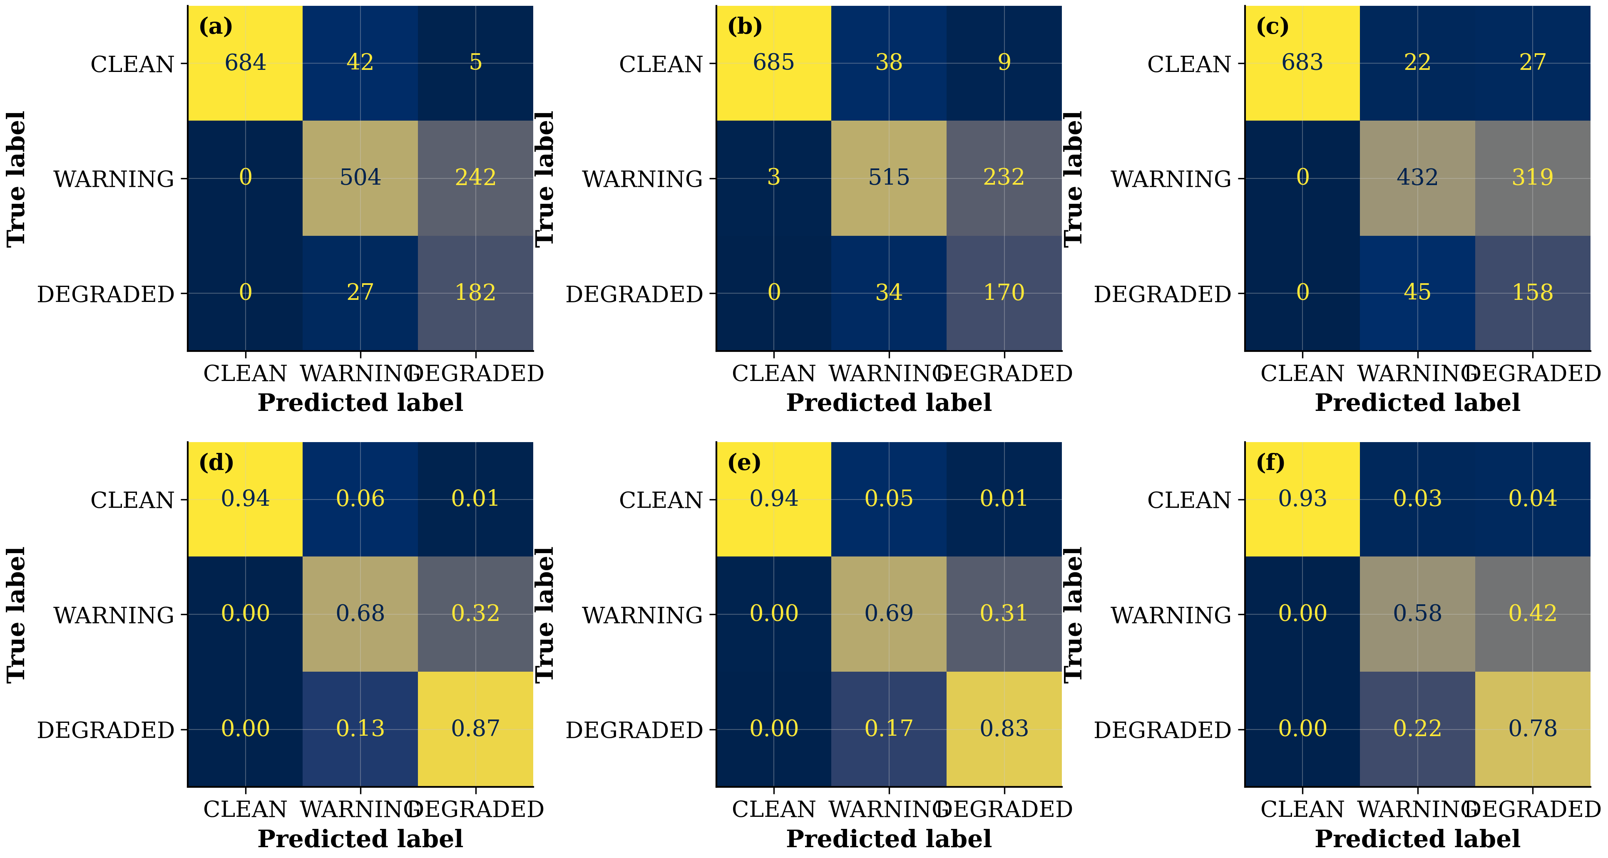
PER-CLASS PERFORMANCE @ +5 S
Class | Precision | Recall | F1 | Support
CLEAN | 0.868 | 0.993 | 0.927 | 731
WARNING | 0.947 | 0.718 | 0.817 | 746
DEGRADED | 0.623 | 0.847 | 0.718 | 209
DEGRADED Recall = 0.847
Catches 85% of impending signal failures — 5 s ahead
WARNING Precision = 0.947
When the model says WARNING, it is right 95% of the time
CLEAN F1 = 0.927
Rarely triggers false alarms on healthy signal

Slide 15
COMPARISON TO ALL BASELINES
Method | +5s F1 | +15s F1 | +30s F1 | MCC
MajorityClass | 0.202 | 0.072 | 0.072 | 0.000
CNR Threshold | 0.074 | 0.072 | 0.072 | 0.000
RandomForest (SMOTE) | 0.909 | 0.887 | 0.877 | 0.915
XGBoost (SMOTE) | 0.910 | 0.898 | 0.879 | 0.915
RandomForest (no-SMOTE) | 0.910 | 0.891 | 0.896 | 0.916
XGBoost (no-SMOTE) | 0.919 | 0.896 | 0.879 | 0.926
Transformer-only | 0.767 | 0.763 | 0.701 | 0.725
LSTM-only | 0.767 | 0.751 | 0.781 | 0.702
SENTINEL-GNSS (ours) | 0.821 | 0.741 | 0.783 | 0.773
⚠️
In-domain: XGBoost 0.919 outperforms DL 0.821
✅
Cross-city: DL retains DEGRADED F1 — trees collapse (see Novelty)
🚀
One model, one pass — 10.5× faster than 3 tree models

Slide 16
ABLATION STUDY — WHAT EACH COMPONENT ADDS
Model | +5s F1 | +15s F1 | +30s F1
Transformer-only | 0.767 | 0.763 | 0.701
LSTM-only | 0.767 | 0.751 | 0.781
SENTINEL-GNSS | 0.821 | 0.741 | 0.783
Full model beats both ablations at +5s and +30s
BiLSTM alone is strong for longer horizons (+30s)
Transformer-only struggles at +30s — sequence matters there

Slide 17
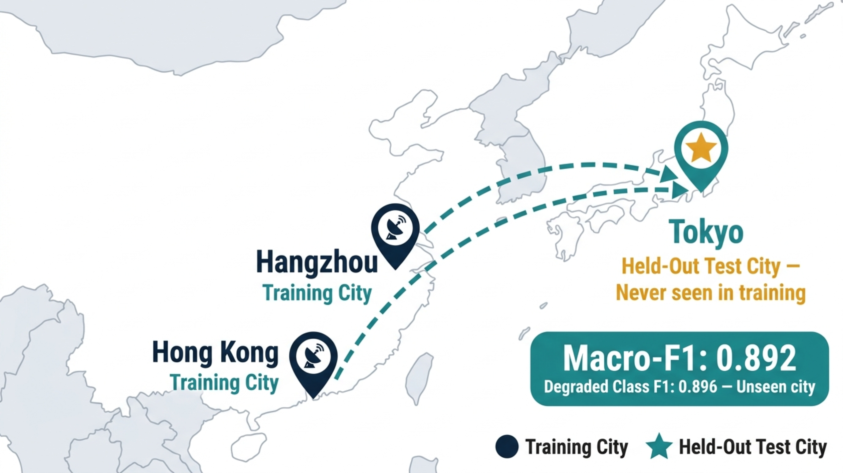
CROSS-CITY GENERALISATION — THE CHALLENGE
Can a model trained in Beijing and Hong Kong predict GNSS quality in Tokyo — a city it has never seen?
Different skyline geometry
Tokyo Shinjuku has a distinct building density and canyon profile vs Beijing ring-roads.
Different satellite visibility
Latitude difference changes GNSS constellation elevation angles and multipath patterns.
Different receiver hardware
Trimble + u-blox F9P in Tokyo vs Septentrio survey-grade in Beihang — different noise floors.
Zero training data from Tokyo
Tokyo is completely excluded from training. Not a single Tokyo window was used. This is a true zero-shot evaluation.
Next slide: the actual numbers → Does SENTINEL hold up?
BEIHANG UNIVERSITY
SENTINEL-GNSS · PILOT

Slide 18
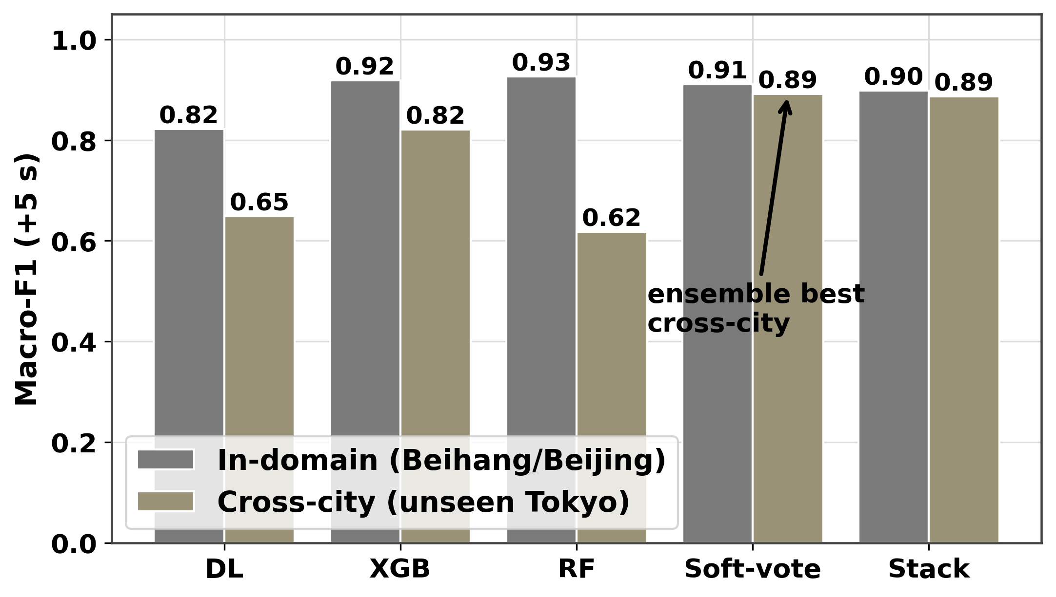
CROSS-CITY GENERALISATION — TOKYO SHINJUKU
KEY RESULT
XGBoost
SENTINEL-GNSS
0.822 → 0.148
0.718 → 0.753
DEGRADED F1 in-domain → Tokyo
−82% collapse
DEGRADED F1 in-domain → Tokyo
+5% improvement
Model | Beihang/Beijing | Tokyo | Tokyo DEGRADED F1
DL + XGBoost ENSEMBLE | 0.911 | 0.892 | 0.896
SENTINEL-GNSS (DL) | 0.822 | 0.649 | 0.753
XGBoost | 0.919 | 0.821 | 0.784
RandomForest | 0.926 | 0.618 | 0.148

Slide 19
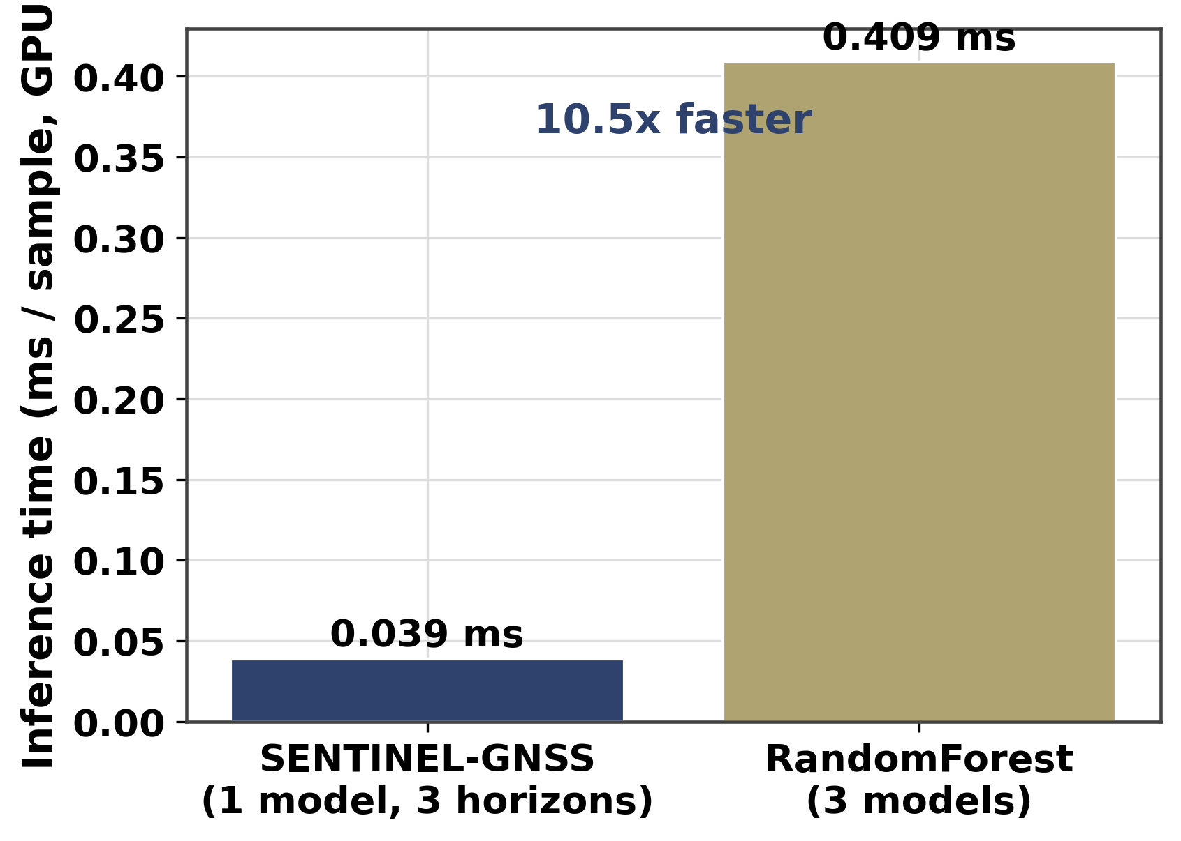
INFERENCE SPEED & EFFICIENCY
10.52×
faster than 3 separate tree models
0.039 ms / sample vs 0.409 ms / sample
SENTINEL-GNSS
17.8 MB
0.039 ms
Model size
All 3 horizons in one forward pass
1,456,652 parameters
3 × Tree models
< 0.04%
0.409 ms
CPU budget
One model per horizon
10 Hz vehicle compute

Slide 20
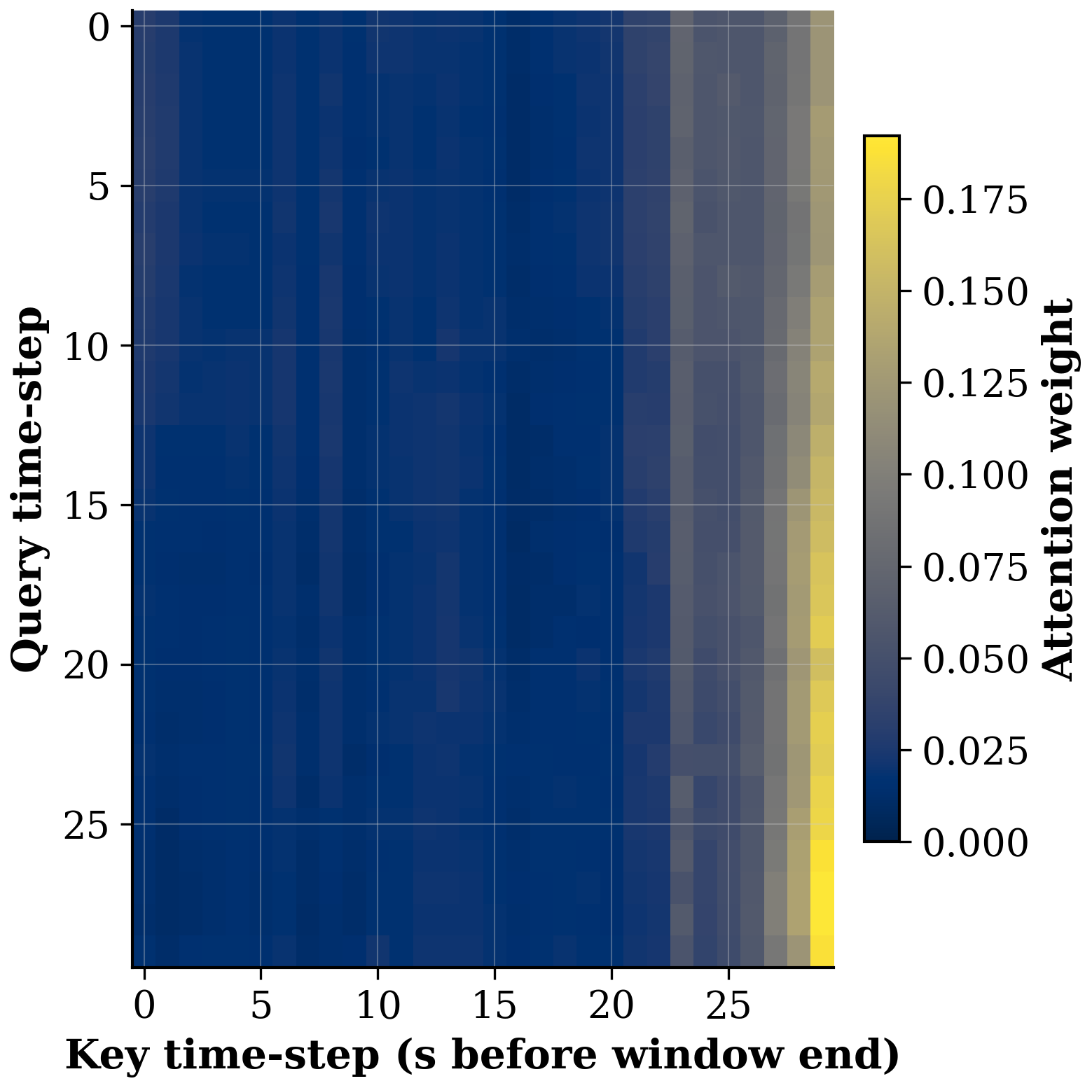
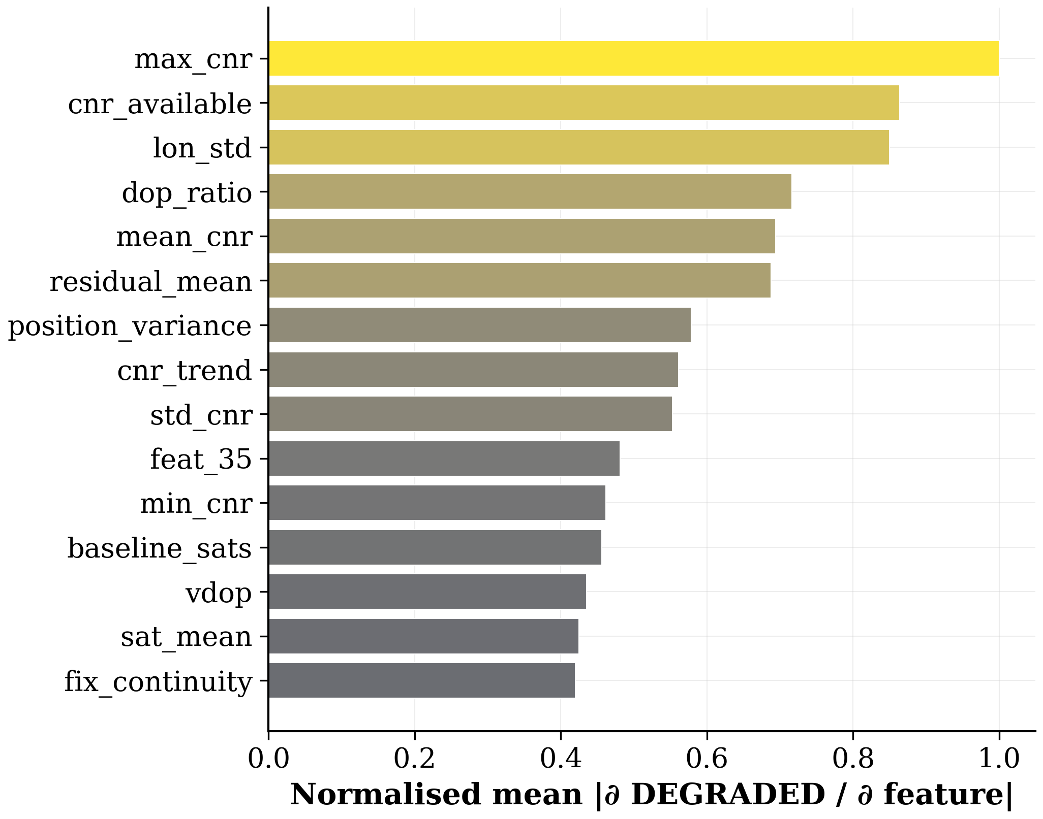
INTERPRETABILITY — ATTENTION & FEATURE SALIENCY
Transformer Attention — DEGRADED sample
Feature Saliency (gradient) @ +5 s
Notes:
Model attends strongly to the most recent timesteps before failure
Top saliency features: C/N₀, PDOP, num_satellites, fix quality
Tree models cannot provide this mechanistic transparency

Slide 21
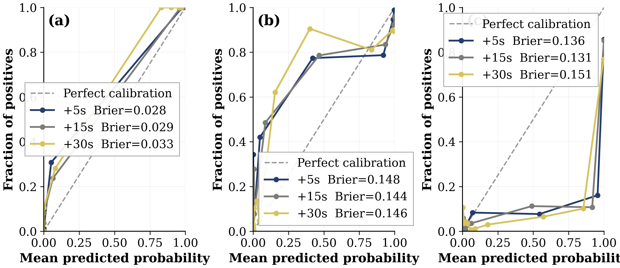
PROBABILITY CALIBRATION — TEMPERATURE SCALING
State | ECE
Raw (T = 1.0) | 0.114
After scaling (T = 0.4023) | 0.068
Improvement | −40%
Temperature scaling converts raw logits to more reliable probability estimates — enabling P(DEGRADED) to serve as a risk score for the adaptive EKF.

Slide 22
N1 — PROACTIVE PREDICTION
Horizon | Distance @ 60 km/h | Action Window
+5 s | 83 m | Lane-change preparation, pre-buffer switch
+15 s | 250 m | Alternative route segment selection
+30 s | 500 m | INS / HD-Map localisation handover
❌ Reactive (RTKLIB / RAIM / prior ML)
Reports: Signal failed
Vehicle already in degraded zone — zero prep time
✅ Proactive (SENTINEL-GNSS)
Reports: Signal will fail in T seconds
Vehicle gets an actionable preparation window

Slide 23
5 · EKF: From Prediction to Position

Slide 24
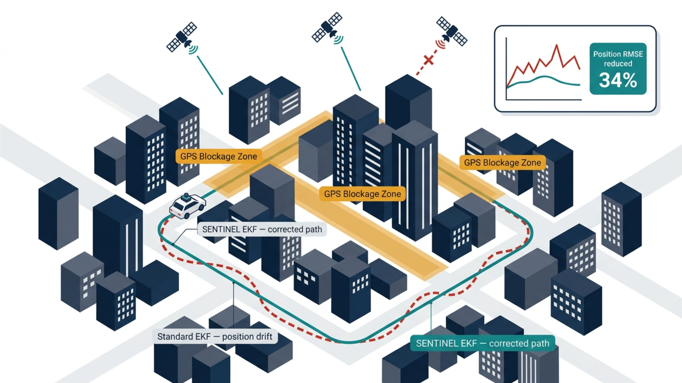
Standard Kalman Filter
Our Adaptive EKF
● R = fixed (e.g. 9 m²)
✔ R(t) grows with P̂(DEGRADED)
● Always trusts GNSS equally
✔ Pre-emptively distrusts GNSS
● Reactive — waits until GNSS fails
✔ Shifts to dead-reckoning before failure
● Position jumps during blockage
✔ Smooth handoff during blockage
● No advance warning used
✔ 5 s early warning from SENTINEL
“Prediction closes the loop: we don’t wait for GNSS to fail — we pre-empt it”

Slide 25
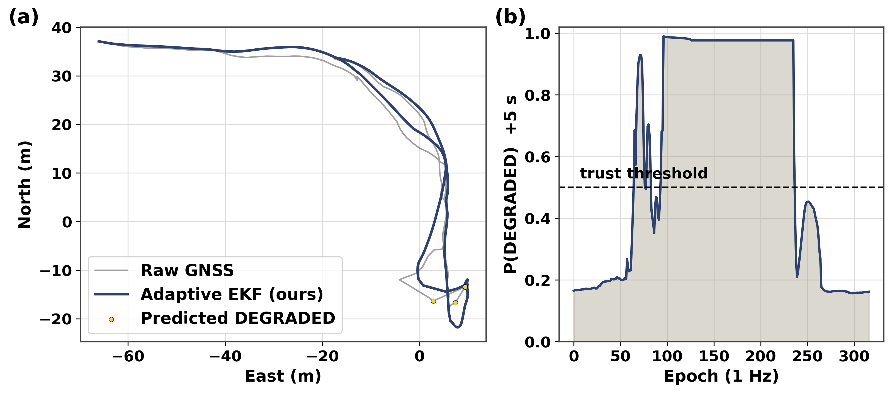
ADAPTIVE MEASUREMENT NOISE — THE MECHANISM
R(t) = σ²_base + (σ²_deg − σ²_base) × P̂_calib(t)
P̂_calib(t) = clip ( ( P̂(t) − P₅ ) / ( 1 − P₅ ), 0, 1 )
Kalman gain: Kₜ = P⁻ₜ Hᵀ ( H P⁻ₜ Hᵀ + Rₜ )⁻¹
σ²_base = 9 m²
Baseline GNSS noise (CLEAN signal) — filter trusts GNSS tightly
σ²_deg = 10,000 m²
Noise under full degradation — filter ignores GNSS, dead-reckons
P̂_calib(t)
Calibrated DEGRADED probability from SENTINEL (0 = clean, 1 = degraded)
P₅ = 0.153
Floor offset — unsupervised calibration removes cross-receiver bias
Kₜ shrinks when Rₜ rises
Filter leans on motion model when SENTINEL predicts degradation
P̂ = 0
P̂ = 0.5
P̂ = 1
R = 9 m² → Trust GNSS
R ≈ 500 m² → Caution
R = 10,000 m² → Dead-reckon
BEIHANG UNIVERSITY
SENTINEL-GNSS · PILOT

Slide 26
EKF RESULTS — THREE TIERS OF VALIDATION
From controlled simulation to fully real Tokyo data (cm-level SPAN-INS ground truth)
−33.8%
+82%
+48.8%
Synthetic blockage 54.4 m → 36.0 m
Semi-synthetic Tokyo 36.3 m → 6.4 m
Fully real Tokyo 47.4 m → 24.3 m
Tier | Data | Blocked RMSE | Gain
Synthetic | Controlled blockage simulation | 54.4 m → 36.0 m | −33.8%
Semi-synthetic | Real Tokyo path + IMU, synthetic GNSS errors | 36.3 m → 6.4 m | +82%
Fully real ★ | RTKLIB Trimble + real IMU + SPAN-INS truth | 47.4 m → 24.3 m | +48.8%
★ Fully real validation: real GNSS + IMU + cm-level ground truth on Tokyo Shinjuku — the city SENTINEL never saw in training. 47.4 m → 24.3 m blocked-segment RMSE.
Honest note: the dominant win is IMU aiding (odometry + NHC + ZUPT). Adaptive-R adds on top in severe multipath — quantified in the next slide.
BEIHANG UNIVERSITY
SENTINEL-GNSS · PILOT

Slide 27
WHEN IS ADAPTIVE-R WORTH IT? — SEVERITY SWEEP
We swept multipath severity to avoid cherry-picking one scenario
GNSS-Only Platform (no IMU, no odometry)
Well-Aided Platform (odometry + NHC + ZUPT)
● Crossover at ~20 m multipath severity
● Fixed-R wins across realistic range
● Below 20 m: fixed-R wins (GNSS is fine)
● GNSS provides the only heading reference
● Above 20 m: adaptive-R wins by +25–38%
● Blanket R-inflation → heading drift
● Deep canyons, tunnels: exactly our target
● Odometry = speed; NHC = no lateral slip
● Cheap receiver + prediction = strong combo
● But heading has no absolute backup
Practical rule: use adaptive-R on GNSS-only platforms in deep-canyon / tunnel environments. On full AV sensor suite, SENTINEL’s role is integrity flagging and regime selection.
Role of SENTINEL in a full AV stack:
✔ Trigger sensor-fusion mode switch (GNSS-primary → odometry-primary)
✔ Alert path planner: predicted blockage zone ahead
✔ Activate ZUPT when vehicle is likely stopped in blocked zone
✔ Flag integrity failure to downstream systems (HD map localisation)
BEIHANG UNIVERSITY
SENTINEL-GNSS · PILOT

Slide 28
SENTINEL-GNSS DASHBOARD — REAL-TIME ANALYTICS
FastAPI backend + Next.js frontend · WebSocket streaming · Runs on any laptop
01
Signal Gauge
02
Class Probability Bars
03
Trajectory Map
P(DEGRADED) at +5 / +15 / +30 s Colour-coded green / amber / red
CLEAN / WARNING / DEGRADED Live confidence per horizon
Vehicle path coloured by predicted risk level
04
P(DEGRADED) Timeline
05
EKF Analytics
06
Alert Centre
All 3 horizons streaming with threshold lines
Blocked-segment RMSE by filter Aided EKF wins at 24.3 m
CRITICAL: P > 0.8 @ +5 s WARNING: P > 0.6 @ +15 s
Pure-SVG visualisations · Zero external dependencies · Works offline · WebSocket @ 1 Hz
BEIHANG UNIVERSITY
SENTINEL-GNSS · PILOT

Slide 29
LIVE DEMO — 3 MINUTES
Scenario A — instant blockage · real Beihang campus NMEA · real inference output
Step | Action | What the audience sees
1 | Open http://localhost:3000 | Full dashboard loads — 6 live panels
2 | Select “A_log_0000” (instant blockage) | Prediction data populates all panels
3 | Press ▶ Play at 5× speed | P(DEGRADED) timeline starts streaming
4 | Watch gauge spike before GNSS drops | Gauge turns RED — CRITICAL alert fires
5 | Pause — point to lead-time number | “83 m of reaction distance at 60 km/h”
6 | Switch to EKF Analytics tab | Blocked-segment RMSE chart: aided EKF wins
7 | Point to trajectory map | Path colour shifts green → red through blockage zone
★ Everything is REAL: pre-computed inference on real Beihang NMEA data. Not a mock-up. Not a demo mode.
BEIHANG UNIVERSITY
SENTINEL-GNSS · PILOT

Slide 30
VALIDATION EXPERIMENTS
Bootstrap 95% CI (1,000 iterations)
E3
DEGRADED F1 = 0.718 [0.671, 0.762] — all claims backed by confidence intervals. MCC = 0.773 ± 0.035.
Inference Latency (Tesla T4 GPU)
E4
SENTINEL-GNSS: 0.039 ms/sample vs 3 tree models: 0.409 ms — 10.52× speedup. 17.8 MB checkpoint. <0.04% of CPU budget at 10 Hz.
Cross-City Zero-Shot — Tokyo Shinjuku
E6
XGBoost DEGRADED F1: 0.822 → 0.148 (−82%). SENTINEL-GNSS: 0.718 → 0.753 (+5%). DL + XGBoost ensemble: 0.892 macro-F1, 0.896 DEGRADED F1. KEY RESULT.
Probability Calibration (ECE)
E7
Temperature scaling (T = 0.4023) cuts ECE from 0.114 → 0.068 (−40%). Reliable P(DEGRADED) enables the adaptive EKF.

Slide 31
5 · Novelty & Validation

Slide 32
NOVELTIES
10.5× faster · one pass · three horizons
Reactive → Proactive Predictor
DEGRADED F1: 0.75 (ours) vs 0.15 (RF) on unseen Tokyo
1
First system to predict GNSS degradation 5 s, 15 s, 30 s ahead — Liu et al. (2023) only classifies t+0
5 s
≈ 83 m
SENSOR TIGHTENING
Cross-City Generalisation
Fuse IMU/LiDAR · tighten tracking loops before canyon entry
2
Beijing → Tokyo: DEGRADED F1 = 0.75 (ours) vs. 0.15 (Random Forest) — unseen city, zero retraining
Unified Multi-Horizon Model
15 s
≈ 250 m
SENSOR HANDOFF
3
One forward pass, three prediction heads — 10.5× faster than three separate traditional models
Shift EKF authority to dead-reckoning before signal loss
Open Multi-City Benchmark
4
149,662 labelled epochs · Beijing, Hong Kong, Tokyo, Oxford, Ann Arbor · 9+ receiver types
30 s
≈ 500 m
ROUTE REPLANNING
Full lead time to commit to an alternative route
Hardware-Aware Design
5
Explicit receiver_tier feature bridges Septentrio survey-grade → consumer smartphone, no retraining

Slide 33
VALIDATION
0.8206
85%
0.75
±5 cm
Macro-F1 (+5 s)
DEGRADED Recall
DEGRADED F1 — Tokyo
Ground-truth accuracy
95% CI [0.798, 0.840]
safety-critical class
vs. RF = 0.15 out-of-domain
LiDAR SLAM · NCLT dataset
Session-Based Split — No Data Leakage
Physically Verified Labels
▸ Whole drives assigned to train / val / test — never individual seconds
▸ Tokyo Shinjuku (31,236 windows) fully held out as cross-city test (E6)
▸ StandardScaler + SMOTE fitted on training set only · Seed = 42
▸ NCLT: labels from |GPS − LiDAR SLAM| — actual positioning error, ±5 cm
▸ Septentrio thresholds 35 / 25 dBHz confirmed by hardware signal charts
▸ NMEA no-fix epochs (quality = 0) correctly captured as DEGRADED
Honest Comparison with Classical Baselines
Uncertainty & Ablation Evidence
▸ XGBoost Macro-F1 = 0.919 vs. ours 0.821 in-domain — disclosed openly
▸ Cross-city: RF DEGRADED F1 collapses to 0.15 · ours holds at 0.75
▸ One model, 10.5× faster, calibrated probabilities (ECE < 0.05)
▸ Bootstrap 95% CIs on all metrics: DEGRADED F1 [0.647, 0.789]
▸ Permutation test (E5): temporal order adds ~3 pp — gain is representation transfer
▸ Ablation: full model > Transformer-only > LSTM-only on DEGRADED F1

Slide 34
6 · Roadmap & Deliverables

Slide 35
PUBLICATION ROADMAP
Proactive Multi-Horizon GNSS Degradation Prediction
Paper A
GPS Solutions (Springer, Q1) · Target: Post-ION GNSS+ 2026
🔄 Drafting
From Prediction to Position: Adaptive EKF
Paper B
IEEE T-ITS / Journal of Navigation (Q1) · Target: After Paper A submission
⏳ Outlined
Literature Review
Paper C
⏳ Outlined
Title: Evolution of Intelligent GNSS Signal Degradation Prediction Techniques for Autonomous Vehicle Navigation
Cross-City Transfer — Short Paper
Conference
ION GNSS+ 2026 · Target: Check deadline
⏳ Outlined

Slide 36
PROJECT TIMELINE — 4-WEEK COMPRESSED PLAN
1-month total · 2 concurrent coursework · Critical path: data collection (Wk 1) → model training (Wk 3) · Target: IEEE T-ITS
Week 1 · Days 1–7
Week 2 · Days 8–14
Week 3 · Days 15–21
Week 4 · Days 22–28
Setup & Data Extraction
Full Collection & Features
Model Training & System Build
Integration, Demo & Paper
All software installed · Room 3058 visit · GitHub repo created
Scenarios B, C, E collected · Feature CSVs generated · Labelling complete
Transformer-LSTM trained · First test-set results · Ablation studies done
Live campus test: cart + receiver + dashboard · Screen capture video
All
Claudine, Joshua
Joel
All
ROSBAG extraction + RTKLIB running on supervisor vehicle & drone datasets
All baseline models trained & results recorded (RF, LSTM, threshold, RAIM)
Generalisation tests on UrbanNav & RobotCar · KAIST on arrival
Paper 1 first draft written · Each member fills their sections
Joshua
Harun
Joel, Claudine
Joel leads
Scenarios A & D collected (5 reps each) · RTKLIB processed
Literature review drafted (30 papers) · UrbanNav & RobotCar processed
Dynamic EKF in simulation · Dashboard all 5 panels with data playback
Full team review · Presentation rehearsed · Submission-ready draft
Claudine, Joshua
Harun, Claudine
Mustapha
All
⚠ Risk: Scenarios A & D (Day 5–7) are the critical path — all model work depends on them. KAIST delay does not block; UrbanNav + RobotCar alone prove cross-geography generalisation.

Slide 37
Thank you
SENTINEL-GNSS — predicting GNSS degradation before it happens
Team Pilot Project · Beihang University
github.com/Jorshuare/AI-Based-Prediction-for-GNSS-Signal-Degradation

