Slide 1


Integration of an Extended Kalman Filter
into the SENTINEL-GNSS Project
Degradation-Aware GNSS / IMU Sensor Fusion for Urban Autonomous Driving
Team Pilot Project · Beihang University · June 2026

Slide 2
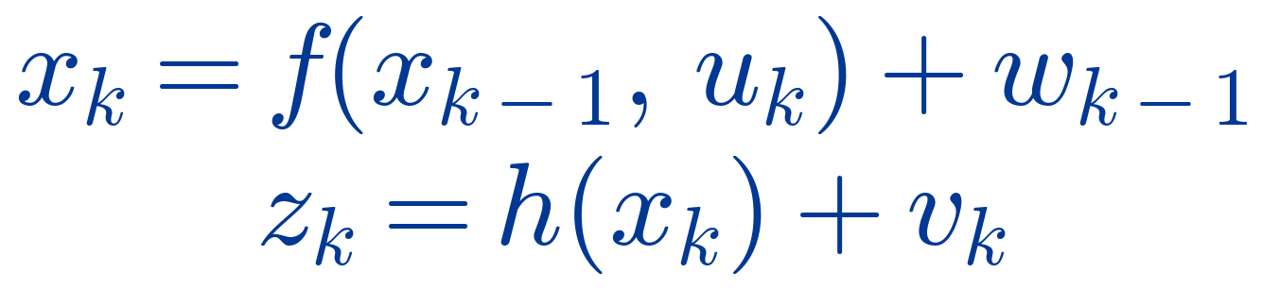
Why EKF for this Project?
Urban canyons, tunnels, multipath and NLOS break GNSS — the exact conditions SENTINEL-GNSS targets.
Continuous navigation needs sensor fusion: GNSS + IMU + odometry, not GNSS alone.
The motion model is nonlinear — body-frame IMU accelerations rotate into the navigation frame by vehicle heading.
The EKF linearizes it with Jacobians: accurate for our mild nonlinearity, fast enough for real time.
EKF over UKF for the pilot — lower compute, simpler to validate; UKF kept as an advanced comparison.
Nonlinear state-space form

Slide 3
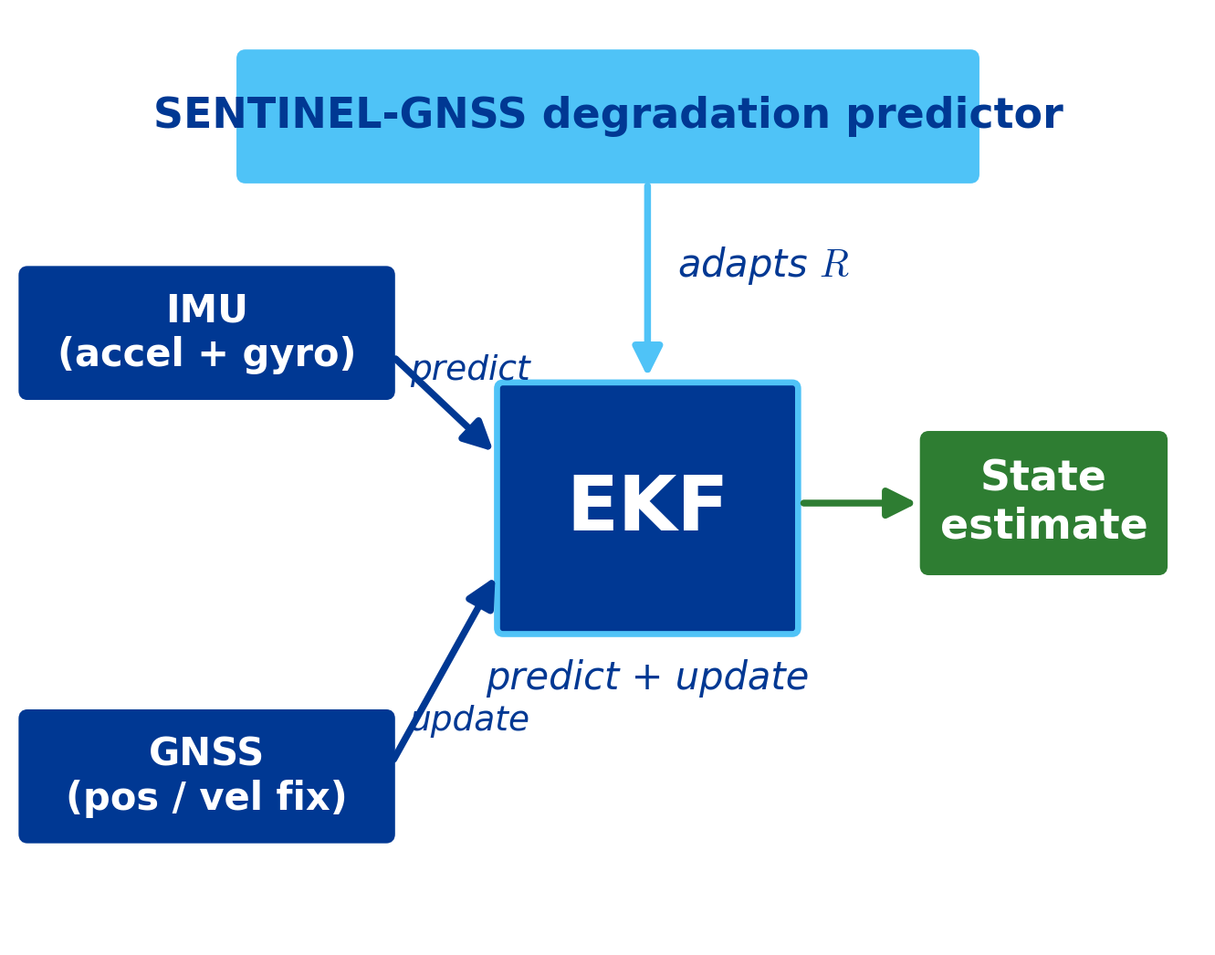
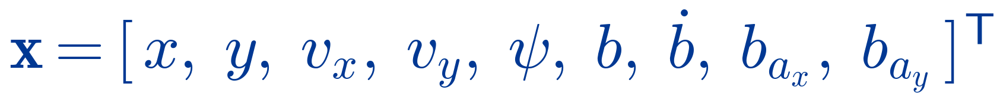
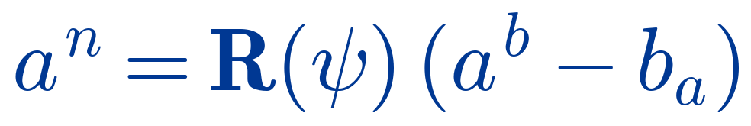
The Project-Specific EKF Architecture
9-state vector
Predict step — driven by the IMU (accelerometer + yaw rate).
Update step — GNSS position / velocity; linear measurement H.
Estimated online: GNSS clock bias and drift, plus accelerometer biases.
Why “Extended”?
body → nav rotation by heading makes f(·) nonlinear

Slide 4

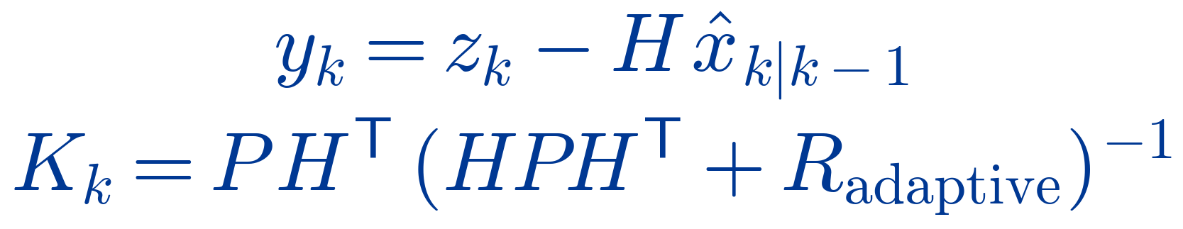

Wiring the AI Prediction into the EKF
The AI prediction enters the UPDATE step (via R) — not the predict step.
Take the calibrated P(DEGRADED) at the +5 s horizon from SENTINEL-GNSS.
Zero-order-hold the latest prediction to align predictor and filter rates.
Inflate the GNSS noise covariance R in proportion to it (hero formula).
Run the EKF update with the inflated R; tune scaling and threshold on validation.
If the prediction exceeds the threshold, coast on IMU (skip GNSS) for continuity.
EKF update with adaptive R
Fallback — coasting
then coast on IMU, skip GNSS

Slide 5
Implementation Results & Expected Outcome
0.8206
+5 s Macro-F1
0.773
MCC (+5 s)
0.75 / 0.15
Tokyo DEGRADED F1
DL vs RF baseline
Expected fusion outcome
Lower position RMSE during DEGRADED epochs vs a fixed-R baseline EKF.
Maintained continuity — coasting holds the track through full GNSS loss.
Degradation-aware trust: fewer multipath-driven position jumps.
Predictor metrics from Run 14 (current best). Fusion-stage RMSE pending — integration evaluation in progress.

