Slide 1

Web UI Testing with
(Not Sponsored)
** Opinions and view points in this presentation may not be the opinions and viewpoints of anyone.

Slide 2


Introduction
Who am I
Software Engineer 10+ years
so not a QA, but hoping I can still be relevant ;)
What is the Goal of this presentation
Cypress
Some of the common pitfalls and best practices
Introduction / Highlights
Case Study
Simplified example to make it feel real!
Design principles
Intended to make software designs more understandable, flexible and maintainable
Introduction / Highlights

Slide 3
What is Cypress
https://www.cypress.io/
The web has evolved. Finally, testing has too.
Fast, easy and reliable testing for anything that runs in a browser.
Cypress does not use Selenium.
Currently, Cypress has support for Chrome-family browsers (More coming)
Cypress tests run fast.
Cypress is free however they do operate under a SaaS business model.
While it is possible to run tests in parallel without the dashboard, it requires an amount of scripting and it would be difficult to match the integrated performance that cypress provides. (Essentially the service which distributes jobs across parallel runners is a paid for service, but running tests locally is free)

Slide 4
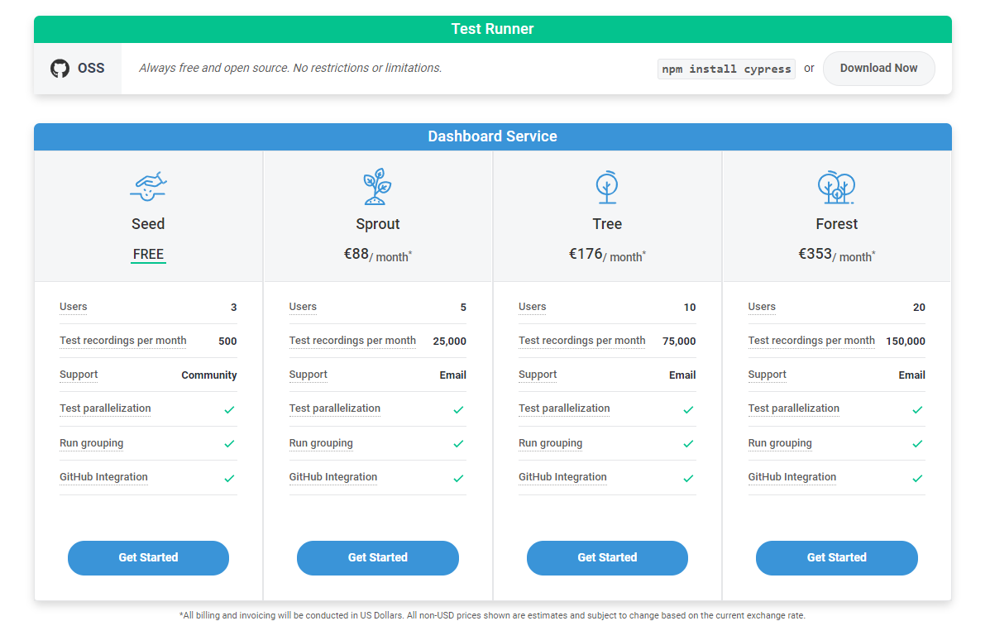

Slide 5
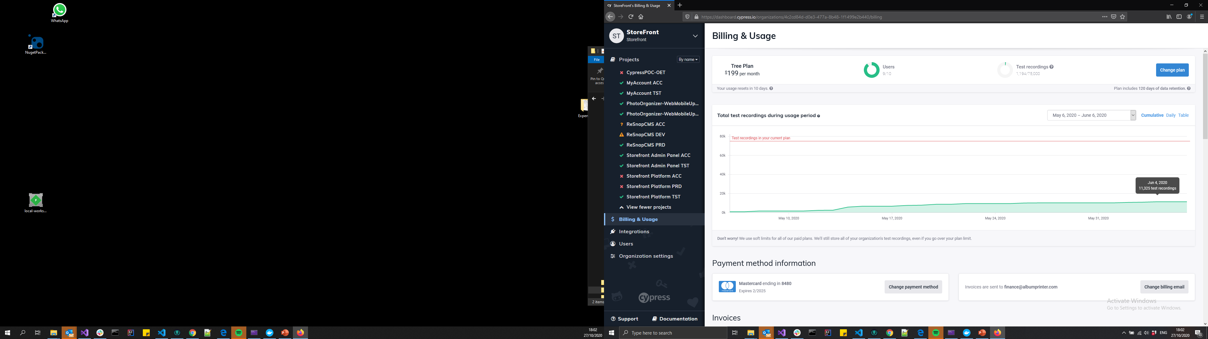
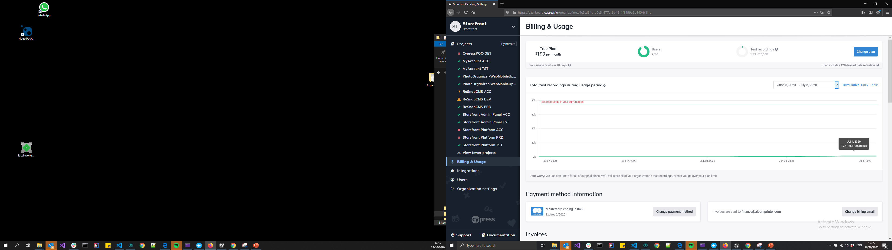

Total Test Recordings- What do we use

Slide 6
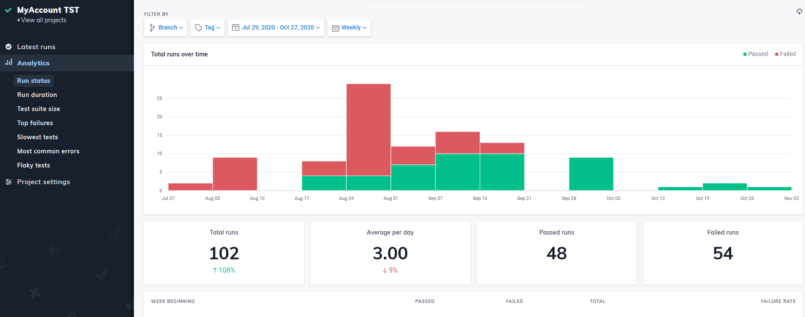

Slide 7
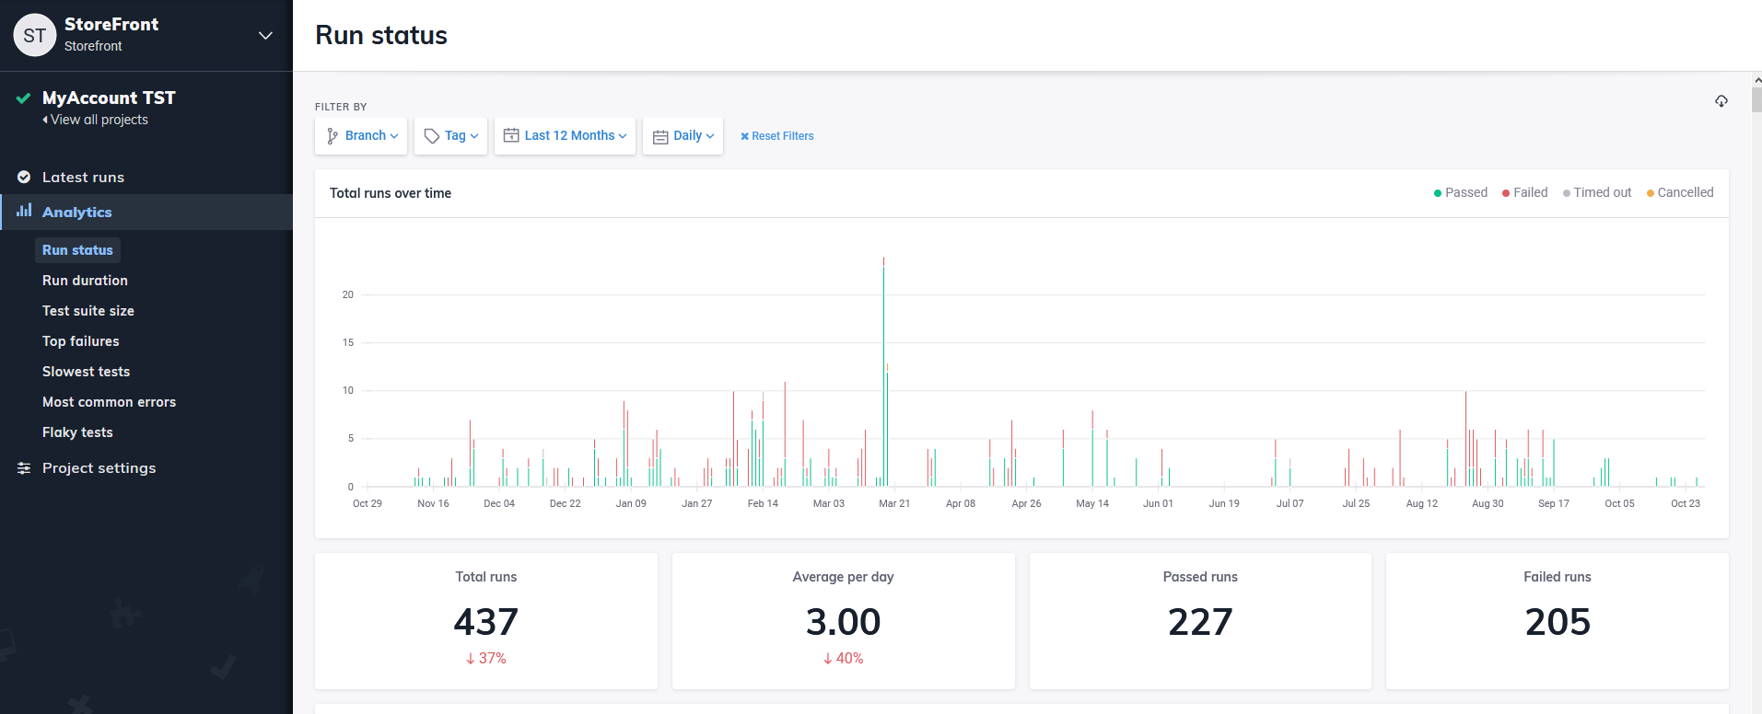

Slide 8
What is cypress not
Cypress is not a general purpose automation tool.
Cypress commands run inside of a browser.
There will never be support for multiple browser tabs.
You cannot use Cypress to drive two browsers at the same time.
Each test is bound to a single origin.
Two URLs have the same origin if the protocol, port (if specified), and host are the same for both.
e.g. compared to https://www.cypress.io
https://cypress.io
https://docs.cypress.io
https://example.cypress.io/commands/querying

Slide 9
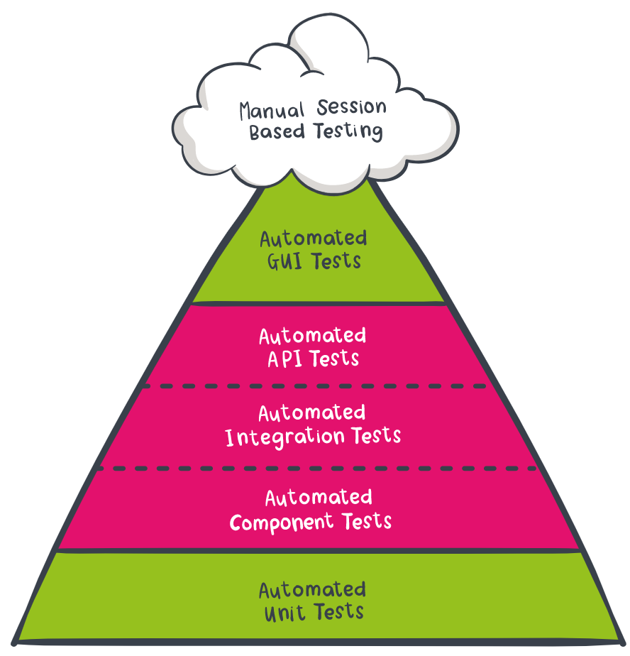
What is cypress not
Limitations prevent it from testing every possible GUI scenario.
I.e. limited to certain web browsers
Quicker and easier to use and setup than other more complete UI testing applications and well integrated with the browser
Mocking and stubs allow you to test in isolation

Slide 10
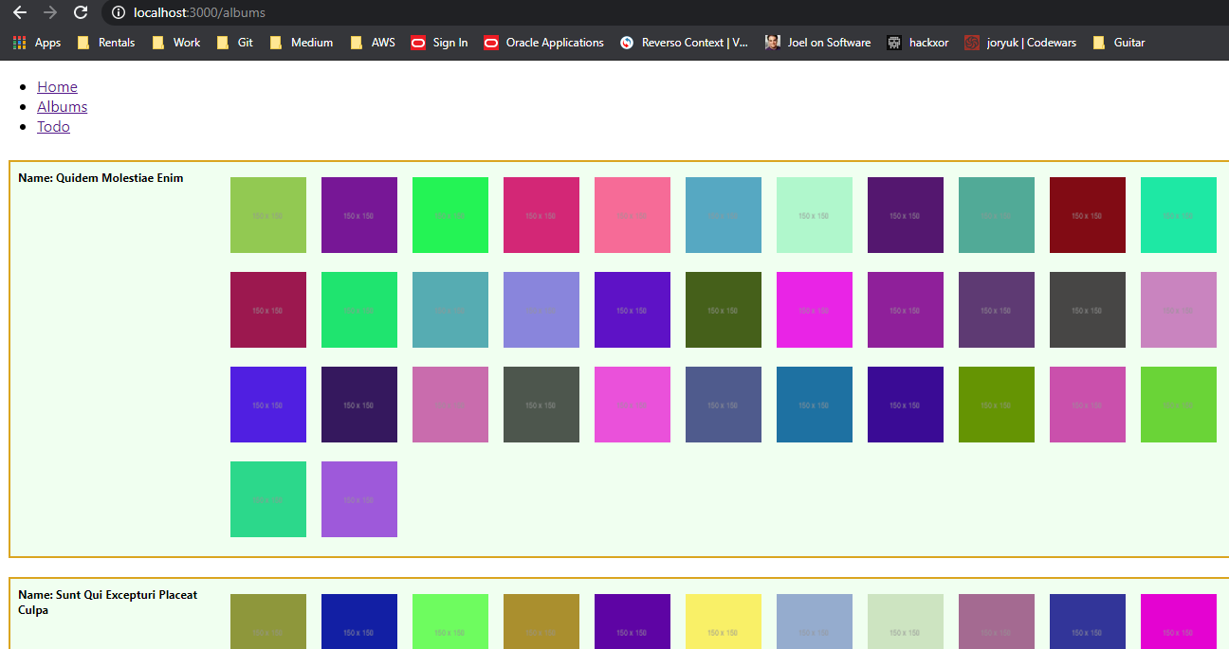
Case Study – Simple Website

Slide 11
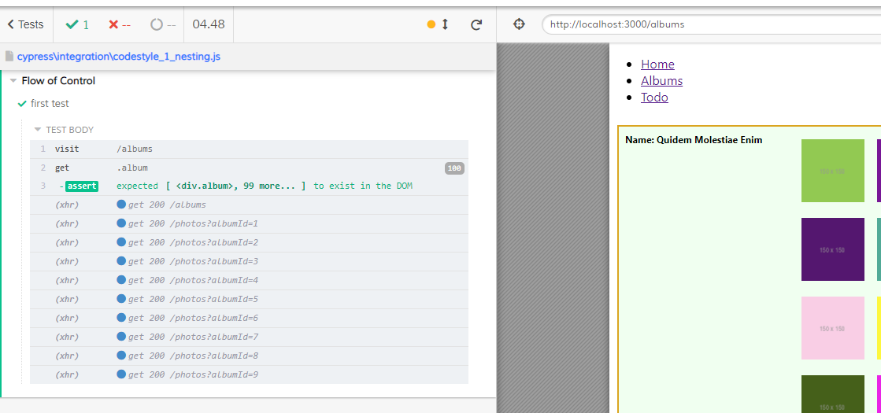
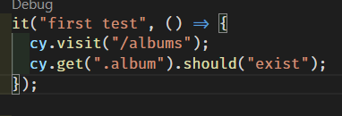
Case Study – Simple Test

Slide 12
Code Style / Flow of Control
Cypress supports a mixture of asynchronous (promises) and synchronous code styles
Cypress will execute code the in a synchronous manner
The next 3 examples all result in the same execution but the clarity of the code differs greatly…

Slide 13
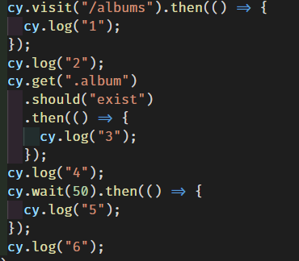
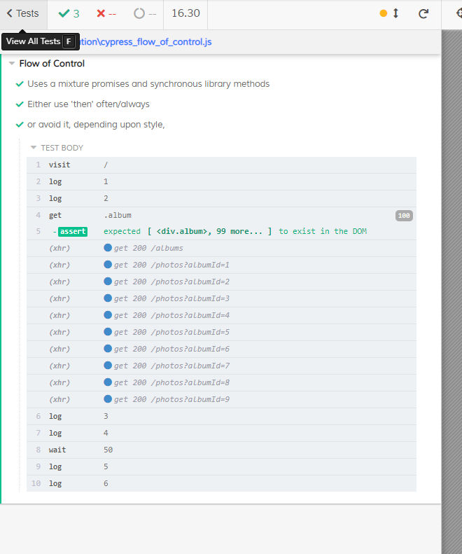
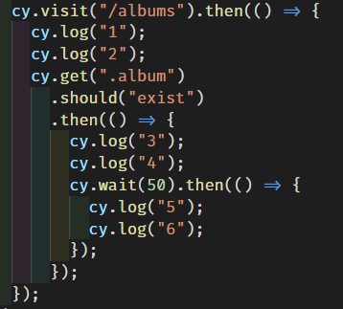
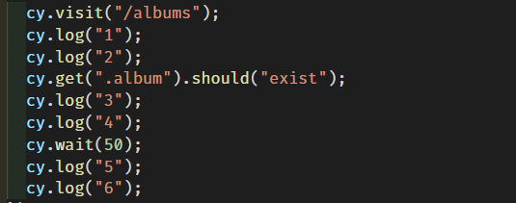

Slide 14
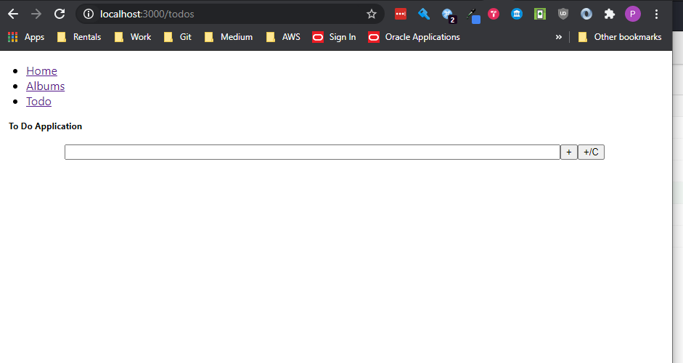

Slide 15
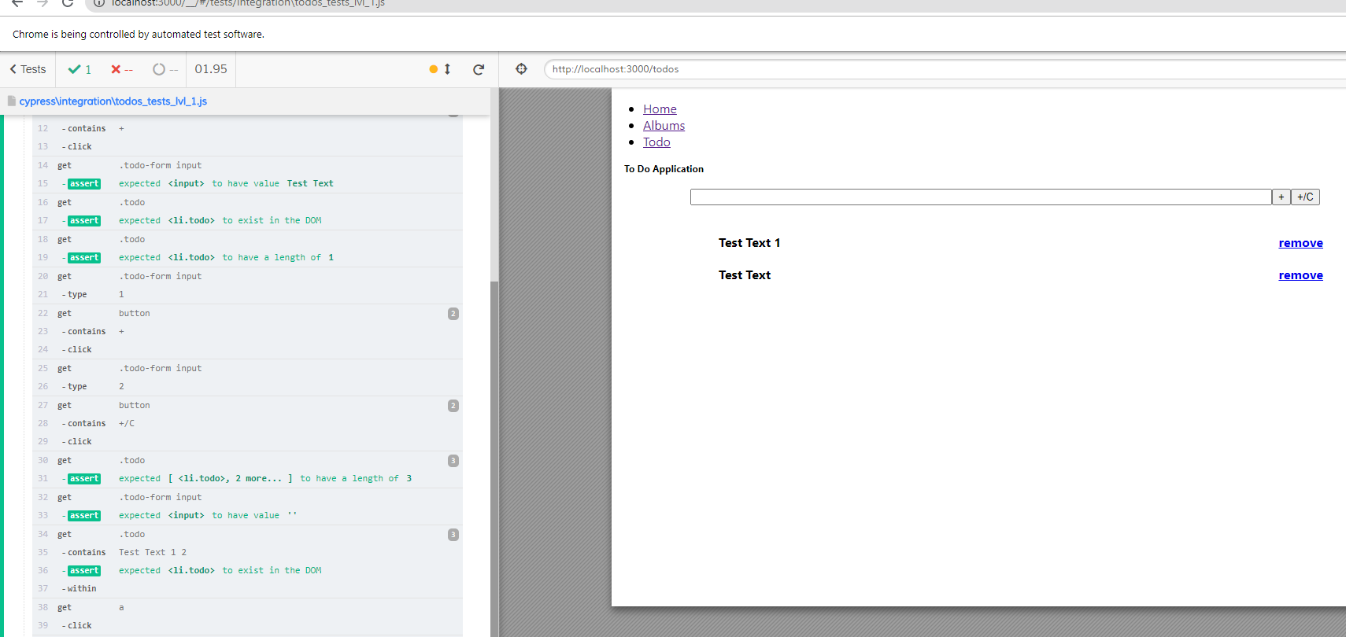

Slide 16
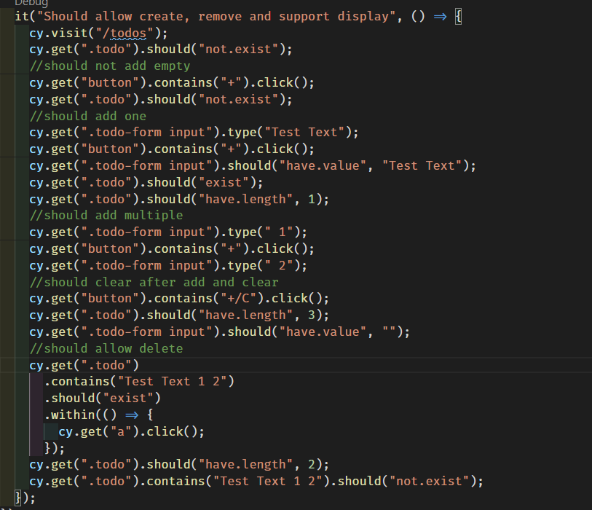

Slide 17


Pitfalls Example
Always check something if you look it up
Checks work like check points in the cypress flow
Once a check passes it will not be retried (this can cause strange issues in the flow if not expected)
Cypress checks will retry each assertion
There is a default timeout
Make several steps towards your goal asserting the state is expected
No need to check absolutely everything

Slide 18
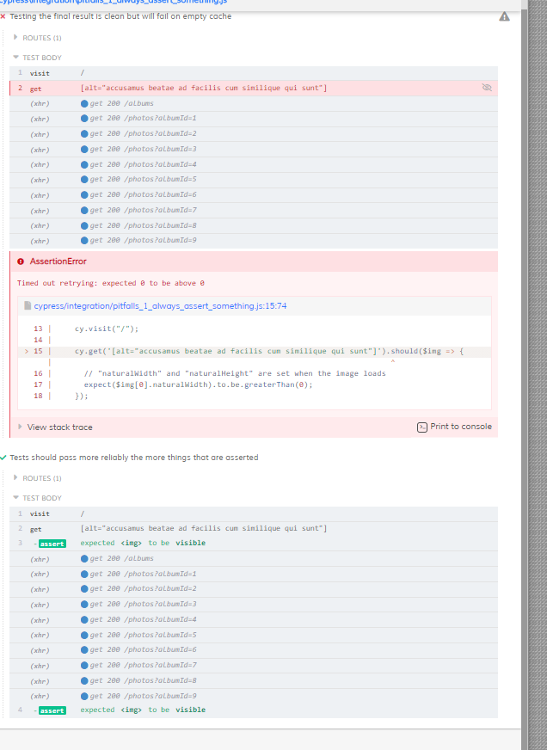
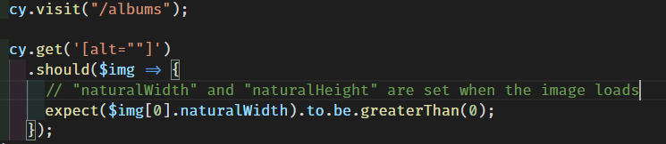
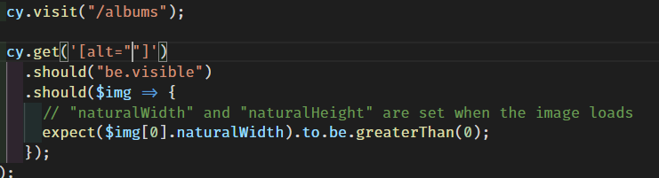

Pitfalls, Retry & Waiting
Rely upon the automatic retry
One possible solution would be to manually wait

Slide 19
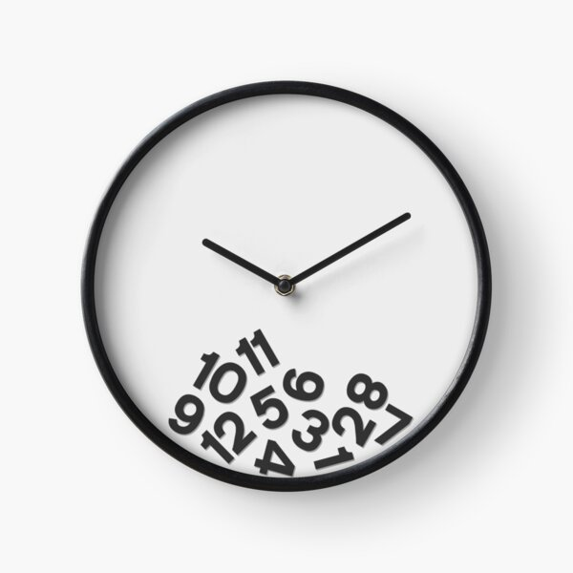
The Problems with Waiting
Waiting for arbitrary times is an anti-pattern
Waiting for things that are outside the scope of the test is wasteful
Is this request the item that is under test and if it were to fail would you want the test to fail?
Certain things should be tested programmatically, or separately and asserted to be true in all other cases e.g. Login, test this once and programmatically log in elsewhere.

Slide 20
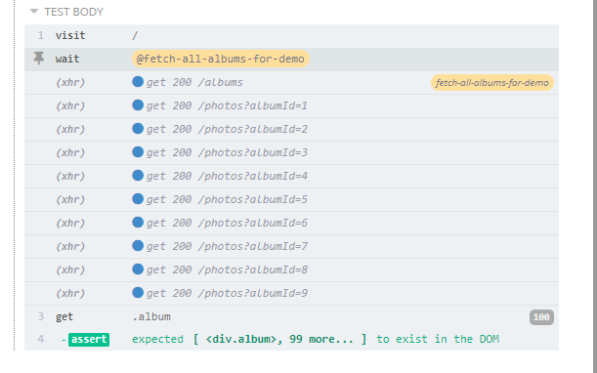
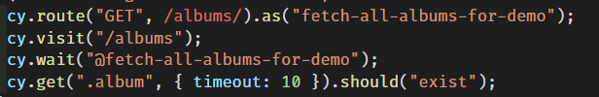
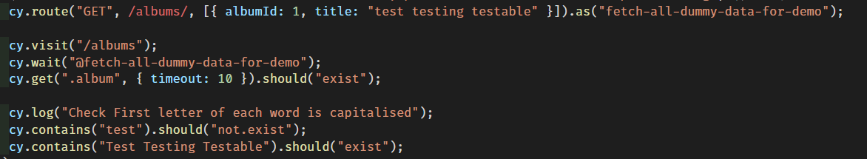
Better Options
Without mocking the data – just wait for the request to be made
and respond (also gives it a name in the console)
With mock data you can do environment agnostic tests

Slide 21
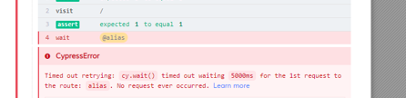
The more you know
Fetch not fully handled – but there is experimentalFetchPolyfill
The default retry timeout can be overridden

Slide 23
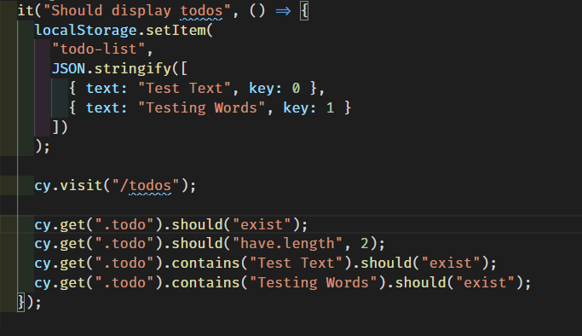
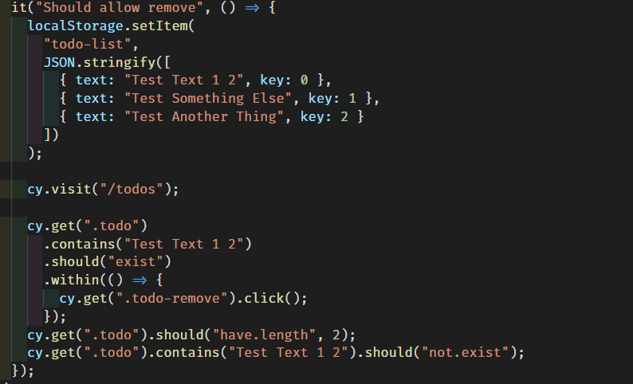

Slide 24
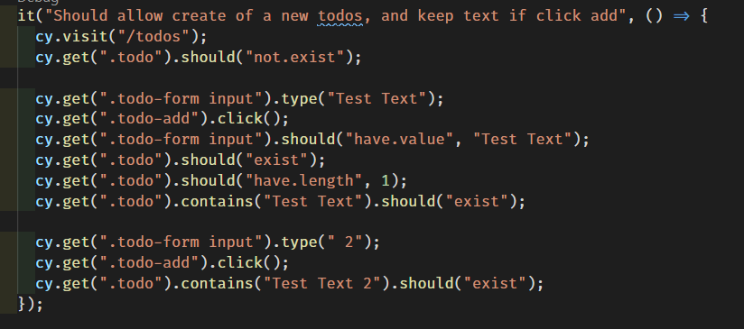
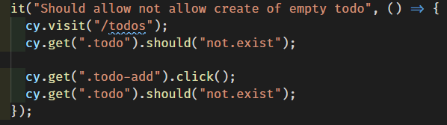

Slide 25
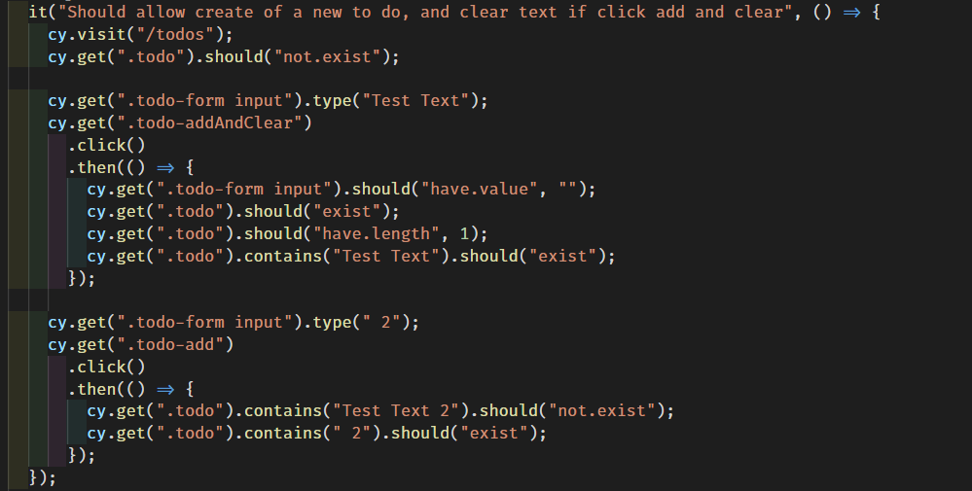

Slide 26
Best Practices
Cypress has a detailed list online I encourage you to check out, some are worth mentioning briefly and I will show some examples with will lead nicely into and introduction to some of the design patterns I find useful when writing Integration tests.
Test in isolation
Use data-* attributes to provide context to your selectors
Tests should always be able to be run independently
Integration Tests are not unit tests, assert multiple things, test entire flows * but some separation is essential to maintainability of the test project itself.
Cypress provides route aliases which can be mocked or awaited as necessary.

Slide 27
Design Patterns Intended to make software designs more understandable, flexible and maintainable
Understandable, Flexible and Maintainable
Understandable – Keep it Simple & Show me what you got
Flexible – Above + Good reusability, easy to extend + Flexible Tests (-Rigid Test)
Maintainable – All the above + Good Testing Coverage (not 100%)
Breaking up the software into more manageable chunks – how you do this and balance it against code reusability and requirements is effectively the design of your system,
Whether it is intentional, systematic and consistent throughout, an organic free for all or something in-between.
Some food for thought the next time you are trying to decide whether to (yes) and how to (systematically) split up your next application.

Slide 28
Design Patterns – SOLID Intended to make software designs more understandable, flexible and maintainable
Separation of Concerns
A class (or test) should only have a single responsibility, that is, only changes to one part of the software's specification should be able to affect the specification of the class (or test).
In the instance of the test or spec file, we test a single software specification (flow/functionality) and isolate from external forces
Open/Closed Principle
Open for extension, Closed for modification
I take this one a little more abstractly and try to think of it as, I should be able to add new functionality/tests without modifying any existing functionality/tests
i.e. shared functionality should be so generic it never changes, Utility classes are truly utilitarian, think like core language functionality or third party libraries.
Complex logic is kept to the lowest number of places possible (ideally all in the test)
Interface-segregation principle (ISP) states that no client should be forced to depend on methods it does not use
For me this is about reducing the amount of cognitive load at any one time, make files such that I can look at it once and mentally tag it and dismiss it, so I can focus on the things important to the problem at hand.

Slide 29
Design Patterns - SOLID
It should be obvious to anyone reading the test what it does, what it tests and the steps it performs to do this
Each test class is clearly named,
Complexity can be abstracted away, but not too far away
Don’t abstract too soon, don’t abstract too late - YAGNI
striking the right balance here is the difference between software that can’t be changed for fear it something will break and making software hard to understand (and often hard to extend)
It should be obvious to anyone looking at the solution files what functionality this solution provides and at these abstractly how it does this.
Shared functionality should be obvious
External dependencies likewise
More files, sensibly grouped together are better than less badly named super files that do many things, even if it feels easier to add to an existing class, this should be avoided. **

Slide 30
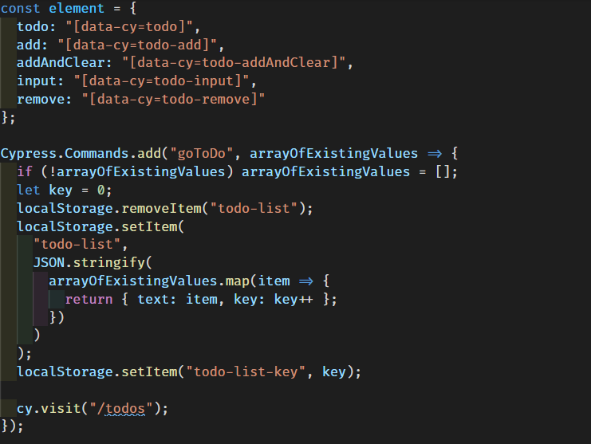

Slide 31
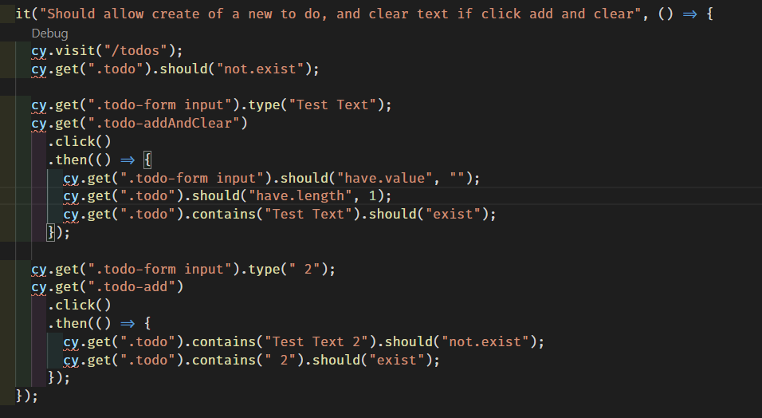
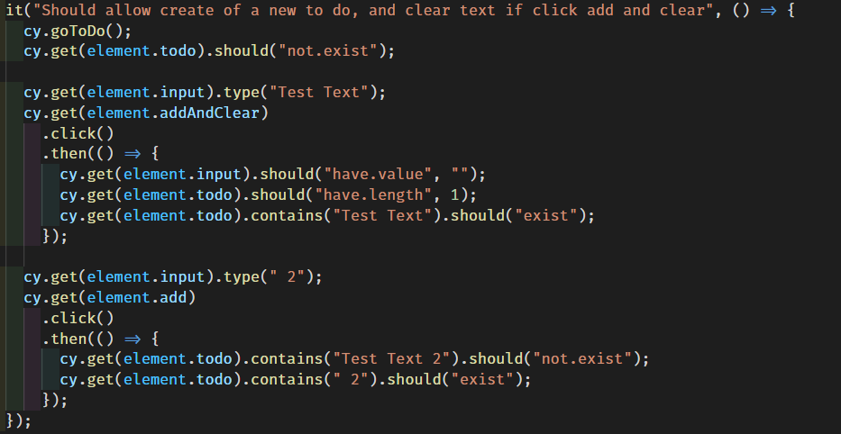

Slide 32
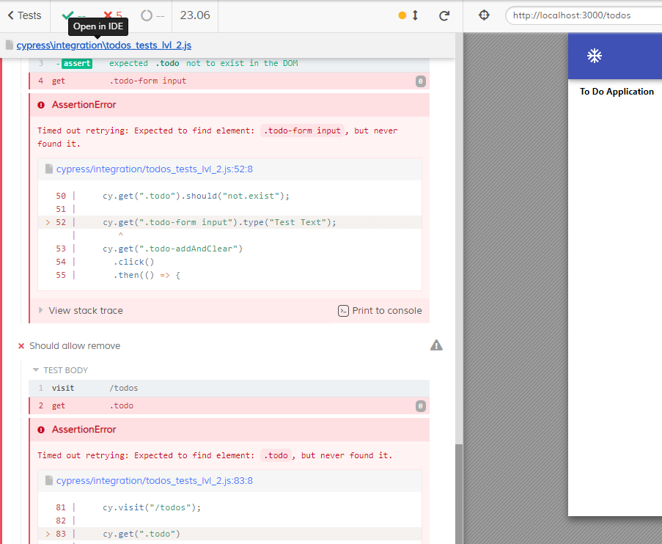

Slide 33
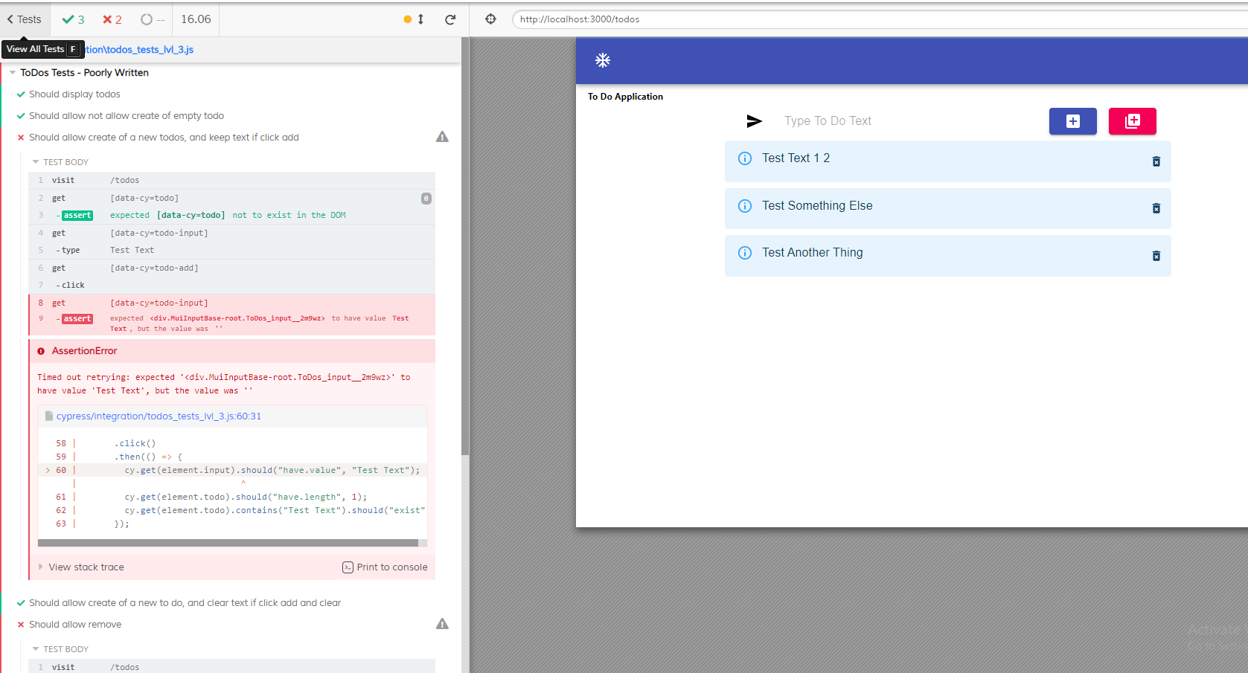

Slide 34
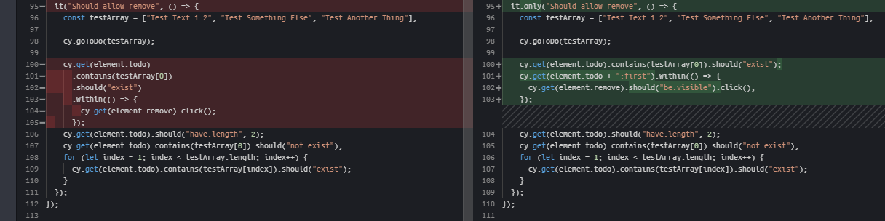

Slide 35
Will the code that I write today be
Easy for anyone to understand
Easy to change
Easy to investigate when something fails
Easy to extend in future

