Slide 1


SALARYPREDICT AI
NAME: ZENITH JOSHUA J
REG NO: 311123205064
AICTE - IBM SKILLSBUILD (AI)

Slide 2
INTRODUCTION
An internship centered on AI & Machine Learning, building SalaryPredict AI, a model that predicts an employee's annual salary from their profile and explains every prediction, taken from a raw dataset to a genuinely usable, explainable web application.
Stack: Python with Pandas and NumPy for data handling, Scikit-Learn for modelling and SHAP for explainability, all served through a Flask backend developed in Jupyter Notebook and VS Code.
Job seekers and hiring teams often lack a fast, evidence-based way to estimate fair compensation, and most tools give a number without explaining it — leaving pay decisions to guesswork or an opaque black box.
Core systems built: end-to-end preprocessing and EDA, three trained regressors (Linear Regression, Random Forest, gradient-boosted trees) compared on accuracy, the best model exported as a .pkl file, and a Flask web app (main.py) that predicts salary from 5 inputs with an exact SHAP-based explanation.

Slide 3
ABOUT THE PROGRAM
AICTE (All India Council for Technical Education) is the apex regulatory body for technical education in India, coordinating the IBM SkillsBuild initiative together with its program partners.
IBM provides the SkillsBuild learning platform and the AI & Machine Learning curriculum used throughout the program, while Edunet Foundation delivers the virtual internship platform, mentorship, and project milestones.
This 6-week virtual internship gave hands-on, project-based exposure to the applied data-science workflow — from a raw dataset to a deployed, explainable prediction tool — under the AICTE B2 (AI) batch of IBM SkillsBuild.
Register No: 311123205064
Mode: Virtual Internship
Duration: 18 Jun - 31 Jul 2025

Slide 4
ABOUT THE INTERNSHIP
Tools & Technology:
Language: Python 3.11 (VS Code, Jupyter Notebook)
Libraries: Pandas, Scikit-Learn, SHAP, Flask
Algorithms: Linear Regression, Random Forest, Gradient-Boosted Trees
Visualization: Matplotlib, Seaborn
Dataset: Salary Data.csv — 373 employee compensation records
Deployment: Flask web app (main.py)
Core Concept: ML-Based Salary Prediction with Explainability
Predicts annual salary from 5 scaled and encoded profile inputs
Best-performing model exported as a .pkl file for deployment
Trained and compared in Jupyter Notebook, with EDA via Matplotlib & Seaborn
The objective was a single tool where a user enters five basic profile details and instantly gets a predicted salary with an exact explanation — replacing guesswork with a transparent, data-driven estimate, no negotiation research beyond the tool required.
The project moved from a raw CSV file to a production-style workflow: cleaning and preprocessing the dataset, comparing three regression algorithms on real metrics, and deploying the winner behind an explainable Flask interface.
Notes:
The goal of dynamic pricing is to allow a company that sells goods or services over the Internet to adjust prices on the fly in response to market demands.

Slide 5
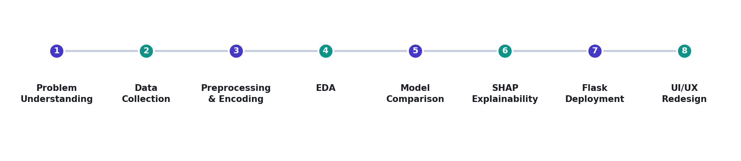
WORK FLOW

Slide 6
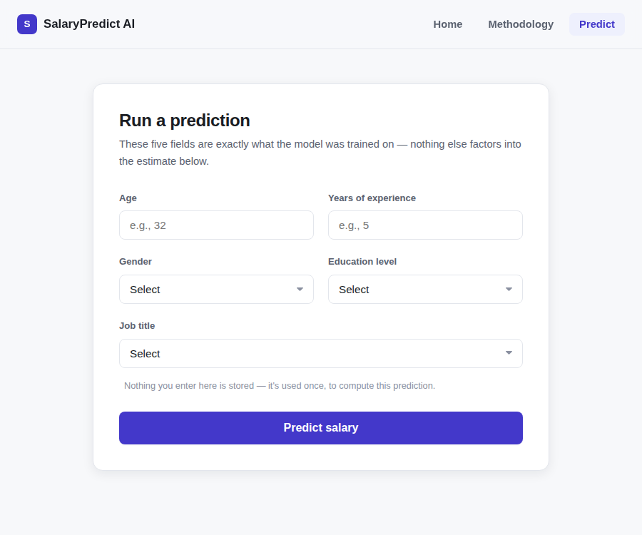
WORK SAMPLES - Prediction Form

Slide 7
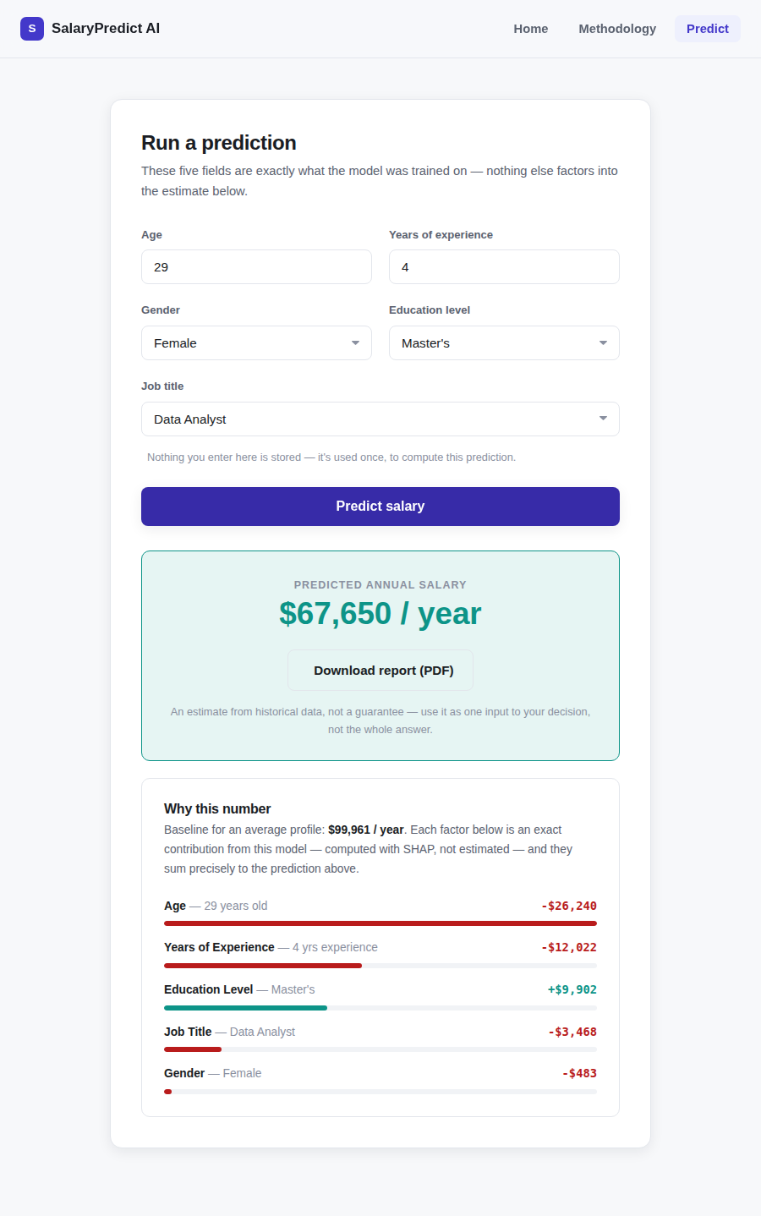
WORK SAMPLES - Prediction Result

Slide 8
FEEDBACK OF THE INTERNSHIP
The importance of carrying a project end-to-end — not just training a model in a notebook — became clear once I started building the Flask app and had to make each prediction explainable to someone who isn't a data scientist.
Comparing Linear Regression, Random Forest, and gradient-boosted trees side by side, instead of picking one algorithm on faith, taught me that model choice and evaluation matter as much as the modelling itself for a real decision-support tool.
TAKEAWAY:
Learned to carry a project end-to-end: raw data, EDA, modelling, and a deployed, explainable Flask app.
Understood why comparing multiple algorithms beats defaulting to a single familiar one.
Got hands-on with real explainability and correctness challenges — SHAP contributions, feature scaling, and honest unit presentation — concepts that were largely theoretical before this project.
Notes:
The goal of dynamic pricing is to allow a company that sells goods or services over the Internet to adjust prices on the fly in response to market demands.

Slide 9
CONCLUSION
This internship took SalaryPredict AI from a raw CSV dataset to a working, explainable web application — comparing multiple regression models, exporting the best performer, and wrapping it in a Flask interface that turns a five-field profile into an instant, fully explained salary prediction.
The system gives job seekers and hiring teams a transparent, evidence-based starting point for compensation decisions, and makes every prediction auditable rather than a black box — with future scope for region-specific salary datasets and confidence intervals around each estimate.

Slide 10
THANK YOU
github.com/Jos-zenith | Salary_Predictor

