Slide 1
Digiknight BCDR Plan
Group CLI

Slide 2
WORK LOG (TEMPORARY)
Phase: | Section of doc: | Name: | Status of Section (In progress, complete, etc.)
1 | Section 1 Threats | Robert | Complete
2 |  |  | Complete
3 | Section 3 Backup | Robert | Complete
4
5 | Sites | Daniel | Complete
6 |  |  | Complete
7 | Emergency contacts | Daniel | Skipped for Presentation of Phase 6
8 | Section VII Testing Procedures | Daniel | In progress
9 | Section 8 Evac Procedure | Jose R | Complete

Slide 3
Phase Summaries (Temporary)
Phase 1 Done
Identify all natural threats
Identify all man-made threats
Identify all IT and technology-based threats
Phase 2 Done
Identify all environmental/infrastructure threats
Prioritize business functions into mission-critical, important, minor
For each mission-critical function (non-IT), identify risk mitigation strategies for consideration including risk acceptance, avoidance, transferene, and limitation
Phase 3 Done
Create a checklist for contacting an insurance provider
Perform research over the internet to discover possible risks to the company as reported by FEMA
Identify resources required including computer equipment, communication links (Internet, dial up, etc.), communications equipment (walkie talkies, cell phones, land lines, etc.), office equipment, office supplies, BC/DR plans, contact lists, and inventory lists.
Phase 4 Done
Develop a procedure to notify and activate an alternate work site
Create a plan to run a cold site backup location, detail what equipment and other resources are needed.
Create a plan to run a warm site backup location, detail what equipment and other resources are needed Also create an executive summary of the site explaining it’s pros and cons
Phase 5 Done
Create a plan to run a hot site backup location, detail what equipment and other resources are needed.
Create a plan to run a mobile site backup location, detail what equipmentand other resources are needed.
Create a plan to run a mirrored site backup location, detail what equipment and other resources are needed.
Develop a procedure to notify crisis communication command center.

Slide 4
Phase Summaries (Temporary)
Phase 6 Done
Create an inexpensive and feasible backup solution for the VMware infrastructure. There are a total of 16TB currently, but not all of the data requires backup.
Phase 7 Done
SKIPPED FOR PRESENTATION IN CLASS
Phase 8
Identify and locate the address of the appropriate emergency response organizations and determine the best method of initial notification of possible, impending, or in-progress disruption or disaster.
Create and determine appropriate BC/DR activation steps
Create an assessment for determining structural damage, health and safety impact and risks template
Identify and create the policy for location and testing of alarms, emergency signals, first aid supplies, CPR equipment, fire suppression equipment and hazardous materials safety equipment
Phase 9 Done
Identify and create the policy for evacuation procedures including evacuating, securing, shutting down facility and internal assembly points
Identify and create the policy for shelter-in-place procedures including internal assembly points (safe areas), water, water purification tablets, shelf-stable food supplies, clothing, blankets, and other long-term stay materials.
Create a checklist for contacting and interviewing a disaster recovery specialist (See Table 6-5 on page 168 of the “Guide to Disaster Recovery” textbook. A scanned pdf version is available in Files)
Create a checklist for contacting and working with suppliers (See Table 6-10 on page 173 of the “Guide to Disaster Recovery” textbook. A scanned pdf version is available in Files).

Slide 5
Introduction
Section I

Slide 6
Introduction
Daniel Serrano
Jose Colunga
Robert O’Connor
Jose Ramirez
Emmett Rohrbough
Dennis Entsie

Slide 7
Index
Section I ~ Introduction
Section II ~ Threats
Section III ~ Backups
Section IV ~ Insurance Information
Section V ~ Back up Sites
Section VI~ Emergency Contacts
Section VII~ Testing Procedures
Section VIII~ Evacuation Procedure

Slide 8
Threats
Section II

Slide 9
Overview
With multiple threats affecting a company it is essential that they are divided into their respectable categories: Natural threats, man-made threats, and IT threats. By dividing these threats we can then identify what impact they can have on your company. We will first identify these threats and identify the impact it will have on your organization. We can then proceed to mitigate and prevent these threats.

Slide 10
Threats Overview
Natural Threats ( Earthquakes, landslides/mudslides, Water Damage)
Man-Made Threats (Stolen/Lost/Damaged Property, Active Shooter, Social Engineering, and Employee Error)
IT and Technology Based Threats (DDoS Attack, Malware, Malicious Links, Ransomware, and Zero Day Attack)

Slide 11
Natural Threats
Water Damage: Water damage can be caused as a result of many things. Could relate from a bad rain storm or could be caused by something man made, such as a broken water pipe or water that someone never cleaned up.

Slide 12
Natural Threats Cont.
Earthquakes & Landslides: Due to earthquakes having a wide range of strength of the tremors, it is difficult to gauge how much damage will occur in the future. They can range from minor shakes that might knock over light items on desks to resulting in buildings collapsing. Some of the more serious sources of damage can occur from structural damage, windows breaking over employees, machinery falling over, ceiling tiles falling, landslides, and building collapse. On the lower end, the most damage caused would be items falling off walls and desks. Another potential damage earthquakes can cause would be landslides. Landslides could affect the distribution of our products as well as affect our manufacturing process by affecting our suppliers.

Slide 13
Natural Threats Cont.
Flooding: Flooding is a common occurrence in California and can cause catastrophic damage to buildings and it’s interior. Of course this poses a huge risk for electronic and power equipment, the loss of life, and structural damage. These raging waters can literally drag a building off of it’s foundation.
Wind Damage: Wind damage would damage caused as a result of high winds. This can just be winds affecting the building, winds blowing a tree down and into the building, or objects flying into/onto the building

Slide 14
Natural Threats Cont.
Fire: The source of fire would be dry plant matter. Area that have droughts and low rain would have dense about of dry plant matter. It can also be caused by volcanoes and lightning strikes nearby.
EMPs: Solar flares are caused by the sun. A relatively well known example is the Carrington Solar Flare of 1859. These cause power grid disruptions, this may cause power issues and could result in an EMP on the building. Some scientists predict that these kinds of flares occur once every 350 years. Alternative sources could be from terror attacks, acts of war, and anything else appears to be unlikely enough to not worry about.

Slide 15
Natural Threats Cont.
Power Outage: The source of the power outage would be multiple things from a powerline down that connected the company to the power, to the electric company generator losing power and shutting down causing a power outage for the company. A down power line is not very probable cause as most powerline are now underground hidden from view and from harm, unless an animal or natural causes from a natural disaster would happen.

Slide 16
Man-Made Threats
Stolen/Lost/Damaged Company Property: The internal threat that may come from our own employees is not one that should be ignored under any circumstances. We must of course be prepared for the dangers of company property being lost, stolen or damaged.
Active Shooters: The source/cause of an active shooter can vary greatly depending on your political stance on this controversial issue. Some think the gun is at fault and some think the human is at fault. One thing can be said for sure, active shooters are a result of anger and/or mental illness in an individual, combined with access to arsenal.

Slide 17
Man-Made Threats Cont.
Social Engineering: Social engineering notably had become a very common attack against enterprises and small businesses and perhaps growing more in its sophistication with how it operates. Hackers had learned to be dynamic with many genius ways that are being used to fool employees and other individuals from businesses to hand over confidential data and sensitive information.The most common of social engineering attacks involve the use of emails and other communication mediums to cause a sense of urgency, fear and or other similar emotions to victims. This is also known as Phishing and according to the online article, 90% of data breaches come from phishing, ("Social Engineering Attacks: Common Techniques & How to Prevent an Attack," 2019). Phishing in the category of social engineering scams comes in many forms including Banking Link Scam, Fax Notice Scam, Dropbox Link Scam, Court Secretary Complaint Link Scam and Facebook Message Link Scam. The use of social engineering mostly involves humans as the element hence fighting against this can be very dicey.

Slide 18
Man-Made Threats Cont.
Mishandled Drinks: Mishandled drinks near expensive server or data equipment can be dangerous. The cause of this is lax policies or enforcement of said policies within a company, and the clumsiness and ineptitude of involved employees.
Employee Error: Your employees are a liability, you may have guidelines and regulations in place, but employee mistakes are ranked as a top threat to sensitive data (Ncipher, 2019). Falling victim to social engineering, phishing, bribery, and other threats that could lead to data loss or hardware failure. Human error is inevitable, we are not perfect, so knowing how to train your employees to prevent further or future troubles is important.

Slide 19
IT & Technology Based Attacks
DDoS Attack: DDoS attacks usually come from a person controlling a botnet designed to overload a server with requests for service. In doing so, the server will be overloaded with requests that it will usually crash. A DDoS attack could cause a lot of financial damage to the DigiKnight servers.
Malware: Malware can come in many different forms, if it can get onto a system or a network it can cause a lot of damage. It can delete important files on a system that can significantly slow production of a company.

Slide 20
IT & Technology Based Attacks Cont.
Malicious Links: With Javascript being one of the most popular languages used in web development.”JavaScript is currently being used by more than 94 percent of all the websites. (Toledo, 2018)” Malicious actors can hide malicious links on the web page that is served to the client or they can even disguise trojans as innocent links to bait a user to click on them. The client then proceeds to click on the link and has now given the actor access to their system or access to personal information.

Slide 21
IT & Technology Based Attacks Cont.
Ransomware: In the most recent attack Baltimore has been infected by ransomware. The ransomware dubbed ‘Robbinhood’ has caused the city a reportedly $18.2 million (Duncan, 2019).
Zero Day Attack: The threat source would be from the company developing the software and a user finding it, and could have it could affect the use of the software . The best way to stop a zero day attack would be to patch it or finish the software before releasing the software. If a zero day exploit is found by a person willing to tell about it, it can be fixed before anything bad can happen with it minimizing public reputation with the zero day. If a zero day attack is found and made public it should be patched and fixed immediately

Slide 22
Backups
Section III

Slide 23
Overview
Backups is one of the most crucial aspects and tasks of the IT department. It ensures that important data will always be available if something happens and copies of it are destroyed. Depending on how often backups are done within the business it will determine how accurate and recent the backup data will be available to employees if the first copies are lost/damage/destroyed.

Slide 24
Backup Overview
High Priority
Low Priority
What the data would be backed up to
Software used for the backup
Would the backup be incremental or full or both
How long would the backups take based on the method of replication
What is a good way of backing up the vCSA Appliance
Cost of Cloud vs On-Premise

Slide 25
Backups - High Priority
High Priority: Sales information regarding manufacturing, distribution, and destinations of the product. Tracking information should also be reliably stored in a back up to prevent disasters from having a greater financial burden on the company.
Information from the administration department containing any financial information regarding the company or it’s employees. All information regarding employees such as contacts, payment information, and other data should be a higher priority for the company to have stored and backed up.

Slide 26
Backups - High Priority Cont.
Shipping information regarding our contacts, expected arrival dates of supplies, and expected distribution dates should have a higher priority in being backed up, as being unable to locate a necessary shipment could impact reputation along with financial damage.

Slide 27
Backups - Low Priority
Information from the research and development team have important functions which bring increased margins of profit to the company by researching ways to cut manufacturing expenses. However, the information isn’t crucial to the functions of the company, as such they aren’t a priority in keeping backups of the information.

Slide 28
Backups - Low Priority Cont.
Administration information unrelated to any financing or HR related information (employee information). Examples of information would be training modules and scheduling.
Marketing information, while important to the company’s growth with proven results, isn’t a high priority to being backed up. The information from the department isn’t a high priority since the functions and information from the department aren’t crucial or a necessity to the continuity of the company in the event of a disaster.

Slide 29
Backups - What the data would be backed up to
The data would be backed up to virtual machines on the cloud computing platform, AWS. The storage type would be SAN on HDD to lower expenses. The 16 TB storage databases would be spread across 4 different VMs that have 2 CPU cores and 16 GB of RAM per VM. The VMs will be running MySQL.

Slide 30
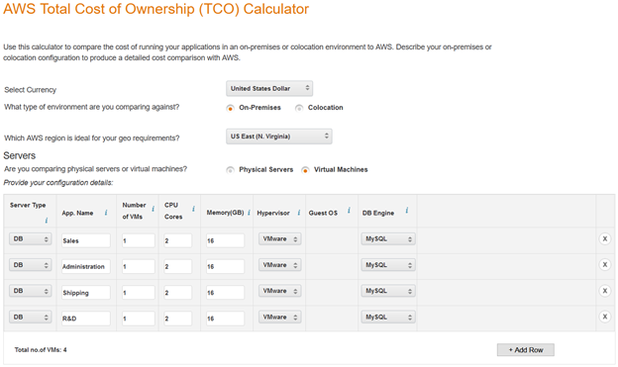
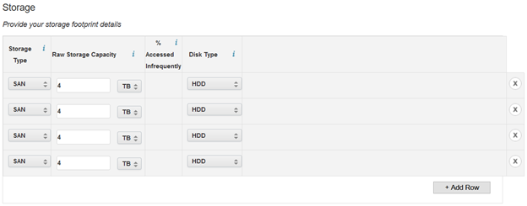
Backups - What the data would be backed up to Cont.

Slide 31
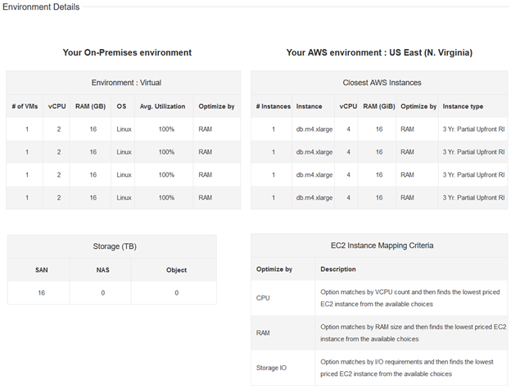
Backups - What the data would be backed up to Cont.

Slide 32
Backups - Software used for the backup
We will be using MySQL on the AWS virtual machines. MySQL has 3 different business oriented editions we can choose from: standard edition, enterprise edition, and cluster edition. We will be using MySQL Enterprise Edition since we are only using 4 VM’s to store information. If we wanted to spend an extra $5000 and get some more features such as cluster management and geo-replication we could go Cluster Edition. MySQL Enterprise edition comes with Transparent Data Encryption, meaning all of our data will be encrypted while at rest and decrypted when read.

Slide 33
Backups - Software used for the backup Cont.
It also allows us to create full, incremental, and partial backups. MySQL Enterprise edition comes with a firewall that blocks SQL injection attacks through whitelisting. It also has intrusion detection, real time monitoring, and can block suspicious traffic. Overall, MySQL Enterprise edition is a great way to store our data backups since it offers quick deployment, security, and easy management.

Slide 34
Backups - Would the backup be incremental or full or both
A combination of backup types will be used to ensure quick and reliable recovery. Across all information being backed up, periodic full backups will be created with a monthly schedule. Using the created full back ups, differential backups will be created on a daily basis using the latest full backup as its reference point. Using a differential backup would allow for faster restore times to ensure quicker recovery with the downside of larger storage required and more data being backed with each cycle until the next full backup.

Slide 35
Backups - How long would the backups take based on the method of replication
The initial backup will take a couple of days depending on the network connection to back up 16 TB of data. Backups would then be conducted once every month to ensure that backups are up to date. If need be, the data could instead be scheduled to be backed up weekly instead of monthly.

Slide 36
Backups - What is a good method of backing up the vCSA Appliance
There is a backup feature within vCenter Server Appliance that allows you to backup your vCSA appliance. It allows you to choose which method you would like to send the backfile as it even allows you to send it as an encrypted file (preferred method) where you can have a key pair and only the person that has the key can open that file.

Slide 37
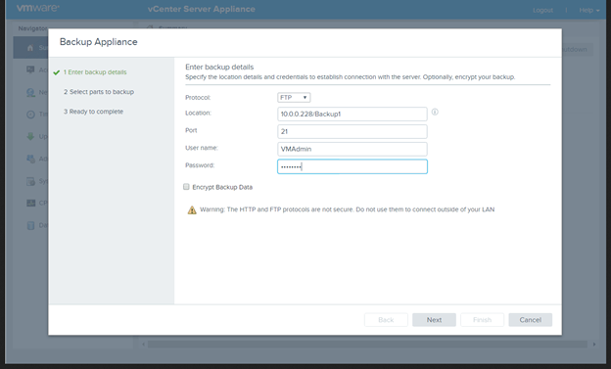
Backups - What is a good method of backing up the vCSA Appliance Cont.
You must have an FTP, FTPS, HTTP, HTTPS, or SCP server up and running with sufficient disk space to store the backup.

Slide 38
Backups - What is a good method of backing up the vCSA Appliance Cont.
Backup files then save as a a .tar files and in some instances take up to 757 MB in Hard Drive space.
By using the VMware method it is very straight forward. ALso FTP is not recommended unless you are on a secure network in a LAN not open to the public. In any instances FTP and any unencrypted transactions are not recommended.

Slide 39
Backups - Cost of Cloud vs On-Premise
Hosting backups on-premise rather than on the cloud can become very expensive. You have to pay for labor costs, hardware of the servers, and repairs if something breaks on the server. Switching to the cloud essentially decreases that cost by a lot. For the 16 TB scenario, DigiKnight could end up saving $234,991 by switching to AWS over 3 years.

Slide 40
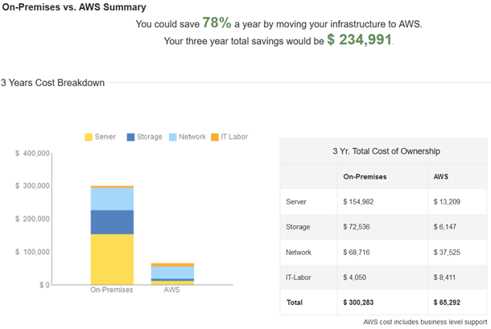
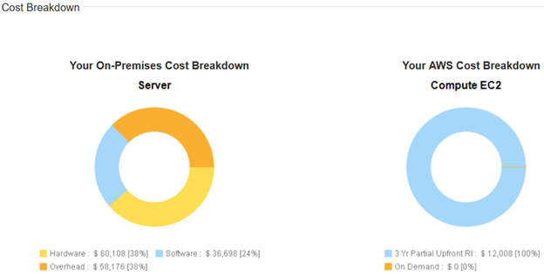
Backups - Cost of Cloud vs On-Premise

Slide 41
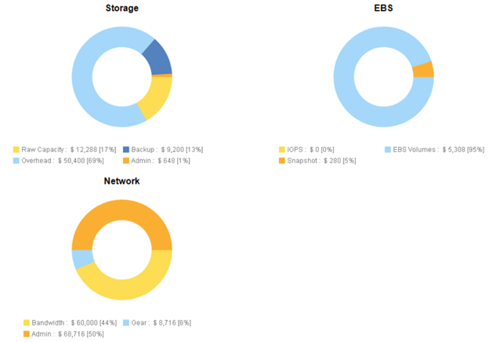
Backups - Cost of Cloud vs On-Premise

Slide 42
Insurance Information
Section IV

Slide 43
Employee Insurance
Why do we have it?
It covers accidents in the workplace such as strains, trip , falls, and accidental deaths.
We are able to avoid lawsuits and other health costs that may come up.
What will it cost us?
The cost of workers compensation insurance in California is $1.85 per $100 in wages.
3 types of programs
State-run program
Insurance company
Self-Insured program

Slide 44
Building Insurance
Why do we have it?
Property insurance will cover property expenses cause by natural disasters, theft, and vandalism.
Property insurance will cover property costs, computers, equipment, exterior signs, fences, important documents, and inventory.
What will it cost us?
Small businesses pay around $500 per year and major companies pay around $500,000
The average business pays $1,000 to $3,000 per million dollars of coverage.

Slide 45
Insuring our Machinery
Why do we have it?
It can be very expensive to completely replace a machine.
Some machines can cost from $1,000 to $1,000,000 to replace.
It will save the company money.
How much will it cost us?
The average cost of a $1,000,000 policy is less than $1,000 per year
If more is needed, the average cost of a $2,000,000 policy is around $1,300 per year.

Slide 46
Insuring our IT Infrastructure
Why do we have it?
We want to be able to protect our IT infrastructure, not all of it, just the important parts.
Things like thin clients and basic computers do not need to be insured, but the 10 servers DigiKnight uses do.
How much will it cost us?
The average cost of IT insurance is anywhere between $650 to $1,300 per year.
This depends on what needs to be covered, but as said before, we don’t need to cover the basic computers and thin clients.

Slide 47
Back Up Sites
Section V

Slide 48
Back up Sites Introduction
Emergencies
Work disruptions
Plan activation

Slide 49
Types of Emergencies
Man Made
Natural Disasters
IT Technology Based

Slide 50
Back up Sites Overview
Alternate Work Site
Cold Site
Warm Site
Hot Site
Mobile Site
Mirrored Site

Slide 51
Alternate Work Site
Location (Houston, Tx)
Personnel
Plan Activation

Slide 52
Plan Activation
Management Team will contact Emergency Response Team to assess damages(if any).
Retrieve vital docs(if possible)
Arrange Transportation
Management and key personnel will travel to sites
Once site has been activated and inspected other personnel will be able to access new sites

Slide 53
Cold Site
Location (Arlington,Va)
Equipment Needed
Resources Needed

Slide 54
Warm Site
Location (Dallas, Tx)
Equipment Needed (phones,workstations)
Resources Needed

Slide 55
Hot Site
Location (Austin,Tx)
Equipment Needed
Resources Needed

Slide 56
Mobile Site
Location (Seattle,WA)
Equipment Needed
Resources Needed

Slide 57
Mirrored Site
Location (Twin Falls, ID)
Equipment Needed
Resources Needed

Slide 58
Emergency Contacts & Event Templates
Section VI

Slide 59
Emergency Contacts Introduction
Emergencies
e.g. search and rescues,HAZMAT, injuries
Contact information
e.g. how to contact,
Activation steps

Slide 60
Emergency Contacts
Life Threatening Emergencies
Dial 911
Fire Department
Police Department
HAZMAT
Hospitals

Slide 61
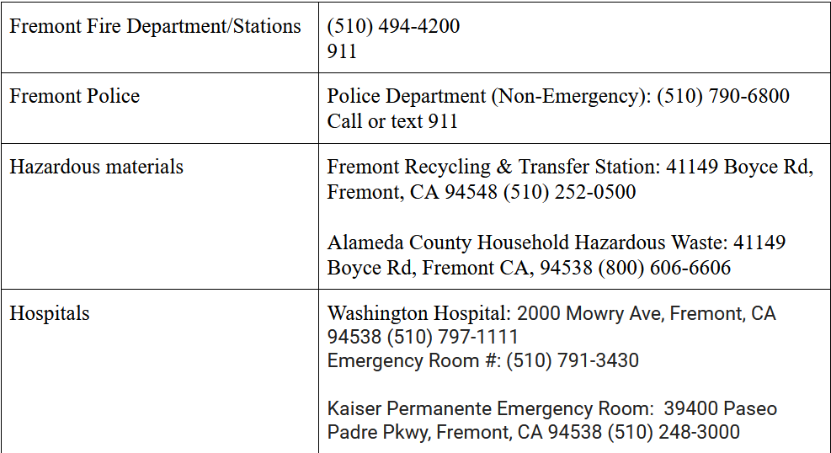
Emergency Contacts Cont.

Slide 62
Activation Steps
Personnel Safety
Secure Important/confidential documents
Service Contracts
Sales Receipts

Slide 63
Event Templates
Section VI

Slide 64
Event Templates Overview
Easier to manage
Create custom event reports as needed
All events will be documented

Slide 65
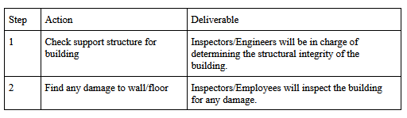
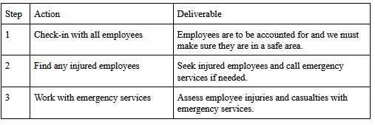
Event Templates example
Structural Damage
Health and Safety

Slide 66
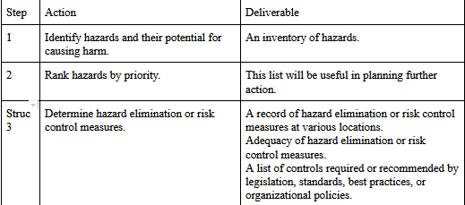
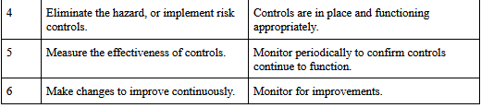
Event Templates ex. Continued
Risks Template

Slide 67
Testing Procedures
Section VII

Slide 68
Testing Procedures Overview
Working Condition
Accountability
Supply lists

Slide 69
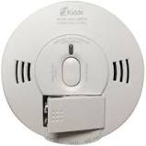
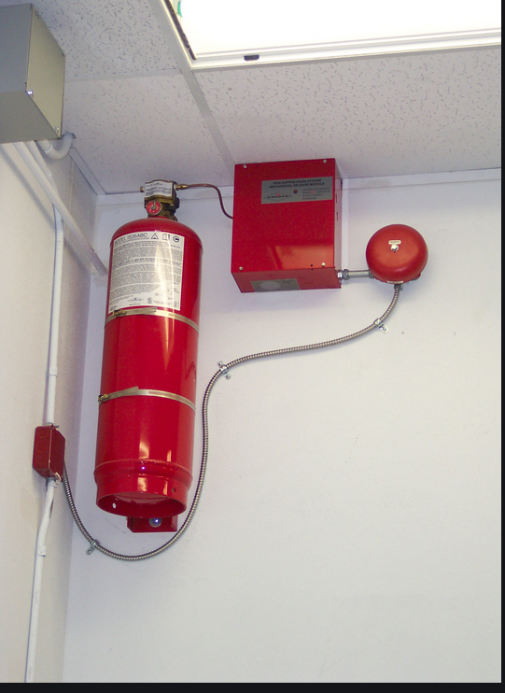
Testing Fire Safety
*Alarms can detect carbon
dioxide
Test Alarms weekly
Inspect Fire Extinguishers Monthly

Slide 70
Supplies and CPR
First Aid
e.g. Bandages and tape, burn treatment, antiseptic/antibiotic treatment
CPR - personnel will be trained and certified

Slide 71
Evacuation Procedure
Section VIII

Slide 72
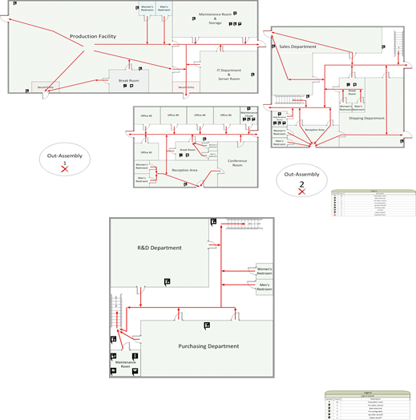
Evacuation Procedure
Emergency services are to be called immediately.
If accessible, management and maintenance staff are responsible for turning of utilities. Utility shut-offs in maintenance rooms.
Employees are expected to evacuate the building and stay outside.
Assembly areas are marked on the floor plan, employees will meet here.
First aid can be found in break rooms.
Employees are not expected to save lives.
Proper training is done after the hiring of each employee.

Slide 73
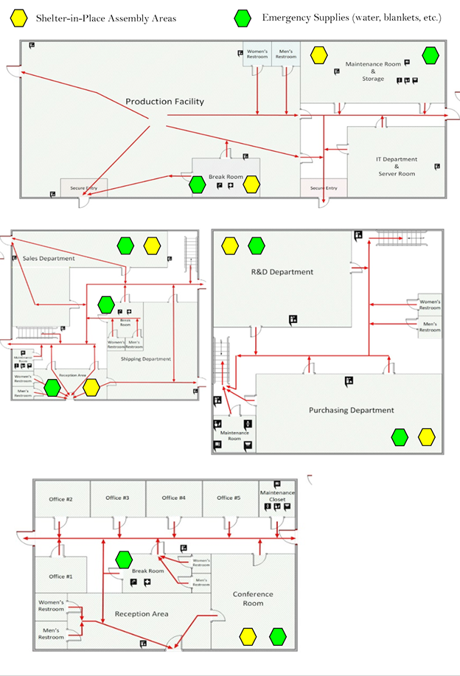
Stay-In-Place Procedure
Emergency services are to be called immediately.
If accessible, management and maintenance staff are responsible for turning of utilities.
Employees will need to head to an inside assembly point, break rooms are recommended.
Food, water, and first aid kits can be found in the break rooms. Radios in maintenance rooms.
Stay inside until instructed to leave.

Slide 74
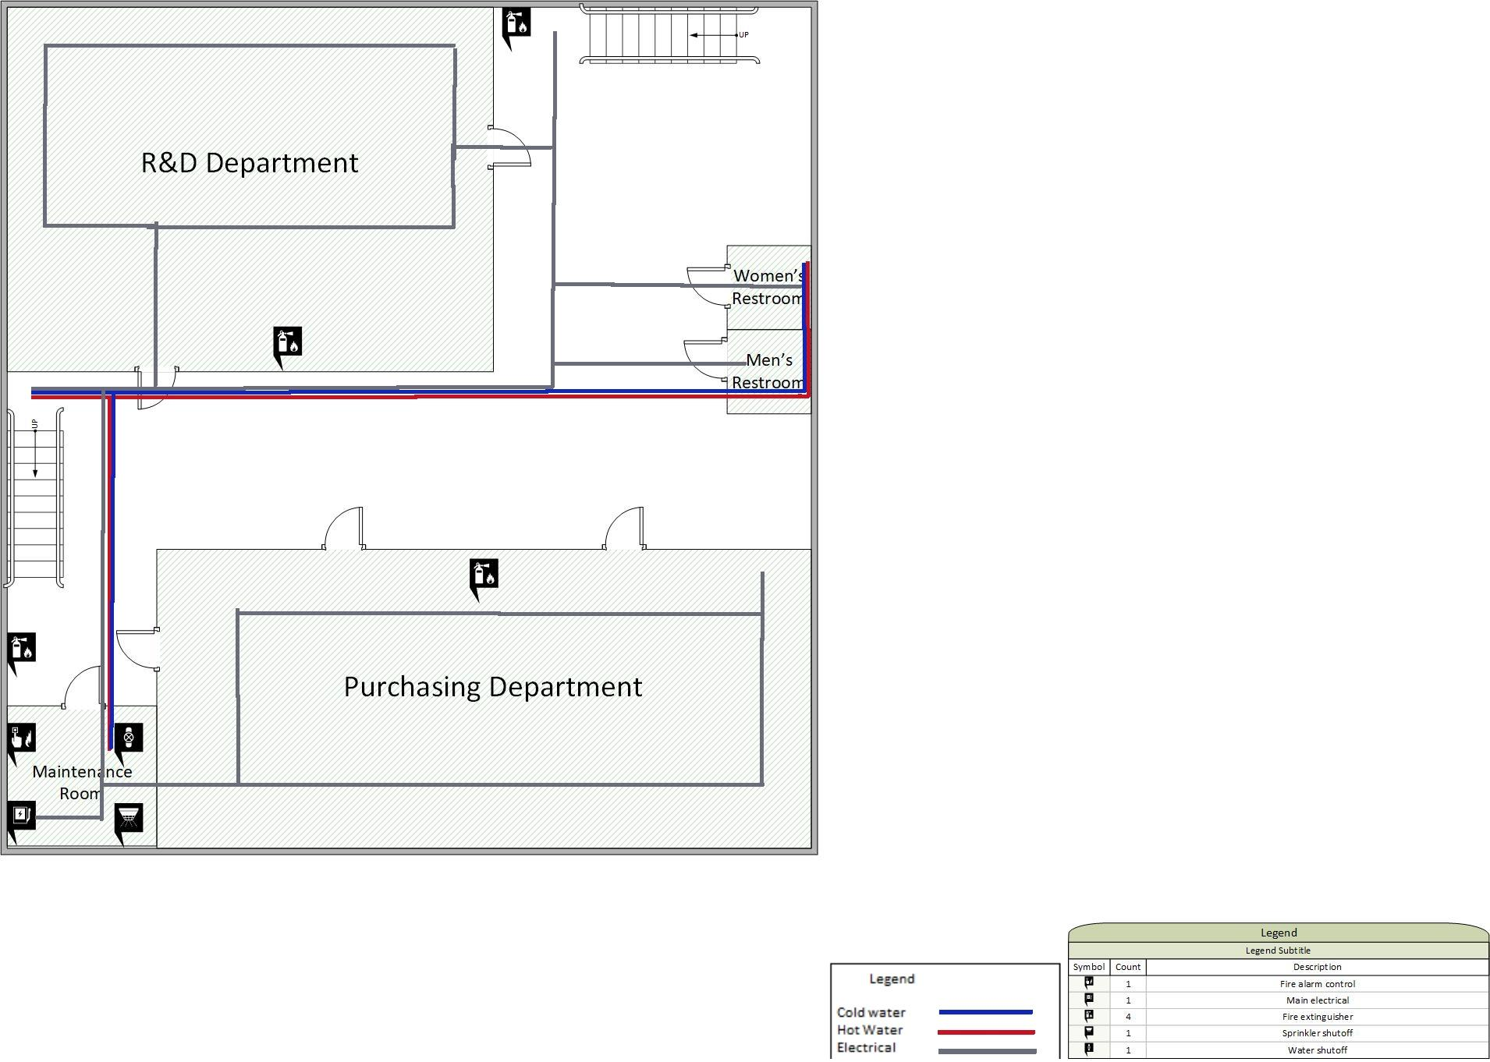
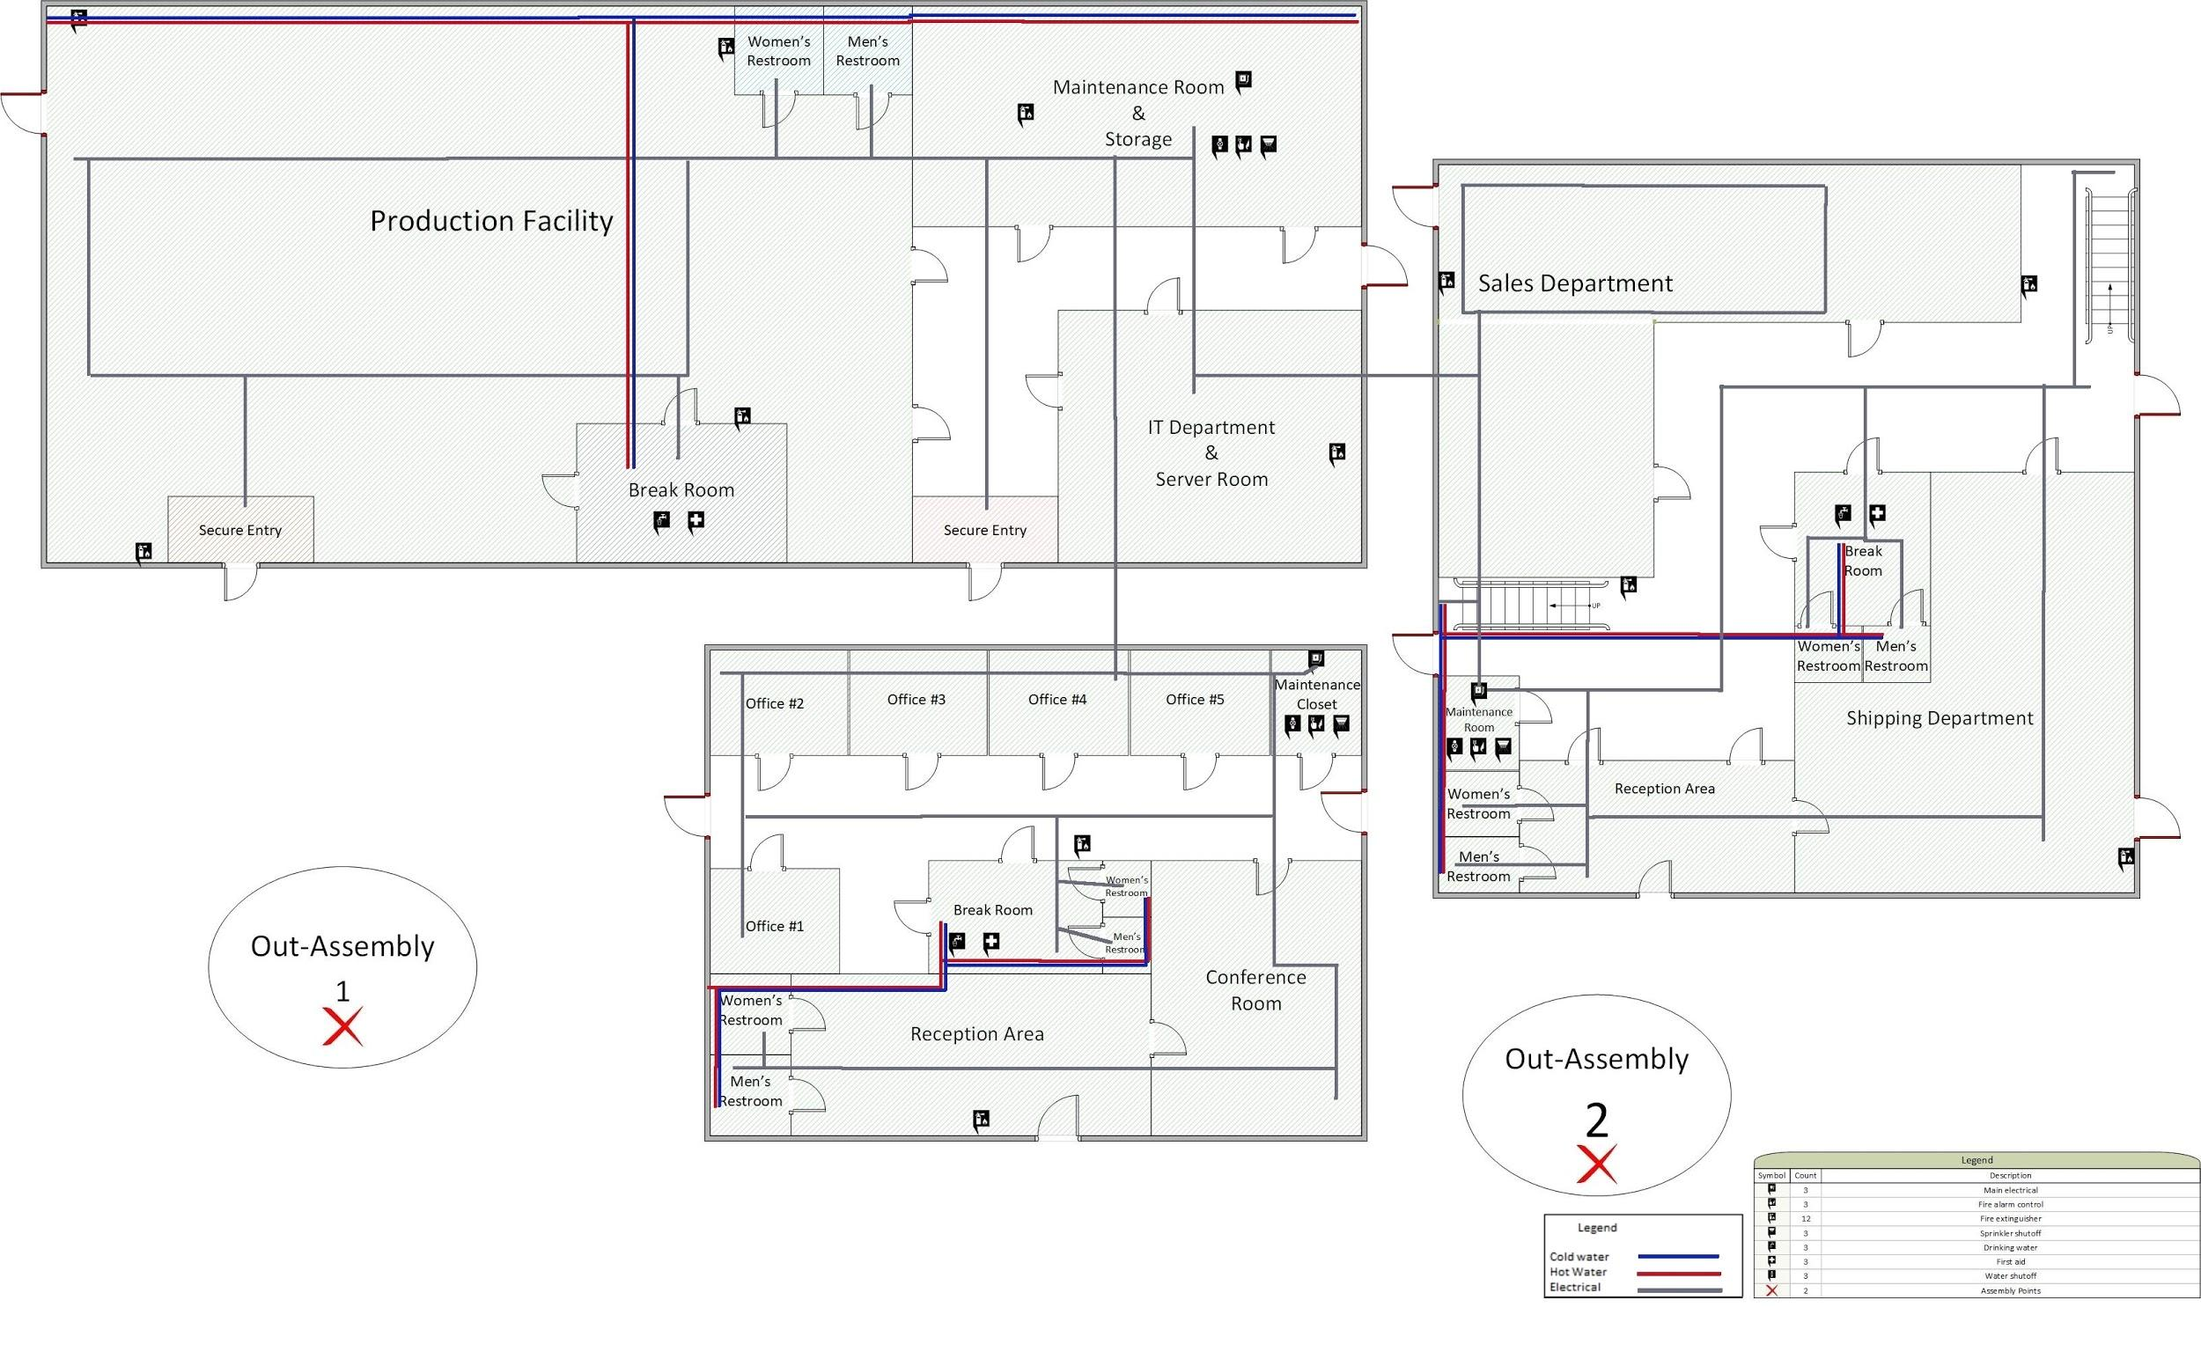
Floor Plans and Utility Mappings
These are the buildings floor plans.
These blueprints can be obtained from the building manager or from the county clerk.
Building manager is responsible for documenting any changes made to the building (such as new water lines, newrooms, etc.).
Anything done to the building will comply to the state’s building codes.

Slide 75
References
See write up document for references.

