Slide 1
Reklusive Administration Industries Network Renovation Plan
By Jose Ramirez

Slide 2

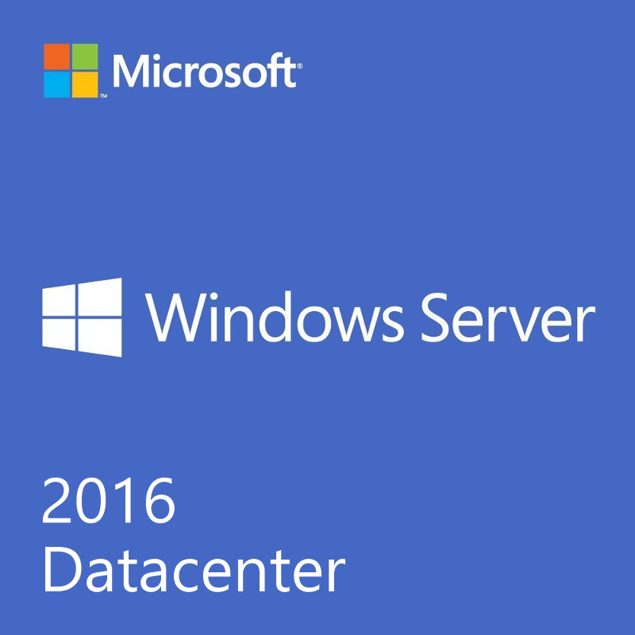
Why Windows Server 2016?
New Features:
Storage Replica
Failover Clustering
Windows Server Containers
Maximum 24 TB RAM
Up to 64, 64-bit cores
Usual Features:
Active Directory Domain Services
Dynamic Host Configuration Protocol
Domain Name System
Web Services
File Server Resource Manager

Slide 3
Sites and Servers
Two sites (Site Linked)
Phoenix
San Diego
Servers (5 Servers)
Root Domain Server located in San Diego
Child Domain server located in San Diego
Root Domain Server located in Phoenix
Child Domain server located in Phoenix
VoIP server in Phoenix

Slide 5
Domains, Organizational Units, Groups, etc.
3 Domains
Root Domain: RAI.com
Child Domain: SD.RAI.com
Child Domain: PHX.RAI.com
3 Organizational Units
SALES
MANAGEMENT
CALL CENTER
4 Groups – 60 Users
Sales’ Users
5 Users with 5 Computers
Management Users
5 Users with 6 Computers
Call Center Employees
45 Users with 45 Computers/VoIP Phones
Administrator/Manager
5 Users with 6 Computers

Slide 7
Network Properties and Other Devices
San Diego
Router
3 Firewalls
IP Addresses & Subnet
192.168.100.1 /25
255.255.255.128
Phoenix
Router
3 Firewalls
IP Addresses & Subnet
192.168.300.1 /25
255.255.255.128
Root Domain Servers replicate at certain times.
Router or Root Server can handle IP addressing with DHCP settings.
Group Policy set for strong passwords and lock-out settings.
Network Monitoring and Administration on Admin Console and Clients.

Slide 8
