Slide 1
IDPS Integration (SP 800-94)
By Jose Ramirez

Slide 2
What is the problem?
You have no way of detecting intrusions on your network.
You have no way of detecting anomalies on your network.
You want to be able to stop common threats on your network.
We want to stop trojans, worms, and other types of malware.
We want to detect and stop malformed packets.
We want to keep the network safe.

Slide 3
Solution based on SP 800-94
Our solution is based on the NIST’s Special Publication 800-94.
NIST 800-94 is about explaining, setting up, and managing IDPSs.
We want to implement IDPSs into the network.
We think IDPSs are an important implementation to the security infrastructure of nearly every organization.
But why? And what is an IDPS?

Slide 4
IDS, IPS, IDPS
IDS stands for Intrusion Detection System and they are responsible for detecting anomalies in the network.
IPS stands for Intrusion Prevention System and they can also detect anomalies in the network, but they can stop suspicious activity.
IDPS is the term used in SP 800-94 to refer to both technologies.

Slide 5

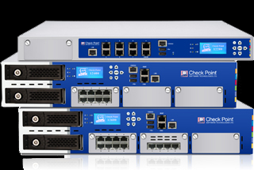
What can IDPSs do for your network?
Focused on identifying possible incidents and how to prevent them.
Can detect when a system’s vulnerability has been exploited.
Can be configured to report policy violations.
Some can monitor file transfers.
Document existing threats.
Notify administrators of important events happening on the network.

Slide 6

What else can they do?
The IPS can stop attacks by:
Terminating the network connection or users.
Block access to the target from the offending IP.
Block all access to the target.
Some IPSs can change the security environment by:
Configuring routers
Configuring firewalls
Configuring switches
And some IPSs can also change the attacks content.

Slide 7
False Readings
IDPSs don’t have 100% detection accuracy.
They can generate false positives and false negatives.
False positive is a incorrect identification
False negative is a fail on identifying malicious activity.
To help with the detection rate, we want to tune the IDPS to produces more false positives than negatives.

Slide 8
Detection Methodologies
IDPS systems use different detection methodologies to accomplish their task.
Signature-Based Detection
Anomaly-Based Detection
Stateful Protocol Analysis
Most IDPSs use one or more of these detection methodologies.

Slide 9
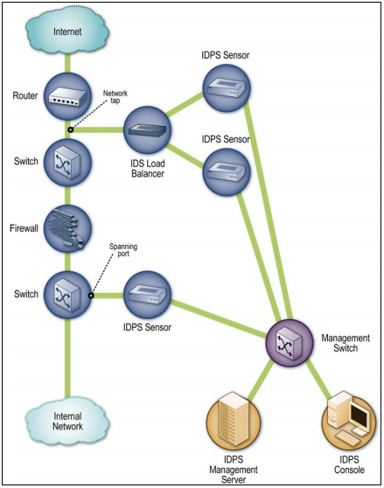
Network-Based IDPS
Monitors network traffic on particular segments or devices.
Most use all three types of detection methods.
It’s sensors monitor and analyze network activity.
Inline and passive sensors.
Very susceptible to high amounts of traffic.

Slide 10
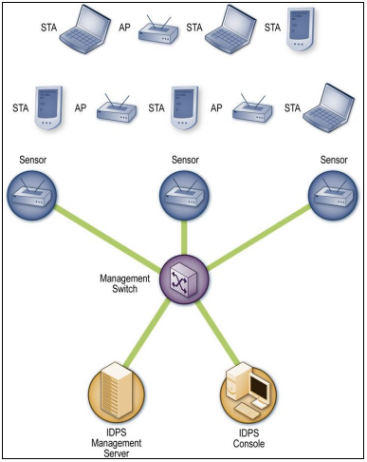
Wireless IDPS
Dedicated sensors and bundled sensors.
Fixed
Mobile
Intrusion prevention methods
Wireless
Wired
Can display the physical location of threats.
Susceptible to physical attacks, DDoS attacks, and don’t detect passive monitoring.

Slide 11
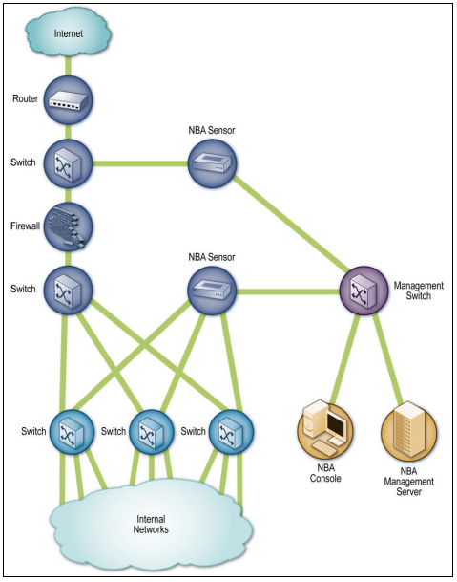
Network Behavior Analysis IDPS
NBA sensors sniff packets to monitor activity, others rely on traffic flow.
Sensors are passive and should be deployed in key network segments.
Anomaly and signature based detection.
Automatic updates, but needs network change information.
Slow to detect quick threats if sensors rely on traffic flow.
Flow sensors can be slower than monitoring sensors, but can monitor more traffic.

Slide 12
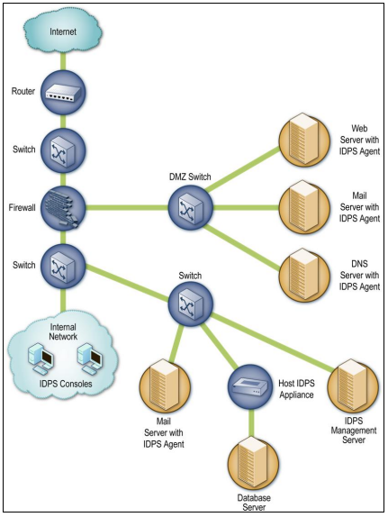
Host-Based IDPS
Agent software is deployed on hosts, some host IDPSs are physical appliances.
Encrypted connections between agents.
Some have the ability to monitor wireless and wired.
Agents will usually alter the internal architecture of the host.
Offer a wide variety of security capabilities.
Require a fair bit of tuning and customization.
May impact the performance of the hosts and the network.

Slide 13

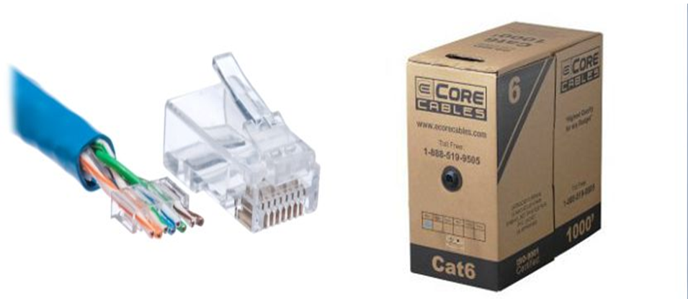
Equipment and personnel
Sensors or Agents
Management Server
Database Server
Console
Or IDPS hardware: Trend Micro Deep Discovery Inspector
CAT 6 Cable
Network Engineering team.
Our security team.
Any extra hands available.

Slide 14
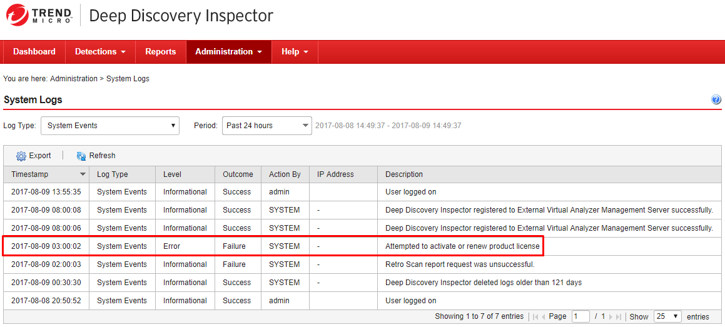
Implementation
Acquire the hardware and staff.
Create a test network.
Set-up the Deep Discovery Inspector.
Set up Console and connect it.
Connect it to the network.
Update and configure.

Slide 16

Implementation Cont.
SP 800-94 recommendations:
Each admin has a separate account.
Limit direct access to hardware.
Make sure data is being encrypted correctly.
Add two-factor authentication.
Management:
Keep all systems up to date.
Monitor for issues.
Vulnerability assessments.
Clean out logs.

Slide 17
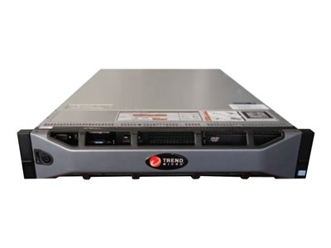
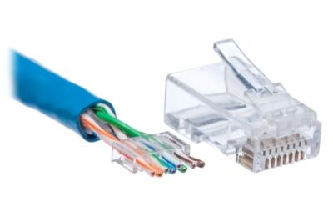

Budget
The Deep Discovery Inspector 1000: $109,527.99
CAT 6 Cable 1000ft and RJ 45 Connectors: $183.26
I estimate the final cost to be around $150,000

Slide 18
Benefits and Conclusion
The Deep Discovery Inspector 1000 has many features:
1000BaseT RJ45 connections.
Monitors all ports and more than 800 protocols.
Detection engine, correlation rules, custom sandboxing.
Detects attacks on many Operating Systems.
With these implementations your network will be safer.
Keep track of all logs and report any suspicious activity
Keep monitoring and doing assessments.

