Slide 1
HireBuddy
One sentence in. Checked jobs out.
Job hunting with a screen reader takes hours.
Notes:
[0:00-0:20 | 20s]
Imagine you're blind and looking for your first job. Most job sites fight your screen reader, and checking every listing for pay, hours, travel and whether it needs sight takes hours. HireBuddy does that work for you, inside WorkBuddy.

Slide 2
One Prompt
From her sentence
"I'm Nadia, blind, NVDA user in Subang Jaya. I type fast in English and Malay. Weekdays 9am-5pm, min RM12/hr. Resume is in Documents."
Blind, uses NVDA
Subang Jaya
English, Malay, typing
Weekdays 9 to 5
RM12/hr minimum
From her resume
Bank hotline, 1 year
Notes:
[0:20-0:45 | 25s]
This is all Nadia types. Twenty-three words, no forms. HireBuddy pulls out what matters: NVDA, Subang Jaya, English and Malay, weekdays, at least RM12 an hour. She just says where her resume is, and WorkBuddy finds it and reads her work history for her application.
[ACTION: paste this sentence into WorkBuddy now and let it run while you talk.]

Slide 3
WorkBuddy Is the Engine
Searches job sites
Her sentence
Reads her resume
Checks every job
Verifies
Saves results
Saves profile
in parallel
WorkBuddy
HireBuddy MCP tools
WorkBuddy features used
Local files
Web search
Automations
Telegram
Email
Notes:
[0:45-1:25 | 40s]
WorkBuddy is the engine. Our skill gives it the plan. It finds her resume in Documents, then searches JobStreet, Indeed and Hiredly while HireBuddy saves her profile, in parallel. Our tools check every job, verify the result, and save it on her computer. WorkBuddy also runs a daily check, takes requests by Telegram, and sends the application she chooses from her own email.

Slide 4
Why It's an Agent
Only 2 of 3 jobs fit
Goal
Plan
Tools
Verify
Deliver
Tests 5 ways to widen
retry
problems
None helps: stops, no padding
Fix
Lower her pay? Asks first
Can't finish until verified.
Notes:
[1:25-2:00 | 35s]
This is the real run on that sentence. Round one found only two jobs that fit. So the agent tested five ways to widen the search, simulating each one first. None added a job that actually suits her, so it stopped and told her what came closest, instead of padding the list with bad fits. Lowering her pay floor? It won't do that without her OK. And it cannot finish until verification passes.

Slide 5
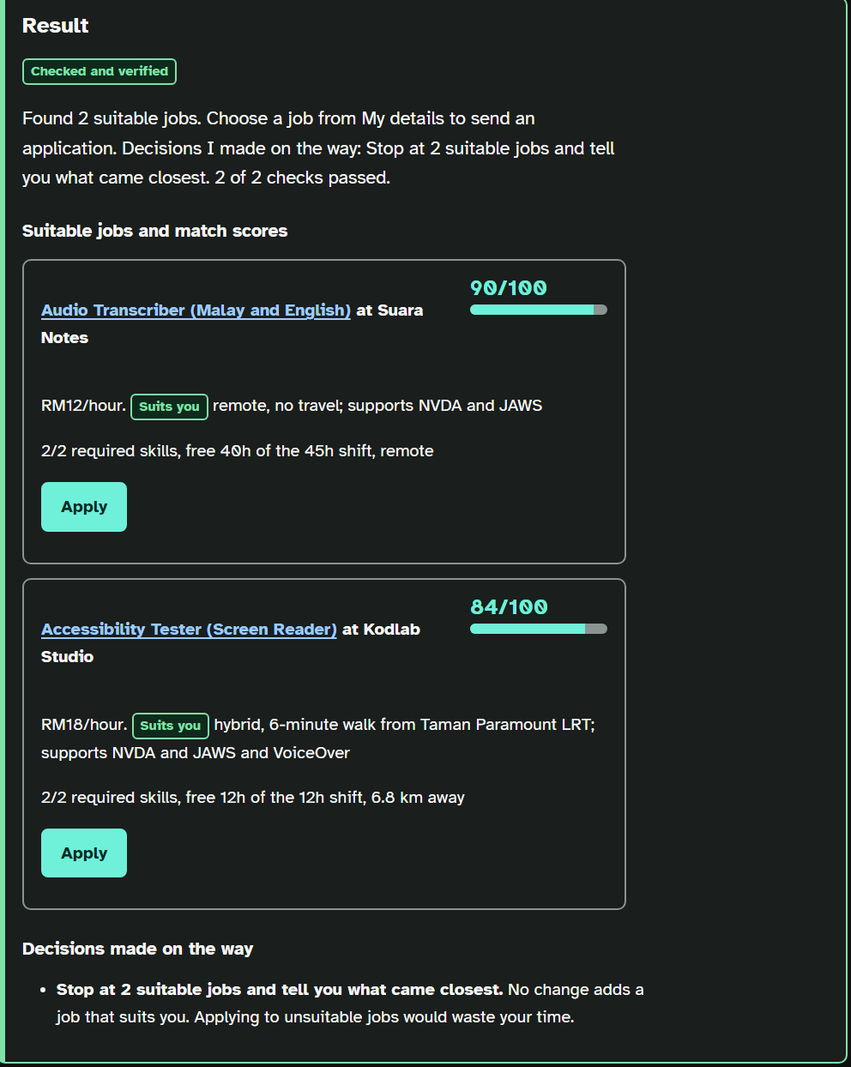
Proof
Notes:
[2:00-2:35 | 35s]
[ACTION: switch to WorkBuddy and show the finished result. If it is not ready, use this screenshot.]
One sentence in. Two suitable jobs, each with a match score and the reason it suits her. Checked and verified. Nothing below the RM8.72 legal minimum, no job that needs sight, and nothing is sent until she presses Apply. HireBuddy: work that gets done.

Slide 6
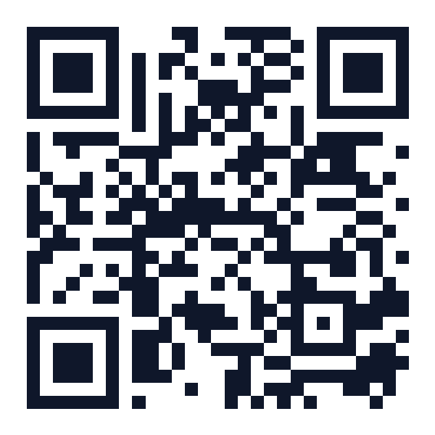
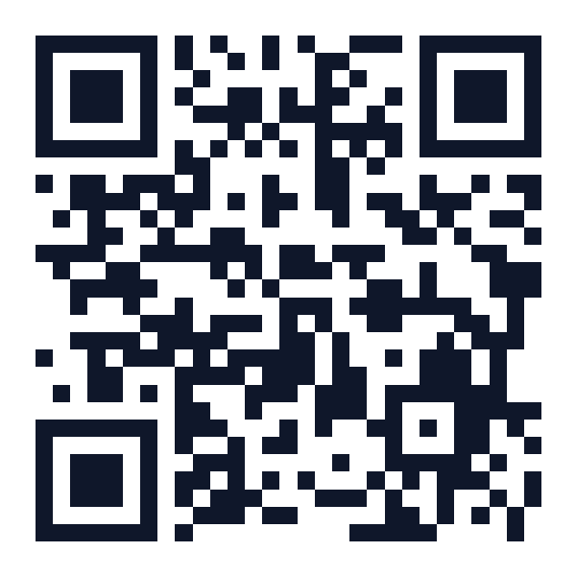
Try It: One Sentence
Live app
Code + WorkBuddy setup
hirebuddy-k543.onrender.com
github.com/Josan88/job-buddy
Paste Nadia's sentence, or write your own.
Notes:
[2:35-2:50 | 15s]
Scan to try it with Nadia's sentence or your own. HireBuddy: work that gets done. Thank you.
[Before presenting: open the live app a minute early, because the free server takes about a minute to wake up.]

Slide 7
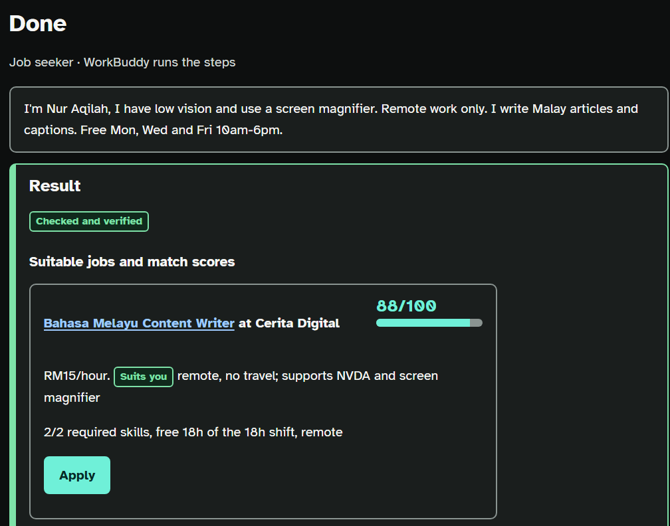
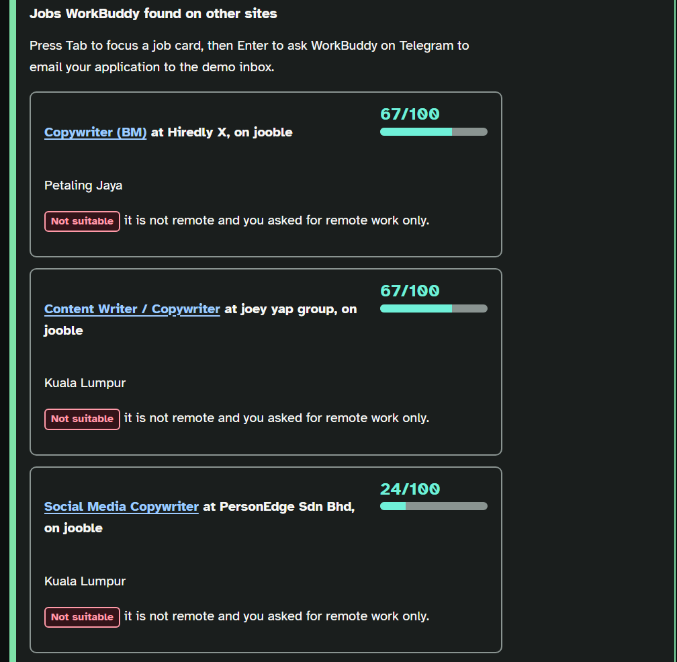
Backup: Real WorkBuddy Run
Notes:
Hidden slide. Only jump here if the live WorkBuddy demo is slow or fails. Say: Here is a real run WorkBuddy did end to end, for another job seeker, Nur Aqilah, who has low vision and needs remote work. WorkBuddy found 20 real listings on job sites. HireBuddy checked every one, gave a reason for each it rejected, found the one that suits her, drafted an application for one worth asking about, and passed all 6 checks. Nothing was sent.

