Slide 1
The effect of reward timescale on the rate of behavioral learning in a two-alternative forced-choice task
Joschua Geuter, Mehul Rastogi, Mrinalini Singh
December 12th, 2024

Slide 2
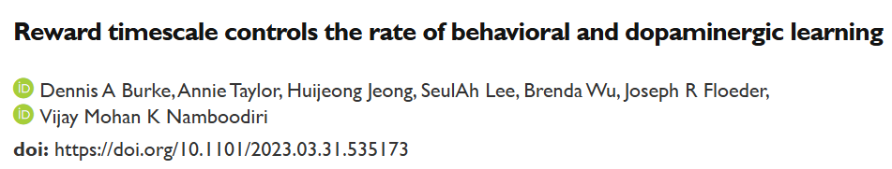
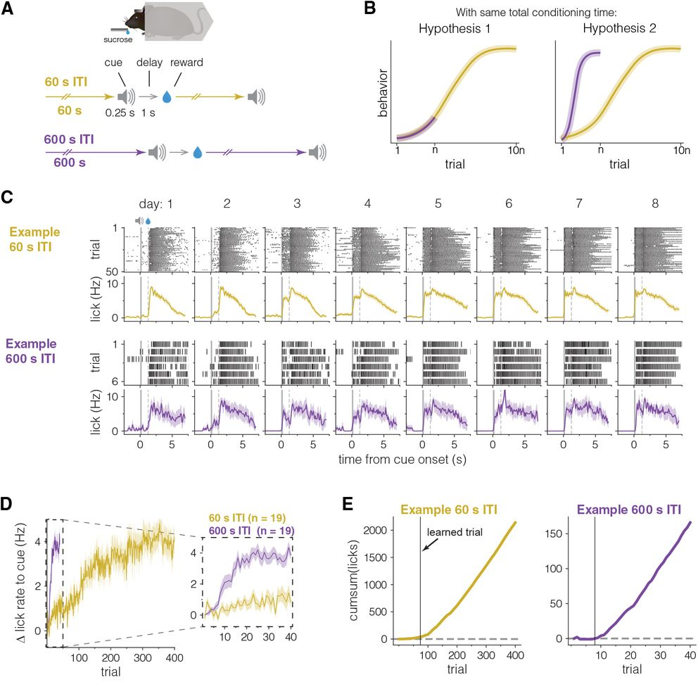
Motivation
Does the hypothesis extend to a 2-AFC task instead of a Pavlovian conditioning setting?
-OR-
Does exposure to number of trials have a more significant effect compared to ITI?

Slide 3
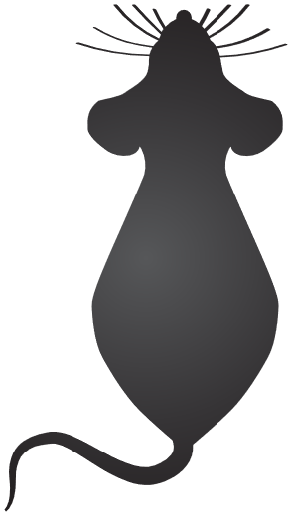



Trial Structure
Reward Delivery
(3s timeout)
Correct Response
Stimulus Presentation
(>0.2s fixation)
Choice Presentation
(5s timeout)
Trial Onset
(5s timeout)
correct
Wrong Response
Violation Noise (0.05s)
wrong
High/Low frequency
Or
High/Low Amplitude
Prob(left/right)=0.5
Inter-trial interval
Short (16s to 24s)
Or
long (80s to 120s)

Slide 4
Results

Slide 5
Conclusion

Slide 6
References

Slide 7
Acknowledgement

Slide 8
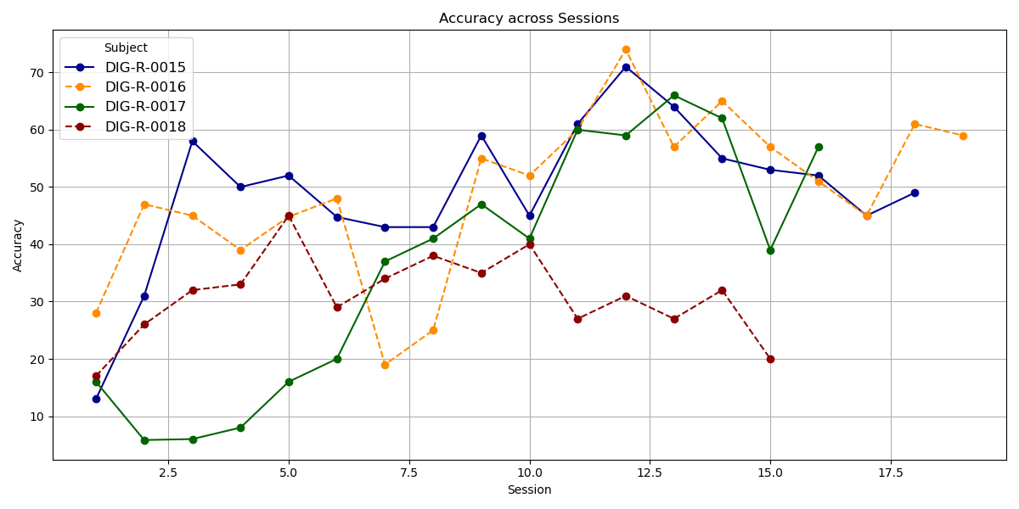
Accuracy for all animals across all sessions

Slide 9
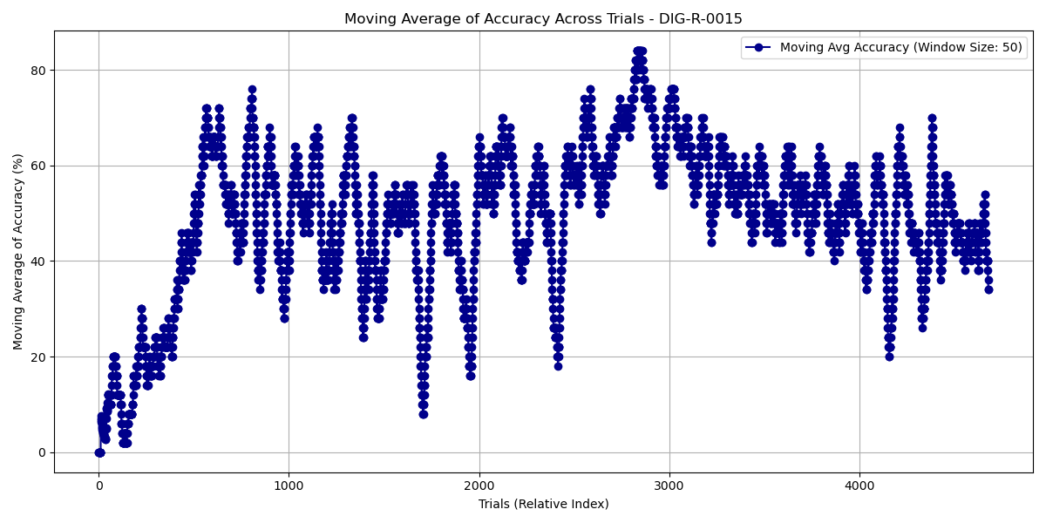

Slide 10
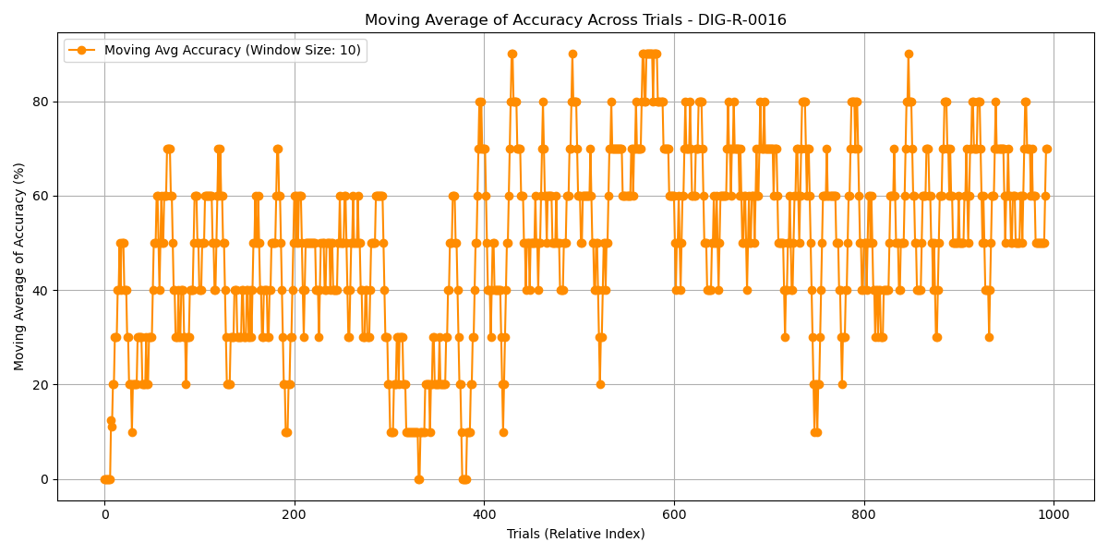

Slide 11
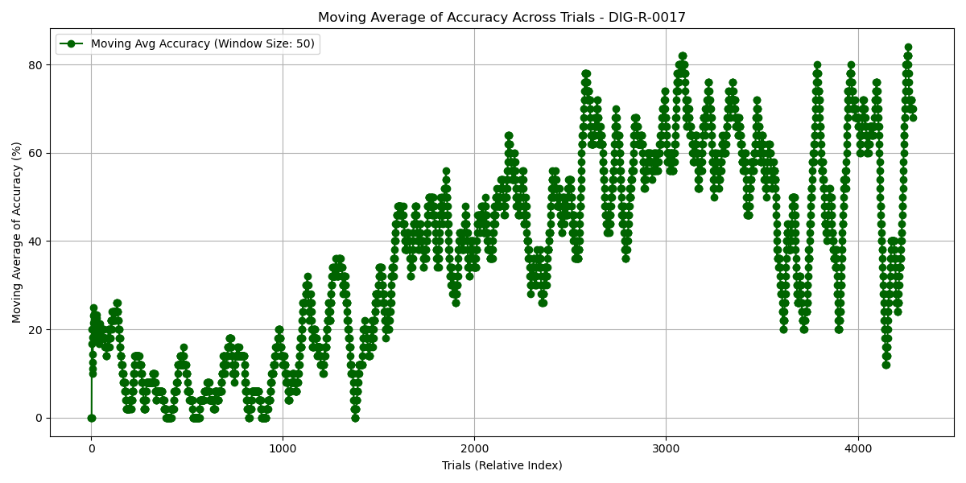

Slide 12
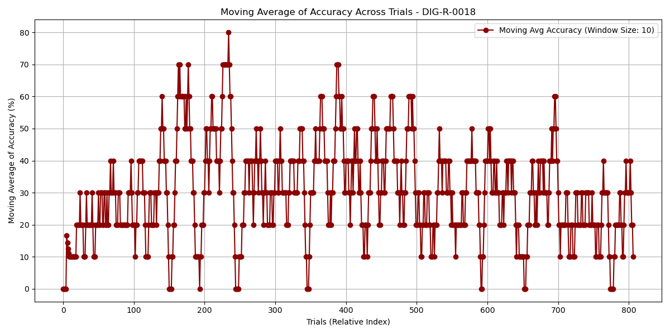

Slide 13
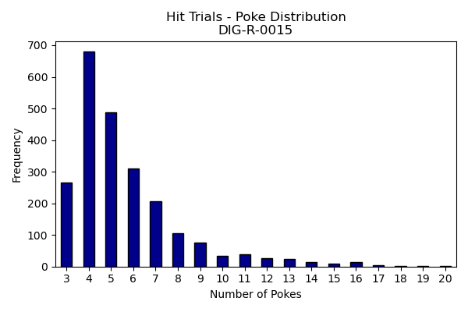
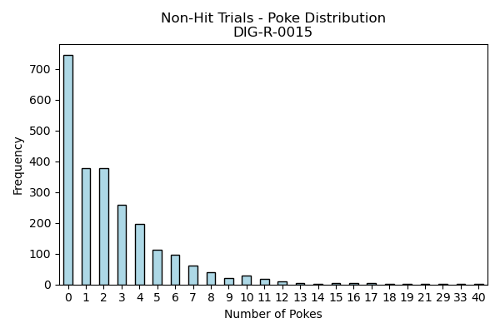
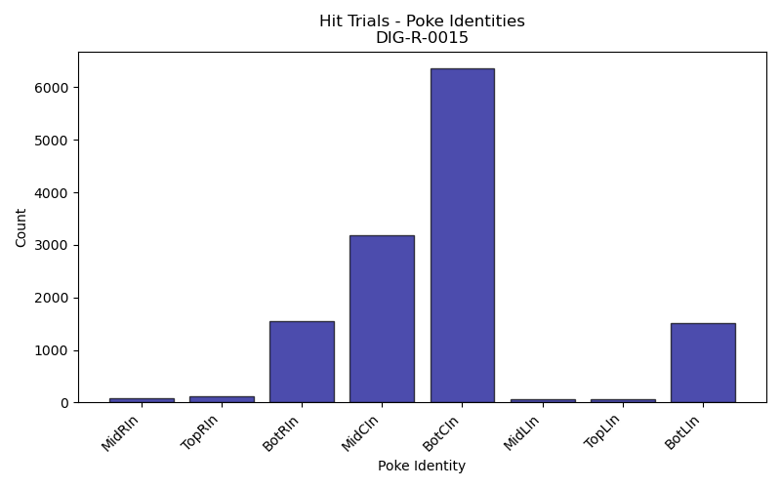
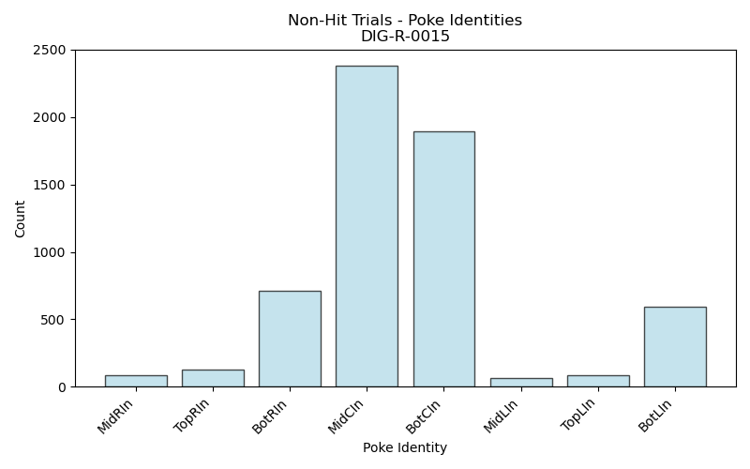
% of 0 poke trials: 31.29

Slide 14
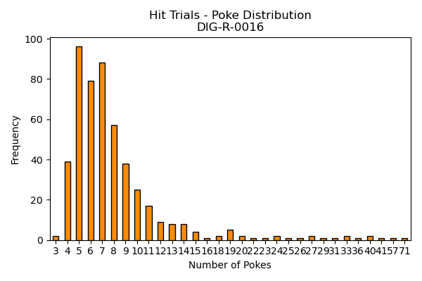
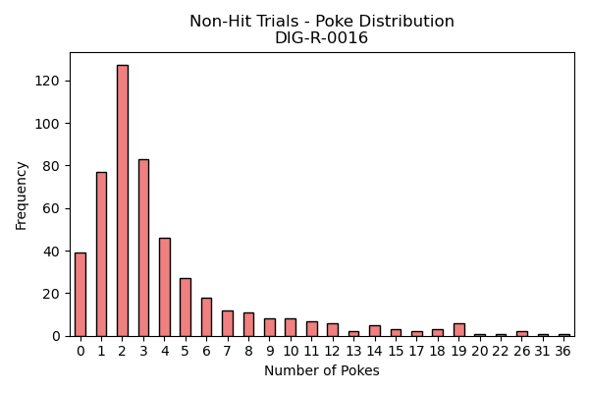
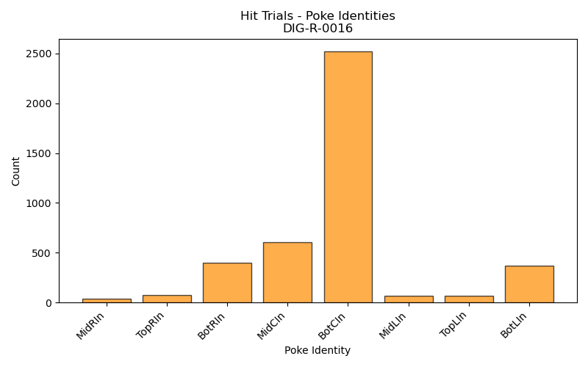
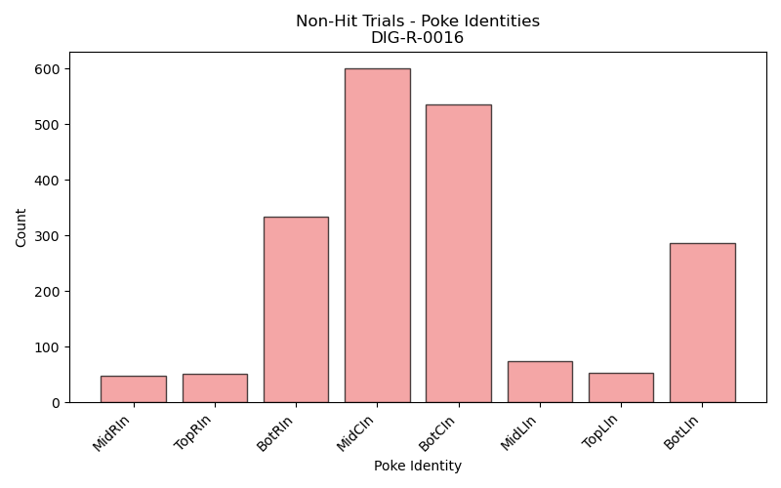
% of 0 poke trials: 7.86%

Slide 15
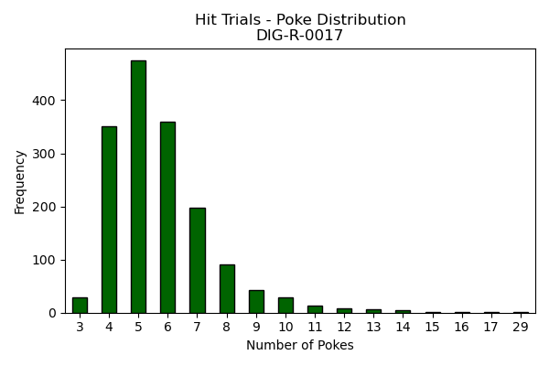
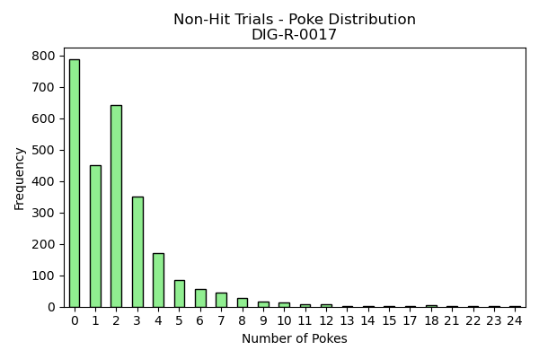
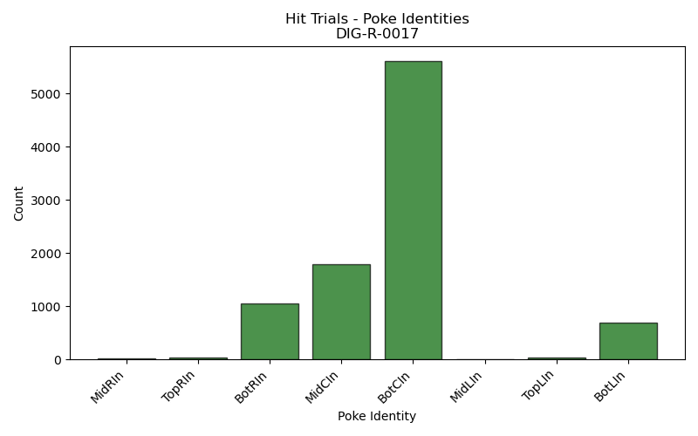
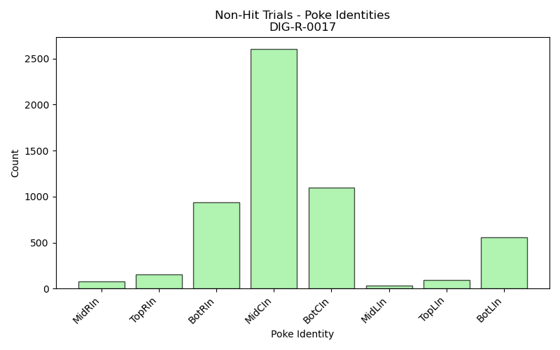
% of 0 poke trials: 29.37

Slide 16
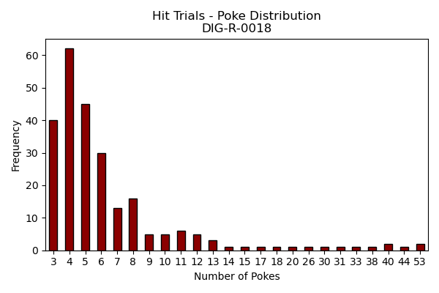
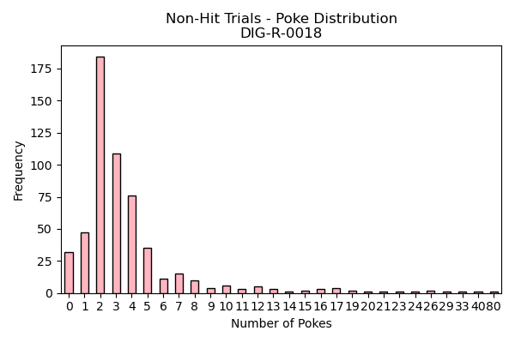
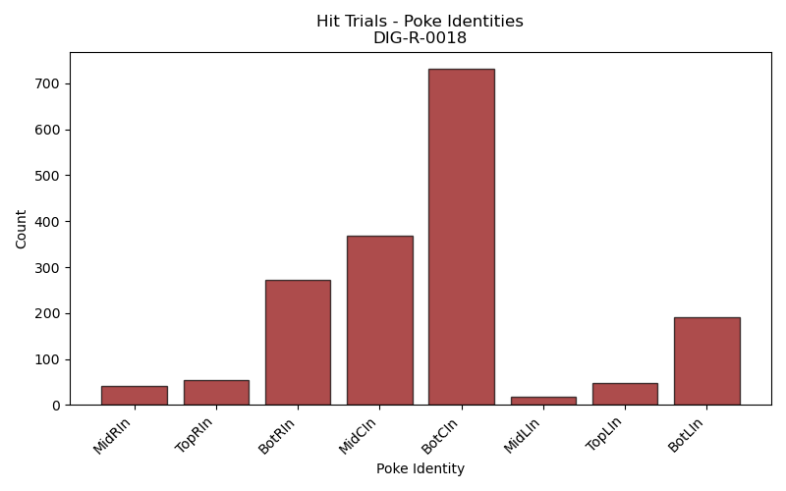
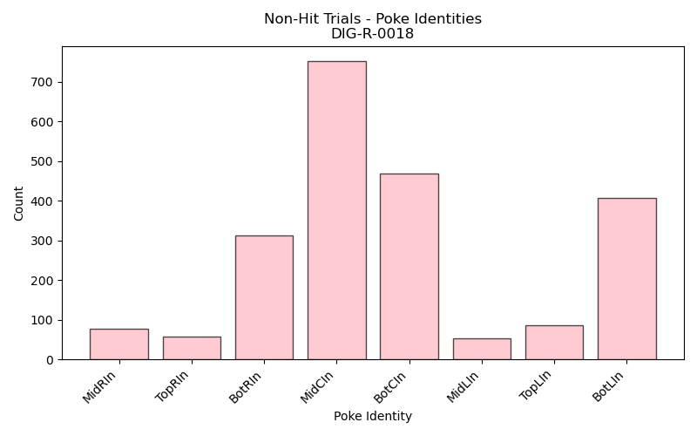
% of 0 poke trials: 5.69

Slide 17
Bias all animals:
Bias calculation: $\frac{\% hit R −\% hit L}{\% hit R+\% hit L}$ → -1 (left bias) to 1 (right bias)
R-15: % hit R = 48.54%, % hit L = 49.77%, Bias = -0.013
R-16: % hit R = 57.40%, % hit L = 42.51%, Bias = 0.149
R-17: % hit R = 44.57%, % hit L = 30.12%, Bias = 0.206
R-18: % hit R = 25.00%, % hit L = 35.84%, Bias = -0.179

Slide 18
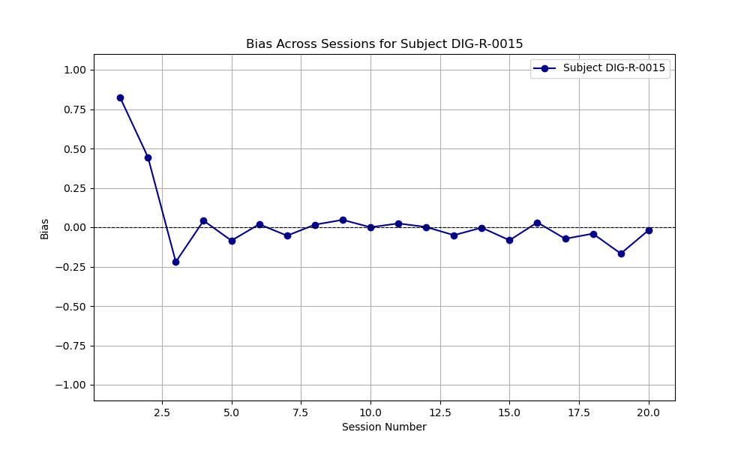
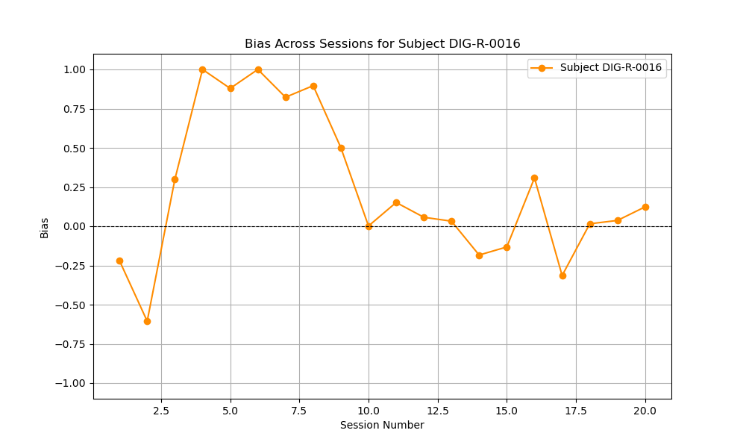
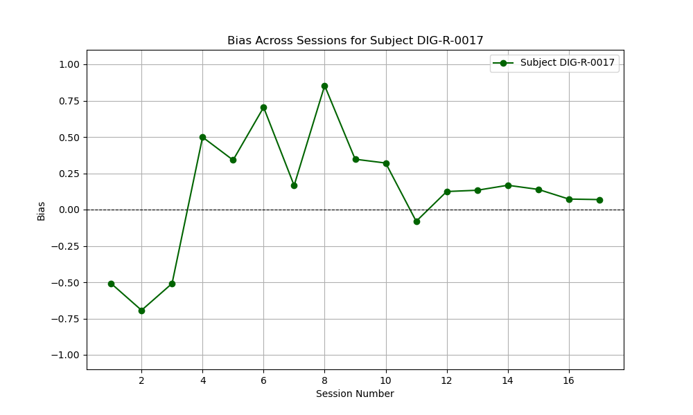
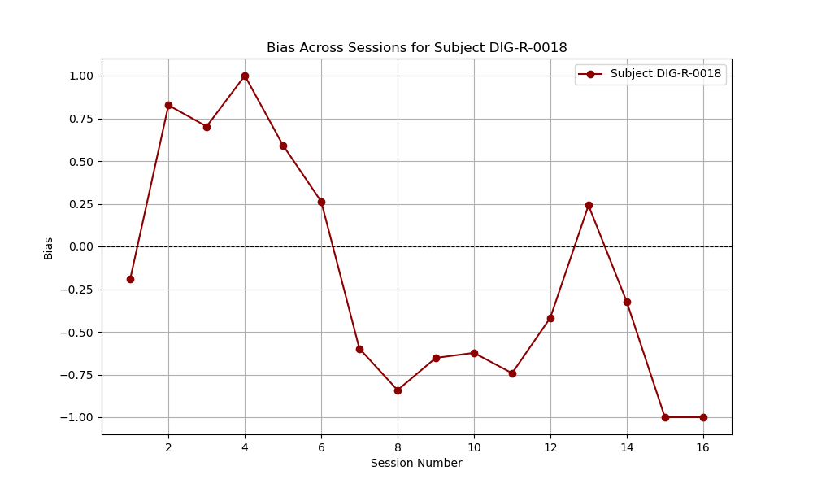
Bias per Session

Slide 19
Reaction times
R-15: Average reaction time for hit trials: 0.410 s
R-16: Average reaction time for hit trials: 0.443 s
R-17: Average reaction time for hit trials: 0.702 s
R-18: Average reaction time for hit trials: 0.659 s

Slide 20
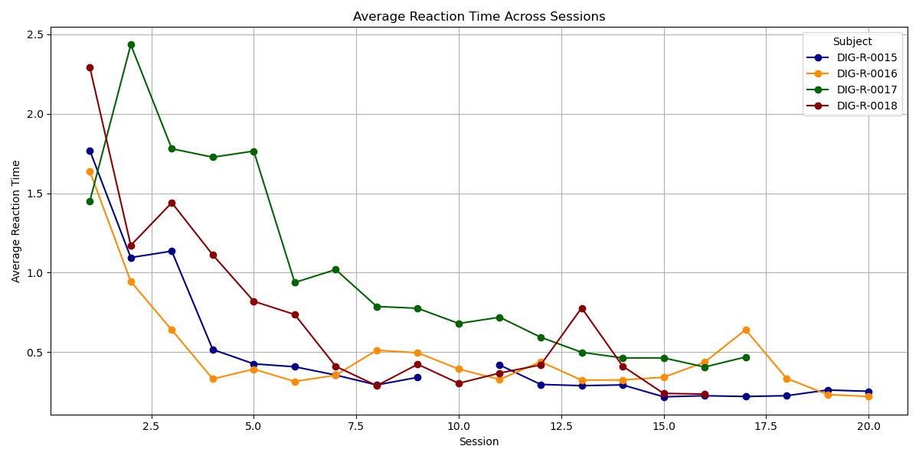
Reaction time declines across learning

