Slide 1
The effect of reward timescale on the rate of behavioral learning in a two-alternative forced-choice task
Joschua Geuter, Mehul Rastogi, Mrinalini Singh
December 12th, 2024

Slide 2
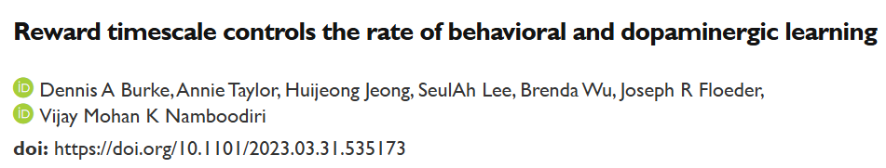
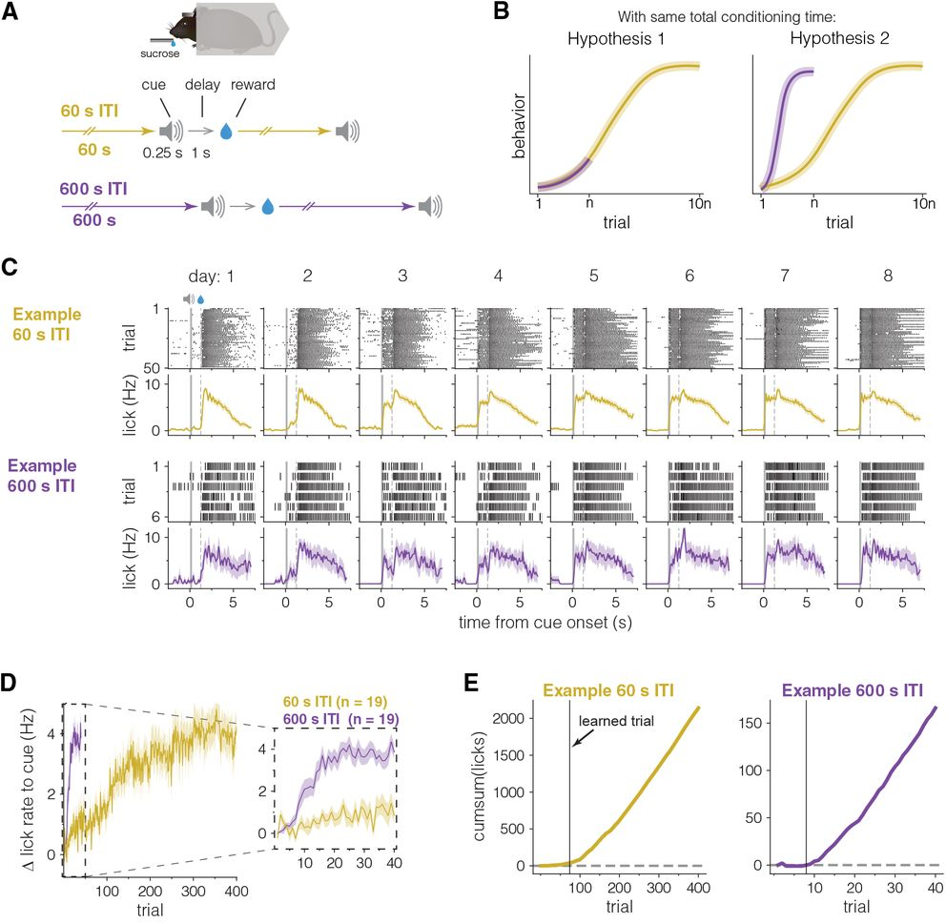
Motivation
Does the hypothesis extend to a 2-AFC task instead of a Pavlovian conditioning setting?
-OR-
Does exposure to number of trials have a more significant effect compared to ITI?

Slide 3




Trial Structure
Reward Delivery
(3s timeout)
Correct Response
Stimulus Presentation
(>0.2s fixation)
Choice Presentation
(5s timeout)
Trial Onset
(5s timeout)
correct
Wrong Response
Violation Noise (0.05s)
wrong
High/Low frequency
Or
High/Low Amplitude
Prob(left/right)=0.5
Inter-trial interval
Short (16s to 24s)
Or
long (80s to 120s)

Slide 4
Results

Slide 5
Conclusion

Slide 6
References

Slide 7
Acknowledgement

