Slide 1

Testing in Flutter
unit and integration testing

Slide 2
Prerequisites
I won't cover flutter and dart basics.
Check out the e-Portfolio of Dennis Rein for that
Flutter and Dart installation
Check out the installation guide on Github
https://github.com/JoschuaGoetz/se_flutter_testing#installation

Slide 3
Build in testing framework
Type | Environment | Covered here | Mockable
Unit | CLI – without UI | yes | yes
Widget | Single Widget in testing environment | no | yes
Integration | Whole app in testing environment | yes | Difficult but yes

Slide 4
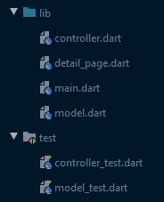
Unit testing - Structure
Folder structure and best practices:
All tests are in the test directory
Each test file corresponds to one file in the lib directory.
Flutter recognizes a file as a test file if it ends with "_test.dart"
To execute you just have to type "flutter test" from your project root

Slide 5
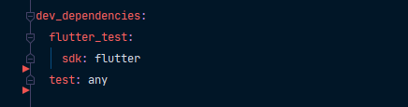
Unit testing - Installation
Add flutter test to your pubspec.yml
Run "flutter pub get"

Slide 6
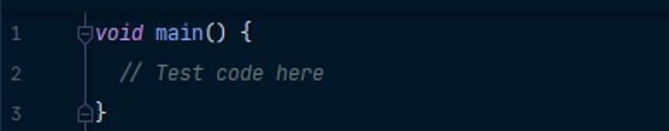
Unit testing - Methods
void main ()
-> Executable file of each test file

Slide 7
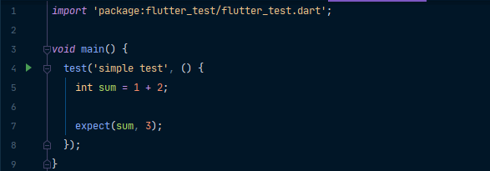
Unit testing - Methods
test(description, body)
Contains test code
expect(actual, matcher)
Test assertion
Must be in a test function
The test function only passes if all expects pass

Slide 8
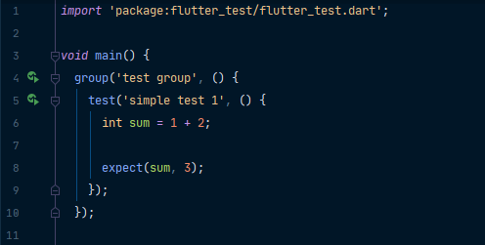
Unit testing - Methods
group(description, body)
groups test inside

Slide 9
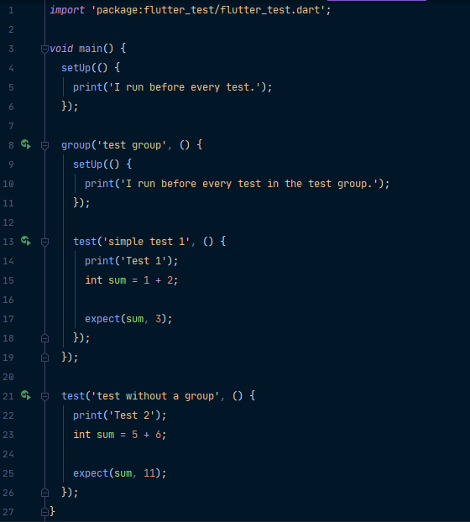
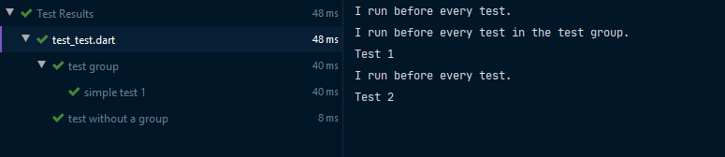
Unit testing - Methods
setUp(body)
runs before every test
If in a group, it runs before each test in the group
Multiple setUp functions are executed from top to bottom
Console output

Slide 10
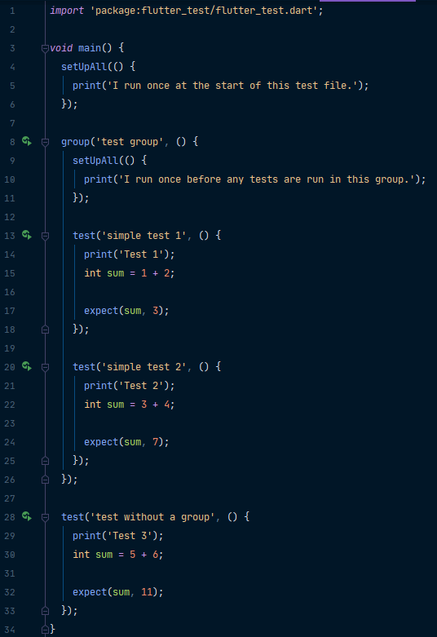
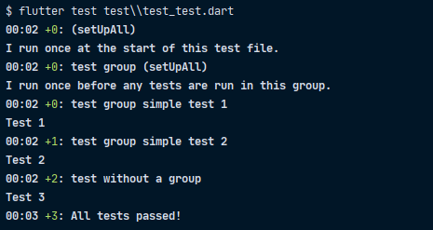
Unit testing - Methods
setUpAll(body)
runs once before any tests are run
If in a group, runs once before any tests in the group are run
Multiple setUpAll functions are executed from top to bottom
Console output

Slide 11
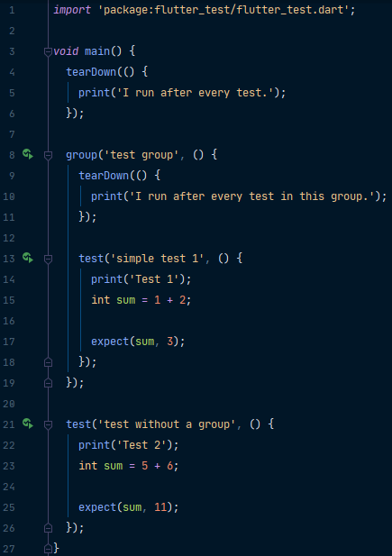
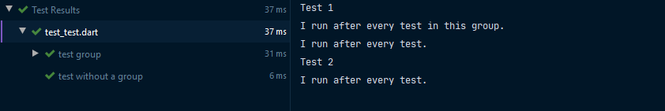
Unit testing - Methods
tearDown(body)
runs after every test
If in a group, it runs after each test in the group
Multiple tearDown functions are executed from bottom to top
Console output

Slide 12
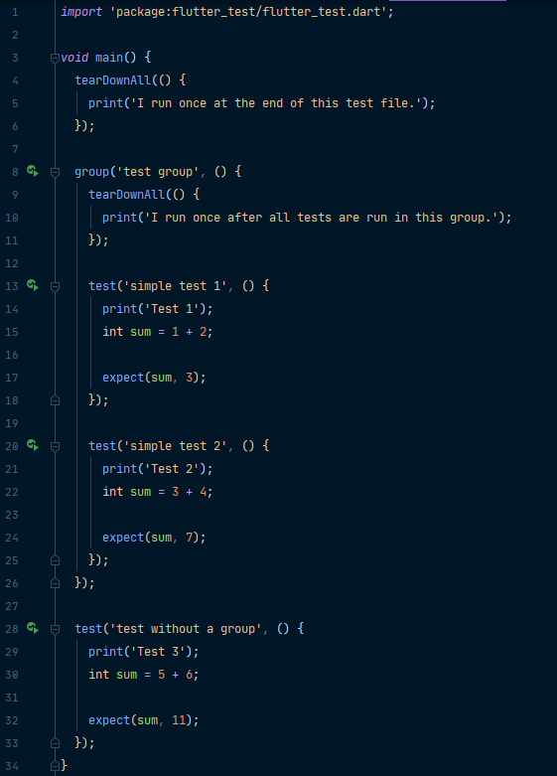
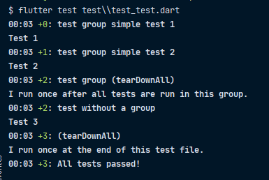
Unit testing - Methods
tearDownAll(body)
runs once after all tests are run
If in a group, runs once after all tests in the group are run
Multiple tearDownAll functions are executed from top to bottom
Console output

Slide 13
Unit Testing - Coverage
To get code coverage just execute yout tests with the "--coverage" flag
This generates a coverage file called lcov.info
Flutter has no native representation for the lcov.info
You need additional tools to make it readable
You could use codacy for example

Slide 14
Unit testing – Additional Resources
Additional info if you are interested
https://flutter.dev/docs/cookbook/testing/unit
https://pub.dev/packages/test
https://pub.dev/packages/mockito

Slide 15

Integration testing - Structure
Folder structure and best practices:
All files are in the test_driver directory
You need two files.
The executable file.
Can have any name. In this case "app.dart"
The test file.
Name must be "<Name of executable>_test.dart". In this case "app_test.dart"
Executable with the command - Needs a running android device (e.g emulator)
Adjust the name of your executable file

Slide 16
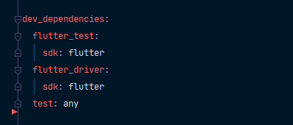
Integration testing - Installation
Add flutter driver to your pubspec.yml
Run "flutter pub get"

Slide 17
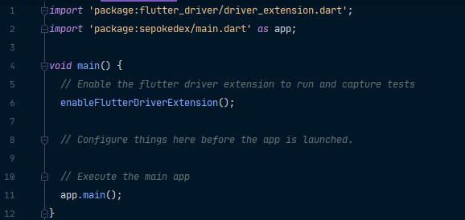
Integration testing – Executable File
This is the minimal execution file for each integration test

Slide 18
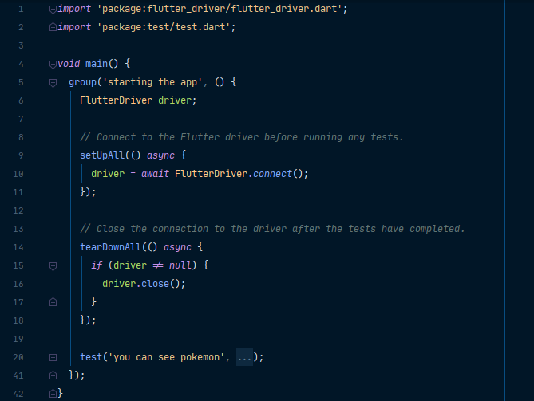
Integration testing – Test File
Same structure as a unit test
The setUpAll and tearDownAll functions are required to ensure correct execution
The driver is executing your app during the test

Slide 19
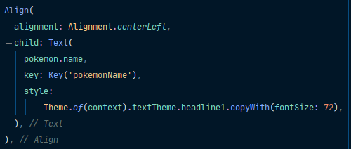

Integration testing - Methods
Finding widgets:
With the built-in object "finder" of flutter_driver
Needs widgets to have a set key property
finder.byValueKey(key)
Returns the widget with the given key

Slide 20
Integration testing - Methods
Interacting with a widget:
driver.tap(widget)
The driver taps on the given widget
driver.enterText(text)
Tries to enter text into an active text field
driver.drag(widget, Offset)
Drags the given widget based on the given Offset
Offset takes two parameters
Vertical distance
Horizontal distance
e.g Offset(500.0, -250.0)

Slide 21

Integration testing - Methods
Reading from a widget:
driver.getText(widget)
Gets the value of the text property of the given widget

Slide 22
Integration testing – Additional Resources
Additional info if you are interested
https://flutter.dev/docs/cookbook/testing/widget/introduction
https://pub.dev/packages/mockito
https://medium.com/stuart-engineering/mocking-integration-tests-with-flutter-af3b6ba846c7
https://flutter.dev/docs/cookbook/testing/integration
https://api.flutter.dev/flutter/flutter_driver/FlutterDriver-class.html

Slide 23
Demo

Slide 24
Flutter testing
Thank you

