Slide 1


Q CHECK
STATA PACKAGE FOR QUALITY CONTROL OF HOUSEHOLD SURVEYS
USER GUIDE
November 2016

Slide 2

OUTLINE
OVERVIEW
HOW DOES qcheck WORK?
SET UP
TEST
Static Test
Dynamic test
RESULTS
Examples
November 2016

Slide 3
OVERVIEW
HOW DOES qcheck WORK?
SET UP
CREATE A TEST
Static Test
Dynamic test
RESULTS
Examples
November 2016

Slide 4
OVERVIEW
qcheck
A STATA package for quality tests of surveys. On the one hand it performs specific tests of logical consistency within the survey. On the other hand, it compares descriptive variables and indicators over time or versions.
qcheck performs two different but complementary types of assessments
1
2
STATIC ASSESSMENT
DYNAMIC ASSESSMENT
Verifies the internal consistent of each variable and its relationship with other variables in the same dataset. It verifies that a variable makes sense in itself and checks the consistency of one variable with the others.
Assuming that all the datasets are standardized, it verifies the consistency of numerical and categorical variables over time. Also, it compares indicators performance over time (or versions). There are four cases of dynamic assessment.
A basic report will give means of a certain variable (like income) over time. If it jumps, attention should be drawn on what could have caused that.
Other reports over time include: poverty, missing values, zeros.
e.g.
it is not expected to find negative values for age
It is expected that paid workers receive a positive income
Household head can not have 8 years old or less
November 2016

Slide 5
OVERVIEW
HOW DOES qcheck WORK?
SET UP
CREATE A TEST
Static Test
Dynamic test
RESULTS
Examples
November 2016

Slide 6




HOW DOES QCHECK WORKS?
1. excel file as input.
2. qcheck runs
3. output files
qcheck uses information needed for assessments from an Excel file that has the variables classifications and tests.
The user can edit or create a different excel file for a particular standardized collection.
After assessment conditions are defined for a particular standardized collection, users can create customized reports by region, country list, particular years, variables.
qcheck saves results in Excel.
Users can analyze and share results using tableau. A Tableau file has been customized with some examples.
November 2016

Slide 7
OVERVIEW
HOW DOES qcheck WORK?
SET UP
CREATE A TEST
Static Test
Dynamic test
RESULTS
Examples
November 2016

Slide 8

INSTALLATION AND SET UP
STEP 1: Necessary files
Save in “C:\ado\plus\q” the following files:
qcheck.ado
qcheck_static.ado
qcheck_dynamic.ado
qcheck.sthlp
Excel input file is named “qcheck_#name#.xlsx”.(see “how does qcheck works?” section). It has the information needed for the assessments. Here, #name# is the name that you define to identify the tests file for a specific collection.
November 2016

Slide 9
INSTALLATION AND SET UP
STEP 2: Modifying the input file
Update the sheet “Test” in the qcheck_#name#.xlsx file.
How to fill the excel file?
variable | warning | description | temporalvars | iff | frequency
countrycode | Urgent | It is not a three letter country code. | cap confirm str4 var countrycode | _rc==0
hsize | Urgent | hsize is Equal to zero or negative. | no | hsize<1
pid | Urgent | Identifier of household member is not unique in the database. | cap destring pid, replace; duplicates report hhid pid; local n=r(unique_value); | `N'!= `n' | `N'-`n'
wage | High Priority | Hourly wage in principal occupation is negative. It should not | no | wage< 0
Variable name
in the dataset
Warning classification
Test description
Code to create temporal
variables needed for the test. Lines can be separated with “;”
STATA syntax to identify the error (test)
By default qcheck counts the total observation with inconsistencies. However, another type of report can be defined.
Important: you may not change any of the name sheets
November 2016

Slide 10
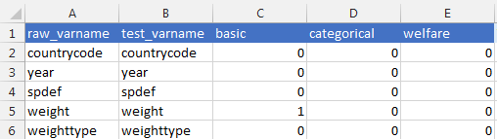
INSTALLATION AND SET UP
STEP 3: Update variables
Update the sheet “Variables” In the qcheck_#name#.xlsx file
How to fill the excel file?
If variable names change in the standardized datasets, users can still use the tests defined in "test" sheet. Using these columns, users can link the new variables (raw) with the name they assume in the test file (test)
Users have to classify the variables in basic, categorical or welfare. This classification helps the program link the variables with the four cases of dynamic assessment.
Important: you may not change any of the name sheets
November 2016

Slide 11

INSTALLATION AND SET UP
STEP 4: Load test file
Load your checks (excel file) into qcheck. This procedure will be repeated every time we have a new or updated input file.
STATA
1
If you save your test (excel) file in C:\ado\plus\q
qcheck load, test(qcheck_#name#)
2
If you save your test file in a different directory
qcheck load, test(qcheck_#name#) path (path)
3
If you save your test file in your current directory
qcheck load, test(qcheck_#name# ) path (CD)
November 2016

Slide 12


INSTALLATION AND SET UP
Now you are ready
to use qcheck
November 2016

Slide 13
OVERVIEW
HOW DOES qcheck WORK?
SET UP
CREATE A TEST
Static Test
Dynamic test
RESULTS
Examples
November 2016

Slide 14
STATIC TEST
syntax for qcheck static:
qcheck static, testfile ( ) countries( ) year( ) variables( ) outfile( ) type() [other options]
Define the static test
name of the Excel file with tests*
country list
year list
variable list
output file name
Dataset collection
*”name” identifies which already loaded excel file (through the qcheck create command) the program will be using.
November 2016

Slide 15
STATIC TEST
Other options available are:
veralt ( )
path()
survey ( )
region ( )
weight ( )
Version of the dataset
Folder where results will be saved
Survey name
Group of countries that belong to a Region e.g. LAC, EAP,ECA, MNA, etc.
Weight variable
* To see more detailed set of options go to qcheck help in the STATA console
November 2016

Slide 16
OVERVIEW
HOW DOES qcheck WORK?
SET UP
CREATE A TEST
Static Test
Dynamic test
RESULTS
Examples
November 2016

Slide 17
DYNAMIC TEST
syntax for qcheck dynamic:
qcheck static, testfile ( ) countries( ) year( ) variables( ) cases( ) type() [other options]
Define the static test
name of the Excel file with tests*
country list
year list
variable list
Cases of dynamic assessment
Dataset collection
*”name” identifies which already loaded excel file (through the qcheck create command) the program will be using.
November 2016

Slide 18
DYNAMIC TEST
Other options available are:
VERalt ( )
type ( )
survey ( )
REGion ( )
Weight ( )
Cases ( )
Version of the datase
Name of the harmonization or dataset group. e.g. GMD
Survey name.
Group of countries belonging to a Region e.g. LAC, EAP,ECA, MNA, etc.
Weight variable
Basic
Categorical
Cases of dynamic assessment
Inequality
Poverty
* To see more detailed set of options go to qcheck help in the STATA console
November 2016

Slide 19
DYNAMIC TEST
There are four cases of dynamic assessment:
Cases ( )
qcheck performs
Basic
Percentage of missing values.
Percentage of zero values.
Mean.
Annualized percentage change of mean
Categorical
qcheck presents changes in the participation share of each category over time in order to find inconsistencies.
Poverty
qcheck presents the main calculations for poverty and inequality (Poverty, Extreme poverty, Gini and Theil index) in order to find atypical changes.
Inequality
November 2016

Slide 20
OVERVIEW
HOW DOES qcheck WORK?
SET UP
CREATE A TEST
Static Test
Dynamic test
RESULTS
Examples
November 2016

Slide 21

RESULTS
The static and dynamic qcheck will show the following results (based on examples)
November 2016

Slide 22
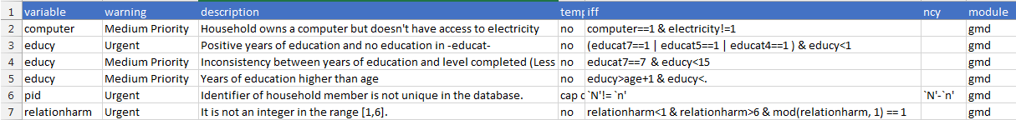
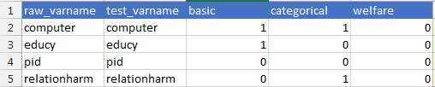
RESULTS
1
EXAMPLE - STATIC TEST
Assume that the user wants to assess the consistency for 4 variables: computer, education, the household identifier and relation with the head of the house in Brazil and Senegal. This, with the GMD database and for 2011 and 2014. Then the user creates a test called qcheck_eva.xls in this way:
Sheet: Test
Sheet: Variables
Then, after qcheck_eva.xls is saved and stored, the basic STATA syntax will come as follows:
qcheck static, test (eva) countries (bra sen) year (2011/2014)
type (gmd) variables (computer educy pid relationharm ) out (excel_bra_sen) path (path)
November 2016

Slide 23
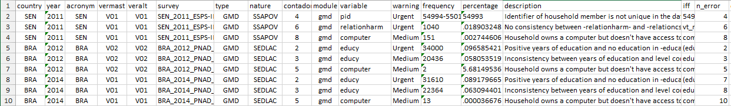
RESULTS
1
EXAMPLE - STATIC TEST
Excel output file will look like:
The results for this test show the inconsistencies found. In Senegal there is one problem that needs urgent review, and it is related to kinship (see first error), 1.8% of observations report this error.
In the case of Brazil, there are two urgent warnings related to the education variable in the years 2012 and 2014. Around 9% of the two survey have the problem of observations having positive years of schooling but showing no education at all in the categorized education attainment variable
November 2016

Slide 24

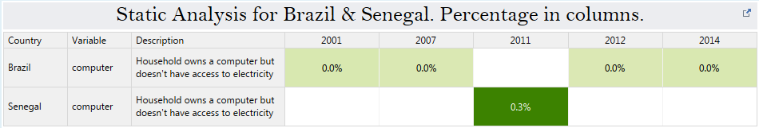
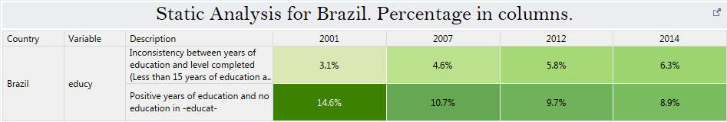
RESULTS
1
EXAMPLE - STATIC TEST
To facilitate the visualization of the results, the user can perform queries dynamically on tableau:
November 2016

Slide 25
RESULTS
2
EXAMPLE – DYNAMIC TEST
Now suppose that the user wants to generate a dynamic evaluation of different variables for the same countries in the period
between 2010 and 2015:
A basic dynamic analysis for the household size and education variables
A dynamic analysis for the urban/rural male/female categorical variables
A dynamic review of poverty indicators
A dynamic review of inequality indices
Then the basic STATA syntax will come as follows:
qcheck dynamic, countries (bra sen) test(qcheck_eva) var (hsize educy) year(2010/2015) type (gmd) case(basic) out(excl_bas) path (path) weight(weight)
qcheck dynamic, countries (bra sen) test(qcheck_eva) var (urban male) year(2010/2015) type (gmd) case(categorical) out(excl_bas) path (path) weight(weight)
qcheck dynamic, countries (bra sen) test(qcheck_eva) var (welfare) year(2010/2015) type (gmd) case(poverty) out(excl_bas) path (path) weight(weight)
qcheck dynamic, countries (bra sen) test(qcheck_eva) var (welfare) year(2010/2015) type (gmd) case(inequality) out(excl_bas) path (path) weight(weight)
November 2016

Slide 26
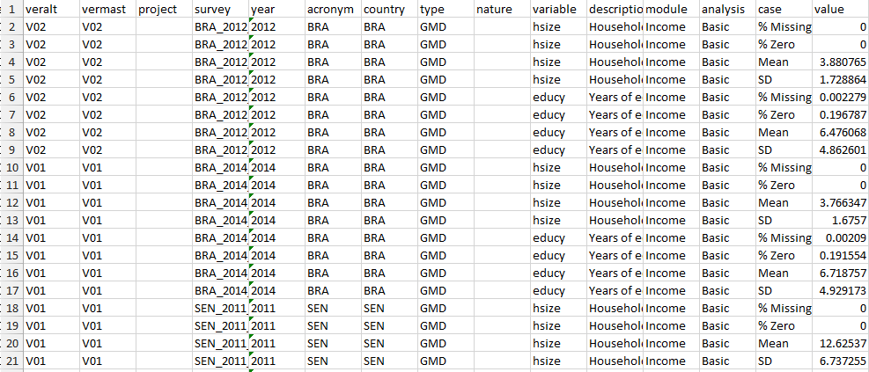
RESULTS
2
EXAMPLE – DYNAMIC TEST
Basic
The first test in the excel output will show to the user four measures: percentage of missing values, percentage of zero values, mean, annualized percentage change of mean. Using the years with the available data for each country from 2010 to 2015 and for each selected variable.
…
November 2016

Slide 27
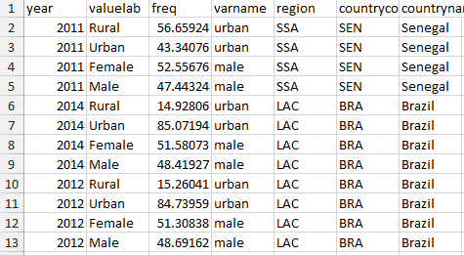
RESULTS
2
EXAMPLE – DYNAMIC TEST
Categorical
The second test in the excel output will show to the user the participation share of each category (male-female and urban-rural) over time, using the years with the available data for each country (Brazil and Senegal) from 2010 to 2015.
November 2016

Slide 28
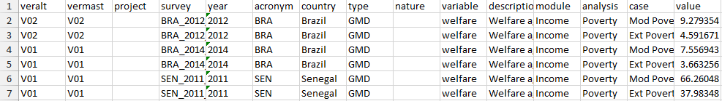
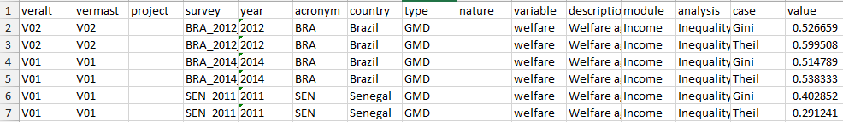
RESULTS
2
EXAMPLE – DYNAMIC TEST
Poverty
The third test in the excel output will two welfare measures: % of population living in poverty and % of population living in extreme poverty
Inequality
The first test in the excel output will show to the user two welfare measures of inequality: Gini index and Theil index, using the years with the available data for each country (Brazil and Senegal) from 2010 to 2015
November 2016

Slide 29
RESULTS
2
EXAMPLE – DYNAMIC TEST
To facilitate the visualization of the results, the user can perform queries dynamically on tableau dashboards, making selections of countries, variables, analysis and chart types. The figures below show the pre-define dashboards for qcheck.
Basic
Categorical
Poverty and Inequality
November 2016

