Slide 1

Mqtt and node-red
41488 – Industrial Project
2018/2019
Authors:
José Manuel Ferreira Dias
Daniel Alberto Pereira Cunha
Bruno de Pinho Barbosa
Tiago José Pereira Marques
José António Meireis Nogueira
Teacher:
Prof. Pedro Nicolau Faria da Fonseca

Slide 2
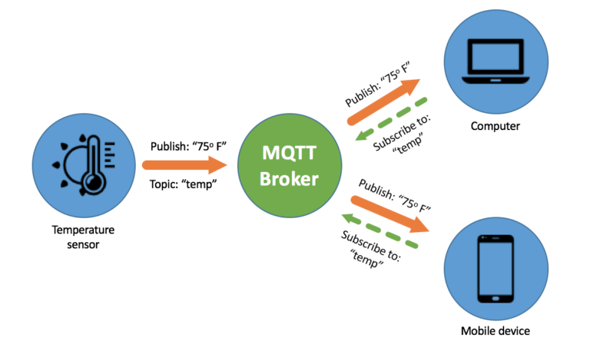
What is MQTT?
MQTT - Message Queuing Telemetry Transport
Publish-Subscribe message system
Client-Broker communication
Reliable QoS
Useful for devices with low power and low bandwidth

Slide 3

MQTT Topic
Specifies where the client wants to publish his message
Topics are strings separated by slashes “/” , which indicate topic level
Topic strings allow for empty spaces and are case-sensitive
More detailed info: https://www.hivemq.com/blog/mqtt-essentials-part-5-mqtt-topics-best-practices/

Slide 4
MQTT Broker
Receives all the messages by topic
Publishes the messages to all subscribed clientes
Example: Mosquitto, Cloud-MQTT

Slide 5

NODE-RED
Flow-based programming tool
Describes an application’s behavior as a network of “nodes”
Allows visual representation of flows

Slide 6
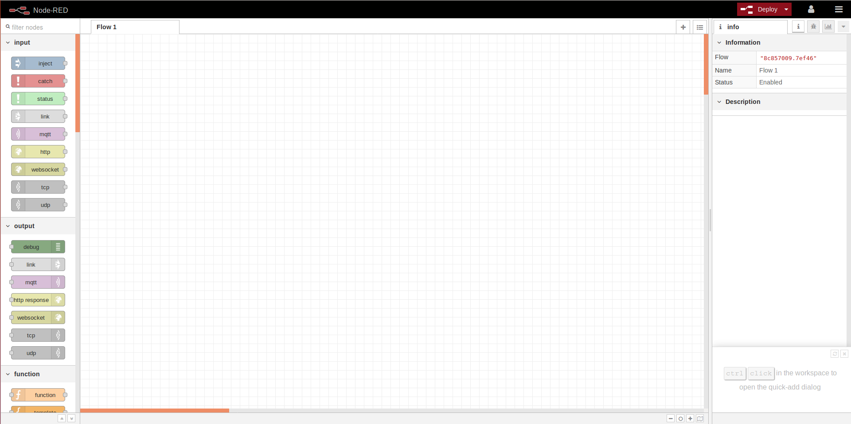
NODE-RED runtime/editor

