Slide 1
Clustering with Gaussian Mixtures
Note to other teachers and users of these slides. Andrew would be delighted if you found this source material useful in giving your own lectures. Feel free to use these slides verbatim, or to modify them to fit your own needs. PowerPoint originals are available. If you make use of a significant portion of these slides in your own lecture, please include this message, or the following link to the source repository of Andrew’s tutorials: http://www.cs.cmu.edu/~awm/tutorials . Comments and corrections gratefully received.
Andrew W. Moore
Professor
School of Computer Science
Carnegie Mellon University
www.cs.cmu.edu/~awm
awm@cs.cmu.edu
412-268-7599

Slide 2
Unsupervised Learning
You walk into a bar.
A stranger approaches and tells you:
“I’ve got data from k classes. Each class produces observations with a normal distribution and variance σ²I . Standard simple multivariate gaussian assumptions. I can tell you all the P(w_{i})’s .”
So far, looks straightforward.
“I need a maximum likelihood estimate of the μ_{i}’s .“
No problem:
“There’s just one thing. None of the data are labeled. I have datapoints, but I don’t know what class they’re from (any of them!)
Uh oh!!

Slide 3
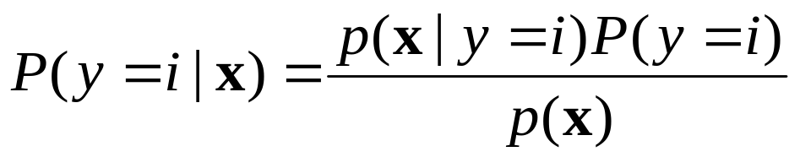
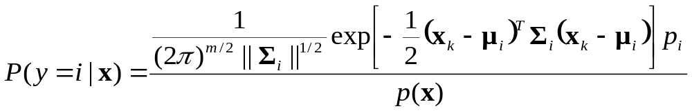
Gaussian Bayes Classifier Reminder
How do we deal with that?

Slide 4
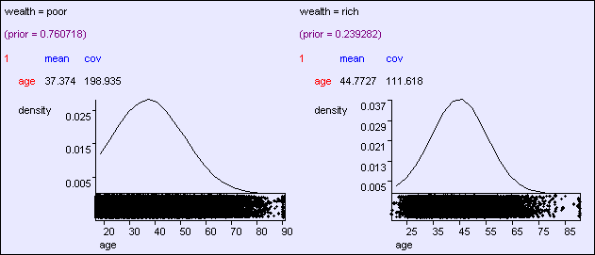
Predicting wealth from age

Slide 5
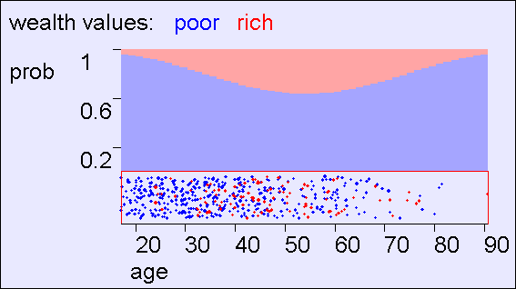
Predicting wealth from age

Slide 6
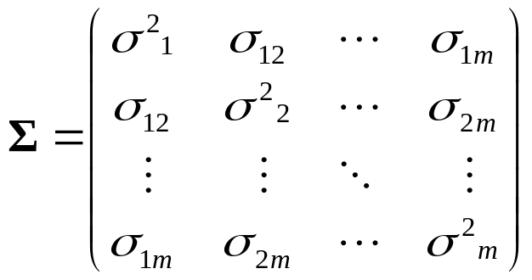
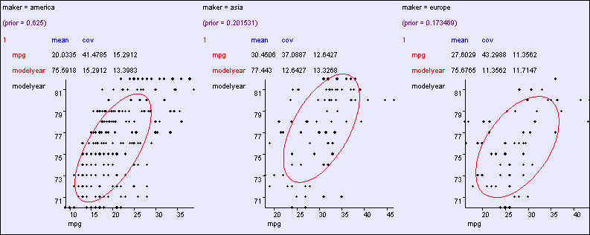
Learning modelyear , mpg ---> maker

Slide 7
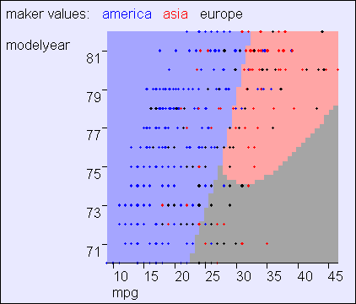
General: O(m²) parameters

Slide 8
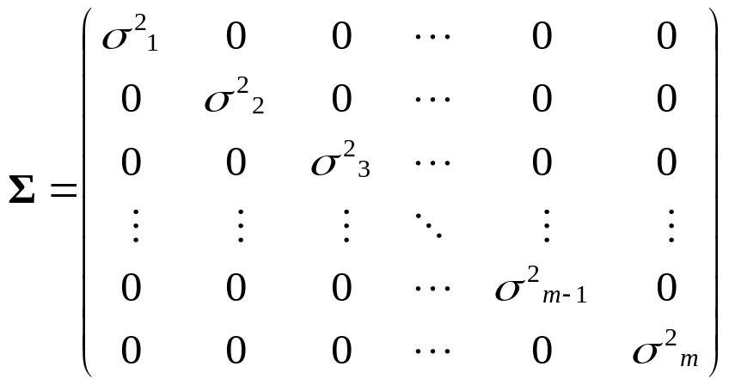
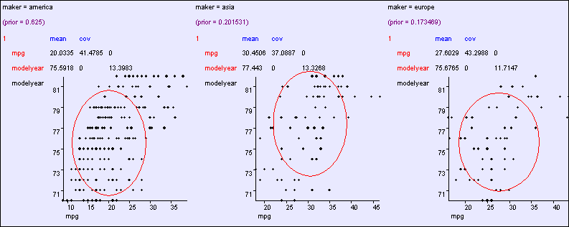
Aligned: O(m) parameters

Slide 9
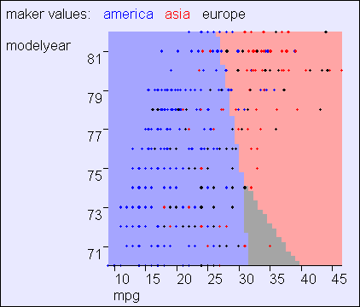
Aligned: O(m) parameters

Slide 10
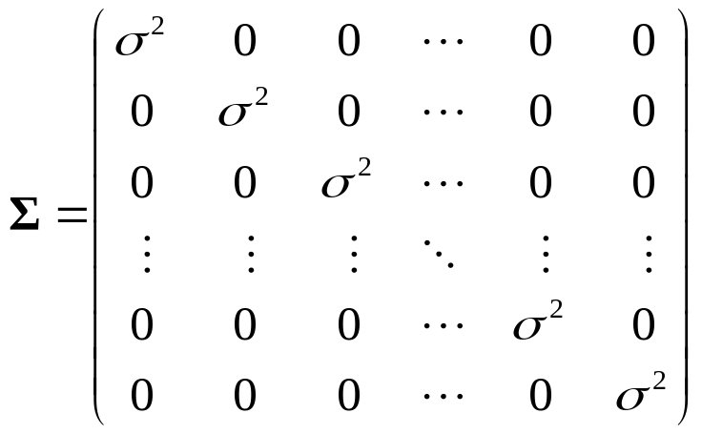
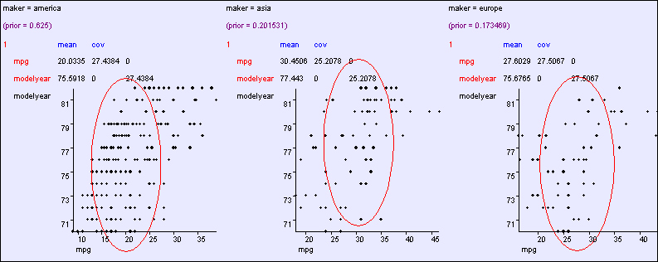
Spherical: O(1) cov parameters

Slide 11
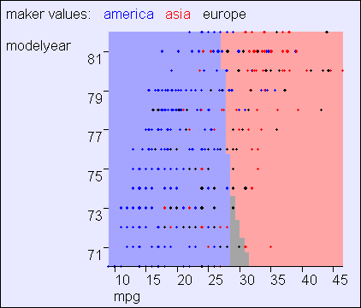
Spherical: O(1) cov parameters

Slide 12
Making a Classifier from a Density Estimator
Categorical inputs only
Real-valued inputs only
Mixed Real / Cat okay
Predict
category
Joint BC
Naïve BC
Gauss BC
Dec Tree
Inputs
Classifier
Density
Estimator
Prob-
ability
Joint DE
Naïve DE
Gauss DE
Inputs
Predict
real no.
Inputs
Regressor

Slide 13
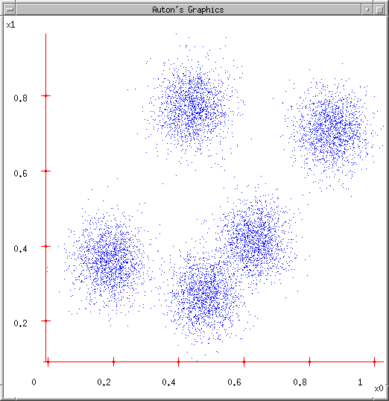
Next… back to Density Estimation
What if we want to do density estimation with multimodal or clumpy data?

Slide 14
The GMM assumption
There are k components. The i’th component is called ω_{i}
Component ω_{i} has an associated mean vector μ_{i}
μ₂
μ₁
μ₃

Slide 15
The GMM assumption
There are k components. The i’th component is called ω_{i}
Component ω_{i} has an associated mean vector μ_{i}
Each component generates data from a Gaussian with mean μ_{i} and covariance matrix σ²I
Assume that each datapoint is generated according to the following recipe:
μ₂
μ₁
μ₃

Slide 16
The GMM assumption
There are k components. The i’th component is called ω_{i}
Component ω_{i} has an associated mean vector μ_{i}
Each component generates data from a Gaussian with mean μ_{i} and covariance matrix σ²I
Assume that each datapoint is generated according to the following recipe:
Pick a component at random. Choose component i with probability P(ω_{i}).
μ₂

Slide 17
The GMM assumption
There are k components. The i’th component is called ω_{i}
Component ω_{i} has an associated mean vector μ_{i}
Each component generates data from a Gaussian with mean μ_{i} and covariance matrix σ²I
Assume that each datapoint is generated according to the following recipe:
Pick a component at random. Choose component i with probability P(ω_{i}).
Datapoint ~ N(μ_{i}, σ²I )
μ₂
x

Slide 18
The General GMM assumption
There are k components. The i’th component is called ω_{i}
Component ω_{i} has an associated mean vector μ_{i}
Each component generates data from a Gaussian with mean μ_{i} and covariance matrix Σ_{i}
Assume that each datapoint is generated according to the following recipe:
Pick a component at random. Choose component i with probability P(ω_{i}).
Datapoint ~ N(μ_{i}, Σ_{i} )
μ₂
μ₁
μ₃

Slide 19
Unsupervised Learning: not as hard as it looks
 | Sometimes easy
 | Sometimes impossible
 | and sometimes in between
IN CASE YOU’RE WONDERING WHAT THESE DIAGRAMS ARE, THEY SHOW 2-d UNLABELED DATA (X VECTORS) DISTRIBUTED IN 2-d SPACE. THE TOP ONE HAS THREE VERY CLEAR GAUSSIAN CENTERS

Slide 20
Computing likelihoods in unsupervised case
We have x₁ , x_{2 , …} x_{N}
We know P(w₁) P(w₂) .. P(w_{k})
We know σ
P(x|w_{i}, μ_{i}, … μ_{k}) = Prob that an observation from class w_{i} would have value x given class means μ₁… μ_{x}
Can we write an expression for that?

Slide 21
likelihoods in unsupervised case
We have x₁ x₂ … x_{n}
We have P(w₁) .. P(w_{k}). We have σ.
We can define, for any x , P(x|w_{i} , μ₁, μ₂ .. μ_{k})
Can we define P(x | μ₁, μ₂ .. μ_{k}) ?
Can we define P(x₁, x₁, .. x_{n} | μ₁, μ₂ .. μ_{k}) ?
[YES, IF WE ASSUME THE X₁’S WERE DRAWN INDEPENDENTLY]

Slide 22

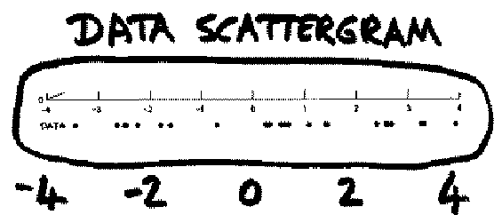
Unsupervised Learning:
Mediumly Good News
We now have a procedure s.t. if you give me a guess at μ₁, μ₂ .. μ_{k,}
I can tell you the prob of the unlabeled data given those μ‘s.
Suppose x‘s are 1-dimensional.
There are two classes; w₁ and w₂
P(w₁) = 1/3 P(w₂) = 2/3 σ = 1 .
There are 25 unlabeled datapoints
(From Duda and Hart)
x₁ = 0.608
x₂ = -1.590
x₃ = 0.235
x₄ = 3.949
:
x₂₅ = -0.712

Slide 23
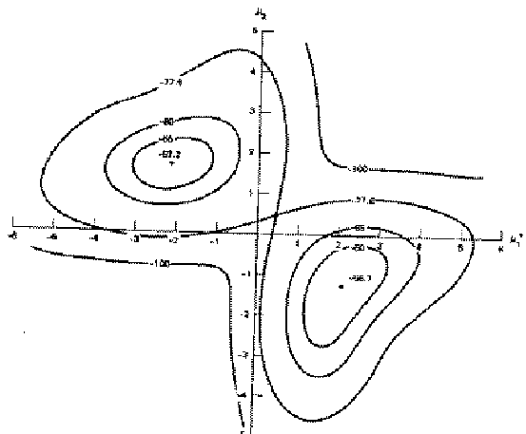
Duda & Hart’s Example
Graph of
log P(x₁, x₂ .. x₂₅ | μ₁, μ₂ )
against μ₁ (→) and μ₂ (↑)
Max likelihood = (μ₁ =-2.13, μ₂ =1.668)
Local minimum, but very close to global at (μ₁ =2.085, μ₂ =-1.257)*
* corresponds to switching w₁ + w₂.

Slide 24
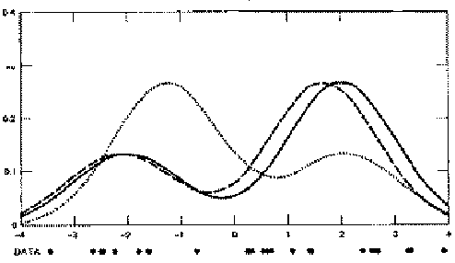
Duda & Hart’s Example
We can graph the prob. dist. function of data given our μ₁ and μ₂ estimates.
We can also graph the true function from which the data was randomly generated.
They are close. Good.
The 2nd solution tries to put the “2/3” hump where the “1/3” hump should go, and vice versa.
In this example unsupervised is almost as good as supervised. If the x₁ .. x₂₅ are given the class which was used to learn them, then the results are (μ₁=-2.176, μ₂=1.684). Unsupervised got (μ₁=-2.13, μ₂=1.668).

Slide 25
Finding the max likelihood μ₁,μ₂..μ_{k}
We can compute P( data | μ₁,μ₂..μ_{k})
How do we find the μ_{i}‘s which give max. likelihood?
The normal max likelihood trick:
Set  log Prob (….) = 0
✰ μ_{i}
and solve for μ_{i}‘s.
# Here you get non-linear non-analytically- solvable equations
Use gradient descent
Slow but doable
Use a much faster, cuter, and recently very popular method…

Slide 26
Expectation Maximalization

Slide 27
The E.M. Algorithm
DETOUR
We’ll get back to unsupervised learning soon.
But now we’ll look at an even simpler case with hidden information.
The EM algorithm
  Can do trivial things, such as the contents of the next few slides.
  An excellent way of doing our unsupervised learning problem, as we’ll see.
  Many, many other uses, including inference of Hidden Markov Models (future lecture).

Slide 28
Silly Example
Let events be “grades in a class”
w₁ = Gets an A P(A) = ½
w₂ = Gets a B P(B) = μ
w₃ = Gets a C P(C) = 2μ
w₄ = Gets a D P(D) = ½-3μ
(Note 0 ≤ μ ≤1/6)
Assume we want to estimate μ from data. In a given class there were
a A’s
b B’s
c C’s
d D’s
What’s the maximum likelihood estimate of μ given a,b,c,d ?

Slide 29
Silly Example
Let events be “grades in a class”
w₁ = Gets an A P(A) = ½
w₂ = Gets a B P(B) = μ
w₃ = Gets a C P(C) = 2μ
w₄ = Gets a D P(D) = ½-3μ
(Note 0 ≤ μ ≤1/6)
Assume we want to estimate μ from data. In a given class there were
a A’s
b B’s
c C’s
d D’s
What’s the maximum likelihood estimate of μ given a,b,c,d ?

Slide 30
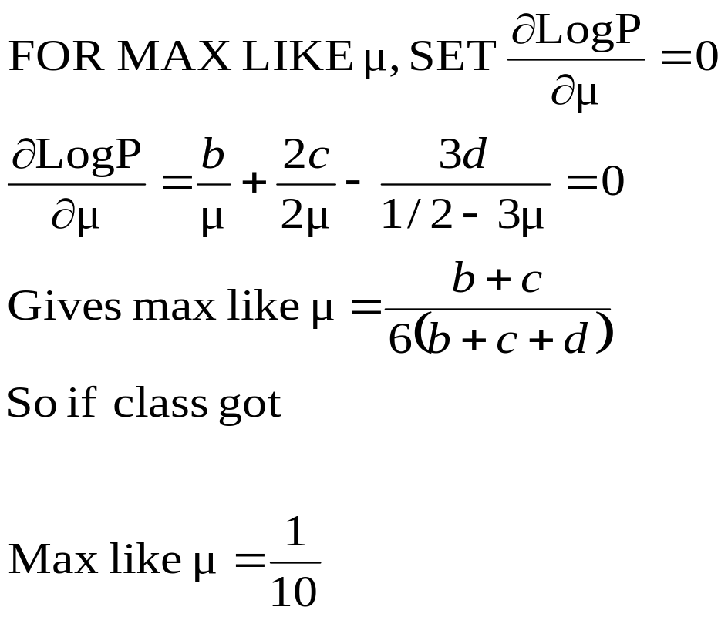
Trivial Statistics
P(A) = ½ P(B) = μ P(C) = 2μ P(D) = ½-3μ
P( a,b,c,d | μ) = K(½)ª(μ)^{b}(2μ)^{c}(½-3μ)^{d}
log P( a,b,c,d | μ) = log K + alog ½ + blog μ + clog 2μ + dlog (½-3μ)
A | B | C | D
14 | 6 | 9 | 10
Boring, but true!

Slide 31
Same Problem with Hidden Information
REMEMBER
P(A) = ½
P(B) = μ
P(C) = 2μ
P(D) = ½-3μ
Someone tells us that
Number of High grades (A’s + B’s) = h
Number of C’s = c
Number of D’s = d
What is the max. like estimate of μ now?

Slide 32
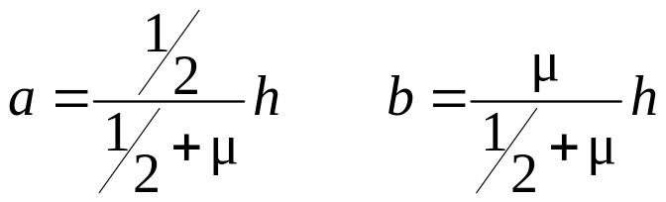
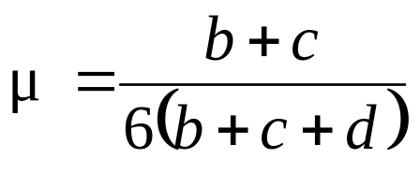
Same Problem with Hidden Information
REMEMBER
P(A) = ½
P(B) = μ
P(C) = 2μ
P(D) = ½-3μ
Someone tells us that
Number of High grades (A’s + B’s) = h
Number of C’s = c
Number of D’s = d
What is the max. like estimate of μ now?
We can answer this question circularly:
EXPECTATION
If we know the value of μ we could compute the expected value of a and b
Since the ratio a:b should be the same as the ratio ½ : μ
MAXIMIZATION
If we know the expected values of a and b we could compute the maximum likelihood value of μ

Slide 33
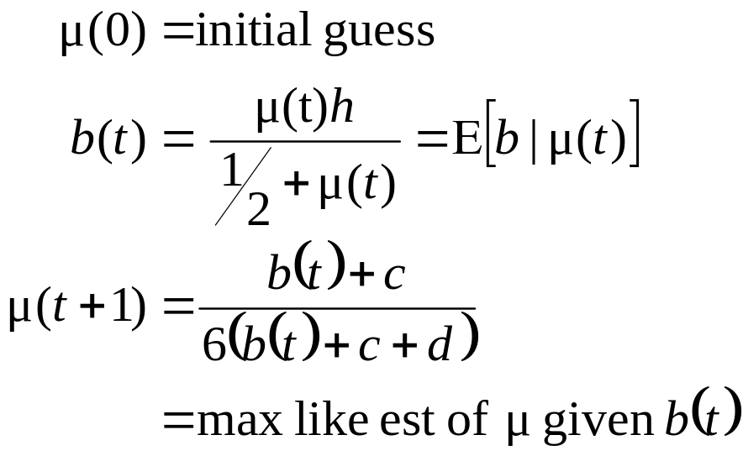
E.M. for our Trivial Problem
REMEMBER
P(A) = ½
P(B) = μ
P(C) = 2μ
P(D) = ½-3μ
We begin with a guess for μ
We iterate between EXPECTATION and MAXIMALIZATION to improve our estimates of μ and a and b.
Define μ(t) the estimate of μ on the t’th iteration
b(t) the estimate of b on t’th iteration
E-step
M-step
Continue iterating until converged.
Good news: Converging to local optimum is assured.
Bad news: I said “local” optimum.

Slide 34
E.M. Convergence
Convergence proof based on fact that Prob(data | μ) must increase or remain same between each iteration [NOT OBVIOUS]
But it can never exceed 1 [OBVIOUS]
So it must therefore converge [OBVIOUS]
In our example, suppose we had
h = 20
c = 10
d = 10
μ(0) = 0
t | μ(t) | b(t)
0 | 0 | 0
1 | 0.0833 | 2.857
2 | 0.0937 | 3.158
3 | 0.0947 | 3.185
4 | 0.0948 | 3.187
5 | 0.0948 | 3.187
6 | 0.0948 | 3.187
Convergence is generally linear: error decreases by a constant factor each time step.

Slide 35
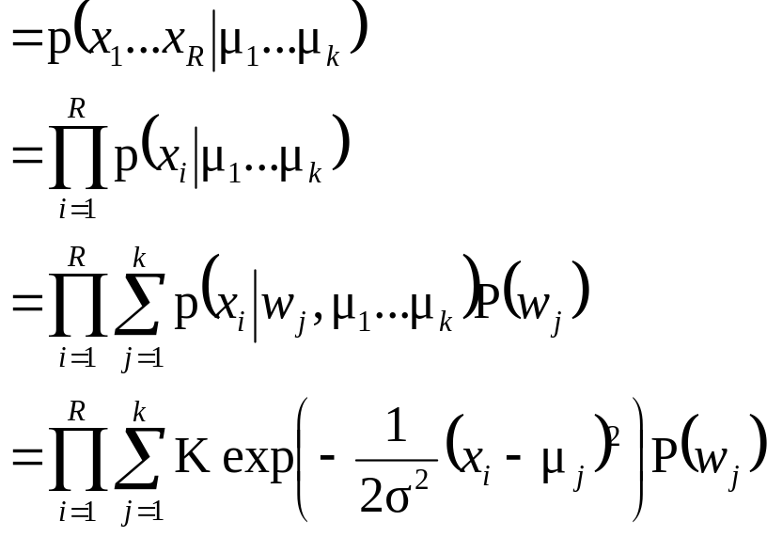
Back to Unsupervised Learning of GMMs
Remember:
We have unlabeled data x₁ x₂ … x_{R}
We know there are k classes
We know P(w₁) P(w₂) P(w₃) … P(w_{k})
We don’t know μ₁ μ₂ .. μ_{k}
We can write P( data | μ₁…. μ_{k})

Slide 36
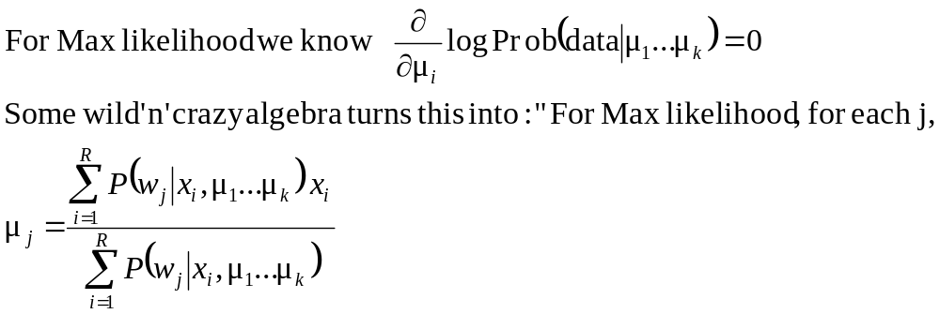
E.M. for GMMs
See
http://www.cs.cmu.edu/~awm/doc/gmm-algebra.pdf
This is n nonlinear equations in μ_{j}’s.”
If, for each x_{i} we knew that for each w_{j} the prob that μ_{j} was in class w_{j} is P(w_{j}|x_{i},μ₁…μ_{k}) Then… we would easily compute μ_{j}.
If we knew each μ_{j} then we could easily compute P(w_{j}|x_{i},μ₁…μ_{k}) for each w_{j} and x_{i}.
…I feel an EM experience coming on!!

Slide 37
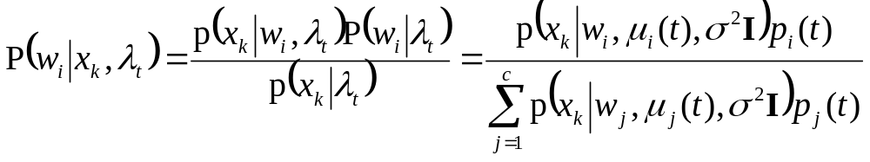
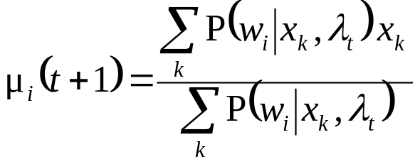
E.M. for GMMs
Iterate. On the t’th iteration let our estimates be
λ_{t} = { μ₁(t), μ₂(t) … μ_{c}(t) }
E-step
Compute “expected” classes of all datapoints for each class
Just evaluate a Gaussian at x_{k}
M-step.
Compute Max. like μ given our data’s class membership distributions

Slide 38
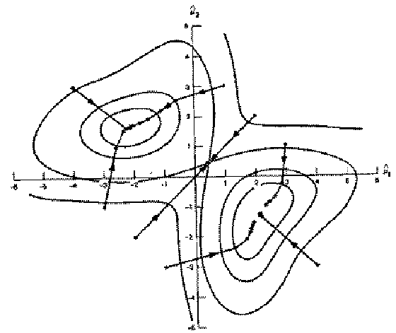
E.M. Convergence
Your lecturer will (unless out of time) give you a nice intuitive explanation of why this rule works.
As with all EM procedures, convergence to a local optimum guaranteed.
This algorithm is REALLY USED. And in high dimensional state spaces, too. E.G. Vector Quantization for Speech Data

Slide 39
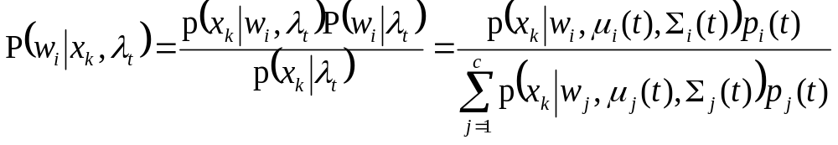
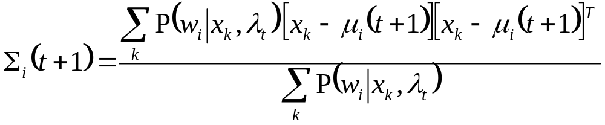
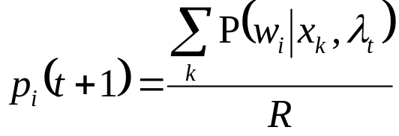
E.M. for General GMMs
p_{i}(t) is shorthand for estimate of P(ω_{i}) on t’th iteration
Iterate. On the t’th iteration let our estimates be
λ_{t} = { μ₁(t), μ₂(t) … μ_{c}(t), Σ₁(t), Σ₂(t) … Σ_{c}(t), p₁(t), p₂(t) … p_{c}(t) }
E-step
Compute “expected” classes of all datapoints for each class
Just evaluate a Gaussian at x_{k}
M-step.
Compute Max. like μ given our data’s class membership distributions
R = #records

Slide 40
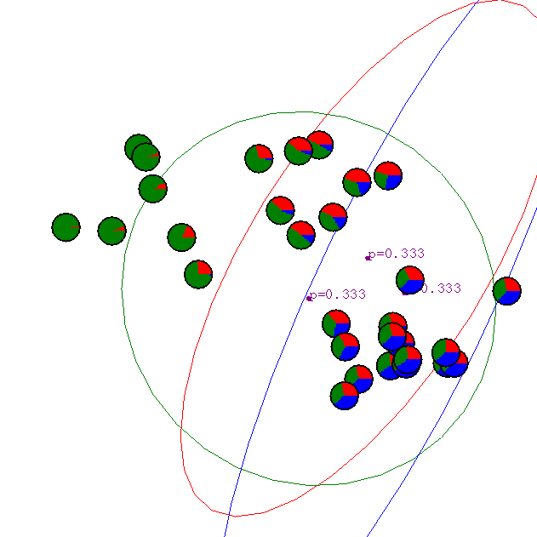
Gaussian Mixture Example: Start
Advance apologies: in Black and White this example will be incomprehensible

Slide 41
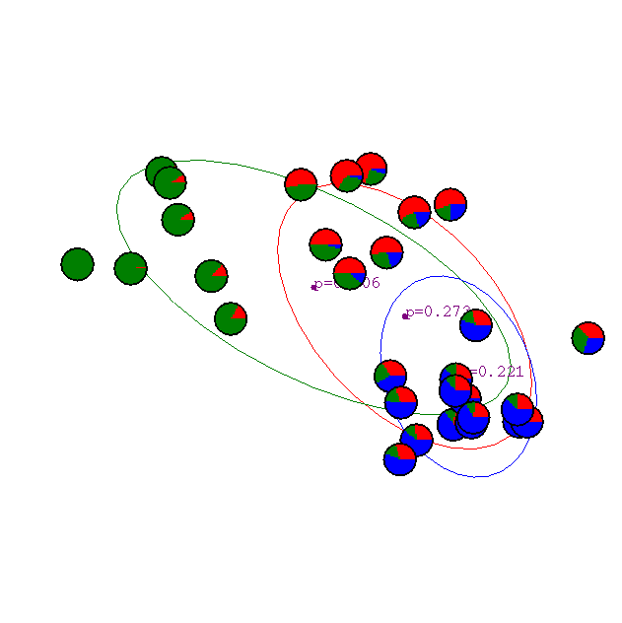
After first iteration

Slide 42

After 2nd iteration

Slide 43

After 3rd iteration

Slide 44

After 4th iteration

Slide 45

After 5th iteration

Slide 46

After 6th iteration

Slide 47

After 20th iteration

Slide 48
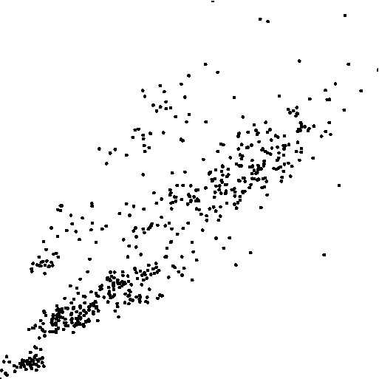
Some Bio Assay data

Slide 49
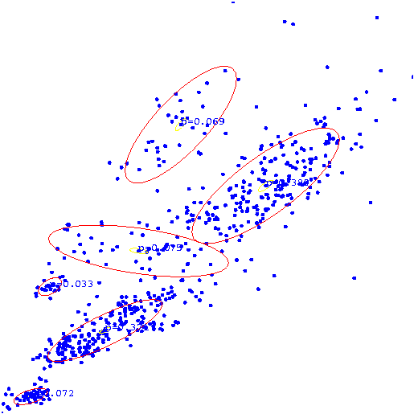
GMM clustering of the assay data

Slide 50

Resulting Density Estimator

Slide 51
Where are we now?
Inference
Engine Learn
Joint DE, Bayes Net Structure Learning
Inputs
P(E₁|E₂)
Predict
category
Dec Tree, Sigmoid Perceptron, Sigmoid N.Net, Gauss/Joint BC, Gauss Naïve BC, N.Neigh, Bayes Net Based BC, Cascade Correlation
Inputs
Classifier
Density
Estimator
Prob-
ability
Joint DE, Naïve DE, Gauss/Joint DE, Gauss Naïve DE, Bayes Net Structure Learning, GMMs
Inputs
Predict
real no.
Linear Regression, Polynomial Regression, Perceptron, Neural Net, N.Neigh, Kernel, LWR, RBFs, Robust Regression, Cascade Correlation, Regression Trees, GMDH, Multilinear Interp, MARS
Inputs
Regressor

Slide 52
The old trick…
Inference
Engine Learn
Joint DE, Bayes Net Structure Learning
Inputs
P(E₁|E₂)
Predict
category
Dec Tree, Sigmoid Perceptron, Sigmoid N.Net, Gauss/Joint BC, Gauss Naïve BC, N.Neigh, Bayes Net Based BC, Cascade Correlation, GMM-BC
Inputs
Classifier
Density
Estimator
Prob-
ability
Joint DE, Naïve DE, Gauss/Joint DE, Gauss Naïve DE, Bayes Net Structure Learning, GMMs
Inputs
Predict
real no.
Linear Regression, Polynomial Regression, Perceptron, Neural Net, N.Neigh, Kernel, LWR, RBFs, Robust Regression, Cascade Correlation, Regression Trees, GMDH, Multilinear Interp, MARS
Inputs
Regressor

Slide 53
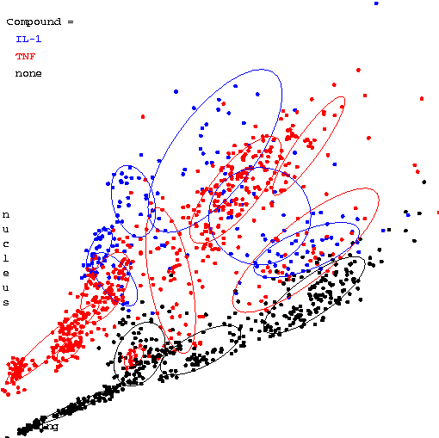
Three classes of assay
(each learned with it’s own mixture model)
(Sorry, this will again be semi-useless in black and white)

Slide 54
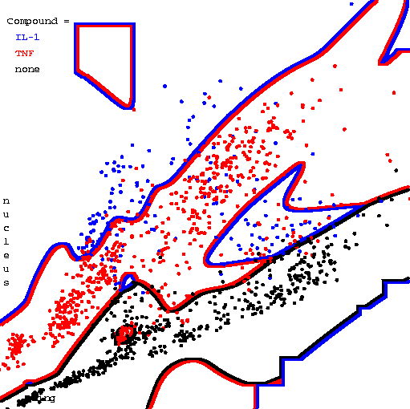
Resulting Bayes Classifier

Slide 55
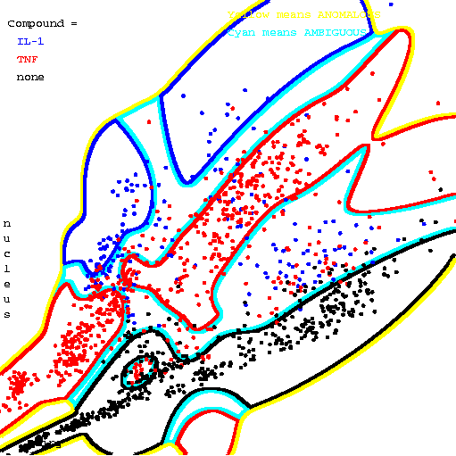
Resulting Bayes Classifier, using posterior probabilities to alert about ambiguity and anomalousness
Yellow means anomalous
Cyan means ambiguous

Slide 56
Unsupervised learning with symbolic attributes
missing
# KIDS
NATION
MARRIED
It’s just a “learning Bayes net with known structure but hidden values” problem.
Can use Gradient Descent.
EASY, fun exercise to do an EM formulation for this case too.

Slide 57
Final Comments
Remember, E.M. can get stuck in local minima, and empirically it DOES.
Our unsupervised learning example assumed P(w_{i})’s known, and variances fixed and known. Easy to relax this.
It’s possible to do Bayesian unsupervised learning instead of max. likelihood.
There are other algorithms for unsupervised learning. We’ll visit K-means soon. Hierarchical clustering is also interesting.
Neural-net algorithms called “competitive learning” turn out to have interesting parallels with the EM method we saw.

Slide 58
What you should know
How to “learn” maximum likelihood parameters (locally max. like.) in the case of unlabeled data.
Be happy with this kind of probabilistic analysis.
Understand the two examples of E.M. given in these notes.
For more info, see Duda + Hart. It’s a great book. There’s much more in the book than in your handout.

Slide 59
Other unsupervised learning methods
K-means (see next lecture)
Hierarchical clustering (e.g. Minimum spanning trees) (see next lecture)
Principal Component Analysis
  simple, useful tool
Non-linear PCA
  Neural Auto-Associators
  Locally weighted PCA
  Others…

