Slide 1


DATA SCIENCE

Slide 2

Schedule
Artificial Intelligence
Data Science
Data Scientist
Big Data
John Rollins
Machine Learning

Slide 3
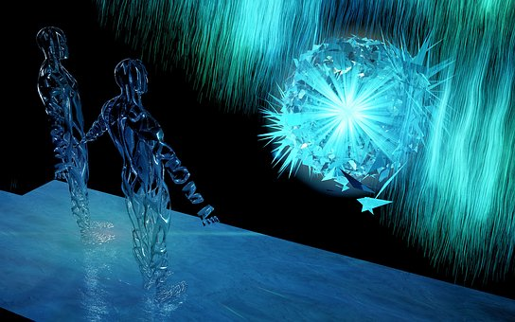
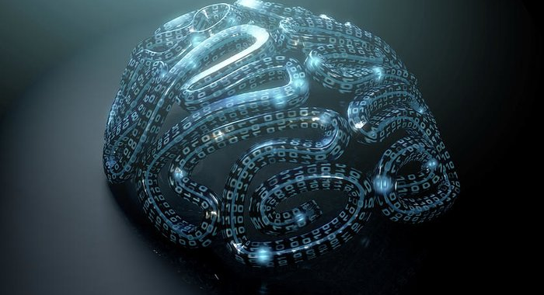
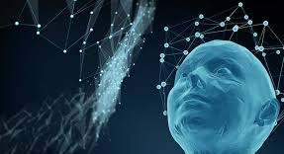

Artificial intelligence
Simulation of human intelligence processes by machines
Applications

Slide 4

Study of data
Art to discover
Insights and trends
Tell a story
Process

Slide 5
What’s a data scientist?

Slide 6

New generation
Skills
Complexity tasks

Slide 7
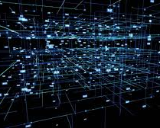

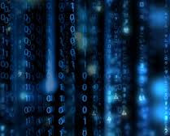
Big data
Datos estructurados y no estructurados
Minería de datos
Petróleo del siglo XXI

Slide 8

john rollins Methodology
Business understanding
Analytic approach
Data requirements
Data collection
Data understanding
Data preparation
Modeling
Evaluation
Deployment
Feedback

Slide 9

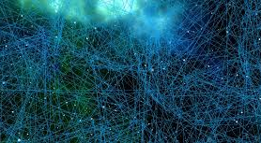
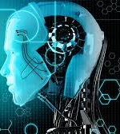

Machine learning

Slide 10
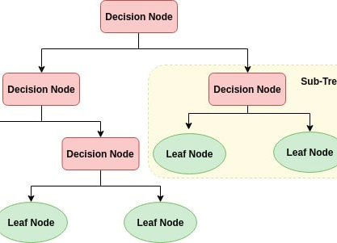
Decision tree
Supervised
Graph that uses branching
Focusing discussion when a group must make a decision
Evaluation

Slide 11
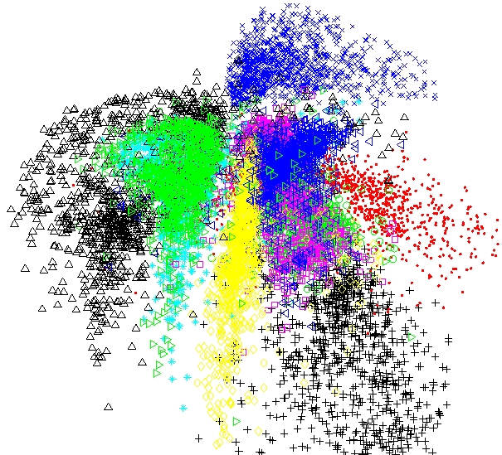
clustering
Unsupervised
Find different groups within the elements into the data, but different to the rest groups
Types of clustering

Slide 12
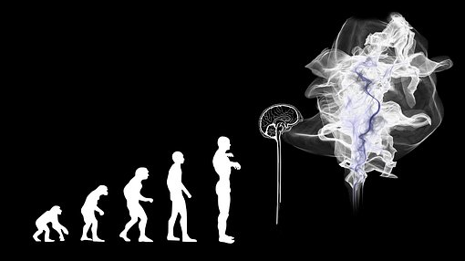
Questions…?

