Slide 1
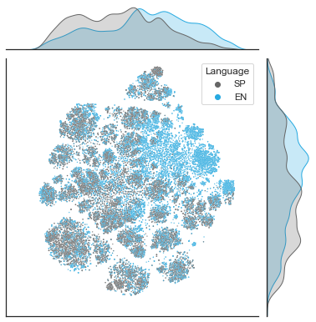
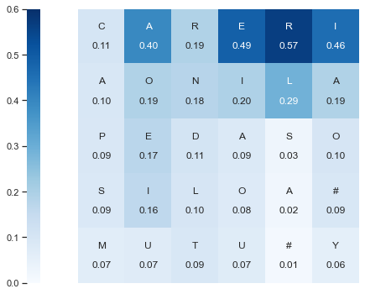
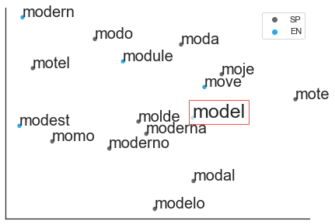
Figure 1
A
# M O D _
C
Spanish-English Word Cloud
27 x 16
connections
Embedding (16)
16 x 128
connections
wake
weak
windy
wispy
wry
…
128 x 128
recurrent connections
LSTM (128)
128 x 27
connections
plum
pluma
perch
percha
plural
…
Output (27)
Dimension 2
P(E | #,M,O,D)
Dimension 1
B
D
P(letter | context)
Dimension 2
t₀
#
t₁
M
t₂
O
t₃
D
t₄
E
t₅
L
t₆
#
Dimension 1

Slide 2
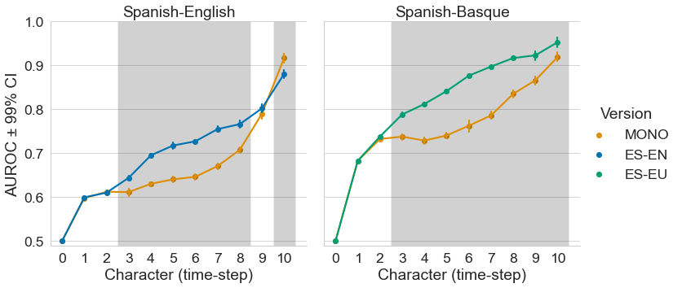
Figure 2

Slide 3
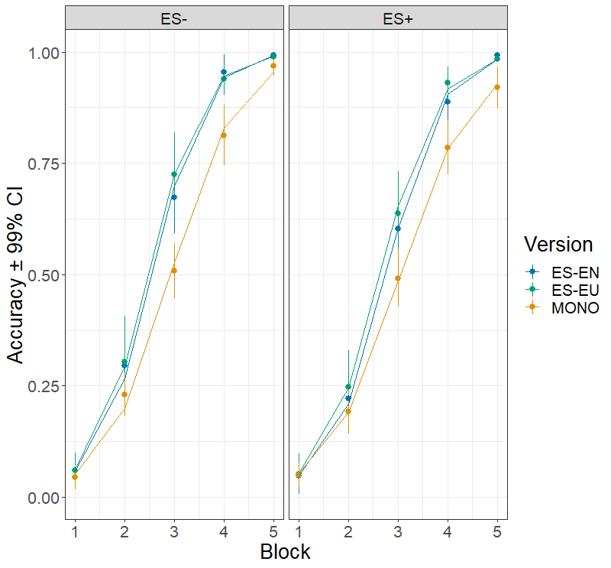
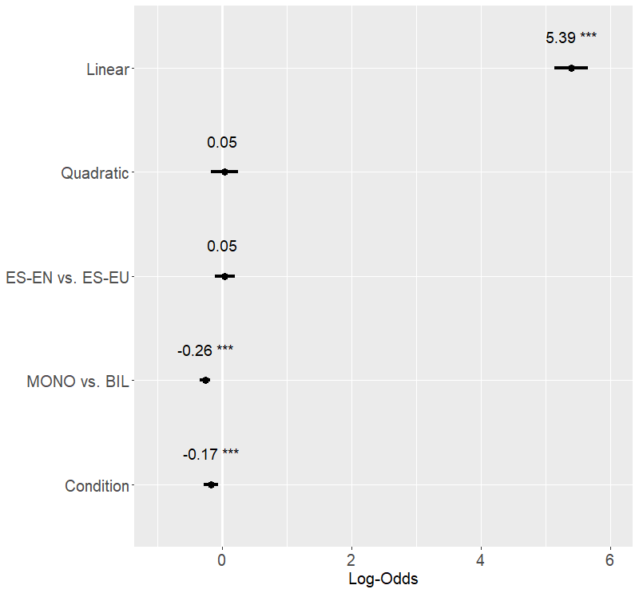
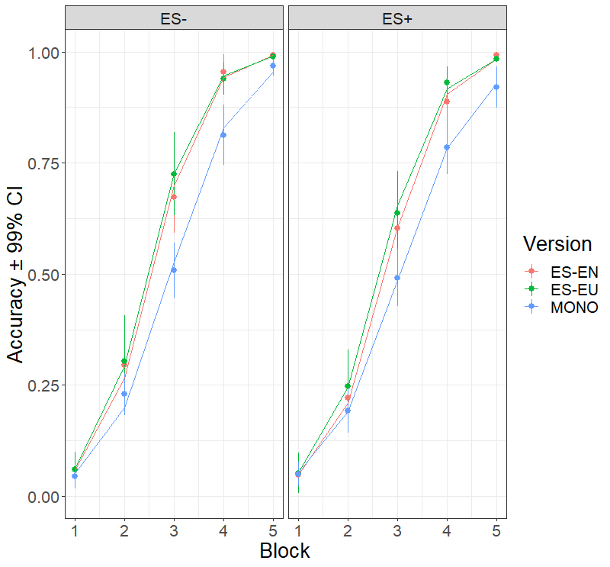

Figure 3: Recognition (models)

Slide 4
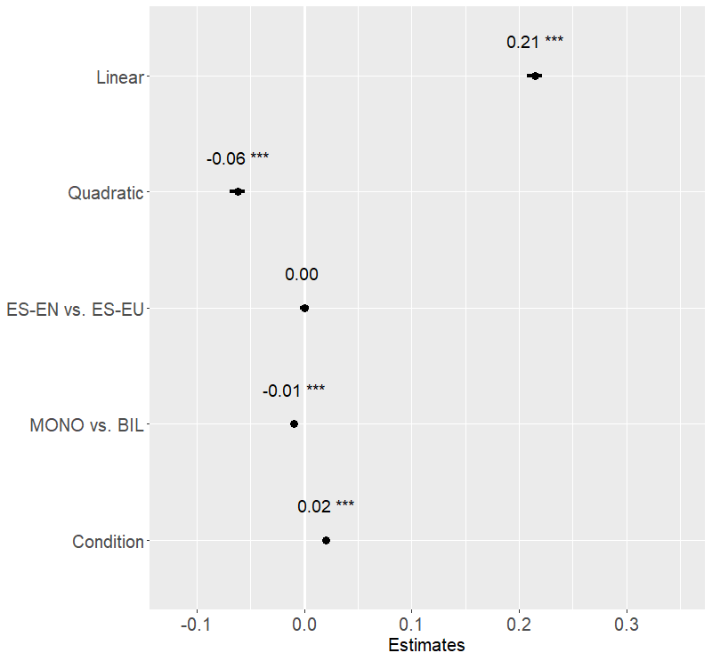
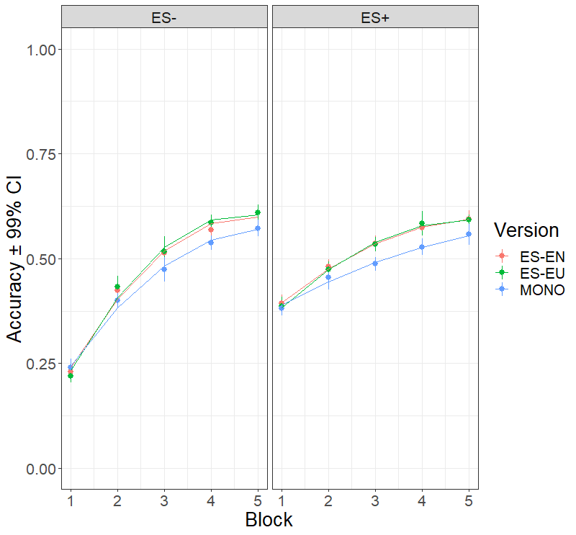
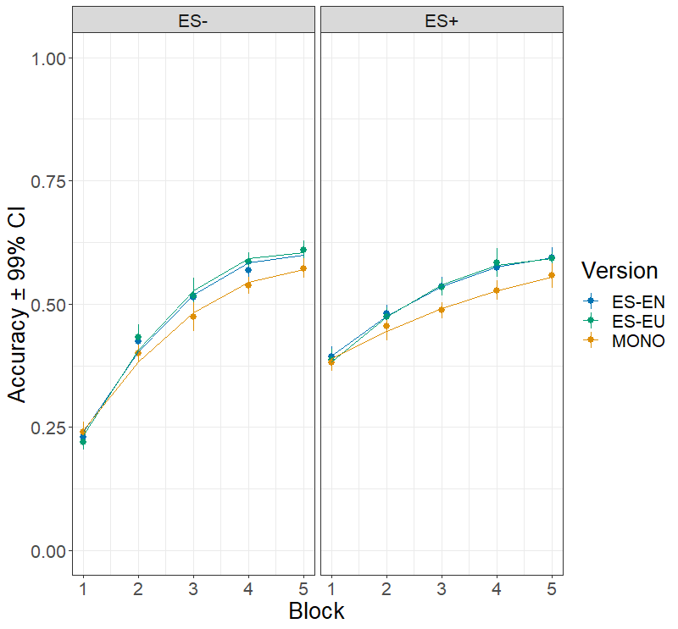

Figure 4: Poduction (models)

Slide 5
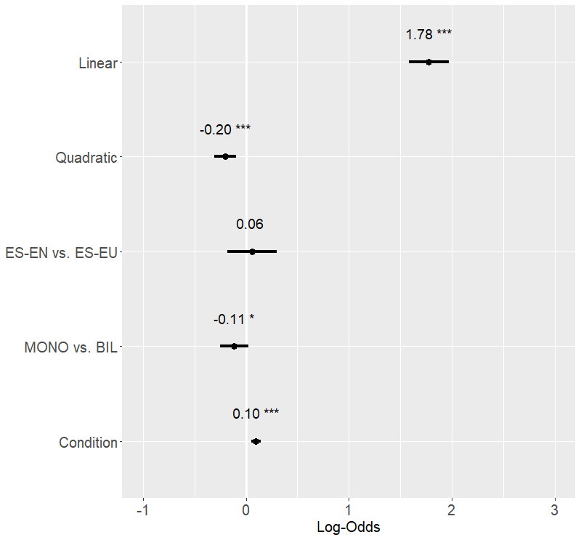
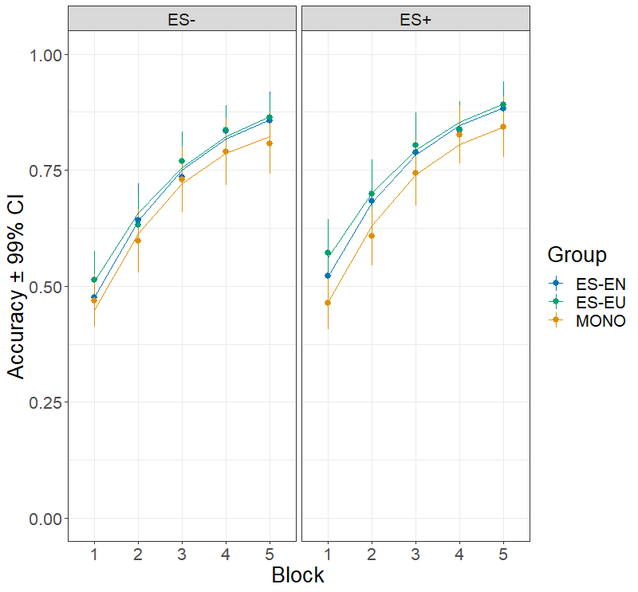
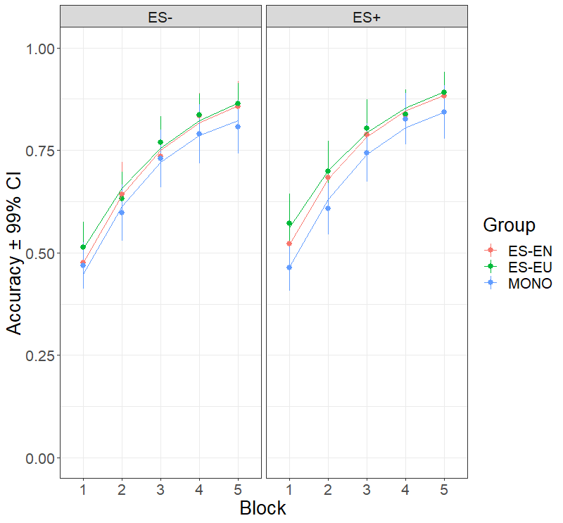
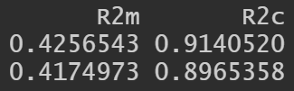
Figure 5: Recognition (participants)

Slide 6
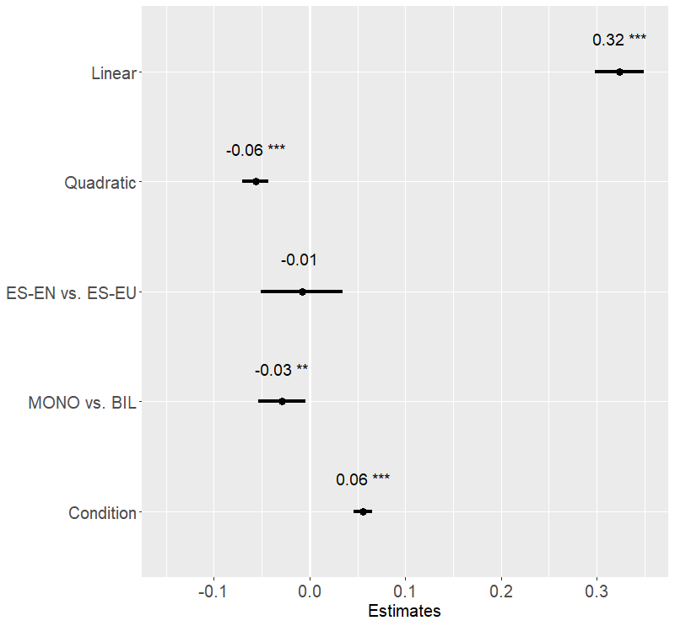
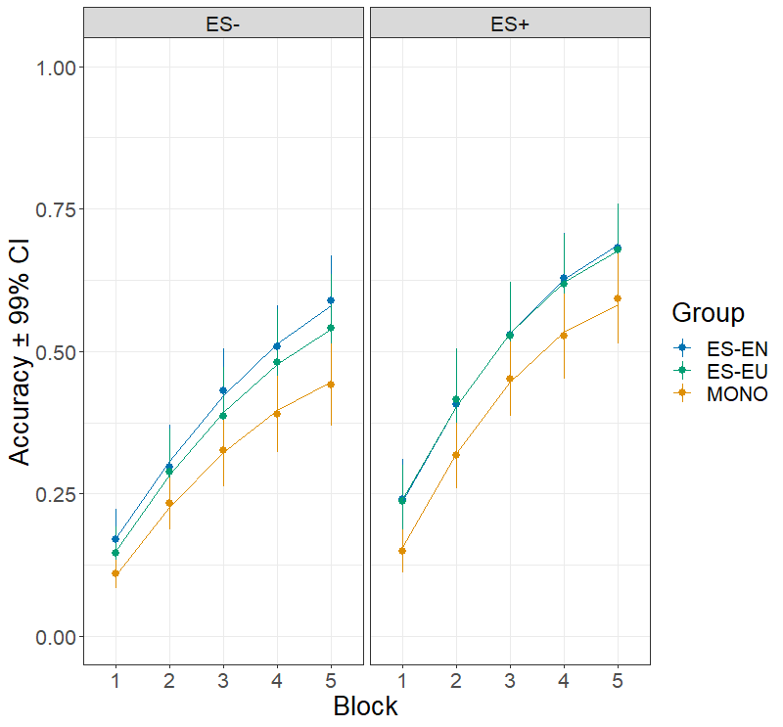
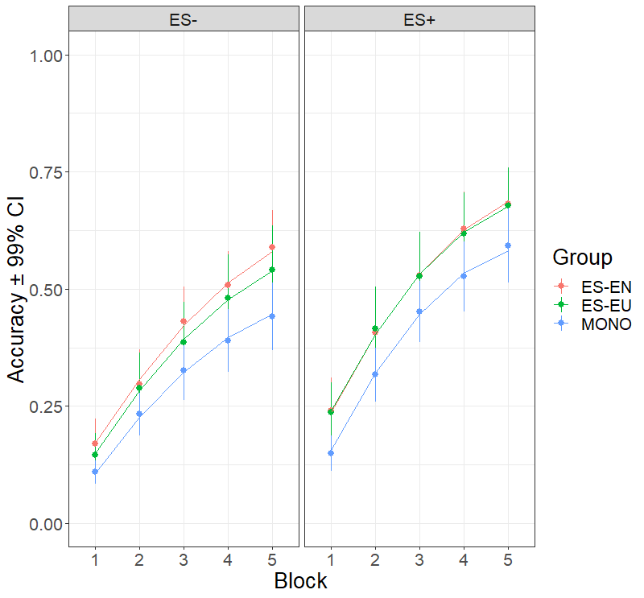

Figure 6: Production (participants)

Slide 7
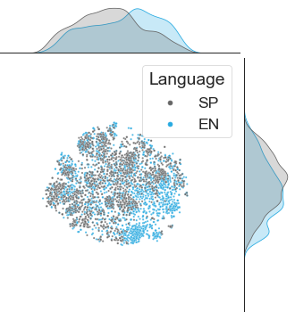
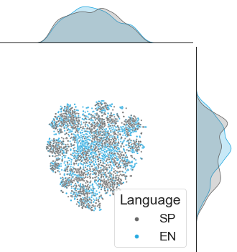
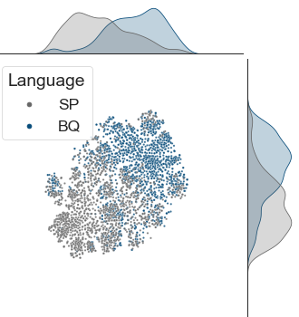
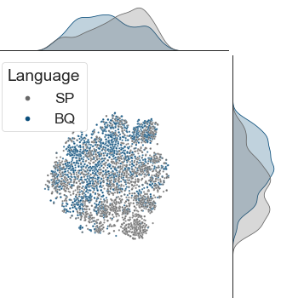
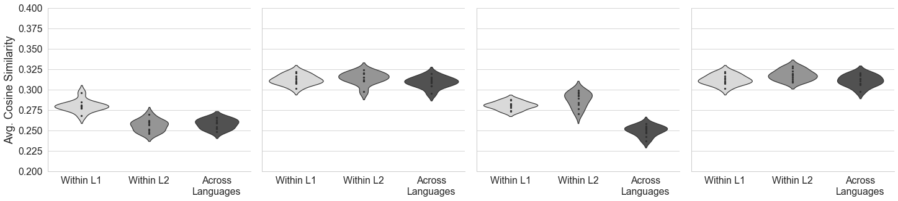
Supplementary Figure 1
Spanish-English
Spanish-Basque
SP-EN
MONO
SP-BQ
MONO
Dimension 2
Dimension 2
Dimension 2
Dimension 2
Dimension 1
Dimension 1
Dimension 1
Dimension 1

Slide 8
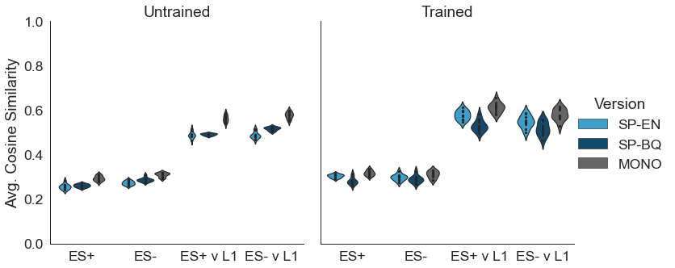
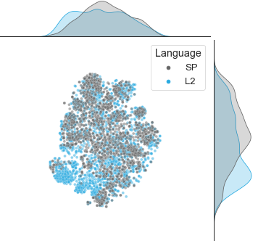
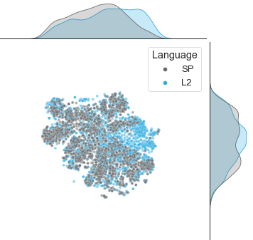
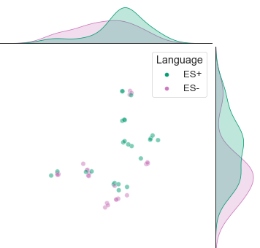
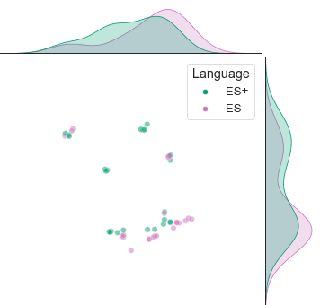
Supplementary Figure 2
A
B
Dimension 2
Dimension 2
Dimension 1
Dimension 1
C
Dimension 2
Dimension 2
Dimension 1
Dimension 1

Slide 9
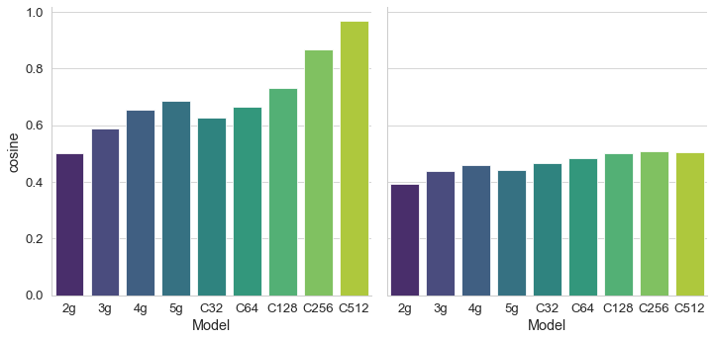
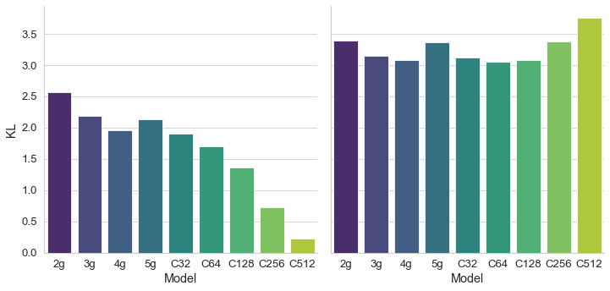
Supplementary Figure 3
Train Words
Test Words
Cosine Similarity
KL Divergence

Slide 10
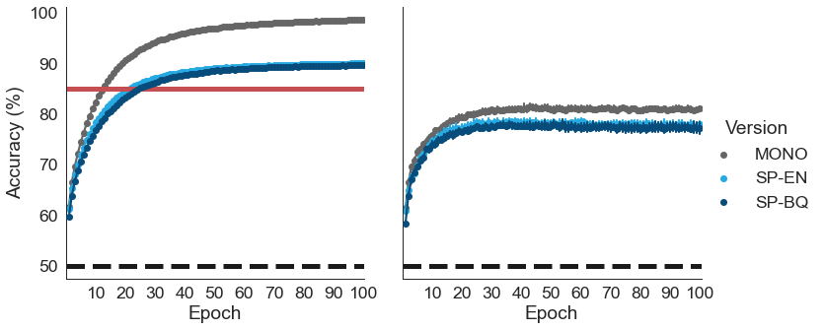
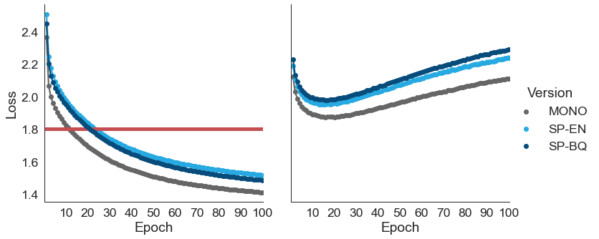
Supplementary Figure 4
LDT Training Set
LDT Test Set

Slide 11

Cloud

