Slide 1
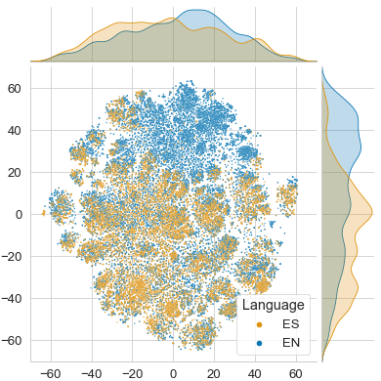
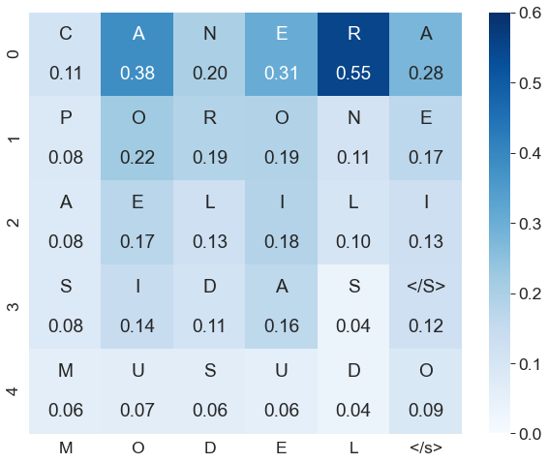
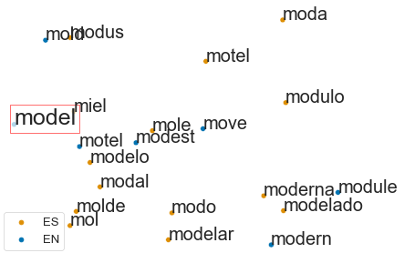
Figure 1
a
<s> M O D _
c
Spanish-English Word Cloud
28 x 32
connections
kids
kiddy
nifty
thank
they
…
Embedding (32)
32 x 128
connections
128 x 128
recurrent connections
LSTM (128)
128 x 28
connections
libra
liana
laguna
lagoon
legion
…
Output (28)
P(E | <s>,M,O,D)
b
d
P(char|context)
t₀
<s>
t₁
M
t₂
O
t₃
D
t₄
E
t₅
L
t₆
</s>

Slide 2
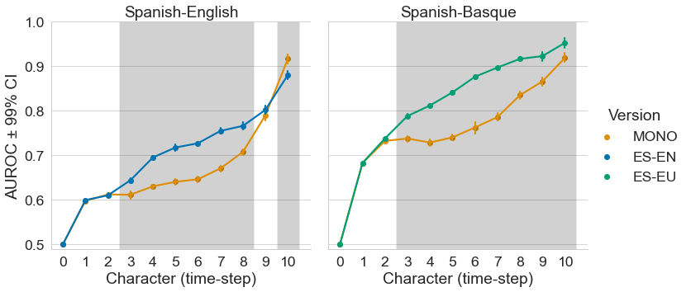
Figure 2

Slide 3
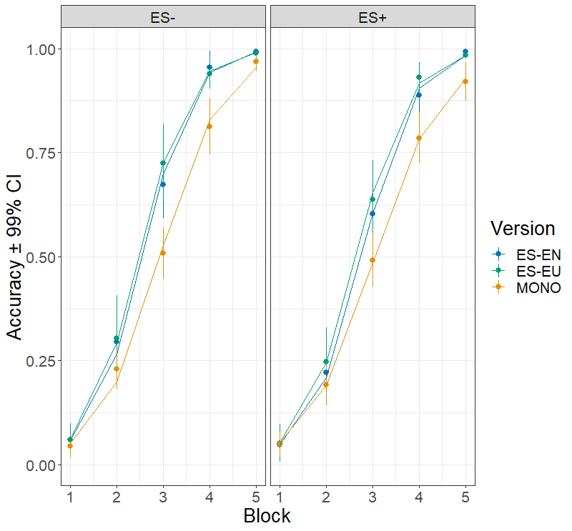
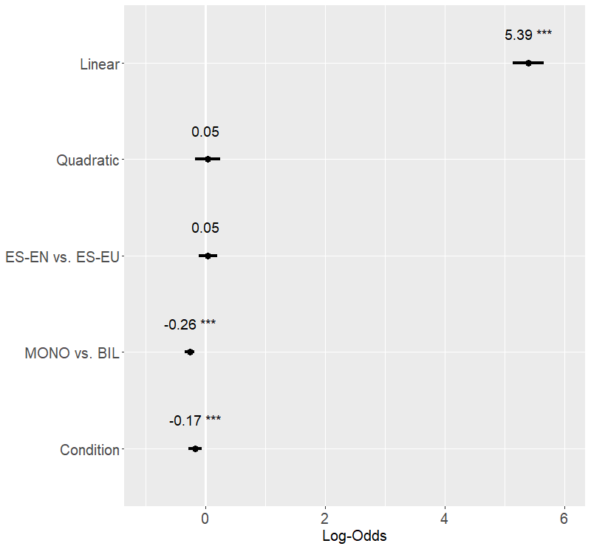
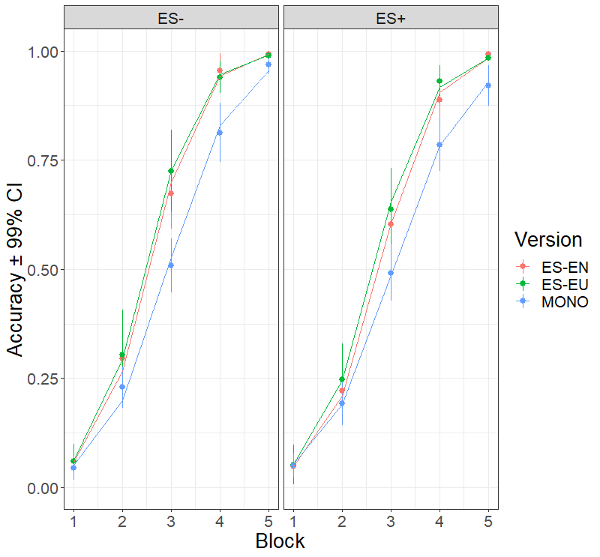

Figure 3: Recognition (models)

Slide 4
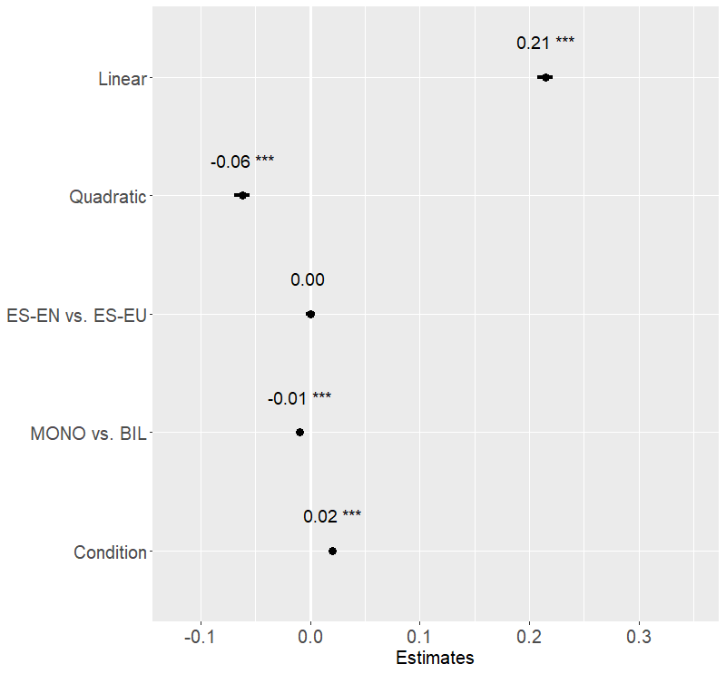
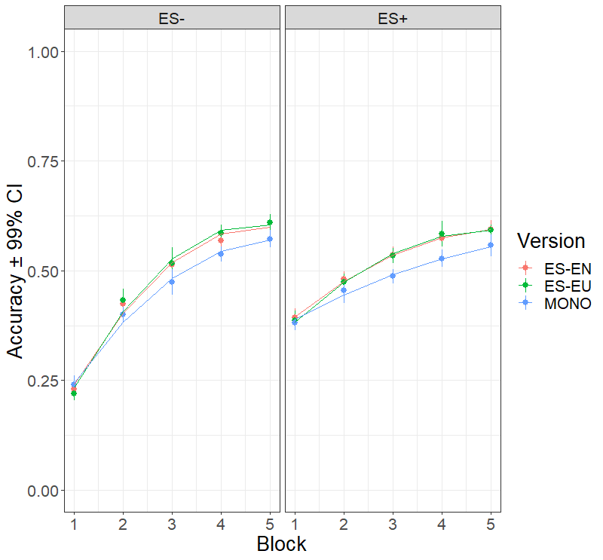
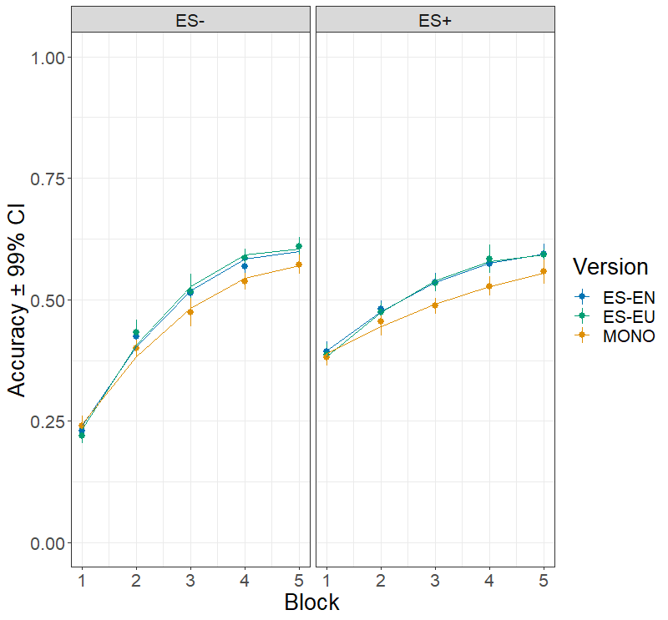

Figure 4: Poduction (models)

Slide 5
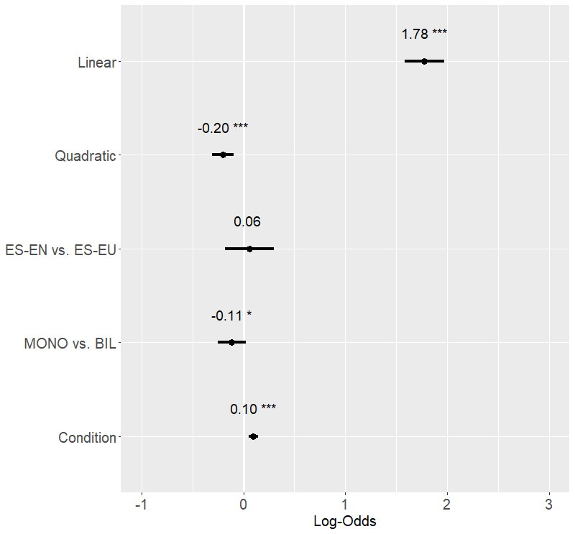
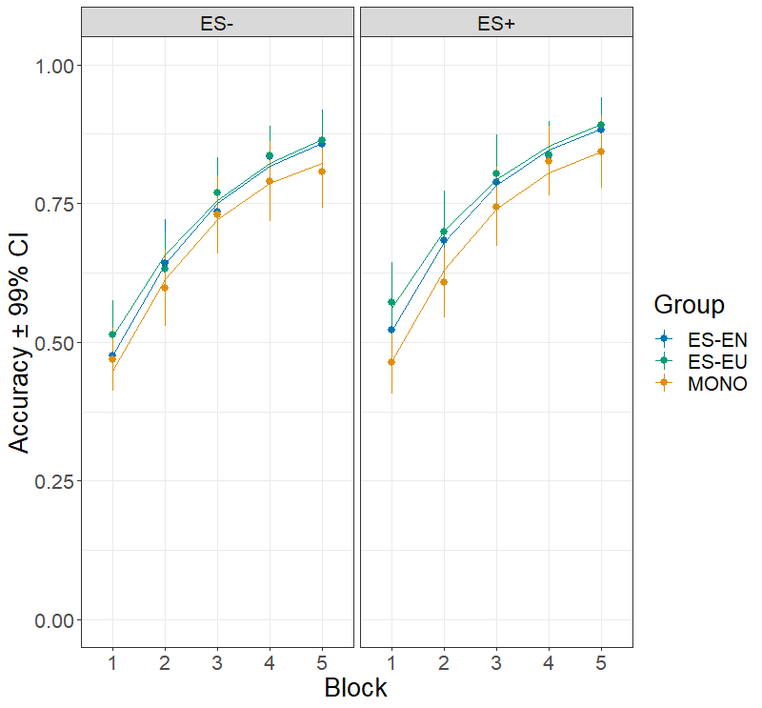
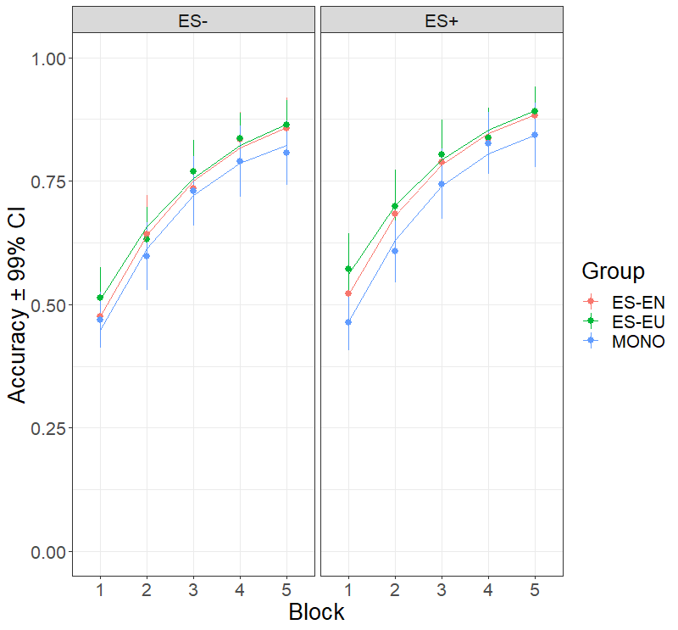

Figure 5: Recognition (participants)

Slide 6
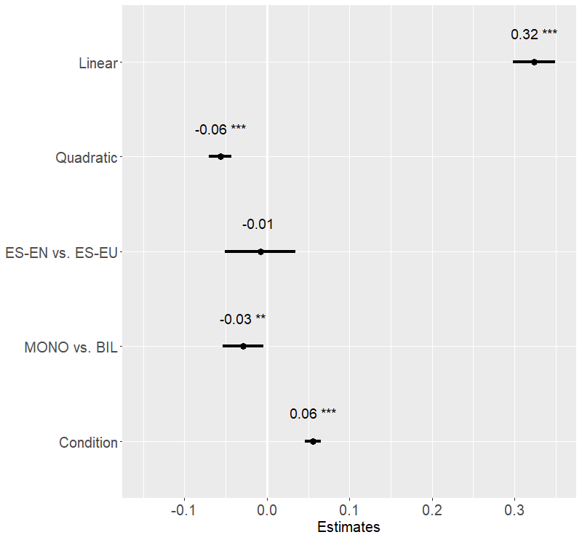
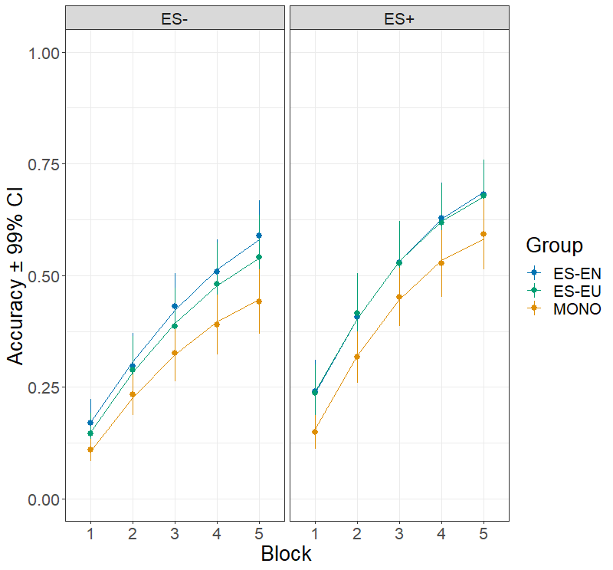
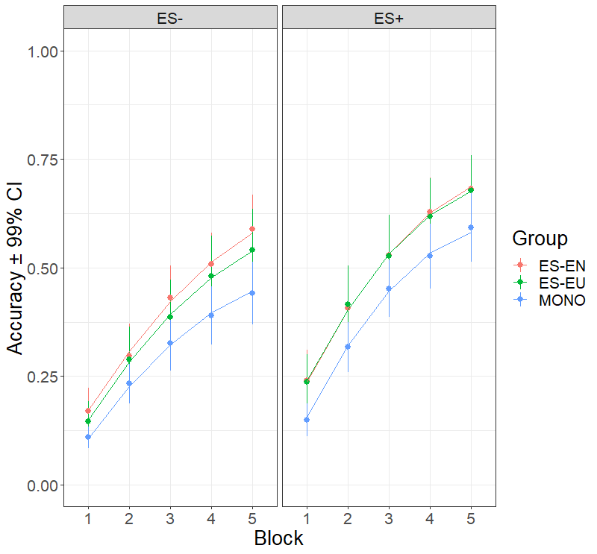

Figure 6: Production (participants)

Slide 7
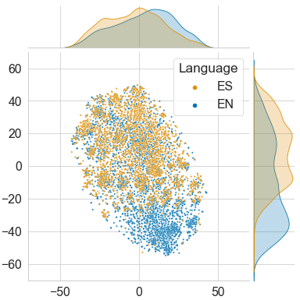
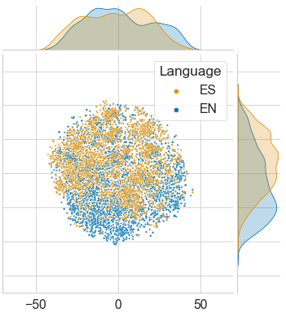
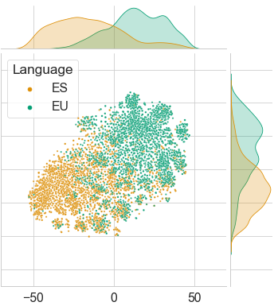
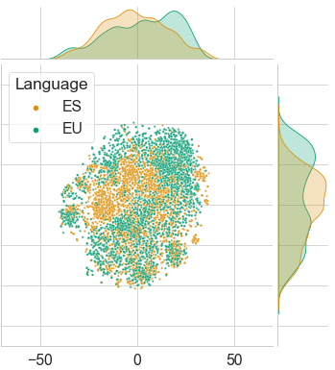

Supplementary Figure 1
Spanish-English
Spanish-Basque
ES-EN
MONO
ES-EU
MONO

Slide 8
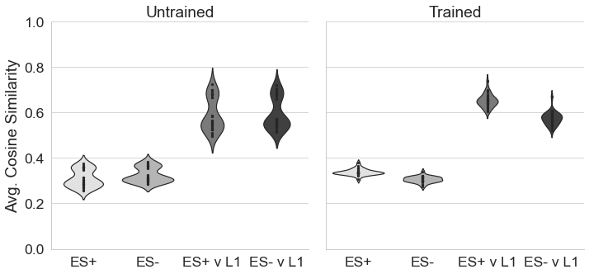
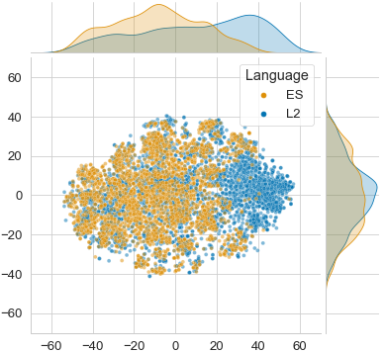
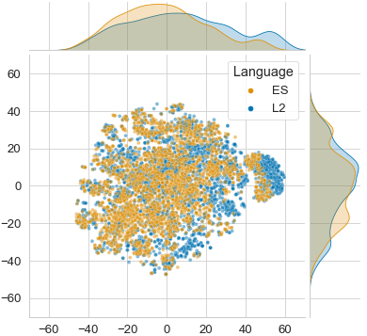
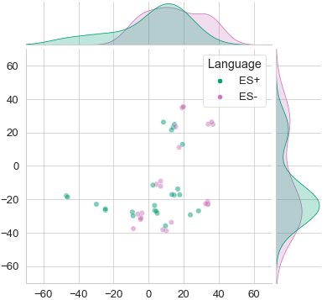
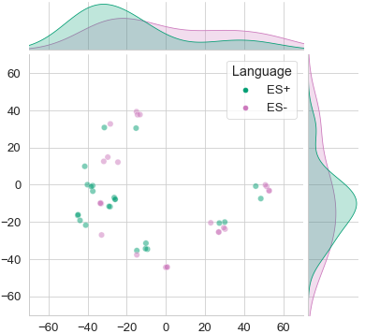
Supplementary Figure 2
a
b
c

Slide 9
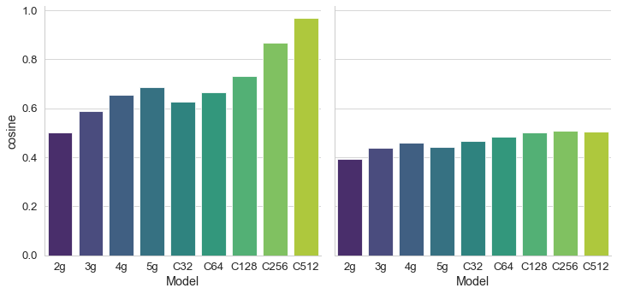
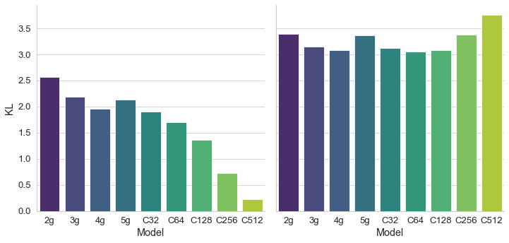
Supplementary Figure 3
Train Words
Test Words
Cosine Similarity
KL Divergence

Slide 10
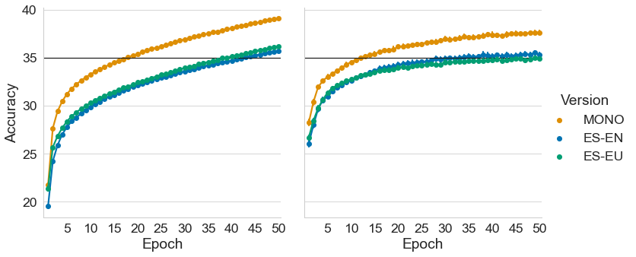
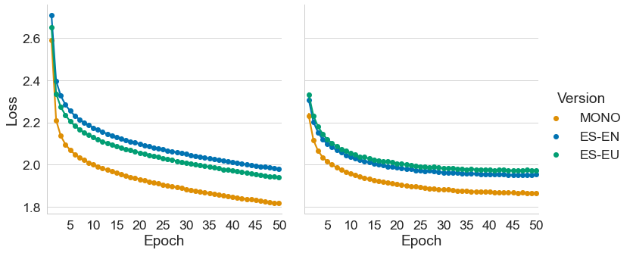
Supplementary Figure 4
Training Set
Spanish Validation Set

