Slide 1
Statistics
SORBONNE DATA ANALYTICS · LESSON 1
Introduction: learning from data by simulation
Jose Angel Garcia Sanchez
Université Paris 1 Panthéon-Sorbonne
Notes:
Opening. This lesson replaces the previous, more mathematical introduction. Idea to announce: before any formula, we simulate. If you can write a few lines that generate fake data from a model, you can see what an estimate, a standard error or a "significant" result really means. A companion Python notebook goes with every section.

Slide 2
Eleven steps, in two parts
ROADMAP
# | Topic | Notebook
1 | Why statistics, and why regression | §1, §9
2 | Data, measurement and aggregation | §2, §10
3 | Probability as a generative model | §3
4 | The mathematical toolkit | §11
5 | Simulating probability models | §4
6 | Estimates, standard errors, intervals | §5, §12
7 | Bias and unmodeled uncertainty | §6
8 | Significance and its traps | §7, §12
9 | Bootstrap and fake-data simulation | §8, §12
10 | Classical and Bayesian inference | §13
11 | Exercises | §14
Statistics · Lesson 1
Notes:
Give the map. This version is deliberately rich, more than fits in 2h30, so it is best taught as two sessions: Part A, steps 1 to 5 (foundations: regression first look, measurement, probability, toolkit, simulation), and Part B, steps 6 to 11 (inference: estimates, bias, significance, bootstrap, Bayesian view, exercises). For a single session, skip the slides about the toolkit and the detailed case studies. Each step is followed by a live demo in the notebook.

Slide 3
At the end of this lesson, you will be able to
GOALS
1
2
3
Formulate
Simulate
Judge
Turn a real situation into a statistical question: what is the population, what do we estimate, how uncertain are we?
Write a few lines of Python that generate fake data from a model, and read what the results say.
Say what a standard error, a confidence interval or a "significant" result does, and does not, tell you.
Statistics · Lesson 1 · Goals
Notes:
Same spirit as the previous version of the course (formulate a problem, choose methods, understand their limits), but the route is now simulation first and formulas second. Stress that the mathematics comes back later, once the intuition is there.

Slide 4
Four skills we will practise
GOALS
Understand
Construct
Fit
Display
What a method does and what it assumes, before pressing a button.
Build a model for the situation, including how the data were generated.
Estimate parameters and know how uncertain the estimates are.
Show the data, the fitted model and the result so that others can check them.
Statistics · Lesson 1
Notes:
These four verbs organise the whole course, and every demo in the notebook exercises at least one of them. We spend more time on understand and display than on fit, because software does the fitting for us but cannot choose the question.

Slide 5
Three questions from three centuries
WHY STATISTICS?
Hydrology
Insurance
Clinical trials
Netherlands, 10th century
Pricing a risk
Does a drug work?
How high should a dyke be? High enough for most floods, not so high that it is too expensive.
Given a driving record, the car and the coverage, what is a fair premium?
A drug is tested on 100 patients: 56 are cured, 44 show no improvement. Is it effective?
What is common to all these examples?
Statistics · Lesson 1 · Why statistics?
Notes:
Keep the examples from the previous version. Let students answer the final question before moving on: the common ingredient is randomness. About 3 minutes.

Slide 6
Randomness
An average
A chance
A variability
What is typical? A "fair" premium.
How likely? "Most of the floods".
How much could it change? Is it significant?
Statistics · Lesson 1 · Why statistics?
Notes:
The common thread is randomness, and it raises three kinds of questions: averages, chances and variability. Everything in this lesson is a way to answer one of them.

Slide 7
The three challenges of statistics
WHY STATISTICS?
1 · SAMPLE TO POPULATION
2 · TREATMENT TO CONTROL
3 · MEASUREMENT TO CONSTRUCT
From the people we measured to the people we did not. Surveys, but also nearly every study.
From those who got the treatment to what would have happened without it. This is causal inference.
From what we recorded to what we actually care about. Data rarely measure the thing itself.
All three are problems of prediction.
Statistics · Lesson 1
Notes:
This is the framing for the whole course and it will come back all course long. Give one concrete example for each: an opinion poll (1), a drug trial (2), a test score standing for ability (3). Prediction for new people, for outcomes under other treatments, for the underlying construct.

Slide 8
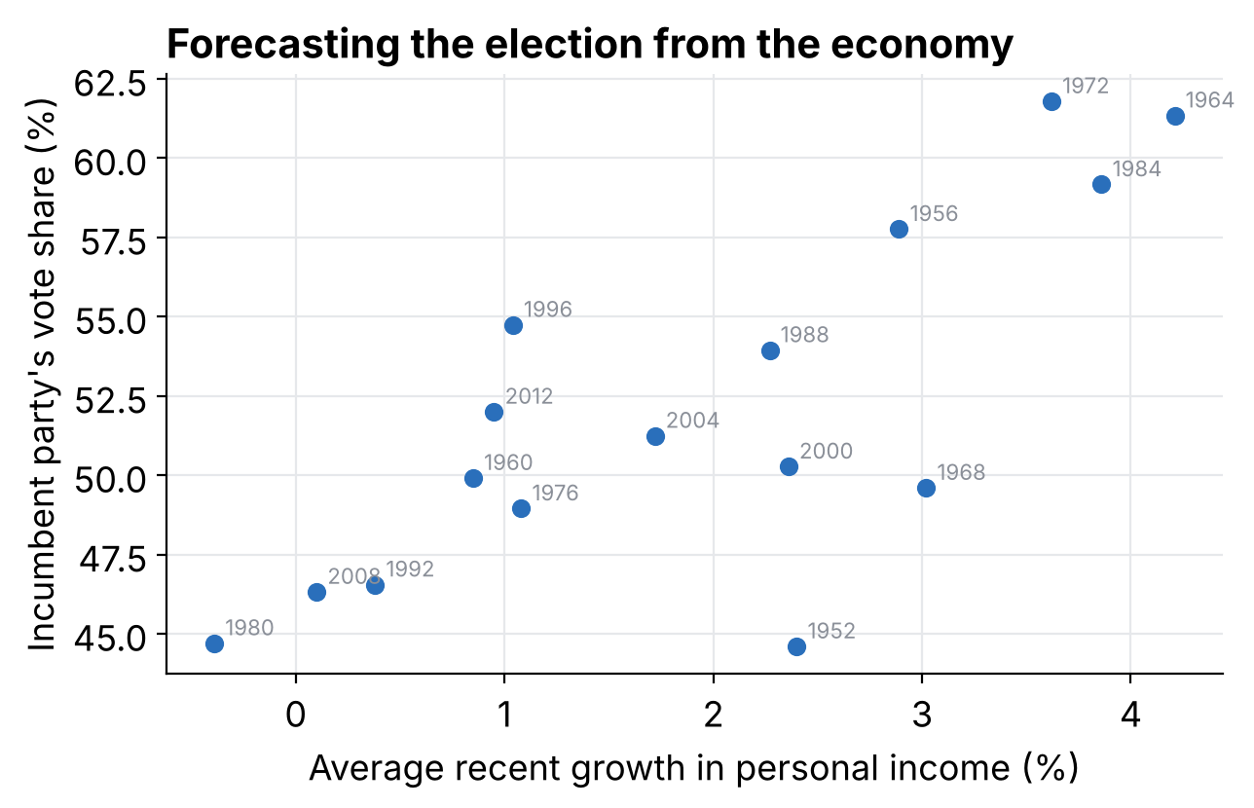
Can the economy predict an election?
REGRESSION: A FIRST LOOK
16 US presidential elections, 1952 to 2012.
Horizontal: average growth of personal income in the years before the election.
Vertical: share of the vote won by the party of the incumbent president.
What pattern do you see?
Notebook §1
Notes:
Open the notebook, section 1. Let students describe the pattern before showing the line: higher growth, higher vote share, but with a lot of scatter. Some elections (1952, 1968) sit far from the trend.

Slide 9
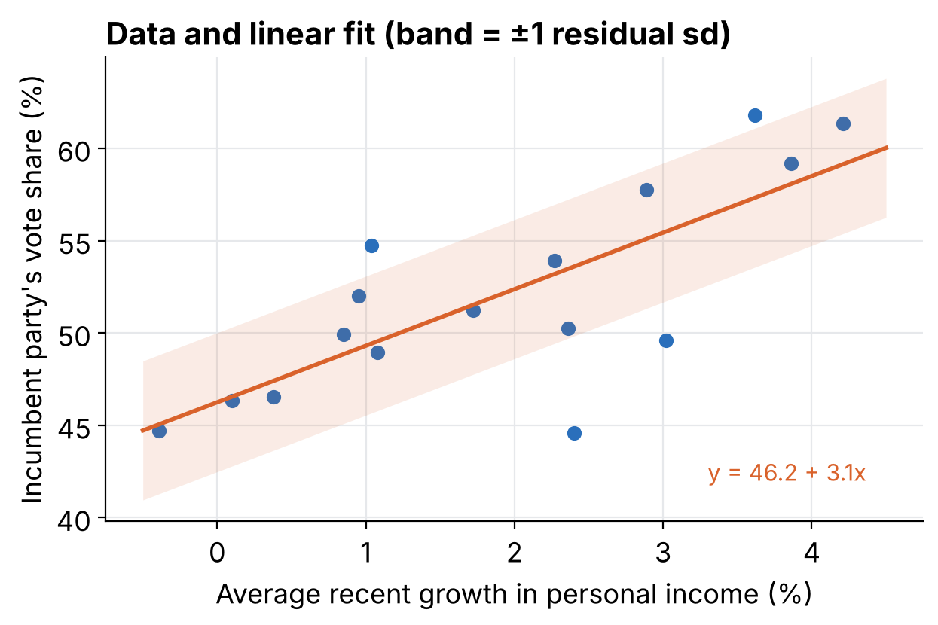
A line, and the scatter around it
REGRESSION: A FIRST LOOK
vote = 46.2 + 3.1 × growth
Slope 3.1. Two elections that differ by one point of growth differ, on average, by about 3 points of vote share.
Scatter 3.8. Even knowing the economy, predictions are off by about ±4 points.
Prediction. Growth of 2%: about 52.4% of the vote, ±3.8.
Notebook §1
Notes:
Run the fit in the notebook (statsmodels). Make the point that a regression gives a prediction with uncertainty, never a certainty. Ask: what does this model not tell us? Only 16 elections, not a random sample of anything, and association is not causation.

Slide 10
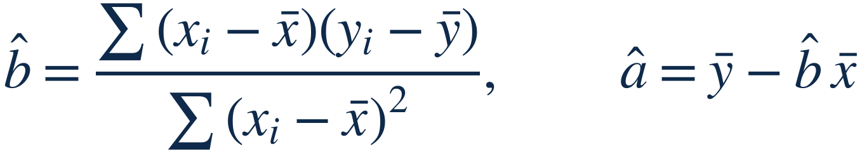
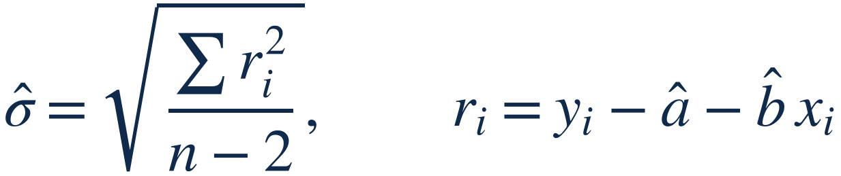
The linear regression model, formally
DEFINITIONS · REGRESSION
Model. A straight line plus independent noise. a is the intercept, b the slope, σ the spread of the points around the line.
Least squares. The values of a and b that minimise Σ(yi − a − b xi)². Elections: b̂ = 3.06, â = 52.06 − 3.06 × 1.90 = 46.2.
Residual sd. Divide by n − 2 because two parameters were estimated from the data. Elections: σ̂ = 3.8 with n = 16.
Notebook §1
Notes:
Formal version of the election slide. The least-squares slope is the covariance of x and y divided by the variance of x. Means used: growth 1.90, vote 52.06. The standard error of the slope, 0.70, is sigma hat divided by the square root of the sum of squared deviations of x.

Slide 11
What is regression used for?
REGRESSION: A FIRST LOOK
Prediction
Exploring associations
Forecast new outcomes: a vote share, next year's sales, a disease diagnosis.
Which variables predict the outcome: risk factors, attitudes, job success.
Extrapolation
Causal inference
Adjust for differences between the sample and the population: polls, self-selected schools.
Estimate the effect of a treatment by comparing treated and control groups.
Statistics · Lesson 1
Notes:
Four common uses. In this course we start with prediction and association (linear regression, then logistic regression), and we will keep coming back to the warning that a regression can always be fitted, but that does not make it a causal claim.

Slide 12
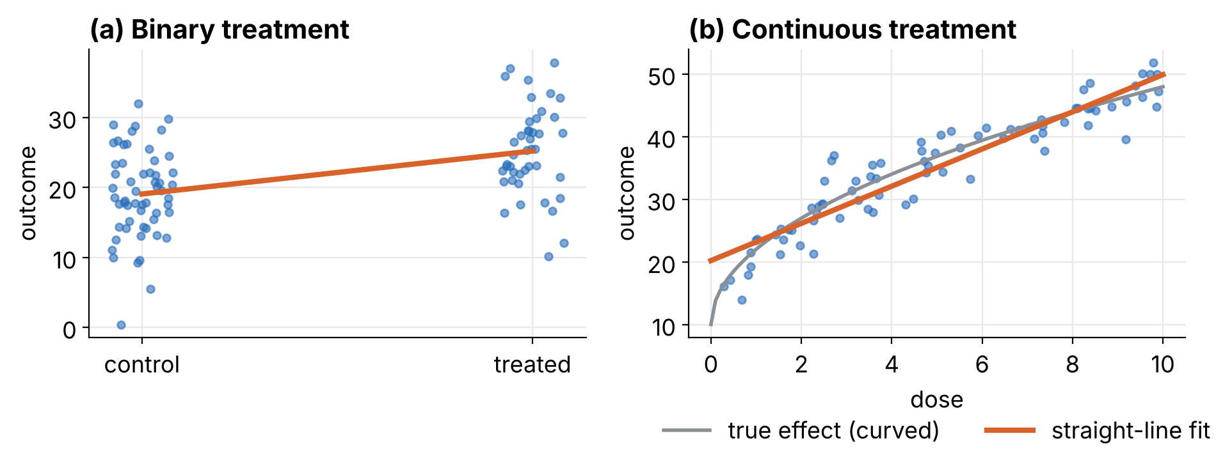
Regression estimates a relationship, even a causal one
REGRESSION: A FIRST LOOK
With a 0/1 treatment the regression line is just the difference of means (6.15 here). With a continuous treatment a straight line is always computable, but it reports an average effect over the range, even when the true effect bends.
Simulated data · Notebook §9.1
Notes:
Panel (a): the coefficient on a binary variable equals the difference of the two group means, printed in the notebook as 6.15 for both. Panel (b): the true effect has diminishing returns, but the line still gives an interpretable summary (slope about 3 per unit of dose) and is a poor description at low doses. Ask students: what would you do about that? Answer: look at the plot, then change the model.

Slide 13
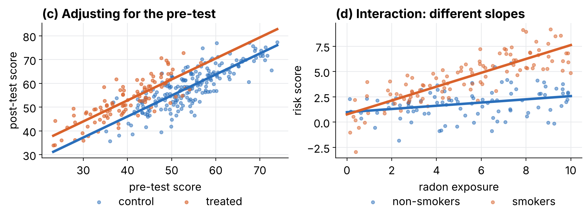
Adjusting for differences, and letting effects vary
REGRESSION: A FIRST LOOK
(c) A remedial program goes mostly to weaker students. Raw difference in final scores: −5.7. Adjusted for the pre-test: +6.8, close to the true +8. (d) An interaction: radon matters much more for smokers.
Simulated data · Notebook §9.2
Notes:
Panel (c): treated students had a mean pre-test of 40 against 54 for controls, so the raw comparison is not like with like and even changes sign. The adjusted estimate 6.8 with standard error 0.8 is within about 1.5 standard errors of the true value 8. Panel (d): the fitted model has an interaction coefficient of about 0.53, so the slope is roughly 0.16 for non-smokers and 0.69 for smokers.

Slide 14
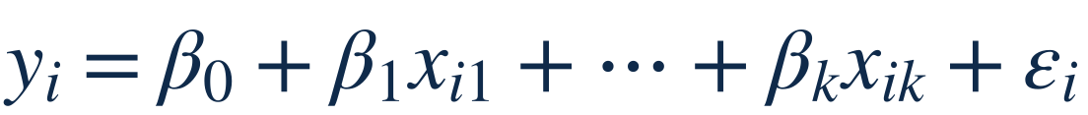
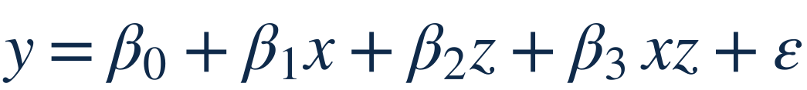
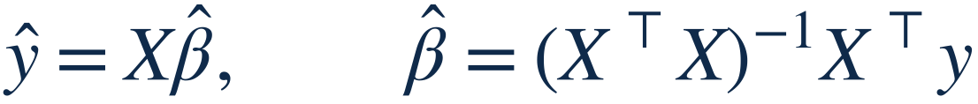
More predictors, interactions and the matrix form
DEFINITIONS · REGRESSION
Multiple regression. βj is the expected difference in y for one more unit of xj, the other predictors held fixed. Panel (c): post = a + b·pre + θ·T, θ̂ = 6.8.
Interaction. The slope of x becomes β1 + β3z. Panel (d): 0.16 for non-smokers, 0.16 + 0.53 = 0.69 for smokers.
Matrix form. One row of X per observation, first column all 1s. With β = (46.3, 3.0) and x = (−1, 0, 3): &ycirc; = (43.3, 46.3, 55.3).
Notebook §9
Notes:
Students who have seen linear algebra get the general formula; the others only need the reading of each coefficient. Stress the phrase held fixed: it is a statement about the model, not a causal claim unless the design supports it.

Slide 15
Four studies, four kinds of difficulty
REGRESSION: A FIRST LOOK
Study | Question | Design | What the analysis does
Xbox poll | Opinion from 750,148 interviews of gamers | Very large, non-representative sample | Regression adjusts sample to population
Electric Company | Does an educational TV show help reading? | Randomized experiment | Compare treated and control classes
UN peacekeeping | Does it prevent a return to civil war? | Observational study | Adjust for how bad the situation was
Gun laws | Effect of 25 firearm laws on deaths | Observational, 50 states, 30 predictors | Estimates hopelessly noisy
Statistics · Lesson 1
Notes:
Walk through the four examples quickly. The Xbox poll: huge sample but not representative, so the issue is sample to population. Electric Company: randomization makes the groups comparable. Peacekeeping: peacekeepers may have chosen easy cases, so adjust for pre-treatment difficulty. Gun laws: 30 predictors and 50 data points, no prior information, plus observational data.

Slide 16
Four studies, in numbers
REGRESSION: A FIRST LOOK
Study | Facts | The issue
Xbox poll | 750,148 interviews of 345,858 gamers, mostly young men | Raw result is far from the population; adjust by age, sex, education, state, past vote
Electric Company | Grades 1 to 4; within each school, pairs of classes, one chosen at random to watch the show; reading test before and after | Randomization compares like with like; use the pre-test to sharpen the comparison
UN peacekeeping | 96 ceasefires in 64 wars. Peace lasted in 56% of cases with peacekeepers, 34% without | Peacekeepers were sent to the easier cases, so adjust for how bad the situation was
Gun laws | 25 laws, 50 states, 30 predictors | More parameters than information: estimates are mostly noise
Statistics · Lesson 1
Notes:
Use this slide when students want to see what real regression questions look like. Xbox: a huge sample does not fix a biased sample. Electric Company: a randomized experiment; we still fit a regression with the pre-test. Peacekeeping: a raw comparison of 56% versus 34% is encouraging but confounded by case difficulty. Gun laws: too many predictors for 50 data points.

Slide 17
Why trust one regression and not the other?
REGRESSION: A FIRST LOOK
MORE CONVINCING · PEACEKEEPING
LESS CONVINCING · GUN LAWS
Starts from a direct comparison of the data.
Targets one concrete worry: peacekeepers may have picked easy cases.
One clear adjustment, and the data show the opposite of the worry.
30 predictors for 50 data points: noisy coefficients.
States differ in many ways the model does not capture.
Each law is "held fixed" while others change, which is unrealistic.
A regression cannot turn observational data into proof, and p-values do not screen out noise.
Statistics · Lesson 1
Notes:
Discussion slide, give it 5 to 8 minutes in breakout rooms if online. Ask: both studies use regression on observational data, so what distinguishes them? Answer: one is focused and addresses a specific threat to validity, the other is diffuse and depends on implausible model assumptions. One could argue that the gun-law claims would never have been published without the false confidence given by regression and statistical significance.

Slide 18
Two questions about every measurement
DATA AND MEASUREMENT
Reliability
Validity
Noise
Bias
If I measure again, do I get the same answer?
Does it capture what I actually care about?
A scale that shows 71.2, 70.9 and 71.1 kg on three tries is reliable.
The same scale, 3 kg off, is reliable but not valid.
Can you build one that is reliable but not valid? We can, on purpose.
Notebook §2
Notes:
Ask students for their own examples: a questionnaire score for "happiness", a test for "ability", clicks for "interest". The next slide shows both problems in simulated data, where we know the truth because we wrote it.

Slide 19
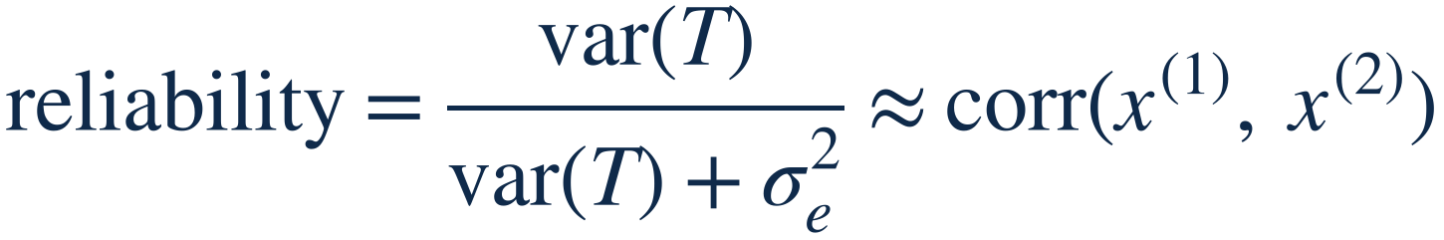
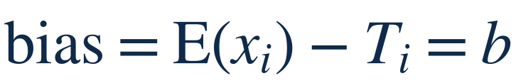
Reliability and validity, formally
DEFINITIONS · DATA AND MEASUREMENT
Measurement model. What we record = true value T + a systematic bias b + random noise e.
Reliability. The share of the variance that is signal, between 0 and 1. Estimated by the test–retest correlation, or by agreement between two raters.
Validity (bias). A valid measure is right on average: b ≈ 0. The scale that is 3 kg off has b = 3, however reliable it is.
Notebook §2
Notes:
This is the classical test theory model. Validity in a broader sense also asks whether we measure the right concept at all; the bias b is the part we can write as a number.

Slide 20
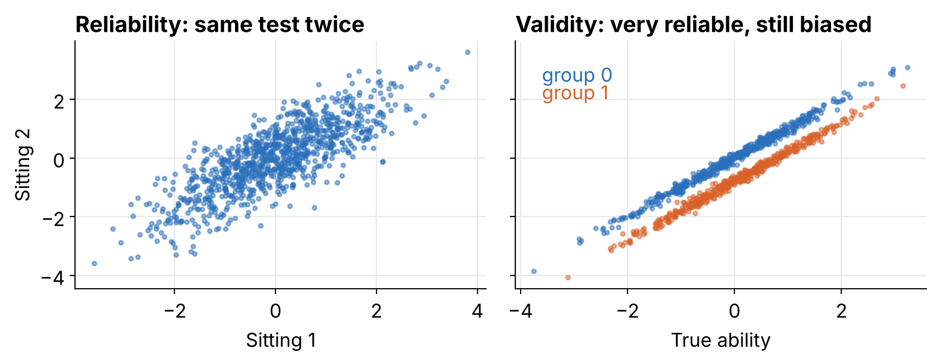
Reliable is not the same as valid
DATA AND MEASUREMENT
Test 1 is noisy but fair. Test 3 is almost perfectly repeatable and still says group 1 is less able. More data will not fix that.
Simulated data · Notebook §2
Notes:
Run section 2 of the notebook. Left: the same test taken twice, correlation about 0.8, which is its reliability. Right: group averages of ability are equal by construction, but test 3 subtracts 0.8 for group 1 (think of a test given in a language some students do not master). Average scores: -0.01 versus -0.74.

Slide 21
How precise must a measurement be?
DATA AND MEASUREMENT
It depends on the use
Scores are constructed
Definitions fail
A 1 kg scale is fine for weighing elephants and useless in a pharmacy.
A depression inventory has 21 items scored 0 to 3, so totals run from 0 to 63. A number, but a built one.
“Never smoker” means fewer than 100 cigarettes in a lifetime. For an adolescent who smoked 50, that is a poor definition.
Statistics · Lesson 1
Notes:
Measurement is a modelling choice. Ask students for a measure they use that has a hidden definition. Reliability can be checked by test-retest correlation or agreement between raters; validity requires that the measure is right on average.

Slide 22
Composite measures and similar-looking questions
DATA AND MEASUREMENT
A composite index
Close measures, different questions
The Human Development Index combines life expectancy, education and log of income per person. Plot it against its parts before trusting it: across US states it mostly tracks income.
Political ideology and party identification both split by income, but not the same way: the relationship differs across the two. Pick the measure that matches your question.
Statistics · Lesson 1
Notes:
Two messages. First, a composite hides weights and choices; plot it in several ways. Second, measures that look interchangeable can give different patterns, so state which one answers your question.

Slide 23
Who is in the data? Selection and external validity
DATA AND MEASUREMENT
Selection
External validity
What to do
Surveying people on a train tells you about train riders. People who respond, or who take a treatment, are rarely a random slice of the population.
An effect found in mice, or in a lab, or last year, may not hold for people, in the field, or tomorrow. Statistics checks the data in hand; the jump to another setting is an assumption.
Say who is in the sample, compare the sample with the target population, and adjust when you can (see the poll example later).
Statistics · Lesson 1
Notes:
Link back to the Xbox poll and forward to the biased poll with reweighting. Invite students to name the target population of their last project.

Slide 24
Before modeling: three habits
DATA AND MEASUREMENT
Ask where the data come from
All graphs are comparisons
Adjust, then compare
A raw trend can hide a changing mix. Mortality rates are age-adjusted before comparing years.
Who is in the data, who is missing, how was each number recorded?
Decide what is being compared, and make that comparison easy to see.
Statistics · Lesson 1
Notes:
Short slide, a few minutes. This part is about habits more than techniques. If time allows, show any graph from the students' own field and ask what comparison it makes. Mortality trends can change once the changing age composition of a group is taken into account.

Slide 25
Rules for graphs
DATA AND MEASUREMENT
Compare
Small multiples
Round
Three uses
Almost every graph is a comparison: spending and life expectancy by country, names ending in each letter in 1906, 1956, 2006. Name the comparison.
Repeat the same small plot for each group instead of one crowded plot.
Report 3.3 and 6.4, not 3.276 and 6.410. Never show a graph you cannot talk about.
Raw data, fitted models, final results. Make all three.
Statistics · Lesson 1
Notes:
Show one good and one bad graph from the students' own work if possible. The three uses give the structure of a data analysis: first look at the data, then at the model, then at the answer.

Slide 26
Averages need weights
DATA AND MEASUREMENT
Country | Population | Mean age | Weight
United States | 310 M | 36.8 | 0.680
Mexico | 112 M | 26.7 | 0.246
Canada | 34 M | 40.7 | 0.075
Weighted mean age 34.6 (naive 34.7). Teachers: 79% women paid $45,865, 21% men paid $49,207. Weighted average $46,567, not $47,536.
Notebook §10.1
Notes:
In the population example the weighted and naive averages happen to be close (34.6 and 34.7), while in the teachers example they differ by about $1,000, which shows the principle. The same idea reappears in poll reweighting and in age adjustment on the next slide. Always ask: weighted by what, and does the weight match the population I care about?

Slide 27
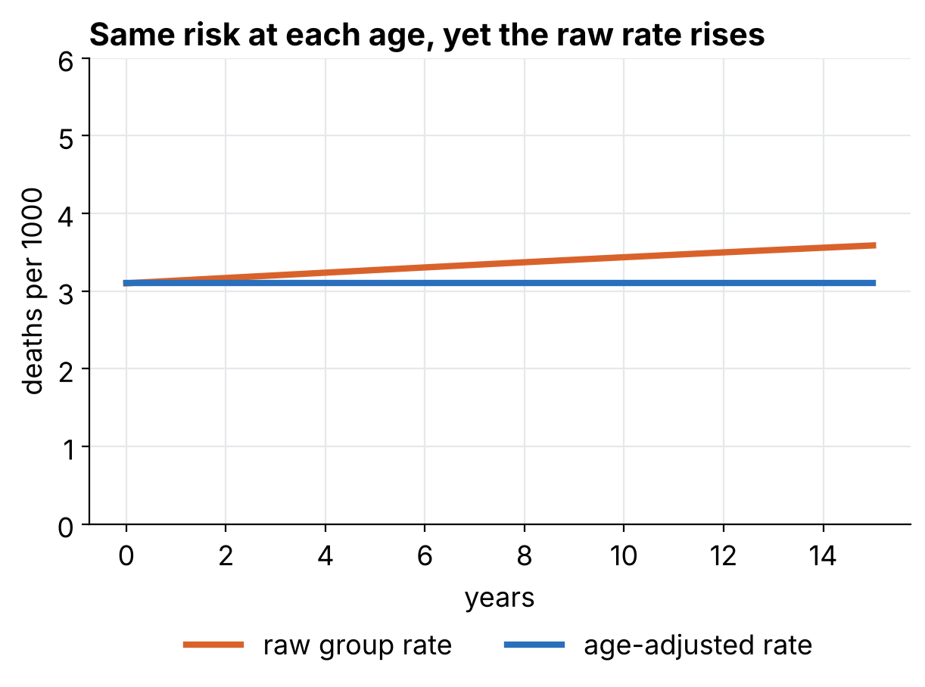
Aggregation can mislead: age adjustment
DATA AND MEASUREMENT
Synthetic example. At every age the death rate stays the same for 15 years, but the group “45 to 54” shifts towards its older end.
Raw rate: up 16%. Age-adjusted rate: 0%.
Real data on middle-aged mortality needed this correction before the trend could be read.
Synthetic data · Notebook §10.2
Notes:
The adjustment is just a weighted average with weights fixed at the year-0 age mix. Emphasise that the numbers are synthetic, built to show the mechanism.

Slide 28
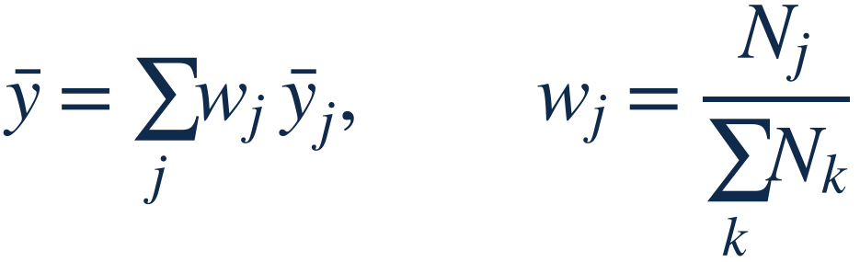
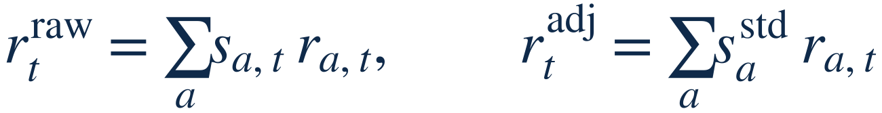
Weighted averages and standardization
DEFINITIONS · DATA AND MEASUREMENT
Weighted mean. Weights are shares of the population, so they add up to 1. North America: 0.680 × 36.8 + 0.246 × 26.7 + 0.075 × 40.7 = 34.6.
Age standardization. The raw rate uses this year's age mix sa,t; the adjusted rate fixes one standard mix, so only the age-specific rates ra,t can move it.
Notebook §10
Notes:
The mortality demo is exactly this: the age-specific rates are constant, so the adjusted rate is flat, while the raw rate rises with the age mix.

Slide 29
Probability and statistics go in opposite directions
PROBABILITY AS A GENERATIVE MODEL
PROBABILITY · MODEL TO DATA
STATISTICS · DATA TO MODEL
Earlier studies say the drug is 80% effective. For 100 patients we expect about 80 cured.
We observe 78 patients cured out of 100. What is the cure rate?
At least 65 are cured with probability 99.99%.
We are 95% confident it lies between 69.9% and 86.1%.
Simulation connects the two: generate data from a model, then ask what we could learn back.
Notebook §5.5
Notes:
This slide comes from the previous version of the course, with the same drug example. In the notebook (section 5.5) both directions are computed in a few lines: the 99.99% by simulating 100,000 trials of 100 patients at 80%, the interval from the standard error. Do not derive the interval here, it comes in section 5.

Slide 30
Who do you want to be, Alice or Bob?
PROBABILITY AS A GENERATIVE MODEL
One die is rolled. Alice gets 1 € if the result is 3 or more. Bob gets 2 € if it is 2 or less.
Alice
Bob
4/6 × 1 €
2/6 × 2 €
0.67 €
0.67 €
Simulated: 0.665 €
Simulated: 0.669 €
Average gain per game · 100,000 simulated games · Notebook §3
Notes:
Ask students to vote (poll or chat) before showing the numbers, as in the previous version. Surprise: the two roles have the same expected gain. The simulated values come from 100,000 rolls in the notebook. Message: when the process is known, we can compute exact answers or simulate and get the same numbers.

Slide 31
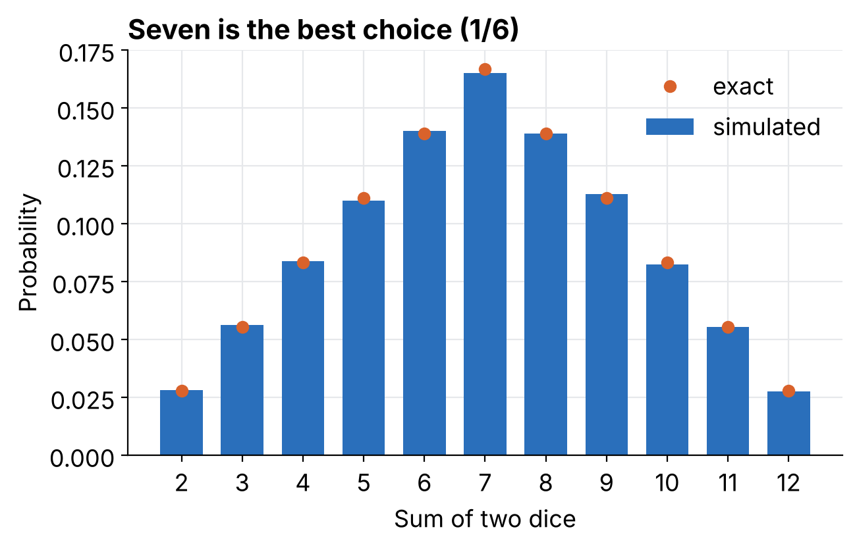
Two dice: which number do you choose?
PROBABILITY AS A GENERATIVE MODEL
Pick a number from 2 to 12. You win 100 € if it is the sum of two dice.
Seven is the best choice: 6 of the 36 combinations, a probability of 1/6.
100,000 simulated rolls reproduce the exact probabilities.
Notebook §3
Notes:
Known physical process: each side has chance 1/6 and the dice are independent, so probabilities of outcomes and expected amounts can be deduced. This is probability. Statistics is what we need when the process is not known.

Slide 32
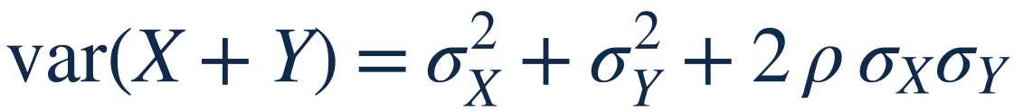
Random variables: mean, variance, standard deviation
DEFINITIONS · PROBABILITY
Definitions. σ = &radic;var is in the units of X. One fair die: μ = 3.5, σ = &radic;(35/12) = 1.71.
Linear change. Inches to centimetres: multiply mean and sd by 2.54. Adding a constant moves the mean, not the sd.
Sums. &rho; is the correlation. Independent: &rho; = 0 and variances add. Two dice: mean 7, sd &radic;(2 × 35/12) = 2.42.
Notebook §3
Notes:
For continuous variables replace the sum by an integral. The variance of a difference has a minus sign before the covariance term, which is why the standard error of a difference of independent estimates is the square root of the sum of the squared standard errors.

Slide 33
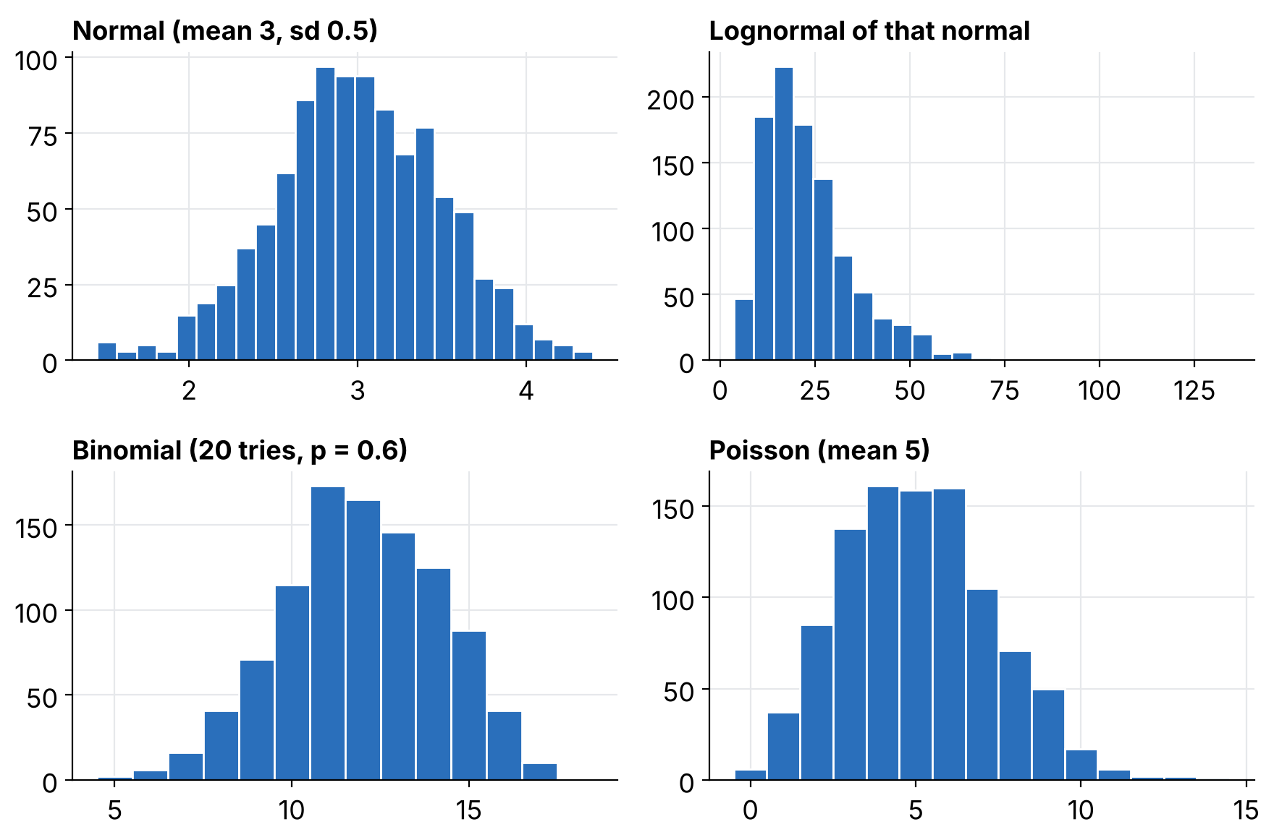
Four distributions cover most of what we need
PROBABILITY AS A GENERATIVE MODEL
Normal. Sums and averages of many small things, such as heights.
Lognormal. Things that multiply, such as incomes. Positive and skewed.
Binomial. Number of successes in n yes/no trials.
Poisson. Counts of rare events: accidents, goals.
1000 simulated draws from each · Notebook §3
Notes:
Each panel is 1000 draws made with one line of numpy. Let students change the parameters in the notebook and watch the shapes move. Normal(3, 0.5), its lognormal, binomial(20, 0.6) and Poisson(5).

Slide 34
The mathematical toolkit: lines, growth, logs
PROBABILITY AS A GENERATIVE MODEL
A line, y = a + bx
Exponential change
Power law
A mile-run record of 1007 − 0.393 x seconds has an intercept at year 0 that means nothing. Recentre: 260 − 0.393 (x − 1900). The slope is a description of the trend, not a cause.
Doubling every 50 years means a factor e0.014 per year. A 20% yearly decline means e−0.22 x.
log y = a + b log x. Metabolic rate 4.1 x0.74: doubling the mass multiplies the rate by 1.67, multiplying it by 10 gives 5.5.
Notebook §11.1
Notes:
Recentring makes the intercept interpretable (the predicted time in 1900 is 260 s). For logs: multiplication becomes addition, so exponential growth is a straight line on a log y axis and a power law is a straight line on log-log axes.

Slide 35
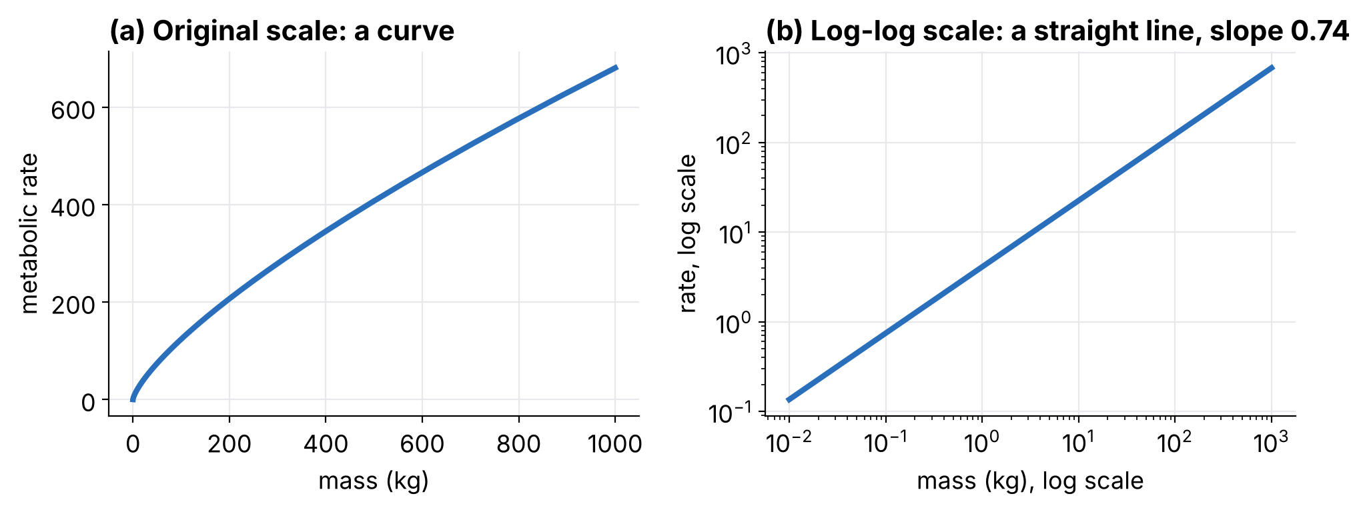
A power law is a straight line on log-log axes
PROBABILITY AS A GENERATIVE MODEL
The slope 0.74 on the log-log plot is the exponent: a 1% rise in mass goes with about a 0.74% rise in rate.
Notebook §11.1
Notes:
Curved on the original scale, straight after taking logs. This is the first hint of why we transform variables in linear regression: the model stays linear in the parameters.

Slide 36
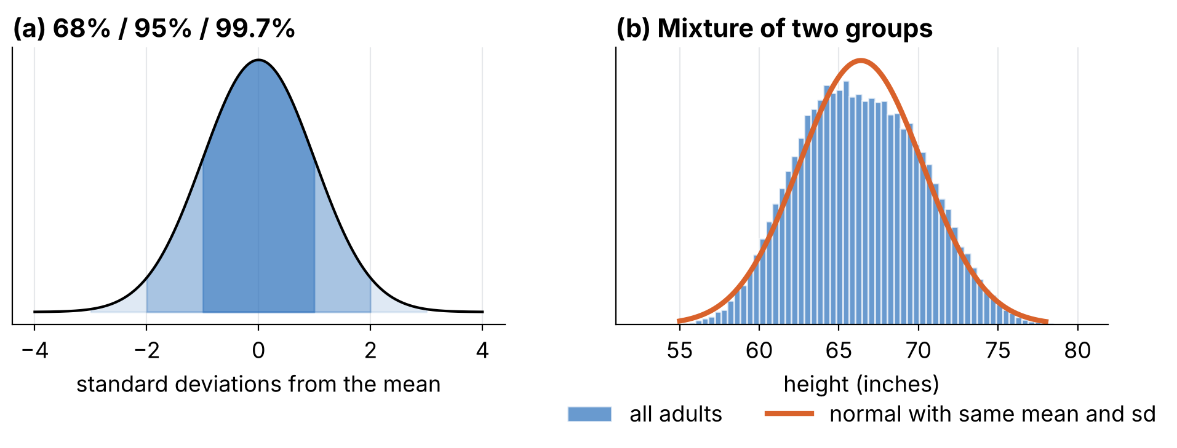
The normal distribution: handy, and not universal
PROBABILITY AS A GENERATIVE MODEL
About 68%, 95%, 99.7% within 1, 2, 3 standard deviations; 50% within 0.67. Heights of women are close to normal. Heights of all adults mix two groups, so a single normal fits worse.
Notebook §11.2
Notes:
Simulated heights: women mean 63.7 in, sd 2.7; men mean 69.1 in, sd 2.9. The mixture is flatter on top than the matching normal. Use this to remind students that a named distribution is a model, not a fact.

Slide 37
Means, variances and the standard families
PROBABILITY AS A GENERATIVE MODEL
Model | Use | Mean | Standard deviation
Normal(m, s) | Sums and averages | m | s
Lognormal | Weights, incomes. Men: log mean 5.13, log sd 0.17 | geometric mean 169 lb | geometric sd 1.19
Binomial(n, p) | Successes in n trials. 20 shots at 0.3 | n p = 6 | &radic;(n p (1−p)) = 2.05
Poisson(λ) | Rare events. 750 people, 1% named Michael | λ = 7.5 | &radic;λ
Notebook §11.3
Notes:
The simulated binomial gives mean 5.99 and sd 2.05, matching the formulas. Remind students that the geometric sd is a multiplicative factor: 68% of men lie within a factor 1.19 of 169 lb.

Slide 38
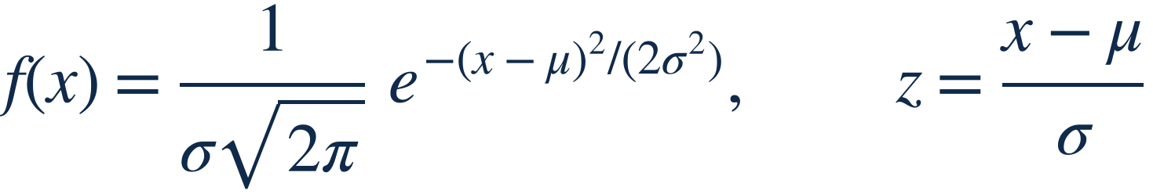
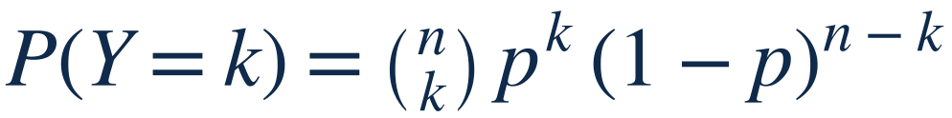
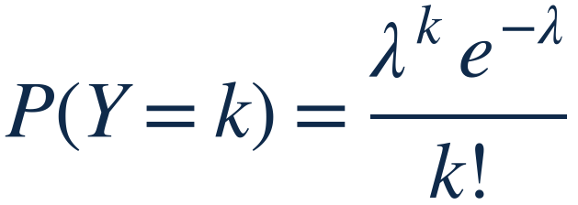
The standard families, as formulas
DEFINITIONS · PROBABILITY
Normal N(μ, σ²). P(|X − μ| ≤ kσ) = 2&Phi;(k) − 1: 0.683, 0.954, 0.997 for k = 1, 2, 3. Lognormal: log Y is normal.
Binomial(n, p). Successes in n independent trials. Mean np, sd &radic;(np(1 − p)).
Poisson(λ). Counts of rare events. Mean = variance = λ, so the sd is &radic;λ.
Notebook §11
Notes:
Phi is the standard normal cumulative distribution function. Remind students that they will rarely compute these densities by hand: numpy draws from them and scipy.stats evaluates them.

Slide 39
Effects against the spread of the data
PROBABILITY AS A GENERATIVE MODEL
A stent trial reports that treated patients exercise 20 seconds longer on a treadmill. Patients vary a lot: mean 510 s, sd 190 s.
What 20 seconds means
A patient at the median (50th percentile) would move to the 54th percentile. Real, but small compared with the variation between patients.
Always compare an effect with the variability it lives in.
Notebook §11.4
Notes:
The calculation is 20/190 = 0.105 standard deviations, a normal cdf of 0.542. Statistical significance can come with a tiny practical effect when samples are large.

Slide 40
When a probability model breaks: the decisive vote
PROBABILITY AS A GENERATIVE MODEL
Model for the vote share | Chance one vote decides (200,000 voters)
Forecast N(0.49, 0.04) | 4.8 × 10−5
Forecast N(0.50, 0.20) | 1.0 × 10−5
Binomial, p = 0.50 | 1.8 × 10−3 (1 in 560)
Binomial, p = 0.49 | 7.5 × 10−21, absurd
Notebook §11.4
Notes:
The binomial treats p as known exactly, so it gives nonsense: tiny when p is slightly off, large when p is exactly 0.5. Putting a forecast distribution on the share gives a sensible answer, of the order of one in 20,000 to 100,000. Lesson: a model is only as good as its handling of uncertainty in its own parameters.

Slide 41
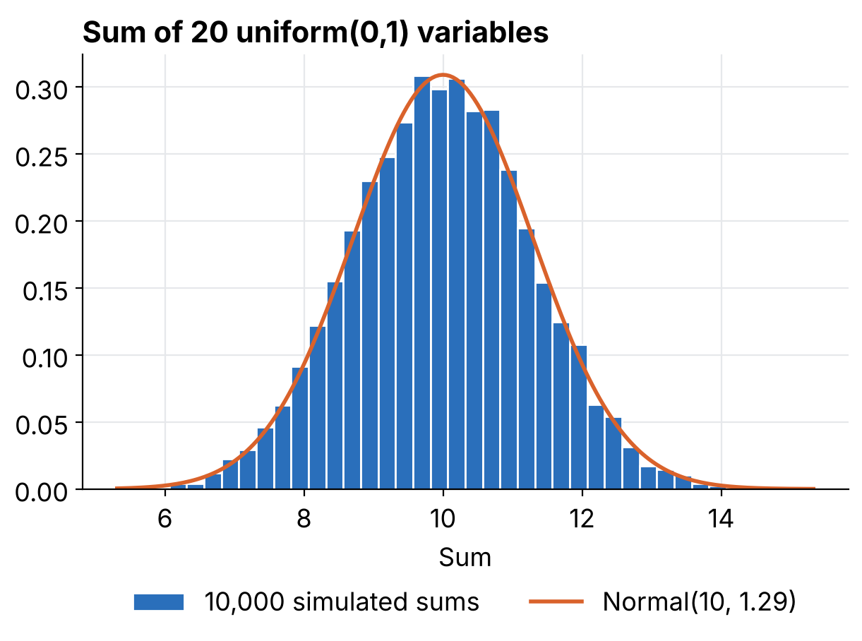
Why the bell curve is everywhere
PROBABILITY AS A GENERATIVE MODEL
Add up 20 independent uniform numbers between 0 and 1. Each one is flat. The sum is bell-shaped.
Averages and proportions from large samples behave the same way. This is the Central Limit Theorem, and the reason confidence intervals work.
We did not prove it. We watched it.
10,000 simulated sums · Notebook §3
Notes:
The experiment gives the intuition first; the formal statement of the law of large numbers and the central limit theorem follows on the next slide. The orange curve is Normal(10, 1.29), with mean 20 × 0.5 and standard deviation the square root of 20/12.

Slide 42
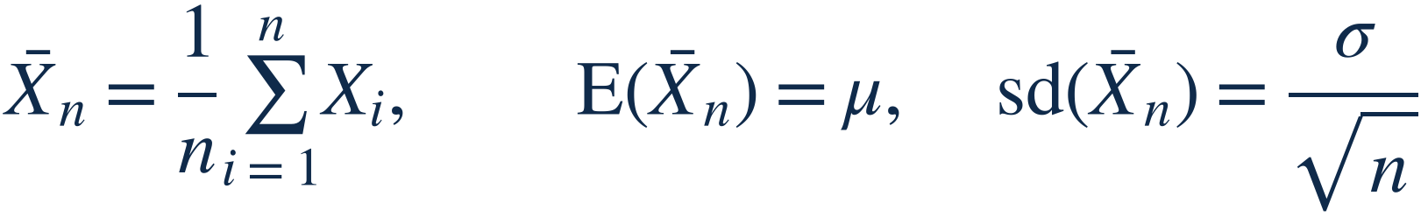
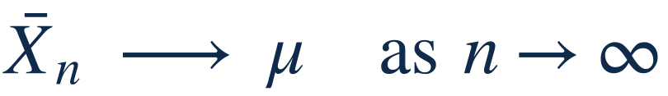
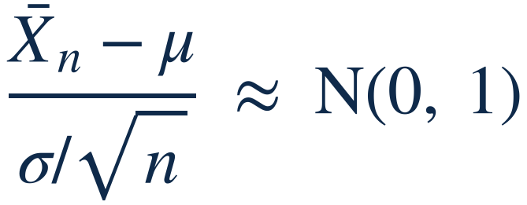
The law of large numbers and the central limit theorem
DEFINITIONS · PROBABILITY
The average. Of n independent draws with mean μ and sd σ. The 1/&radic;n is why four times the data halves the error.
Law of large numbers. The average settles down at the mean.
Central limit theorem. For large n the standardized average is close to N(0, 1), whatever the shape of X. Twenty uniforms: sum has mean 10 and sd &radic;(20/12) = 1.29.
Notebook §3
Notes:
The formal statements that the simulation illustrated. Conditions: independent draws with finite variance. How large n must be depends on how skewed X is; for the uniform, 20 is plenty.

Slide 43
Complicated process = simple process + random noise
KEY PRINCIPLE
Good modeling means choosing a plausible simple process and a noise distribution. Then we can simulate it.
Statistics · Lesson 1 · Probability as a generative model
Notes:
Key idea kept from the previous version. The election regression is exactly this: a straight line (the simple process) plus scatter (the noise). A model is a recipe that could have generated the data. If we can write the recipe in code, we can run it as often as we like.

Slide 44
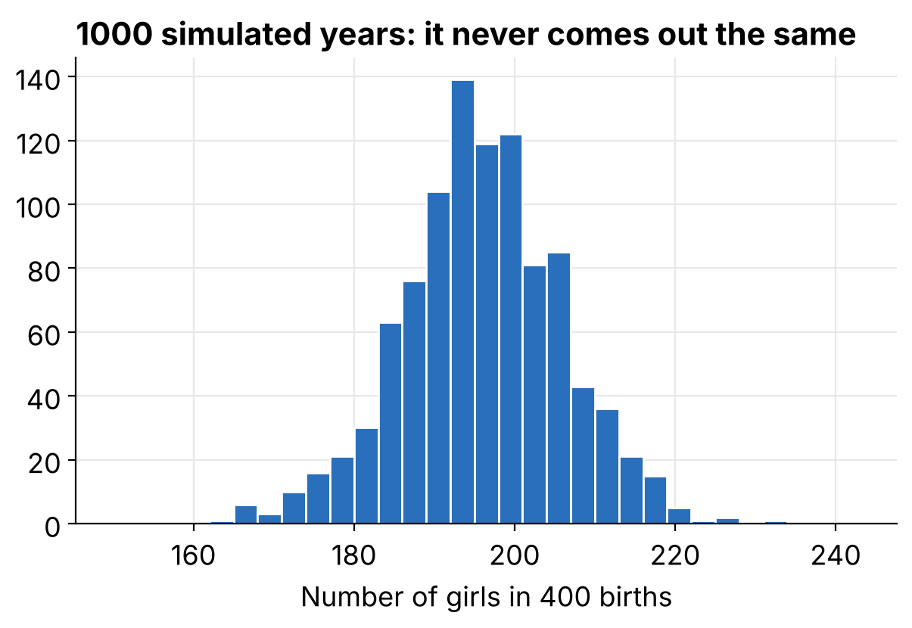
400 births: how many girls?
SIMULATING PROBABILITY MODELS
About 48.8% of babies are girls. One simulated year gave 180.
Repeat it 1000 times: the average is 195, the standard deviation 10, and a central 95% interval runs from about 175 to 215.
Adding twins, which is awkward on paper, takes a few more lines of code.
Notebook §4
Notes:
One draw from a binomial is one possible year. To see what could happen, repeat. With twins (1 birth in 125 fraternal, 1 in 300 identical) the average moves to about 198. Message for students: simulation handles complications that would make the algebra painful.

Slide 45
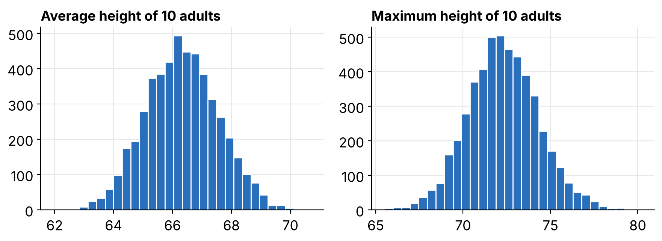
Ten adults at random: average and maximum height
SIMULATING PROBABILITY MODELS
52% women (mean 63.7 in, sd 2.7), 48% men (mean 69.1, sd 2.9). Average: 66.3 in, sd 1.2. Maximum: 72.3 in, sd 2.0. Nobody needs a formula for the maximum.
5000 simulated groups · Notebook §4
Notes:
A mixed discrete and continuous model: first draw the sex, then draw the height given the sex. Compute any summary of the sample (mean, max, median) and repeat. This is the basic move for the rest of the course.

Slide 46
Three kinds of error, and what we are estimating
ESTIMATES, STANDARD ERRORS, INTERVALS
Sampling
Measurement
Model
The people in the sample are not the whole population.
What we record is not exactly what we meant to measure.
The assumed relationship is not the true one.
Statistics · Lesson 1
Notes:
The standard error only captures the first kind, and only if sampling is random. Also separate the estimand (the quantity of interest in the population) from the parameter of a convenient model: they are not always the same thing.

Slide 47
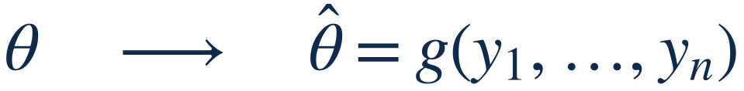
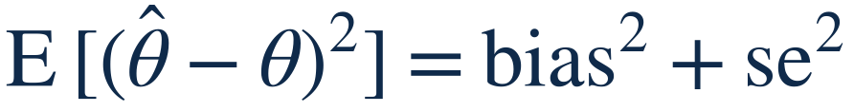
Estimands, estimators and their errors
DEFINITIONS · ESTIMATES AND ERRORS
Estimand and estimator. θ is the quantity we want, such as a population share. θ̂ is a recipe applied to the data.
Bias and standard error. Both describe the sampling distribution: what θ̂ would do over repeated studies.
Mean squared error. The total error. It is why we add non-sampling error as &radic;(se² + bias²) later.
Statistics · Lesson 1
Notes:
Keep this vocabulary for the whole course: the regression coefficient is an estimator, its standard error is the sd of its sampling distribution, and an unbiased but noisy estimator can be worse than a slightly biased stable one.

Slide 48
Do couples turn their heads to the right?
ESTIMATES, STANDARD ERRORS, INTERVALS
"A neonatal right-side preference makes a surprising romantic reappearance later in life."
THE STUDY
THE ESTIMATE
THE QUESTION
124 kissing couples observed. 80 turned to the right.
80/124 = 64.5%
Is that far enough from 50%? What if it had been right, right, left (66.7%)?
Example from the previous version of this lesson (Nature, 2003) · Notebook §5.1
Notes:
We keep the head-turning example from last year's introduction, but we now answer "how large must n be?" with a simulation instead of the Law of Large Numbers and the CLT. Model in one sentence: each couple turns right with probability p, independently. Let students say why 3 couples are not enough.

Slide 49
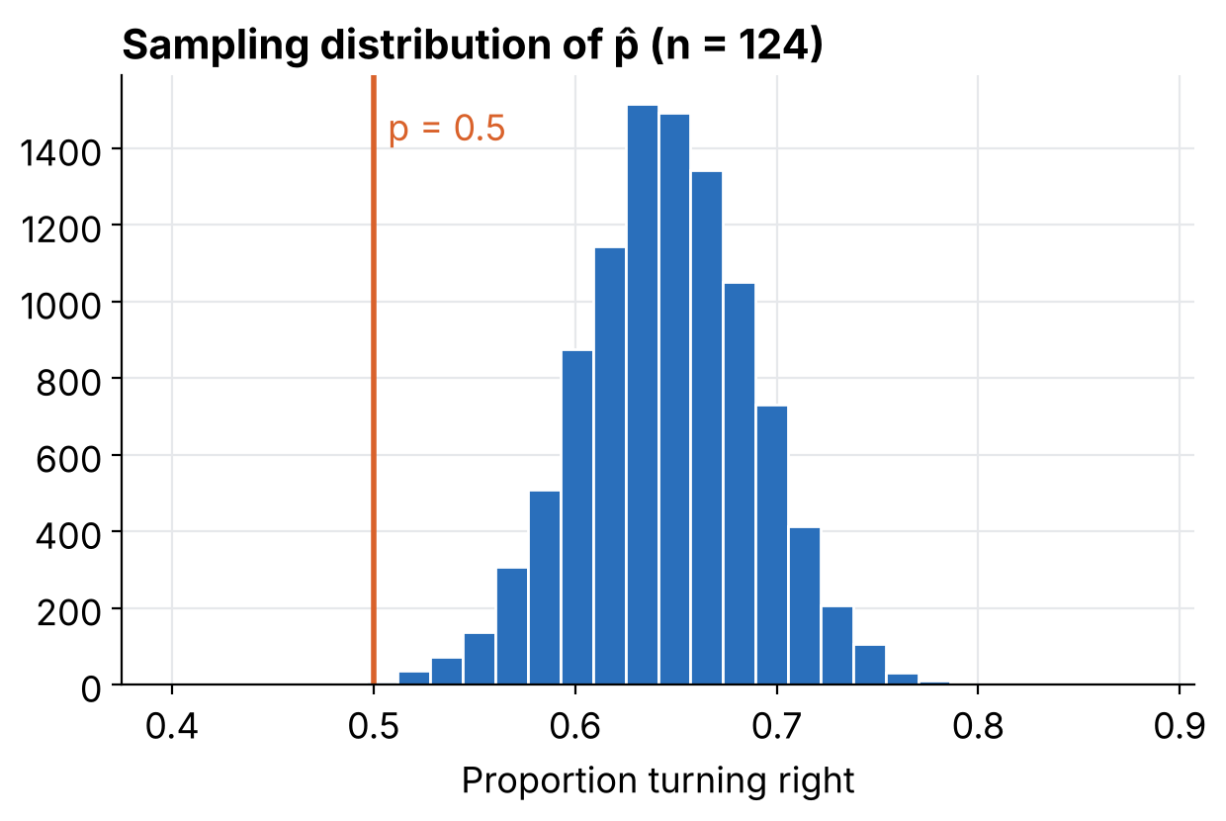
Rerun the study 10,000 times
ESTIMATES, STANDARD ERRORS, INTERVALS
Pretend the truth is p = 0.645 and repeat a study of 124 couples. Each run gives a different estimate.
Spread of the 10,000 estimates: 0.0428.
The formula √(p̂(1 − p̂)/n) gives 0.0430.
That spread is the standard error.
Sampling distribution of the estimate · Notebook §5.1
Notes:
The sampling distribution is the set of datasets we could have seen, with their probabilities. We cannot repeat the real study, but we can repeat a simulated one. The formula is a shortcut for what the computer did by brute force. Note how far 0.5 is from the bulk of the histogram.

Slide 50
A 95% interval is the estimate ± 2 standard errors
ESTIMATES, STANDARD ERRORS, INTERVALS
ESTIMATE
STANDARD ERROR
95% INTERVAL
64.5%
4.3 pts
56% to 73%
The interval does not contain 50%, so the data are not consistent with "no preference".
The same recipe gives the drug interval (69.9% to 86.1%) and the gender gap in a poll (12 ± 6 points).
Notebook §5.1 and §5.4
Notes:
Exact numbers: p-hat 0.645, standard error 0.043, interval 0.561 to 0.729. This is the same interval as in the old slides (with the exact standard error instead of the conservative bound 1/(2 sqrt n)). The poll example: 57% of 400 men versus 45% of 600 women, gap 0.12 with standard error 0.032, so about 12 ± 6 points.

Slide 51
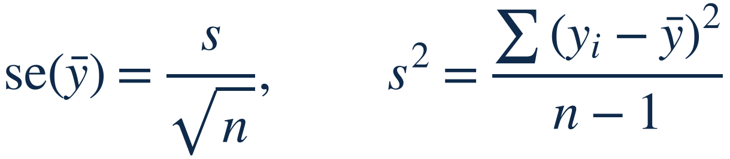
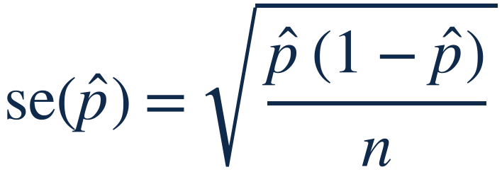
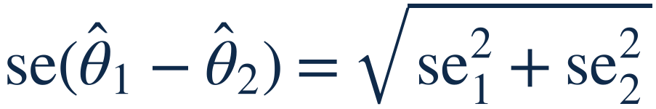
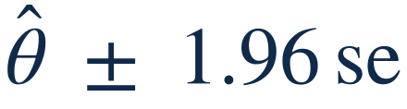
Standard errors and intervals: the formulas
DEFINITIONS · ESTIMATES AND ERRORS
Mean. s is the sample sd; dividing by n − 1 removes its bias.
Proportion. Kissing couples: &radic;(0.645 × 0.355 / 124) = 0.043. With few events, use (y + 2)/(n + 4).
Difference. Poll: &radic;(0.57 × 0.43/400 + 0.45 × 0.55/600) = 0.032.
95% interval. 1.96 ≈ 2; ±1 se gives 68%, ±0.67 se gives 50%. Kissing: 0.645 ± 0.084.
Notebook §5
Notes:
These four formulas cover most of the intervals in the course. The 1.96 comes from the normal approximation of the sampling distribution, which the central limit theorem justifies.

Slide 52
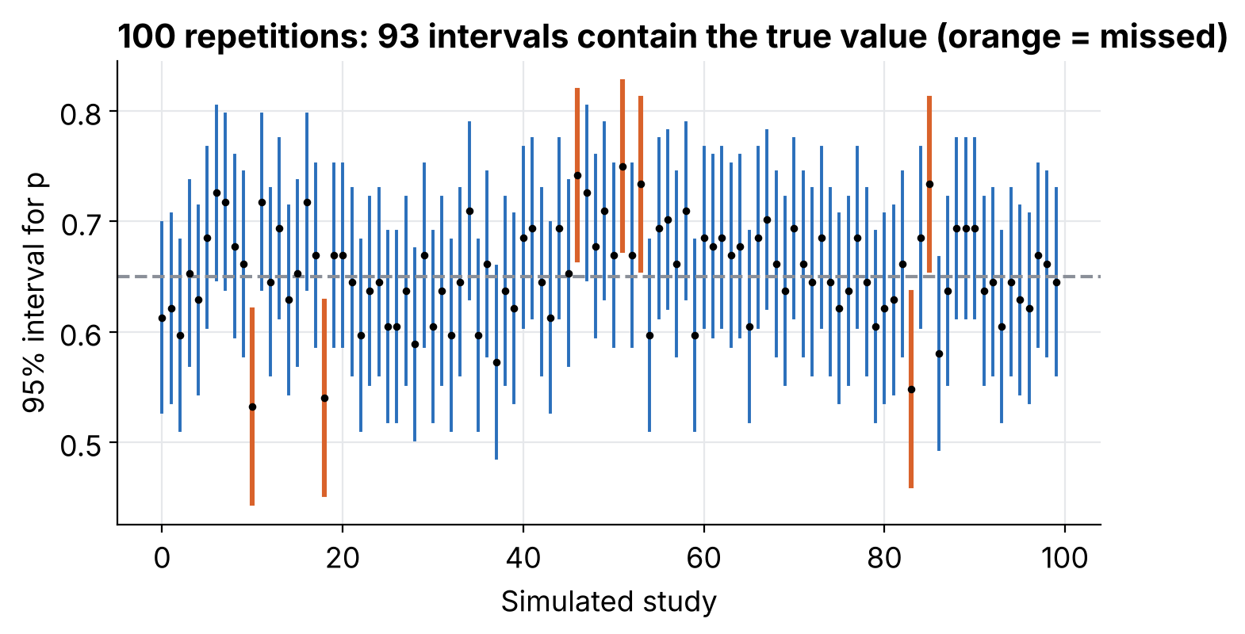
What does "95%" actually mean?
ESTIMATES, STANDARD ERRORS, INTERVALS
100 repeated studies: 93 intervals contain the truth, 7 miss it.
"95%" describes the procedure over many repetitions, not one particular interval.
True p = 0.65, n = 124 · Notebook §5.2
Notes:
In a simulation we know the truth, so we can check the coverage. Run the cell several times with different seeds: the count moves around 95. Orange intervals are the misses. Never say "there is a 95% probability that p is in this particular interval" without being careful: the 95% belongs to the recipe.

Slide 53
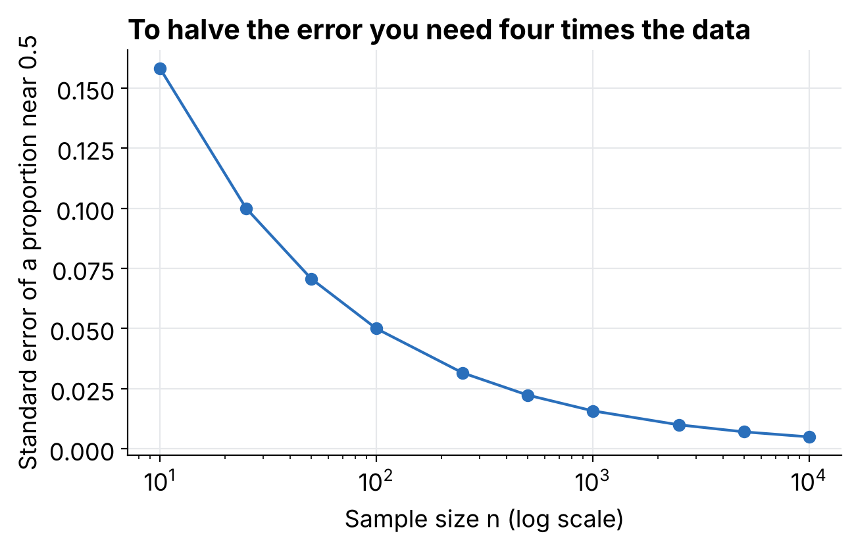
To halve the error, collect four times the data
ESTIMATES, STANDARD ERRORS, INTERVALS
se ≈ 0.5 / √n
For a proportion near 0.5 and n = 1000, the standard error is about 1.6 percentage points.
So how large must n be? It depends on the precision you need, and each extra bit of precision costs more.
Notebook §5.3
Notes:
This answers the question left open in the head-turning example: with n = 3 the standard error is about 0.27, with n = 124 it is 0.043. The x axis is logarithmic: equal steps are factors of ten.

Slide 54
When is a "95% interval" really 95%?
ESTIMATES, STANDARD ERRORS, INTERVALS
n | Simple interval, p = 0.5 | Simple interval, p = 0.05 | Quick fix, p = 0.05
10 | 89% | 40% | 99%
30 | 96% | 79% | 98%
124 | 94% | 94% | 97%
1000 | 95% | 94% | 95%
Share of simulated intervals that contain the truth. Rare events with small samples break the simple formula. The quick fix replaces y/n by (y + 2)/(n + 4).
20,000 simulations per cell · Notebook §5.2
Notes:
A method has assumptions, and simulation is how we check them. For p = 0.05 and n = 10 the usual interval contains the truth only about 40% of the time (when there are zero events it even has zero width). The quick fix works well. Values are from the seeded notebook run, so they move slightly with another seed.

Slide 55
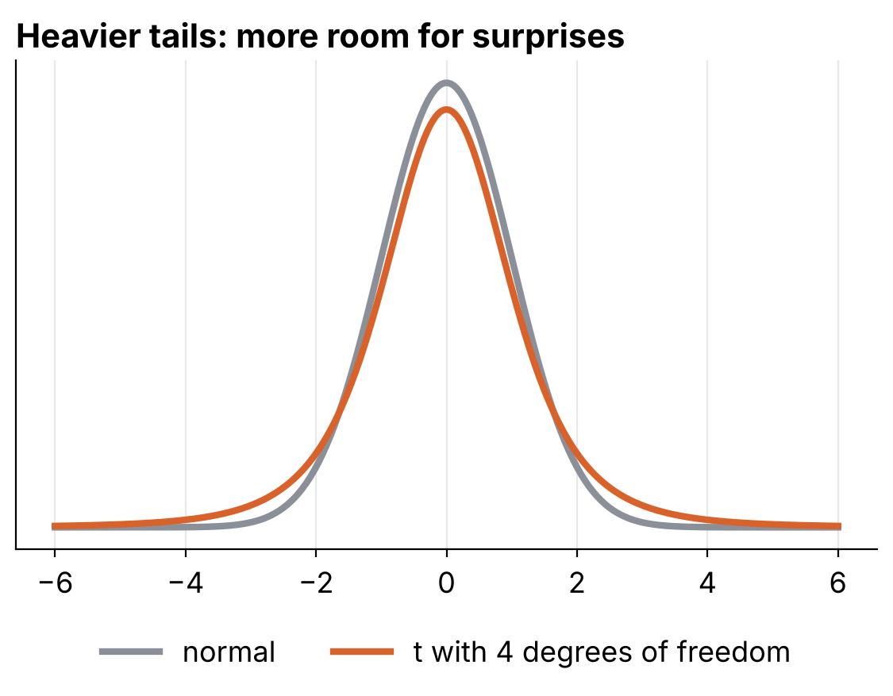
Small samples: the t distribution
ESTIMATES, STANDARD ERRORS, INTERVALS
Five weights: 35, 34, 38, 35, 37. Mean 35.8, standard error 0.73.
Normal interval [34.4, 37.2]. t interval [33.8, 37.8]; critical value 2.78 instead of 1.96.
Coverage with n = 5: normal 88%, t 95%.
Notebook §12.1
Notes:
With so few observations the standard error is itself uncertain, so the t distribution has heavier tails. By about n = 30 the difference is negligible. Coverage values come from 20,000 simulated samples.

Slide 56
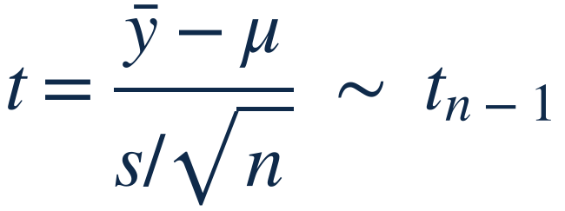
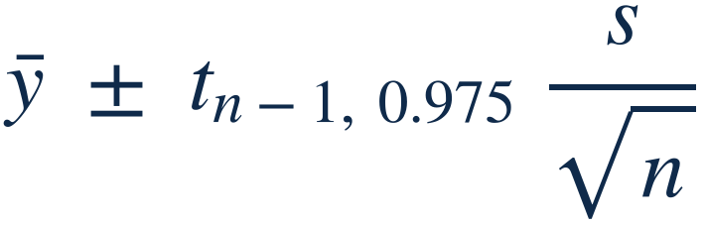
The t interval, formally
DEFINITIONS · ESTIMATES AND ERRORS
Statistic. With normal data the standardized mean follows a t distribution with n − 1 degrees of freedom, because s is itself estimated.
95% interval. Five weights: 35.8 ± 2.78 × 0.73 = [33.8, 37.8]. For n above about 30, tn−1, 0.975 ≈ 1.96.
Notebook §12.1
Notes:
In regression the same idea gives t with n minus k degrees of freedom, where k is the number of coefficients: that is what statsmodels reports in the t column.

Slide 57
A bigger sample around the wrong number
BIAS AND UNMODELED UNCERTAINTY
Truth: 52% women, of whom 60% support a candidate; 40% of men do. Overall support is 50.4%. Women answer the poll twice as often as men.
Respondents | Naive estimate | 95% half-width | Reweighted
600 | 53.5% | ± 4.0 | 49.5%
6,000 | 54.6% | ± 1.3 | 51.4%
60,000 | 53.6% | ± 0.4 | 50.3%
600,000 | 53.6% | ± 0.1 | 50.4%
More data shrinks the interval around the wrong value. Reweighting by population shares removes the bias.
Simulated poll · Notebook §6
Notes:
This is a key lesson: standard errors only measure sampling noise. With a biased sample the naive interval becomes extremely precise and wrong (about 53.6% instead of 50.4%). Weighting by the population share of each group (a weighted average) corrects the bias. The reweighted values still fluctuate a little because of sampling noise: 51.4% at n = 6000 is roughly one and a half standard errors from the truth.

Slide 58
Add the errors that are not in the model
BIAS AND UNMODELED UNCERTAINTY
total se = √(sampling se² + non-sampling se²)
600 RESPONDENTS
60,000 RESPONDENTS
Sampling se 2.0 points
Sampling se 0.2 points
3.2 points
2.5 points
total
total
With 2.5 points of non-sampling error, a sample 100 times larger barely helps. Reduce the larger source of error first.
Non-sampling error of about 2.5 points in election polls · Notebook §6
Notes:
The three ways to deal with error that is not in the model: improve data collection, expand the model, or increase the stated uncertainty. Here we did the third. Errors are assumed independent, so variances add, not standard errors.

Slide 59
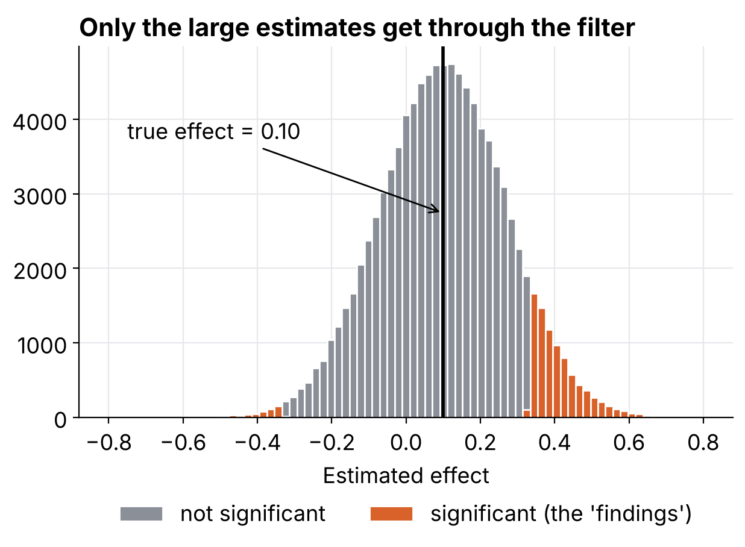
The significance filter
SIGNIFICANCE AND ITS TRAPS
A noisy study of a small effect: true effect 0.10, standard error 0.17. We simulate 100,000 replications.
9% of studies are significant.
Those estimates average 4.1 times the true effect.
5.8% of them have the wrong sign.
Each estimate is unbiased. The ones that pass the filter are not.
Notebook §7.1
Notes:
The most important picture of the lesson. To reach significance an estimate must be at least about two standard errors from zero, here 0.33, so every significant estimate is at least three times the true effect. If only significant results are published, the literature overestimates effects (type M error, magnitude) and some have the wrong sign (type S error). The published estimate in the Jamaica study was 0.35 with a standard error of 0.17.

Slide 60
Three more traps
SIGNIFICANCE AND ITS TRAPS
Significant is not important
Not significant is not zero
A significant and a non-significant result may not differ
+$10 per year, standard error $2: significant, but negligible.
Arterial stents: +16.6 seconds of treadmill time, standard error 9.8, p = 0.20.
Study A: 25 ± 10. Study B: 10 ± 10.
+$10,000, standard error $10,000: not significant, possibly huge.
The difference is 15 ± 14, nowhere near significant.
The fair summary is "uncertain", not "no effect".
Notebook §7.2
Notes:
Three classic pitfalls. The last one is a classic: the difference between "significant" and "not significant" is not itself statistically significant. The standard error of the difference is the square root of 10 squared plus 10 squared, about 14.1, so z is about 1.06 and p about 0.29.

Slide 61
Testing a difference, step by step
SIGNIFICANCE AND ITS TRAPS
Step | Example: a diet and cholesterol, 60 per group
1. Estimate | Difference of means: −22.6
2. Standard error | &radic;(s1²/n1 + s2²/n2) = 5.3
3. Statistic | t = −22.6 / 5.3 = −4.25
4. p-value | Probability of a value this extreme if the true difference were 0: p < 0.001
5. Interval | [−33.1, −12.0]
Report the interval. The p-value alone does not say how large the difference is.
Simulated data · Notebook §12.2
Notes:
Make the point that rejecting zero is not the same as learning the size. Also distinguish type 1 and type 2 errors (wrong rejection, missed effect) from the type S and type M errors seen earlier (wrong sign, wrong magnitude), which matter more for noisy studies.

Slide 62
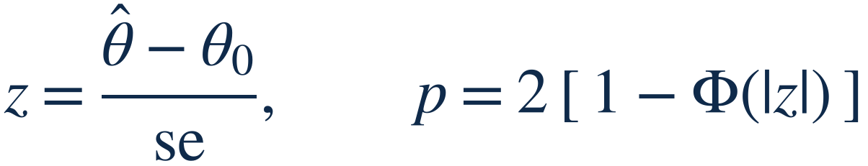
Hypothesis tests, formally
DEFINITIONS · SIGNIFICANCE
Test statistic and p-value. Under H0: θ = θ0, z ≈ N(0, 1). The p-value is the probability of a |z| at least this large if H0 were true. Significant at 5% when |z| > 1.96.
Error rates. Type 1: rejecting a true H0, rate α. Type 2: missing a real effect, rate β. Power = 1 − β. Cholesterol: z = −22.6/5.3 = −4.3, p < 0.001.
Notebook §12.2
Notes:
The p-value is not the probability that H0 is true, and 1 minus p is not the probability that the effect is real. Say it twice.

Slide 63
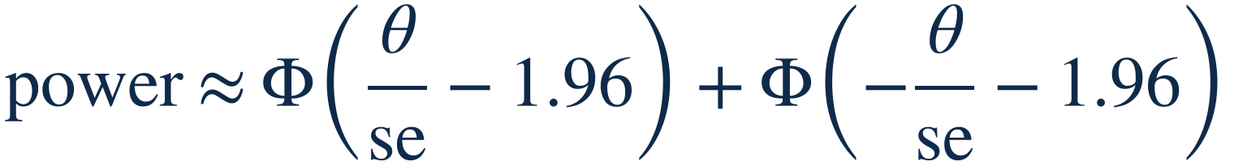
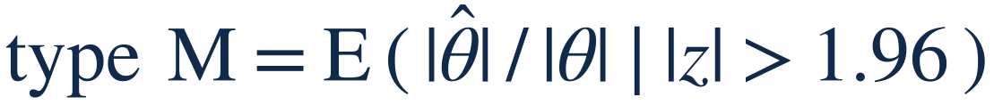
Power and the significance filter, formally
DEFINITIONS · SIGNIFICANCE
Power. Probability that a study with true effect θ and standard error se comes out significant. Filter example: θ = 0.10, se = 0.17 gives 9%.
Type S (sign). Share of significant results with the wrong sign: 6% in the example.
Type M (magnitude). Exaggeration ratio among significant results: 4.1 in the example. Low power means large exaggeration.
Notebook §7.1
Notes:
The analytic values (power 9.0%, type S 6.0%, exaggeration 4.1) match the simulation in section 7.1 (9.0%, 5.8%, 4.1). The power formula ignores nothing but the normal approximation.

Slide 64
Forking paths: noise that looks like a discovery
SIGNIFICANCE AND ITS TRAPS
Two groups of 50, no real effect at all, and 20 possible comparisons: outcomes, subgroups, exclusion rules.
ONE COMPARISON
STUDIES WITH AT LEAST ONE HIT
5%
63%
give p < 0.05
theory: 1 − 0.95²⁰ = 64%
Analyze all your data, show all your comparisons, share the data.
2000 simulated studies · Notebook §7.3
Notes:
Nobody has to cheat on purpose: when analysis choices depend on the data, a low p-value is easy to find in pure noise. A well-known example is a study of ovulation and political attitudes. A better answer than an adjusted p-value is to model the variation hidden in the choices, and to accept uncertainty.

Slide 65
Moving beyond significant or not
SIGNIFICANCE AND ITS TRAPS
Analyse all the data
Present all comparisons
Show the uncertainty
Share data and code
Do not keep only what looks promising.
Estimates with intervals, effect sizes against variation.
So others can check and redo the analysis.
Show every comparison you made, not just the winners.
Statistics · Lesson 1
Notes:
These four habits answer the forking-paths problem on the previous slides. They cost little and make results easier to trust.

Slide 66
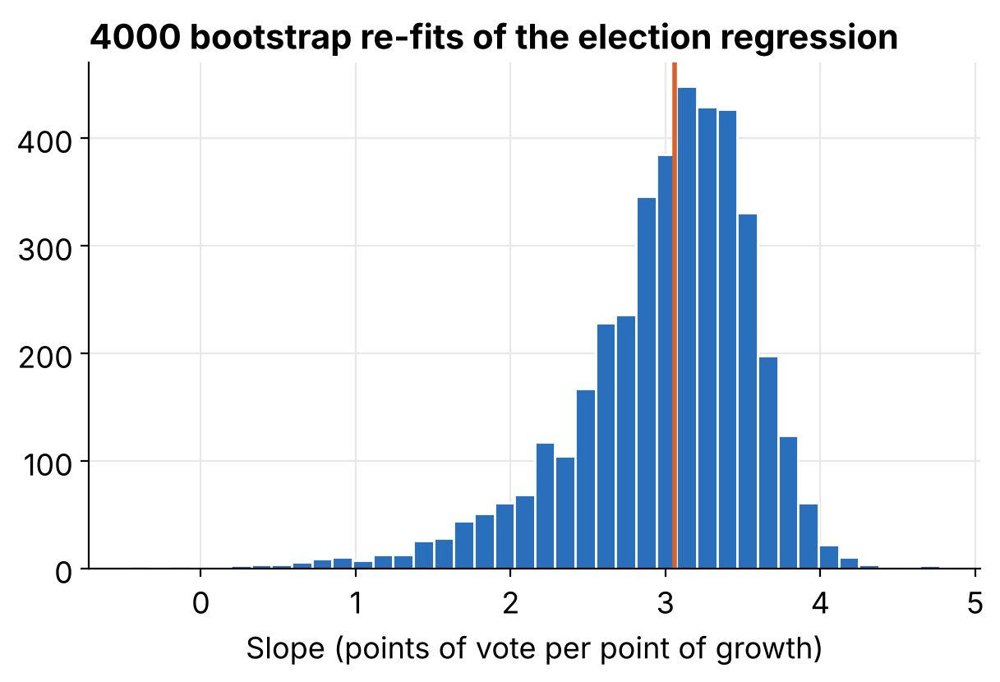
The bootstrap: reuse the data you have
BOOTSTRAP AND FAKE-DATA SIMULATION
Resample the 16 elections with replacement, refit the line, and repeat 4,000 times.
Slope: 3.06
Bootstrap standard error: 0.60
Least-squares standard error: 0.70
No formula needed, and a similar answer.
Notebook §8.1
Notes:
Resampling with replacement lets us build new datasets of the same size. Any estimate can be bootstrapped, which is both the appeal and the danger of the method. It can fail, for instance in a logistic regression where one group has no positive cases: no bootstrap sample contains one either. The bootstrap 95% interval for the slope is about 1.5 to 3.9.

Slide 67
Robust summaries and a bootstrap for any statistic
SIGNIFICANCE AND ITS TRAPS
Case | Result
Clean data, n = 200 | sd 13.6, MAD sd 13.5
Add 3 wild values | sd 136.9, MAD sd 13.9
Ratio of medians, two skewed samples | 1.36, bootstrap se 0.16, 95% interval [1.06, 1.66]
Notebook §12.3
Notes:
MAD sd is 1.4826 times the median absolute deviation, which matches the sd for normal data. The bootstrap works for the ratio of medians even though no simple formula exists, and for almost any statistic you can compute.

Slide 68
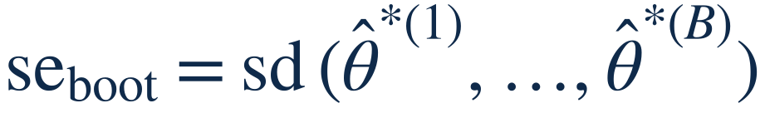
The bootstrap and robust scale, formally
DEFINITIONS · BOOTSTRAP
Bootstrap sample. Same size as the data, drawn with replacement. Repeat for b = 1, …, B (here B = 4000).
Bootstrap se. Recompute the estimate on each sample. Its sd is the standard error; its 2.5% and 97.5% quantiles give a 95% interval.
Robust sd. Barely moved by a few wild values. The factor 1.4826 makes it equal σ for normal data.
Notebook §8 and §12.3
Notes:
Election slope: bootstrap se 0.60 against least-squares 0.70. Ratio of medians: bootstrap se 0.16. The bootstrap assumes the data are a fair sample from the population, which is the same assumption the formulas make.

Slide 69
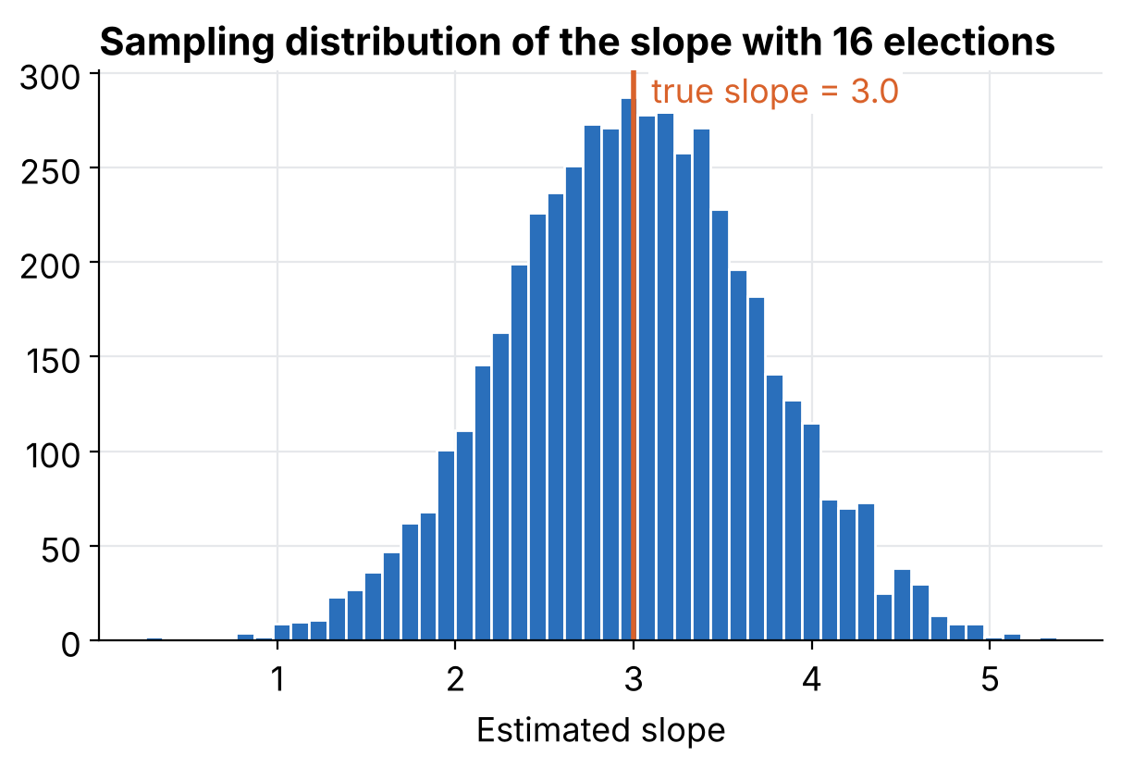
Fake-data simulation: simulate, fit, compare
BOOTSTRAP AND FAKE-DATA SIMULATION
Choose the truth: a = 46.3, b = 3.0, σ = 3.9.
Simulate data from the model.
Fit the model to the fake data.
Compare with the truth. Repeat 5,000 times.
Average slope: 2.99 (truth 3.0). Spread: 0.71. Coverage of the 95% interval: 94.9%.
Notebook §8.2
Notes:
The habit to keep for the whole course. With 16 noisy elections the slope can easily land anywhere between about 1.5 and 4.5, yet the method is unbiased and its interval does cover 95% of the time. The point is not insight into elections but a check of the method in a world where we know the truth. Next lessons: linear regression written properly, then logistic regression, with the same habit.

Slide 70
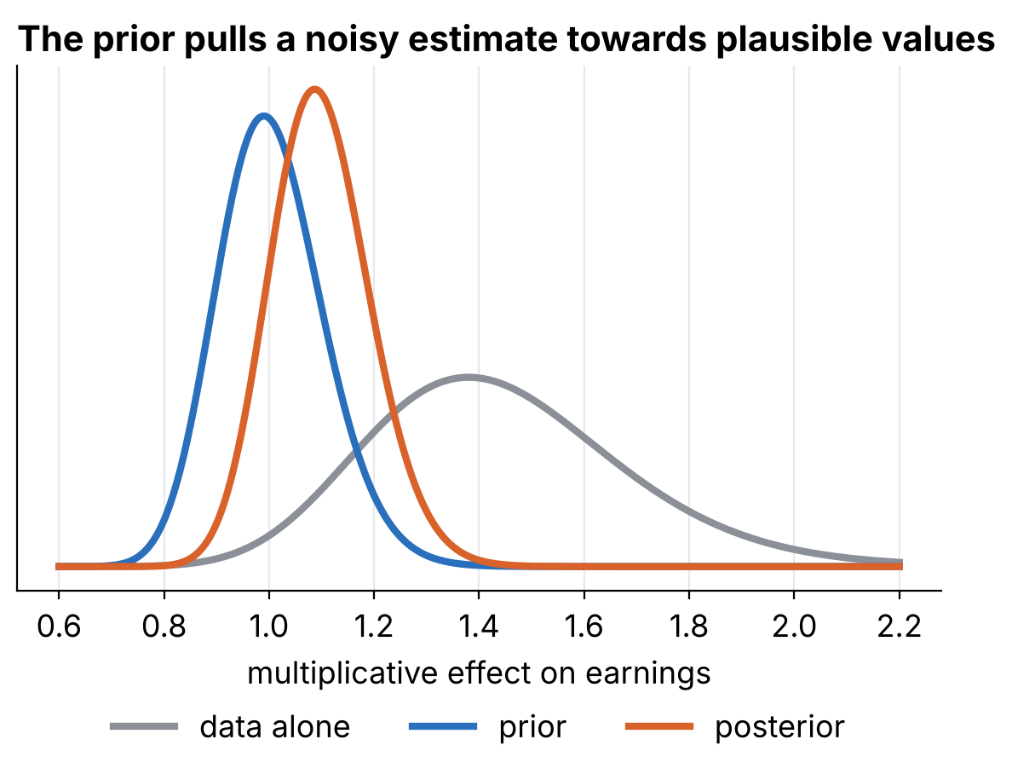
Classical and Bayesian inference, side by side
ESTIMATES, STANDARD ERRORS, INTERVALS
A trial on 127 children reports earnings up by a factor 1.42, interval [1.02, 1.98].
Prior knowledge: effects are typically within 10%. Combined: factor 1.10, interval [0.92, 1.30].
Strength: more reasonable predictions. Cost: an extra assumption to defend.
Notebook §13
Notes:
Classical inference summarises the data alone and is judged by long-run coverage. With weak data the interval is huge and the estimate is probably exaggerated. A Bayesian analysis adds a prior; on the log scale this is a precision-weighted average. The prior here (mean 0, sd 0.10) is my own illustrative choice, so results are indicative.

Slide 71
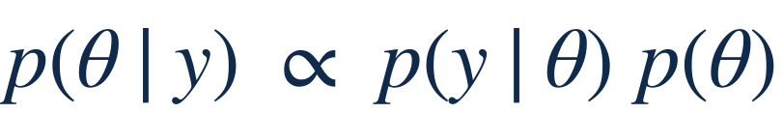

Bayes' rule, and the normal case
DEFINITIONS · CLASSICAL AND BAYESIAN
Bayes' rule. Posterior &prop; likelihood × prior. The data update what we believed before seeing them.
Normal estimate and prior. Estimate θ̂ ± se, prior N(μ0, &tau;²): a precision-weighted average. Earnings (log scale): 0.35 ± 0.17 with prior N(0, 0.10²) gives 0.09 ± 0.09, a factor 1.10 [0.92, 1.30].
Notebook §13
Notes:
Precision is one over the variance. When se is much smaller than tau the data dominate and the Bayesian and classical answers coincide; here se (0.17) is larger than tau (0.10), so the prior dominates.

Slide 72
Five things to remember
TAKE-AWAYS
A model is a recipe for generating data. If you can code it, you can simulate it.
A standard error is the spread of an estimate over repeated studies.
"95%" describes a procedure, and only for sampling error.
Significant results from noisy studies are exaggerated.
Check any method on fake data where you know the truth.
Next: linear regression, with the same habit of simulate, fit, compare.
Statistics · Lesson 1 · Take-aways
Notes:
Pause for questions. A good closing prompt: which of the five would have changed your mind about a study you read recently?

Slide 73
Your turn, in the notebook
EXERCISES
Exercise | Task
1 | Difference of two response rates: estimate, standard error, and a check by simulation
2 | Two basketball shooters, 30% against 40%: who wins over 20 shots, and how large must N be?
3 | Simulate a player who shoots until two misses in a row
4 | Propagate uncertainty: savings per unit times market size
5 | Redo the significance filter with standard error 0.05
Notebook §14
Notes:
Work in pairs or breakout rooms. Each exercise has an empty code cell in section 14 of the notebook. Suggested order of difficulty: 1, 3, 2, 5, 4. Expected result for exercise 5: with standard error 0.05 about half of the studies are significant, the exaggeration factor falls from about 4 to about 1.4 and wrong signs almost disappear, which illustrates the value of sample size.

Slide 74
Where this lesson comes from
SOURCES
Election data. Hibbs: incumbent party vote share and income growth, US presidential elections 1952 to 2012.
Companion notebook. Lesson1_Statistics_Introduction.ipynb, in Python, runs on Google Colab. Figures and numbers on these slides come from it.
Head-turning example. Nature (2003), "Human behaviour: Adult persistence of head-turning asymmetry", as in the previous version of this lesson.
Statistics · Lesson 1
Notes:
The Python code and all simulations on these slides come from the companion notebook, so every figure can be reproduced and modified in class.

