Slide 1
On the Impact of Linguistic Granularity and Fuzzy Semantic Design in Particle Swarm Optimization
Author information
José Barrera-García^{1,2}, Broderick Crawford¹, Eric Monfroy³, Felipe Cisternas-Caneo¹, Ricardo Soto¹, Giovanni Giachetti⁴
Pontificia Universidad Católica de Valparaíso · Universidad de Alcalá · Université d’Angers · Universidad Andrés Bello
Correspondence to jose.barrera@pucv.cl
Notes:
[Sources]
- Uploaded paper, p. 1 (title, authors, affiliations, abstract).

Slide 2
Why this paper matters
Motivation and contribution
Gap in the literature
Study design in one view
Most fuzzy-PSO papers fix linguistic partitions and MFs.
This paper asks whether semantic design itself changes behavior.
Search state
Fuzzy scheme
Controller
progress + diversity
3/5 labels, A/B sets
Mamdani inference
Outcome
fitness + robustness
The paper isolates two design choices that are usually treated as implementation details:
Linguistic granularity: 3 labels vs 5 labels
Membership shape/overlap: Set A vs Set B
Constant control logic across all variants
Main claim
Semantic design is a relevant experimental dimension in adaptive metaheuristics and should be analyzed explicitly.
Notes:
[Sources]
- Uploaded paper, pp. 1-2 (abstract, introduction, positioning of the study).

Slide 3
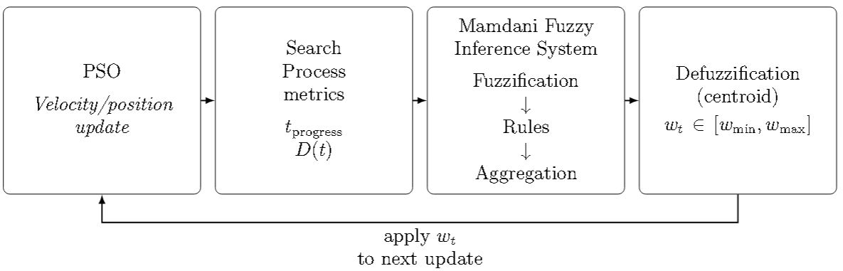
Fuzzy-controlled PSO framework
Method overview
What changes vs baseline PSO
Controller embedded inside the PSO loop
Usually, baseline PSO uses a linear inertia schedule from 0.9 down to 0.1.
The fuzzy variant evaluates one Mamdani controller per iteration at the swarm level.
  Inputs: iteration progress and population diversity.
  Output: inertia weight w_t constrained to [w_min, w_max].
  Defuzzification uses the centroid method.
Key controller inputs
The fuzzy controller replaces a fixed inertia schedule with state-aware adaptation based on where the swarm is in the search and how diverse it remains.
Notes:
[Sources]
- Uploaded paper, pp. 4-5 (baseline PSO, equations, controller description).
- Figure asset on this slide cropped from paper p. 5, Fig. 1.

Slide 4
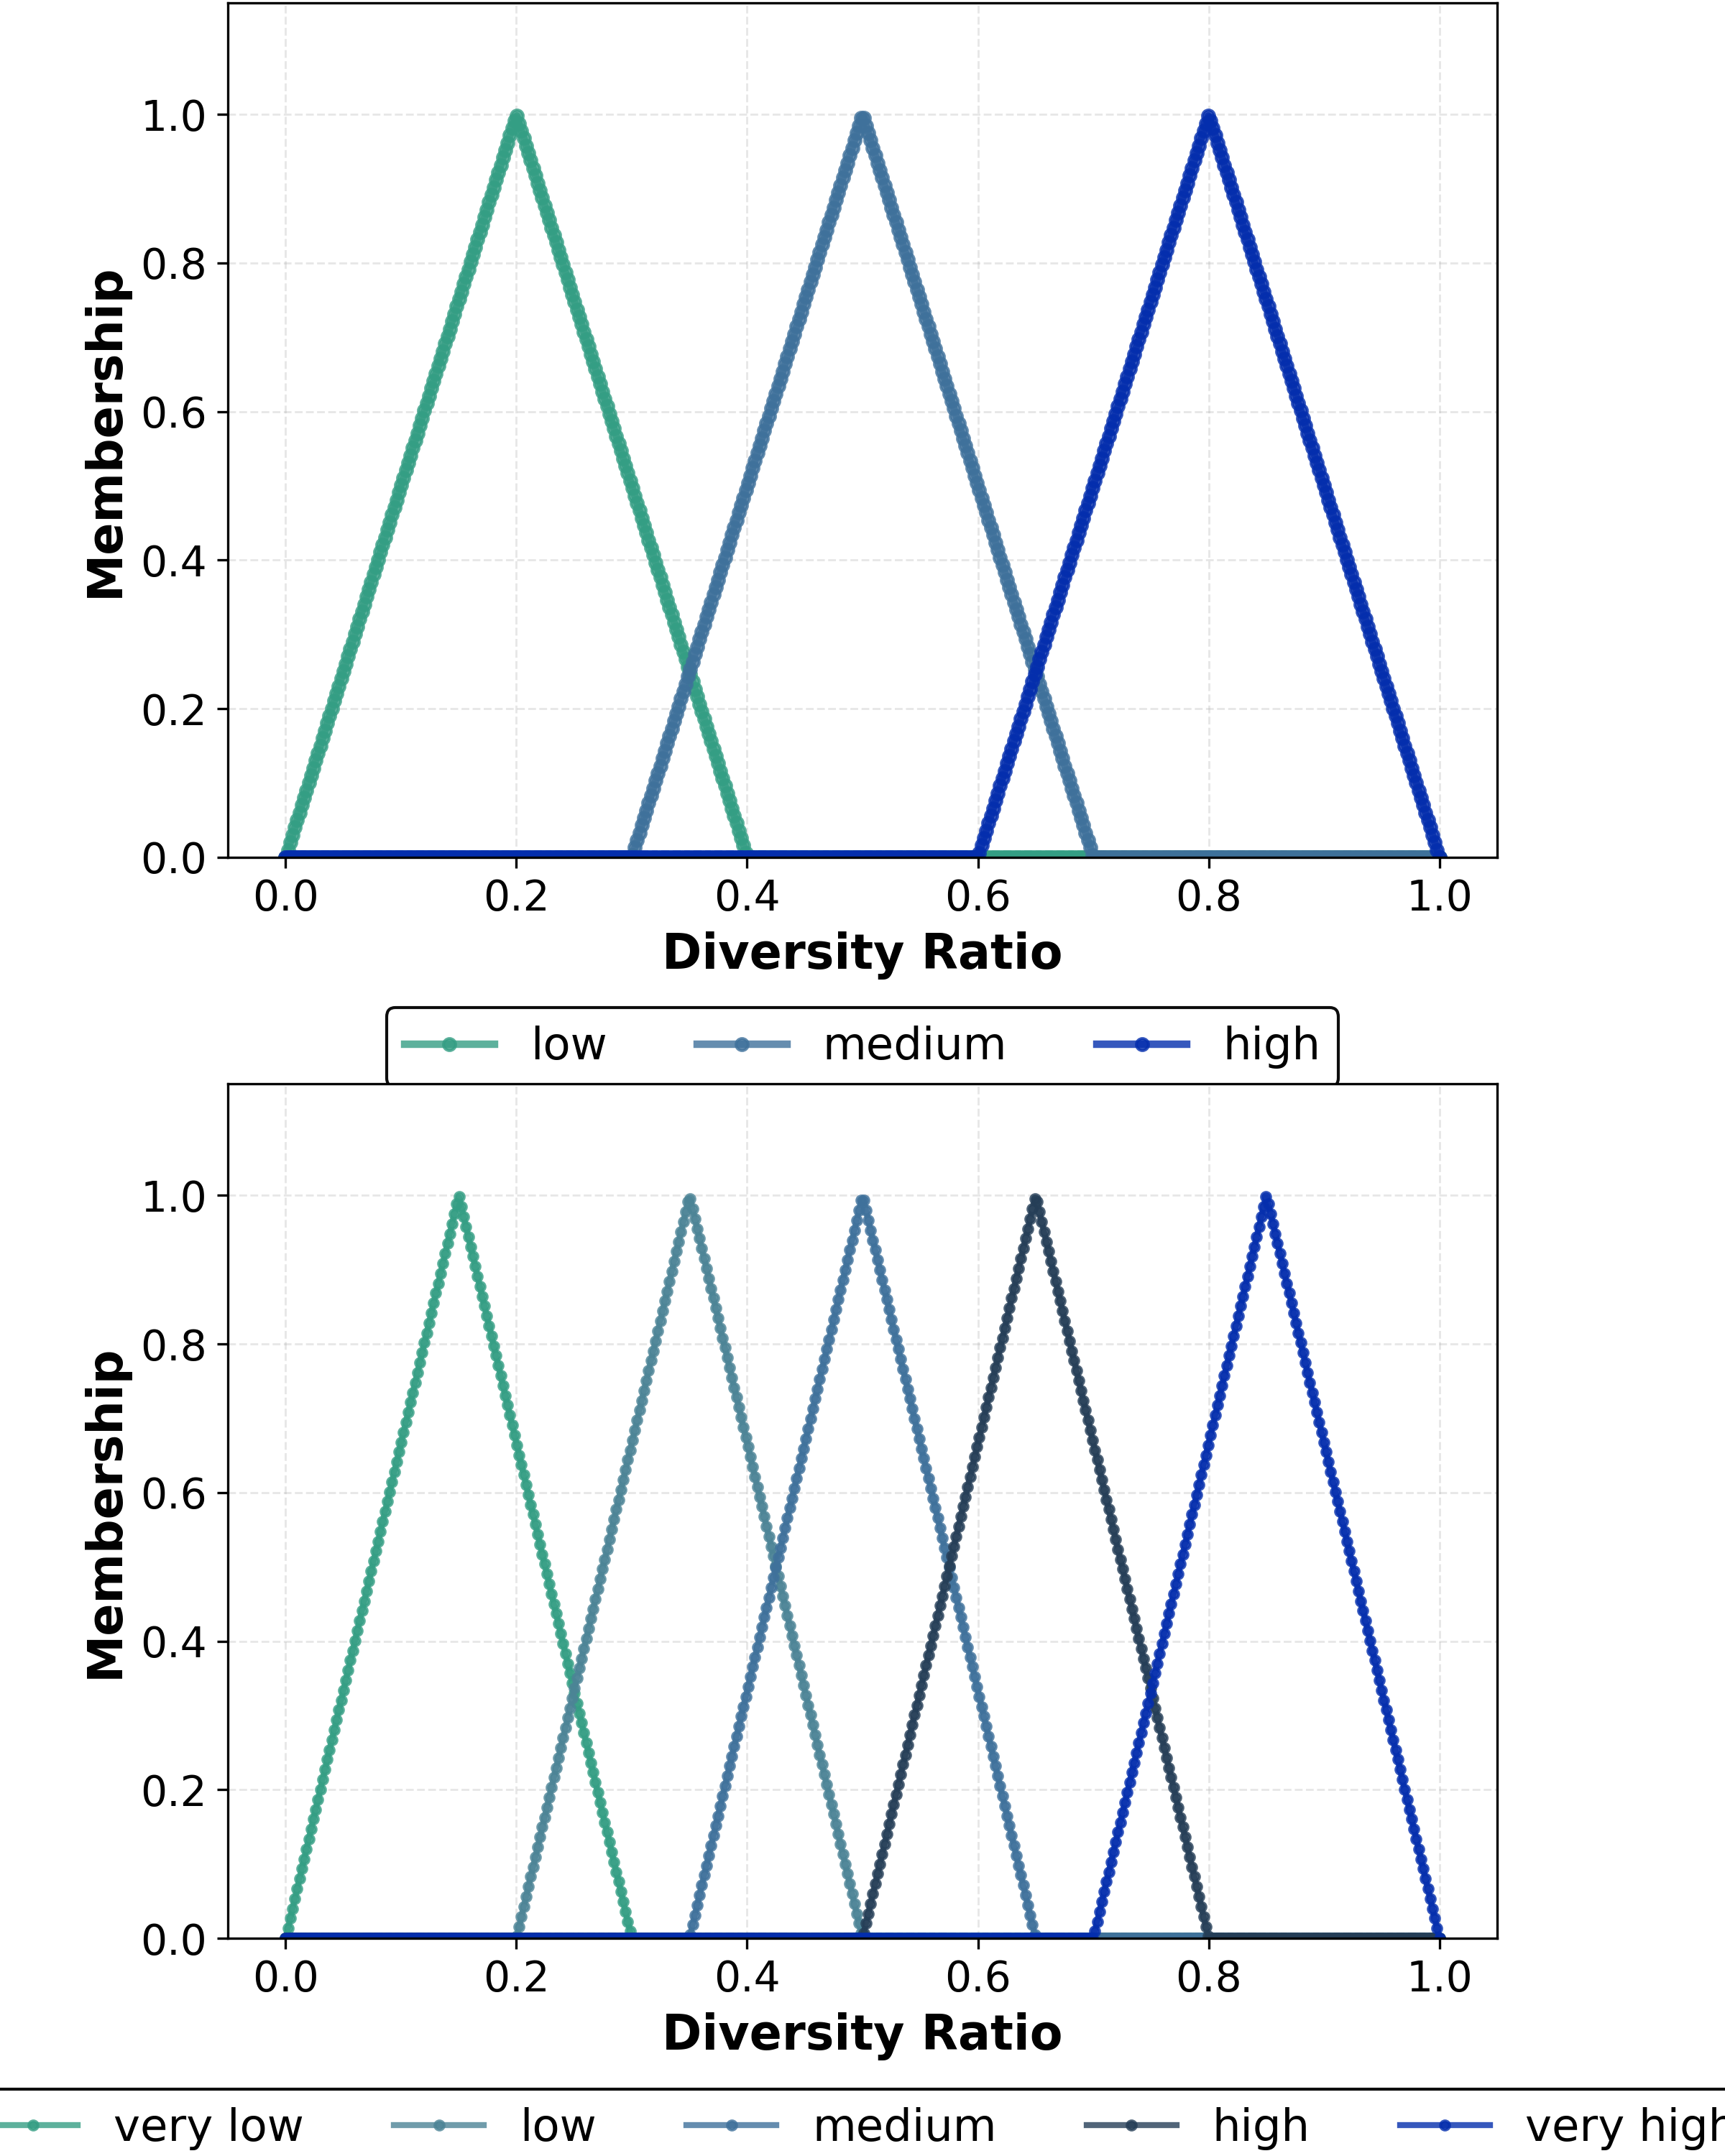
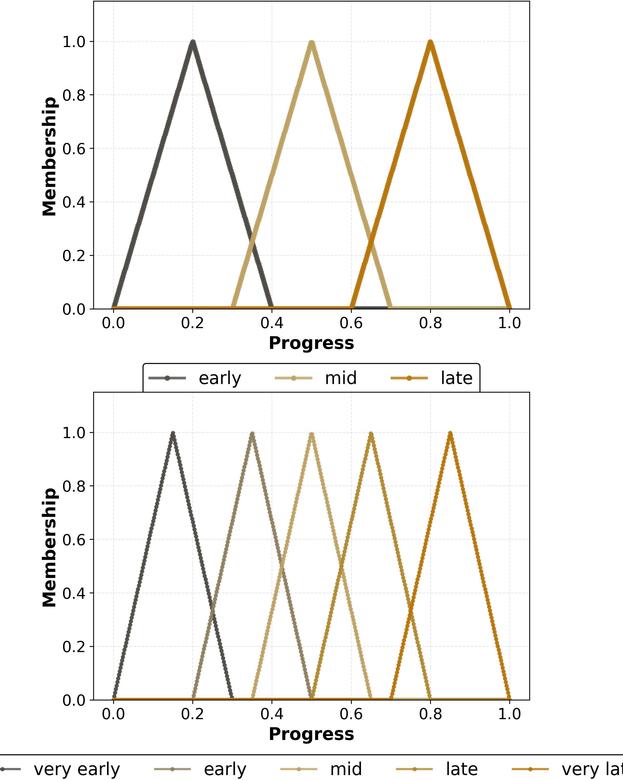
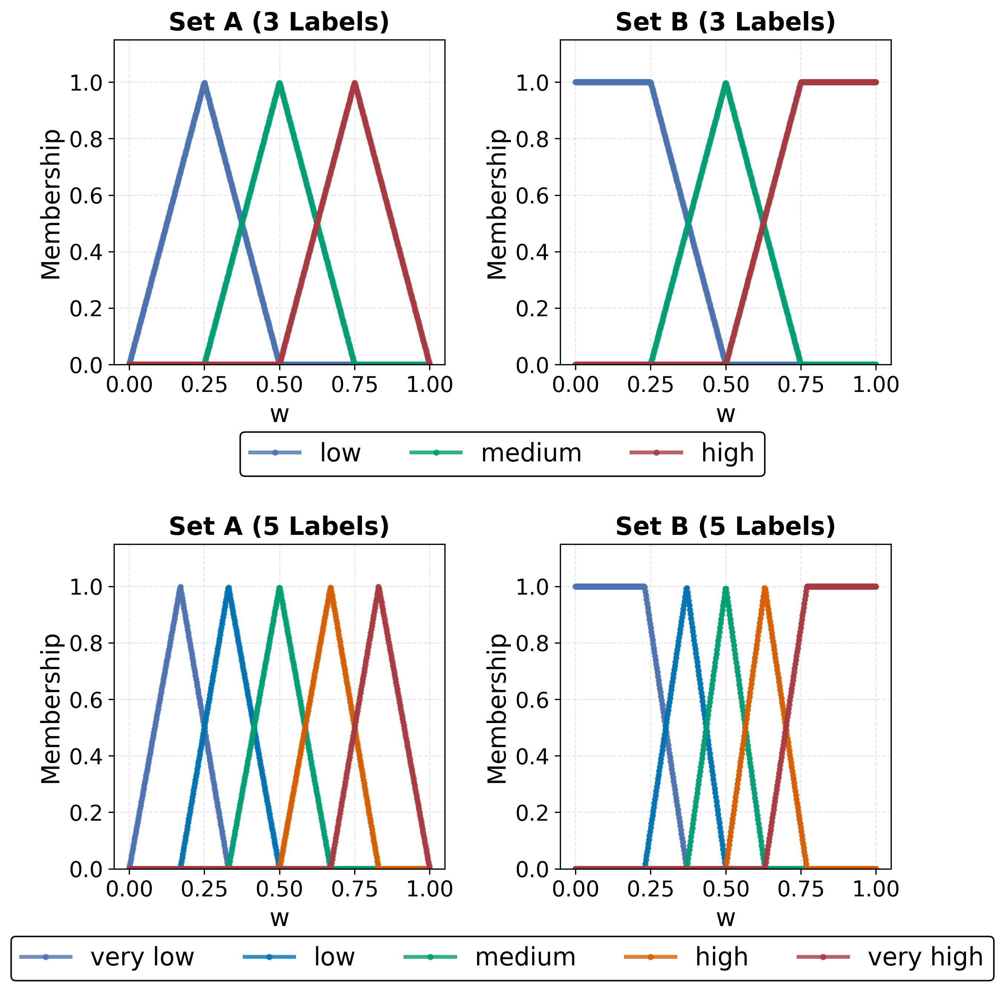
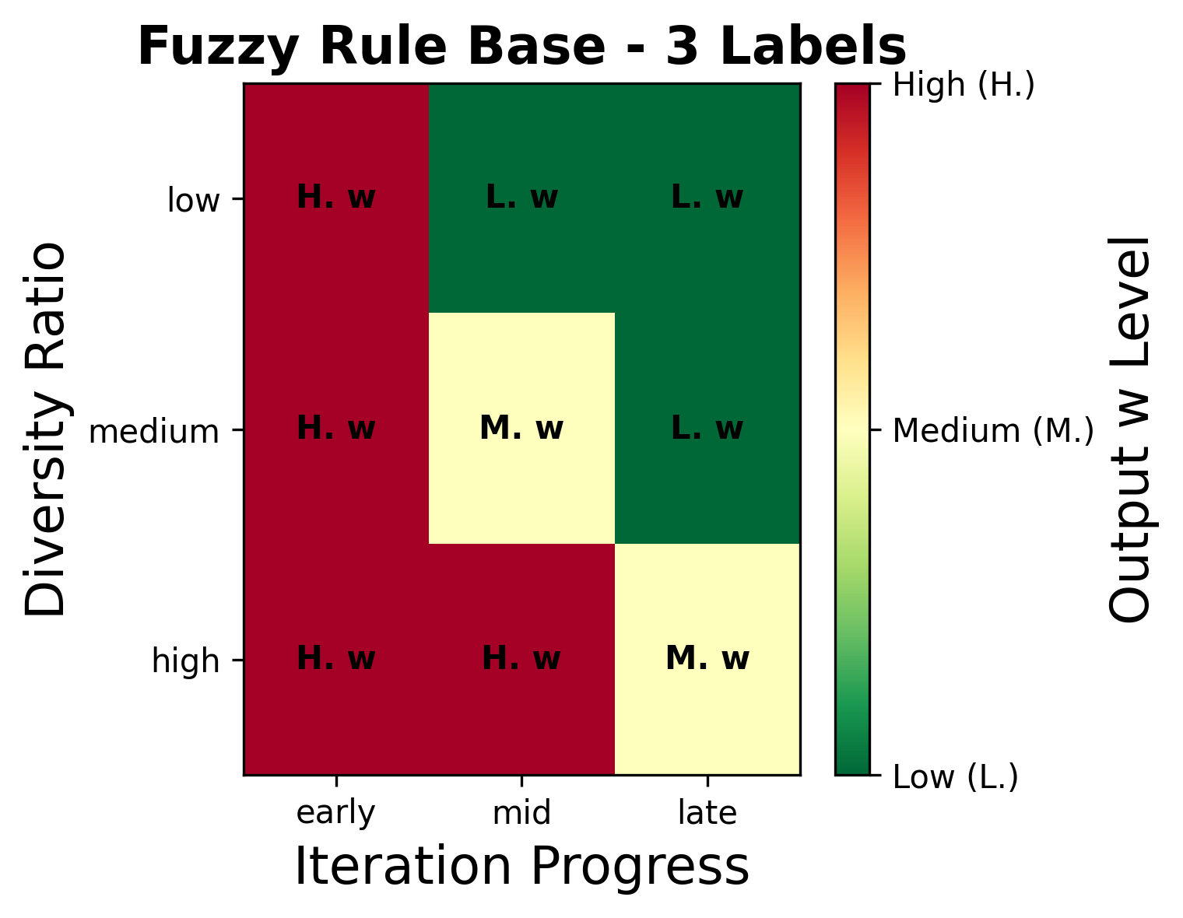
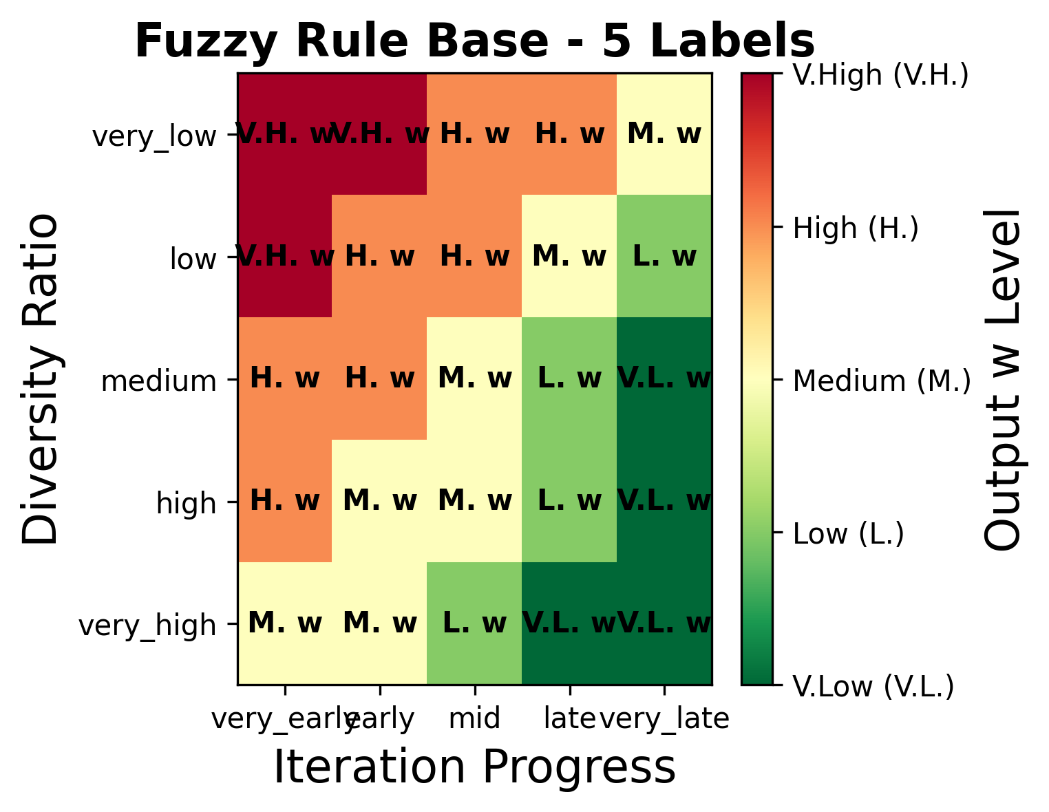
What varies across fuzzy variants
Semantic configuration only
Input Membership functions
Output Membership functions
Rule bases keep the same strategy
3 labels
5 labels
Controlled comparison
Two granularities: 3 labels and 5 labels
Two membership sets for output variable (w): A and B
Same universes of discourse, same rule-base semantics
Only the semantic resolution and overlap patterns change
More labels refine the control surface but do not change the underlying logic.
Notes:
[Sources]
- Uploaded paper, pp. 5-7 (linguistic schemes, membership function configuration, rule base configuration).
- Figure assets on this slide cropped from paper p. 6, Fig. 2 and p. 7, Fig. 3.

Slide 5
Experimental setup
Benchmarks and protocol
Benchmark functions
Function | Landscape | Dim. | Global optimum
F1 - Sphere | Unimodal, smooth | 100 | 0.0
F11 - Griewank | Regular multimodal | 100 | 0.0
F21 - Shekel (m=5) | Rugged multimodal | 4 | -10.1532
F23 - Shekel (m=10) | Rugged multimodal | 4 | -10.5363
Protocol
Population size = 50; maximum iterations = 500.
31 independent runs for every algorithm-function pair.
Shared seeding strategy: seeds start at 42 and increase by 1 per run.
Variants compared: baseline PSO, A3, B3, A5, B5.
Metrics: final best fitness, relative gap to optimum, standard deviation, execution time.
The function set intentionally mixes easy high-dimensional landscapes with difficult low-dimensional multimodal ones.
This makes it possible to test whether fuzzy control helps universally or only under certain landscape structures.
Notes:
[Sources]
- Uploaded paper, pp. 7-8 (benchmark functions, Table 1, parameter settings, evaluation protocol).

Slide 6
Results: performance is landscape-dependent
Table 2 distilled
Where baseline PSO wins
Where fuzzy control wins
Smooth or structurally regular landscapes
Rugged multimodal Shekel landscapes
Function | Best method | Mean gap
F1 - Sphere | PSO | 23.1%
Best fuzzy on F1 | A5 | 74,768.8%
F11 - Griewank | PSO | 1.2%
Best fuzzy on F11 | A5 | 674.6%
Function | Best fuzzy | Gap vs PSO
F21 - Shekel (m=5) | A5 | 23.7% vs 38.1%
Std. dev. on F21 | A5 | 1.275 vs 3.803
F23 - Shekel (m=10) | A3 | 22.1% vs 28.6%
Std. dev. on F23 | B3 | 1.243 vs 3.877
Takeaway: adaptive inertia hurts when the baseline dynamics are already well matched to the landscape.
Robustness improves sharply: variability drops by about two-thirds on both Shekel benchmarks.
How much do semantic details matter?
Five-label schemes sometimes reduce mean gap slightly on the multimodal benchmarks, but the gains are incremental.
Sets A and B perform similarly overall; there is no systematic winner for membership-shape design.
The presence of adaptive control matters more than the exact fuzzy semantic configuration.
Notes:
[Sources]
- Uploaded paper, pp. 9-10 (Table 2 and discussion of overall performance comparison, granularity, and set design).

Slide 7
Conclusions and future work
Bottom line for the audience
Future work
Main conclusions
Add more search-process metrics beyond progress and diversity.
Develop dynamic mechanisms that can select or adapt fuzzy configurations online.
Bridge fuzzy control with machine-learning-enhanced metaheuristics for more context-aware adaptation.
Fuzzy-controlled inertia adaptation is not a universal upgrade for PSO.
It hurts performance on unimodal or regular landscapes, but improves average quality and robustness on harder multimodal problems.
Linguistic granularity and membership design have a measurable but secondary, problem-dependent effect.
The paper contributes a careful experimental lens, not a new optimizer.
Analyze fuzzy semantic design explicitly - but deploy fuzzy control selectively, where the search space is truly rugged and multimodal.
Notes:
[Sources]
- Uploaded paper, pp. 10-11 (conclusions and future work).

