Slide 1
On the Impact of Linguistic Granularity
and Fuzzy Semantic Design in
Particle Swarm Optimization
José Barrera-García¹,² · Broderick Crawford¹ · Eric Monfroy³ · Felipe Cisternas-Caneo¹,² · Ricardo Soto¹ · Giovanni Giachetti⁴
¹ Pontificia Universidad Católica de Valparaíso, Chile
² Universidad de Alcalá, Spain
³ Université d'Angers, LERIA, France
⁴ Universidad Andrés Bello, Chile
OLA 2026 — International Conference on Optimization and Learning
Notes:
SCRIPT (Slide 1 — Title):
Good morning. Thank you for being here. My name is _________and I will present joint work with Broderick Crawford, Eric Monfroy, Felipe Cisternas-Caneo, Ricardo Soto, and Giovanni Giachetti, conducted across PUCV in Chile, the University of Alcalá in Spain, the University of Angers in France, and Universidad Andrés Bello. The talk is titled 'On the Impact of Linguistic Granularity and Fuzzy Semantic Design in Particle Swarm Optimization.' I will spend the next fifteen minutes describing an experimental study that isolates one design dimension of fuzzy-controlled PSO that is rarely analysed in the literature.

Slide 2
Summary
Question: how much does the semantic design of a fuzzy controller actually matter in PSO?
The performance of fuzzy-controlled PSO depends on design choices often treated as secondary.
Linguistic granularity and membership-function design are rarely analyzed explicitly.
Experimental study: three- and five-label schemes under identical control logic (inputs: iteration progress + diversity).
Finding: fuzzy control improves robustness in complex multimodal landscapes; it provides no benefit on unimodal or regular problems.
OLA 2026 — Barrera-García et al.
Notes:
SCRIPT (Slide 2 — Summary):
The work starts from a simple question. Fuzzy controllers are widely used to adapt PSO parameters, but most papers fix one fuzzy configuration up front and never test alternatives. We ask: how much does that semantic design — the number of linguistic labels and the shape of the membership functions — actually matter? Our study compares three- and five-label schemes under exactly the same control logic. The take-away, which I will develop in the rest of the talk, is that fuzzy control is not universally better: it helps on rugged multimodal problems, and clearly hurts on smooth or structurally regular ones.

Slide 3
Motivation
PSO performance depends on the exploration–exploitation balance, regulated by the inertia weight w [1, 2].
Fuzzy control adapts w using qualitative descriptions of the search state [3].
Most fuzzy-PSO variants fix linguistic partitions and membership functions a priori, with no semantic analysis.
Research question: to what extent do different fuzzy schemes — under identical logic — change performance across landscapes?
  Contribution: not a new algorithm. We isolate and measure the effect of fuzzy semantic design.
[1] Kennedy & Eberhart, ICNN 1995 · [2] Shi & Eberhart, IEEE WCCI 1998 · [3] Shi & Eberhart, FUZZ-IEEE 2001
OLA 2026 — Barrera-García et al.
Notes:
SCRIPT (Slide 3 — Motivation):
PSO behaviour is governed by the inertia weight w, which controls the balance between exploration and exploitation. This was already clear in Kennedy and Eberhart's original paper, and was made explicit by Shi and Eberhart shortly after. Fuzzy control is a natural way to adapt w online: it lets us describe the search state qualitatively — 'low diversity', 'late stage', and so on. The problem is that, in the literature, the fuzzy partition and the membership functions are almost always fixed a priori. Nobody asks whether that semantic choice matters. Our research question is exactly that. And let me be very explicit: this paper does not propose a new optimisation algorithm. It is an experimental study designed to isolate the effect of semantic design.

Slide 4
Related Work
Fuzzy adaptation in PSO: Shi & Eberhart [3] (seminal); Nobile et al. [4] FST-PSO; Xia et al. [5] MIMO fuzzy; Komarudin et al. [6] fuzzy signatures.
Membership-function design: Olivas et al. [7] — different shapes give significant differences with the same rule base.
Linguistic granularity & granular computing: Huang [8], Zhang [9], Zhao [10] — semantic resolution is not a neutral choice.
Positioning: linguistic granularity is rarely an explicit experimental factor in PSO. This work fills that gap.
[3] Shi & Eberhart 2001 · [4] Nobile et al. 2018 · [5] Xia et al. 2022 · [6] Komarudin et al. 2021 · [7] Olivas et al. 2014 · [8] Huang 2022 · [9] Zhang 2022 · [10] Zhao 2021
OLA 2026 — Barrera-García et al.
Notes:
SCRIPT (Slide 4 — Related Work):
The literature on fuzzy-adaptive PSO is rich. After Shi and Eberhart's seminal proposal, more sophisticated controllers appeared: Nobile's fuzzy self-tuning PSO, Xia's MIMO fuzzy controller, and Komarudin's fuzzy signatures. All of them focus on the architecture of the controller. A second line of work, exemplified by Olivas, has shown that even when the rule base is held fixed, changing membership-function shapes produces statistically significant performance differences. Finally, the granular-computing community — Huang, Zhang, and Zhao — has shown that linguistic resolution is not a neutral transformation. What is missing is the systematic combination of these observations inside PSO. Our work fills that gap.

Slide 5
Baseline Particle Swarm Optimization
v_i(t+1) = w · v_i(t) + c₁ r₁ (p_i − x_i(t)) + c₂ r₂ (g − x_i(t))
x_i(t+1) = x_i(t) + v_i(t+1)
Baseline inertia: linear decreasing schedule, 0.9 → 0.1 [11].
All other PSO parameters identical across variants — controlled comparison.
Serves as the reference to assess the effect of fuzzy adaptation of w.
[11] Abualigah et al., Computers & Industrial Engineering 2021
OLA 2026 — Barrera-García et al.
Notes:
SCRIPT (Slide 5 — Baseline PSO):
These are the standard PSO update equations. The only thing that changes between our experimental variants is the inertia weight w. The baseline uses a linear decreasing schedule from zero point nine down to zero point one, which is one of the most common choices in the literature. Every other parameter — population, cognitive and social coefficients, velocity bounds — is held identical across all variants. This is what allows us to attribute observed differences to the inertia control mechanism alone.

Slide 6
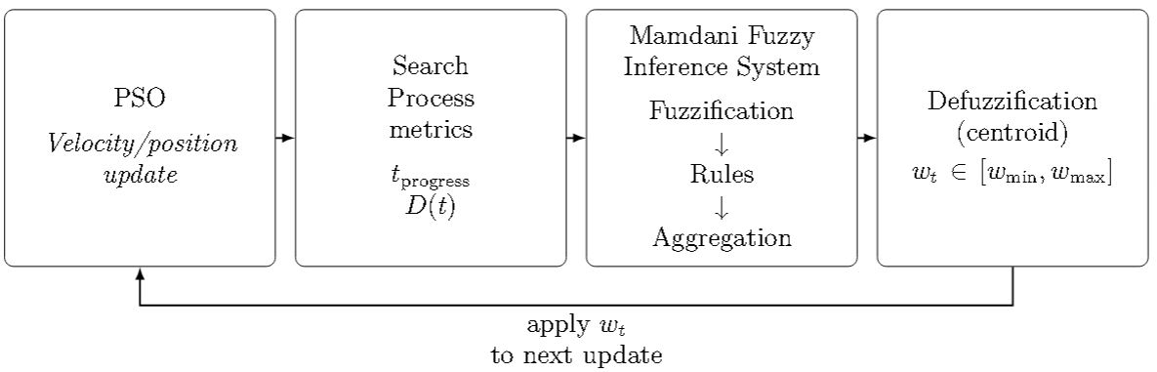
Fuzzy Controller for Inertia Weight Adaptation
Mamdani-type FIS, evaluated ONCE per iteration at the swarm level.
Input 1 — Iteration progress:
Input 2 — Population diversity (per-dimension, normalized):
Output: w_t ∈ [w_min, w_max]; defuzzification by centroid.
OLA 2026 — Barrera-García et al.
Notes:
SCRIPT (Slide 6 — Fuzzy Controller):
We use a standard Mamdani fuzzy inference system, evaluated once per iteration at the swarm level, not at the particle level. It takes two normalised inputs. The first is iteration progress: a simple ratio between the current and the maximum iteration. The second is population diversity, computed per dimension as the normalised spatial spread of the swarm. This is a classical metric and bounds the value to the unit interval. The output is the inertia weight w, restricted to a working interval, and obtained by centroid defuzzification. The point I want to stress is that across all our variants, this architecture is exactly the same. Only the linguistic representation changes.

Slide 7
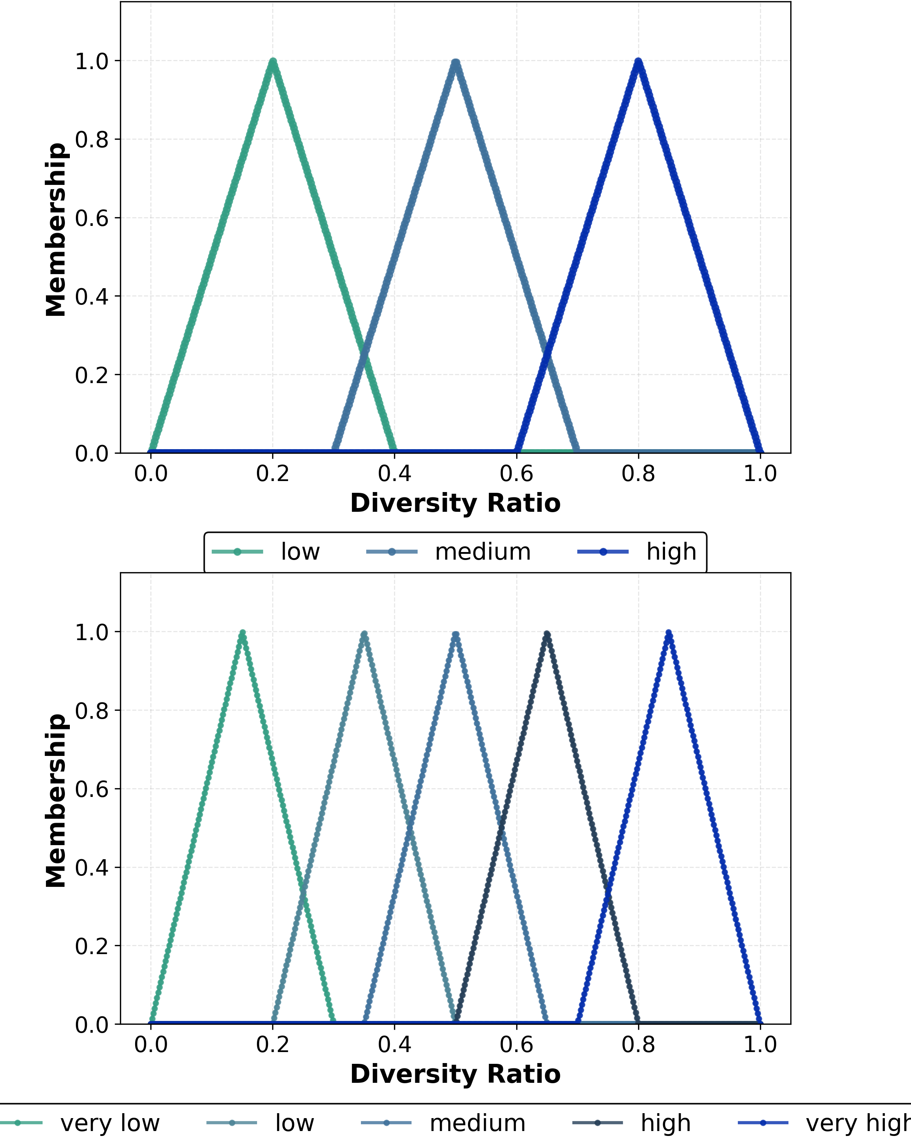
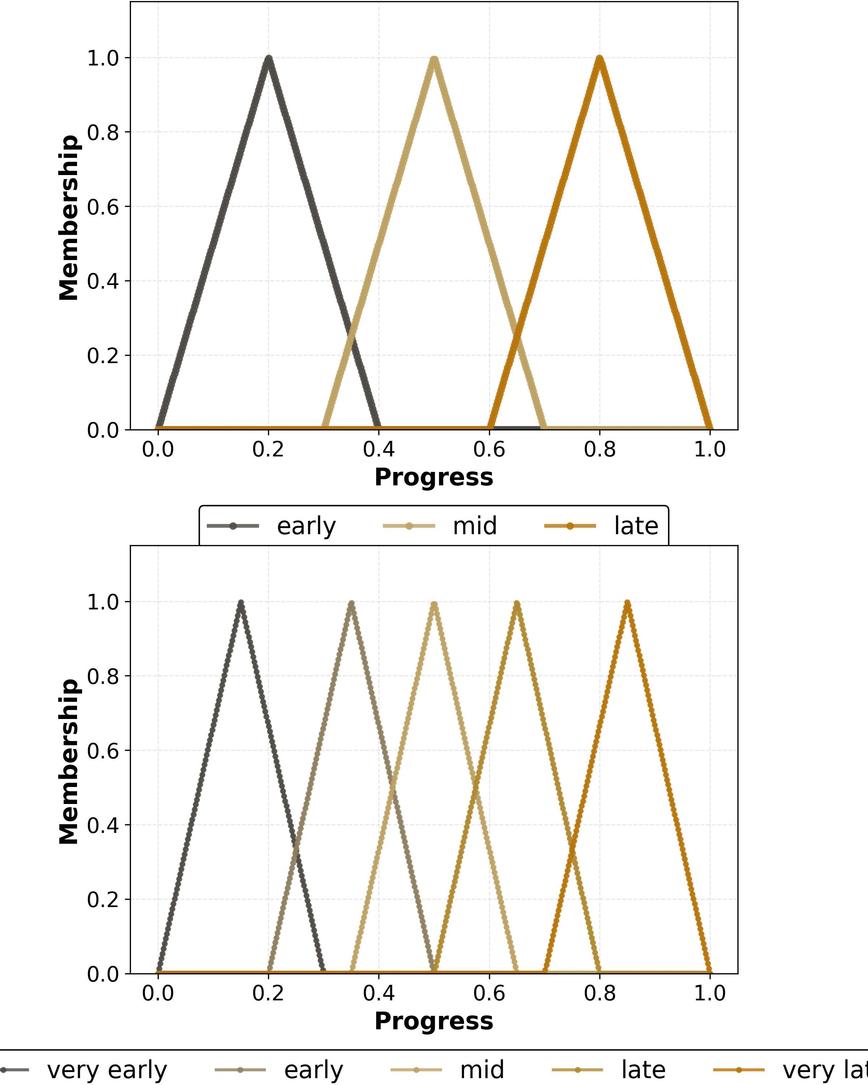
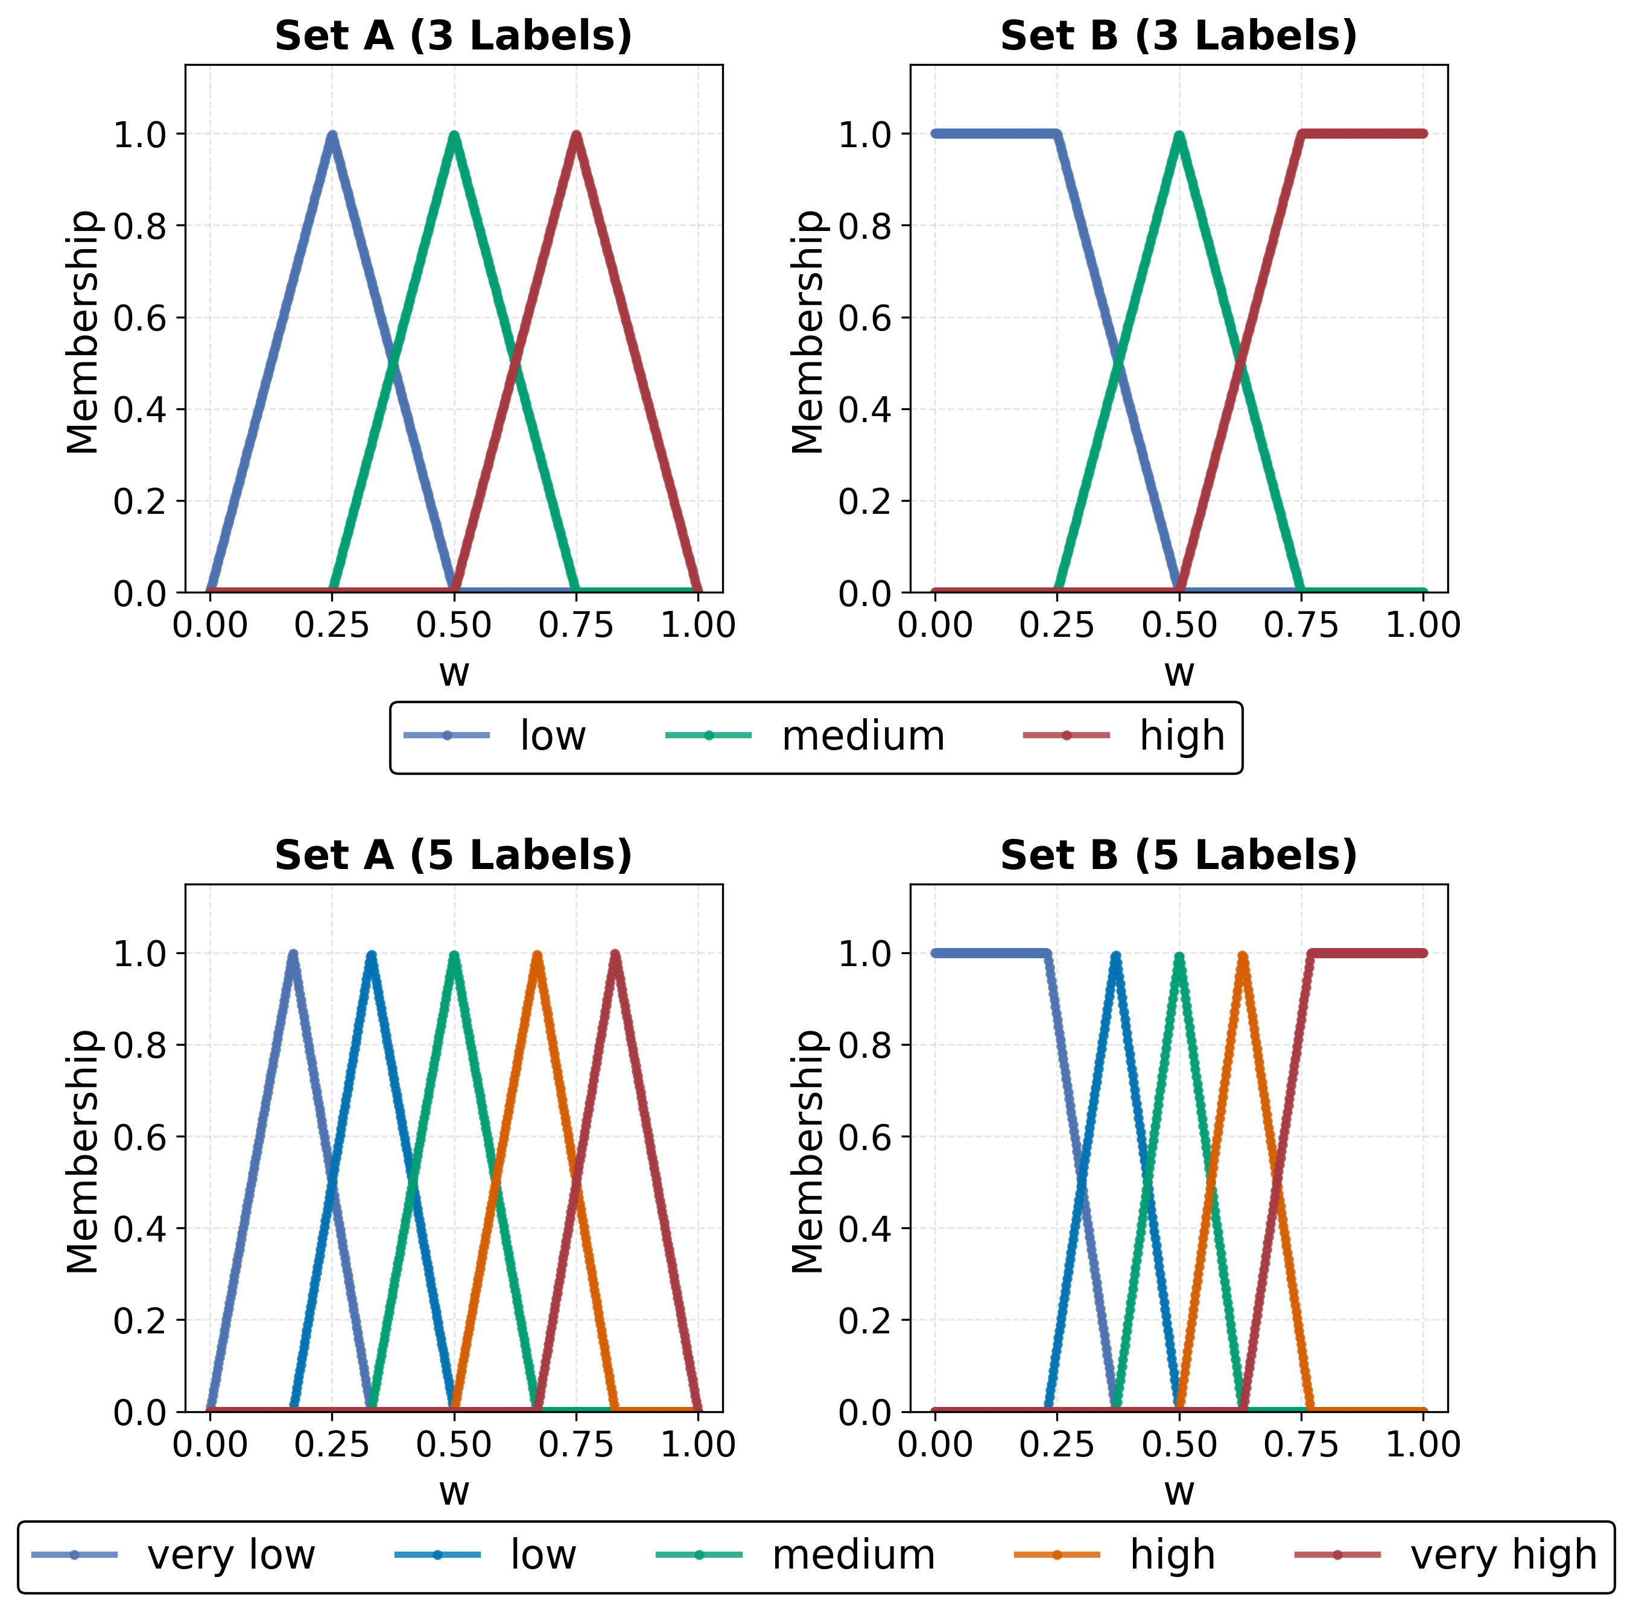
Linguistic Schemes Evaluated
Input Membership functions
Output Membership functions
3 labels
5 labels
Two granularities: 3 labels and 5 labels.
For each granularity, two configurations: Set A and Set B.
Sets A and B differ only in shape, overlap and placement of the membership functions.
Linguistic variables, universes of discourse and rule structure: identical.
Membership functions remain static throughout the optimization.
OLA 2026 — Barrera-García et al.
Notes:
SCRIPT (Slide 7 — Linguistic Schemes):
We evaluate two linguistic granularities — three labels and five labels — and for each granularity we test two distinct configurations of membership functions, called Set A and Set B. Sets A and B differ only in the shape, the overlap, and the placement of the triangular and trapezoidal membership functions. The linguistic variables themselves, the universes of discourse, and the rule structure are kept identical. Membership functions are static — they do not change during the run. On the bottom you can see, on the left, the diversity input membership functions and, on the right, the iteration progress input. This four-way design — A3, B3, A5, B5 — is what lets us isolate the effect of semantic resolution from the effect of control logic.

Slide 8
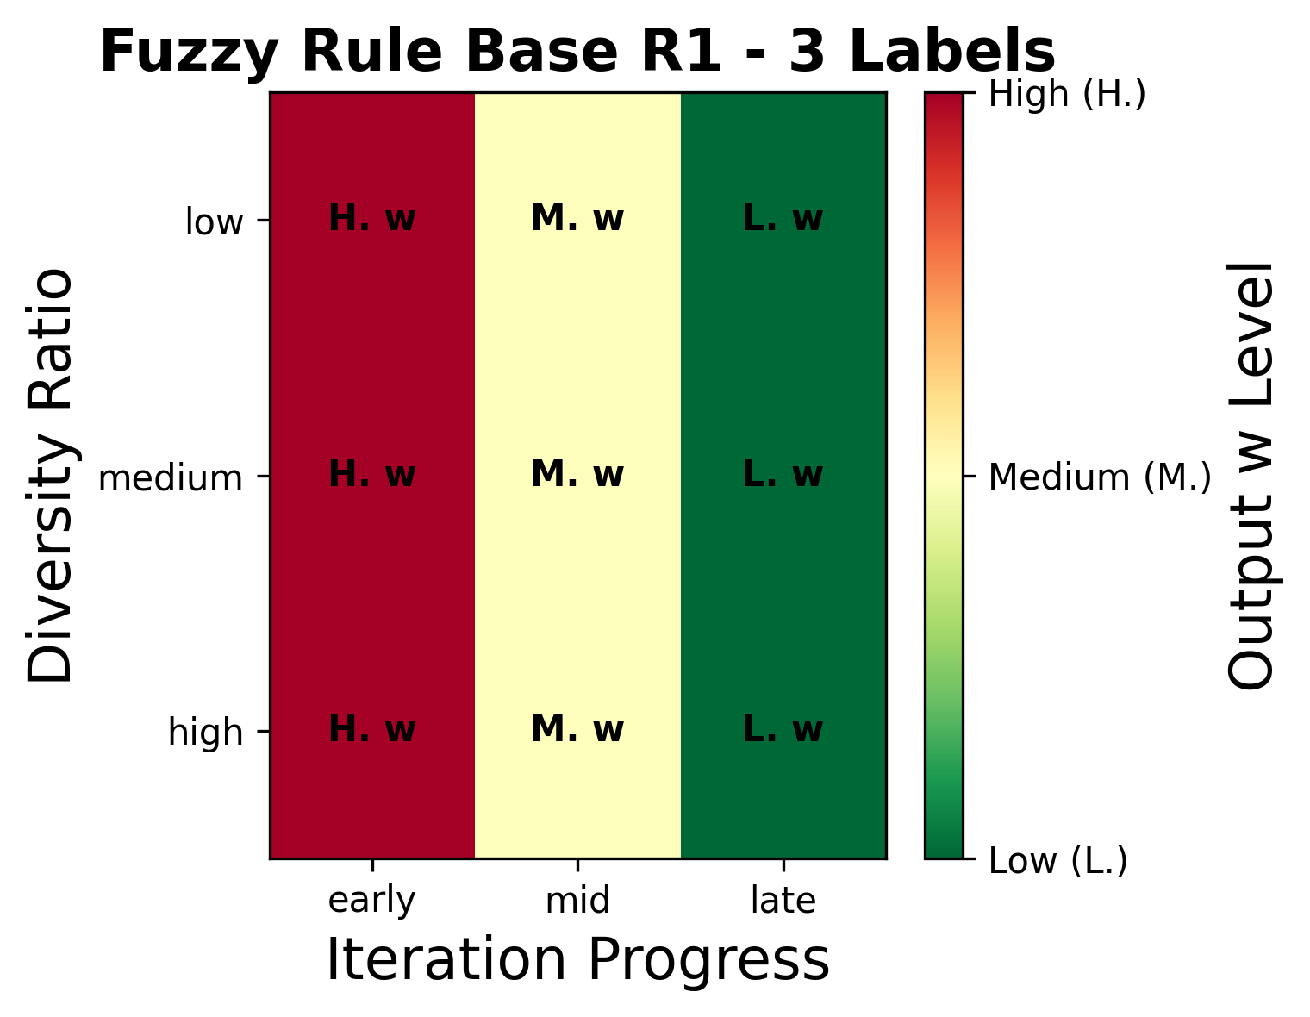
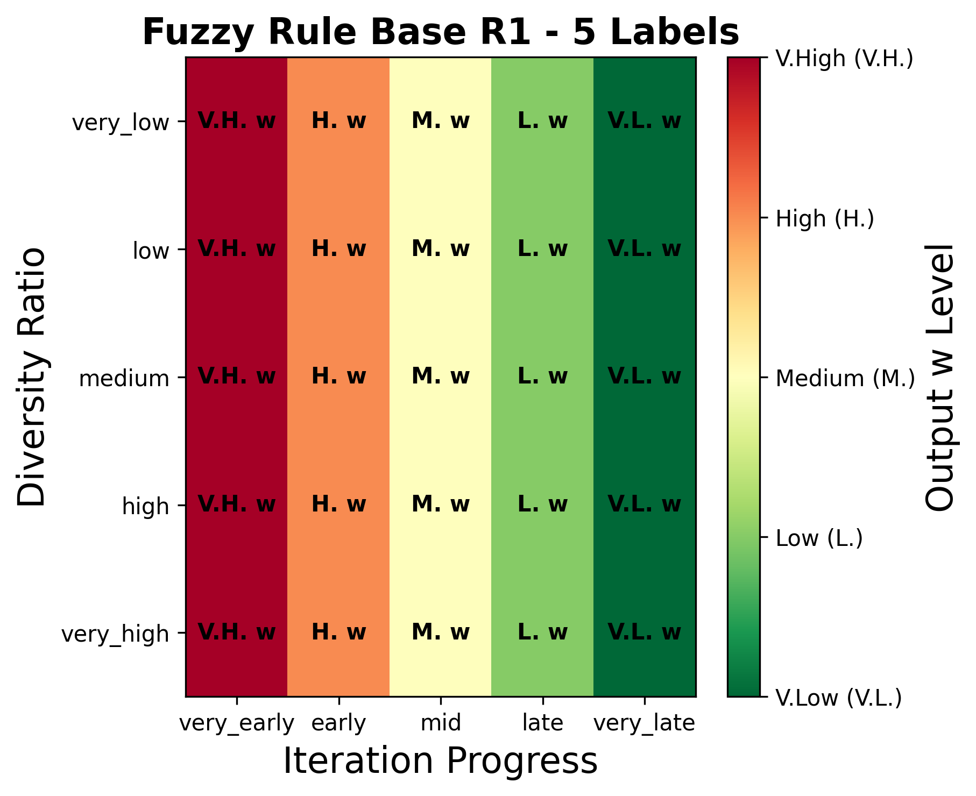
Output and Rule Base
Increasing granularity refines the control surface while preserving the strategy.
Left: 3-label rule base · Right: 5-label rule base
OLA 2026 — Barrera-García et al.
Notes:
SCRIPT (Slide 8 — Rule Base):
These two heatmaps show the rule base for both granularities. On the left, the three-by-three rule matrix for the three-label scheme; on the right, the five-by-five matrix for the five-label scheme. The colour coding indicates the dominant output linguistic term — low, medium, or high inertia — for each combination of inputs. The crucial point is that the qualitative strategy is preserved when we move from three to five labels: the rule base becomes finer, but it does not encode a different control philosophy. So any performance change we observe between granularities will reflect the resolution of the control surface, not a change of strategy.

Slide 9
Benchmark Functions
Classical functions with contrasting landscapes (Opfunu library [12]).
Function | Type | Dim. | Global Optimum
F1 (Sphere) | Unimodal | 100 | 0.0
F11 (Griewank) | Multimodal regular | 100 | 0.0
F21 (Shekel, m=5) | Multimodal rugged | 4 | −10.1532
F23 (Shekel, m=10) | Multimodal rugged | 4 | −10.5363
[12] Van Thieu, Opfunu — Python library for benchmark functions, 2024
OLA 2026 — Barrera-García et al.
Notes:
SCRIPT (Slide 9 — Benchmarks):
We deliberately chose a small set of four classical functions, but with very different landscape characteristics. F1, the sphere function, is smooth and unimodal — we evaluate it in one hundred dimensions to stress convergence in a large search space. F11, Griewank, is multimodal but structurally regular, also in one hundred dimensions. F21 and F23 are Shekel functions in four dimensions, with five and ten components respectively — these are rugged, with many deep local minima concentrated in a small search space. All implementations come from the Opfunu library, so the definitions are reproducible and standard.

Slide 10

Experimental Protocol
Parameter | Value
Population size | 50 particles
Iterations | 500
Independent runs | 31
Random seeds | 42, 43, …, 72 (shared across algorithms)
Hardware | Intel Core i7 2.8 GHz, 16 GB RAM
Implementation | Python 3.11.9, sequential CPU execution
Variants:
PSO baseline
PSO-FCS-A3
PSO-FCS-B3
PSO-FCS-A5
PSO-FCS-B5
Performance metric:
$$\text{Ga}{\text{p}}_{\text{abs}}=\left|f_{\text{best}}−f_{\text{opt}}\right|$$
$$\text{Gap}\left(\%\right)=\frac{\left|f_{\text{best}}−f_{\text{opt}}\right|}{\left|f_{\text{opt}}\right|}×100$$
OLA 2026 — Barrera-García et al.
Notes:
SCRIPT (Slide 10 — Experimental Protocol):
All variants share an identical experimental protocol: fifty particles, five hundred iterations, thirty-one independent runs per algorithm-function combination. To reduce stochastic noise while preserving comparability, we use a shared seeding strategy: every algorithm uses the same seed for the same run number, starting at forty-two. We evaluate the baseline PSO plus the four fuzzy variants — A three, B three, A five, B five. Performance is measured by the relative gap to the known optimum, and we report mean and standard deviation over the thirty-one runs.

Slide 11
Results — Performance Summary
Best variant per function highlighted (mean fitness, std, mean gap, time [s]).
Function | Method | Mean Fitness | Std Dev | Mean Gap (%) | Time (s)
F1 | PSO | 23.070 | 11.474 |  | 9.903
F1 | PSO-FCS-A3 | 74972.756 | 3560.587 |  | 12.028
F1 | PSO-FCS-A5 | 74768.800 | 3863.507 |  | 12.059
F1 | PSO-FCS-B3 | 74912.469 | 3653.264 |  | 12.076
F1 | PSO-FCS-B5 | 76414.155 | 3178.414 |  | 12.769
F11 | PSO | 1.208 | 0.103 |  | 10.308
F11 | PSO-FCS-A3 | 675.755 | 32.045 |  | 12.686
F11 | PSO-FCS-A5 | 674.625 | 34.755 |  | 12.072
F11 | PSO-FCS-B3 | 675.212 | 32.879 |  | 12.176
F11 | PSO-FCS-B5 | 688.725 | 28.603 |  | 12.019
F21 | PSO | −6.289 | 3.803 | 38.1% | 5.928
F21 | PSO-FCS-A3 | −7.649 | 1.598 | 24.7% | 6.190
F21 | PSO-FCS-A5 | −7.749 | 1.275 | 23.7% | 6.385
F21 | PSO-FCS-B3 | −7.683 | 1.659 | 24.3% | 6.216
F21 | PSO-FCS-B5 | −7.699 | 1.602 | 24.2% | 6.353
F23 | PSO | −7.519 | 3.877 | 28.6% | 10.761
F23 | PSO-FCS-A3 | −8.203 | 1.419 | 22.1% | 10.973
F23 | PSO-FCS-A5 | −8.133 | 1.279 | 22.8% | 11.145
F23 | PSO-FCS-B3 | −8.139 | 1.243 | 22.8% | 10.979
F23 | PSO-FCS-B5 | −8.124 | 1.339 | 22.9% | 11.133
OLA 2026 — Barrera-García et al.
Notes:
SCRIPT (Slide 11 — Results Table):
This is the full performance summary; let me walk you through the key rows. On F1, the unimodal sphere, baseline PSO reaches a mean fitness of about twenty-three, while every fuzzy variant collapses to roughly seventy-five thousand — a gap of more than seventy thousand percent. Something similar happens on F11, the regular Griewank function: PSO gets one point two, fuzzy variants stay around six hundred and seventy-five. I want to be direct about this: in these two settings, fuzzy adaptation is catastrophic. The picture flips on the rugged Shekel functions. On F21, baseline PSO has a gap of thirty-eight percent; the best fuzzy variant, A-five, brings it down to twenty-three point seven. On F23, the gap drops from twenty-eight point six to twenty-two point one with A-three. And — importantly — the standard deviation is roughly halved. So fuzzy control buys us robustness on the right kind of problem.

Slide 12
Main Insight: the Effect Is Problem-Dependent
Smooth / regular landscapes (F1, F11) | Rugged multimodal (F21, F23)
Baseline PSO dominates | Fuzzy-controlled PSO dominates
Fuzzy adaptation interferes with efficient baseline dynamics | Fuzzy adaptation improves mean and robustness
Fuzzy variants drastically inflate the gap | Fuzzy variants noticeably reduce the std
Fuzzy time slightly higher (~12 s vs ~10 s) | Modest overhead, justified by the gain
"Fuzzy-controlled inertia adaptation is strongly problem-dependent."
OLA 2026 — Barrera-García et al.
Notes:
SCRIPT (Slide 12 — Problem-Dependent Insight):
The contrast on the previous slide leads us to the central claim of the paper. On the left column, smooth or structurally regular landscapes: baseline PSO dominates, and fuzzy adaptation actually interferes with an already efficient process. On the right column, rugged multimodal landscapes: fuzzy control improves both the mean and the robustness. The execution-time overhead of the fuzzy inference — about two extra seconds per run — is modest and is justified only when fuzzy control actually helps. The honest take-away is the one in italics: fuzzy adaptation is strongly problem-dependent. There is no universal winner, and any future work that claims one should be questioned.

Slide 13
Effect of Granularity and MF Design
On F1 and F11: no configuration (granularity nor Set A/B) recovers the baseline performance.
On F21 and F23: 5-label schemes give a mild improvement in mean gap and, at times, lower variability.
Set A vs Set B: no systematic advantage for either configuration on any function.
Conclusion: semantic design is a measurable but secondary effect.
  The dominant factor is whether an adaptive mechanism is appropriate — not how it is semantically refined.
OLA 2026 — Barrera-García et al.
Notes:
SCRIPT (Slide 13 — Granularity Effect):
Now to the central research question. When fuzzy control fails — on F1 and F11 — neither switching to five labels nor changing from Set A to Set B rescues the performance. When fuzzy control works — on F21 and F23 — five-label schemes do tend to give a small additional improvement in mean gap and sometimes lower variability, but the effect is mild and not consistent. Comparing Set A against Set B, we observe no systematic advantage for either, on any function. So our answer to the research question is: semantic design is a measurable factor, but a secondary one. The first-order question is whether to use adaptive control at all; semantic refinement is a second-order tuning lever.

Slide 14
Conclusions and Future Work
Baseline PSO outperforms fuzzy variants on unimodal or structurally regular problems.
On complex multimodal problems, PSO-FCS improves average performance and robustness (lower mean gap, lower std).
Linguistic granularity and MF design have a measurable but secondary effect — no configuration dominates universally.
Future work:
  Additional search-process metrics as fuzzy inputs.
  Dynamic mechanisms to select / adapt the fuzzy configuration online.
  Machine-learning-assisted meta-control of adaptive fuzzy strategies [13].
[13] Karimi-Mamaghan et al., EJOR 2022 — Machine learning at the service of metaheuristics
OLA 2026 — Barrera-García et al.
Notes:
SCRIPT (Slide 14 — Conclusions and Future Work):
To summarise the three key findings. First: baseline PSO is hard to beat on unimodal or structurally regular problems — adaptive inertia tends to disrupt rather than help. Second: on complex multimodal problems, fuzzy-controlled PSO does deliver a meaningful improvement in both average performance and robustness. Third: the semantic design of the controller — granularity and membership functions — is measurable, but it is a secondary effect compared to the binary decision of using adaptive control or not. Going forward, we plan to enrich the controller's inputs with additional search-process metrics, to design dynamic mechanisms that switch fuzzy configurations during the run, and to explore machine-learning-assisted meta-control, in line with recent work at the intersection of ML and metaheuristics.

Slide 15
Questions?
Contact: jose.barrera@pucv.cl
OLA 2026 — Barrera-García et al.
Notes:
SCRIPT (Slide 15 Q&A):
Thanks again to the OLA programme committee for the opportunity to present, and to all of you for your attention. I would be very happy to take questions now.

