Slide 1

Fog and Cloud Computing Optimization in Mobile IoT Environments
Student:
José Carlos Vieira
Supervisors:
Prof. António Grilo
Prof. João Garcia
January 2019
Notes:
https://www.slidescarnival.com/ursula-free-presentation-template/804

Slide 2
Outline
Introduction
IoT Trends
IoT Applications
Cloud Computing
Fog Computing
Related work
Fog Computing Architecture
Optimization Algorithms
Our Approach
Objective
Simulation Toolkits Features
Optimization Algorithms
Schedule of Future Work
Conclusions

Slide 3
1.
Introduction
What is fog computing?

Slide 4
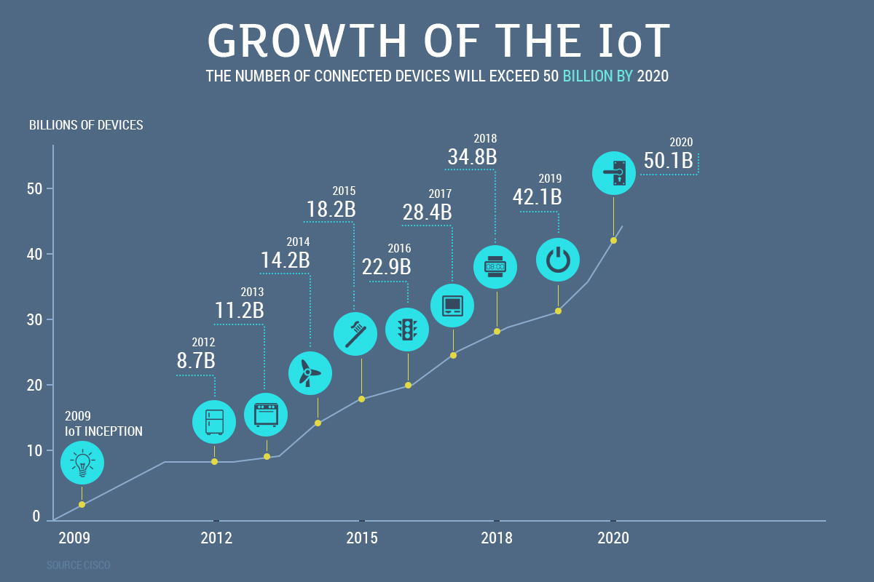
IoT Trends
50 billion IoT units by 2020
11.6 billion mobile devices by 2021
929 million wearables by 2021
World’s projected population by 2021 is “only” 7.8 billion
Notes:
https://mobidev.biz/blog/iot-trends-for-business-2018-and-beyond

Slide 5
IoT Applications
Image Processing
Battery life time, computing and storage capabilities?
How much it costs each processing device?
Do we really need to invest that much?

Slide 6
Cloud Computing
“Cloud computing is a model for enabling convenient, on-demand network access to a shared pool of configurable computing resources (e.g., networks, servers, storage, applications, and services) that can be rapidly provisioned and released with minimal management effort or service provider interaction.” - NIST
Google data center locations
What is the communication delay?
Is cloud suitable for such number of IoT devices?
How about bandwidth?
Is there other solutions?
Notes:
https://www.google.com/about/datacenters/inside/locations/index.html

Slide 7
Fog Computing
“Fog computing is a system-level horizontal architecture that distributes resources and services of computing, storage, control and networking anywhere along the cloud-to-things continuum.” - OpenFog Consortium
Multiple IoT Applications
Virtualization support
Ultra-low latency
Mobility support
Location awareness
Heterogeneity support
Infrastructure need
Geographically distributed
Real-time support
Large-scale support

Slide 8
2.
Related Work
What's missing in fog computing?

Slide 9
Fog Computing Architecture - Actors
Fog nodes
Physical
Gateways
Switches
Routers
Servers
Virtual
Virtualized switches
Virtual machines
Cloudlets
IoT devices
Sense-process-actuate
Send data streams
Receive result
Stream-processing
Send data streams
Store data in fog/cloud for long-term analytics
Applications
Application as a whole
DDF programming model

Slide 10
Fog Computing Architecture – Orchestration (1)
Where to deploy one application?
Fog nodes do not have infinite computing resources!
What to do when they are overloaded?
Should one application already running in one fog node be migrated?
How to offload?
Where to offload?
When to offload?

Slide 11
Fog Computing Architecture – Orchestration (2)
How to offload?
Migration
Virtual machines
Non-live migration
Live migration
Pre-copy memory
Post-copy memory
Containers reduce:
Service downtime
Bandwidth consumption
Computational overhead
Proactive migration
Deployment of replicas
Update replicas
Bigger overhead
Bandwidth
Computing resources
Further reduced downtime
Reactive migration

Slide 12
Fog Computing Architecture – Orchestration (3)
Where to offload?
Arbitrary number of colonies
Each colony has:
Arbitrary number of fog nodes
One orchestrator
Each fog node has one fog cell
Fog cells are responsible for:
Receive tasks from IoT devices
Decide whether to execute it in the current fog node or ask orchestrator to offload to somebody else
Fog colonies

Slide 13
Fog Computing Architecture – Orchestration (4)
When to offload?
Run the optimization algorithm:
Periodically
Periodicity = ?
When a task request is performed
When a QoS violation is predicted
Uses mobility and requests patters
When an handover is predicted
Uses mobility patters
Which is the best solution?
What variables should we consider?
What algorithm should be used?

Slide 14
Optimization Algorithms (1)
What variables should we consider?
From the review literature:
Quality of Service (QoS)
Bandwidth
Energy consumption
Cost
Bandwidth
Energy consumption
Computational resources
Power up and down servers
Penalization for QoS violation
Mobility of users
Mobility of fog nodes
Distributed Data Flow (DDF)
No one has considered them all together

Slide 15
Optimization Algorithms (2)
What algorithm should be used?
From the review literature:
Particle Swarm Optimization
Markov Decision Process
Alternating Direction Method of Multipliers
Mixed-Integer Linear Programming
Mixed-Integer Quadratic Programming
Genetic Algorithm
Lyapunov Optimization
Minimum Graph Cuts
Interior Point Method
Convex Programming

Slide 16
3.
Our approach
Our contributions for the improvement of fog computing

Slide 17
Objective
Multi-objective fog system design
Mobility support
Implement it in an open-source
simulation toolkit

Slide 18
Simulation Toolkits Features
 | iFogSim | MyiFogSim | iFogSimWith DataPlacement
QoS, Cost, Energy, Bandwidth | ✓ | ✓ | ✓
Distributed Data Flow | ✓ | ✓ | ✓
Fog nodes mobility | ✕ | ✕ | ✕
IoT devices mobility | ✕ | ✓ | ✕
Migration support | ✕ | ✓ | ✕
Partitioning techniques | ✕ | ✕ | ✓
Data placement optimization | ✕ | ✕ | ✓
Migration Optimization | ✕ | ✕ | ✕

Slide 19
Optimization Algorithms (1)
Genetic Algorithm
Arbitrary number of individuals
Representing points in the search space
Fitness score defined by its genes
Natural selection between generations:
Selection operator
Crossover operator
Mating between two individuals
Mutation operator
Randomly introduce genes
Gen. 0
Gen. 1
Gen. n

Slide 20
Optimization Algorithms (2)
Particle Swarm Optimization
Arbitrary number of particles
Initialized with random solutions
Store the best fitness for itself and for the swarm as a whole
Identify the global best
Compute the vector direction to the global best
Movement is characterized by the time step and velocity
Initialization with spread of particles too:
Local may lead to a local minimum finding
Spread out may not converge

Slide 21
Optimization Algorithms (3)
Markov Decision Process
Goal-oriented algorithms
Software agent
Determines the ideal behavior within a specific context
Using a reward feedback
Set of possible states
Set of models
Probability to go to state s’, while being at state s and taking action a
Set of possible actions
Benefit to take action a while being at state s and ending up in state s’
Real valued reward function
Policy
Represents the goal
Gives the optimal action to take in every state

Slide 22
Schedule of Future Work
Feb, 1st - Feb, 21th : Choice of applications and specifications of test target scenarios
Feb, 22th - Mar, 21th: Communication between fog nodes at the same level
Mar, 22th - May, 30th: Static Optimization
May, 23th - Jun, 5th: Preliminary results
Jun, 6th - Jul, 31th: Mobility implementation
Aug, 1st - Sep, 25th: Optimization with mobility
Sep, 18th - Oct, 8th: Final results
Mar, 1st - Oct, 10th: Write the dissertation about the work performed

Slide 23
4.
Conclusions
Some thoughts about fog computing

Slide 24
Conclusions
IoT devices suffer from
Lack of processing, memory and battery capabilities
Cloud computing is able to solve these problems but introduces new ones
Latency and bandwidth usage
Fog computing is a promising solution but…
Is a new computing paradigm
Has lack of support for mobile fog computing
Takes into account few parameters in the decision-making of migration
Has few and limited simulator toolkits available to test applications

Slide 25
thanks!
Any questions?
You can find me at
josecarlosvieira@tecnico.ulisboa.pt

Slide 26
Credits
Special thanks to all the people who made and released these awesome resources for free:
Presentation template by SlidesCarnival

