Slide 1
HyParView (a membership protocol
for reliable gossip-based broadcast)
Presented by
Guilherme Pascoal
José Cutileiro
Vasco Vaz
Authors
João Leitão
José Pereira
Luís Rodrigues
Original paper

Slide 2
Gossip algorithm (key concepts)
It works even in partition scenarios
CAP theorem -> A + P scenario
It sacrifices a bit of coherence (don’t guarantee strong consistency)
Different replicas can have different views
A client always reads consistent values

Slide 3
Gossip algorithm (benefits)
Fast access to clients
Scales very quickly and easily.

Slide 4
Gossip algorithm (use cases)
Large scale distributed systems
Decentralized databases
Cloud computing
(basically, every system with a large number of nodes)

Slide 5
Gossip algorithm (how it works)
Replicate the behavior of how viruses and rumors are spread in our society.
Map data: Ceros

Slide 6

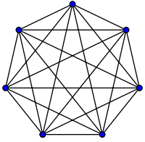
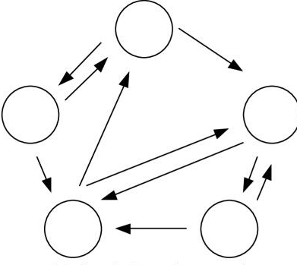
Gossip algorithm (how it works)
Each node maintains a partial view of the system, they together maintain the entire system (the knowledge graph is directed, meaning node A can know about B, and the reverse is not necessarily true)

Slide 7
Gossip algorithm (Fanout)
Fanout: The number of nodes to which a given node spreads is information
Properties:
If the fanout is very big, then the system might become overloaded with redundant messages (might become impossible to respond to everything)
If the fanout is very small, the dissemination of the information will be slower, the system will have reduced fault tolerance and there will be lower resilience to network partitions
How to select the best fanout?
Each system can have a different value for the fanout, depending on the chosen implementation of the gossip algorithm and the system's ultimate goal.

Slide 8
Membership service
Maintains the partial views
Track nodes
Find new nodes
Which nodes are failing
Organize the quorums
Elasticity and scalability of the system
Security: Which nodes can join the system

Slide 9
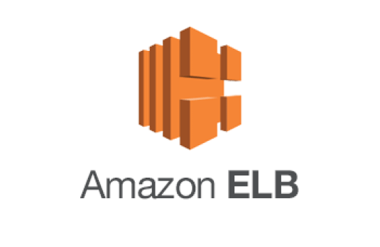

Membership service (popular systems)

Slide 10
SCAMP - Membership Protocols
Reactive* membership protocol
*Reactive means that you only have to deal with updates in case of a system change (either due to failures or because we want to add nodes).
Uses another protocol – subscription protocol*
*Used when a node wants to join (or rejoin) the system
Heartbeat*
*If a node doesn't respond to the heartbeat after a timeout, we assume it is isolated and attempt to bring it back to the system
More about SCAMP: Peer-to-peer lightweight membership service for large-scale group communication

Slide 11
Cyclon - Membership Protocols
Cyclic* membership protocol - What they refer to as a 'shuffle' occurs every ∆T. In this operation, a node selects the oldest node in its partial view and simply exchanges with that node. During this process, the nodes exchange information from their respective partial views
*because the system doesn't require changes; this protocol runs at regular intervals.
More about Cyclon: Inexpensive membership
management for unstructured p2p overlays

Slide 12
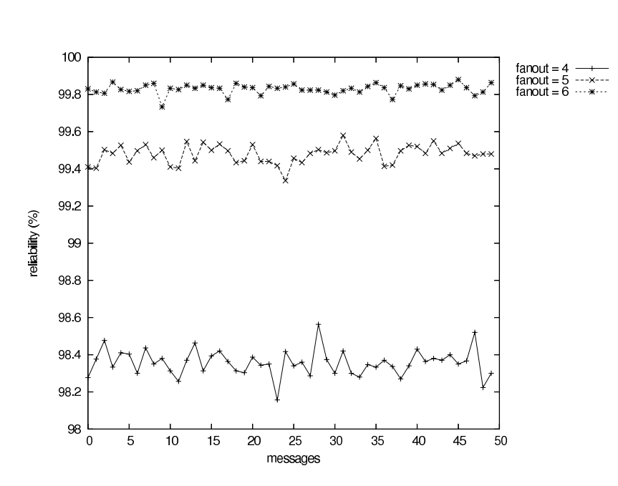
Cyclon - Protocol evaluation

Slide 13
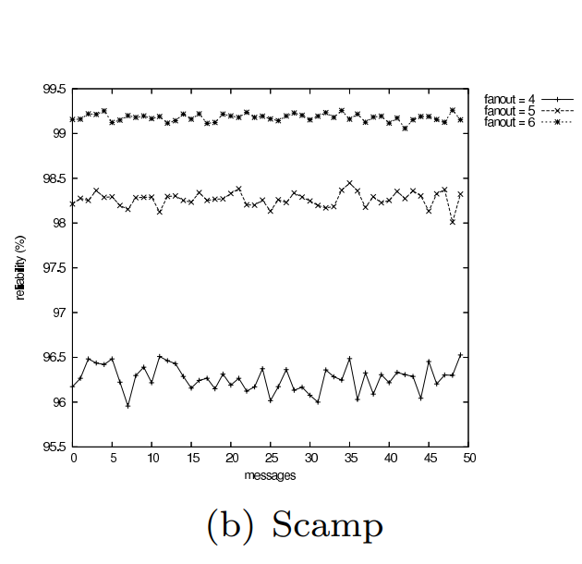
Scamp - Protocol evaluation

Slide 14
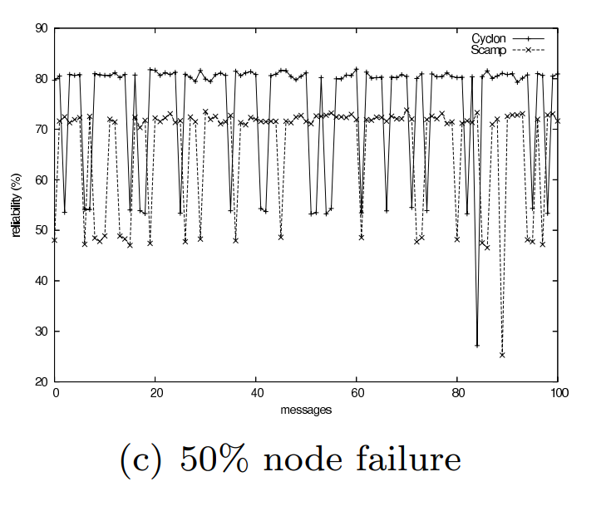
50% node failure - Protocol evaluation

Slide 15
Standard membership protocols are not the perfect solution
Partial view => More vulnerability to failures
More failures => Overload in membership services
Long time to restore => Long time to respond
Reliability is greatly affected
These algorithms are not very effective when many failures occur

Slide 16
The importance of dealing with many failures
Availability: You don't want your service to stop running in case a natural disaster occurs.
Security: You don't want your service to stop running if there's malware spreading in it rapidly

Slide 17
This is where our protocol comes into play

Slide 18
HyParView – Hybrid partial view

Slide 19
HyParView (key concepts)
Try to reduce the fanout to log(n)
Maitain two views – Active view and Passive view
Active view: small, with log(n) + 1
Passive view: larger, with k(log(n) + 1) (k time bigger than the partial view)
Links in the overlay are symmetric (if p is on q active view, then q is on p active view) “Due to HyParView’s symmetric active view, almost all nodes in the overlay are known by the maximum amount of nodes possible, which is the active view length”
Open TCP connection to every node on the active view, we can do this because the active view is very small

Slide 20
The importance of using TCP
Mask network omissions
Used as a failure detector
Disseminate information across the overlay
Eliminate correlated messages losses due to network congestion

Slide 21
HyParView (membership protocol)
Hybrid protocol:
1. Active view: Reative strategy
– By using TCP we can test every node on the active view with every message.
- New nodes can join to this view once they connect to the system
- Nodes will be removed once they fail
2. Passive view: Cyclic strategy
- Periodically performs a shuffle just like the original Cyclon
- But this shuffle causes the probability of active nodes being in the passive view to be high, which allows for the removal of failed nodes from the passive views almost automatically

Slide 22
Join mechanism
“When a node wishes to join the overlay, it must know another node that already belongs to the overlay” – The contact node
“The new node n establishes a TCP connection to the contact node c and sends to c a Join request”
“A node that receives a join request will start by adding the new node to its active view, even if it has to drop a random node from it” – Disconnect message

Slide 23

Join mechanism (Pseudo-Code)
NEW NODE
TCP connection to contact node
SEND JOIN
CONTACT NODE

Slide 24
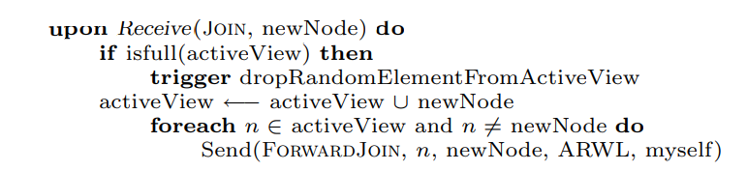
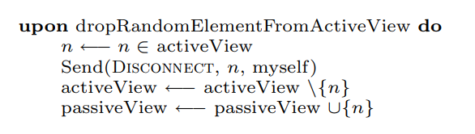
Join mechanism (Pseudo-Code)
CONTACT NODE
SEND DISCONNECT
SEND FORWARD JOIN
All Nodes on active view
Random Node

Slide 25
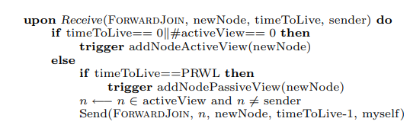
Join mechanism (Pseudo-Code)
ALL NODES ON ACTIVE VIEW
SEND FORWARD JOIN
One N on active view that is not a sender (random walk)

Slide 26
Join mechanism (Random walk)
Load Balancing: Random walks help distribute the load evenly across the network.
Robustness: Random walks contribute to the robustness of the overlay network.
Efficiency: Random walks can efficiently explore the network without excessive overhead.

Slide 27
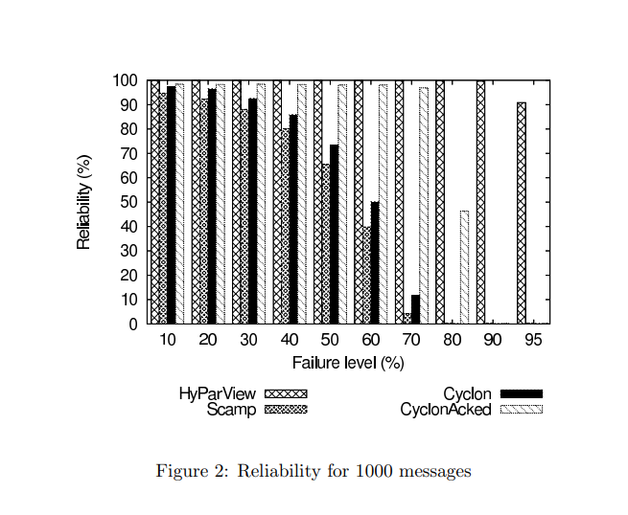

Slide 28
