Slide 1
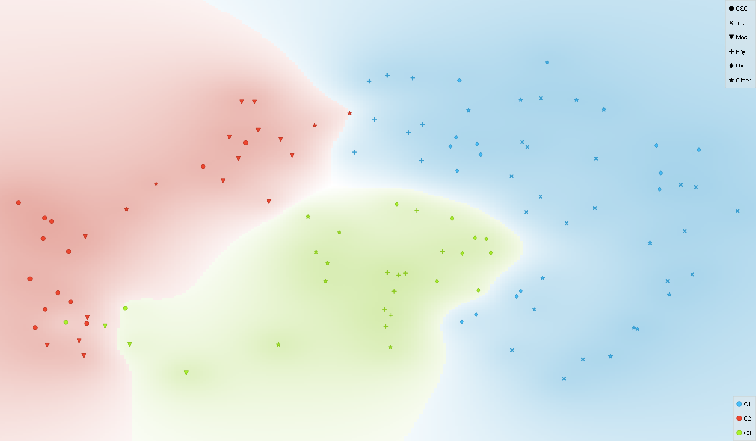
Vines et al.(2013)
Kokubun et al. (2014)
Gaugne et al. (2014)
Reda et al.(2013)
Kucukyilmaz et al. (2013)
Okamoto et al. (2013)
Kehrer and Hauser(2013)
Tazz and Patel (2013)
Z.Wang and Wang(2014)
Cavrag et al.(2014)
Diaz et al.(2014)
Oiu et al. (2013)
Mars et al.(2014)
C.-Y.Chen et al.(2014)
Pietroni and Adami (2014)
Altendorf et al.(2014)
Prachyabrued and borst(2014)
Dima et al(2014)
Pappaefthymiou et al.(2015)
Hekler et al.(2013)
Khanal et al.(2014)
Velaz et al. (2014)
Jeon and Harders(2014)
Hamam et al.(2014)
Groten et al.(2013)
Olshannikova et al.(2015)
Nakamura and Yamamoto (2014)
Gonzalez-Badillo et al.(2014)
Kober and Neuper(2013)
Grane and Bengstsson(2013)
Pan et al.(2015)
Xia et al. (2016)
Diefenbach et al.(2014)
Madan et al.(2015)
Odom et al.(2014)
Bombari et al.(2015)
Gavish et al.(2015)
D. Wang et al. (2015)
Al-Ahmari et al.(2016)
Aras et al.(2014)
Kemeny(2014)
S-C.Kim and kwon (2014)
Donalek et al.(2014)
Radkowaski et al.(2015)
Perretet et al.(2013)
Esteban et al.(2014)
Fittkau et al.(2015)
Grajewski et al.(2015)
Ruffaldi et al.(2015)
D. Wang et al. (2016)
Carvalheiro et al..(2016)
Achibet et al.(2015)
Ruthenbeck and Reynolds et al.(2015)
Moran et al.(2015)
Atienza et al. (2016)
Maeslandug et al:. (2016)
Jung et al. (2016)
Hamid et al.(20xx)
Achibet et al.(2014)
Amirkhani and Nahvi(2016)
Piumsomboon et al.
(2013)
Al-Ahmari et al.(2016)
X. Wang et al.(2016)
Aslandere et al. (2015)
Deng et al.(2014)
Pacchierotti et al.(2017)
Li and Zhou(2016)
Magana et al.(2017)
Choi et al. (2015)
Slater and Sanchez-Vives(2016)
Younes et al.(2017)
Berg and Vance(2017)
Muhanna(2015)
Valentino et al. (2017)
Oberhauser and Dreyer (2017)
LInd et al. (2016)
Pesdianketssandrakis (2019)
Freina and Ott (2015)
Yuksel et al.(2017)
Sapika et al. (2017)
Maereg et al.(2017)
Rubio-Tamayo et al. (2017)
Y.-S.Chen et al.(2016)
Y.-S.Chen et al.(2016)
M.Kim et al.(2017)
Xia et al. (2016)
Chavan (2016)
Fortmeier et al. (2015)
Marayong et al. (2017)
Neri et al.(2018)
Edwards et al.(2018)
Kersten et al.(2017)
Bekele et al. (2018)
Won et al. (2017)
Yuksel et al.(2019)
Kyriakou et al.(2017)
Rose et al. (2018)
Walsh et al.(2018)
Lee et al. (2017)
Barbieri et al.(2018)
Cariozzno et al.(2018)
Vaughan et al. (2016)
Z Wang et al. (2018)
Tsai et al. (2017)
Athes et al (2016)
Escobar-Castillejos et al. (2016)
Lonch et al. (2018)
Andaluz et al. (2016)
Stamer et al. (2020)
Ho et al. (2018)
Hamza-Lup et al. (2019)
Roldan et al. (2019)

