Slide 1
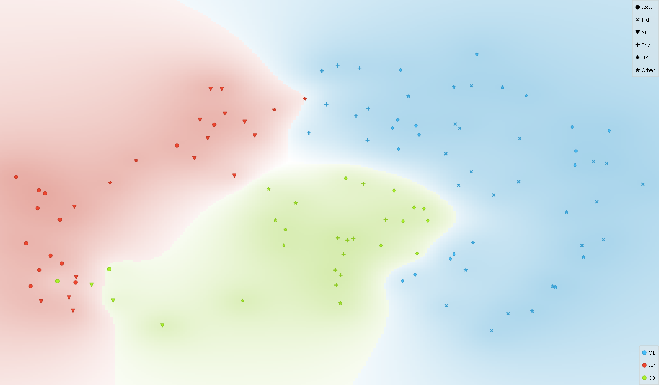
Vines et al.(2013)
Tazz and Patel (2013)
Kokubun et al. (2014)
Okamoto et al. (2013)
Gaugne et al. (2014)
Reda et al.(2013)
Diaz et al. (2014)
Kucukyilmaz et al. (2013)
Cavrag et al.(2014)
Dima et al(2014)
C.-Y.Chen et al.(2014)
Khanal et al.(2014)
Z.Wang and Wang(2014)
Oiu et al. (2013)
Kehrer and Hauser(2013)
Hamam et al.(2014)
Pan et al.(2015)
Mars et al.(2014)
Pietroni and Adami (2014)
Jeon and Harders (2014)
Altendorf et al.(2014)
Odom et al.(2014)
Pappaefthymiou et al.(2015)
Hekler et al.(2013)
Diefenbach et al.(2014)
Prachyabrued and borst(2014)
Groten et al.(2013)
D. Wang et al. (2015)
Velaz et al. (2014)
Kober and Neuper(2013)
Olshannikova et al.(2015)
Gonzalez-Badillo et al.(2014)
Nakamura and Yamamoto et al. (2014)
Donalek et al.(2014)
Perretet et al.(2013)
Grane and Bengstsson(2013)
Bombari et al.(2015)
Gavish et al.(2015)
D. Wang et al. (2016)
Al-Ahmari et al.(2016)
Aras et al. (2014)
Kemeny (2014)
Moran et al.(2015)
Donalek et al.(2014)
Fittkau et al.(2015)
Radkowaski et al.(2015)
Grajewski et al. (2015)
Esteban et al. (2014)
Ruffaldi et al.(2015)
Moran et al.(2015)
Moran et al.(2015)
Carvalheiro et al..(2016)
Atienza et al. (2016)
Achibet et al.(2015)
Ruthenbeck and Reynolds et al.(2015)
Jung et al. (2016)
Amirkhani and Nahvi(2016)
Maeslandug et al:. (2016)
Achibet et al.(2014)
Li and Zhou(2016)
Piumsomboon et al.(2013)
Al-Ahmari et al.(2016)
X. Wang et al.(2016)
Xia et al.(2013)
Slater and Sanchez-Vives(2016)
Aslandere et al. (2015)
Oberhauser and Dreyer(2017)
Magana et al.(2017)
LInd et al. (2016)
Pacchierotti et al.(2017)
Yuksel et al.(2017)
Pesdianketssandrakis (2019)
Younes et al.(2017)
Hamid et al. (2014)
Muhanna(2015)
Valentino et al. (2017)
Maereg et al.(2017)
Choi et al. (2015)
Rubio-Tamayo et al.(2017)
Marayong et al. (2017)
Y-S Chen et al. (2016)
M.Kim et al.(2017)
Sapika et al. (2017)
Neri et al.(2018)
Fortmeier et al. (2015)
Ahmed et al. (2016)
Kersten et al.(2017)
Xia et al. (2016)
Won et al. (2017)
Yuksel et al.(2019)
Deng et al.(2014)
Edwards et al.(2018)
Bekele et al. (2018)
Rose et al. (2018)
Yuksel et al.(2019)
Kyriakou et al.(2017)
Freina and Ott (2015)
Z Wang et al.(2018)
Lee et al.(2017)
Berg and Vance et al. (2017)
Andaluz et al. (2016)
Cariozzno et al.(2018)
Hamza-Lup et al.(2019)
Walsh et al.(2018)
Barbieri et al. (2018)
Vaughan et al. (2016)
Escobar-Castillejos et al. (2016)
Tsai et al. (2017)
Chavan (2016)
Athes et al (2016)
Stamer et al.(2020)
Lonch et al.(2018)
Roldan et al. (2019)
Ho et al. (2018)

