Slide 1
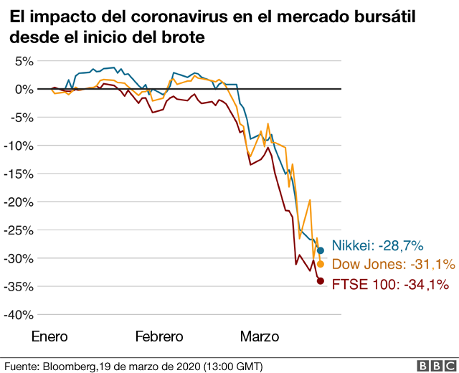
covid 19 affects the United States
While there is great uncertainty regarding the prospects for economic growth in the United States, the impact of the pandemic is harsh The record economic expansion of the United States came to an end due to COVID-19, with forecasts of a deep recession in 2020

Slide 2

motorcyclist dies
the accident caused the death of the motorcyclist
the red cross reported the collision between a light vehicle and a motorcycle in the afternoon
The crash happened in San Rafael de Santa Ana, when for unknown reasons she was intercepted by the car

