Slide 1


strivon
Every shelf tells you what it needs before it runs empty.
Sensei challenge · JunctionX Lisbon 2026

Slide 2
An empty shelf is a lost sale.
An overstocked one is waste.

Slide 3
Today, the staff check
by walking the store.

Slide 4
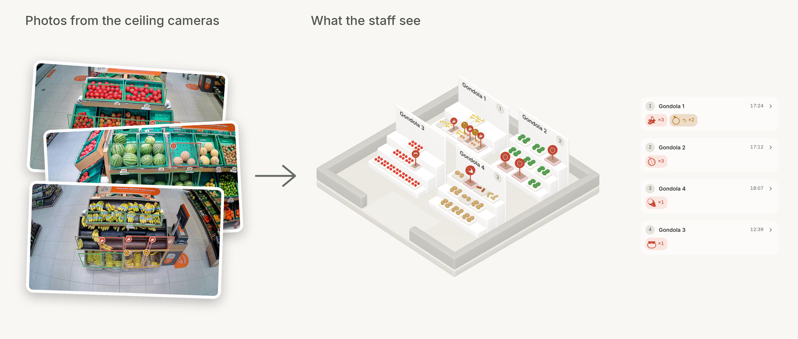
From a camera photo to a list of work

Slide 5
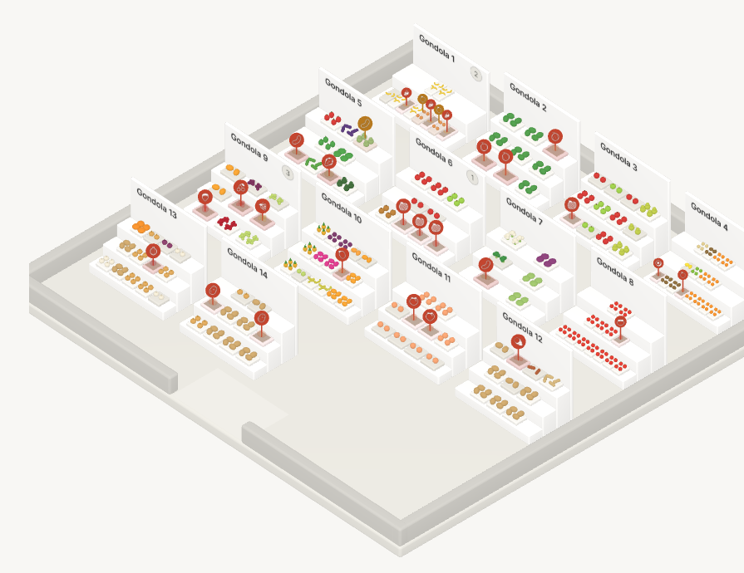
The store, with the problems marked

Slide 6
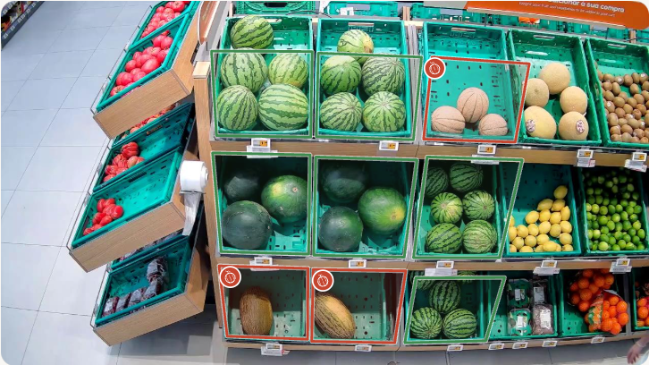
Open a shelf, see what is wrong

Slide 7
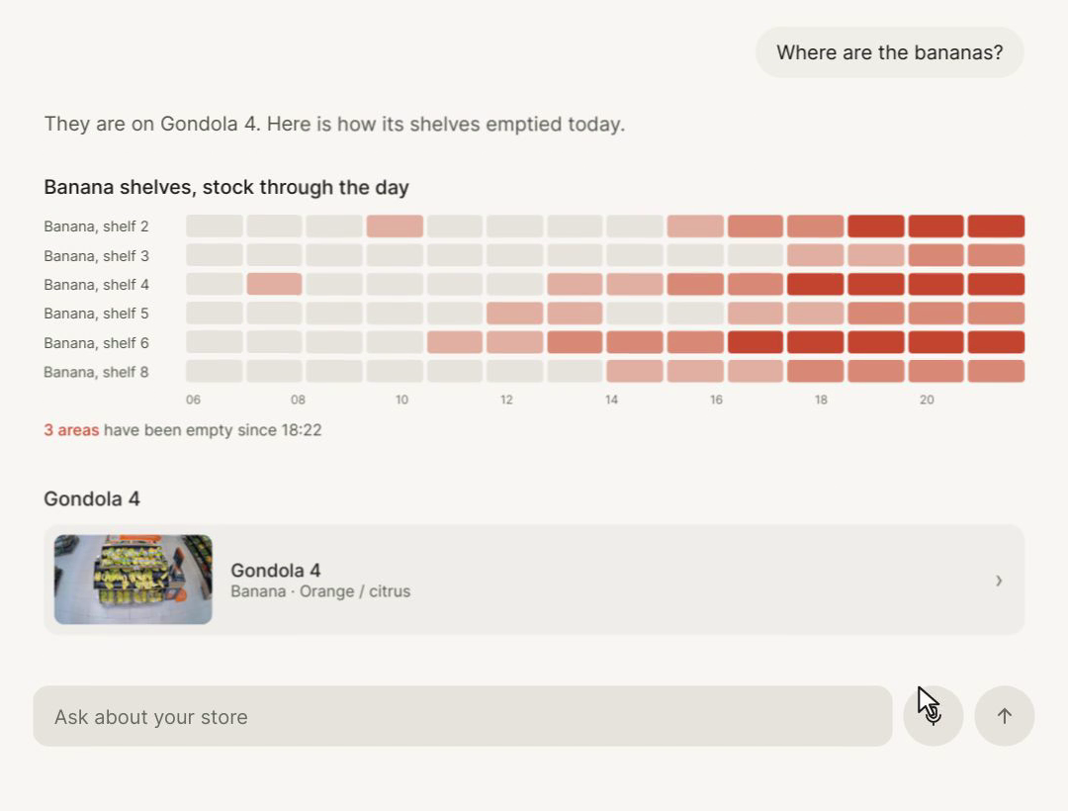
Generative UI

Slide 8
3,399
points of 3,858 on our benchmark
Team benchmark of 1,929 areas, not the hidden set.

Slide 9
Try it
strivon-landing.vercel.app
Jose · Miguel · André · Leonor

