Slide 1
ICP Presentation 2
Jose Fonseca

Slide 2
ICP8 Main Focus
Simple login application.
IDE: Android Studio
Basic CSS, XML, Java

Slide 3

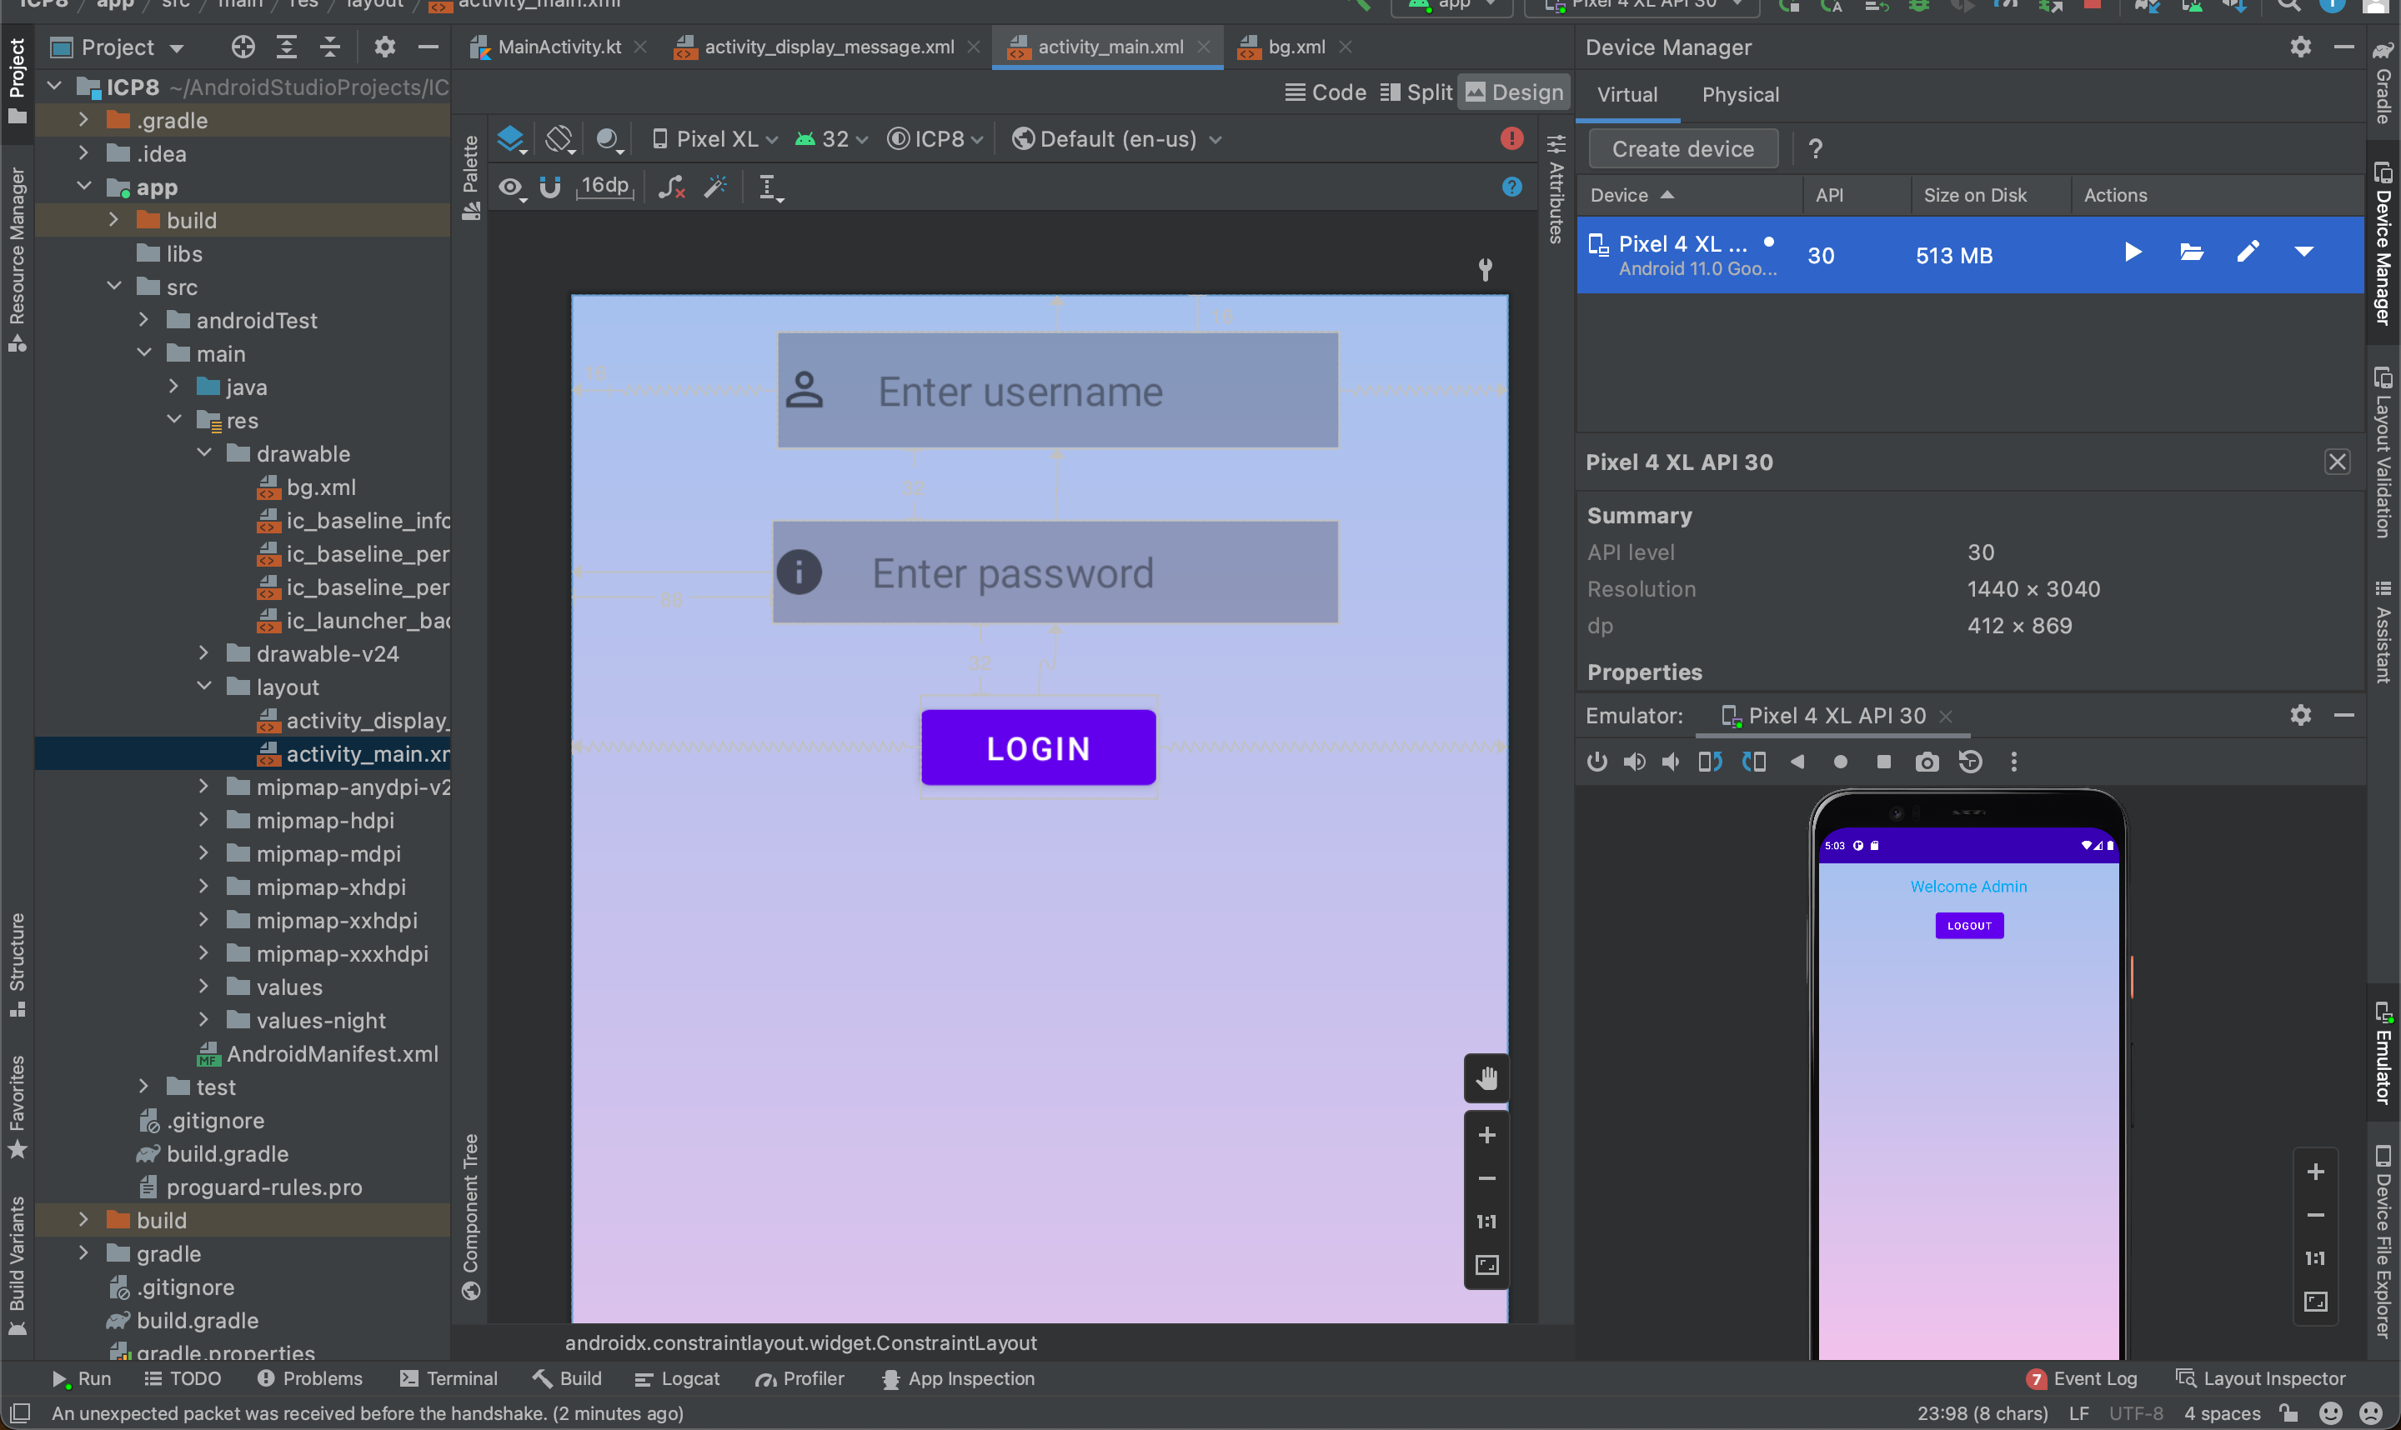
ICP8 approach
Created logic in MainActivity
Simple UI and Gradient background
Button triggers event on press
If valid credentials starts new Activity

Slide 4
ICP8 Conclusion
Great start to learn new environment and skills.
Can be modified to use API instead of hard coded logic.
Useful android developer’s page.

Slide 5
ICP9 Main Focus
Pizza app
layouts, views, and intents
Improve our knowledge and experience with Android applications.

Slide 6
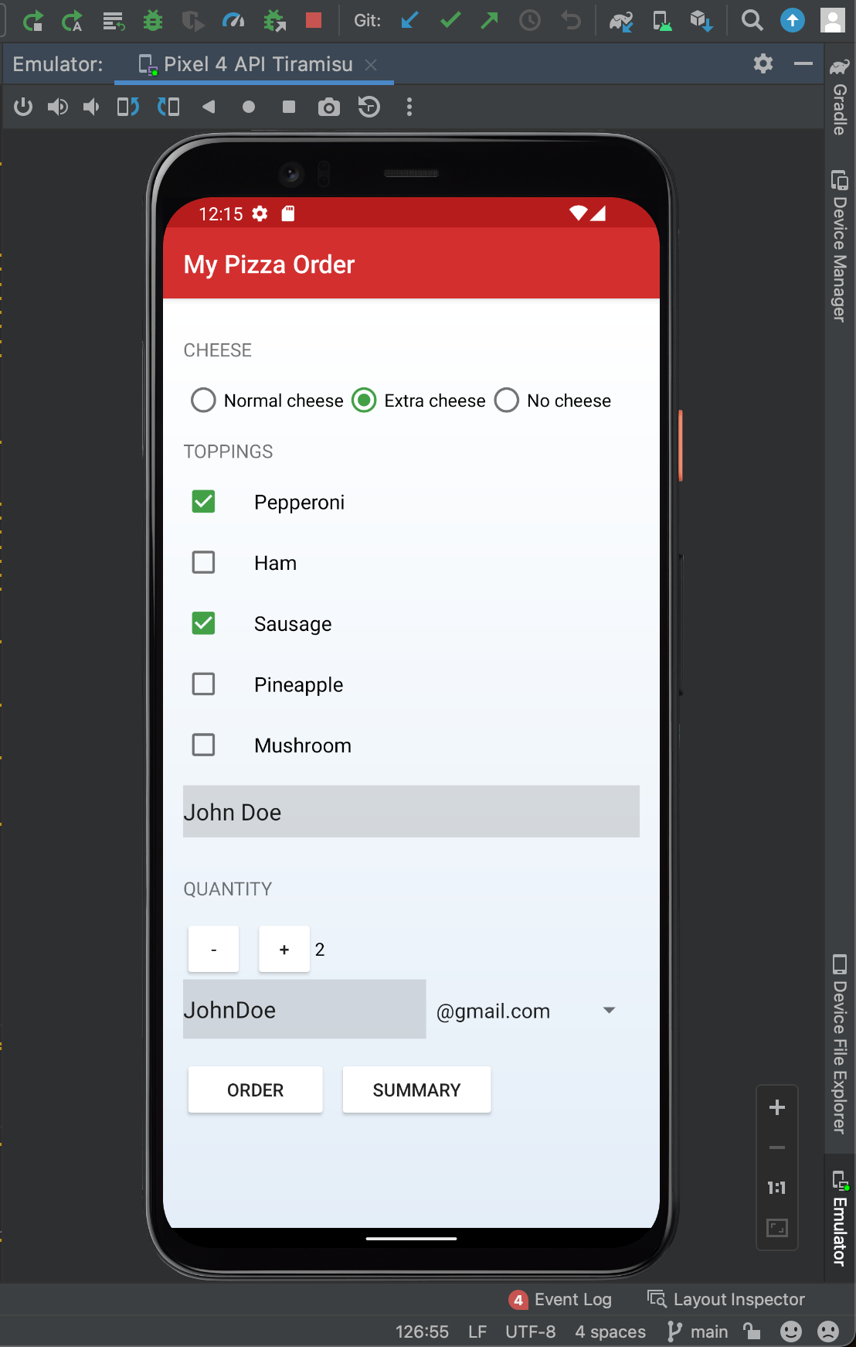
ICP9 approach
Provided with an unfinished application
Linear Layout and View Group to organize screen
Used spinner, checkboxes, Radio View
Intents to display new activities
Intent ACTION_SENDTO to send email

Slide 7
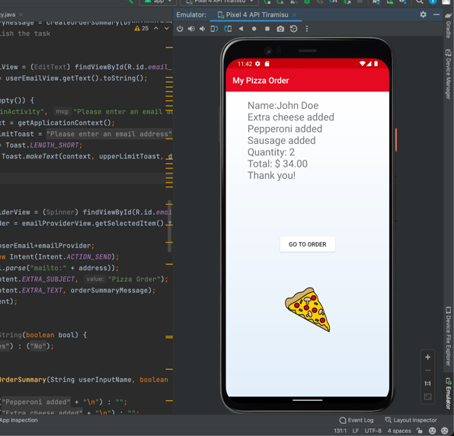
ICP9 conclusion
Comfortable with IDE
Good difficulty to learn and improve
Great for learning how to layout a page

Slide 8
Link to video
https://youtu.be/8vDr2maU6_s

