Slide 1


Start
Introduction Joint angles A. Functions Program Results Conclusions
Asymmetry Functions
of Joint Angles
in the Human Gait
JOSÉ CARLOS LARA GÓMEZ
JACEK J. DUSZA

Slide 2
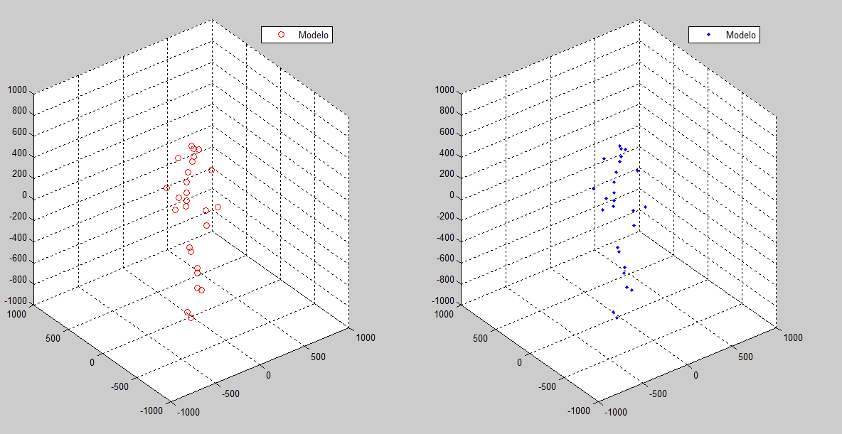
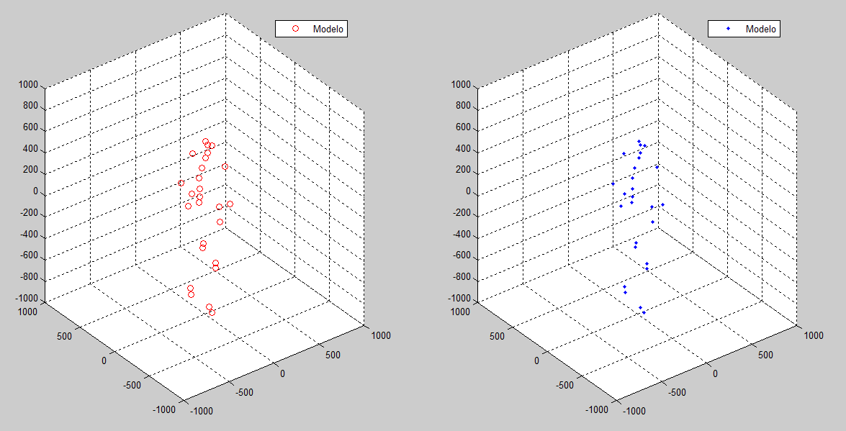

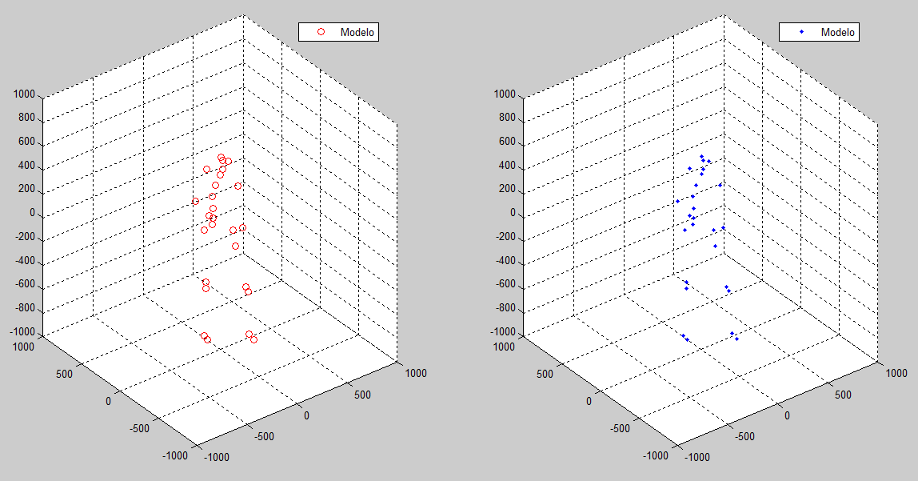
1
Introduction Joint angles A. Functions Program Results Conclusions
Idea of Asymmetry Functions

Slide 3
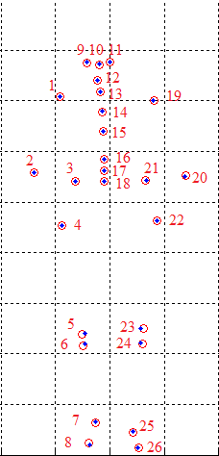
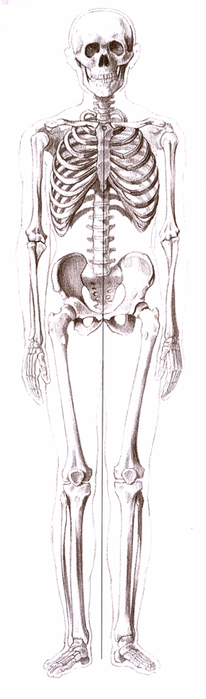
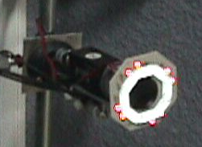
1
Introduction Joint angles A. Functions Program Results Conclusions
Data capture

Slide 4

1
Introduction Joint angles A. Functions Program Results Conclusions
Middle Double Step models
Middle Double Step model:
  Change of the reference point of the data where the center of mass is located.
  Segmentation of data.
  Standardization of data matrices.
  Inverse Fourier transformation.
Left step and right step models:
  Separation of steps.
  Creation of symmetrical models by functional extensions.

Slide 5
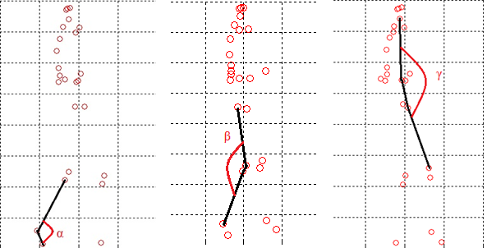
2
Introduction Joint angles A. Functions Program Results Conclusions
Definition of joint angles
Alpha Beta Gamma

Slide 6
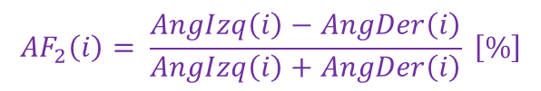
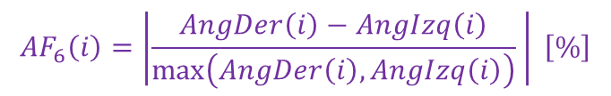




3
Introduction Joint angles A. Functions Program Results Conclusions
Asymmetry Functions
$${AF}_{4}\left(i\right)=\left(\frac{AngDer\left(i\right)}{AngIzq\left(i\right)}+\frac{AngIzq\left(i\right)}{AngDer\left(i\right)}−2\right) \left[\%\right]$$
$${AF}_{1}\left(i\right)=AngIzq\left(i\right)−AngDer\left(i\right)\left[º\right]$$
$${AF}_{2}\left(i\right)= \frac{AngIzq\left(i\right)−AngDer\left(i\right)}{AngIzq\left(i\right)+AngDer\left(i\right)} \left[\%\right]$$
${AF}_{5}\left(i\right)= \frac{AngDer\left(i\right)−AngIzq\left(i\right)}{\max\left(AngDer\left(i\right), AngIzq\left(i\right)\right)} \left[\%\right]$
${AF}_{3}\left(i\right)= \left|\frac{AngDer\left(i\right)}{AngIzq\left(i\right)}−\frac{AngIzq\left(i\right)}{AngDer\left(i\right)}\right| \left[\%\right]$
$${AF}_{6}\left(i\right)=\left|\frac{AngDer\left(i\right)−AngIzq\left(i\right)}{\max\left(AngDer\left(i\right), AngIzq\left(i\right)\right)} \right| \left[\%\right]$$

Slide 7
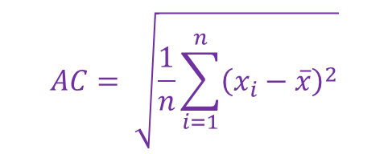
3
Introduction Joint angles A. Functions Program Results Conclusions
Asymmetry coefficient
Once we have the values ​​of the asymmetry function we can define the asymmetry coefficient!
$$AC= \sqrt{\frac{1}{n}\sum_{i=1}^{n}{{\left(x_{i}−\overline{x}\right)}^{2}}}$$

Slide 8
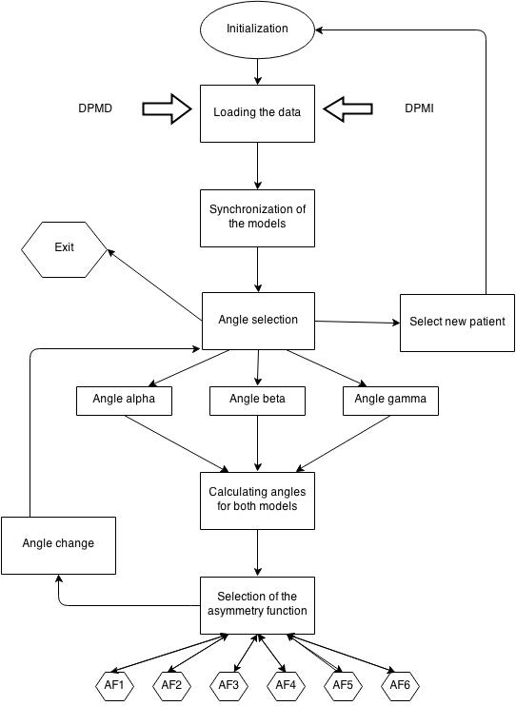

4
Introduction Joint angles A. Functions Program Results Conclusions
How does the program work

Slide 9
4
Introduction Joint angles A. Functions Program Results Conclusions
Other options

Slide 10
5
Introduction Joint angles A. Functions Program Results Conclusions
Representation of the
joint angle

Slide 11

5
Introduction Joint angles A. Functions Program Results Conclusions
Representation of the
Asymmetry Functions
$${AF}_{1}\left(i\right)=AngIzq\left(i\right)−AngDer\left(i\right)\left[º\right]$$

Slide 12
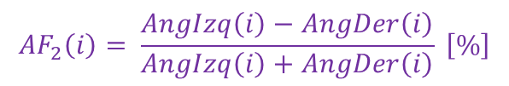
5
Introduction Joint angles A. Functions Program Results Conclusions
Representation of the
Asymmetry Functions
$${AF}_{2}\left(i\right)= \frac{AngIzq\left(i\right)−AngDer\left(i\right)}{AngIzq\left(i\right)+AngDer\left(i\right)} \left[\%\right]$$

Slide 13

5
Introduction Joint angles A. Functions Program Results Conclusions
Representation of the
Asymmetry Functions
${AF}_{3}\left(i\right)= \left|\frac{AngDer\left(i\right)}{AngIzq\left(i\right)}−\frac{AngIzq\left(i\right)}{AngDer\left(i\right)}\right| \left[\%\right]$

Slide 14

5
Introduction Joint angles A. Functions Program Results Conclusions
Representation of the
Asymmetry Functions
$${AF}_{4}\left(i\right)=\left(\frac{AngDer\left(i\right)}{AngIzq\left(i\right)}+\frac{AngIzq\left(i\right)}{AngDer\left(i\right)}−2\right) \left[\%\right]$$

Slide 15

5
Introduction Joint angles A. Functions Program Results Conclusions
Representation of the
Asymmetry Functions
${AF}_{5}\left(i\right)= \frac{AngDer\left(i\right)−AngIzq\left(i\right)}{\max\left(AngDer\left(i\right), AngIzq\left(i\right)\right)} \left[\%\right]$

Slide 16

5
Introduction Joint angles A. Functions Program Results Conclusions
Representation of the
Asymmetry Functions
$${AF}_{6}\left(i\right)=\left|\frac{AngDer\left(i\right)−AngIzq\left(i\right)}{\max\left(AngDer\left(i\right), AngIzq\left(i\right)\right)} \right| \left[\%\right]$$

Slide 17

6
Introduction Joint angles A. Functions Program Results Conclusions
Categorization of a patient
Asymmetry Function
or
Asymmetry Coefficient

Slide 18
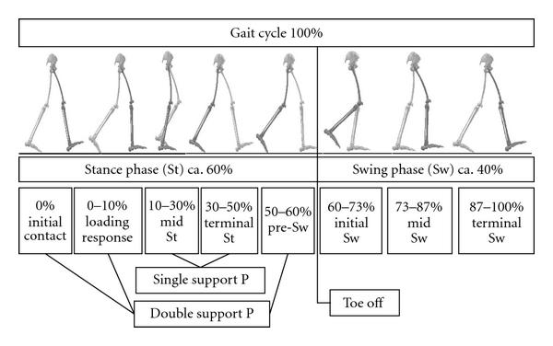
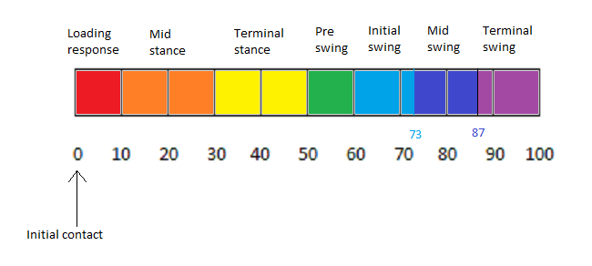
6
Introduction Joint angles A. Functions Program Results Conclusions
Division of the asymmetry function
in phases

Slide 19
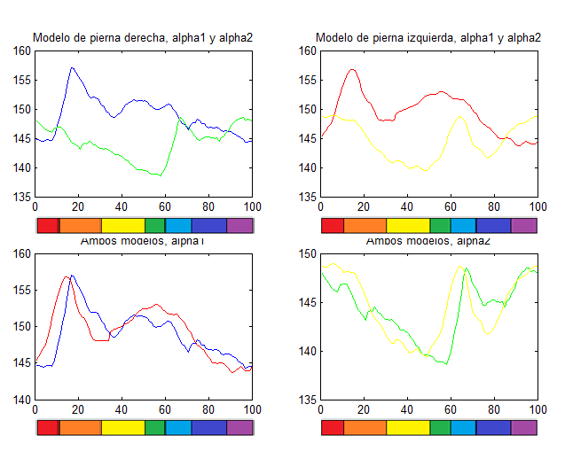
6
Introduction Joint angles A. Functions Program Results Conclusions
Division of the asymmetry function
in phases

Slide 20
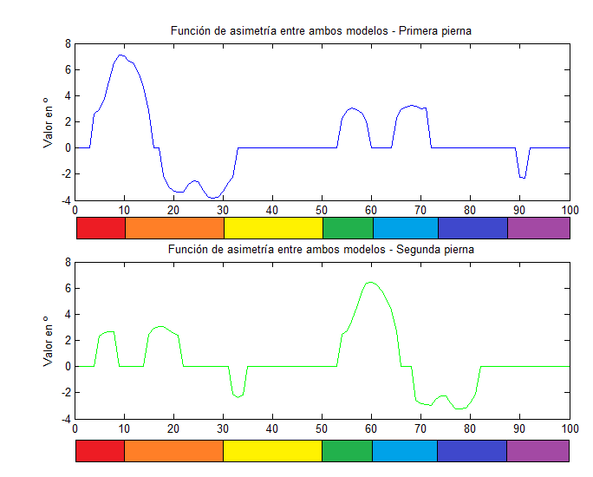
6
Introduction Joint angles A. Functions Program Results Conclusions
Division of the asymmetry function
in phases

Slide 21
Start
Introduction Joint angles A. Functions Program Results Conclusions
THANK YOU FOR YOUR ATTENTION!

