Slide 1
Adaboost for building robust classifiers
KH Wong

Slide 2
Overview
Part A: Adaboost
Objectives of AdaBoost
Solve 2-class classification problems
Will discuss
Training
Detection
Examples
Part B: How to evaluate a machine learning system

Slide 3

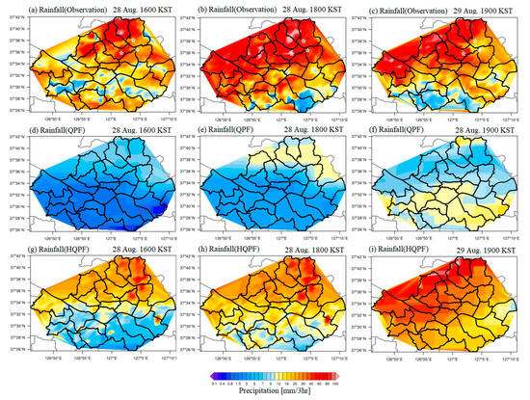
Part A: Adaboost: Objectives
Automatically classify inputs into different categories of similar features
Example
Spam mail detection and filtering
https://ieeexplore.ieee.org/document/6607244
Weather forecast
https://journals.ametsoc.org/view/journals/wefo/32/3/waf-d-16-0208_1.xml
Face detection:
find the faces in the input image
Extreme rainfall forecast
https://www.mdpi.com/2073-4433/11/1/111/htm
Partial distribution of a 3 h accumulated rainfall for observation

Slide 4
Detection problems
Two-class problem (will be discussed here)
E.g. face detection
In a picture, are there any faces or no face?
Multi-class problems (Not discussed here)
Adaboost can be extended to handle multi class problems
One-Vs-One for Multi-Class Classification
One-vs-One (OvO for short) is another heuristic method for using binary classification algorithms for multi-class classification.
Like one-vs-rest, one-vs-one splits a multi-class classification dataset into binary classification problems. Unlike one-vs-rest that splits it into one binary dataset for each class, the one-vs-one approach splits the dataset into one dataset for each class versus every other class.
https://machinelearningmastery.com/one-vs-rest-and-one-vs-one-for-multi-class-classification/#:~:text=Like%20one%2Dvs%2Drest%2C,class%20versus%20every%20other%20class .

Slide 5
Define a 2-class classifier Methods and Procedures
Supervised training
Show many positive samples (face) to the system
Show many negative samples (non-face) to the system.
Learn the parameters and construct the final strong classifier.
Detection
Given an unknown input image, the system can tell if there are faces or not.

Slide 6

We will learn
Training procedures
Give +ve and –ve examples to the system, then the system will learn to classify an unknown input.
E.g. give pictures of faces (+ve examples) and non-faces (-ve examples) to train the system.
Detection procedures
Input an unknown (e.g. an image) , the system will tell you it is a face or not.
Face non-face

Slide 7
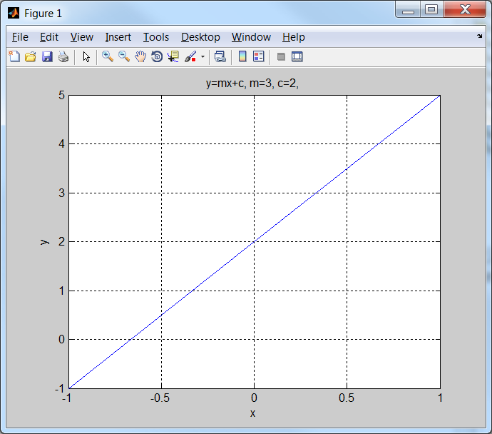
Exercise 1 :A linear programming example
A line y=mx+c
m=3, c=2
(a) When x=1, y=3*x+2=5. So, when X=1 , y’=5.5, is (x,y’) above[i]/below[ii] the line?
Answer: [i] or [ii]?________
(a) When x=0, y=3*x+2=2. So, when x=0,y”=1.5, is (x,y”) above[i]/below[ii] the line?
Answer: [i] or [ii]?________
Conclusion,
if a point (x,y) is above and on the left of the line y=mx+c, y>mx+c
if a (x,y) is below and on the right side of the line y=mx+c, y<mx+c
x=1,y=5
y-mx>c
y-axis
y=mx+c
x=0,y=2
y-mx<c
(0,0)
x=-1,y=-1
X-axis

Slide 8
ANSWER 1 :A linear programming example
A line y=mx+c
m=3, c=2
(a) When x=1, y=3*x+2=5. So, when x=1,y’=5.5, is (x,y’) above[i]/below[ii] the line?
Answer: [i] or [ii]?_i above
(a) When x=0, y=3*x+2=2. So, when x=0,y”=1.5, is (x,y”) above[i]/below[ii] the line?
Answer: [i] or [ii]?_ii below
Conclusion,
if a point (x,y) is above and on the left of the line y=mx+c, y>mx+c
if a (x,y) is below and on the right side of the line y=mx+c, y<mx+c
x=1,y=5
y-mx>c
y-axis
y=mx+c
x=0,y=2
y-mx<c
(0,0)
x=-1,y=-1
X-axis

Slide 9
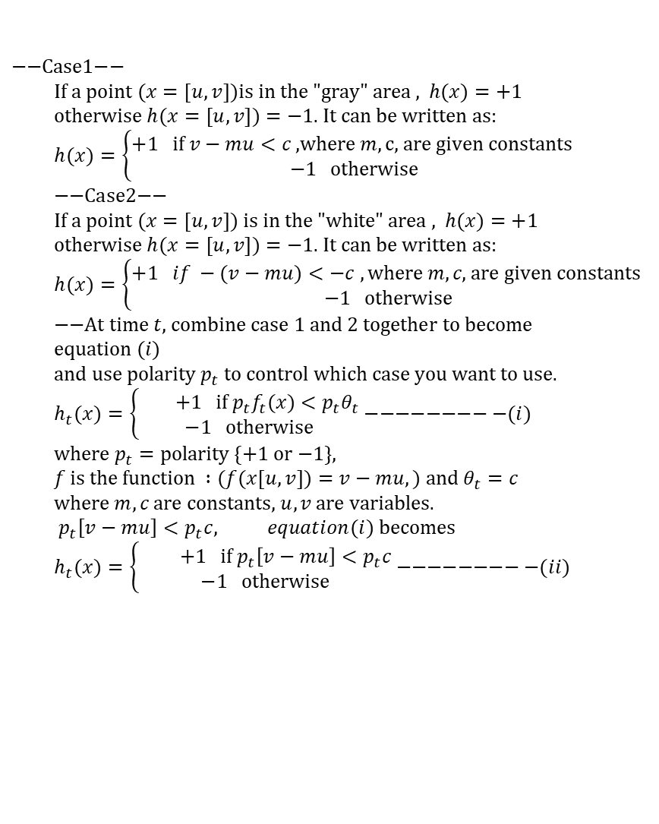
First let us learn what is a weak classifier h( )
$$\text{−−}\text{Case}\text{1−− } \\ \text{If} \text{a} \text{point} (x=[u,v])\text{is} \text{in} \text{the}\text{ "}\text{gray}\text{" }\text{area}\text{ , }h(x)=+1 \\ \text{otherwise} h(x=[u,v])=−1\text{. }\text{It} \text{can} \text{be} \text{written} \text{as}\text{:} \\ h(x)=\left\{\begin{matrix}+1 \text{if} v−mu<c\text{ ,}\text{where} m,\text{c}\text{, }\text{are} \text{given} \text{constants} \\ −1 \text{otherwise}\end{matrix}\right. \\ \text{−−}\text{Case}\text{2−−} \\ \text{If} \text{a} \text{point} (x=[u,v]) \text{is} \text{in} \text{the}\text{ "}\text{white}\text{" }\text{area}\text{ , }h(x)=+1 \\ \text{otherwise} h(x=[u,v])=−1\text{. }\text{It} \text{can} \text{be} \text{written} \text{as}\text{:} \\ h(x)=\left\{\begin{matrix}+1 if −(v−mu)<−c ,\text{where} m,c\text{, }\text{are} \text{given} \text{constants} \\ −1 \text{otherwise}\end{matrix}\right. \\ \text{−−}\text{At} \text{time} t\text{, }\text{combine} \text{case}\text{ 1 }\text{and}\text{ 2 }\text{together} \text{to} \text{become} \text{equation} (i) \\ \text{and} \text{use} \text{polarity} p_{t} \text{to} \text{control} \text{which} \text{case} \text{you} \text{want} \text{to} \text{use}\text{.} \\ h_{t}(x)=\left\{\begin{matrix} +1 \text{if} p_{t}f_{t}(x)<p_{t}θ_{t} \\ −1 \text{otherwise}\end{matrix}\right.−−−−−−−−−(i) \\ \text{where} p_{t}=\text{polarity} \{+\text{1 }\text{or}\text{ −1}\}\text{, } \\ f \text{is} \text{the} \text{function} :(f(x[u,v])=v−mu,) \text{and} θ_{t}=c \\ \text{where} m,c \text{are} \text{constants}\text{, }u,v \text{are} \text{variables}\text{.} \\ p_{t}\left[v−mu\right]<p_{t}c, equation(i) \text{becomes} \\ h_{t}(x)=\left\{\begin{matrix} +1 \text{if} p_{t}\left[v−mu\right]<p_{t}c \\ −1 \text{otherwise}\end{matrix}\right.−−−−−−−−−(ii)$$
For this weak classifier p_{t},m,c are constants defining the classifier. Variables
u,v are inputs.
v=mu+c
or
v-mu=c
If u,v is here , h(x=[u,v])=-1
v
Gradient m
v-mu>c
c
v-mu<c
(0,0)
u
If u,v is here , h(x=[u,v])=1
m,c are used to define the line
Any points in the gray area satisfy v-mu<c
Any points in the white area satisfy v-mu>c

Slide 10
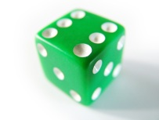
The weak classifier (a summary)
Function f is a straight line
v=mu+c
or
v-mu=c
By definition, a weak classifier should be slightly better than a random choice (probability of correct classification =0.5) . Otherwise, you should use a dice!
In [u,v] space, the decision function f : (v-mu)=c is a straight line defined by m,c.
v
Gradient m
v-mu>c
c
v-mu<c
(0,0)
u

Slide 11
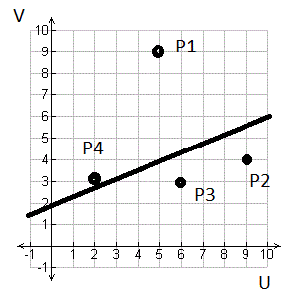
Example 2 :
Find the equation of the line :v=mu+c
Answer: c=2, m=(6-2)/10=0.4, So v=0.4u+2
Assume polarity Pt=1, classify P1,2,3,4.
P1(u=5,v=9)
Answer: V-mu=9-0.4*5=7, since c=2, so v-mu>c, so it is class: -1
P2(u=9,v=4):
Answer: V-mu=4-0.4*9=0.4, since c=2, so v-mu<c, so it is class:+1
P3 (u=6,v=3):
P4(u=2,v=3):
Repeat using P_{t}= -1
Assume Polarity P_{t} is 1
v=mu+c
or
v-mu=c
Class -1:
V-mu>c
6-2
Class +1:
V-mu<c
(0,0)
10

Slide 12
Answer for exercise 2
P3(u=6,v=3):
V-mu=3-0.4*6=0.6, since c=2, so v-mu<c, so it is class +1
P4(u=2,v=3):
V-mu=3-0.4*2=2.2, since c=2, so v-mu>c, so it is class -1

Slide 13
Learn what is h( ), a weak classifier. Decision stump
Decision stump definition
A decision stump is a machine learning model consisting of a one-level decision tree.[1] That is, it is a decision tree with one internal node (the root) which is immediately connected to the terminal nodes. A decision stump makes a prediction based on the value of just a single input feature. Sometimes they are also called 1-rules.[2]
From http://en.wikipedia.org/wiki/Decision_stump
Example
Temperature T
T<=10ºc 10ºc<T<28ºc T>=28⁰c
Cold mild hot

Slide 14
A weak learner (classifier ) is a decision stump
Define weak learners based on rectangle features
The function f_{t}(x) of a decision-line in space
θ_{t} =threshold
p_{t}= polarity{+1,-1}
Select which side separated by the line you prefer
-1 region
Decision
line
+1 region
Notes:
14

Slide 15
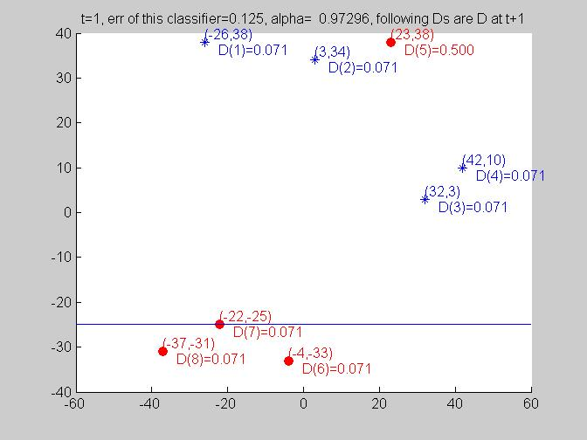
Weak classifier we use here: Axis parallel weak classifier
In order to simplify the derivation, we will use the simple “axis parallel weak classifier”. E.g., when m=0 for v=mu+c, hence v=c; (v=input, c=constant)
It assumes gradient (m) of the decision line is =0(horizontal) or ∞(vertical).
The decision line is parallel to either the horizontal or vertical axis.
If polarity p_{t}=1, this region is -1
If polarity p_{t}=-1, this region is +1
h_{t}(x)
v₀
If polarity p_{t}=+1, this region is +1
If polarity p_{t}=-1, this region is -1

Slide 16
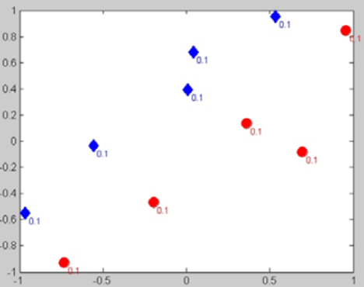
An example to show how Adaboost works
v-axis
[xi={-0.48,0},yi=’+’]
Training,
Present ten samples to the system :[xi={ui,vi},yi={’+’ or ‘-’}]
5 +ve (blue, diamond) samples
5 –ve (red, circle) samples
Train up the system
Detection
Give an input xj=(1.5,3.4)
The system will tell you it is ‘+’ or ‘-’. E.g. Face or non-face
Example:
Example1: u=weight, v=height
Classification: suitability to be a boxer.
Example2: u=rainfall, v=wind speed
Classification: landslide will occur
u-axis
[xi={-0.2,-0.5},yi=’+’]

Slide 17
Adaboost concept
Training data
6 squares,
5 circles.
Use this training data, how to make a classifier
Objective: Train a classifier to classify an unknown input to see if it is a circle or a square.
h3( )
h1( )
h2 ( )
The solution is a
H_complex( )
Only one axis-parallel weak classifier cannot achieve 100% classification. For the above example, h1() or h2() or h3() alone will fail. That means no matter how you place the decision line (horizontally or vertically) you cannot get 100% classification result.
You may try it yourself!
The above strong classifier should work, but how can we find it?
ANSWER:
Combine many weak classifiers to achieve it.

Slide 18
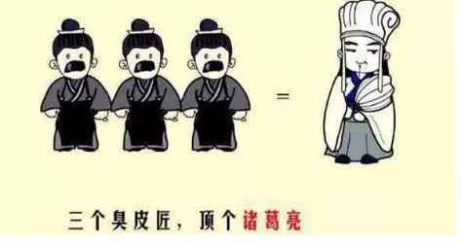
Main ideal of ensemble methods such as Adaboost
Integrate many weak classifiers to become a strong classier.
English idiom: Two heads are better than one.
https://kknews.cc/zh-hk/history/pk9g6g2.html

Slide 19
How? Each classifier may not be perfect, but each can achieve over 50% correct rate.
h_{t=1}( ) h_{t=2}( ) h_{t=3}( ) h_{t=4}( ) h_{t=5}( ) h_{t=6}( ) h_{t=7}( )
Classification
Result
Combine weak classifiers
to form the
Final strong classifier
Main steps: Find
Weak classifiers h()_{t=1,2,3,..,T}
Weights or confidents values α_{t=1,2,3,..,T}

Slide 20
The Adaboost algorithm N=samples, D=dimension
Initialization: Treat all samples equal weight
Loop t=1 to T {
From samples, find the best weak classifier that has the smallest error h_{t}() . The search space of h() is D*2*N-1 (will explain later)
Find weight(confident value α_{t}) for h_{t}()
Readjust weight for each sample for t+1 based on:
Correctly classified by h_{t}() will decrease weight
Incorrectly classified by h_{t}() will increase weight
Stop if all (or most) samples are correctly classified by the strong classifier H(x) at by setting T= current t.
}
What is sign()?
Answer: check the sign of the number, examples:
Sign(+0.123)=sign(10000056)=sign(0.0000000001)= +1
Sign(-1200) = sign(-0.000001)=sign(-12345000000)= -1
The absolute values are irrelevant.

Slide 21
THE ADABOOST ALGORITHM (will explain this algorithm in the following slides)
Initialization
Main
Training
loop
The final strong classifier

Slide 22
Overview: Initialization

Slide 23
Overview: D_{t}(i) =weight
D_{t}(i) = probability distribution of the i-th training sample at time t . i=1,2…n.
It shows how much you trust this sample.
At t=1, all samples are the same with equal weight. D_{t=1}(all i) are the same
At t >1 , D_{t>1}(i) will be modified, we will see later.

Slide 24
Overview: Main loop (step1,2,3) t is the index for the weak classifier at stage t, T is the number of weak classifiers (NWC) needed
Z_{t} = normalization factor, it will be discussed later

Slide 25
Overview: Main Loop Step 4 (updated)
Step 4 in English:
If all training samples x_{i=1,..,all} are correctly classified by H(),then stop the training

Slide 26
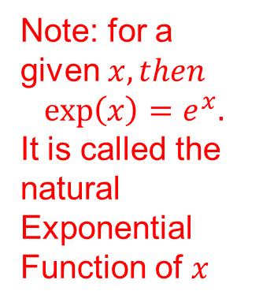
Note: To find Normalization factor Z_{t} in step3
AdaBoost chooses this weight_update function deliberately
Because the idea is,
when a training sample is correctly classified, weight decreases
when a training sample is incorrectly classified, weight increases
Note: for a given $x, then$
$${\exp\left(x\right)=e}^{x}.$$
It is called the natural
Exponential
Function of $x$

Slide 27
An example to show how Adaboost works
v-axis
[xi={-0.48,0},yi=’+’]
Training,
Present ten samples to the system :[xi={ui,vi},yi={’+’ or ‘-’}]
5 +ve (blue, diamond) samples
5 –ve (red, circle) samples
Train up the classification system.
Detection example:
Give an input xj=(1.5,3.4)
The system will tell you it is ‘+’ or ‘-’. E.g. Face or non-face.
Example:
You may treat u=skills, v=height
Classification task: suitability to play in a school basketball team.
u-axis
[xi={-0.2,-0.5},yi=’+’]

Slide 28
Initialization
M=5 +ve (blue, diamond) samples
L=5 –ve (red, circle) samples
n=M+L=10 (usually make M≈N)
Initialize weight D_{(t=1)}(i)= 1/10 for all i=1,2,..,10,
So, D₍₁₎(1)=0.1, D₍₁₎ (2)=0.1,……, D₍₁₎(10)=0.1

Slide 29
Main training loop
Step 1a, 1b

Slide 30
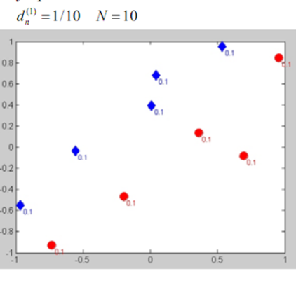
Select h( ): For simplicity in implementation we use the axis-parallel weak classifier
h_{b}(x)
v₀
h_{a} (x)
u₀

Slide 31
Step1a, 1b
Incorrectly classified by h_{q}()
Assume h() can only be horizontal or vertical separators. (axis-parallel weak classifier)
There are still many ways to set h(), here, for example, if this h_{q}() is selected, there will be 3 incorrectly classified training samples (errors).
See the 3 circled training samples
We can go through all h( )s and select the best with least misclassification (see the following 2 slides)
h_{q}()

Slide 32
Example :Training example slides from [Smyth ] classifier the ten red (circle)/blue (diamond) dots Step 1a:
There are 9x2 choices here,
h_{i=1,2,3,..9,} (polarity +1)
h’_{i=1,2,3,..9,} (polarity -1)
h_{i=1}(x) ………….. h_{i=4}(x) ……………… h_{i=9}(x)
You may choose
one of the following axis-parallel (vertical line) classifiers
v-axis
u1 u2 u3 u4 u5 u6 u7 u8 u9
Initialize:
D_{n}^{(t=1)}=1/10
u-axis
E.g. Vertical Dotted lines are possible choices

Slide 33
Example :Training example slides from [Smyth 2007] classifier the ten red (circle)/blue (diamond) dots Step 1a:
For parallel-axis weak classifiers, if you have N (+ve and –ve) training samples, you will have (N-1)x4
There are 9x2 choices here,
h_{j=1,2,3,..9,} (polarity +1)
h’_{j=1,2,3,..9,} (polarity -1)
Altogether including the previous slide, there are 36 choices
h_{j=1}(x)
h_{j=2}(x)
:
h_{j=4}(x)
:
:
:
:
:
h_{j=9}(x)
v1
v2
v3
V4
V5
V6
V7
V8
v9
You may choose
one of the following axis-parallel (horizontal lines) classifiers
v-axis
u-axis
Initialize:
D_{n}^{(t=1)}=1/10
E.g. Horizontal dotted lines are possible choices

Slide 34
Step 1b: Find and check the error of the weak classifier h( )
To evaluate how successful is your selected weak classifier h( ), we can evaluate the error rate of the weak classifier
For parallel-axis weak classifiers, if you have N (+ve and –ve) training samples, you will have (N-1)x4 (Proof that!)
ɛ_{t} = Misclassification probability of h( )
Checking: If ε_{t}>= 0.5 (something wrong), stop the training
Because, by definition, a weak classifier should be slightly better than a random choice, i.e. probability =0.5
So if ε_{t} >= 0.5 , your h( ) is a bad choice, redesign another h”( ) and do the training based on the new h”( ).

Slide 35
Exercise 3 for Step1a,1b
Assume h() can only be horizontal or vertical separators.
How many different classifiers are available?
If h_{j}() is selected as shown, circle the misclassified training samples. Find ɛ( ) to see misclassification probability if the probability distribution (D) for each sample is the same.
Find h() with minimum error.
h_{j}(): below the line are squares, above are circles)

Slide 36
Answer 3 : Example B for Step1a,1b
Assume h() can only be horizontal or vertical separators.
How many different classifiers are available?
Answer: because there are 12 training samples, we will have 11x2 vertical + 11x2 horizontal classifies. so the total is (11x2+11x2)=44. (updated)
If h_{j}() is selected as shown, circle the misclassified training samples. Find ɛ( ) to see misclassification probability if the probability distribution (D) for each sample is the same.
Answer=(1/12), 4 misclassified (circled) samples. ɛ=4*(1/12)
Find h() with minimum error. Answer:
?? Repeat above and find ɛ_{j}( ) for each of the h_{j=1,,..44}(), compare ɛ_{j}( ) and find the smallest ɛ_{j}( ). Then this indicates the best h_{j}()
h_{j}(): below the line are squares, above are circles)

Slide 37
Weak classifiers required
D=Dimension on of the problem
N=Number of total training samples
M=Number of weak classifier required
=D*2*(N-1). The ‘2’ is for +ve and –ve choices
Explain why?
Question: If the problem is three dimension, and the number of total training samples (positive +ve plus negative –ve samples) is 20, Calculate M.
Answer: M=3*2*(20-1)=114, explain the answer

Slide 38
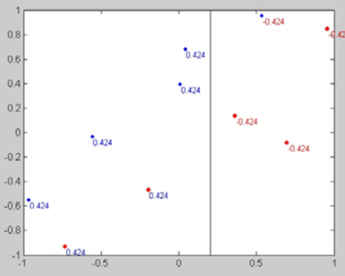
Result of step2 at t=1
Incorrectly classified by h_{t=1}(x)
h_{t=1}(x)

Slide 39
Step2 at t=1 (refer to the previous slide)
Using ε_{t=1}=0.3, because 3 samples are incorrectly classified
The proof can be found at http://vision.ucsd.edu/~bbabenko/data/boosting_note.pdf
Also see appendix.

Slide 40

Step3 at t=1, update D_{t} to D_{t+1}
Update the weight D_{t}(i) for each training sample i
Update rule:
${ D}_{t+1}\left(i\right)$∝ $D_{t}(i)\exp{(}−α_{t}y_{i}h_{t}(x_{i}))$,
∝=proportional, hence
$$Step3:D_{t+1}(i)=\frac{D_{t}(i)\exp{(}−α_{t}y_{i}h_{t}(x_{i}))}{Z_{t}} \\ \text{where} Z_{t}=\text{normalization} \text{factor}\text{, } \\ \text{so} D_{t} \text{is} \text{a} \text{distribution} (\text{prob}\text{. }\text{function}) \\ \text{Note}\text{:}$$
$$y_{i}h_{t}(x_{i})=1\text{ :} \text{If} \text{the} \text{classification} \text{of} \text{h}\text{t}\text{( )} \text{is} \text{correct} \\ y_{i}h_{t}(x_{i})=−1:\text{If} \text{the} \text{classification} \text{of}\text{h}\text{t}\text{( )} \text{is} \text{incorrect}$$
The proof can be found at http://vision.ucsd.edu/~bbabenko/data/boosting_note.pdf
Also see appendix.

Slide 41
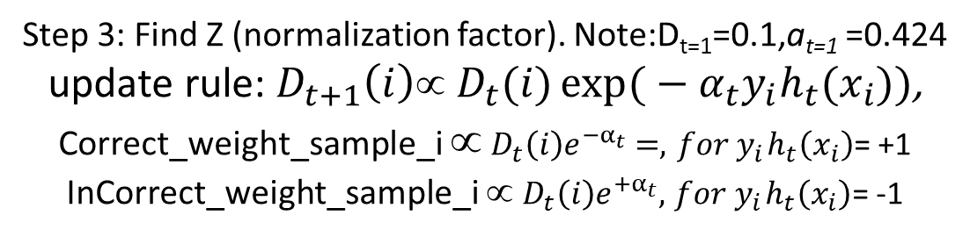

Step 3: Find Z (normalization factor). Note:D_{t=1}=0.1,a_{t=1} =0.424 update rule: $D_{t+1}\left(i\right)$∝ $D_{t}(i)\exp{(}−α_{t}y_{i}h_{t}(x_{i}))$, Correct_weight_sample_i ∝ $D_{t}\left(i\right)e^{−α_{t}}=,{ for y}_{i}h_{t}\left(x_{i}\right)$= +1 InCorrect_weight_sample_i ∝ $D_{t}\left(i\right)e^{+α_{t}},{ for y}_{i}h_{t}\left(x_{i}\right)\text{=}\text{ -}\text{1}$
$$D_{t=1}=0.1,α_{t=1}=0.424 \\ \text{7 }\text{correct} \text{and}\text{ 3 }\text{incorrect} \text{samples}\text{, }=1 \\ Z_{t}=\sum_{y_{i}=h_{i}(x_{i})}{correct_weight+\sum_{yi≠h_{i}(x_{i})}{incorrect_weight}} \\ Z_{t}=\sum_{y_{i}=h_{i}(x_{i})}{D_{t}(i)e^{−α_{t}y_{i}h_{t}(x_{i})}}+\sum_{yi≠h_{i}(x_{i})}{D_{t}(i)e^{−α_{t}y_{i}h_{t}(x_{i})}}−−−−(i) \\ \text{correctly} \text{classified}:y_{i}=h_{i}(x_{i}),\text{so} y_{i}h_{i}(x_{i})=+1,\text{put} \text{it} \text{in} (i) \\ \text{incorrectly} \text{classified}:y_{i}≠h_{i}(x_{i}),\text{so} y_{i}h_{i}(x_{i})=−1,\text{put} \text{it} \text{in} (i) \\ Z_{t}=\sum_{y_{i}=h_{i}(x_{i})}{D_{t}(i)e^{−α_{t}(+1)}}+\sum_{yi≠h_{i}(x_{i})}{D_{t}(i)e^{−α_{t}(−1)}}=\sum_{y_{i}=h_{i}(x_{i})}{D_{t}(i)e^{−α_{t}}}+\sum_{yi≠h_{i}(x_{i})}{D_{t}(i)e^{α_{t}}} \\ (total_correct_weight)+(total_incorrect_weight) \\ =0.1∗7∗e^{−0.424}+0.1∗3∗e^{+0.424}=0.1∗7∗0.65+0.1∗3∗1.52 \\ =0.455+0.456 \\ Z_{t=1}=0.911$$
Note: currently t=1, D_{t=1}(i)=0.1 for all i
7 correctly classified
3 incorrectly classified

Slide 42
Step 3: Example: update D_{t} to D_{t+1} If correctly classified, weight D_{t+1} will decrease, and vice versa.

Slide 43
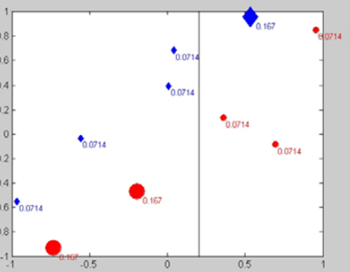
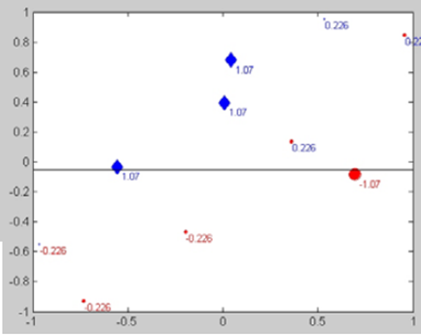
Now run the main training loop the second time(t=2)

Slide 44
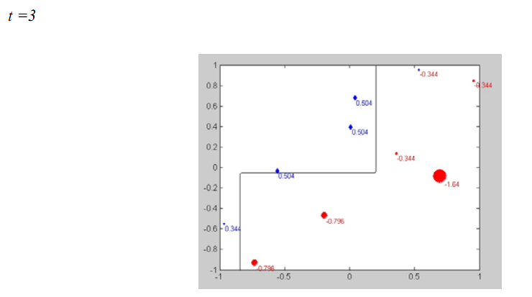
Now run the main training loop second time t=2, and then t=3
Final classifier by combining three weak classifiers

Slide 45
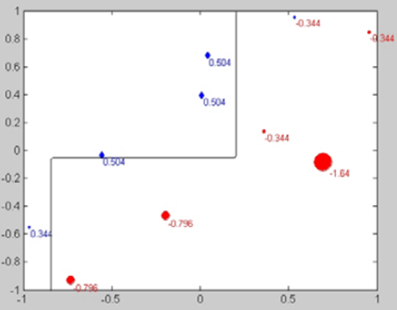
Combined classifier for t=1,2,3 Exercise: work out α₁and α₂
Define sign(y)
e.g.
sign(-0.42) = -1
sign(-272) = -1
sign(123.2) = +1
h_{t=1}()
h_{t=2}()
h_{t=3}()
α_{t=1}=0.424
α_{t=2}
α_{t=3}
Combine to form the
classifier.
May need one more step for the final classifier

Slide 46
Exercise 4
if example ==1
blue(*)=[
-26 38
3 34
32 3
42 10];
red(O)=[
23 38
-4 -33
-22 -25
-37 -31];
datafeatures=[blue;red];
dataclass=[ -1 -1 -1 -1 1 1 1 1 ];
See
%Red = +1, Blue= -1
http://www.mathworks.com/matlabcentral/fileexchange/27813-classic-adaboost-classifier

Slide 47
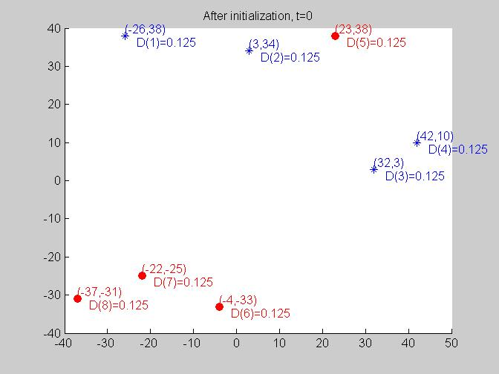
Answer-4 , initialized, t=1 Find the best h() by inspection What is D(i) for all i=1 to 8?
Red = +1,
Blue= -1

Slide 48
Answer-4, t=1 h1(upper half =*, lower= o)
Weak classifier h1(upper half =*, lower= o) We see that Feature(5) is wrongly classified, 1 sample is wrong
err =ε(t)=D(t)*1,
ε(t) =0.125
Alpha=α=0.5*log[1- ε(t) )/ ε(t)]
=0.973
Find next D(t+1) =D(t)*exp(α*(h(x)≠y)
I.e. Incorrect=D_{t+1}(i)=D_{t}(i)*exp(α)
D(5)=0.125*exp(0.973)
=0.3307 (not normalized yet)
Correct=D_{t+1}(i)=D_{t}(i)*exp(-α)
D(1)=0.125*exp(-0.973)=0.0472 (not normalized yet)
------------
Z=(7*0.0472+0.3307)=0.6611
After normalization, D at t+1
D(5)=0.3307 / Z=0.5002
D(1)=D(2)..etc =0.0472 / Z=0.0714
Work out the rest:
For h(t=1), this area is blue :-1
h1( )
Red = +1
Blue= -1
For h(t=1), this area is red :+1

Slide 49
Answer-4, Result at t=1, α_{(t=1)}=0.973
Use Step4 of the AdaBoost algo.
To find CE_{t}
##display result t_step=1 ## O_=cascaded_sum, S_=sign(O_),Y=train_class,CE=classification error##
t= 1,i= 1, err =0.13,alpha=0.97,D=0.07,dc=-1,ec(i)=-1,correct= 1,oe=0.13
t= 1,i= 2, err =0.13,alpha=0.97,D=0.07,dc=-1,ec(i)=-1,correct= 1,oe=0.13
t= 1,i= 3, err =0.13,alpha=0.97,D=0.07,dc=-1,ec(i)=-1,correct= 1,oe=0.13
t= 1,i= 4, err =0.13,alpha=0.97,D=0.07,dc=-1,ec(i)=-1,correct= 1,oe=0.13
t= 1,i= 5, err =0.13,alpha=0.97,D=0.50,dc= 1,ec(i)=-1,correct=-1,oe=0.13 (incorrect)
t= 1,i= 6, err =0.13,alpha=0.97,D=0.07,dc= 1,ec(i)= 1,correct= 1,oe=0.13
t= 1,i= 7, err =0.13,alpha=0.97,D=0.07,dc= 1,ec(i)= 1,correct= 1,oe=0.13
t= 1,i= 8, err =0.13,alpha=0.97,D=0.07,dc= 1,ec(i)= 1,correct= 1,oe=0.13>weak classifier specifications:
-dimension: 1=vertical :direction:1=(left="blue_*", right="red_O"); -1=(reverse direction of 1)
-dimension: 2=horizontal:direction:1=(up="red_O", down="blue_*"); -1=(reverse direction of 1)
>#-new weak classifier at stage(1):dimension=2,threshold=-25.00;direction=-1
>Sum of Cascaded (Strong) classifier H(x) error up to stage(t=1)for(N=8 training samples)
=error /N=[sum(correct== -1)/N]= 0.125

Slide 50
Answer-4, Result at t=1, α_{(t=1)}=0.973
Use Step4 of the AdaBoost algo.
To find CE_{t}
h(t=1,xi=1)= -1 , true class =-1
h(t=1,xi=2)= -1, true class = -1
h(t=1,xi=3)= -1, true class = -1
h(t=1,xi=4)= -1, true class = -1
h(t=1,xi=5)= -1, true class = 1 (incorrect)
h(t=1,xi=6)= 1, true class = 1
h(t=1,xi=7)= 1, true class = 1
h(t=1,xi=8)= 1, true class = 1
Incorrect classified by h(t=1)
For h(t=1), this area is blue :-1
Assume the red dot is under
h(t=1)
h(t=1)
Red = +1
Blue= -1
For h(t=1), this area is red :+1

Slide 51
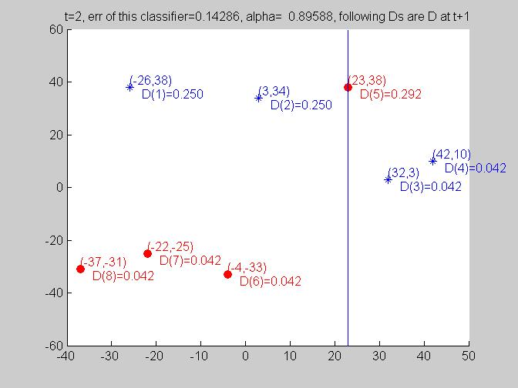
Answer-4, t=2, α_{(t=2)}=0.8961
Weak classifier h1(left =o, eight= *) :Feature(1),(2) are wrongly classified, 2 samples are wrong.
err =ε(t)=D_{t}(1)+D_{t}(2)=0.0714+0.0714=
ε(t) =0.1428
Alpha=α=0.5*log[1- ε(t) )/ ε(t)]=0.8961
Find next D(t+1) =D(t)*exp(α*(h(x)≠y), ie.
Incorrect=D_{t+1}(i)=D_{t}(i)*exp( α)
D(1)=D(2)=0.0714*exp(0.8961)
=0.1749 (not normalized yet)
correct=D_{t+1}(i)=D_{t}(i)*exp(-α)
D(7)=D(6)=D(3)D=(4)=D(8)=0.071*exp(-0.8961)=0.029
Same for sample (7)(6)(3,)(4), but
D(5)=0.5*exp(-0.8961)=0.2041
Z=(2*0.1749 +5*0.029+0.2041)=0.6989
After normalization
D at t+1, D(1)=D(2) = 0.1749 /0.6989=0.2503
D(5)= 0.2041 /0.6989=0.292
D(8)= 0.029 / 0.6989=0.0415
Incorrectly classifier
By weak h(t=2)
h(t=2)
For h(t=2), this side is red= 1
This side
is blue -1

Slide 52
Answer-4, t=2, α_{(t=2)}=0.8961
%%%%%%%%%%%%%%%%%%%%%
h(t=2,xi=1)=1 , true class =-1 (incorrect)
h(t=2,xi=2)=1, true class =-1 (incorrect)
h(t=2,xi=3)=-1, true class =-1
h(t=2,xi=4)=-1, true class =-1
h(t=2,xi=5)=1, true class =1
h(t=2,xi=6)=1, true class =1
h(t=2,xi=7)=1, true class =1
h(t=2,xi=8)=1, true class =1
Assume the red dot is on the left side of h(t=2)
Incorrectly classifier
By weak h(t=2)
Red = +1,
Blue= -1
h(t=2)
For h(t=2), this side is red= 1
This side
is blue -1

Slide 53
Answer-4, Result at t=2
Use Step4 of the AdaBoost algo.
To find CE_{t}
Check with H(xi) for each sample
Xi, and
CE =sum(| (Yi_{class}-H(xi)) |)/N
Since CE is non-zero, so
Adaboost will run again to
search for another h_{(t=3)}
##display result t_step=2 ## O_=cascaded_sum, S_=sign(O_),Y=train_class,CE=classification error##
t= 2,i= 1, err =0.14,alpha=0.90,D=0.25,dc=-1,ec(i)= 1,correct=-1,oe=0.13 (incorrect)
t= 2,i= 2, err =0.14,alpha=0.90,D=0.25,dc=-1,ec(i)= 1,correct=-1,oe=0.13 (incorrect)
t= 2,i= 3, err =0.14,alpha=0.90,D=0.04,dc=-1,ec(i)=-1,correct= 1,oe=0.13
t= 2,i= 4, err =0.14,alpha=0.90,D=0.04,dc=-1,ec(i)=-1,correct= 1,oe=0.13
t= 2,i= 5, err =0.14,alpha=0.90,D=0.29,dc= 1,ec(i)= 1,correct= 1,oe=0.13
t= 2,i= 6, err =0.14,alpha=0.90,D=0.04,dc= 1,ec(i)= 1,correct= 1,oe=0.13
t= 2,i= 7, err =0.14,alpha=0.90,D=0.04,dc= 1,ec(i)= 1,correct= 1,oe=0.13
t= 2,i= 8, err =0.14,alpha=0.90,D=0.04,dc= 1,ec(i)= 1,correct= 1,oe=0.13
data_class=dc, estimated_class=ec, overall_error=oe
-dimension: 1=vertical :direction:1=(left="blue_*", right="red_O"); -1=(reverse direction of 1)
-dimension: 2=horizontal:direction:1=(up="red_O", down="blue_*"); -1=(reverse direction of 1)
>#-new weak classifier at stage(2):dimension=1,threshold=23.00;direction=-1
>Sum of Cascaded (strong) classifier H(x) error up to stage(t=2)for(N=8 training samples) =error/N=[sum(correct == -1)/N]= 2/8=0.25
Example for >i=1

Slide 54
Analysis of strong classifier H(t=2,x)
h(t=1,xi=1)= -1 , true class =-1
h(t=1,xi=2)= -1, true class = -1
h(t=1,xi=3)= -1, true class = -1
h(t=1,xi=4)= -1, true class = -1
h(t=1,xi=5)= -1, true class = 1 (incorrect)
h(t=1,xi=6)= 1, true class = 1
h(t=1,xi=7)= 1, true class = 1
h(t=1,xi=8)= 1, true class = 1
% For the Strong classifier H(x), weak h(x) classifiers’ correctness is not important any more
h(t=2,xi=1)=1 , true class =-1 (incorrect)
h(t=2,xi=2)=1, true class =-1 (incorrect)
h(t=2,xi=3)=-1, true class =-1
h(t=2,xi=4)=-1, true class =-1
h(t=2,xi=5)=1, true class =1
h(t=2,xi=6)=1, true class =1
h(t=2,xi=7)=1, true class =1
h(t=2,xi=8)=1, true class =1
H(t=2,xi) =sign{ a1*h1(xi)+ a2*h2(xi) }, recall earlier : a1= 0.973,a2= 0.8961
Now Test each xi,
H(xi=1)= sign(0.973*h(t=1,xi+0.896*h(t=2,xi))=sign(0.973*-1+0.896*1)=-1, true class =-1, (correct)
H(xi=2)= sign(0.973*h(t=1,xi+0.896*h(t=2,xi))=sign(0.973*-1+0.896*1)=-1, true class =-1, (correct)
H(xi=3)= sign(0.973*h(t=1,xi+0.896*h(t=2,xi))=sign(0.973*-1+0.896*-1)=-1, true class =-1, (correct)
H(xi=4)= sign(0.973*h(t=1,xi+0.896*h(t=2,xi))=sign(0.973*-1+0.896*-1)=-1, true class =-1, (correct)
H(xi=5)= sign(0.973*h(t=1,xi+0.896*h(t=2,xi))=sign(0.973*-1+0.896*1)=-1, true class =1, (incorrect)
H(xi=6)= sign(0.973*h(t=1,xi+0.896*h(t=2,xi))=sign(0.973*1+0.896*1)=1, true class =-1, (correct)
H(xi=7)= sign(0.973*h(t=1,xi+0.896*h(t=2,xi))=sign(0.973*1+0.896*1)=1, true class =-1, (correct)
H(xi=8)= sign(0.973*h(t=1,xi+0.896*h(t=2,xi))=sign(0.973*1+0.896*1)=1, true class =-1, (correct)
The overall error for the strong (cascade) classifer is total error/N=1/8=0.125, still need another h(t=3)

Slide 55
Answer-4, Result at t=3,
Check with H(xi) for each sample
xi, and
CE =sum(| (Yi_{class}-H(xi)) |)/N
If CE=0, Adaboost will stop
No need to find more classifiers
So in this example
T=3 is final, no t-4 or more
Use Step4 of the AdaBoost algo.
To find CE_{t}
##display result t_step=2 ## O_=cascaded_sum, S_=sign(O_),Y=train_class,CE=classification error##
t= 3,i= 1, err =0.21,alpha=0.67,D=0.16,dc=-1,ec(i)=-1,correct= 1,oe=0.00
t= 3,i= 2, err =0.21,alpha=0.67,D=0.16,dc=-1,ec(i)=-1,correct= 1,oe=0.00
t= 3,i= 3, err =0.21,alpha=0.67,D=0.10,dc=-1,ec(i)= 1,correct=-1,oe=0.00 (incorrect)
t= 3,i= 4, err =0.21,alpha=0.67,D=0.10,dc=-1,ec(i)= 1,correct=-1,oe=0.00 (incorrect)
t= 3,i= 5, err =0.21,alpha=0.67,D=0.18,dc= 1,ec(i)= 1,correct= 1,oe=0.00
t= 3,i= 6, err =0.21,alpha=0.67,D=0.10,dc= 1,ec(i)=-1,correct=-1,oe=0.00 (incorrect)
t= 3,i= 7, err =0.21,alpha=0.67,D=0.10,dc= 1,ec(i)=-1,correct=-1,oe=0.00 (incorrect)
t= 3,i= 8, err =0.21,alpha=0.67,D=0.10,dc= 1,ec(i)=-1,correct=-1,oe=0.00 (incorrect)
data_class=dc, estimated_class=ec, overall_error=oe
>weak classifier specifications:
-dimension: 1=vertical :direction:1=(left="blue_*", right="red_O"); -1=(reverse direction of 1)
-dimension: 2=horizontal:direction:1=(up="red_O", down="blue_*"); -1=(reverse direction of 1)
>#-new weak classifier at stage(3):dimension=1,threshold=3.00;direction=1
>Cascaded classifier error up to stage(t=3)for(N=8 training samples) =[sum(CE_)/N]= 0.000

Slide 56
Update from D(t=2) to D(t=3), select h(t=3) Find error, then find a3= 0.6625
Error(e ) of h(t=3), e = 3*0.0415+2*0.0415
a3=0.5*log( (1-e)/e)=0.6625
Not normalized weights
D(t=3,i=1)=D(t=2,i=1)*exp(a2)=0.25*exp(-0.6625)=0.1289
D(t=3,i=2)=D(t=2,i=2)*exp(a2)= 0.25*exp(-0.6625)=0.1289
D(t=3,i=3)=D(t=2,i=3)*exp(-a2)=0.042*exp(0.6625)=0.0815
D(t=3,i=4)=D(t=2,i=4)*exp(-a2)= 0.042*exp(0.6625)=0.0815
D(t=3,i=5)=D(t=2,i=5)*exp(-a2)=0.292*exp(-0.6625)=0.1506
D(t=3,i=6)=D(t=2,i=6)*exp(-a2)= 0.042*exp(0.6625)=0.0815
D(t=3,i=7)=D(t=2,i=7)*exp(-a2)= 0.042*exp(0.6625)=0.0815
D(t=3,i=8)=D(t=2,i=8)*exp(-a2)= 0.042*exp(0.6625)=0.0815 Normalize weights
Z=0.1289*2+0.0815*5+0.1506=0.8159
D(t=3,i=1) =0.1289/0.0.8159=0.158
D(t=3,i=2) =0.1289/0.0.8159=0.158
D(t=3,i=3)= 0.0815/0.0.8159=0.1
D(t=3,i=4)= 0.0815/0.0.8159=0.1
D(t=3,i=5)= 0.1506/0.08159=1.8458
D(t=3,i=6)= 0.0815/0.8159=0.1
D(t=3,i=7)= 0.0815/0.8159=0.1
D(t=3,i=8)= 0.0815/0.8159=0.1
incorrect
incorrect
h(t=3)
Fro h(t=3)
This side
is blue -1
For h(t=3), this side is red= 1
56

Slide 57

Answer-4, Result at t=3,
Check with H(xi) for each sample
xi, and
CE =sum(| (Yi_{class}-H(xi)) |)/N
If CE=0, Adaboost will stop
No need to find more classifiers
So in this example
T=3 is final, no t-4 or more
Use Step4 of the AdaBoost algo.
To find CE_{t}
##display result t_step=3 ## O_=cascaded_sum, S_=sign(O_),Y=train_class,CE=classification error##
>i=1, a1*h1(xi)=-0.973, a2*h2(xi)=0.896, a3*h3(xi)=-0.668, O_=-0.745, S_=-1.000, Y_=-1, CE_=0
>i=2, a1*h1(xi)=-0.973, a2*h2(xi)=0.896, a3*h3(xi)=-0.668, O_=-0.745, S_=-1.000, Y_=-1, CE_=0
>i=3, a1*h1(xi)=-0.973, a2*h2(xi)=-0.896, a3*h3(xi)=0.668, O_=-1.201, S_=-1.000, Y_=-1, CE_=0
>i=4, a1*h1(xi)=-0.973, a2*h2(xi)=-0.896, a3*h3(xi)=0.668, O_=-1.201, S_=-1.000, Y_=-1, CE_=0
>i=5, a1*h1(xi)=-0.973, a2*h2(xi)=0.896, a3*h3(xi)=0.668, O_=0.590, S_=1.000, Y_=1, CE_=0
>i=6, a1*h1(xi)=0.973, a2*h2(xi)=0.896, a3*h3(xi)=-0.668, O_=1.201, S_=1.000, Y_=1, CE_=0
>i=7, a1*h1(xi)=0.973, a2*h2(xi)=0.896, a3*h3(xi)=-0.668, O_=1.201, S_=1.000, Y_=1, CE_=0
>i=8, a1*h1(xi)=0.973, a2*h2(xi)=0.896, a3*h3(xi)=-0.668, O_=1.201, S_=1.000, Y_=1, CE_=0
>weak classifier specifications:
-dimension: 1=vertical :direction:1=(left="blue_*", right="red_O"); -1=(reverse direction of 1)
-dimension: 2=horizontal:direction:1=(up="red_O", down="blue_*"); -1=(reverse direction of 1)
>#-new weak classifier at stage(3):dimension=1,threshold=3.00;direction=1
>Cascaded classifier error up to stage(t=3)for(N=8 training samples) =[sum(CE_)/N]= 0.000
$$\text{Resulting} \text{strong} \text{classifier}\text{:} \\ H(x)=sign\left(\sum_{t=1}^{T}{α_{t}h_{t}(x)}\right)$$

Slide 58
Analysis of the strong classifier H(t=3,x)
h(t=3,xi=1)= 1 ,
h(t=3,xi=2)= 1,
h(t=3,xi=3)= -1,
h(t=3,xi=4)= -1 ,
h(t=3,xi=5)= -1 ,
h(t=3,xi=6)= 1 ,
h(t=3,xi=7)= 1 ,
h(t=3,xi=8)= 1 ,
h(t=2,xi=1)=1 ,
h(t=2,xi=2)=1,
h(t=2,xi=3)=-1,
h(t=2,xi=4)=-1,
h(t=2,xi=5)=1,
h(t=2,xi=6)=1,
h(t=2,xi=7)=1,
h(t=2,xi=8)=1,
h(t=1,xi=1)= -1 ,
h(t=1,xi=2)= -1,
h(t=1,xi=3)= -1,
h(t=1,xi=4)= -1,
h(t=1,xi=5)= -1,
h(t=1,xi=6)= 1,
h(t=1,xi=7)= 1,
h(t=1,xi=8)= 1,
% For the Strong classifier H(x), weak h(x) classifiers’ correctness is not important any more
H(t=2,xi) =sign{ a1*h1(xi)+ a2*h2(xi) + a3*h3(xi) }, recall earlier : a1= 0.973,a2= 0.8961, a3=-0.668
Now Test each xi,
H(xi=1)= sign{a1*h1(xi)+ a2*h2(xi) + a3*h3(xi)}=sign(0.973*-1+0.896*1-0.668*1)=-1, true class =-1, (correct)
H(xi=2)= sign{a1*h1(xi)+ a2*h2(xi) + a3*h3(xi)}=sign(0.973*-1+0.896*1-0.668*1)-1=, true class =-1, (correct)
H(xi=3)= sign{a1*h1(xi)+ a2*h2(xi) + a3*h3(xi)}=sign(0.973*-1+0.896*-1-0.668*-1)=-1, true class =-1, (correct)
H(xi=4)= sign{a1*h1(xi)+ a2*h2(xi) + a3*h3(xi)}=sign(0.973*-1+0.896*-1-0.668*-1)=-1, true class =-1, (correct)
H(xi=5)= sign{a1*h1(xi)+ a2*h2(xi) + a3*h3(xi)}=sign(0.973*-1+0.896*1-0.668*-1)=1, true class =-1, (correct)
H(xi=6)= sign{a1*h1(xi)+ a2*h2(xi) + a3*h3(xi)}=sign(0.973*1+0.896*1-0.668*1)=1, true class =-1, (correct)
H(xi=7)= sign{a1*h1(xi)+ a2*h2(xi) + a3*h3(xi)}=sign(0.973*1+0.896*1-0.668*1)=1, true class =-1, (correct)
H(xi=8)= sign{a1*h1(xi)+ a2*h2(xi) + a3*h3(xi)}=sign(0.973*1+0.896*1-0.668*1)=1, true class =-1, (correct)
H(t=3) is all correct for all xi, so adaboost will stop.

Slide 59
Overall result discussion
////////// cycle t=1 ///////////////
sample index = i, num of samples N=8
model(t=1).alpha=0.973
model(t=1).dimension=2.000
Strong (cascade) classifier err=sum_all_i(error_samples_i)/N)=0.125
////////// cycle t=2 ///////////////
sample index = i, num of samples N=8
model(t=2).alpha=0.896
model(t=2).dimension=1.000
Strong (cascade) classifier err=sum_all_i(error_samples_i)/N)=0.125
////////// cycle t=3 ///////////////
sample index = i, num of samples N=8
model(t=3).alpha=0.668
model(t=3).dimension=1.000
Strong (cascade) classifier err=sum_all_i(error_samples_i)/N)=0.000
Since this error =0, so Adaboost stops
For each cycle, after H(x) is calculated up to that time cycle t, say t2
The strong cascade classifier is H(t=2, x) = sign{ alpha(t=1)*h(t=1,x)+alpha(t=2)*h(t=2,x)}
Based on this H(x), You test all xi from i=1,..,N , and see if there is error. In exercise 4, it has 1 error at t=2 (Note: 2 is the number of errors for weak classifier h(t=2), but for H(t=2,x) it has 1 error. You can repeat the calculate yourself, it is not shown in my note here) , so total error/N=1/8=0.125
At t=3, H(t=3,X) , it has no error for all 8 samples. So adaboost stops at=3.

Slide 60
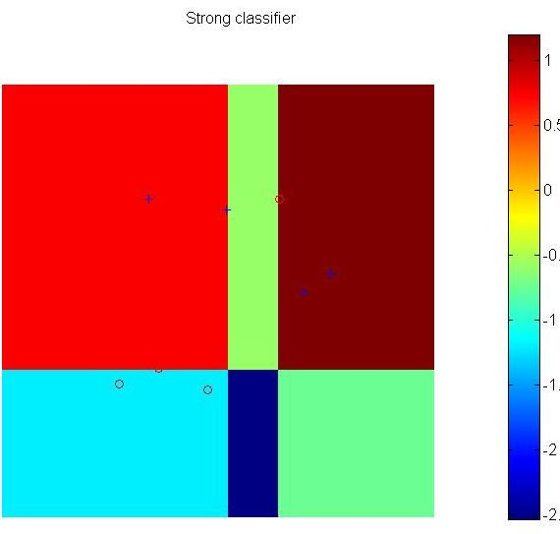
Answer-4, strong classifier
h3
h2
The strong
classifier
h1
h1,h3,h2 are axes-parallel decision lines used by weak classifiers

Slide 61
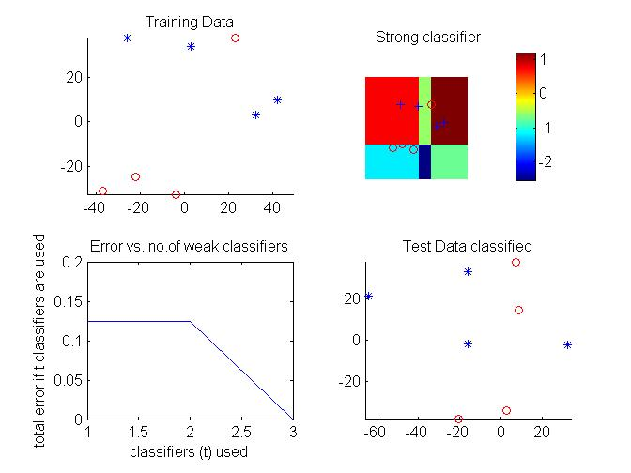
Answer-4 :Test result, example 5.1
CE_{t}
Test data is generated randomly to test the final Adaboost-strong classifier.
Data are classified correctly to ‘*’ or ‘o’
Use Step4 of the AdaBoost algo.
To find CE_{t}

Slide 62
Class exercise 5
Blue=* (star)
Red = (circle)
if example ==2
blue=[ -46 18
-30 -30
-31 -19
-8 15
8 -45
-22 2];
red=[ 33 38
30 10
21 35
1 19
14 23
37 -41];
datafeatures=[blue;red];
dataclass=[ -1 -1 -1 -1 -1 -1 1 1 1 1 1 1 ];

Slide 63
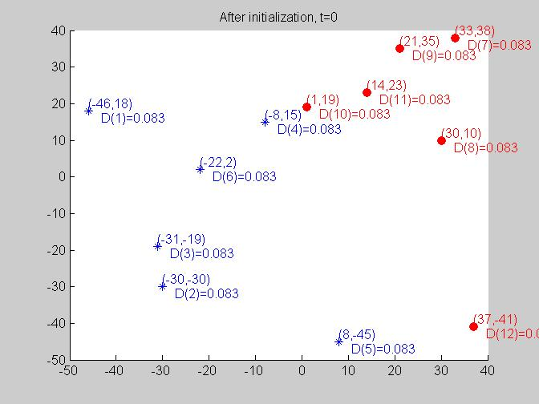
Answer: exercise 5 ,t=0
Blue=* (star)
Red = (circle)

Slide 64
Part B How to evaluate a classification system
in machine learning

Slide 65
Define terms
True Positive (TP)
False Positive (FP)
True Negative (TN)
False Negative (FN)
The first word shows the system is correct or not
True = correct
False = not correct.
The second word shows what the system thinks.
Positive = the system thinks it is positive.
Negative = the system thinks it is negative.

Slide 66
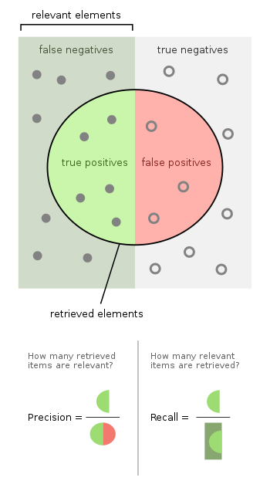
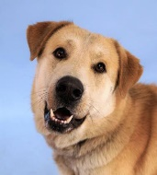

Example
Relevant elements=5+7
Program X reads all pics, recognizes dogs & exclude cats. Positive=dogs, Negative=cats.
The truth is there are 12 dogs (relevant elements filled dots) and 10 cat (unfilled dots)
Program X outputs 8 dogs (selected elements inside the circle) and others are cats.
But the truth is : Inside the retrieved elements (circled) only 5 are dogs, 3 are cats. Thus, True positives [TP] =5, False positives [FP]=3
7 dogs missed(false negatives [FN])=7, these dots represent the system is incorrect, and thinks they are not dogs.
7 cats excluded (true negatives [TN])=7, these dots represent the system is correct, and thinks they are not dogs.
Selected elements= TP+FP = 8
X’s Precision = (true positives [TP]/ selected elements)= TP/(TP+FP)=5/8 = 0.625
X’s Recall= (true positives [TP]/ relevant elements)=TP/(FN+TP)=5/12
FN=7
TN=7
TP=5
FP=3
Retrieved elements=8
Truth:
12 dogs
Truth:
10 cats
https://en.wikipedia.org/wiki/Precision_and_recall
https://www.dataschool.io/simple-guide-to-confusion-matrix-terminology/
Dog :This Photo by Unknown Author is licensed under CC BY
Cat: This Photo by Unknown Author is licensed under CC BY
Recall=
Precision=

Slide 67
How to evaluate classifiers
A summary:
True Positives (TP)
True Negatives (TN)
False Positives (FP)
False Negatives (FN)
Accuracy = (TP+TN)/(TP+TN+FP+FN)
Precision = TP/(TP+FP)
Recall= TP/(TP+FN)
F1 score = 2*(Recall * Precision) / (Recall + Precision)
In program x, for example,
TP =5
FP=3
FN=7
TN=7
Accuracy=(5+7)/(5+3+7+7)=0.545
Precision=5/(5+3)=0.625
Recall=5/(5+7)=0.4166
F1 score=
2*(0.4166* 0.625)/(0.4166+ 0.625)
=0.49995

Slide 68
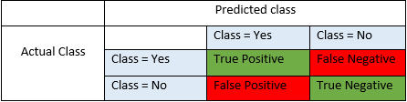
True/False, and Positive/ Negative
Source: https://blog.exsilio.com/all/accuracy-precision-recall-f1-score-interpretation-of-performance-measures/
True positive and true negatives are the observations that are correctly predicted and therefore shown in green. We want to minimize false positives and false negatives so they are shown in red color. These terms are a bit confusing. So let’s take each term one by one and understand it fully.
True Positives (TP) - These are the correctly predicted positive values which means that the value of actual class is yes and the value of predicted class is also yes. E.g. if actual class value indicates that this passenger survived (in an accident) and predicted class tells you the same thing.
True Negatives (TN) - These are the correctly predicted negative values which means that the value of actual class is no and value of predicted class is also no. E.g. if actual class says this passenger did not survive and predicted class tells you the same thing.
False positives and false negatives, these values occur when your actual class contradicts with the predicted class.
False Positives (FP) – When actual class is no and predicted class is yes. E.g. if actual class says this passenger did not survive but predicted class tells you that this passenger will survive.
False Negatives (FN) – When actual class is yes but predicted class in no. E.g. if actual class value indicates that this passenger survived and predicted class tells you that passenger will die.

Slide 69
Accuracy, Precision, Recall and F1 score
Accuracy - Accuracy is the most intuitive performance measure and it is simply a ratio of correctly predicted observation to the total observations.
Accuracy = (TP+TN)/(TP+FP+FN+TN)
Precision - Precision is the ratio of correctly predicted positive observations to the total predicted positive observations.
Precision = TP/(TP+FP)
Recall (Sensitivity) - Recall is the ratio of correctly predicted positive observations to the all observations in actual class - yes. Recall = TP/(TP+FN)
F1 score - F1 Score is the weighted average of Precision and Recall. Therefore, this score takes both false positives and false negatives into account
F1 Score = 2*(Recall * Precision) / (Recall + Precision)
So, whenever you build a model, this article should help you to figure out what these parameters mean and how good your model has performed.

Slide 70
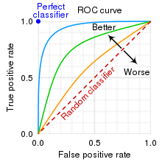
ROC (Receiver operating characteristic) Ref: https://en.wikipedia.org/wiki/Receiver_operating_characteristic
A Receiver Operating Characteristic curve, or ROC curve, is a graphical plot that illustrates the diagnostic ability of a binary classifier system as its discrimination threshold is varied.
We prefer this : high True positive rate and small False positive rate
The ROC space for "better" and "worse" classifiers.

Slide 71
Summary
Learned
What are weak classifiers, strong classifiers
The classification technique Adaboost
Studied Adaboost work examples
How to evaluate a decision support system.

Slide 72
Appendix

Slide 73

Theory
We first make up a measurement function called “Exponential Loss function” to measure the strength of a strong classifier.
Exponential Loss function L (H) =a measurement of the misclassification rate of a strong classifier H .
y_{i}H(x_{i})=+1 ( correctly classified)
y_{i}H(x_{i})=-1 ( incorrectly classified)
A good Strong classifier should have low L(H)
Note: If $y_{i} and H\left(x_{i}\right)$ agree with each other (both have the same sign), the loss= L(H) will be decreased. This is what we want to achieve.

Slide 74
Theory: By definition, the weight update rule is chosen to achieve adaptive boosting
AdaBoost chooses this weight update function deliberately
Because,
when a training sample is correctly classified, weight decreases
when a training sample is incorrectly classified, weight increases
Some other systems may use different weight update formulas but with the same spirit (correctly classified samples will result in decreased weight, and vice versa) .

Slide 75
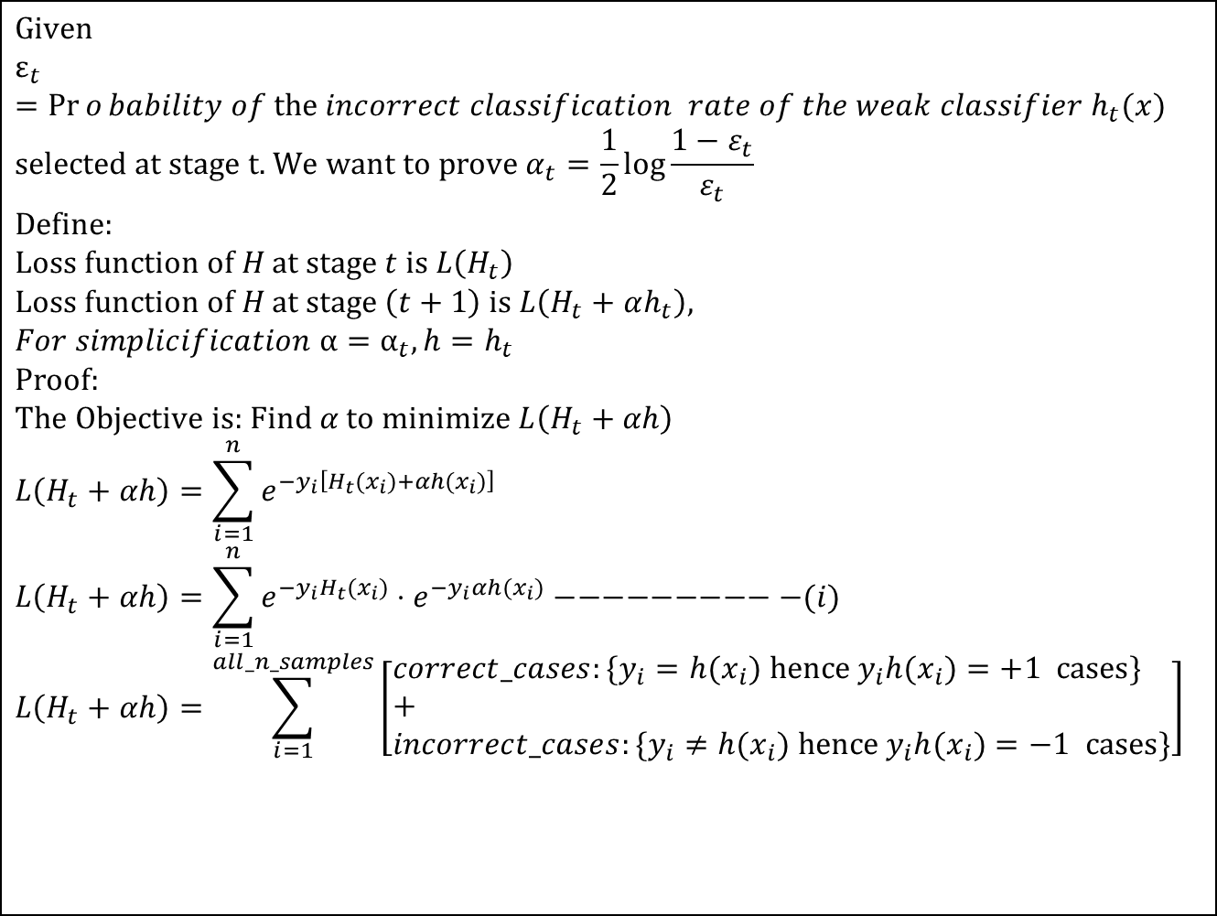
Theory: part1a
$$\text{Given} \\ ε_{t}=\operatorname{Pr}{o}bability of \text{the} incorrect classification rate of the weak classifier h_{t}(x) \\ \text{selected} \text{at} \text{stage} \text{t}\text{. }\text{We} \text{want} \text{to} \text{prove} α_{t}=\frac{1}{2}\log{\frac{1−ε_{t}}{ε_{t}}} \\ \text{Define}\text{: } \\ \text{Loss} \text{function} \text{of} H \text{at} \text{stage} t \text{is} L\left(H_{t}\right) \\ \text{Loss} \text{function} \text{of} H \text{at} \text{stage} \left(t+1\right) \text{is} L\left(H_{t}+αh_{t}\right), \\ For simplicification α=α_{t}, h=h_{t} \\ \text{Proof}\text{:} \\ \text{The} \text{Objective} \text{is}\text{: }\text{Find} α \text{to} \text{minimize} L\left(H_{t}+αh\right) \\ L\left(H_{t}+αh\right)=\sum_{i=1}^{n}{e^{−y_{i}\left[H_{t}(x_{i})+αh(x_{i})\right]}} \\ L\left(H_{t}+αh\right)=\sum_{i=1}^{n}{e^{−y_{i}H_{t}(x_{i})}⋅e^{−y_{i}αh(x_{i})}}−−−−−−−−−−(i) \\ L\left(H_{t}+αh\right)=\sum_{i=1}^{all_n_samples}{\left[\begin{aligned}&correct_cases:\{y_{i}=h(x_{i}) \text{hence} y_{i}h(x_{i})=+1 \text{cases}\} \\ &+ \\ &incorrect_cases:\{y_{i}≠h(x_{i}) \text{hence} y_{i}h(x_{i})=−1 \text{cases}\}\end{aligned}\right]}$$

Slide 76
Theory : part2a

Slide 77
Theory : part3a
This is because of step 3 of previous stage (t-1) and step1b of current stage t

Slide 78
Advanced topic: Viola Jones’ implementation, compared with the original AdaBoost
Also , classes can be {1,0} rather than {1,-1}

Slide 79
Face detection idea
1) in Adaboost use parallel-axis (tree decision) classifier 2) in Viola Jones, the weak classifier is the specially designed classifier described in the paper.

Slide 80
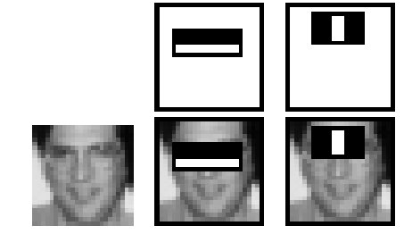
Useful Features Learned by Boosting

Slide 81
A Cascade of Classifiers will be discussed in the next chapter

Slide 82
Reference
[Chen 007] Qing Chen, Nicolas D. Georganas and Emil M. Petriu,” Real-Time Vision-Based Gesture Recognition Using Haar-like Features”, IMTC 2007, Warsaw, Poland, May 1-3, 2007
[smyth 2007] : slides: smyth, “Face Detection using the Viola-Jones Method” slide: http://www.ics.uci.edu/~smyth/courses/cs175/slides12_viola_jones_face_detection.ppt
[Deng 2007 ] slides: Hongbo Deng A brief introduction to adaboost, 6 Feb, 2007, sildes: http://dtpapers.googlecode.com/files/Hongbo.ppt
[Freund ] slides: A tutorial on boosting , A Tutorial on Boosting A Tutorial on Boosting
www.cs.toronto.edu/~hinton/csc321/notes/boosting.pdf
[Hoiem 2004]: sildes: Derek Hoiem, Adaboost , March 31, 2004, http://www.cs.uiuc.edu/~dhoiem/presentations/Adaboost_Tutorial.ppt
[Jensen 2008] Jensen , “Implementing the Viola-Jones Face Detection Algorithm”,
http://orbit.dtu.dk/getResource?recordId=223656&objectId=1&versionId=1
http://informatik.unibas.ch/lehre/ws05/cs232/_Folien/08_AdaBoost.pdf
[Boris Babenko]: Boris Babenko , “Note: A Derivation of Discrete AdaBoost”, Department of Computer Science and Engineering,University of California, San Diego http://vision.ucsd.edu/~bbabenko/data/boosting_note.pdf
[Kroon 2010] http://www.mathworks.com/matlabcentral/fileexchange/27813-classic-adaboost-classifier
Wu, Yanli, et al. "Application of alternating decision tree with AdaBoost and bagging ensembles for landslide susceptibility mapping." Catena 187 (2020): 104396.

Slide 83
Matlab demo
[Kroon 2010] http://www.mathworks.com/matlabcentral/fileexchange/27813-classic-adaboost-classifier
http://people.csail.mit.edu/torralba/shortCourseRLOC/boosting/boosting.html

Slide 84
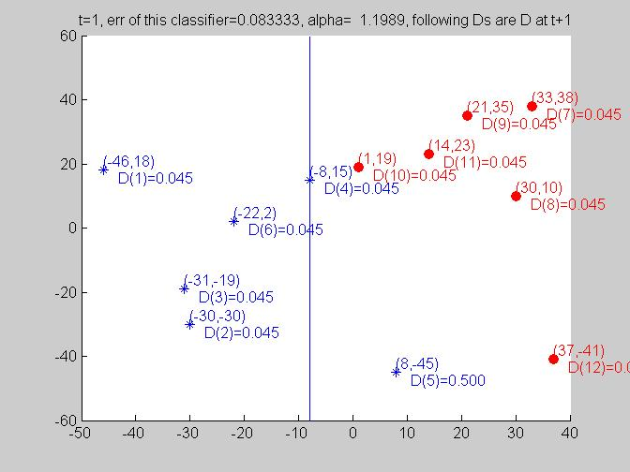
Answer : Exercise 5, t=1, α_{t=1}=1.1989

Slide 85
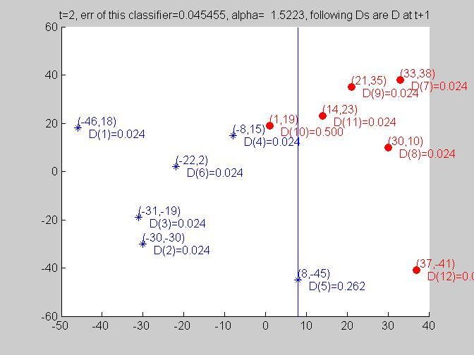
Answer : Exercise 5, t=2, α_{t=2}=1.5223

Slide 86
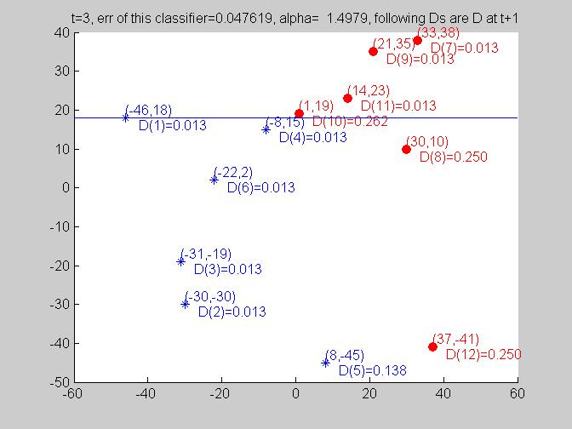
Answer : Exercise 5, t=3, α_{t=3}=1.4979

Slide 87
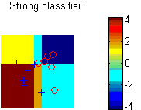
Answer : Exercise 5, strong classifier
h1
h2
h3

Slide 88
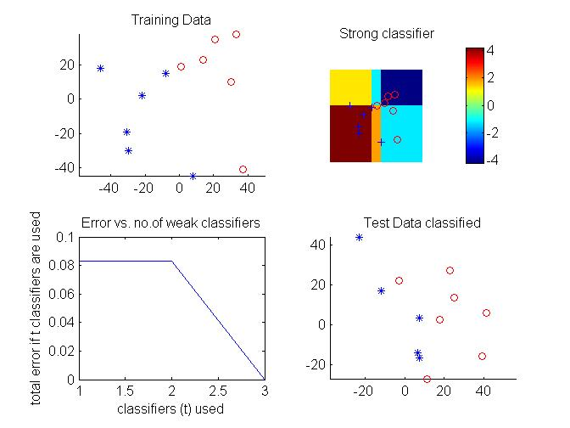
Answer:5 Testing example 5
CE_{t}
Use Step4 of the AdaBoost algo.
To find CE_{t}

Slide 89
exercise 6 (Take home exercise ) Find the strong classifier from this training data set. Write clearly the types of h( ) (e.g. left=blue, right =red, threshold at u or v etc) and value of ε and α of each stage t.
if example ==3 %assign 13
blue=[ -23 19
18 13
3 23
12 22];
red=[ 13 18
-43 -3
21 -14
29 -8]; datafeatures=[blue;red];
dataclass=[ -1 -1 -1 -1 -1 1 1 1 1 1 ];

Slide 90
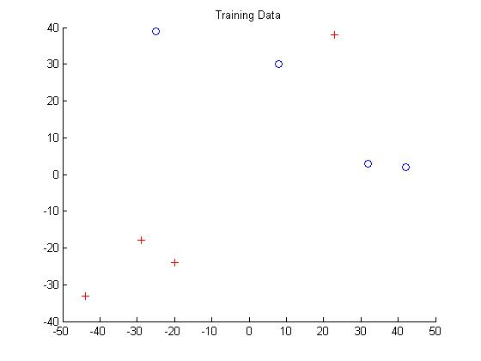
Take home exercise 6 on AdaBoost , t=0
ｉ

