Slide 1
Ch.1: Introduction to audio signal processing
KH WONG,
CSE Dept. CUHK,
Email: khwong@cse.cuhk.edu.hk
http://www.cse.cuhk.edu.hk/~khwong

Slide 2
References
Audio signals processing
Theory and Applications of Digital Speech Processing, Lawrence Rabiner , Ronald Schafer , Pearson 2011
DAFX: Digital Audio Effects by Udo Zölzer (2nd Edition 2011) , JohnWiley & Sons, Ltd. First edition can be found at http://books.google.com.hk
The Audio Programming Book by Richard Boulanger, Victor Lazzarini 2010, The MIT press, can be found at CUHK e-library
Digital Audio Signal Processing by Udo Zölzer, Wiley 2008.
Real sound synthesis for interactive applications : by Perry Cook, AK Peters
Machine learning useful tutorials
https://www.tensorflow.org/tutorials (GPU based)
https://scikit-learn.org/stable/ (non-GPU based)

Slide 3
Overview of Audio signal processing
Chapter 1: Introduction
Chapter 2: Preprocessing
Chapter 3: Feature extraction
Chapter 4: Speech compression : Vector quantization, K-means
Chapter 5: Recognition Procedures

Slide 4
Chapter 1:
Chapter 1.A : Introduction
Chapter 1.B : Signals in time & frequency domain

Slide 5
Chapter 1: introduction
Content
Components of a speech recognition system
Types of speech recognition systems
Speech recognition Hardware
A speech production model
Phonetics: English and Cantonese

Slide 6
Components of a speech recognition system
Pre-processor
Feature extraction
Training of the system
Recognition

Slide 7
Types of speech recognition technology
Isolated speech recognition - the speaker has to speak into the system word-by-word.
Continuous speech recognition - like human.
Current products
http://developer.android.com/reference/android/speech/SpeechRecognizer.html
https://chrome.google.com/webstore/detail/voice-recognition/ikjmfindklfaonkodbnidahohdfbdhkn?hl=en

Slide 8
Types depending on speakers
Speaker dependent recognition - designed for one speaker who has trained the system.
Speaker independent recognition - designed for all users without prior training.

Slide 9
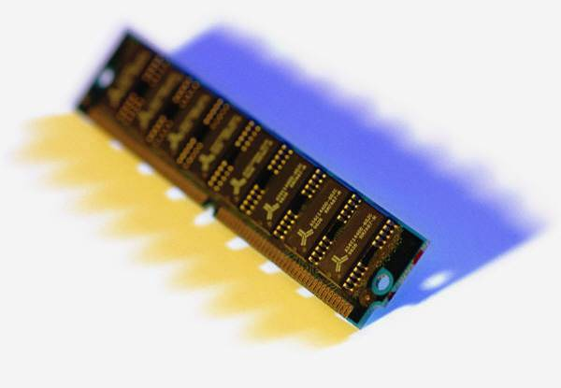
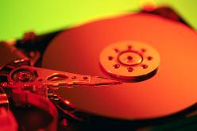
Speech recognition hardware
DAC
(Digital to Analog Converter)
ADC
(analog-to-digital conversion system)
Speech
Recording
System
Or

Slide 10
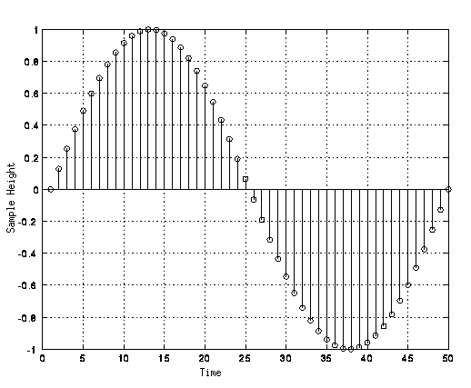
Sampling example
16-bit
Voltage or pressure range
0->(2¹⁶-1)=65535) digitized levels
Time in ms
Sampling is at 1KHz
Voltage
or pressure
65535
0
Time in ms
www.webkinesia.com/games/images/quant.gif

Slide 11

Conversion time and sampling time
Human listening range (frequency) from 20Hz to 20KHz,
Sampling frequency (freq.) must double or higher than the highest freq. (sampling theory). So, sampling for Hi-Fi music > 40KHz.
74 minutes CD music, 44.1KHz sampling 16-bit sound=44.1KHz*2bytes*2channels*60seconds*70min.=783,216,000 bytes (747~ MB). (see http://en.wikipedia.org/wiki/CD-ROM)
Compromise: telephone quality sound is 8KHz 8-bit sampling – still ok for human speech.

Slide 12
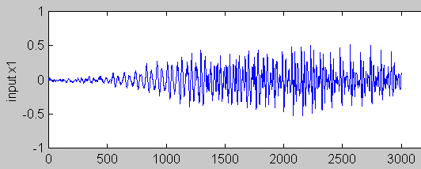
A speech wave
Time samples

Slide 13
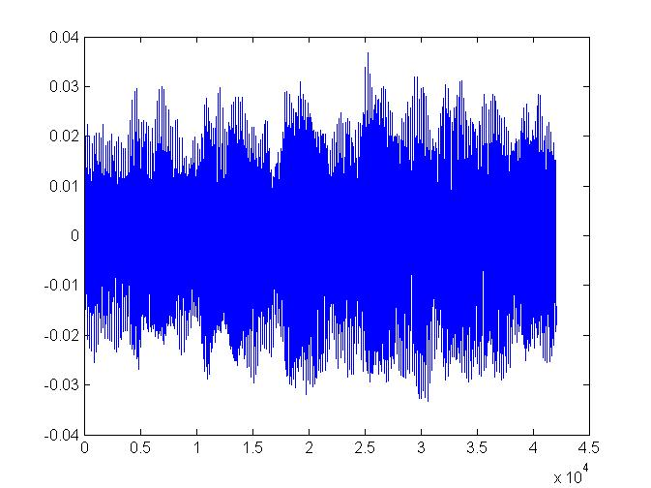
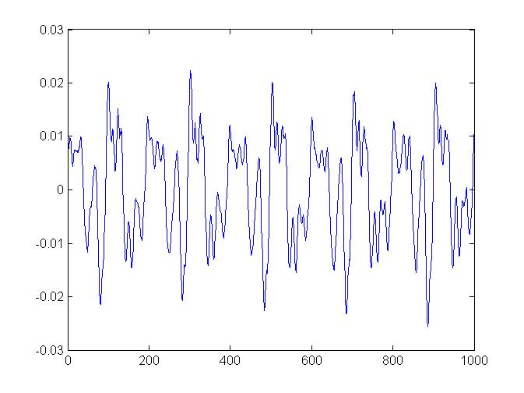
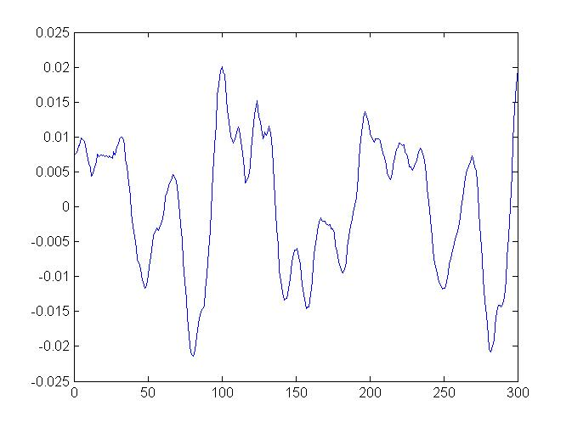
Music wave: violin3.wav (repeated 6 times for demo purposes) (http://www.youtube.com/watch?v=xdMX5D99xgU&feature=youtu.be) Sampling Frequency=FS=44100 Hz ( 42070 samples)
How long is the play time?
Answer:(1/44100)*42070
=0.954 seconds
All 42070 samples
Zoom in to see 1000 samples
Zoom in to see 300 samples

Slide 14
Class exercise 1.1
For a 20KHz, 16-bit sampling signal, how many bytes are used in 5 seconds?
Answer:?

Slide 15
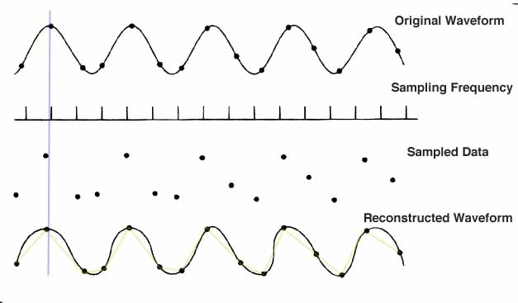
Sampling and reconstruction
https://edocs.uis.edu/jduva1/www/courses/455/sampling.jpg
(2¹⁶-)-1= 65535
0
time
After sampling you only have the data points
You may reconstruct the signal by joining the data points

Slide 16
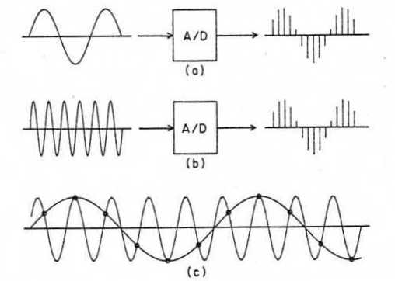
Hardware for speech recognition setup
Speech is captured by a microphone , e.g.
Sampled periodically ( 16KHz) by an analogue-to-digital converter (ADC)
Each sample converted is a 16-bit data.
Tutorial: For a 16KHz/16-bit sampling signal, how many bytes are used in 1 second. (=32Kbytes)
If sampling is too slow, sampling may fail , see
http://www.ras.ucalgary.ca/grad_project_2005/asph_sampling.jpg
Sampling theorem for a signal X: The sampling frequency must be higher or equal to double the highest frequency in the signal X.
E.g.
If the highest frequency in a signal is 16K Hz, sampling frequency is 32 KHz or higher.
If the highest frequency in a signal is 20K Hz, sampling frequency is 40 KHz or higher.

Slide 17
Exercise 1.2
If the sampling rate of the analog-to-digital conversion system is 20KHz , how large is the frequency of the sound that that can be sampled?
Answer: ________________?
If the sound is 20KHz, what is the minimum sampling rate of the analog-to-digital conversion system?
Answer: ________________?

Slide 18
Discussion: Conversion resolution
Music
44.1KHz , 16-bit is very good.
Higher specifications may be used : e.g., 96 KHz sampling 24-bit
Compression: MP3,etc can compress data
Speech
20KHz sampling 16-bit is good enough.

Slide 19
Class exercise 1.3
A sound is sampled at 22-KHz and resolution is 16 bit. How many bytes are needed to store the sound wave for 10 seconds?
Answer: ?
What is the highest frequency allowed in the sound signal?

Slide 20
Signal analysis
spectrum

Slide 21

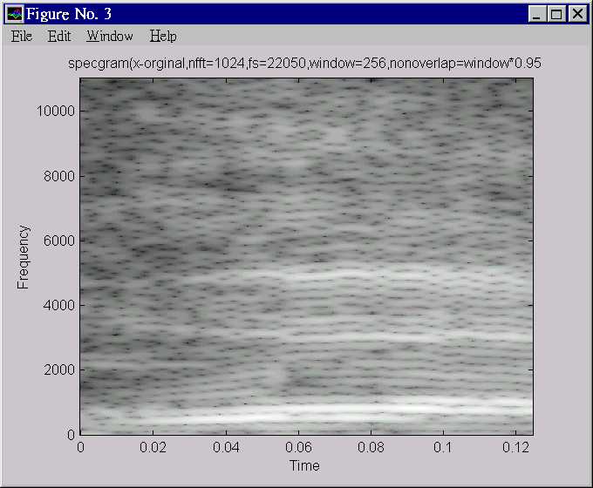
Can we see speech?
Pressure
/output
of mic
Time domain signal
Yes, using spectrogram.
The “time domain signal” shows the amplitude of air-pressure against time.
The “spectrogram” shows the energies of the frequency contents against time.
time
Freq.
Spectrogram
Spectrogram
(matlab function
spectrogram.m)
Time

Slide 22
Basic Phonetics
Phonemes are symbols to show how a word is pronounced.
Phonemes
Consonants
-Nasals /M/
-stops /B/,/P/
-fricative /V/,/S/
-whisper /H/
-affricates /JH/,/CH/
Vowel
/AA/,/I/,/UH/
Diphthongs
/AY/,/AW/

Slide 23
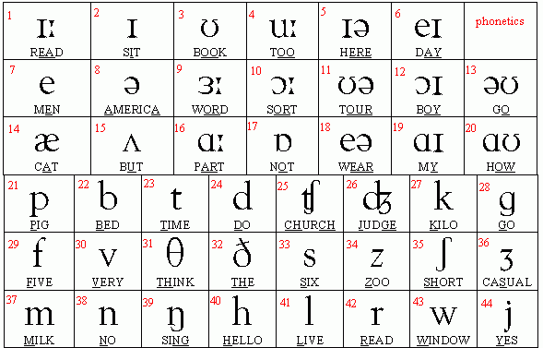
Phonetic table
http://www.telefonica.net/web2/eseducativa/phonetics/tablea.gif

Slide 24
Special features for Cantonese phonetics 廣東話
Each word is combined by an Initial (consonant 聲母) and a final (vowel 韵母); entering tone (入聲) are ended by /p/, /t/ or /k/
Nine tones(九聲):
lower-flat(陽平),lower-rising(陽上),lower-go(陽去)
higher-flat(陰平),higher-rising(陰上),higher-go (陰上)
Entering (入聲) : ended by /p/, /t/ or /k/

Slide 25
Summary
Studied
Basic digital audio recording systems
Speech recognition system applications and classifications

Slide 26
Appendix

Slide 27
Answer: Class exercise 1.1
For a 20KHz, 16-bit sampling signal, how many bytes are used in 5 seconds?
Answer: 20KHz*2bytes*5 seconds=200Kbytes.

Slide 28
Answer: Exercise 1.2
If the sampling rate of the analog-to-digital conversion system is 20KHz , how large is the frequency of the sound that that can be sampled?
Answer: ___20/2=10KHz_____________?
If the sound is 20KHz, what is the minimum sampling rate of the analog-to-digital conversion system?
Answer: _______20x2=40KHz________?

Slide 29
Answer: Class exercise 1.3
A sound is sampled at 22-KHz and resolution is 16 bit. How many bytes are needed to store the sound wave for 10 seconds?
Answer:
One second has 22K samples , so for 10 seconds: 22K x 2bytes x 10 seconds =440K bytes
*note: 2 bytes are used because 16-bit = 2 bytes
What is the highest frequency allowed in the sound signal?
ANS: 11KHz because the sampling frequency is 22KHz, so the signal cannot be higher than 22KHz/2=11KHz.

