Slide 1
Ch. 2 : Preprocessing of audio signals in time and frequency domain
Time framing
Frequency model
Fourier transform
Spectrogram

Slide 2
Revision: Raw data and PCM
Human listening range 20Hz → 20K Hz
CD Hi-Fi quality music: 44.1KHz (sampling) 16bit
People can understand human speech sampled at 5KHz, e.g., Telephone quality speech can be sampled at 8KHz using 8-bit data.
Speech recognition systems normally use: 10→16KHz,12→16 bit.

Slide 3
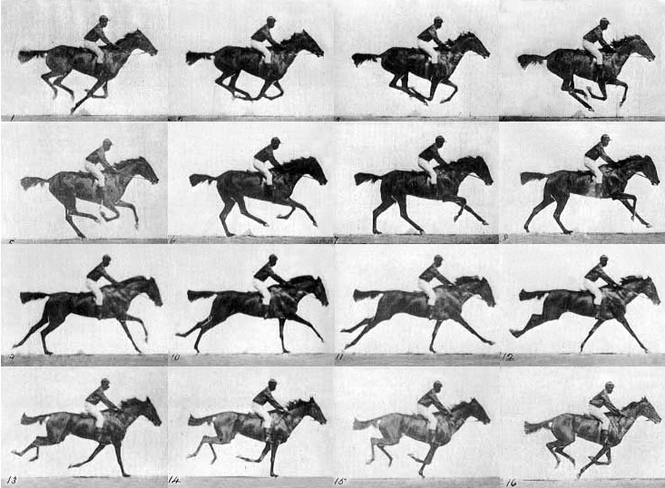
Concept: Human perceives data in blocks
We see 24 still pictures in one second, then
we can build up the motion perception in our brain.
It is likewise for speech.
Source: http://antoniopo.files.wordpress.com/2011/03/eadweard_muybridge_horse.jpg?w=733&h=538

Slide 4

Time framing
Since our ear cannot response to very fast change of speech data content, we normally cut the speech data into frames before analysis. (similar to watch fast changing still pictures to perceive motion )
Frame size is 10~30ms (1ms=10⁻³ seconds)
Frames can be overlapped, normally the overlapping region ranges from 0 to 75% of the frame size .
Time framing Video demo: https://youtu.be/lOu-c2UHU00

Slide 5
Frame blocking and Windowing
To choose the frame size (N samples )and adjacent frames separated by m samples (non-overlap samples).
I.e. a 16KHz sampling signal, a 10ms window has N=160 samples, (non-overlap samples, or hop_length , or hop_size= m=40 samples)
l=2 (second window), length = N
s_{k}
N
k
m
time
N
l=1 (first window), length = N

Slide 6
Tutorial for frame blocking
A signal is sampled at 12KHz, the frame size is chosen to be 20ms and adjacent frames are separated by m=5ms. Calculate N (Frame size) and m (hop_length) and draw the frame blocking diagram.(ans: N=240, m=60.)
Repeat above when adjacent frames do not overlap.(ans: N=240, m=240.)

Slide 7
Class exercise 2.1
For a 22-KHz/16 bit sampling speech wave, frame size is 15 ms and frame overlapping period is 40 % of the frame size.
Draw the frame blocking diagram.

Slide 8
The frequency model
For a frame we can calculate its frequency content by Fourier Transform (FT)
Computationally, you may use Discrete-FT (DFT) or Fast-FT (FFT) algorithms. FFT is popular because it is more efficient.
FFT algorithms can be found in most numerical method textbooks/web pages.
E.g. http://en.wikipedia.org/wiki/Fast_Fourier_transform

Slide 9
A time domain signal of N samples
s=
Signal
level
s_{k=2}
s_{k=1}
s_{k=0}
k=0 1 2….
Time k
N-1
End of the signal
Beginning of the signal

Slide 10
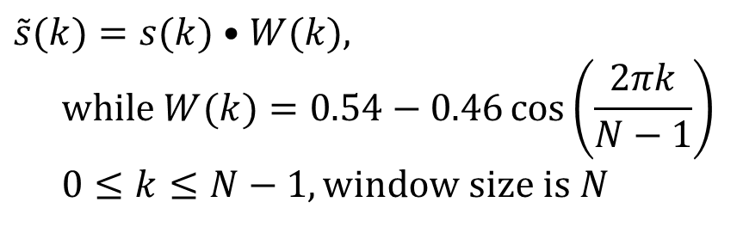
Windowing
This is to smooth out the discontinuities at the beginning and end. Otherwise, sudden change of signal level will result into high frequency noise at the frequency domain after Fourier transform
Hamming or Hanning windows can be used.
Hamming window
Tutorial: write a program segment to find the result of passing a speech frame, stored in an array int s[1000] into the Hamming window.
$$\tilde{s}(k)=s(k)•W(k), \\ \text{while} W(k)=0.54−0.46\cos\left(\frac{2πk}{N−1}\right) \\ 0≤k≤N−1,\text{window} \text{size} \text{is} N$$

Slide 11
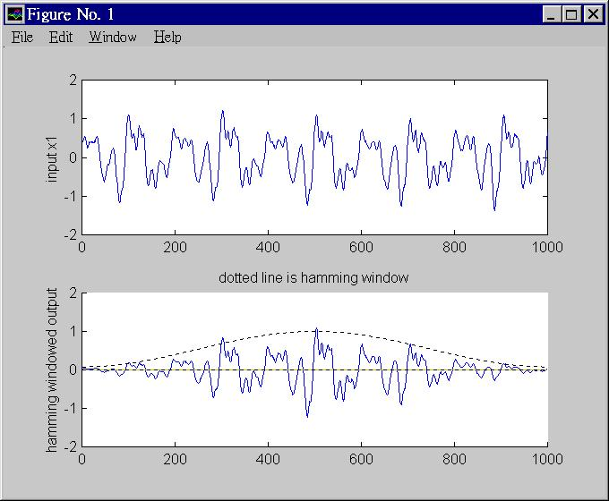
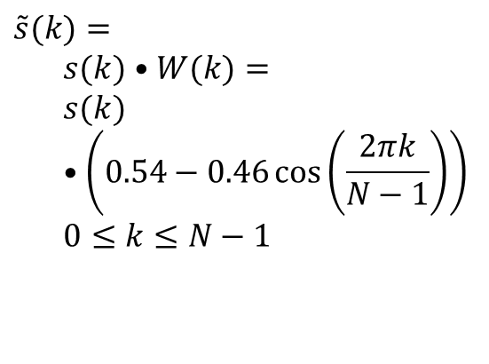
Effect of Hamming window (For Hanning window See http://en.wikipedia.org/wiki/Window_function )
Original signal s(k)
$$\tilde{s}(k)= \\ s(k)•W(k)= \\ s(k)•\left(0.54−0.46\cos\left(\frac{2πk}{N−1}\right)\right) \\ 0≤k≤N−1$$
Signal after hamming window operation
Beginning of the signal frame
End of the signal frame

Slide 12
Matlab code segment
s1=wavread('violin3.wav');
for k=1:N
hamming_window(k)=
abs(0.54-0.46*cos(k*(2*pi/N)));
s_hat1(k)=hamming_window(k)*s1(k);
end

Slide 13
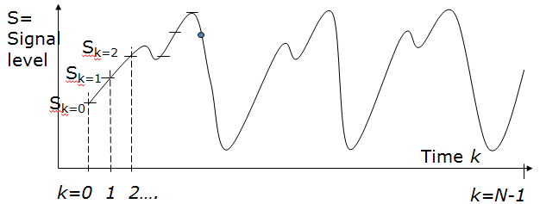


The Fourier Transform FT method (Assume Signal S_{k} is already smoothed by a hamming window to simplify the discussion)
Forward Transform (FT) of N samples: $X_{m}$ =$FT$($s_{k}$)
$X_{m=0,1.,N−1}(\text{com}\text{plex} numbers)= FT \{ s_{k=0,1,2..,N−1}(\text{real} \text{numbers})\}$, the equation is $$X_{m}=\sum_{k=0}^{N−1}{s_{k}e^{−j\left(\frac{2πkm}{N}\right)}},m=0,1,2,3,...,N−1,\text{and} e^{jθ}=\cos{(}θ)+j\sin{(}θ),j=\sqrt{−1} \\ \text{Input} (\text{is} \text{in} \text{time} \text{domain}) =s_{k=0,1,2,..N−1}=s_{0,}s_{1,}s_{2,}...,s_{N−1,}( \text{total} \text{N} \text{samples}) \\ \text{Output} (is in \text{Frequency} \text{domain}) \text{after} FT=X_{m=0,}X_{m=1,}X_{m=2,},..,X_{m=N−1,} \text{which} \\ \text{are} (N) \text{complex} \text{numbers}$$ $X_{m}={\left\|X_{m}\right\|}_{2}e^{jθ_{m}}\text{,}\text{so} X_{m} \text{is} \text{complex}$. ${\left\|\right\|}_{2}=$Euclidean norm, or 2-norm, i.e.
$$\text{If} Z=(z_{1},z_{2},..,x_{n}),\text{then} {\left\|Z\right\|}_{2}=\sqrt{z_{1}^{2}+z_{2}^{2}+...+z_{n}^{2}}$$
Demo Matlab code:
demo_dft_tutorial.rar
https://ww2.mathworks.cn/matlabcentral/fileexchange/77789-discrete-fourier-transform

Slide 14

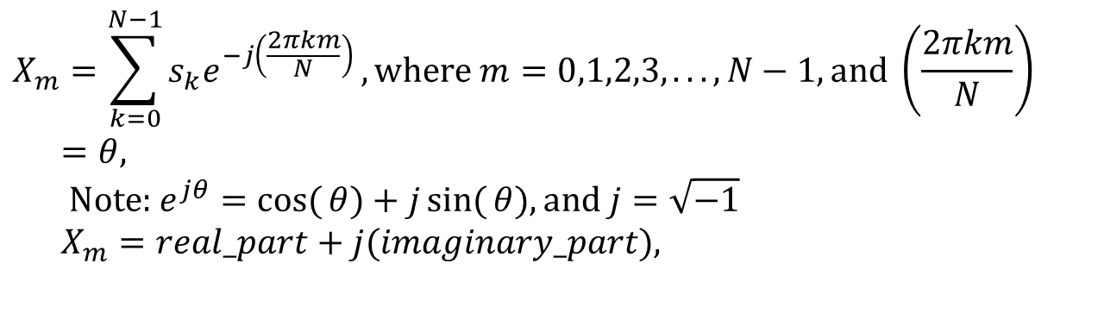
Fourier Transform From time domain to frequency domain
$$X_{m}=\sum_{k=0}^{N−1}{s_{k}e^{−j\left(\frac{2πkm}{N}\right)}},\text{where} m=0,1,2,3,...,N−1,\text{and} \left(\frac{2πkm}{N}\right)=θ, \\ \text{Note}\text{: }e^{jθ}=\cos{(}θ)+j\sin{(}θ),\text{and} j=\sqrt{−1} \\ X_{m}=real_part+j(imaginary_part),$$
Power=||X_{m}||₂²= (real²+imginary²)
Signal
voltage/
pressure
level
single freq..
Fourier Transform
Time
S₀,S₁,S₂,S_{3.} … S_{N-1}
freq. (m)
This curve is called spectral envelop
Demo Matlab code: demo_dft_tutorial.rar
Demo Video

Slide 15

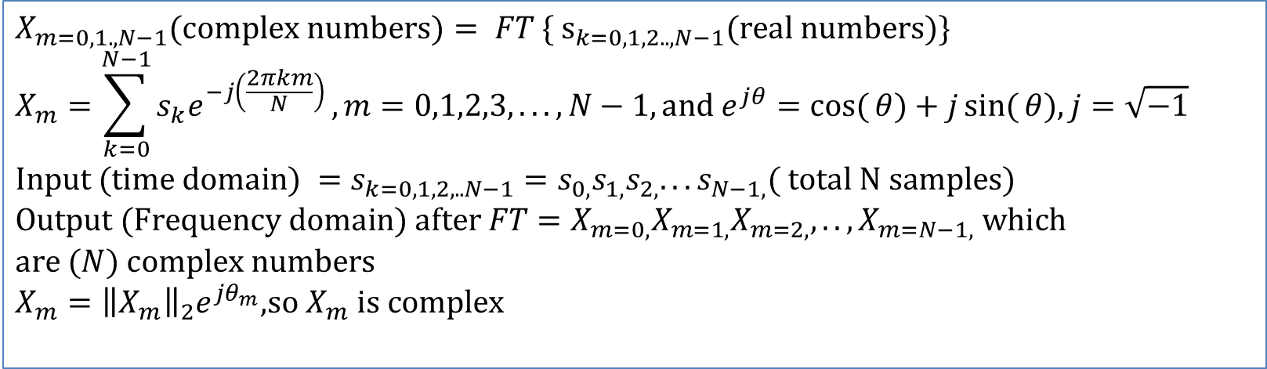
Example
$$X_{m}=\sum_{k=0}^{N−1}{s_{k}e^{−j\left(\frac{2πkm}{N}\right)}}$$
[s0,s1,s2,…]=[1 ,3 ,4,…], N=128, m=0,…,127
X_{m=0}=1*e^{-j(2*pi*0*0/128)}+3*e^{-j(2*pi*1*0/128)}+4*e^{-j(2*pi*2*0/128)} +..
X_{m=1}=1*e^{-j(2*pi*0*1/128)}+3*e^{-j(2*pi*1*1/128)}+4*e^{-j(2*pi*2*1/128)} +..
X_{m=2}=1*e^{-j(2*pi*0*2/128)}+3*e^{-j(2*pi*1*2/128)}+4*e^{-j(2*pi*2*2/128)} +..
$$X_{m=0,1.,N−1}(\text{complex} \text{numbers})= FT \{ {\text{s}}_{k=0,1,2..,N−1}(\text{real} \text{numbers})\} \\ X_{m}=\sum_{k=0}^{N−1}{s_{k}e^{−j\left(\frac{2πkm}{N}\right)}},m=0,1,2,3,...,N−1,\text{and} e^{jθ}=\cos{(}θ)+j\sin{(}θ),j=\sqrt{−1} \\ \text{Input} (\text{time} \text{domain}) =s_{k=0,1,2,..N−1}=s_{0,}s_{1,}s_{2,}...s_{N−1,}( \text{total} \text{N} \text{samples}) \\ \text{Output} (\text{Frequency} \text{domain}) \text{after} FT=X_{m=0,}X_{m=1,}X_{m=2,},..,X_{m=N−1,} \text{which} \\ \text{are} (N) \text{complex} \text{numbers} \\ X_{m}={\left\|X_{m}\right\|}_{2}e^{jθ_{m}}\text{,}\text{so} X_{m} \text{is} \text{complex}$$

Slide 16

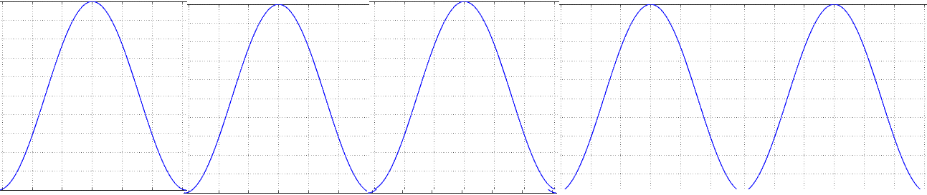

Examples of FT (Pure wave vs. speech wave)
s_{k}
$${{\left\|X_{m}\right\|}_{2}}^{2}$$
pure cosine has one frequency band
FT
single freq..
time(k)
freq.. (m)
complex speech wave
has many different frequency bands
$${{\left\|X_{m}\right\|}_{2}}^{2}$$
s_{k}
single freq..
time(k)
freq. (m)
Spectral envelop
http://math.stackexchange.com/questions/1002/fourier-transform-for-dummies
DFT and Inverse: DFT https://www.mathworks.com/matlabcentral/fileexchange/41228-dft-and-idft/content/Untitled3.m

Slide 17


Discrete Fourier transform DFT and Inverse Discrete Fourier transform IDFT
https://en.wikipedia.org/wiki/Discrete_Fourier_transform
Matlab code:
https://www.mathworks.com/matlabcentral/fileexchange/41228-dft-and-idft/content/Untitled3.m
$$\text{Fourier} \text{Transform} \\ X_{m}=\sum_{k=0}^{N−1}{s_{k}⋅e^{−i\frac{2πkm}{N}}}=\sum_{k=0}^{N−1}{s_{k}⋅\left(\cos\left(\frac{2πkm}{N}\right)−i\sin\left(\frac{2πkm}{N}\right)\right)} \\ \text{Inverse} \text{Fourier} \text{Transform} \\ s_{k}=\frac{1}{N}\sum_{m=0}^{N−1}{X_{m}⋅e^{i\frac{2πkm}{N}}}=\frac{1}{N}\sum_{m=0}^{N−1}{X_{m}⋅\left(\cos\left(\frac{2πkm}{N}\right)+i\sin\left(\frac{2πkm}{N}\right)\right)}$$
$$\text{Note}\text{: } \\ e^{jθ}=\cos{(}θ)+j\sin{(}θ), \\ \sin{(}−θ)=−\sin{(}θ), \\ \cos{(}−θ)=\cos{(}θ)$$
N=number of time samples
k=time index of the current sample , it is from 0 to N-1
s_{k}=value of the signal sample at time k
m=frequency index (from 0 Hz to N-1 Hz)
X_{m}= amount of frequency m in the signal of all s_{k}
Notes:
\begin{equation}\label{eq3_FOURIER}
\begin{split}
&X_m=\sum_{k=0}^{N-1}s_k \cdot e^{-i \frac{s\pi k m}{N}}=\sum_{k=0}^{N-1} s_k \cdot
\left( cos \left(- \frac {2 \pi k m} {N} \right)
+i \cdot sin \left(- \frac {2 \pi k m} {N} \right)
\right) \\
%
&s_m=\frac{1}{N} \sum_{k=0}^{N-1}X_m \cdot e^{-i \frac{s\pi k m}{N}}=\frac{1}{N} \sum_{k=0}^{N-1} X_m \cdot
\left( cos \left( \frac {2 \pi k m} {N} \right)
+i \cdot sin \left( \frac {2 \pi k m} {N} \right)
\right)
\end{split}
\end{equation}Where,\\
$N$=number of time samples\\
$k$=time index of the current sample , it is from 0 to $N-1$\\
$s_k$=value of the signal sample at time $k$\\
$m$=frequency index (from 0 Hz to $N-1$ Hz)\\
$X_m$= amount of frequency m in the signal of all s$_k$

Slide 18

Use of short term Fourier Transform (Fourier Transform of a frame)
Power spectrum envelope is a plot of the energy Vs frequency.
FFT video demo: https://youtu.be/EuX2uKZSd40
Time domain signal
of a frame
DFT or FFT
Frequency
domain output
Amplitude x_{k}
time domain signal
of a frame
Energy=||X_{m}||₂²
Spectral envelop
0
Fourier
Transform
First formant
Second formant
N-1
Time index k
freq.index m.
1KHz
2KHz

Slide 19
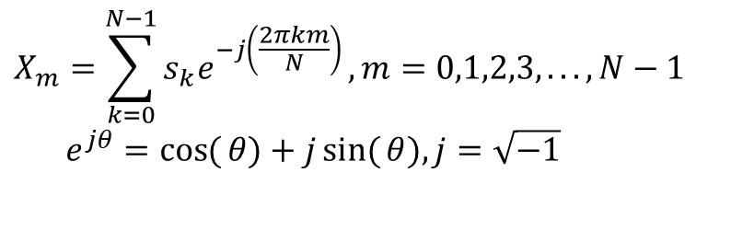
Class exercise 2.2: Fourier Transform
Write pseudo code (or a C/matlab/octave program segment but not using a library function) to transform a signal in an array.
Int s[256] into the frequency domain in
float X[256] (real part result) and
float IX[256] (imaginary result).
How to generate a spectrogram?
$$X_{m}=\sum_{k=0}^{N−1}{s_{k}e^{−j\left(\frac{2πkm}{N}\right)}},m=0,1,2,3,...,N−1 \\ e^{jθ}=\cos{(}θ)+j\sin{(}θ),j=\sqrt{−1}$$

Slide 20
The spectrogram: to see the spectral envelope as time moves forward
It is a visualization method (tool) to look at the frequency content of a signal.
Parameter setting: (1)Window size = N=(e.g. 512)= number of time samples for each Fourier Transform processing. (2) non-overlapping sample size D . (3) frame index is j.
t is an integer, initialize t=0, j=0. X-axis = time, Y-axis = freq.
Step1: FT samples s_{t+j*D} to s_{t+512+j*D}
Step2: plot FT result (freq v.s. energy) spectral envelope vertically using different gray scale.
Step3: j=j+1
Repeat Step1,2,3 until j*D+t+512 >length of the input signal.

Slide 21
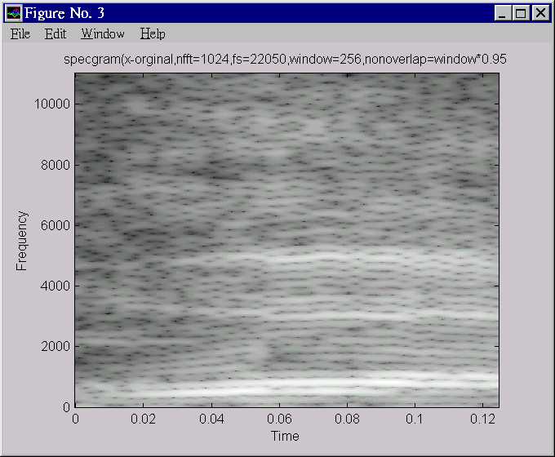
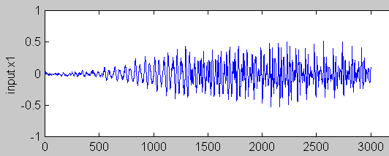
A specgram
Specgram: The white bands are the formants which represent high energy frequency contents of the speech signal

Slide 22
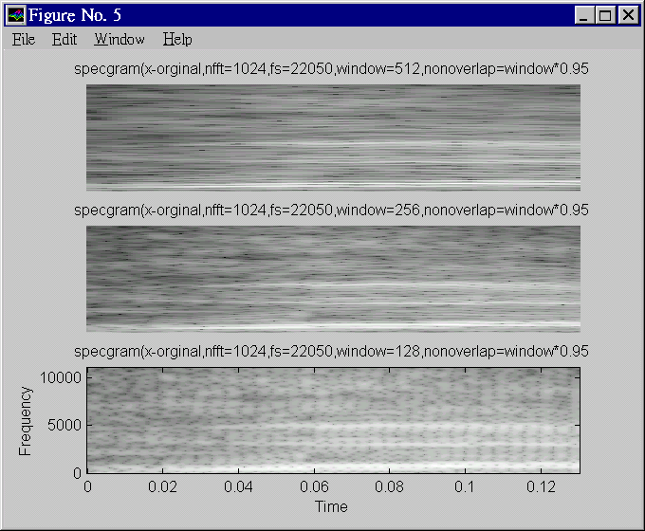
Freq.
Better frequency resolution
Freq.
Better time. resolution

Slide 23
How to generate a spectrogram?

Slide 24
Procedures to generate a spectrogram (Specgram1)
Window=256-> each frame has 256 samples
Sampling is fs=22050, so maximum frequency is 22050/2=11025 Hz
Nonverlap =window*0.95=256*.95=243 , overlap is small (overlapping =256-243=13 samples)
|X(128)|
For each frame (256 samples)
Find the magnitude of Fourier
X_magnitude(m), m=0,1,2, 128
Plot X_magnitude(m)=
Vertically,
-m is the vertical axis
-|X(m)|=X_magnitude(m) is
represented by intensity
Repeat above for all frames
q=1,2,..Q
|X(i)|
|X(0)|
Frame q=Q
Frame q=1
frame q=2

Slide 25
Class exercise 2.3: In specgram1
Calculate the
first sample location and last sample location of the frames q=3 and 7. Note: N=256, m=243
Answer:
q=1, frame starts at sample index =?
q=1, frame ends at sample index =?
q=2, frame starts at sample index =?
q=2, frame ends at sample index =?
q=3, frame starts at sample index =?
q=3, frame ends at sample index =?
q=7, frame starts at sample index =?
q=7, frame ends at sample index =?

Slide 26
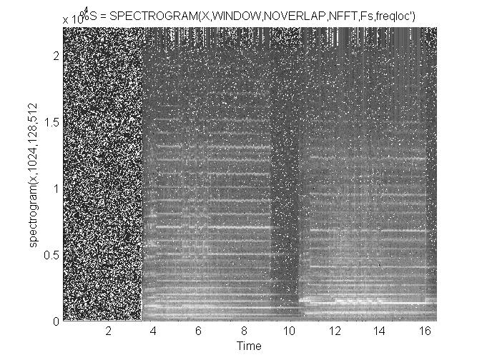
Spectrogram plots of some music sounds sound file is tz1.wav
Matlab Code:
demo_spectrogram_release16.rar
High
energy
Bands:
Formants
seconds

Slide 27
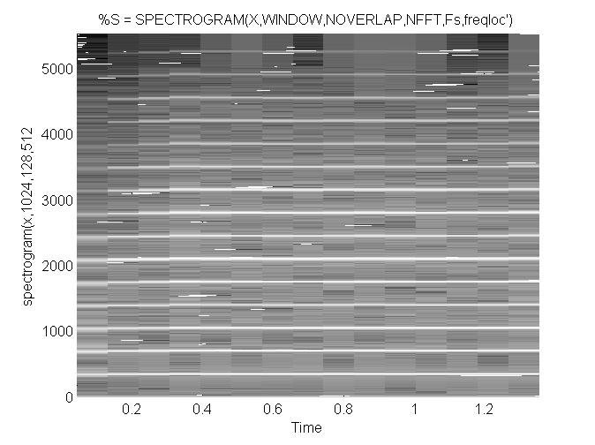
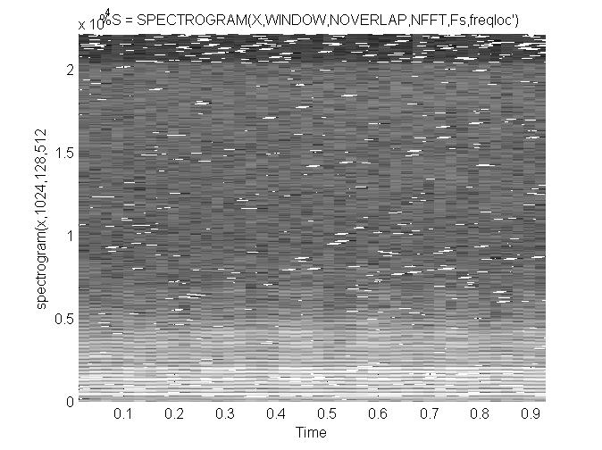
spectrogram plots of some music sounds
http://www.cse.cuhk.edu.hk/%7Ekhwong/www2/cmsc5707/tz1.wav
http://www.cse.cuhk.edu.hk/~khwong/www2/cmsc5707/trumpet.wav
http://www.cse.cuhk.edu.hk/%7Ekhwong/www2/cmsc5707/violin3.wav
Spectrogram of
Trumpet.wav
Spectrogram of
Violin3.wav
High
energy
Bands:
Formants
Violin has
complex
spectrum
seconds

Slide 28
Exercise 2.4
Write the procedures for generating a spectrogram from a source signal X.

Slide 29
Summary
Studied
Basic digital audio recording systems
Speech recognition system applications and classifications
Fourier analysis and spectrogram

Slide 30
Appendix %demo_ch2_dft_using_exp_sin_cos.m %Matlab program for DFT/IDFT without using the inbuilt functions
%demo_ch2_dft_using_exp_sin_cos.m
%Matlab program for DFT/IDFT without using the inbuilt functions
%http://newlinecode.blogspot.com/2013/02/dft-idft-without-using-function-matlab.html
%this to show how to code discrete Fourier forward/inverse (2020 Sept 10)
% It shows using exp() and cos()+sin() functions generate the same result
%program to find the DFT/IDFT of a sequence without using the inbuilt functions
close all;
clear all;
%xn=input('Enter the sequence x(n)'); %Get the sequence from user
xn=[8,16,24,32,40,48,56,64]
ln=length(xn); %find the length of the sequence
xk=zeros(1,ln); %initialize an array of same size as that of input sequence
xk2=zeros(1,ln); %initialize an array of same size as that of input sequence
ixk=zeros(1,ln); %initialize an array of same size as that of input sequence
ixk2=zeros(1,ln); %initialize an array of same size as that of input sequence
%code block to find the DFT of the sequence
i=sqrt(-1);
%-----------------------------------------------------------
for k=0:ln-1
for n=0:ln-1
xk(k+1)=xk(k+1)+(xn(n+1)*exp((-i)*2*pi*k*n/ln));
xk2(k+1)=xk2(k+1)+(xn(n+1)*( cos(2*pi*k*n/ln) - i*sin(2*pi*k*n/ln) ) );
%this is to show xk and xk2 are exactly teh same, see result at the
%end of this code
end
end
%------------------------------------------------------------
%code block to plot the input sequence
%------------------------------------------------------------
t=0:ln-1;
subplot(221);
stem(t,xn);
ylabel ('Amplitude');
xlabel ('Time Index');
%---------------------------------------------------------------
magnitude=abs(xk) % Find the magnitudes of individual DFT points
%code block to plot the magnitude response
%------------------------------------------------------------
t=0:ln-1;
subplot(222);
stem(t,magnitude);
ylabel ('Amplitude');
xlabel ('K');
%------------------------------------------------------------
phase=angle(xk); % Find the phases of individual DFT points
%code block to plot the magnitude sequence
%------------------------------------------------------------
t=0:ln-1;
subplot(223);
stem(t,phase);
ylabel ('Phase');
xlabel ('K');
%------------------------------------------------------------
% Code block to find the IDFT of the sequence
%-------------------------inverse transform -----------------------------------
for n=0:ln-1
for k=0:ln-1
ixk(n+1)=ixk(n+1)+(xk(k+1)*exp(i*2*pi*k*n/ln));
ixk2(n+1)=ixk2(n+1)+(xk2(k+1)*(cos((2*pi*k*n/ln)) + i* sin(2*pi*k*n/ln)));
end
end
ixk=ixk./ln;
ixk2=ixk2./ln;
%----------------------------------------------------------
%code block to plot the input sequence
%------------------------------------------------------------
t=0:ln-1;
subplot(224);
stem(t,ixk);
ylabel ('Amplitude');
xlabel ('Time Index');
%%%%%%%%%%%%%%%%%%%%%%%
'number of samples'
ln
'results'
'source input ='
xn
'xk frequency is calculated by exp(), xk2 frequency is calculated by sin()_cos(),'
'It shows they are the same'
xk
xk2
xk-xk2
'hit key to continue'
pause
%
ixk %recovered xn by using exp() function
ixk2%recovered xn by using sin(),cos() functions
%magnitude=abs(ixk)
magnitude=abs(ixk)
magnitude2=abs(ixk2)
ixk-ixk2
disp('the result shows ixk and ixk2 are the same: ')
disp('magnitude=abs(ixk) , ixk :recovered xn by using exp() function')
disp('magnitude2=abs(ixk2) , ixk2: recovered xn by using sin(),cos() functions')

Slide 31
Answer: Class exercise 2.1
For a 22-KHz/16 bit sampling speech wave, frame size is 15 ms and frame overlapping period is 40 % of the frame size. Draw the frame block diagram.
Answer: Number of samples in one frame (N)= 15 ms / (1/22K)
= 15*(10^-3) /(1/(22000))=330
Overlapping samples = 132, m=N-132=198.
Overlapping time = 132 * (1/22k)= 132 * (1/22000) =6ms;
Time in one frame= 330* (1/22k)= 330* (1/22000)=15ms.
l=2 (second window), length = N
s_{k}
N
k
m
time
N
l=1 (first window), length = N

Slide 32
Answer Class exercise 2.2: Fourier Transform
http://en.wikipedia.org/wiki/List_of_trigonometric_identities
For (m=0;m<=N-1;m++)
{
tmp_real=0; tmp_img=0;
For(k=0;k<=N-1;k++)
{
tmp_real=tmp_real+S_{k}*cos(2*pi*k*m/N);
tmp_img=tmp_img-S_{k}*sin(2*pi*k*m/N);
}
X_real(m)=tmp_real;
X_img(m)=tmp_img;
}
E.g. s_{k}=s₀,s₁,..,s₅₁₁ → X_real₀,X_real₁,..,X_real_{511,} X_imgl₀,X_img₁,..,X_img_{511,}
Note that X_magnitude(m)= sqrt[X_real(m)²+ X_img(m)²]

Slide 33
Answer: Class exercise 2.3: In specgram1 (updated)
Calculate the
first sample location and last sample location of the frames q=3 and 7. Note: N=256, m=243
Answer:
q=1, frame starts at sample index =0
q=1, frame ends at sample index =255
q=2, frame starts at sample index =0+243=243 (so the gap between the q=1 frame and q=2 frame is 243)
q=2, frame ends at sample index =243+(N-1)=243+255=498 (so q=2 frame has 256 samples)
q=3, frame starts at sample index =0+243+243=486
q=3, frame ends at sample index =486+(N-1)=486+255=741
q=7, frame starts at sample index =243*6=1458
q=7, frame ends at sample index =1458+(N-1)=1458+255=1713

Slide 34
Appendix: Why in practical Discrete Fourier transform, the summation is from k=0 to k=N-1 , and m is ranging from 0 to N/2 but not N?
Since , Fourier frequency real-value outputs are mirrored around the vertical axis at 0, so using half are fine for calculating the energy during the calculation of the spectrum. It is only an engineering approach to save time. In fact, the real definition is using N sample for forward and inverse Fourier transform where all complex numbers are used.
The problem is actual very deep mathematically, i.e., how many samples should we use in forward and reverse transform. To get the best result, one should add more zeros to the original sequence (zero padding at the end of the sequence) to increase frequency resolution. x = 1 2 4 6 5 4 3 >> fft(x), Columns 1 through 4 25.0000 + 0.0000i -7.5734 + 0.3479i -0.4620 + 1.7568i -0.9647 - 0.5410i -0.9647 + 0.5410i -0.4620 - 1.7568i -7.5734 - 0.3479i
Antilasing Demo: https://www.youtube.com/watch?v=ByTsISFXUoY
https://www.youtube.com/watch?v=Fy9dJgGCWZI

Slide 35
Answer: Exercise 2.4
Write the procedures for generating a spectrogram from a source signal X.
Answer: to be completed by students

