Slide 1
Ch. 3: Feature extraction from audio signals
W2
We will study
Filtering
Mel scale
Linear predictive coding LPC
Cepstrum

Slide 2
(A) Filtering
Ways to find the spectral envelope
Filter banks: uniform
Filter banks can also be non-uniform
LPC and Cepstral LPC parameters
Use Vector quantization method to represent data more efficiently
Spectral
envelop
energy
spectral
envelop
filter2
output
filter1
output
filter3
output
filter4
output
freq..

Slide 3
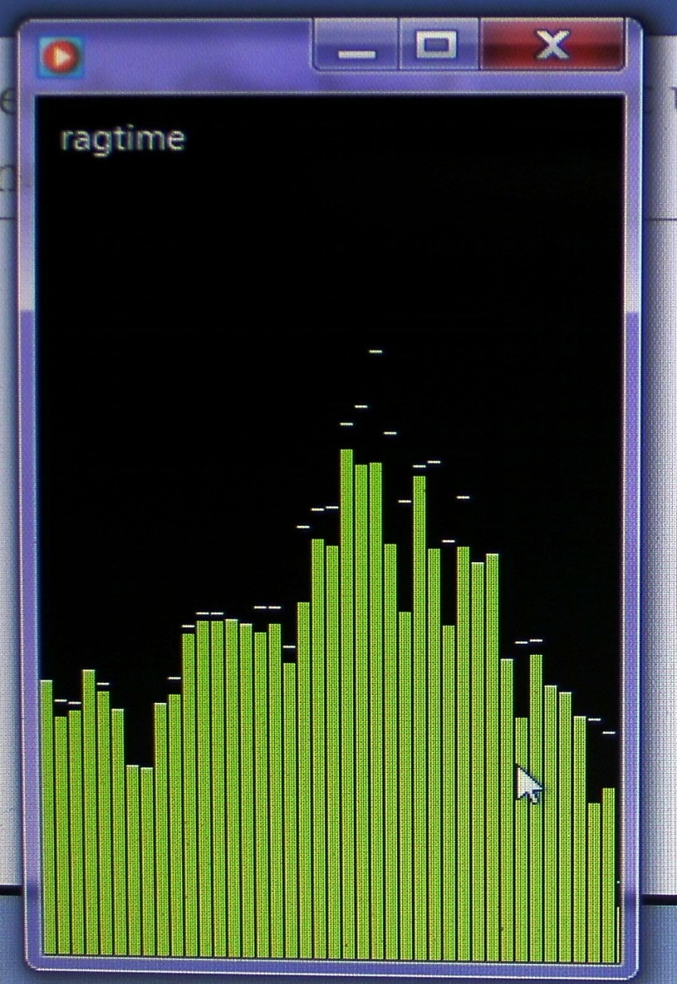
You can see the filter band output using windows-media-player for a frame
Try to look at it
Run
windows-media-player
To play music
Right-click, select
Visualization / bar and waves
Video Demo
energy
Spectral envelop
Frequency

Slide 4
Speech recognition idea using 4 linear filters, each bandwidth is 2.5KHz
Two sounds with two Spectral Envelopes SE_{ar},SE_{ei} ,E.g. Spectral Envelop (SE) “ar”, Spectral envelop “ei”
Spectral envelope SE_{ar}=“ar”
Spectral envelope SE_{ei}=“ei”
energy
energy
Spectrum A
Spectrum B
Freq.
Freq.
0
0
10KHz
10KHz
filter 1 2 3 4
filter 1 2 3 4
Filter
out
Filter
out
v1 v2 v3 v4
w1 w2 w3 w4

Slide 5
Difference between two sounds (or spectral envelopes SE_{ar} , SE_{ei})

Slide 6
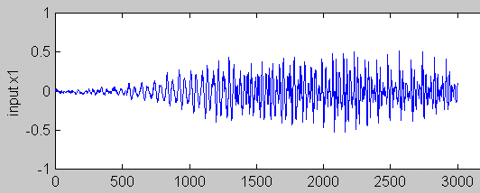
Filtering method
Example: For each frame (N=30 ms), a set of filter outputs will be calculated. (frame overlap 5ms), that is non-overlapping samples=hop_length=hop_size=N-5ms.
There are many different methods for setting the filter bandwidths -- uniform or non-uniform
Input waveform
Time frame i
Filter outputs (v1,v2,…)
30ms
Time frame i+1
Filter outputs (v’1,v’2,…)
30ms
Time frame i+2
Filter outputs (v’’1,v’’2,…)
30ms
5ms

Slide 7
How to determine filter band ranges
The pervious example of using 4 linear filters is too simple and primitive.
We will discuss
Uniform filter banks
Non-uniform filter banks: Log frequency
Mel filter bands

Slide 8
Uniform Filter Banks
Uniform filter banks
bandwidth B= Sampling Freq... (Fs)/no. of banks (N)
For example, Fs=10Kz, N=20 then B=500Hz
Simple to implement but not too useful
V
Filter
output
v3
v1
v2
1
2
3
4
5
....
Q
...
freq..
500
1K
1.5K
2K
2.5K
3K
...
(Hz)

Slide 9
Non-uniform filter banks: Log frequency
Log. Freq... scale : close to human ear
V
Filter
output
v1
v2
v3
200
400
800
1600
3200
freq.. (Hz)

Slide 10
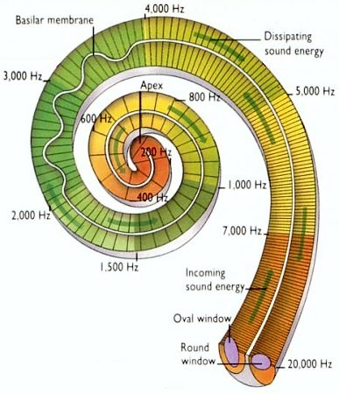
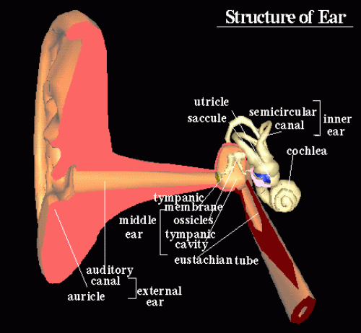
(B) Mel Scale: Inner ear and the cochlea (human also has filter bands)
Ear and cochlea
http://universe-review.ca/I10-85-cochlea2.jpg
http://www.edu.ipa.go.jp/chiyo/HuBEd/HTML1/en/3D/ear.html

Slide 11
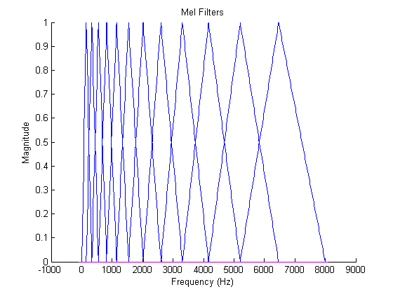
Mel filter bands (found by psychological and instrumentation experiments)
Freq. lower than 1 KHz has narrower bands (and in linear scale)
Higher frequencies have larger bands (and in log scale)
More filter below 1KHz
Less filters above 1KHz
Filter
output
http://instruct1.cit.cornell.edu/courses/ece576/FinalProjects/f2008/pae26_jsc59/pae26_jsc59/images/melfilt.png

Slide 12
Mel scale (Melody scale) From https://en.wikipedia.org/wiki/Mel_scale
Measure relative strength in perception of different frequencies.
The mel scale, named by Stevens, Volkmann, and Newman in 1937,^{[1]} is a perceptual scale of pitches judged by listeners to be equal in distance from one another. The reference point between this scale and normal frequency measurement is defined by assigning a perceptual pitch of 1000 mels to a 1000 Hz tone, 40 dB above the listener's threshold. Above about 500 Hz, increasingly large intervals are judged by listeners to produce equal pitch increments. As a result, four octaves on the hertz scale above 500 Hz are judged to comprise about two octaves on the mel scale. The name mel comes from the word melody to indicate that the scale is based on pitch comparisons.

Slide 13
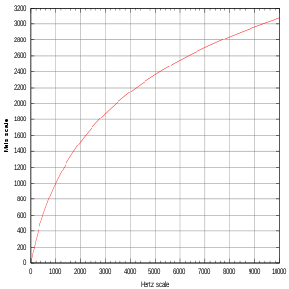
Critical band scale: Mel scale
Mel
Scale
(m)
Based on perceptual studies
Log. scale when freq. is above 1KHz
Linear scale when freq. is below 1KHz
Popular scales are the “Mel” (stands for melody) or “Bark” scales
Δm=150
(f) Freq in hz
Δf=7000-6000
Below 1KHz, Δf≈Δm, linear
Above 1KHz, Δf>Δm, log scale
http://en.wikipedia.org/wiki/Mel_scale

Slide 14
Exercise 3.0:
Exercise (i): When the input frequency ranges from 200 to 800 Hz (Δf=600Hz), what is the delta Mel (Δm) in the Mel scale?
Exercise (ii): When the input frequency ranges from 6000 to 7000 Hz (Δf=1000Hz), what is the delta Mel (Δm) in the Mel scale?

Slide 15
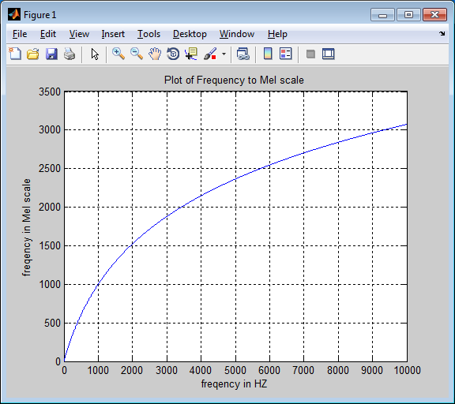
Matlab program to plot the mel scale
%plot mel scale, matlab
f=1:10000 %input frequency range
mel=(2595* log10(1+f/700));
figure(1)
clf
plot(f,mel)
grid on
xlabel('freqeuncy in HZ')
ylabel('freqeuncy Mel scale')
title('Plot of Frequency to Mel scale')
Plot
%Note: Someone uses log (natural log)
format shortG
f=1200 %1200 Hz
mel_1=1127.01048 * log((f/700) +1) %mel scale, using ln (natural log)
mel_2=2595.01048 * log10((f/700) +1) %mel scale , using log10, (base10)
> %got similar result
mel_1 = 1125.4
mel_2 = 1125.3

Slide 16
(C) Use Linear Predictive coding LPC to implement filters
Linear Predictive coding LPC methods

Slide 17
Motivation
Fourier transform is a frequency method for finding the parameters of an audio signal, it is the formal method to implement filter. However, there is an alternative, which is a time domain method, and it works faster. It is called Linear Predicted Coding LPC coding method. The next slide shows the procedure for finding the filter output.
The procedures are: (i) windowing (Hamming) (ii) Pre-emphasis, (iii) autocorrelation, (iv) LPC calculation, (v) (optional) Cepstral coefficient calculation
to find the representations the filter output.

Slide 18
Feature extraction data flow - The LPC (Liner predictive coding) method based method
Signal
windowing,
pre-emphasis -> autocorrelation-> LPC -->cepstral coef
(pre-emphasis) r₀,r₁,.., r_{p} a₁,.., a_{p} c₁,.., c_{p}
windowing is discussed in the previous chapter (Durbin alog.)

Slide 19
Pre-emphasis
“ The high concentration of energy in the low frequency range observed for most speech spectra is considered a nuisance because it makes less relevant the energy of the signal at middle and high frequencies in many speech analysis algorithms.”
From Vergin, R. etal. ,“"Compensated mel frequency cepstrum coefficients ", IEEE, ICASSP-96. 1996 .

Slide 20
Pre-emphasis -- high pass filtering (the effect is to suppress low frequency)
To reduce noise, average transmission conditions and to average signal spectrum.
Notes:
\begin{equation}\label{eq3_preamp}
\begin{split}
&S^{'}(k)=S(k)-\tilde{a}S(k-1)\\
&0.9<a<1.0, \text{typically } \tilde{a}=0.95\\
&For S(0),S(1),S(2),...\\
&\text{the value } S^{'}(0) \text{does not exist and is not used. Assume } S^{'}(0)=S^{'}(1)\\
&\tilde{a} = \text{pre\_emphasis constant }
\end{split}
\end{equation}

Slide 21
Class exercise 3.1
A speech waveform S has the values s0,s1,s2,s3,s4,s5,s6,s7,s8= [1,3,2,1,4,1,2,4,3].
Find the pre-emphasized wave if the pre-emphasis constant is 0.98.

Slide 22
The Linear Predictive Coding LPC method
Linear Predictive Coding LPC method
Time domain
Easy to implement
Achieve data compression

Slide 23
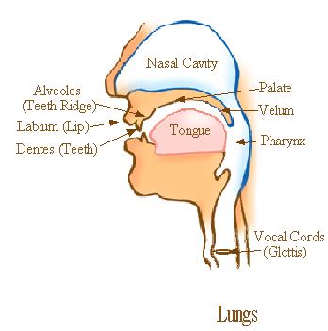
The LPC speech production model
Speech synthesis model:
Impulse train generator governed by pitch period-- glottis
Random noise generator for consonant.
Vocal tract parameters = LPC parameters
http://home.hib.no/al/engelsk/seksjon/SOFF-MASTER/ill061.gif
Glottal excitation
for vowel
LPC parameters
Voice/unvoiced
switch
Impulse train
Generator
Time varying
digital filter
Time-varying
X
output
digital filter
Noise
Generator
(Consonant)
Gain

Slide 24
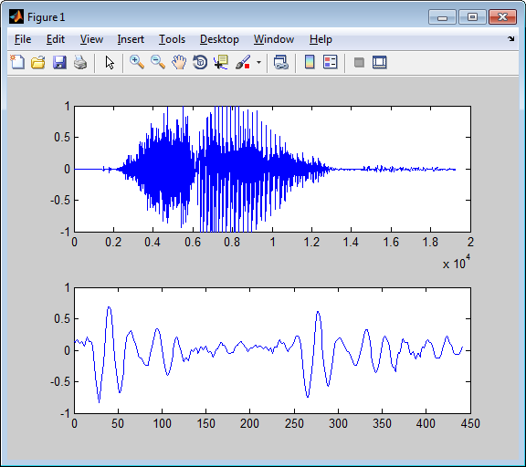
Example of a Consonant and Vowel Sound file : http://www.cse.cuhk.edu.hk/~khwong/www2/cmsc5707/sar1.wav
The sound of ‘sar’ (沙) in Cantonese
The sampling frequency is 22050 Hz, so the duration is 2x10⁴x(1/22050)=0.9070 seconds.
By inspection, the consonant ‘s’ is roughly from 0.2x10⁴ samples to 0.6 x10⁴samples.
The vowel ‘ar’ is from 0.62 x10⁴ samples to 1.2 2x10⁴ samples.
The lower diagram shows a 20ms (which is (20/1000)/(1/22050)=441=samples) segment (vowel sound ‘ar’) taken from the middle (from the location at the 1x10⁴ ^{th} sample) of the sound.
%Sound source is from http://www.cse.cuhk.edu.hk/~khwong/www2/cmsc5707/sar1.wav
[x,fs]=wavread('sar1.wav'); %Matlab source to produce plots
fs % so period =1/fs, during of 20ms is 20/1000
%for 20ms you need to have n20ms=(20/1000)/(1/fs)
n20ms=(20/1000)/(1/fs) %20 ms samples
len=length(x)
figure(1),clf, subplot(2,1,1),plot(x)
subplot(2,1,2),T1=round(len/2); %starting point
plot(x(T1:T1+n20ms))
Consonant (s), Vowel(ar)
The vowel
wave is periodic

Slide 25
For vowels (voiced sound), use LPC to represent the signal
The concept is to find a set of parameters ie. α₁, α₂, α₃, α₄,.. α_{p=8} to represent the same waveform (typical values of p=8->13)
For example
Input waveform
Can reconstruct the waveform from
these LPC codes
Time frame y
α1, α2, α3, α4,.. α8
30ms
Time frame y+1
α’1, α’2, α’3, α’4,.. α’8
30ms
α’’1, α’’2, α’’3, α’’4,.. α’’8
:
Time frame y+2
30ms
Each time frame y=512 samples
(S₀,S₁,S₂,. S_{n},S_{N-1=511})
512 integer numbers (16-bit each)
Each set has 8 floating point numbers (data compressed)

Slide 26

Class Exercise 3.2 Concept: we want to find a set of a1,a2,..,a8, so when applied to all Sn in this frame (n=0,1,..N-1), the total error E (n=0→N-1)is minimum
$$\text{Predicted} {\tilde{s}}_{n} \text{at} n \text{using} \text{the} \text{past} \text{history} \\ {\tilde{s}}_{n}=a_{1}s_{n−1}+a_{2}s_{n−2}+a_{3}s_{n−3}+...+a_{p}s_{n−p} \\ \text{predicted} \text{error} \text{at} n=e_{n}=s_{n}−{\tilde{s}}_{n} \\ \text{so}\text{,} \text{error} E is \text{for} \text{the} \text{whole} \text{segment} \text{from} n=0 to N−1 \\ E=\sum_{n=0}^{n=N−1}{{\left(e_{n}\right)}^{2}}$$
Exercise 2.2
Write the error function e_{n} at n=130, draw it on the graph
Write the error function at n=288
Why e₀= s₀?
Write E for n=1,..N-1, (showing n=1, 8, 130,288,511)
S
Signal
level
S_{n-1}
S_{n-2}
S_{n}
S_{n-4}
S_{n-3}
Time n
0
n
N-1=511
Notes:
\begin{equation}\label{eq3_LPC0}
\begin{split}
&\text{Predicted } \tilde{s}_n \text{ at $n$ using the past history }\\
&\tilde{s}_n=a_1s_{n-1}+a_2s_{n-2}+...+a_ps_{n-p}\\
&\text{predicted error at $n$ }=e_n=s_n-\tilde{s_n} \\
&\text{So the error $E$ for the whole segment from } n=0 \text{ to } N-1 \text { is }\\
&R=\sum_{n=0}^{n=N-1}\left( e_n \right)^2
\end{split}

Slide 27
LPC idea and procedure
W3
The idea: from all samples s₀,s₁,s₂,s_{N-1=511}, we want to find a_{p}(p=1,2,..,8), so that E is a minimum. The periodicity of the input signal provides information for finding the result.
Procedures
For a speech signal, we first get the signal frame of size N=512 by windowing(will discuss later).
Sampling at 25.6KHz, it is equal to a period of 20ms.
The signal frame is (S₀,S₁,S₂,. S_{n}..,S_{N-1=511}) total 512 samples.
Ignore the effect of outside elements by setting them to zero, I.e. S_{-∞} ..=S₋₂ = S₋₁ =S₅₁₂ =S₅₁₃=…= S∞=0 etc.
We want to calculate LPC parameters of order p=8, i.e. α₁, α₂, α₃, α₄,.. α_{p=8}.
P=8 is the minimal choice , using higher P, say up to 13 will get better sound quality. But experiments show that p>13 has no significant impact on the sound quality.

Slide 28

For each 30ms time frame
Input waveform
Time frame y
α1, α2, α3, α4,.. α8
30ms
$$\text{The} \text{predicted} \text{value} s_{n} \text{is} \text{denoted} \text{by} {\tilde{s}}_{n} \\ {\tilde{s}}_{n}=a_{1}s_{n−1}+a_{2}s_{n−2}+a_{3}s_{n−3}+...+a_{p}s_{n−p}−−−(1) \\ \text{prediction} \text{error} \\ e_{n}=s_{n}−{\tilde{s}}_{n},\text{from} (1) \\ e_{n}=s_{n}−(a_{1}s_{n−1}+a_{2}s_{n−2}+a_{3}s_{n−3}+...+a_{p}s_{n−p}) \\ e_{n}=s_{n}−\sum_{i=1}^{i=p}{a_{i}s_{n−i}}, \\ \text{so}\text{, }\text{for} \text{the} \text{whole} \text{frame} \text{from} n=0 to N−1 \\ E=\sum_{n=0}^{n=N−1}{{\left(e_{n}\right)}^{2}}=\sum_{n=0}^{n=N−1}{{\left(s_{n}−\sum_{i=1}^{i=p}{a_{i}s_{n−i}}\right)}^{2}} \\ \text{To} \text{find} a_{i=1,2,..p} \text{that} \text{generates} Emin\text{, }\text{need} \text{to} \text{solve} \text{for} \frac{∂E}{∂a_{i}}\text{=0, }\text{for} \text{all} \text{i}\text{=1,2,}…p$$
Notes:
\begin{equation}\label{eq3_LPC1}
\begin{split}
&\text{The predicted value } s_n \text{ is denoted by }\tilde{s}_n\\
&\tilde{s}_n=a_1s_{n-1}+a_2s_{n-2}+...+a_ps_{n-p}---(*)\\
&\text{predicted error }\\
&e_n=s_n-\tilde{s}, \text{from} (*)\\
&e_n=s_n-(a_1s_{n-1}+a_2s_{n-2}+...+a_ps_{n-p})\\
&e_n=s_n-\sum_{i=1}^{i=p}a_is_{n-i},\\
&\text{So the whole frame from n=0 to N-1}\\
&E=\sum_{n=1}^{n=N-1}{(e_n)}^2=\sum_{n=1}^{n=N-1}{\left( s_n-\sum_{i=1}^{i=p}a_is_{n-i} \right) }^2\\
&\text{To find } a_{i=1,2,...p} \text{ that generate } E_{min}, \text{solve }\frac{\partial E}{\partial a_i}=0 \text{ for all i=1,2,...,p}
\end{split}
\end{equation}

Slide 29
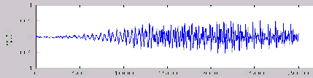
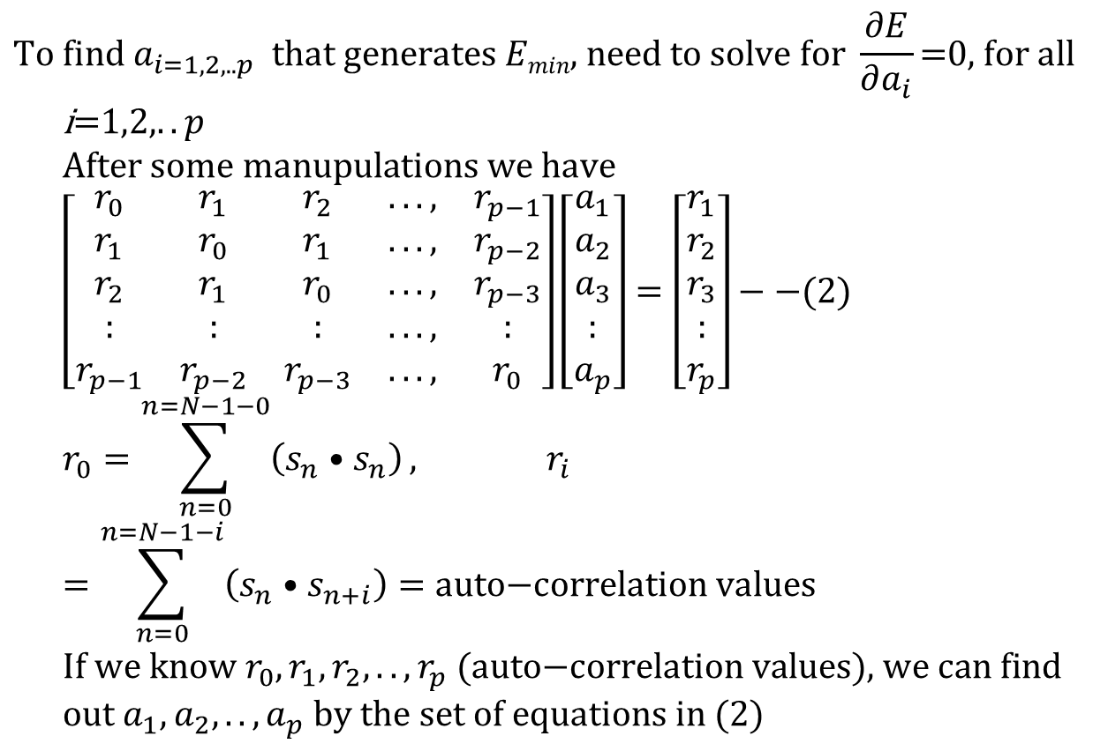
Solve for a_{1,2,…,p}
Input waveform
Time frame y
α1, α2, α3, α4,.. α8
30ms
$$\text{To} \text{find} a_{i=1,2,..p} \text{that} \text{generates} Emin\text{, }\text{need} \text{to} \text{solve} \text{for} \frac{∂E}{∂a_{i}}\text{=0, }\text{for} \text{all} \text{i}\text{=1,2,}..p \\ \text{After} \text{some} \text{manupulations} \text{we} \text{have} \\ \left[\begin{matrix}r_{0} & r_{1} & r_{2} & ..., & r_{p−1} \\ r_{1} & r_{0} & r_{1} & ..., & r_{p−2} \\ r_{2} & r_{1} & r_{0} & ..., & r_{p−3} \\ : & : & : & ..., & : \\ r_{p−1} & r_{p−2} & r_{p−3} & ..., & r_{0}\end{matrix}\right]\left[\begin{matrix}a_{1} \\ a_{2} \\ a_{3} \\ : \\ a_{p}\end{matrix}\right]=\left[\begin{matrix}r_{1} \\ r_{2} \\ r_{3} \\ : \\ r_{p}\end{matrix}\right]−−(2) \\ r_{0}=\sum_{n=0}^{n=N−1−0}{\left(s_{n}•s_{n}\right)}, r_{i}=\sum_{n=0}^{n=N−1−i}{\left(s_{n}•s_{n+i}\right)=\text{auto}\text{−}\text{correlation} \text{values}} \\ \text{If} \text{we} \text{know} r_{0},r_{1},r_{2},..,r_{p}\text{ (}\text{auto}\text{−}\text{correlation} \text{values}\text{)}\text{, }\text{we} \text{can} \text{find} \text{out} a_{1},a_{2},..,a_{p} \text{by} \text{the} \text{set} \text{of} \text{equations} \text{in} (2)$$
Derivations can be found at
http://www.cslu.ogi.edu/people/hosom/cs552/lecture07_features.ppt
See (https://en.wikipedia.org/wiki/Linear_prediction)
Use Durbin’s equation
to solve this
Notes:
\begin{equation}\label{eq3_LPC2}
\begin{split}
%
&\begin{bmatrix}
r_0 & r_1 & r_2 & ..., & r_{p-1} \\
r_1 & r_0 & r_1 & ..., & r_{p-2} \\
r_2 & r_1 & r_0 & ..., & r_{p-3} \\
: & : & : & ..., & : \\
r_{p-1} & r_{p-2} & r_{p-3} & ..., & r_0
\end{bmatrix}
%
\begin{bmatrix}
a_1\\
a_2\\
a_3\\
:\\
a_{p}
\end{bmatrix}=
%
\begin{bmatrix}
r_1\\
r_2\\
r_3\\
:\\
r_{p}
\end{bmatrix}-----(**)\\
&\text{where } r_0=\sum_{n=0}^{n=N-1-0}(s_n \cdot s_n), r_i=\sum_{n=0}^{n=N-1-i}(s_n \cdot s_{n+i})=\text{ auto-correlation function } \\
\end{split}
\end{equation}\\
If we know $r_0,r_1,r_2,...,r_p$, we can find out $a_1,a_2,a_3,...,a_p$ by the set of equation in (**). See \cite{LPC_wiki} for more information.

Slide 30
The example
For each time frame (25 ms), data is valid only inside the window.
20.48 KHZ sampling, a window frame (25ms) has 512 samples (N)
Require 8-order LPC, i=1,2,3,..8
Calculate using r₀, r₁, r₂,.. r₈, using the above formulas, then get LPC parameters a₁, a₂,.. a₈ by the Durbin recursive Procedure.

Slide 31

Steps for each time frame to find a set of LPC
(step1) N=WINDOW=512, the speech signal is s₀,s₁,..,s₅₁₁
(step2) Order of LPC is 8, so r₀, r₁,.., s₈ required are:
(step3) Solve the set of linear equations (see previous slides)
$r_{0}=s_{0}s_{0}+s_{1}s_{1}+s_{2}s_{2}+s_{3}s_{3}+s_{4}s_{4}+...+s_{511}s_{511}$ $$r_{1}=s_{0}s_{1}+s_{1}s_{2}+s_{2}s_{3}+s_{3}s_{4}+s_{4}s_{5}+...+s_{510}s_{511} \\ r_{2}=s_{0}s_{2}+s_{1}s_{3}+s_{2}s_{4}+s_{3}s_{5}+s_{4}s_{6}+...+s_{509}s_{511} \\ r_{3}=s_{0}s_{3}+s_{1}s_{4}+s_{2}s_{5}+s_{3}s_{6}+s_{4}s_{7}+...+s_{508}s_{511} \\ ⇓ \\ r_{7}=s_{0}s_{7}+s_{1}s_{8}+s_{2}s_{9}+s_{3}s_{10}+s_{4}s_{11}+...+s_{504}s_{511} \\ r_{8}=s_{0}s_{8}+s_{1}s_{9}+s_{2}s_{10}+s_{3}s_{11}+s_{4}s_{12}+...+s_{503}s_{511}$$
Notes:
\begin{equation}\label{eq3_LPC3}
\begin{split}
&r_0=s_0 s_0 + s_1 s_1 +s_2 s_2 +s_3 s_3 +s_4 s_4 +...+s_{511} s_{511}\\
&r_1=s_0 s_1 + s_1 s_2 +s_2 s_3 +s_3 s_4 +s_4 s_5 +...+s_{510} s_{511}\\
&r_2=s_0 s_2 + s_1 s_3 +s_2 s_4 +s_3 s_5 +s_4 s_6 +...+s_{509} s_{511}\\
&r_3=s_0 s_3 + s_1 s_4 +s_2 s_5 +s_3 s_6 +s_4 s_7 +...+s_{508} s_{511}\\
:\\
&r_7=s_0 s_7 + s_1 s_8 +s_2 s_9 +s_3 s_{10} +s_4 s_{11} +...+s_{504} s_{511}\\
&r_8=s_0 s_8 + s_1 s_9 +s_2 s_{10} +s_3 s_{11} +s_4 s_{12} +...+s_{503} s_{511}\\
\end{split}
\end{equation}

Slide 32
Program segmentation algorithm for auto-correlation
WINDOW=size of the frame; auto_coeff = autocorrelation matrix; sig = input, ORDER = lpc order
void autocorrelation(float *sig, float *auto_coeff)
{int i,j;
for (i=0;i<=ORDER;i++)
{
auto_coeff[i]=0.0;
for (j=i;j<WINDOW;j++)
auto_coeff[i]+= sig[j]*sig[j-i];
}
}
Notes:
%%MMMMMMMMMMMMMMMMMMMMMMMMMMMMMMMMMMMMMMMM
\section*{program segment for auto-correlation}
\begin{lstlisting}
WINDOW=size of the frame; auto\_coeff=autocorrelation matrix; sig =input
ORDER=lpc\_order
void autocorrelation(float *sig, float *auto\_coeff}
{int i,j;
for (i=0;i<=ORDER;i++)
auto\_coeff[i]=0.0;
for(j=i;j<WINDOW;j++)
auto_coeff[i]+=sig[j]*sig[j-i];
}
}
\end{lstlisting}
%%MMMMMMMMMMMMMMMMMMMMMMMMMMMMMMMMMMMMMMMM

Slide 33
To calculate LPC a[ ] from auto-correlation matrix *coef using Durbin’s Method (solve equation 2)
void lpc_coeff(float *coeff)
{int i, j; float sum,E,K,a[ORDER+1][ORDER+1];
if(coeff[0]==0.0) coeff[0]=1.0E-30;
E=coeff[0];
for (i=1;i<=ORDER;i++)
{ sum=0.0;
for (j=1;j<i;j++) sum+= a[j][i-1]*coeff[i-j];
K=(coeff[i]-sum)/E; a[i][i]=K; E*=(1-K*K);
for (j=1;j<i;j++) a[j][i]=a[j][i-1]-K*a[i-j][i-1];
}
for (i=1;i<=ORDER;i++) coeff[i]=a[i][ORDER];}
Example matlab -code can be found at
http://www.mathworks.com/matlabcentral/fileexchange/13529-speech-compression-using-linear-predictive-coding
Notes:
%%%LLLLLLLLLLLLLLLLLLLLLLLLLLLLLLLLLLLLLLLLLLLLLLLLLL
\section*{To calculate LPC a[ ] from auto-correlation matrix *coef using Durbin’s Method (solve equation **) }
\begin{lstlisting}
void lpc_coeff(float *coeff)
{int i, j; float sum,E,K,a[ORDER+1][ORDER+1];
if(coeff[0]==0.0) coeff[0]=1.0E-30;
E=coeff[0];
for (i=1;i<=ORDER;i++)
{ sum=0.0;
for (j=1;j<i;j++) sum+= a[j][i-1]*coeff[i-j];
K=(coeff[i]-sum)/E; a[i][i]=K; E*=(1-K*K);
for (j=1;j<i;j++) a[j][i]=a[j][i-1]-K*a[i-j][i-1];
}
for (i=1;i<=ORDER;i++) coeff[i]=a[i][ORDER];}
\end{lstlisting}
%%%%LLLLLLLLLLLLLLLLLLLLLLLLLLLLLLLLLLLLLLLLLLLLLLL

Slide 34
Class exercise 3.3
A speech waveform S has the values s0,s1,s2,s3,s4,s5,s6,s7,s8= [1,3,2,1,4,1,2,4,3]. The frame size is 4.
For this exercise , for simplicity no pre-emphasis is used (or assume pre-emphasis constant is 0)
Find auto-correlation parameter r0, r1, r2 for the first frame.
If we use LPC order 2 for our feature extraction system, find LPC coefficients a1, a2.
If the number of overlapping samples for two frames is 2, find the LPC coefficients of the second frame.
Repeat the question if pre-emphasis constant is 0.98

Slide 35
Application of LPC for speech data compression
Example code in Matlab
https://www.mathworks.com/matlabcentral/fileexchange/13529-speech-compression-using-linear-predictive-coding/content/LPC_fin
Demo video: Sound recorder and reconstructed using LPC https://youtu.be/KpmvGju_WcM
Pulse train simulates
Glottal Pluses
e.g (50Hz)
LPC parameters (order 10)
Voice/unvoiced
switch
Impulse train
Generator
Time varying
digital filter
Time-varying
X
output
digital filter
Gain
35

Slide 36
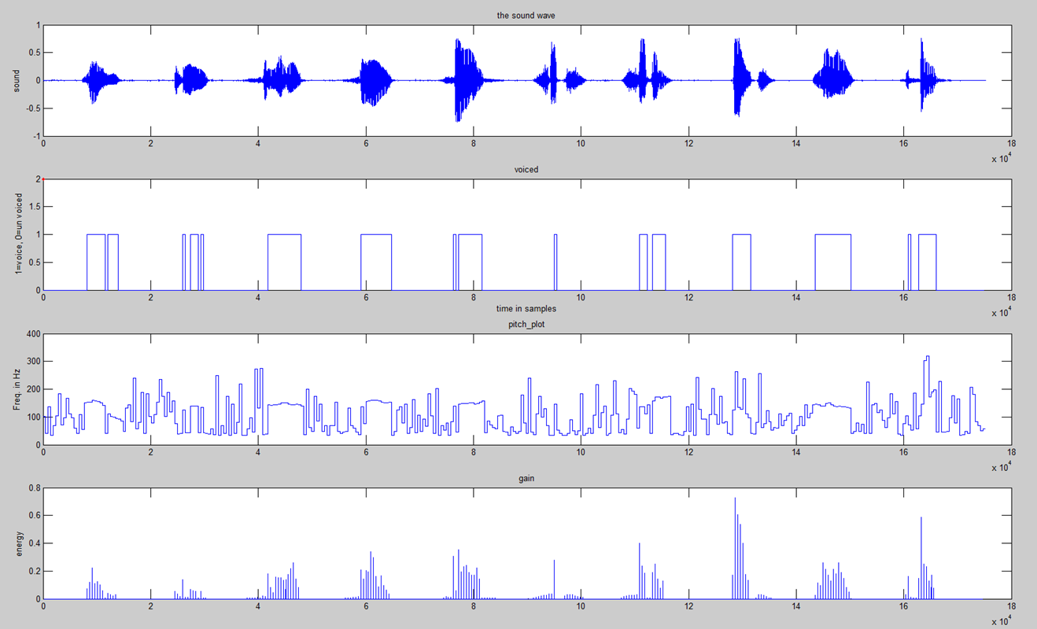
1 2 3 4 5 6 7 8 9 10
Sound
Source
In time
samples
1=Voice
or
0=unvoiced
Pitch
Frequency
In Hz
Energy
Demo video: Sound recorder and reconstructed using LPC https://youtu.be/KpmvGju_WcM

Slide 37
(D) Cepstrum
A new word by reversing the first 4 letters of spectrum → cepstrum.
It is the spectrum of a spectrum of a signal
MFCC (Mel-frequency cepstrum) is the most popular audio signal representation method nowadays

Slide 38
Glottis and cepstrum Speech wave (X(m))= Excitation (E(m)) . Filter (H(m))
[X(m)]
[H(m)]
(Vocal tract filter)
Output
So voice has a
strong glottis
Excitation,
X(m) is in Frequency domain content
In Ceptsrum
We can easily identify and
remove the glottal excitation
[E(m)]
Glottal excitation
From
Vocal cords
(Glottis)
http://home.hib.no/al/engelsk/seksjon/SOFF-MASTER/ill061.gif

Slide 39


Recall: Discrete Fourier transform DFT and Inverse Discrete Fourier transform IDFT
https://en.wikipedia.org/wiki/Discrete_Fourier_transform
Matlab code:
https://www.mathworks.com/matlabcentral/fileexchange/41228-dft-and-idft/content/Untitled3.m
$$\text{Fourier} \text{Transform} \\ X_{m}=\sum_{k=0}^{N−1}{s_{k}⋅e^{−i\frac{2πkm}{N}}}=\sum_{k=0}^{N−1}{s_{k}⋅\left(\cos\left(\frac{2πkm}{N}\right)−i\sin\left(\frac{2πkm}{N}\right)\right)} \\ \text{Inverse} \text{Fourier} \text{Transform} \\ s_{k}=\frac{1}{N}\sum_{m=0}^{N−1}{X_{m}⋅e^{i\frac{2πkm}{N}}}=\frac{1}{N}\sum_{m=0}^{N−1}{X_{m}⋅\left(\cos\left(\frac{2πkm}{N}\right)+i\sin\left(\frac{2πkm}{N}\right)\right)}$$
$$\text{Note}\text{: } \\ e^{jθ}=\cos{(}θ)+j\sin{(}θ), \\ \sin{(}−θ)=−\sin{(}θ), \\ \cos{(}−θ)=\cos{(}θ)$$
N=number of time samples
k=time index of the current sample , it is from 0 to N-1
s_{k}=value of the signal sample at time k
m=frequency index (from 0 Hz to N-1 Hz)
X_{m}= amount of frequency m in the signal of all s_{k}
Notes:
\begin{equation}\label{eq3_FOURIER}
\begin{split}
&X_m=\sum_{k=0}^{N-1}s_k \cdot e^{-i \frac{s\pi k m}{N}}=\sum_{k=0}^{N-1} s_k \cdot
\left( cos \left(- \frac {2 \pi k m} {N} \right)
+i \cdot sin \left(- \frac {2 \pi k m} {N} \right)
\right) \\
%
&s_m=\frac{1}{N} \sum_{k=0}^{N-1}X_m \cdot e^{-i \frac{s\pi k m}{N}}=\frac{1}{N} \sum_{k=0}^{N-1} X_m \cdot
\left( cos \left( \frac {2 \pi k m} {N} \right)
+i \cdot sin \left( \frac {2 \pi k m} {N} \right)
\right)
\end{split}
\end{equation}Where,\\
$N$=number of time samples\\
$k$=time index of the current sample , it is from 0 to $N-1$\\
$s_k$=value of the signal sample at time $k$\\
$m$=frequency index (from 0 Hz to $N-1$ Hz)\\
$X_m$= amount of frequency m in the signal of all s$_k$

Slide 40
Cepstral analysis
Ref: http://iitg.vlab.co.in/?sub=59&brch=164&sim=615&cnt=1
Signal(s)=convolution(*) of
glottal excitation (e) and vocal_tract_filter (h)
s(k)=e(k)*h(k), k is time index
After Fourier transform FT: FT{s(k)}=FT{e(k)*h(k)}
Convolution(*) becomes multiplication (.)
n(time index)→ m(frequency index),
S(m) = E(m).H(m)
Find the magnitude of the spectrum
|S(m)| = |E(m)|.|H(m)|
log₁₀ |S(m)|= log₁₀{|E(m)|}+ log₁₀{|H(m)|}
Cepstrum C(n)=IDFT(log₁₀ |S(m)|)=IDFT(log₁₀{|E(m)|}+ log₁₀{|H(m)|})
Note: Fourier transform has Linearity property:
DFT{ax(t)+b(y(t)}=a∙DFT{x(t)}+b∙DFT{y(t)}
See http://fourier.eng.hmc.edu/e101/lectures/handout3/node2.html

Slide 41
Cepstrum
In MFCC (Mel scale cepstral coefficients) implementation
IDCT (Inverse Discrete Cosine Transform) is used to reduce dimension from filter bands (e.g. 20) to MFCC (e.g. 13).see appendix
C(n)=IDFT[log₁₀ |X(m)|]=
IDFT[ log₁₀{|E(m)|} + log₁₀{|H(m)|} ]
Why do we prefer to use Cepstrum? Because in C(n), you can see E(n) and H(n) are at two different positions along the n axis.
Therefore you can use it for
(i) glottal excitation removal
(ii) vocal tract filter analysis
X(m)
Log|X(w)|
S(k)
windowing
DFT
Log|X(m)|
IDFT
/IDCT
C(n)
k=time index
m=frequency
I-DFT=Inverse-discrete Fourier transform
n=index for Cepstrum

Slide 42
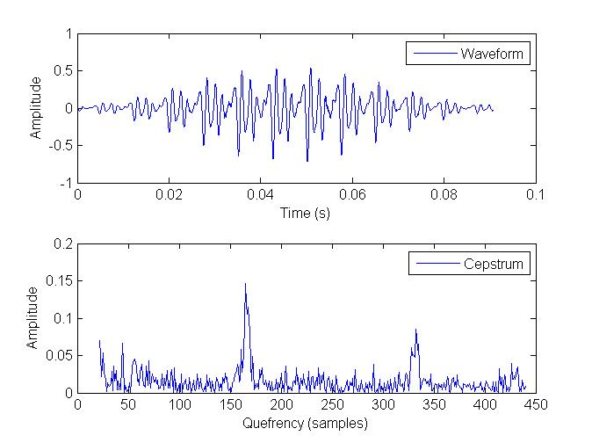
Example of cepstrum http://www.cse.cuhk.edu.hk/%7Ekhwong/www2/cmsc5707/demo_for_ch4_cepstrum.zip Run spCepstrumDemo in matlab
'sor1.wav‘=sampling frequency 22.05KHz
S(k)
Cepstral
transform
K time index
Cepstrum
n axis

Slide 43
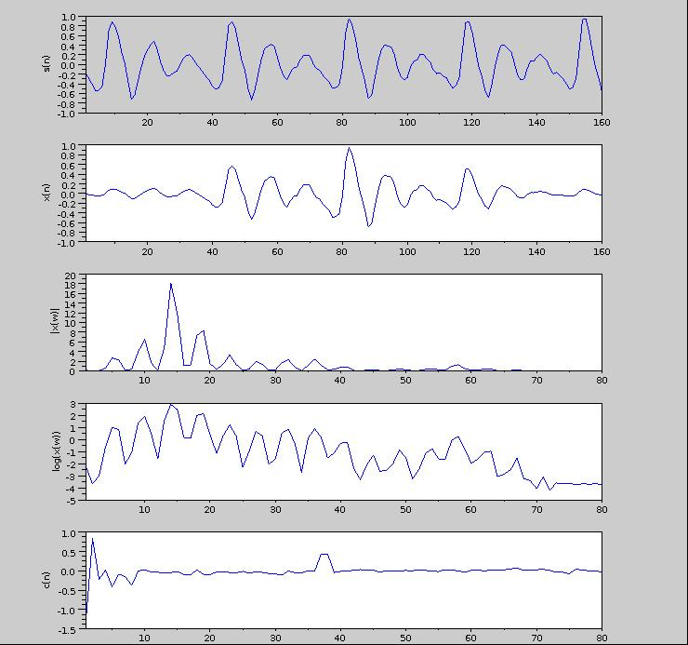
s(n) time
domain signal
x(n)=windowed(s(n))
Suppress two sides
|x(w)|=dft(x(n))
= frequency signal
(dft=discrete Fourier transform)
Log (|x(w)|)
C(n)=
iDft(Log (|x(w)|))
gives Cepstrum
Glottal excitation cepstrum
Vocal track
cepstrum
http://iitg.vlab.co.in/?sub=59&brch=164&sim=615&cnt=1
http://www.engineeringproductivitytools.com/stuff/T0001/PT01.HTM

Slide 44
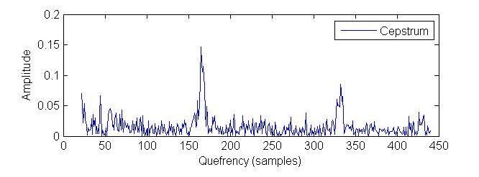
Liftering (to remove glottal excitation)
Low time liftering:
Magnify (or Inspect) the low time to find the vocal tract filter cepstrum
High time liftering:
Magnify (or Inspect) the high time to find the glottal excitation cepstrum (remove this part for speech recognition.
Vocal tract
Cepstrum
Used for
Speech
recognition
Glottal excitation
Cepstrum, useless for
speech recognition,
Cut-off Found
by experiment
Frequency =FS/ quefrency
FS=sample frequency
=22050

Slide 45
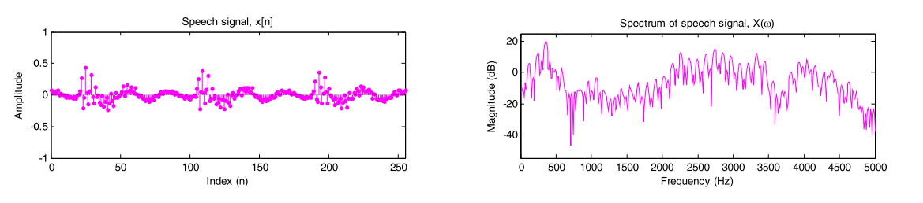
Reasons for liftering Cepstrum of speech
Why we need this?
Answer: remove the ripples
of the spectrum caused by
glottal excitation.
Too many ripples in the spectrum caused by vocal
cord vibrations (glottal excitation).
But we are more interested in
the speech envelope (vocal track characteristic) for recognition and reproduction
Fourier
Transform
Input speech signal x
Spectrum of x
http://isdl.ee.washington.edu/people/stevenschimmel/sphsc503/files/notes10.pdf

Slide 46
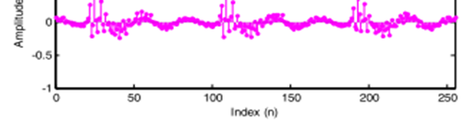
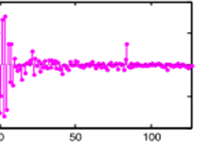
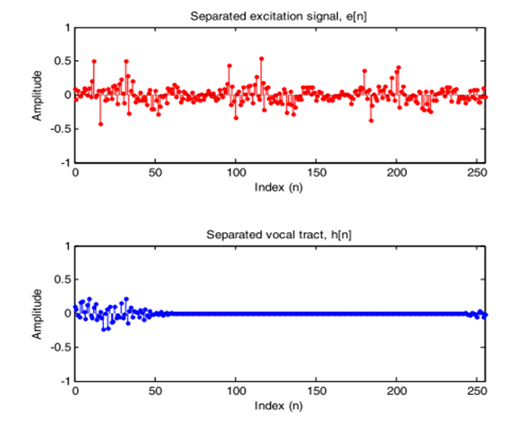
Liftering method: Select the high time and low time liftering
Signal X
Cepstrum
(quefrency)
Select low time
C_low (show vocal track characteristic)
Select high time, C_high (show glottal excitation characteristic)

Slide 47
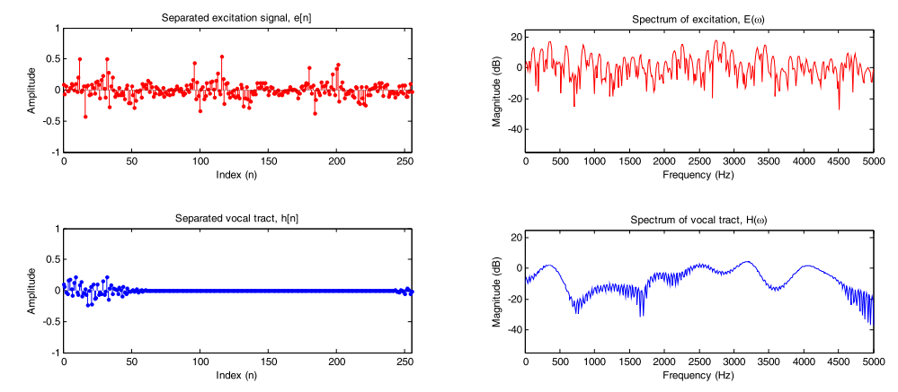
Recover Glottal excitation and vocal track spectrum
No use
Spectrum of glottal excitation
Cepstrum of glottal excitation
C_high
For
Glottal
excitation
C_low
For
Vocal track
characterictic
Frequency
Spectrum of vocal track filter
Cepstrum of vocal track
Frequency
quefrency (sample index)
This peak may be the pitch period:
This smoothed vocal track spectrum can be used to find pitch
For more information see :
http://isdl.ee.washington.edu/people/stevenschimmel/sphsc503/files/notes10.pdf

Slide 48
Exercise 3.4
Write the procedure for finding the cepstral coefficients of a speech signal S(k).
Why do we need low time liftering?
Why do we need high time liftering?
Given X(m) is the spectrum , C(n) is the cepstrum , E(m) is the glottal excitation and H(w) is the vocal track response and
|X(m)| = |E(m)|.|H(m)|,
log₁₀ |X(m)|= log₁₀{|E(m)|}+ log₁₀{|H(m)|}
Cepstrum C(n)=IDFT(log₁₀ |X(m)|)=IDFT(log₁₀{|E(m)|}+ log₁₀{|H(m)|})
Why do cepstrum rather spectrum is used for glottal excitation (E) removal?

Slide 49
Summary
Learned
Audio feature types
Signal filtering
How to extract audio features
Mel scale signal processing
Cepstrum and cepstral coefficients

Slide 50
Appendix: Discrete Cosine Transform DCT demo_ch3_dct_vs_fft.m see also https://en.wikipedia.org/wiki/Discrete_cosine_transform
% demo_ch3_dct_vs_fft.m
%MATLAB program to show difference between dct and fft
%this is to sow exp () and sin, cos generate the same result
%program to find the DFT/IDFT of a sequence without using the inbuilt functions
close all;
clear all;
%xn=input('Enter the sequence x(n)'); %Get the sequence from user
xn=[8,16,24,32,40,48,56,64]
xk_fft=fft(xn);
xn_recovered_full_magnitude=abs(ifft(xk_fft));
'if we remove the last 4 fft parameters, we can still recover the sequence xn'
xk_fft(5)=0;
xk_fft(6)=0;
xk_fft(7)=0;
xk_fft(8)=0;
xn_recovered_truncated4_magnitude=abs(ifft(xk_fft));
'show all rsulst'
'orginal xn'
xn
'xn_recovered_full_magnitude'
xn_recovered_full_magnitude
'xn_recovered_truncated4_magnitude'
xn_recovered_truncated4_magnitude
'press key to continue, will test dct'
'it shows the xn_recovered_truncated4_magnitude is not the same as xn'
pause
%%%%%%%%%%%%%%%%%%%%%%%%%%%%%%%%%%%%%%%%%%%%%%%%%%%%%%%%%%%%%%%%%%%%%%%%%%
'if we remove the last 4 dct parameters, we can still recover the sequence xn'
xn_recovered_by_idct_full=idct(dct(xn))
'xn_recovered_by_idct_full'
xn_recovered_by_idct_full
%%% now truncate some dct parameters
xk3_dct=dct(xn)
xk3_dct(5)=0;
xk3_dct(6)=0;
xk3_dct(7)=0;
xk3_dct(8)=0;
xn_recovered_by_idct_truncated4=idct(xk3_dct);
'compare results'
'original input xn'
xn
'xn_recovered_by_idct_full'
xn_recovered_by_idct_full
'xn_recovered_by_idct_truncated4'
xn_recovered_by_idct_truncated4
disp('the whole program shows for dct even you truncate 4 high frequency parameters')
disp('you can still recovered most of the original data xn')
disp('but it is not true for fft , so dct is suitable for data compression, it is used in mp3 and jpeg')

Slide 51
ANSWER: Exercise 3.0:
Answer(i): also Δm=600Hz, because it is a linear scale for this frequency range.
Answer (ii): By observation, in the Mel scale diagram it is from 2600 to 2750, so delta Mel (Δm) in the Mel scale from 2600 to 2750, Δm=150 . It is a log scale change. We can re-calculate the result using the formula M=2595 log₁₀(1+f/700),
M_low=2595 log₁₀(1+f_low/700)= 2595 log₁₀(1+6000/700),
M_high=2595 log₁₀(1+f_high/700)= 2595 log₁₀(1+7000/700),
Delta_m(Δm) = M_high - M_low = (2595* log10(1+7000/700))-( 2595* log10(1+6000/700)) = 156.7793 (Δm≈150 , which agrees with the observation, it shows Mel scale is a log scale for this frequency range)

Slide 52
Answer: Class exercise 3.1
A speech waveform S has the values s0,s1,s2,s3,s4,s5,s6,s7,s8= [1,3,2,1,4,1,2,4,3]. The frame size is 4.
Find the pre-emphasized wave if is 0.98.
Answer:
s’1=s1- (0.98*s0)=3-1*0.98= 2.02
s’2=s2- (0.98*s1)=2-3*0.98= -0.94
s’3=s3- (0.98*s2)=1-2*0.98= -0.96
s’4=s4- (0.98*s3)=4-1*0.98= 3.02
s’5=s5- (0.98*s4)=1-4*0.98= -2.92
s’6=s6- (0.98*s5)=2-1*0.98= 1.02
s’7=s7- (0.98*s6)=4-2*0.98= 2.04
s’8=s8- (0.98*s7)=3-4*0.98= -0.92

Slide 53
Answers: Exercise 3.2
Prediction error
measured
predicted
Write error function at N=130,draw e_{n} on the graph
Write the error function at N=288
Why e₁= 0?
Answer: Because s₋₁, s₋₂,.., s₋₈ are outside the frame and they are considered as 0. The effect to the overall solution is very small.
Write E for n=1,..N-1, (showing n=1, 8, 130,288,511)
$$e_{130}=s_{130}−{\tilde{s}}_{130}=s_{130}−(a_{1}s_{129}+a_{2}s_{128}+a_{3}s_{127}+...+a_{p}s_{130−8=122})$$
$$e_{288}=s_{288}−{\tilde{s}}_{288}=s_{288}−(a_{1}s_{287}+a_{2}s_{286}+a_{3}s_{285}+...+a_{p}s_{288−8=280})$$
$$E={\left[s_{0}−{\tilde{s}}_{0}\right]}^{2}+{\left[s_{1}−{\tilde{s}}_{1}\right]}^{2}+..+{\left[s_{8}−{\tilde{s}}_{8}\right]}^{2}+..+{\left[s_{130}−{\tilde{s}}_{130}\right]}^{2}+..+{\left[s_{288}−{\tilde{s}}_{288}\right]}^{2}+..{\left[s_{511}−{\tilde{s}}_{511}\right]}^{2}$$

Slide 54

Answer: Class exercise 3.3
Frame size=4, first frame is [1,3,2,1]
r0=1x1+ 3x3 +2x2 +1x1=15
r1= 3x1 +2x3 +1x2=11
r2= 2x1 +1x3=5
$$\left[\begin{matrix}r0 & r1 \\ r1 & r0\end{matrix}\right]\left[\begin{matrix}a1 \\ a2\end{matrix}\right]=\left[\begin{matrix}r1 \\ r2\end{matrix}\right] \\ \left[\begin{matrix}15 & 11 \\ 11 & 15\end{matrix}\right]\left[\begin{matrix}a1 \\ a2\end{matrix}\right]=\left[\begin{matrix}11 \\ 5\end{matrix}\right] \\ \left[\begin{matrix}a1 \\ a2\end{matrix}\right]=inverse\left(\left[\begin{matrix}15 & 11 \\ 11 & 15\end{matrix}\right]\right)\left[\begin{matrix}11 \\ 5\end{matrix}\right] \\ \left[\begin{matrix}a1 \\ a2\end{matrix}\right]= \left[\begin{matrix}\text{1.0577} \\ \text{−0.4423}\end{matrix}\right]$$

Slide 55
Answer: Exercise 3.4
Write the procedure for finding the cepstral coefficients of a speech signal S(k).
s(n) time
domain signal
s’(k)=windowed(s(k)) Suppress two sides
→|X(m)|=dft(s’(k)) = frequency signal
→(dft=discrete Fourier transform)
→Log (|X(m)|)
→C(n)=iDft(Log (|X(m)|))
C(n) =Cepstrum coefficients
Why do we need low time liftering?
Answer: remove glottal excitation, so that vocal track responses can be found
Why do we need high time liftering?
Answer: remove vocal track information , so that glottal excitation can be found
Given X(m) is the spectrum , C(n) is the cepstrum , E(m) is the glottal excitation and H(m) is the vocal track response and
|X(w)| = |E(m)|.|H(m)|
log₁₀ |X(m)|= log₁₀{|E(m)|}+ log₁₀{|H(m)|}
Cepstrum C(n)=IDFT(log₁₀ |X(w)|)=IDFT(log₁₀{|E(m)|}+ log₁₀{|H(m|})
Why do cepstrum rather spectrum is used for glottal excitation E(m) removal?
Answer: Because spectrum, E and H are mixed by multiplication, While in Cepstrum
Glottal excitation E and vocal track characteristic H are appear separately on the quefrency axis indexed by n. So it can easily be separated.

