Slide 1
Ch. 4: Feature representation
Using Vector Quantization (VQ) and K-means

Slide 2
Representing features using Vector Quantization (VQ)
Speech data is not random, human voices have limited forms.
Vector quantization is a data compression method
raw speech 10KHz/8-bit data for a 30ms frame is 300 bytes
10th order LPC =10 floating numbers=40 bytes
after VQ it can be as small as one byte.
Used in tele-communication systems.
Enhance recognition systems since less data is involved.

Slide 3
8-bit Linear Quantization Analog–to-digital conversion
Note: 1/(2^8)=1/256= 0.00390625x1
Input analog voltage Vin
Quantized 8-bit value representation
if Vin falls into this range
1 Volt
1111 1111B=FF Hex
1- 0.00390625x1 Volts
1- 0.00390625x2 Volts
1111 1110B=FE Hex
:
:
E.g.
34H,38H,76H ….
E.g.
0.00390625x2 Volts
0.00390625x1 Volts
0000 0001B=01 Hex
0000 0000B=00 Hex
0 Volt

Slide 4
Use of Vector quantization for Further compression
If the order of LPC is 10, it is a data in a 10-dimensional space
after VQ it can be as small as one byte.
Example, the order of LPC is 2 (2 D space, it is simplified for illustrating the idea)
LPC coefficient a2
e:
e.g. same voices (i:) spoken by the same person at different times
i:
u:
LPC coefficient a1

Slide 5
Vector Quantization (VQ) (weeek3) A simple example, 2nd order LPC, LPC2
 | Sound | Mean values of samples
code |  | Lpc code: a1 | Lpc code:a2
1 | e: | 0.5 | 1.5
2 | i: | 2 | 1.3
3 | u: | 0.7 | 0.8
We can classify speech sound segments by Vector quantization
Make a table
The standard sound is
the centroid of all
samples of I (a1,a2)=(2,1.3)
The standard sound is
the centroid of all
samples of e: (a1,a2)=(0.5,1.5)
a2
2
e:
i:
1
Using this table, 2 bits are
enough to encode each sound
u:
Feature space and sounds are
classified into three different types
e:, i: , u:
2
a1
The standard sound is the centroid of all samples of u:, (a1,a2)=(0.7,0.8)

Slide 6
Another example LPC8
256 different sounds encoded by the table (one segment which has 512 samples is represented by one byte)
Use many samples to find the centroid of that sound, “i”,“e:”, or “i:”
Each row is the centroid of that sound in LPC8.
In telecomm sys., the transmitter only transmits the code (1 segment using 1 byte), the receiver reconstructs the sound using that code and the table. The table is only transmitted once at the beginning.
One segment (512 samples ) compressed into 1 byte
transmitter
receiver
Code (1 byte) | a1 | a2 | a3 | a4 | a5 | a6 | a7 | a8
0=(e:) | 1.2 | 8.4 | 3.3 | 0.2 | .. | .. | .. | ..
1=(i:) | .. | .. | .. | .. | .. | .. | .. | ..
2=(u:)
:
255 | .. | .. | .. | .. | .. | .. | .. | ..

Slide 7
VQ techniques, M code-book vectors from L training vectors
Method 1: standard K-means clustering algorithm(slower, more accurate)
Arbitrarily choose M vectors
Nearest Neighbor search
Centroid update and reassignment, back to above statement until error is minimum.
Method 2: Binary split K-means (faster) clustering algorithm, this method is more efficient.
Video Demo:
https://www.youtube.com/watch?v=BVFG7fd1H30
Matlab Demo
http://www.mathworks.com/matlabcentral/fileexchange/16762-k-means-algorithm-demo

Slide 8
Method 1: Standard K-means
Example: the goal is to partition these sample data into 3 clusters (groups).

Slide 9
The Standard K-means algorithm

Slide 10
Method 1: Standard K-means example for 3 clusters
Step1: Randomly select 3 samples among the candidates as centroids. Each centroid represents a cluster (a group) .
Step2: For each sample, find the nearest centroid and that sample becomes a member of that cluster.
After step2, three
clusters are formed
= randomly selected
as centroid at the beginning

Slide 11
Method 1: Standard K-means
Step3: Find the new centroid within a cluster for all clusters.
Step4: Regroup all samples based on the new centroids.
Step5: Repeat until no change of grouping. Each final centroid is the presentative of that cluster. Done!
=New centroid
=Old centroid

Slide 12
Method 2(more efficient):Binary split K-means:(assume you use all available samples in building the centroids at all stages of calculations)
Split function:
new_centroid=
old_centriod(1+/-e),
for 0.01≤e ≤ 0.05
1 centroid
2 centroids
4 centroids
8 centroids
splitting
m is the counter of how many clusters are current using.
M is the number of clusters you want
A simplified model of the Binary split K-means VQ algorithm

Slide 13
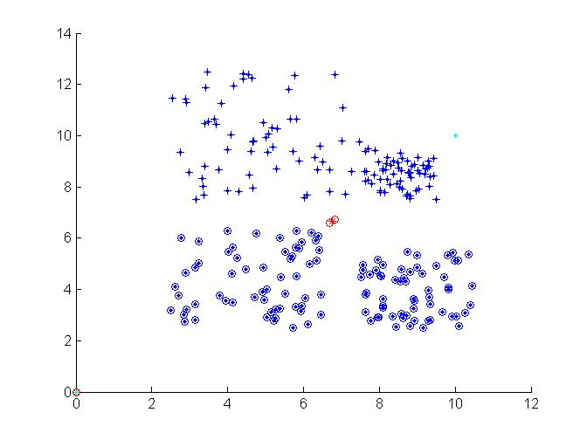
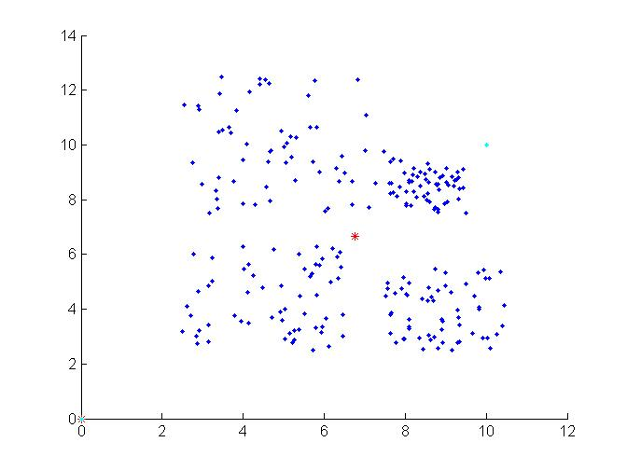
Example: VQ : 240 samples use VQ-binary-split to split to 4 classes
Steps
Step1: all data find centroid C
C1=C(1+e)
C2=C(1-e)
Step2:
Split the centroid into two C1,C2
Regroup data into two classes according to the two new centroids C1,C2

Slide 14
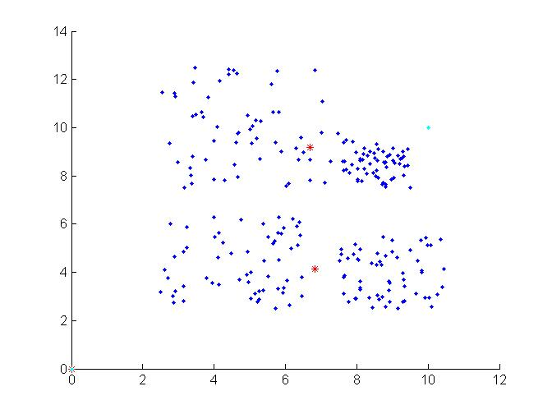
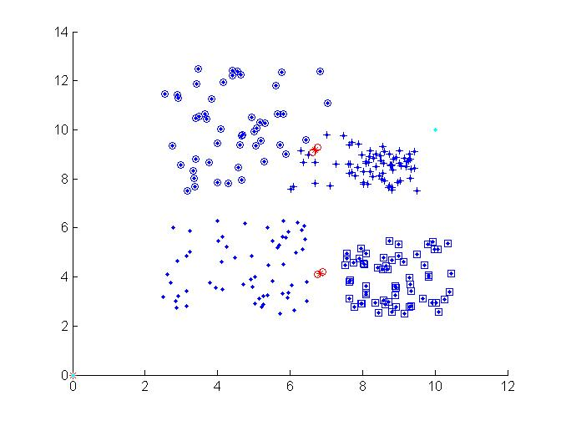
continue
Stage3:
Update the 2 centroids according to the two spitted groups
Each group find a new centroid.
Stage 4: split the 2 centroids again to become 4 centroids

Slide 15
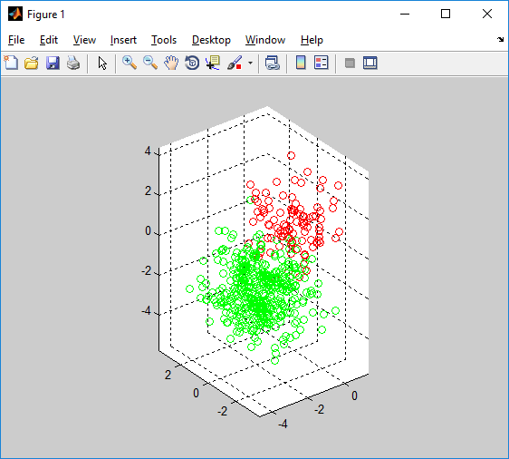
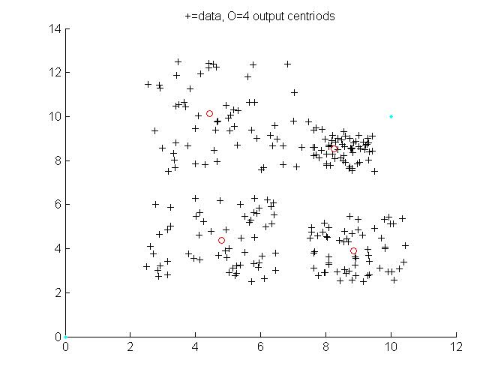

Final result
demo041_kmeans_demo_3D video
Video Demo: 3D , 3 clusters
Stage 5: regroup and update the 4 new centroids, done.

Slide 16
Exercise 4.1: VQ
Given 4 speech frames, each is described by a 2-D vector (x,y) as below.
P1=(1.2,8.8); P2=(1.8,6.9); P3=(7.2,1.5); P4=(9.1,0.3).
Use K-means method to find the two centroids.
Use Binary split K-means method to find the two centroids. Assume you use all available samples in building the centroids at all stages of calculations
A raw speech signal is sampled at 10KHz/8-bit. Estimate compression ratio (=raw data storage/compressed data storage) if LPC-order is 10 and frame size is 25ms with no overlapping samples.

Slide 17
Exercise 4.2: Binary split K-means method for the number of required centroids is fixed (assume you use all available samples in building the centroids at all stages of calculations) .Find the 4 centroids
P₁=(1.2,8.8);P₂=(1.8,6.9);P₃=(7.2,1.5);P₄=(9.1,0.3),P₅=(8.5,6.0),P₆=(9.3,6.9)
first centroid C₁=((1.2+1.8+7.2+9.1+8.5+9.3)/6, 8.8+6.9+1.5+0.3+6.0+6.9)/6) = (6.183,5.067)
Use e=0.02 find the two new centroids
Step1: CC_{a}= C₁(1+e)=(6.183x1.02, 5.067x1.02)=(6.3067,5.1683)
CC_{b}= C₁(1-e)=(6.183x0.98,5.067x0.98)=(6.0593,4.9657) CCa=(6.3067,5.1683) ; CCb=(6.0593,4.9657)
The function dist(Pi,CCx )=Euclidean distance between Pi and CCx
Group to the side
(a or b) if |diff| for that side is smaller
Points | Dist. To CC_{a} | -1 *Dist. To CC_{b} | Diff | Group to
P1 | 6.2664 | -6.1899 | 0.0765 | CC_{b}
P2 | 4.8280 | -4.6779 | 0.1500 | CC_{b}
P3 | 3.7755 | -3.6486 | 0.1269 | CC_{b}
P4 | 5.6127 | -5.5691 | 0.0437 | CC_{b}
P5 | 2.3457 | -2.6508 | -0.3051 | Cc_{a}
P6 | 3.4581 | -3.7741 | -0.3160 | CC_{a}

Slide 18
Recall: Application of K-means to build the vector quantization (VQ) table
Record many sound samples, each sound sample should belong to one of the 256 clusters (sound group) such as a “i”,“e:”, “i:”.. etc. Construct the VQ table as follows.
Use K-means to find 256 centroids , each is an representation of that sound group.
Each row is a centroid which has 8-columns, each column is an LPC code (a1,..,a8 etc.)
Use one byte to index each row, enough for a table of 256 rows.
In telecomm sys., the transmitter only transmits the code (1 sound segment of 20ms using 1 byte), the receiver reconstructs the sound using that code and the table. The table is only transmitted once at the beginning. This table can also be used for speech recognition.
One segment (512 samples ) compressed into 1 byte
transmitter
receiver
Code (1 byte) | a1 | a2 | a3 | a4 | a5 | a6 | a7 | a8
0=(e:) | 1.2 | 8.4 | 3.3 | 0.2 | .. | .. | .. | ..
1=(i:) | .. | .. | .. | .. | .. | .. | .. | ..
2=(u:)
:
255 | .. | .. | .. | .. | .. | .. | .. | ..

Slide 19
4.3 Exercise
% Answer:
%matlab code
X =[1.5 5.9
0.6 4.2
4.9 8.5
9.5 10
7.0 9.5
6.9 0.3
11.2 4.2
4.8 2.1]
[cts,c]=kmeans(X,4)
cts
c
%run the above to check the result
%warning https://www.mathworks.com/matlabcentral/answers/367432-k-means-clustering-giving-different-results
%K-means clustering giving different results
%So, the results depend on the initial guess which is random. But if you have large number of sample data, the result is more stable and acceptable.
X =[1.5 5.9
0.6 4.2
4.9 8.5
9.5 10
7.0 9.5
6.9 0.3
11.2 4.2
4.8 2.1]
e=0.1
Use Binary Split K-means to find centroids of 4 cluster 4
Answer:

Slide 20
Summary
Learned
Audio feature types
How to extract audio features
How to represent these features

Slide 21
Appendix

Slide 22
Answer 4.1 : Class exercise 4.1 : K-means method to find the two centroids
P₁=(1.2,8.8);P₂=(1.8,6.9);P₃=(7.2,1.5);P₄=(9.1,0.3)
Arbitrarily choose P₁ and P₄ as the 2 centroids. So C₁=(1.2,8.8); C₂=(9.1,0.3).
Nearest neighbor search; find closest centroid
P₁-->C₁ ; P₂-->C₁ ; P₃-->C₂ ; P₄-->C₂
Update centroids
C’₁=Mean(P₁,P₂)=(1.5,7.85); C’₂=Mean(P₃,P₄)=(8.15,0.9).
Nearest neighbor search again. No further changes, so VQ vectors =(1.5,7.85) and (8.15,0.9)
Draw the diagrams to show the steps.

Slide 23
Answer for exercise 4.1
A raw speech signal is sampled at 10KHz/8-bit. Estimate compression ratio (=raw data storage/compressed data storage) if LPC-order is 10 and frame size is 25ms with no overlapping samples.
Answer:
Raw data for a frame is 25ms/(1/10KHz)=25*10^-3/(1/(10*10^3)) bytes=250 bytes
LPC order is 10, assume each code is a floating point of 4 bytes, so totally 40 bytes
Compression ratio is 250/40=6.25

Slide 24
Answer 4.2: Binary split K-means method for the number of required contriods is fixed (assume you use all available samples in building the centroids at all stages of calculations)
P₁=(1.2,8.8);P₂=(1.8,6.9);P₃=(7.2,1.5);P₄=(9.1,0.3)
first centroid C₁=((1.2+1.8+7.2+9.1)/4, 8.8+6.9+1.5+0.3)/4) = (4.825,4.375)
Use e=0.02 find the two new centroids
Step1: CC_{a}= C₁(1+e)=(4.825x1.02,4.375x1.02)=(4.9215,4.4625)
CC_{b}= C₁(1-e)=(4.825x0.98,4.375x0.98)=(4.7285,4.2875) CCa=(4.9215,4.4625)
CCb=(4.7285,4.2875)
The function dist(Pi,CCx )=Euclidean distance between Pi and CCx
points dist to CCa -1*dist to CCb =diff Group to
P1 5.7152 -5.7283 = -0.0131 CCa
P2 3.9605 -3.9244 = 0.036 CCb
P3 3.7374 -3.7254 = 0.012 CCb
P4 5.8980 -5.9169 = -0.019 CCa

Slide 25
Answer 4.2: Nearest neighbor search to form two groups. Find the centroid for each group using K-means method. Then split again and find new 2 centroids. P1,P4 -> CCa group; P2,P3 -> CCb group
Step2: CCCa=mean(P1,P4),CCCb =mean(P3,P2);
CCCa=(5.15,4.55)
CCCb=(4.50,4.20)
Run K-means again based on two centroids CCCa,CCCb for the whole pool -- P1,P2,P3,P4.
points dist to CCCa -dist to CCCb=diff2 Group to
P1 5.8022 -5.6613 = 0.1409 CCCb
P2 4.0921 -3.8148 = 0.2737 CCCb
P3 3.6749 -3.8184 = -0.1435 CCCa
P4 5.8022 -6.0308 = -0.2286 CCCa
Regrouping we get the final result
CCCCa =(P3+P4)/2=(8.15, 0.9); CCCCb =(P1+P2)/2=(1.5,7.85)

Slide 26
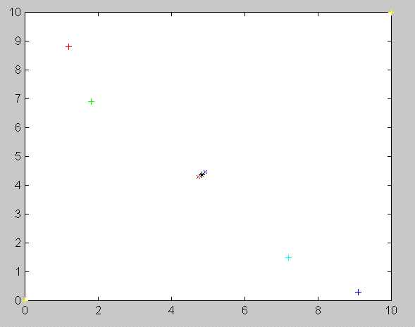
Answer 4.2
P₁=(1.2,8.8);
Step1:
Binary split K-means method
for the number of required
contriods is fixed, say 2, here.
CC_{a},CC_{b}= formed
P₂=(1.8,6.9)
CC_{a}= C₁(1+e)=(4.9215,4.4625)
C1=(4.825,4.375)
CC_{b}= C₁(1-e)=(4.7285,4.2875)
P₃=(7.2,1.5);
P₄=(9.1,0.3)

Slide 27
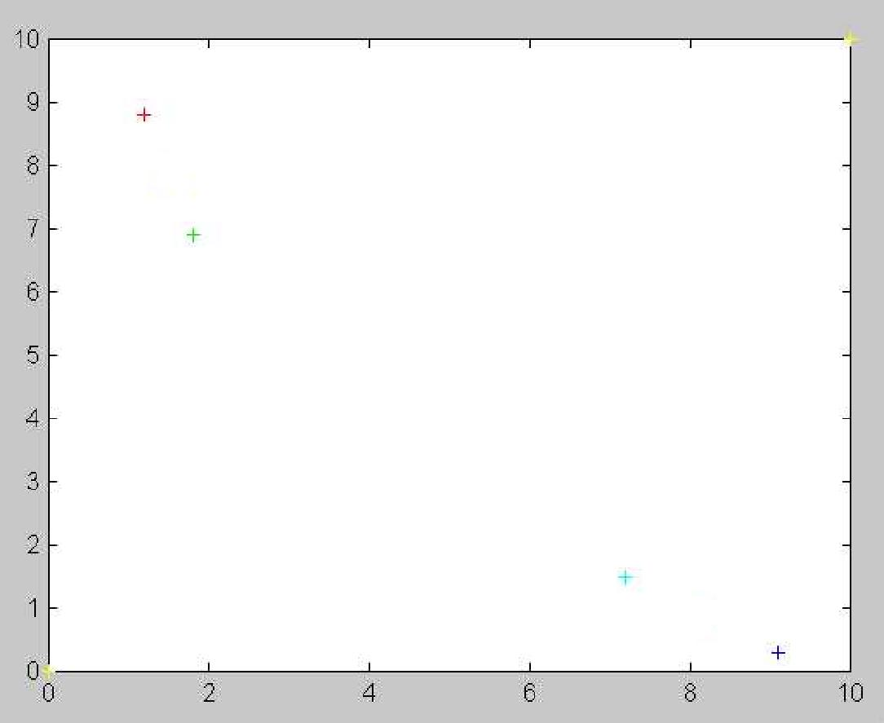
Answer 4.2
Direction
of the split
P₁=(1.2,8.8);
Step2:
Binary split K-means method
for the number of required
contriods is fixed, say 2, here.
CCC_{a},CCC_{b}= formed
CCCCb=(1.5,7.85)
P₂=(1.8,6.9)
CCCa=(5.15,4.55)
CCCb=(4.50,4.20)
P₃=(7.2,1.5);
CCC_{b} =(8.15,0.9)
CCCCa=(8.15,0.9)
P₄=(9.1,0.3)

Slide 28
4.3 Exercise
X =[1.5 5.9
0.6 4.2
4.9 8.5
9.5 10
7.0 9.5
6.9 0.3
11.2 4.2
4.8 2.1]
e=0.01
Use Binary Split K-means to find centroids of 4 clusters.
Answer:

