Slide 1
Ch. 5: Speech Recognition
An example of a speech recognition system using dynamic programming

Slide 2
Overview
(A) Recognition procedures
(B) Dynamic programming

Slide 3
(A) Recognition Procedures
Preprocessing for recognition
endpoint detection
Pre-emphasis
Frame blocking and windowing
distortion measure methods
Comparison methods
Vector quantization
Dynamic programming
Hidden Markov Model

Slide 4
LPC processor for a 10-word isolated speech recognition system
Steps
End-point detection
Pre-emphasis -- high pass filtering
(3a) Frame blocking and (3b) Windowing
Feature extraction
Find Cepstral coefficients by LPC
Auto-correlation analysis
LPC analysis,
Find Cepstral coefficients,
or find Cepstral coefficients directly
Distortion measure calculations

Slide 5
Example of speech signal analysis Frame size is 20ms, separated by 10 ms, S is sampled at 44.1 KHz Calculate: N and m.
E.g. whole duration about is 1 second
Speech signal S
1st frame
(one set of LPC -> code word)
One frame
=N samples
2nd frame
(one set of LPC -> code word)
3rd frame
(one set of LPC -> code word)
4th frame
(one set of LPC -> code word)
5th frame
Separated
by m samples
Answer:
N=20ms/(1/44100)=882,
m=10ms/(1/44100)=441

Slide 6
Step1: Get one frame and execute end point detection
To determine the start and end points of the speech sound
It is not always easy since the energy of the starting energy is always low.
Determined by energy & zero crossing rate
In our example it is about 1 second
s(k)
end-point
detected
k
recorded

Slide 7
A simple End point detection algorithm
At the beginning the energy level is low.
If the energy level and zero-crossing rate N_{zc_start} (e.g. 3) of successive frames is high it is a starting point.
After the starting point if the energy and zero-crossing rate N_{zc_end} (e.g. 5) for successive frames are low it is the end point.
The actual values of N_{zc_start} and N_{zc_end} and the threshold setting depend on the actual noise level and condition of the recording. (They should be found by empirical methods)

Slide 8
Energy calculation from time signal s(k)
Energy(k) = s(k).s(k)
For a frame of size N,
The program to calculate the energy level:
for(k=0;k<N;k++)
{
Energy(k)=s(k) s(k);
}

Slide 9
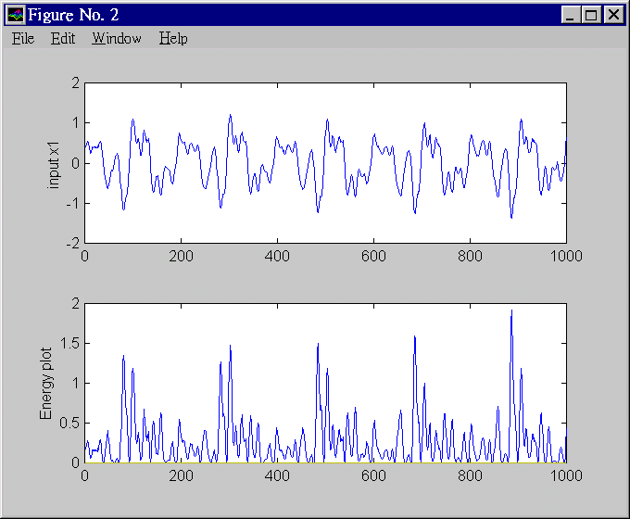
Energy plot

Slide 10
Zero crossing calculation
A zero-crossing point is obtained when
sign[s(k)] != sign[s(k-1)] (=at change of sign)
The zero-crossing points of s(k)= 6 (you may exclude k=0 and k=N-1.
s(k)
5
k
4
6
2
1
3
k=0
k=N-1

Slide 11
Step2: Pre-emphasis -- high pass filtering
To reduce noise, average transmission conditions and to average signal spectrum.
Tutorial: write a program segment to perform pre-emphasis to a speech frame stored in an array int s[1000].

Slide 12
Pre-emphasis program segment
input=sig1, output=sig2
void pre_emphasize(char far *sig1, float *sig2)
{
int k;
sig2[0]=(float)sig1[0];
for (k=1;k<WINDOW;k++)
sig2[k]=(float)sig1[k] - 0.95*(float)sig1[k-1];
}

Slide 13
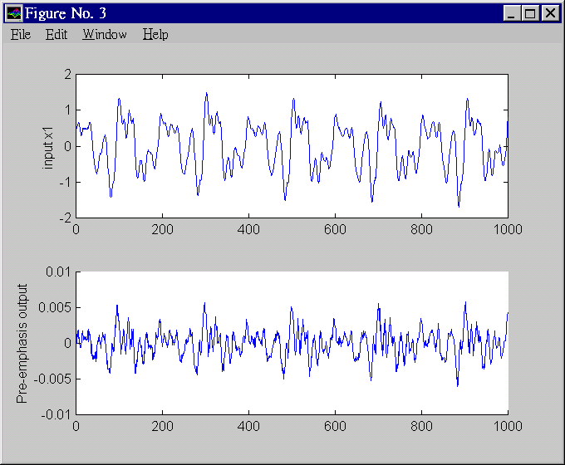
Pre-emphasis

Slide 14
Step3(a): Frame blocking and Windowing
To choose the frame size (N samples )and adjacent frames separated by m samples.
I.e.. a 16KHz sampling signal, a 10ms window has N=160 samples, m=40 samples.
l=2 window, length = N
s_{k}
N
n
m
N
l=1 window, length = N

Slide 15
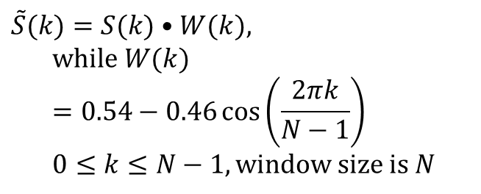
Step3(b): Windowing
To smooth out the discontinuities at the beginning and end.
Hamming or Hanning windows can be used.
Hamming window →
Tutorial: write a program segment to find the result of passing a speech frame, stored in an array int s[1000], into the Hamming window.
Hamming window
$$\tilde{S}(k)=S(k)•W(k), \\ \text{while} W(k)=0.54−0.46\cos\left(\frac{2πk}{N−1}\right) \\ 0≤k≤N−1,\text{window} \text{size} \text{is} N$$

Slide 16
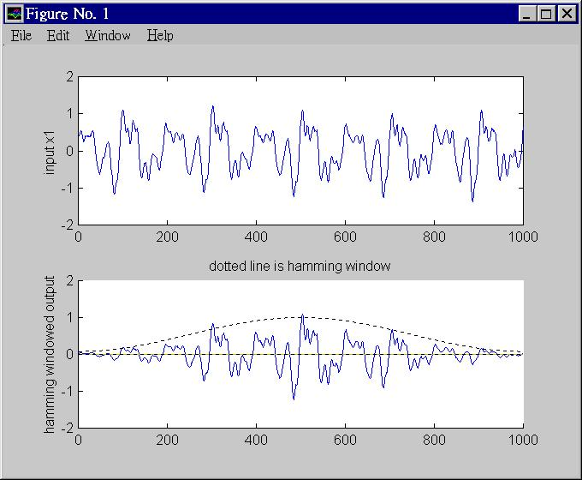
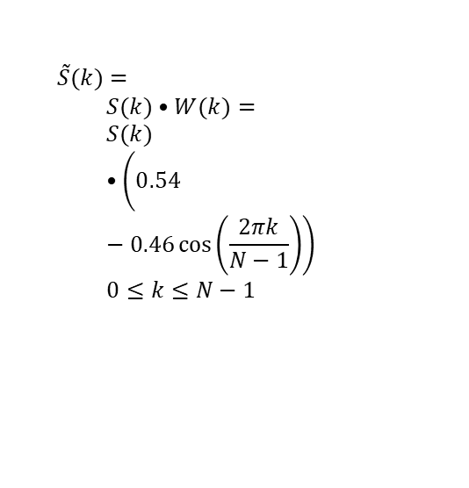
Effect of Hamming window (For Hanning window See http://en.wikipedia.org/wiki/Window_function )
$$\tilde{S}(k)= \\ S(k)•W(k)= \\ S(k)•\left(0.54−0.46\cos\left(\frac{2πk}{N−1}\right)\right) \\ 0≤k≤N−1$$

Slide 17
Matlab code segment
x1=wavread('violin3.wav');
for i=1:N
hamming_window(i)=
abs(0.54-0.46*cos(i*(2*pi/N)));
y1(i)=hamming_window(i)*x1(i);
end

Slide 18
Cepstrum Vs spectrum
The spectrum is sensitive to glottal excitation (E). But we only interested in the filter H
In frequency domain
Speech wave (X)= Excitation (E) . Filter (H)
Log (X) = Log (E) + Log (H)
Cepstrum =Fourier transform of log of the signal’s power spectrum
In Cepstrum, the Log(E) term can easily be isolated and removed.

Slide 19
Step 4 : Cepstral coefficients calculation (more accurate) If Cepstral coefficients are weight by the Mel scale, it is called MFCC (Mel scale Cepstral coefficients)
In MFCC (Mel scale cepstral coefficients) implementation
IDCT (inverse cosine transform) is used to reduce dimension from filter bands (e.g. 20) to MFCC (e.g. 13).
C(n)=IDFT[log₁₀ |S(m)|]=
IDFT[ log₁₀{|E(m)|} + log₁₀{|H(m)|} ]
In C(n), you can see E(n) and H(n) at two different positions
Application: useful for (i) glottal excitation removal (ii) vocal tract filter analysis
X(k)
X(m)
Log|x(m)|
S(k)
windowing
DFT
Log|x(m)|
IDCT
C(n)
N=time index
w=frequency
I-DFT=Inverse-discrete Fourier transform

Slide 20
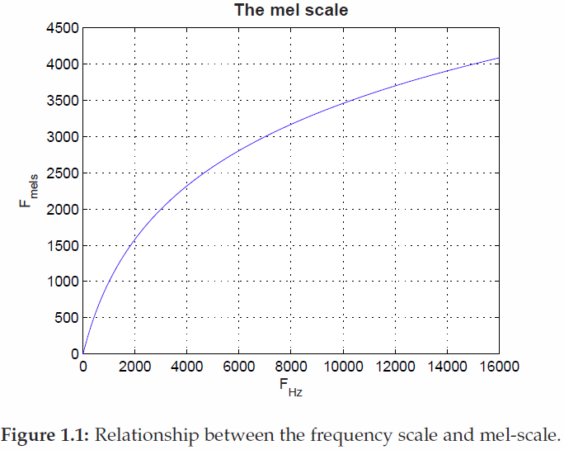
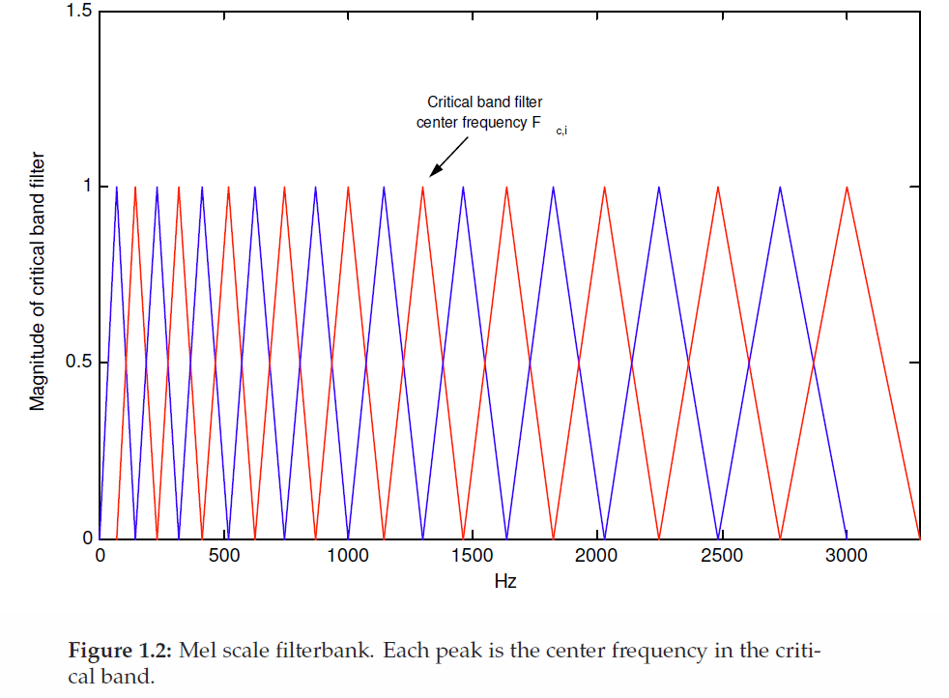
MFCC (Mel scale Cepstral coefficients) implementation
Detailed implementation of using filter banks and Fourier transform to obtain the MFCC parameters:
Signal s(k)→ (each filter band m)→ power ceptrum → c(n)
Magnitude of band
filters
Mel scale filters. Each peak
is the center frequency in the band
Mel / frequency relation
Ref: https://haythamfayek.com/2016/04/21/speech-processing-for-machine-learning.html

Slide 21

Step 5: Distortion measure - difference between two signals
Measure how different two signals is:
Cepstral distances between a frame (described by cepstral coeffs (c₁,c₂…c_{p} )and the other frame (c’₁,c’₂…c’_{p}) is
w(n) is the weight correspond to the Mel scale (found by experimentation)
MFCC (Mel scale Cepstral coefficients) : Weighted Cepstral distances to give different weighting to different cepstral coefficients( more accurate)
$$d^{2}=\sum_{n=1}^{p}{{\left(c_{n}−c_{n}^{′}\right)}^{2}}$$ $${d_{MFCC}}^{2}=\sum_{n=1}^{p}{w(n)•{\left(c_{n}−c_{n}^{′}\right)}^{2}}$$

Slide 22
Matching method: Dynamic programming DP
Correlation is a simple method for pattern matching BUT:
The most difficult problem in speech recognition is time alignment. No two speech sounds are exactly the same even produced by the same person.
Align the speech features by an elastic matching method -- DP.

Slide 23
Example: A 10 words speech recognizer Small Vocabulary (10 words) DP speech recognition system
Store 10 templates of standard sounds : such as sounds of one , two, three ,…
Unknown input –>Compare (using DP) with each sound. Each comparison generates an error
The one with the smallest error is result.

Slide 24
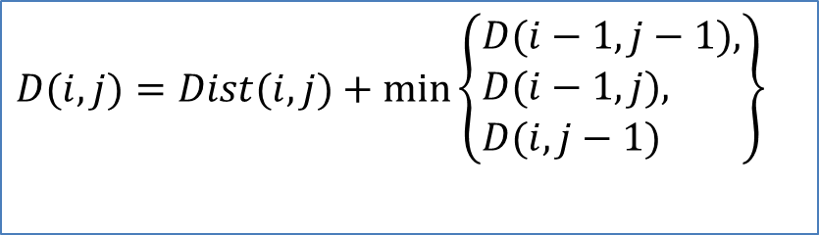
(B) Dynamic programming algo.
Step 1: calculate Distortion score matrix: Dist(i,j)
Step 2: calculate Accumulated distortion score matrix for D(i,j)
Based on the formula
$$D(i,j)=Dist(i,j)+\min\left\{\begin{aligned}&D(i−1,j−1), \\ &D(i−1,j), \\ &D(i,j−1)\end{aligned}\right\}$$
D( i-1, j)
D( i, j)
D( i-1, j-1)
D( i, j-1)

Slide 25
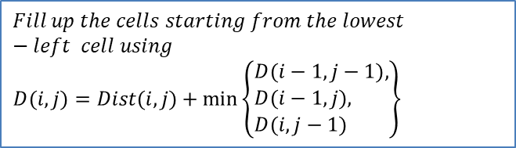
Example
j-axis
Distortion score matrix: Dist(i,j)
Step 1 : find
Distortion score matrix
Dist(I,j)
Step 2: Find
Reference
j=1
i=1 2 3 4
$$Fill up the cells starting from the lowest−left cell using$$
$$D(i,j)=Dist(i,j)+\min\left\{\begin{aligned}&D(i−1,j−1), \\ &D(i−1,j), \\ &D(i,j−1)\end{aligned}\right\}$$
unknown input
i-axis
Optimal path is (1,3,4,5,7)
Accumulated distortion score matrix D(i,j)
j-axis
Accumulated
distortion score matrix
D(i,j)
j=1
Reference
DP(LEA , Trends in speech recognition.)
i=1 2 3 4
unknown input
i-axis

Slide 26
How to produce the distortion score matrix
From the previous slide, the distortion score matrix shows the differences between two sequences. For example (1) you record the reference-speech of "FFOOR", you may assume the numbers are LPC code a1 in LPC8 (but only a1 is shown, this is to simplify the problem). (2) And you record the input-speech "FORR" . It is shorter, but it doesn't matter, Dynamic Programming can handle it.
The distortion matrix is found by comparing the two sequences , here, the first element in the reference sequence is F, it compares with the first element in the input sequence which is also F. The distortion between them is 1 (small distortion due to noise), because they are supposed to be F so they are similar.
The second element in reference is F, it compares to the first in the input which is F, they are similar too, so the score is 2 (small). But the third element in the reference is O , when compared to the first element of the input which is F, they are not the same, so the distortion is 8 (large),etc.

Slide 27
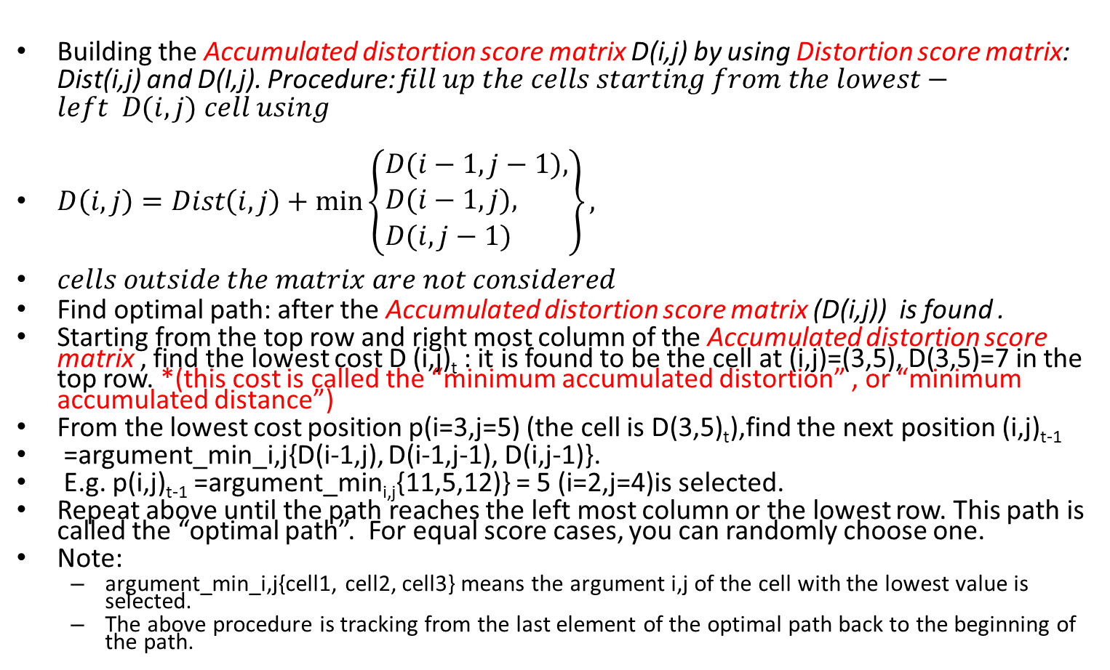
To find the optimal path in the accumulated distortion (or distance) score (or cost) matrix
Building the Accumulated distortion score matrix D(i,j) by using Distortion score matrix: Dist(i,j) and D(I,j). Procedure: f$ill up the cells starting from the lowest−left D(i,j) cell using$
$D\left(i,j\right)=Dist\left(i,j\right)+\min\left\{\begin{aligned}&D(i−1,j−1), \\ &D(i−1,j), \\ &D(i,j−1)\end{aligned}\right\},$
$cells outside the matrix are not considered$
Find optimal path: after the Accumulated distortion score matrix (D(i,j)) is found .
Starting from the top row and right most column of the Accumulated distortion score matrix , find the lowest cost D (i,j)_{t} : it is found to be the cell at (i,j)=(3,5), D(3,5)=7 in the top row. *(this cost is called the “minimum accumulated distortion” , or “minimum accumulated distance”)
From the lowest cost position p(i=3,j=5) (the cell is D(3,5)_{t}),find the next position (i,j)_{t-1}
=argument_min_i,j{D(i-1,j), D(i-1,j-1), D(i,j-1)}.
E.g. p(i,j)_{t-1} =argument_min_{i,j}{11,5,12)} = 5 (i=2,j=4)is selected.
Repeat above until the path reaches the left most column or the lowest row. This path is called the “optimal path”. For equal score cases, you can randomly choose one.
Note:
argument_min_i,j{cell1, cell2, cell3} means the argument i,j of the cell with the lowest value is selected.
The above procedure is tracking from the last element of the optimal path back to the beginning of the path.

Slide 28
More discussions on the Optimal path
The path should be from any element in the ‘top-row’ or ‘right-most-column’ to any element in the ‘bottom-row’ or ‘left-most-column’.
The reason is noise may be corrupting elements at the beginning or the end of the input sequence.
However, in fact, in actual processing the path should be restrained near the 45-degree diagonal (from bottom-left to top-right), see the diagram in the next slide, the path cannot pass over the restricted regions. The user can set a reasonable range for this regions.
If the optimal path (score) is inside the restricted region, that means the reference and input sequence lengths are very different, that is not a good solution even the optimal distortion score is low. So, avoid the optimal score goes inside the restriction region, it also makes the algorithm runs faster because less data-cells are considered.
In the accumulated matrix example shown earlier, since we only pick the smallest value (optimal distortion score -- Op_{dist_core} ) in the top row, OR the right column, therefore the optimal path is (1,3,4,5,7), 9 is formally not included in the optimal path. There are three cases for the optimal path:
The optimal path ends at (where Op_{dist_core} is located) the top-row, in this case, it means the input sequence is shorter than the reference sequence.
The optimal path ends at (where Op_{dist_core} is located) the top-right corner cell, in this case, it means the input sequence is the same length as reference sequence.
The optimal path ends at (where Op_{dist_core} is located) the right-column, in this case, it means the input sequence is longer than the reference sequence.

Slide 29
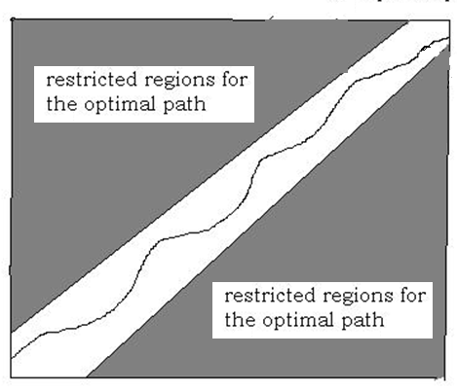
Optimal path and restricted regions
E.g. we pick this as the Op_{dist_core}
The optimal distortion score (Op_{dist_core}) is the minimum score located either at the top-row or the right-most-column of the accumulated matrix table . Also, the
Op_{dist_core} (and optimal path) should not be inside the restricted regions because if it is true, the input and reference sequence lengths are would be very different and is not a good (or possible) solution
Top row which is not in the restricted region
Right-most-column which is not in the restricted region
Reference
The accumulated
matrix
Optimal path
Input

Slide 30
Example
A speech signal is 0.8 seconds in duration. A frame blocking method is applied to obtain the frames, the frame size is 20ms and non-overlapping region is 5ms. Estimate how many frames (+/-1 accuracy allowed) will you obtain for this signal.
Answer:
(Duration - frame_size)/non-overlapping_region
(800-20)/5=156 frames

Slide 31
Example of an isolated 10-word recognition system
A word (with duration 1 second) is recorded 5 times to train the system, so there are 5x10 templates.
Sampling freq.. = 16KHz, 16-bit, so each sample has 16,000 integers.
Each frame is 20ms, overlapping 50%, so there are about =(duration-frame_size)/overlapping=(1000-20)/10= 98 frames.
For 12-ordered LPC, each frame generates 12 LPC floating point numbers,, hence 12 cepstral coefficients C₁,C₂,..,C₁₂.

Slide 32
So, there are 5x10samples=5x10x98 frames
Each frame is described by a vector of 12-th dimensions (12 cepstral coefficients = 12 floating point numbers)
Put all frames to train a code-book of size 64. So, each frame can be represented by an index ranged from 1 to 64 (See ** below)
Use dynamic programming (DP) to compare an input with each of the templates based on the index (See ** below) to obtain the optimal result of minimum distortion.
**Q&A
Question: How to convert a frame to an index?
Answer: Assume each word is 1 second, you choose 20 ms as the frame size, and if the non-overlapping time (hop time ) between 2 frames is 50% of 20ms (=10ms), you have =(duration-frame_size)/overlapping =(1000-20)/10=98 frames.
For a frame i, you can obtain cepstral coefficients (such as MFCC) for that frame, i.e. 13 MFCC parameters: [C0,C1,C2, ... C12]_frame_i
Because you have 5 recordings for each word (your target 10 words are 'one' to 'ten') , and each word has 99 frames , so altogether there are 5*10 *98 = 4900 frames. Imagine you have an MFCC-space of 13 dimensions, and each frame( [C0,C1,C2, ... C12]_frame_i) is a point in that space.
So, you have 4950 points (each point represent a frame) in that space, run a K-means algo. and assume there are 64 clusters, you will get 64 centroids. Then, you index the centroids from 1 to 64. However, it is not very accurate to use the index directly in the Dynamic Programming DP algorithm in the next slide, because the distortion(distance or difference) between two indexes is not the squared difference as in the note: (index_i-index_j)^2. To be more precise, it is the distortion (Euclidean distance ) between the 2 points of index_i, index_j in the 13-dimensional MFCC space. The example used in the next slide is just to illustrate the idea of Dynamic program, so a very crude description of the distortion function (index_i-index_j)^2 is given in that slide.

Slide 33
Exercise 5.1: for DP
The VQ-LPC codes of the speech sounds of ‘YES’and ‘NO’ and an unknown ‘input’ are shown.
Find Op__{score}(reference=‘yes’, input) and Op__{score}(reference=‘No’, input) , which is smaller?
Is the ‘input’ = ‘Yes’ or ‘NO’? {ans: is ‘Yes’, because Op__{score}(reference=‘yes’, input) is smaller}

Slide 35
Confusion matrix table: an example https://en.wikipedia.org/wiki/Confusion_matrix
Example: A speech recognition system for 5 words of different types of fruits
The confusion table contains optimal distortion scores between entries in the reference class and unknown input.
For every reference/input pair , find the distortion and accumulated score, then Op_{score}.
As shown in the table, if the type matched (e.g. reference class =Pear, input =Pear), then Op_{score}( Pear,Pear) the accumulated distortion score is low. Therefore, the diagonal of the table should contain the lower scores.
Recall: The optimal distortion score (Op_{score})should be located at the top row or right-column (outside the restricted regions) of the accumulated table, see previous slides.
 |  | Actual class (reference class)
 |  | Apple | Lemon | Pear | Peach | Banana
Predicted class (unknown input) | Apple | 2 | 10 | 14 | 7 | 11
 | Lemon | 21 | 3 | 9 | 9 | 8
 | Pear | 9 | 13 | 1 | 23 | 13
 | peach | 21 | 22 | 14 | 0 | 10
 | Banana | 13 | 14 | 20 | 14 | 1

Slide 36
Summary
Speech processing is important in communication and AI systems to build more user friendly interfaces.
We studied the data processing pathway for a simple speech recognition system.
We studied the use of dynamic programming for speech recognition, it can also be used in many pattern recognition problems.

Slide 37
Appendix 1. Cepstrum Vs spectrum
the spectrum is sensitive to glottal excitation (E). But we only interested in the filter H
In frequency domain
Speech wave (X)= Excitation (E) . Filter (H)
Log (X) = Log (E) + Log (H)
Cepstrum =Fourier transform of log of the signal’s power spectrum
In Cepstrum, the Log(E) term can easily be isolated and removed.

Slide 38
Appendix 2: LPC analysis for a frame based on the auto-correlation values r(0),…,r(p), and use the Durbin’s method (See P.115 [Rabiner 93])
LPC parameters a₁, a₂,..a_{p} can be obtained by setting for i=0 to i=p to the formulas

Slide 39
Appendix 3 Program to Convert LPC coeffs. to Cepstral coeffs.
void cepstrum_coeff(float *coeff)
{int i,n,k; float sum,h[ORDER+1];
h[0]=coeff[0],h[1]=coeff[1];
for (n=2;n<=ORDER;n++){ sum=0.0;
for (k=1;k<n;k++)
sum+= (float)k/(float)n*h[k]*coeff[n-k];
h[n]=coeff[n]+sum;}
for (i=1;i<=ORDER;i++)
coeff[i-1]=h[i]*(1+ORDER/2*sin(PI_10*i));}

Slide 40
Appendix 4 Define Cepstrum: also called the spectrum of a spectrum
“The power cepstrum (of a signal) is the squared magnitude of the Fourier transform (FT) of the logarithm of the squared magnitude of the Fourier transform of a signal” From Norton, Michael; Karczub, Denis (2003). Fundamentals of Noise and Vibration Analysis for Engineers. Cambridge University Press
Algorithm: signal → FT → abs() → square → log₁₀ → FT → abs() → square → power cepstrum
http://mi.eng.cam.ac.uk/~ajr/SA95/node33.html
http://en.wikipedia.org/wiki/Cepstrum

Slide 41
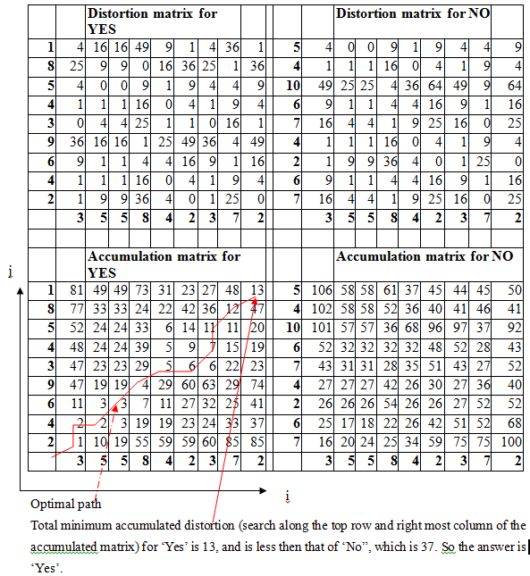
Appendix 5, Ans for ex. 5.1
Starting from the top row and right most column, find the lowest cost D (i,j)t : it is found to be the cell at (i,j)=(9,9), D(9,9)=13.
From the lowest cost position (i,j)t, find the next position (i,j)t-1
=argument_mini,j{D(i-1,j), D(i-1,j-1), D(i,j-1)}. E.g. position (i,j)t-1 =argument_mini,j{48,12,47)} =(9-1,9-1)=(8,8) that contains “12” is selected.
Repeat above until the path reaches the right most column or the lowest row.
Note: argument_min_i,j{cell1, cell2, cell3} means the argument i,j of the cell with the lowest value is selected.
Q&A
Question: During the process of getting the optimal path which is indicated by the red line: (13,12,11,7,6,.....), there are equal values (11 and 11) when picking the 3th element. Is it OK to pick another 11 instead? Or, is the diagonal movement has higher priority?
Answer : In this case, either one is correct. And it does not affect the final optimal score (at the top right corner). There are two optimal paths, and according to the data, they are equally correct. Choose either one as the answer is your personal own choice.
Op__{score}(reference=‘yes’, input) =13
Op__{score}(reference=‘No’, input)=37

Slide 42
Appendix 6: LPC to Cepstral coefficients conversion (an alternative method for Cepstral coefficient valuation. This is more efficient as compared to the Fourier-FFT-IFFT method discussed earlier)
Cepstral coefficient is more accurate in describing the characteristics of speech signal
Normally cepstral coefficients of order 1<=m<=p are enough to describe the speech signal.
Calculate c₁, c₂, c₃,.. c_{p} from LPC a₁, a₂, a₃,.. a_{p}
Note:
c1=a1 and
a0=-1 (see chapter 3)
Ref:http://www.mathworks.com/help/dsp/ref/lpctofromcepstralcoefficients.html
http://www.clear.rice.edu/elec532/PROJECTS98/speech/cepstrum/cepstrum.html

