Slide 1
Ch. 7: Face detection
KH Wong

Slide 2


Introduction
Face interface
Face detection
Face recognition
Face database
Output:
Mr.Chan
Prof..Cheng
Face detection
Face recognition

Slide 3
Face detection [1]
To detect faces in an image (Not recognize it yet)
Challenges
A picture has 0,1 or many faces.
Faces are not the same: with spectacles, mustache etc.
Sizes of faces vary a lot.
Available in most digital cameras nowadays
The simple method
Slide a window across the window and detect faces.
Too slow, pictures have too many pixels. (1280x1024=1.3M pixels)

Slide 4
Evaluation of face detection
Detection rate
Total number of faces that are correctly detected/total number of faces actually exist in the picture
Should be high > 95%.
False positive rate
The detector output is positive, but it is false (there is actually no face).Definition of False positive: A result that is erroneously positive when a situation is normal. An example of a false positive: a particular test designed to detect cancer of the toenail is positive, but the person does not have toenail cancer. (http://www.medterms.com/script/main/art.asp?articlekey=3377)
Should be low <10⁻⁶
A good system has
High detection rate,
Low false positive rate.
False positive result

Slide 5
Example
What are the detection rate and false positive rate here?
Answer
detection rate=(6/9)*100%
false positive rate=(1/7)*100%
6 faces correctly detected in the picture, 9 actually faces exist in the image
7 windows reported to have faces , but in 1 window it is not a face
False positive result

Slide 6
Class exercise 8.1
Detected results are in red frames
What are the detection rate and false positive rate here?
Answer
detection rate=?
false positive rate=?

Slide 7
How to evaluate classifiers
A summary:
(Actual) (predicted)
True Positives (TP)
True Negatives (TN)
False Positives (FP)
False Negatives (FN)
Accuracy = (TP+TN)/(TP+FP+FN+TN)
Precision = TP/(TP+FP)
Recall= TP/(TP+FN)
F1 score = 2*(Recall * Precision) / (Recall + Precision)

Slide 8
How to evaluate classifiers
For machine learning

Slide 9
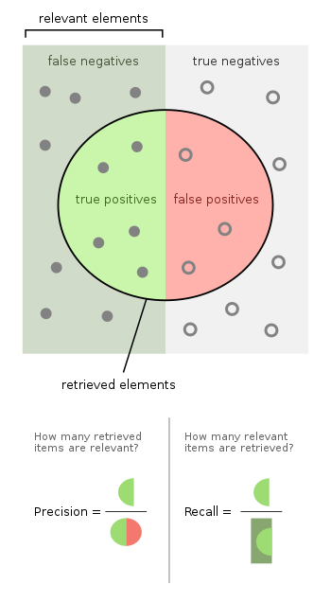
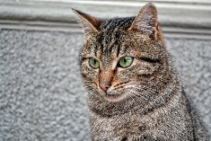
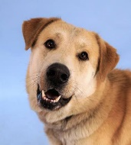
Define terms
Program X recognized
as dogs
=all dogs
Program X reads all pics and recognizes dogs (see image) and exclude cats.
The truth is there are 12 dogs (relevant elements filled dots) and 10 cat (unfilled dots)
Program X reported 8 dogs (selected elements inside the circle) and others are cats.
But the truth is : Inside the retrieved elements (circled) only 5 are dogs, 3 are cats.
Thus, True positives [TP] =5
False positives [FP]=3
7 dogs missed(false negatives [FN])=7, False Negatives (FN) – When actual class is yes but predicted class in no
7 cats excluded (true negatives [TN])=7, True Negatives (TN) - These are the correctly predicted negative values which means that the value of actual class is no and value of predicted class is also no
Selected elements= TP+FP = 8
X’s Precision = (true positives [TP]/ selected elements)= TP/(TP+FP)=5/8 = 0.625
X’s Recall= (true positives [TP]/ relevant elements)=5/12 (same as Ture positive rate)
FN=7
TN=7
12 dogs
TP=5
FP=3
10 cats
https://en.wikipedia.org/wiki/Precision_and_recall
https://www.dataschool.io/simple-guide-to-confusion-matrix-terminology/
Dog :This Photo by Unknown Author is licensed under CC BY
Cat: This Photo by Unknown Author is licensed under CC BY

Slide 10
How to evaluate classifiers
A summary:
True Positives (TP)
True Negatives (TN)
False Positives (FP)
False Negatives (FN)
Accuracy = (TP+TN)/(TP+TN+FP+FN)
Precision = TP/(TP+FP)
Recall= TP/(TP+FN)
F1 score = 2*(Recall * Precision) / (Recall + Precision)
In program x example
TP =5
FP=3
FN=7
TN=7
Accuracy=(5+7)/(5+3+7+7)=0.545
Precision=5/(5+3)=0.625
Recall=5/(5+7)=0.4166
F1 score=
2*(0.4166* 0.625)/(0.4166+ 0.625)
=0.49995

Slide 11
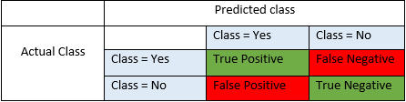
True/False, and Positive/ Negative
Source: https://blog.exsilio.com/all/accuracy-precision-recall-f1-score-interpretation-of-performance-measures/
True positive and true negatives are the observations that are correctly predicted and therefore shown in green. We want to minimize false positives and false negatives so they are shown in red color. These terms are a bit confusing. So let’s take each term one by one and understand it fully.
True Positives (TP) - These are the correctly predicted positive values which means that the value of actual class is yes and the value of predicted class is also yes. E.g. if actual class value indicates that this passenger survived (in an accident) and predicted class tells you the same thing.
True Negatives (TN) - These are the correctly predicted negative values which means that the value of actual class is no and value of predicted class is also no. E.g. if actual class says this passenger did not survive and predicted class tells you the same thing.
False positives and false negatives, these values occur when your actual class contradicts with the predicted class.
False Positives (FP) – When actual class is no and predicted class is yes. E.g. if actual class says this passenger did not survive but predicted class tells you that this passenger will survive.
False Negatives (FN) – When actual class is yes but predicted class in no. E.g. if actual class value indicates that this passenger survived and predicted class tells you that passenger will die.

Slide 12
Accuracy, Precision, Recall and F1 score
Accuracy - Accuracy is the most intuitive performance measure and it is simply a ratio of correctly predicted observation to the total observations.
Accuracy = (TP+TN)/(TP+FP+FN+TN)
Precision - Precision is the ratio of correctly predicted positive observations to the total predicted positive observations.
Precision = TP/(TP+FP)
Recall (Sensitivity) - Recall is the ratio of correctly predicted positive observations to the all observations in actual class - yes. Recall = TP/(TP+FN)
F1 score - F1 Score is the weighted average of Precision and Recall. Therefore, this score takes both false positives and false negatives into account
F1 Score = 2*(Recall * Precision) / (Recall + Precision)
So, whenever you build a model, this article should help you to figure out what these parameters mean and how good your model has performed.

Slide 13
The Viola and Jones method [1]
The most famous method
Training may need weeks
Recognition is very fast, e.g. real-time for digital cameras.
Techniques
Integral image for feature extraction
Ada-Boost for face detection
Attentional cascade for fast rejection of non-face sub-windows

Slide 14
The Viola and Jones method Technique 1:
Integral image for feature extraction

Slide 15

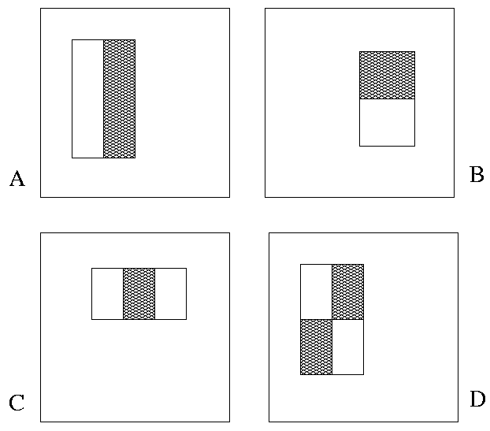
Image Features ref[3]
A very simple feature calculation method
“Rectangle filters”
Rectangle_Feature_value f=
∑ (pixels values in white area) – ∑ (pixels values in shaded area)
Notes:
15
For real problems results are only as good as the features used...
This is the main piece of ad-hoc (or domain) knowledge
Rather than the pixels, we have selected a very large set of simple functions
Sensitive to edges and other critcal features of the image
** At multiple scales
Since the final classifier is a perceptron it is important that the features be non-linear… otherwise the final classifier will be a simple perceptron.
We introduce a threshold to yield binary features

Slide 16
Example
An image with gray levels shown
1 | 2 | 3 | 3
3 | 0 | 1 | 3
5 | 8 | 7 | 1
0 | 2 | 3 | 6
Find the Rectangle_Feature_value (f) of the box enclosed by the dotted line
Rectangle_Feature_value f=
∑ (pixel value in white area) – ∑ (pixel value in shaded area)
f=(8+7)-(0+1)
=15-1= 14

Slide 17
Class exercise 8.2
Find the Rectangle_Feature_value (f) of the box enclosed by the dotted line
Rectangle_Feature_value f=
∑ (pixel value in white area) – ∑ (pixel value in shaded area)
f=
2 | 7 | 5 | 8
2 | 6 | 2 | 9
5 | 4 | 8 | 2
8 | 2 | 5 | 10

Slide 18

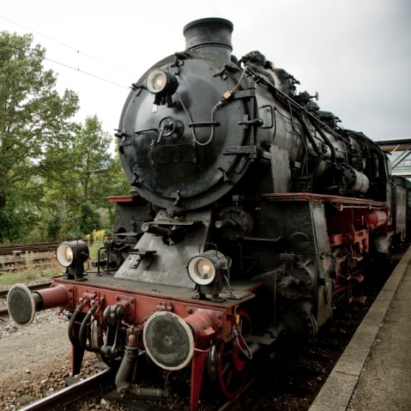

Example: A simple face detection method using one feature in the middle of image
Rectangle_Feature_value f
f= ∑(pixels in white area) – ∑ (pixels in shaded area)
If (f) is large, then it is face ,i.e.
if (f)>threshold, then
face
Else
non-face
Result
This is a face: The eye-area (shaded area)is dark, the nose-area(white area) is bright.
So f is large, hence it is face
This is not a face.
Because f is small
Notes:
18

Slide 19
How to find features faster? Integral images fast calculation method [Lazebnik09 ]
The integral image = sum of all pixel values above and to the left of (x,y)
Can be found very quickly by the hardware system
(x,y)
Notes:
19

Slide 20
Examples
Top-left corner(x,y)position=(1,1)
x
The integral image = sum of all pixel values above and to the left of (x,y)
Pixel P is at (x=3,y=2)
integral image of P is =1+2+3+3+4+6
integral image of Q is
=1+2+3+3+4+6+5+2+4+0+2+3
1 | 2 | 3 | 3
3 | 4 | 6 | 3
5 | 2 | 4 | 1
0 | 2 | 3 | 6
P
Q
y

Slide 21
Computing the integral image [Lazebnik09 ]
(x=1,y=1)
Integral_img_ii(x, y-1)
i(x, y-1)
row_s(x-1, y)
i(x, y)
Cumulative row sum: row_s(x, y) = row_s(x–1, y) + i(x, y)
Integral image : Integral_img_ii(x, y) = Integral_img_ii(x, y−1) + row_s(x, y)
Notes:
21

Slide 22
Calculate sum within a rectangle
A,B,C,D are the values of the integral images at the corners of the rectangle R.
The sum of image values inside R is:
Area_R = A – B – C + D
If A,B,C,D are found , only 3 additions are needed to find Area_R
Calculations of areas can reused for other windows.
D
B
For the
Rectangle R
the Area is Area_R
C
A
Notes:
22

Slide 23
Why do we need to find pixel sum of rectangles? Answer: We want to get face features
You may consider these features as face features
Left Eye: (Area_A-Area_B)
Nose :(Area_C+Area_E-Area_D)
Mouth:(Area_F+Area_H-Area_G)
They can be different sizes, polarity and aspect ratios
A
B
C
D
E
F
G
H

Slide 24
Face feature and example
Pixel values inside
the areas
10 | 20 | 4
7 | 45 | 7
216 | 102 | 78
129 | 210 | 111
Shaded area
-1
White area
+2
F=Feat_val =
pixel sum in white area - pixel sum in shaded area
Example
Pixel sum in white area= 216+102+78+129+210+111=846
Pixel sum in shared area= 10+20+4+7+45+7=93
Feat_val=F=846-93=753
If F>threshold,
feature= +1
Else
feature= -1 End if;
If we can choose threshold =700 , so feature is +1.
A face
Notes:
24

Slide 25
Definition: Area_X = sum of pixels in the rectangular area from the left-top corner to pixel X (including the top left corner and pixel X).
Top-left corner
1 | 2 | 3 | 3
3 | 4 | 6 | 3
5 | 2 | 4 | 1
0 | 2 | 3 | 6
Find the feature output of this image.
Area_D=1
Area_B=1+2+3=6
Area_C =1+3=4
Area_A=1+2+3+3+4+6=19
Area_E=? 1+3+5=9
Area_F=? 1+2+3+3+4+6+5+2+4=30
Pixel sum of the area inside the box enclosed by the dotted lines=
Area_F - Area_B - Area_E +Area_D =? 30-6-9+1=16
D
B
C
A
E
F

Slide 26
Class exercise 8.3 Definition: Area at X =pixel sum of the area from top-left corner to X= Area_X
Top-left corner
Find the feature output of this image.
Area_D=1
Area_B=1+2+3=6
Area_C =1+3=4
Area_A=1+2+3+3+4+6=19
Area_E=? 1+3+5=9
Area_F=? 1+2+3+3+4+6+5+2+4=30
Pixel sum of the area inside the box enclosed by the dotted lines=
Area_F - Area_B - Area_E +Area_D =30-6-9+1=16
WA=White area enclosed by the dotted line=?
GA=Gray area enclosed by the dotted line=?
(white area-shaded area)=WA-WG=?
1 | 2 | 3 | 3
3 | 4 | 6 | 3
5 | 2 | 4 | 1
0 | 2 | 3 | 6
D
B
C
A
E
F

Slide 27
Basic types of Rectangular Features for (white_area)-(gray_area)
Type) Rows x columns
Type 1) 1x2
Type 2) 2x1
Type 3) 1x3
Type 4) 3x1
Type 5) 2x2
Each basic type can have difference sizes and aspect ratios.
I.e. the following feature windows are of the same type (Type2) even they have different sizes, or aspect ratios
Each rectangle inside is of the same dimension

Slide 28
Faces can be any sizes,
Example: a face can be big or small , from 24 x24 to 1024x1024,
So, we need feature windows with different sizes.
There are faces with different sizes
As long as white/gray areas have the relations
The followings are Type2 Rectangular Features
The white rectangle is above the shaded rectangle
White and shaded rectangle are of same dimension

Slide 29
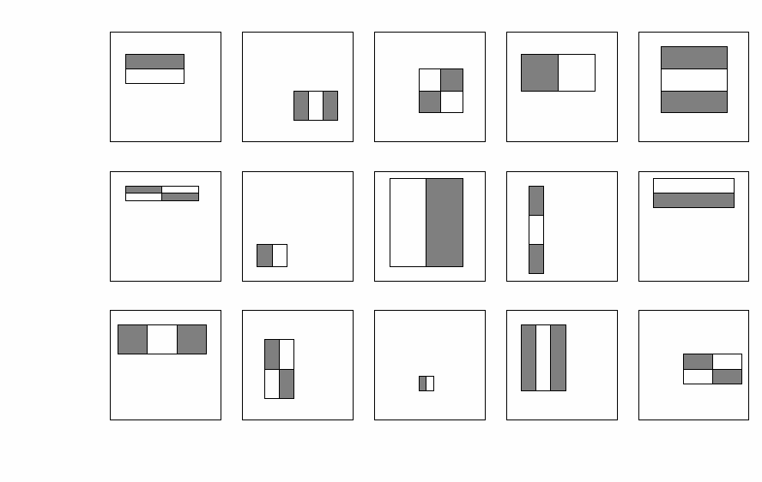
Class exercise 8.4 Feature selection [Lazebnik09 ]
Some examples and their types
Fill in the types for the 2nd, 3rd rows
For a 24x24 detection region, the number of possible rectangle features is ~160,000!
Name the types (type 1,2,3,4,5) of the rectangular features in the figures.
2
3
5
1
4
Standard Rectangular Feature Types
1)
2)
3)
4)
5)
Notes:
29

Slide 30
Class exercise 8.5: Features in a 24x24 (pixel) window
Exercise 8.5a : How many rectangular features of all-5-types can be found a 24x24 pixel window?
Answer: 162,336 (explain)
Exercise 8.5b : How many type 1 features are in a 24x24 (pixel) window?
Answer:_43200 (explain)
http://stackoverflow.com/questions/1707620/viola-jones-face-detection-claims-180k-features

Slide 31
Class exercise 8.6?
Still keeping the 5 basic rectangular features types (1,2,3,4,5) (5 types: 2x1,1x2,3x1,1x3,2x2)
Find the number of rectangular features for a resolution of 36 x36 windows
Answer: 816264, explain your answer.
Standard Types
1)
2)
3)
4)
5)

Slide 32
The Viola and Jones method Technique 2:
AdaBoost for face detection

Slide 33
Class exercise 8.7: The detection challenge
Use 24x24 base window
For y=1;y<=1024;y++
{For x=1;x<=1024;x++{
Set (x,y) = the left top corner of the 24x24 sub-window, different scales are needed to be considered too.
For the 24x24 sub-window, extract 162,336 features and see they combine to form a face or not.}
}
Exercise 7 : Discuss the number of operations required.
Conclusion : too slow, solution use boosting
(x,y)
24x24Sub-window
X-axis
1280
(1,1)
Y-axis
1024
Answer 7:

Slide 34
Solution to make it efficient
The whole 162,336 feature set is too large
Solution: select good features to make it more efficient.
Use: “Boosting”
Boosting
Combine many small weak classifiers to become a strong classifier.
Training is needed.

Slide 35
Boosting for face detection
Define weak learners based on rectangle features
value of rectangle feature
P_{t}= polarity{+1,-1}
threshold
window
Notes:
35

Slide 36
Face detection using Adaboost
AdaBoost training
E.g. Collect 5000 faces, and 9400 non-faces. Different scales.
Use AdaBoost for training to build a strong classifier.
Pick suitable features of different scales and positions, pick the best few. (Take months to do , details is in [Viola 2004] paper)
Testing
Scan through the image (any where), pick a window (any size ≥ 24x24) and rescale it to 24x24,
Pass it to the strong classifier for detection.
Report face, if the output is positive
Notes:
36

Slide 37
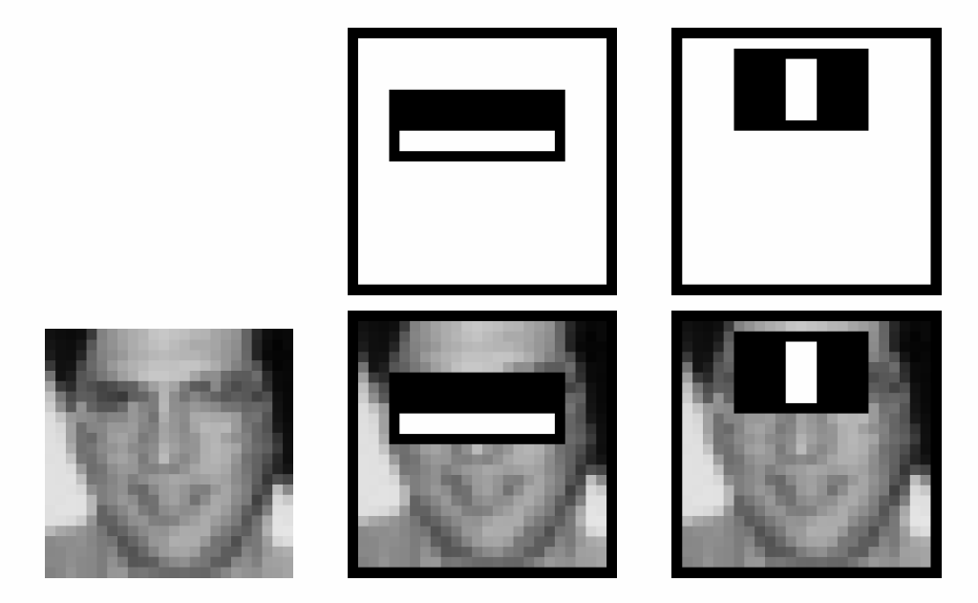
Boosting for face detection [viola2004]
In the paper it shows that the following two features (obtained after training) in cascaded picked by AdaBoost have 100% detection rate and 50% false positive rate
But 50% false positive rate is not good enough
Approach [viola2004] :Attentional cascade
I.e. Strong classifier
H(face)=
Sign{α₁h₁(image)
+α₂h₂(image)}
H(face)=+1→ face
H(face)=-1→non-face
Pick a window in the image and rescale it to 24x24 as “image”
h₂(image)
h₁(image)
type3
type2
Standard Types
1)
2)
3)
4)
5)
Notes:
37

Slide 38
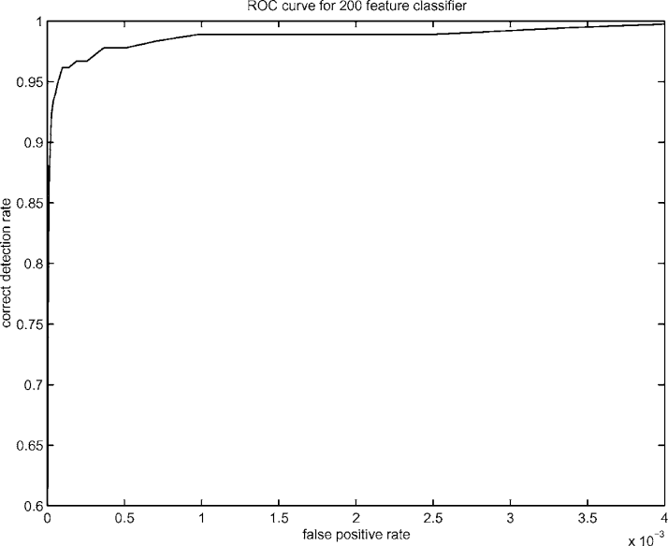
Boosting for face detection
An experiment shows: A 200-feature classifier can yield 95% detection rate and a false positive rate of 1 in 14084 (7.1x10⁻⁵ Still not good enough)
Recall: False positive rate
The detector output is positive but it is false (there is actually no face). Definition of False positive: A result that is erroneously positive when a situation is normal. An example of a false positive: a particular test designed to detect cancer of the toenail is positive but the person does not have toenail cancer. (http://www.medterms.com/script/main/art.asp?articlekey=3377)
Correct
Detection
rate
Still not good enough!
X10⁻³
False positive rate
Notes:
38

Slide 39
The Viola and Jones method Technique 3:
Attentional cascade for fast rejection of non-face sub-windows

Slide 40
To improve false positive rate: Attentional cascade
Cascade of many AdaBoost strong classifiers.
Begin with simple classifiers to reject many negative sub-windows.
Many non-faces are rejected at the first few stages.
Hence the system is efficient enough for real time processing.
Input image
Adaboost
Classifier1
True
Adaboost
Classifier2
True
Adaboost
Classifier3
True
Face
found
False
False
False
Non-face
Non-face
Non-face
Notes:
40

Slide 41
An example
More features for later stages in the cascade [viola2004]
type2
type3
2 features
Based on type2,3
10 features
25 features
50 features…
Input image
Adaboost
Classifier1
True
Adaboost
Classifier2
True
Adaboost
Classifier3
True
Face
found
False
False
False
Non-face
Non-face
Non-face

Slide 42
Class exercise 8.8: Attentional cascade
Chain classifiers that are progressively more complex and have lower false positive rates:
Receiver operating characteristic
% False Pos
Fill in ?: Name the classifier (1 or 2 or3), explain your answer
0
50
vs
false
neg
determined by
?__
?__
?__
0 100
% True positive
False positive rate
Input image
Adaboost
Classifier1
True
Adaboost
Classifier2
True
Adaboost
Classifier3
True
Face
found
False
False
False
Non-face
Non-face
Non-face
Notes:
42
In general simple classifiers, while they are more efficient, they are also weaker.
We could define a computational risk hierarchy (in analogy with structural risk minimization)…
A nested set of classifier classes
The training process is reminiscent of boosting…
- previous classifiers reweight the examples used to train subsequent classifiers
The goal of the training process is different
- instead of minimizing errors minimize false positives

Slide 43
Attentional cascade [Viola2004]
Detection rate for each stage is 0.99 , for 10 stages,
overall detection rate is 0.99¹⁰ ≈ 0.9
False positive rate at each stage is 0.3, for 10 stages
false positive rate =0.3¹⁰ ≈ 6×10⁻⁶
Input image
Adaboost
Classifier1
True
Adaboost
Classifier2
True
Adaboost
Classifier3
True
Face
found
False
False
False
Non-face
Non-face
Non-face
Notes:
43

Slide 44
Detection process in practice [smyth2007]
Use 24x24 sub-window
Scaling
scale the detection (not the input image)
Features evaluated at scales by factors of 1.25 at each level
Location : move detector around the image (1 pixel increments)
Final detections
A real face may result in multiple nearby detections (merge them to become the final result)

Slide 45
Summary
Learned
How to extract face feature
How to apply adaboost for face detection
How to train up the system and how to detect faces
Learned the technique of attentional cascade

Slide 46

Additional Exercise A1
Type | Rows × Columns | Feature value | Features
Type-3 | 1 × 3 | (Sum of pixles in shaded area) - (Sum of pixles in white area) | Three rectangular blocks in a row. Width of each rectangle =W pixels. Height of each rectangle =H pixels.
Definition: = Area_X = sum of pixels in the area from left-top corner to pixel X
Based on the window in image1, answer the following questions.
i) Find Area_A, Area_B, Area_C, Area_D, Area_E, Area_F
In image1, calculate the number of Type-3 features found in each of the following different cases :
W=1 pixel, H=1 pixel,
W=2 pixels, H=2 pixels.
2 A | 7 | 3 | 8 | 2 | 4 B
0 C | 4 | 2 | 3 | 5 | 5 D
1 E | 3 | 6 | 8 | 2 | 8 F
8 | 0 | 3 | 5 | 3 | 2
1 | 3 | 5 | 7 | 4 | 1
Image 1

Slide 47
Answer for A1
Definition: = Area_X = sum of pixels in the area from left-top corner to pixel X
Based on the window in Figure 1, answer the following questions.
i) Find Area_A, Area_B, Area_C, Area_D, Area_E, Area_F
Answer:
Area_A=2
Area_B=2+7+3+8+2+4=26
Area_C=2
Area_D=AreaB+4+2+3+5+5=26+4+2+3+5+5=45
Area_E=3
Area_F=Area_D+1+3+6+8+2+8=45+73
ii) Find the area inside the box CDFE based on the result in (i).
Answer: Area_F-Area_B=73-26=47
iii)Calculate the type 3 feature value in the area CDFE.
Answer:(2+3+6+8)-(0+4+1+3)-(5+5+2+8)= -9
iv)Calculate the number of features found in each of the following cases if W and H are the features are :
W=1 pixel,H=1 pixels, answer=5x4=20
W=2 pixels,H=2 pixels, Answer:4x1= 4
2 A | 7 | 3 | 8 | 2 | 4 B
0 C | 4 | 2 | 3 | 5 | 5 D
1 E | 3 | 6 | 8 | 2 | 8 F
8 | 0 | 3 | 5 | 3 | 2
1 | 3 | 5 | 7 | 4 | 1

Slide 48
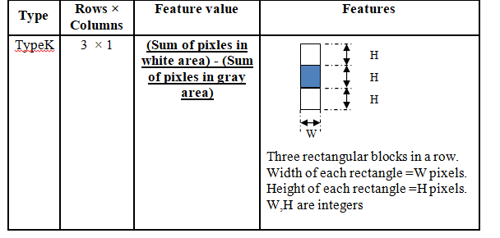
Additional exercise: A2
If the window is 6x6, how many type K features are there in the window?

Slide 49
Answer: ex for A2
Hi=Horizontal width of possible choices i
Wi=vertical height of possible choices j
In this problem possible choices of i and j are: possible i=1,2, j=1,2,3,4,5,6
H=1, W=1: 4x6=24
H=2, W=1: =6
H=1, W=2: 4x5=20
H=2, W=2: =5
H=1, W=3: =4x4=16
H=2, W=3: =4
H=1, W=4: =4x3=12
H=2, W=4: =3
H=1, W=5: =4x2=8
H=2, W=5: =2
H=1, W=6: =4x1=4
H=2, W=6: =1
ii) Total= 24+6 +20+5+ 16+4+ 12+3+ 8+2+ 4+1 =105

Slide 50
References
[viola2004] Paul A. Viola, Michael J. Jones: Robust Real-Time Face Detection. International Journal of Computer Vision 57(2): 137-154 (2004) (PDF: http://citeseerx.ist.psu.edu/viewdoc/download?doi=10.1.1.137.4879&rep=rep1&type=pdf )
[viola2001] Paul A. Viola, Michael J. Jones, Rapid object detection using a boosted cascade of simple features CVPR 2001 (PDF: http://research.microsoft.com/en-us/um/people/viola/Pubs/Detect/violaJones_CVPR2001.pdf)
[Lazebnik09 ] www.cs.unc.edu/~lazebnik/spring09/lec23_face_detection.ppt
[stackoverflow] http://stackoverflow.com/questions/1707620/viola-jones-face-detection-claims-180k-features
[Jensen 2008 ] Ole Helvig Jensen," Implementing the Viola-Jones Face Detection Algorithm "Kongens Lyngby 2008 “, IMM-M.Sc.-2008-93,Technical University of Denmark Informatics and Mathematical Modeling
[smyth2007] Face detection using the viola Jones method ppt, UL Irvine (lecture notes of CS175 Fall 2007)
[yu tm ]http://aimm02.cse.ttu.edu.tw/class_2009_1/PR/Lecture%207/Adaboost.ppt
[stackoverflow] http://stackoverflow.com/questions/1707620/viola-jones-face-detection-claims-180k-features

Slide 51
Appendix1
Advanced topics

Slide 52
Training
The face Adaboost detection system

Slide 53
Adaboost face detection Training algorithm [Jensen 2008 ]

Slide 54
Inside the main loop for training For t=1,…T
Step1
Init all weights
Same weights all for samples at t=1

Slide 55
Inside the main loop for training For t=1,…T -assume at stage t
Step2: select the best weak classifier (weak learner)
For all f (1,2,3,… 162,336 feature set)
For all p (p=+1 or -1)
For different θ, (θ as low as possible to produce good result)
{
}
Mistakenly classified

Slide 56
Step2 : more explanation -assume at stage t
Test every feature in the feature set {1,2,3,… 162,336 feature set}
Test different polairty{+1,-1}: dark/white reversed.
Try different θ (for simplicity start from 0.4), make it lower to see if performance (recognition, false-positive rates are improved.
Output= {f_{t} (type of feature), p_{t} (polarity), θ_{t} (threshold)} which give the minimum error ɛ_{t}
{f_{t} , p_{t} , θ_{t}}= (minimizer of ɛ_{t}) at stage t

Slide 57
Inside the main loop for training For t=1,…T -assume at stage t
Step3

Slide 58
Inside the main loop for training For t=1,…T -assume at stage t
step4

Slide 59
Inside the main loop for training For t=1,…T -assume at stage t
step5

Slide 60
Appendix2
Answers to exercises

Slide 61
Answer: Class exercise 8.1
Detected results are in red frames
What are the detection rate and false positive rate here?
Answer
detection rate=(7/9)*100%
false positive rate=(3/10)*100%
7 faces correctly detected in the picture, 9 actually faces exit in the image
10 windows reported to have faces , but in 3 windows they are not faces.
False positive results

Slide 62
Answer: Class exercise 8.2
Find the Rectangle_Feature_value (f) of the box enclosed by the dotted line
Rectangle_Feature_value f=
∑ (pixel value in white area) – ∑ (pixel value in shaded area)
f=(4+8)-(6+2)=12-8=4
2 | 7 | 5 | 8
2 | 6 | 2 | 9
5 | 4 | 8 | 2
8 | 2 | 5 | 10

Slide 63
Answer: Class exercise 8.3 Definition: Area at X =pixel sum of the area from top-left corner to X= Area_X
Top-left corner
Find the feature output of this image.
Area_D=1
Area_B=1+2+3=6
Area_C =1+3=4
Area_A=1+2+3+3+4+6=19
Area_E=? 1+3+5=9
Area_F=? 1+2+3+3+4+6+5+2+4=30
Pixel sum of the area inside the box enclosed by the dotted lines=
Area_F - Area_B - Area_E +Area_D =? 30-6-9+1=16
WA=White area enclosed by the dotted line= Area_F - Area_A - Area_E +Area_C=30-19-9+4= 6
GA=Gray area enclosed by the dotted line= Area_A - Area_B - Area_C +Area_D=19-6-4+1=10
(white area-shaded area)=WA-WG=6-10=-4
1 | 2 | 3 | 3
3 | 4 | 6 | 3
5 | 2 | 4 | 1
0 | 2 | 3 | 6
D
B
C
A
E
F

Slide 64
Answer: class exercise 8.4 Feature selection [Lazebnik09 ]
Some examples and their types
Fill in the types for the 2nd, 3rd rows
For a 24x24 detection region, the number of possible rectangle features is ~160,000!
Name the types (type 1,2,3,4,5) of the rectangular features in the figures .
Answer: see the labels in the diagram.
2
3
5
1
4
1
1
4
5
2
5
1
3
5
3
Standard Types
1)
2)
3)
4)
5)
Notes:
64

Slide 65
Answer(i): Class exercise 8.5a : How many type 1 features in a 24x24 (pixel) window? We see that win_width=24, win_height=24,
win_width=24, win_height=24
temp=0; %Type1 feature: block aspect ratio is width=2 units, height=1unit
for nx=1:win_width/2%nx=no. of x pixels in white area. Min =1,max=win_width/2
for ny=1:win_height%ny=no. of y pixels in white area. Min =1,max=win_height
number_of_blocks_x=(win_width-2*nx+1);%no.of x Blocks fit in win_width
number_of_blocks_y=(win_height-ny+1);%no.of y Blocks fit in win_height
temp=number_of_blocks_x*number_of_blocks_y+temp;
end
end
temp %type 1 total= 43200. Same for type 2 (similar case) , total(1+2)=43200*2
nx (from 1 to win_width/2 pixels for Type1)
ny (from 1 to win_width pixels for Type 1)
)
win_height=24
Two examples of Type1 feature blocks
(aspect ratio is 2-column x 1-row)
win_width=24
http://stackoverflow.com/questions/1707620/viola-jones-face-detection-claims-180k-features

Slide 66
Answer(ii): Class exercise 8.5a : How many type 3 features in a 24x24 (pixel) window?
temp=0;
%Type3: aspect ratio of the feature block, width=3 units, height=1unit
for nx=1:win_width/3 %nx=no. of x pixels in white area.Min =1,max=win_width/3
for ny=1:win_height %ny=no. of y pixels in white area.Min =1,max=win_height
number_of_blocks_x=(win_width-3*nx+1);%no.of x Blocks fit in win_width
number_of_blocks_y=(win_height-ny+1);%no.of y Blocks fit in win_height
temp=number_of_blocks_x*number_of_blocks_y+temp;
end
end
N_Type3=temp %answer= 27600. similar for type 4, total(type3+type4)=27600*2
nx (from 1 to win_width/2 pixels for Type3)
ny (from 1 to win_width pixels for Type 3)
win_height=24
Example of Type3 feature blocks
(aspect ratio is 3-column x 1-row)
win_width=24
http://stackoverflow.com/questions/1707620/viola-jones-face-detection-claims-180k-features

Slide 67
Answer(iii): Exercise 8.5b : How many type 5 features in a 24x24 (pixel) window?
temp=0; %--------------------------------------------------------------------
%type5: aspect ratio of the feature block, width=2 units, height=2unit
for nx=1:win_width/2%nx=no. of x pixels in white area.Min =1,max=win_width/2
for ny=1:win_height/2%ny=no. of y pixels in white area.Min =1,max=win_height/2
number_of_blocks_x=(win_width-2*nx+1);%no.of x Blocks fit in win_width
number_of_blocks_y=(win_height-2*ny+1);%no.of y Blocks fit in win_height
temp=number_of_blocks_x*number_of_blocks_y+temp;
end
end
N_Type5=temp %=20736
nx (from 1 to win_width/2 pixels for Type5)
ny (from 1 to win_width/2 pixels for Type 5)
)
win_height=24
An example of Type5 feature blocks
(aspect ratio is 2-column x 2-row)
win_width=24
http://stackoverflow.com/questions/1707620/viola-jones-face-detection-claims-180k-features

Slide 68
Answer for Exercise 8.5 and 8.6:Matlab: for a 24x24 windows, add all types N_type1x2+N_type3x2+N_type5=(43200x2+27600x2+20736)=162336
clear; temp=0;
%--matlab program to find number of features %(5 types (columns x rows):
%type1: 2x1; type2: 1x2; type3: 3x1; type 4: 1x3; type 5: 2x2)
%in Viola-Jones face detection cascaded Adaboost algorithm-
%%%% 2x1 shape : (2 rows x 1 column, same as 1 row x 2 columns) , 2 types
%win_width=24%(you may choose 36 or 24 etc.)
win_width=24%(you may choose 36 or 24 or 12etc.)
win_height=win_width; %x=hornizontal direction; y=vertical direction
%Type1: aspect ratio of the feature block, width=2 units, height=1unit
for nx=1:win_width/2%nx=no. of x pixels of each square. Min =1,max=win_width/2
for ny=1:win_height%ny=no. of y pixels of each square. Min =1,max=win_height
number_of_blocks_x=(win_width-2*nx+1);%no.of x Blocks fit in win_width
number_of_blocks_y=(win_height-ny+1);%no.of y Blocks fit in win_height
temp=number_of_blocks_x*number_of_blocks_y+temp;
end
end
N_Type1=temp
N_Type2=N_Type1 % same as 2 rows x 1 column
pause
temp=0;
%Type3: aspect ratio of the feature block, width=3 units, height=1unit
for nx=1:win_width/3%nx=no. of x pixels of each square.Min =1,max=win_width/3
for ny=1:win_height%ny=no. of y pixels of each square.Min =1,max=win_height
number_of_blocks_x=(win_width-3*nx+1);%no.of x Blocks fit in win_width
number_of_blocks_y=(win_height-ny+1);%no.of y Blocks fit in win_height
temp=number_of_blocks_x*number_of_blocks_y+temp;
end
end
N_Type3=temp
N_Type4=N_Type3 % same as 3 rows x 1 column
pause
%
temp=0; %--------------------------------------------------------------------
%type5: aspect ratio of the feature block, width=2 units, height=2unit
for nx=1:win_width/2%nx=no. of x pixels of each square.Min =1,max=win_width/2
for ny=1:win_height/2%ny=no. of y pixels of each square.Min =1,max=win_height/2
number_of_blocks_x=(win_width-2*nx+1);%no.of x Blocks fit in win_width
number_of_blocks_y=(win_height-2*ny+1);%no.of y Blocks fit in win_height
temp=number_of_blocks_x*number_of_blocks_y+temp;
end
end
N_Type5=temp
'total'
N_ALL=N_Type1+N_Type2+N_Type3+N_Type4+N_Type5
%Result= 162336 if width =24
%Result= : 816264 if width =36 ( ??or 704004??)

Slide 69
Answer 8.7: The detection challenge
(x,y)
24x24Sub-window
X-axis
1280
Use 24x24 base window
For y=1;y<=1024;y++
{For x=1;x<=1024;x++{
Set (x,y) = the left top corner of the 24x24 sub-window, different scales are needed to be considered too.
For the 24x24 sub-window, extract 162,336 features and see they combine to form a face or not.
}
}
Exercise 7 : Discuss the number of operations required.
Conclusion : too slow, solution use boosting
(1,1)
Y-axis
1024
Answer 8.7:
possible locations of (x,y)≈(1024-24)x(1280-24).
Each (x,y) location, for zoom factor i=1,2,3..obtain sub-images: each sub-image window has size (24ix24i) with left-top corner at (x,y) as long as x+24i<1024
For a sub-image, shrink it to a 24x24 window for processing.
For each 24x24 window, it has 162336 features to be calculated as calculated before.

Slide 70
Answer: Class exercise 8.8: Attentional cascade
Chain classifiers that are progressively more complex and have lower false positive rates:
Receiver operating characteristic
% False Pos
Fill in ?: Name the classifier (1 or 2 or3), explain your answer
0
50
vs
false
neg
determined by
?_3_
?_2_
?_1_
0 100
% True Positive
False positive rate
Input image
Adaboost
Classifier1
True
Adaboost
Classifier2
True
Adaboost
Classifier3
True
Face
found
False
False
False
Non-face
Non-face
Non-face
Notes:
70
In general simple classifiers, while they are more efficient, they are also weaker.
We could define a computational risk hierarchy (in analogy with structural risk minimization)…
A nested set of classifier classes
The training process is reminiscent of boosting…
- previous classifiers reweight the examples used to train subsequent classifiers
The goal of the training process is different
- instead of minimizing errors minimize false positives

